Slide 1
Introduction to R: Basics and Data Analysis
TAMIDS Workshop
Jack Manning

Slide 2
Outline
Welcome and Overview
What is R?
High level programming language used for
Statistical modeling
Machine learning
Data visualization
Bioinformatics
Why use R instead of other languages?
Free and open source, statisticians use it
High level functional language
Easy to process and visualize data
How do we use R?
Download R
R Studio

Slide 3
High level language
Computers don’t know English – they know binary
Code has to be converted to binary before being executed (i.e. compiled)
R is interpreted, not compiled
Can be compiled, but you will probably never use it like that
Benefit is that it can be run line-by-line instead of running the whole script
Negatives are the interpretation is slower an requires higher memory useage
For basic applications you won’t ever care about the speed – you won’t notice it
More complicated applications like machine learning might be faster in Python

Slide 4
Setting up R and R Studio
You can download R and R Studio from the link below: 🔗 RStudio Download (includes R link): https://posit.co/download/rstudio-desktop/
If you need help installing R, here are some helpful YouTube guides: ▶ Windows: Install R on Windows ▶ Mac: Install R on Mac

Slide 5
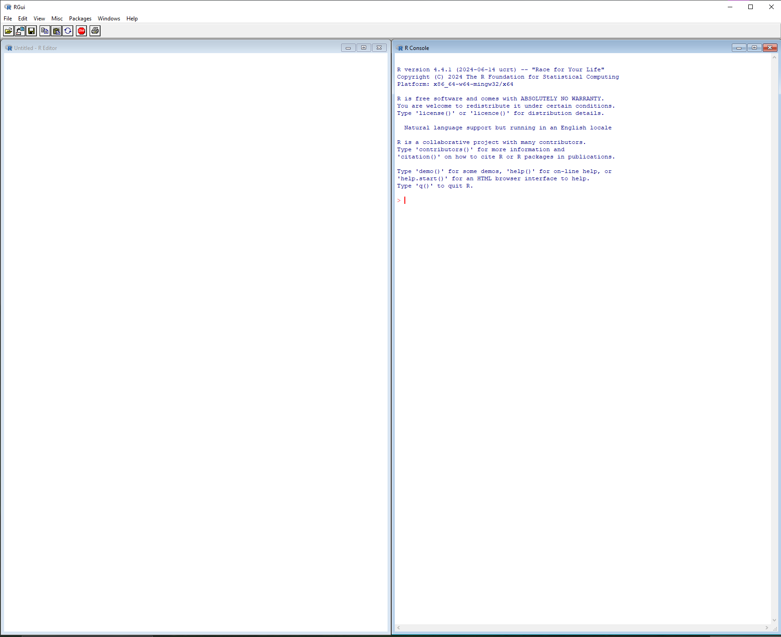
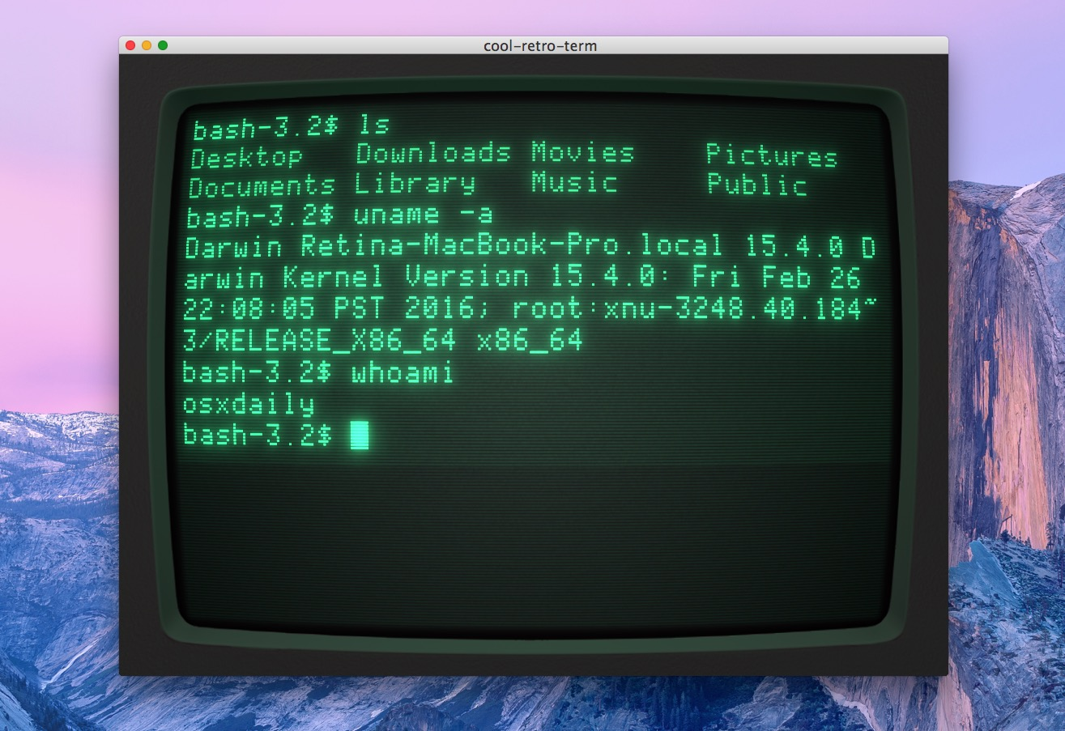
Using the R GUI
Script vs. Terminal (Console)

Slide 6
Basic R Data Types and Structure
Data structures:
Vectors
c()
seq()
rep()
Matrices
matrix()
Lists
list()
Data frames
data.frame()

Slide 7
Basic Operations in R
Arithmetic operations (+, -, *, /, ^)
Logical operators (==, !=, >, <, &, |)
Using functions (mean(), sum(), sd(), length(), summary())
Indexing and subsetting ([ ], $, filter())

Slide 8
Loading in data

Slide 9
Resources
https://learnxinyminutes.com/r/
Data Code Camp
https://www.r-bloggers.com/2021/04/basic-functions-in-r/

