Slide 1


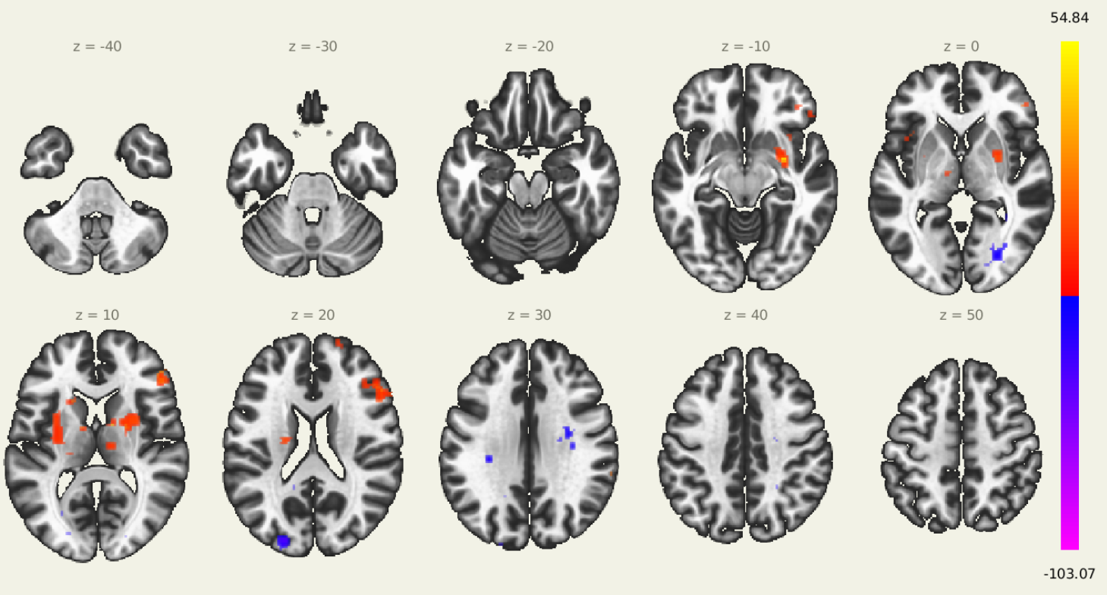
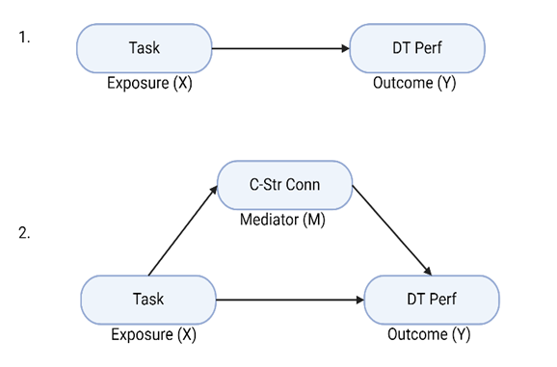
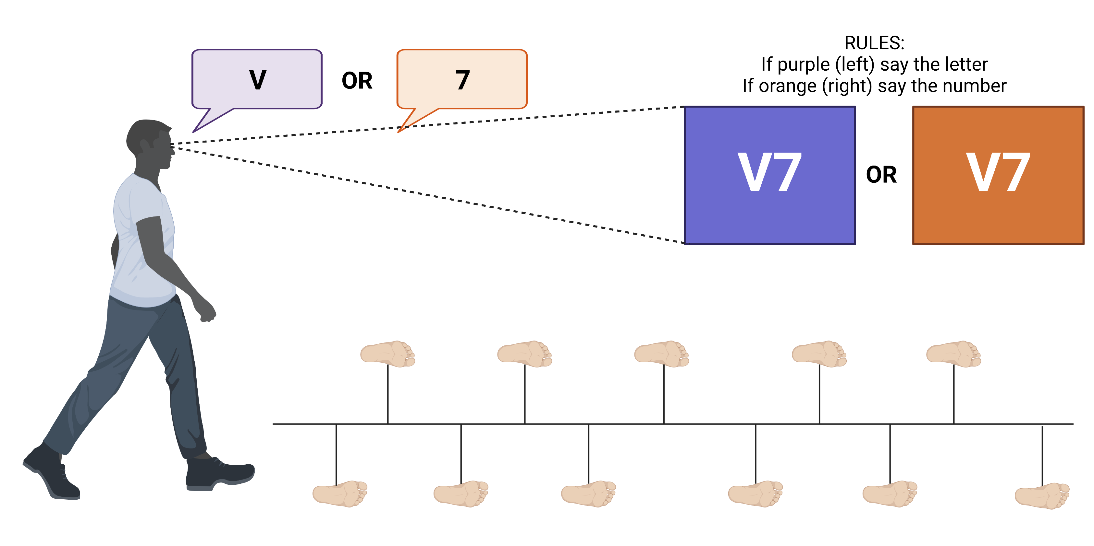
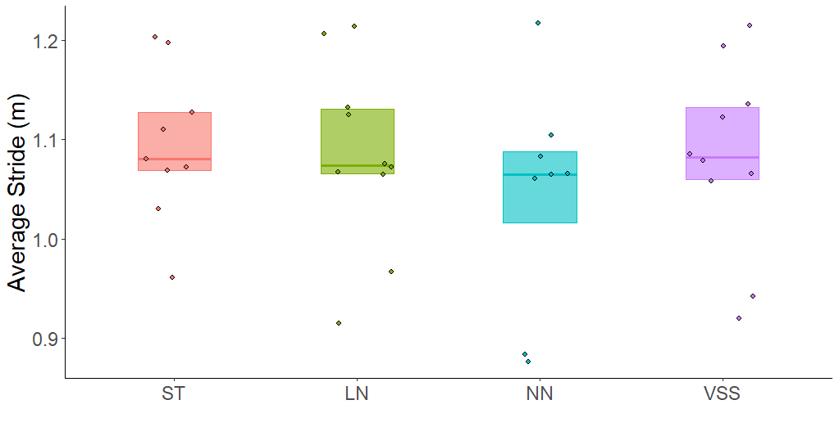

The Mediating Effect of Brain Connectivity on Dual-Task Performance: A Pilot Study
jack manning¹, Jessica Bernard², Joseph Orr², & JENNIFER M. YENTES¹
Jack Manning, M.S.Ed.
Doctoral Student
Department of Kinesiology and Sport Management
Human Movement Complexity Laboratory
Email: jackpmanning@tamu.edu
¹Department of Kinesiology and Sport Management, Texas A&M University, College Station, TX, USA
²Department of Psychological and Brain Sciences, Texas A&M University, College Station, TX, USA
INTRODUCTION
A
Dual tasking is an experimental paradigm where a motor task and a cognitive task are completed simultaneously, which is useful in determining whether the tasks share neural processing. Set-shifting is a cognitive task where participants switch their behavior based on predefined rules. PURPOSE: Investigate the effects of cognitive set shifting and brain functional connectivity (between the striatum and prefrontal cortex) on gait performance during a dual-task.
L
R
METHODS
Gait visit: Five older adult participants (mean age 70 years) were asked to walk on a treadmill at a self-selected speed during four different trials (Figure 1):
Single task: no concurrent cognitive task
Set-shifting: the background changed randomly
Letter naming: the background stayed purple
Number naming: the background stayed orange
Gait measures: stride length and cadence were calculated.
MRI visit: high resolution T2*-weighted magnetic resonance images of subjects’ brains were collected.
MRI measures: T2*-weighted images were pre-processed using fMRIPrep. Then, a seed-based, resting-state functional connectivity analysis was completed with six striatal seeds using CONN toolbox (Figure 2.).
Statistics: A mediation analysis was done to test the direct and indirect effects of cortico-striatal functional connectivity on dual task performance during a set-shifting dual task (Figure 3.).
P
Figure 2: Ten axial plane slices showing voxels with significant functional connectivity to the left dorsal causal putamen at rest (cluster threshold: p<0.05; cluster size p-FDR corrected; voxel threshold: p<0.001 p-uncorrected). Warm colors indicate positive correlations, while cold colors indicate negative correlations.
Figure 3. Schematic of mediation analysis.
The total effect of Task on dual-task performance (DT perf) and
The hypothesized indirect effect of Task on DT perf through cortico-striatal connectivity (C-Str Conn)
RESULTS
A significant relationship was found between left dorsal caudal putamen and 22% of the right inferior frontal gyrus pars triangularis (p<0.001)(Figure 2.).
Simple linear regression showed no significant relationship between trial and average stride length (all p>0.05) (Figure 4), indicating no direct effect.
Mediation analysis failed to find a significant indirect effect of cortico-striatal functional connectivity on dual-task performance (p=0.71).
Figure 1: Schematic of the visual set-shifting task and accompanying gait measurements. During treadmill walking the participant is presented a letter-number combination on a screen in front of them. If the background is purple, they verbalize the letter, if it is orange, the number.
SUMMARY STATEMENTS
These preliminary data do not indicate a relationship between cortico-striatal functional connectivity and the selected gait parameters of stride length and cadence during a set shifting dual task.
This pilot work provides proof-of-principal and feasibility data regarding investigations for future studies of neural functional connectivity and gait behaviors.
Figure 4: Boxplot of the repeated measures ANOVA comparing the differences in average stride length (m) across trials. The darker colored bars represent the mean, while the boxes represent the interquartile range. LN = letter naming, NN = number naming, ST = single task, VSS = Visual Set-shifting
ACKNOWLEDGEMENTS
ADDITIONAL INFORMATION
This work was support by a research SEED grant and a Graduate Research Grant, both provided by the Texas A&M School of Education and Human Development’s Department of Kinesiology and Sport Management.
Contact me: jackpmanning@tamu.edu
Save the poster:

