Slide 1
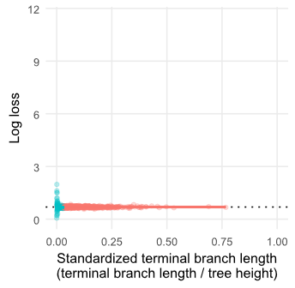
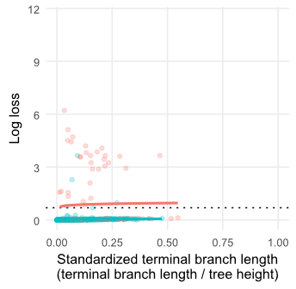
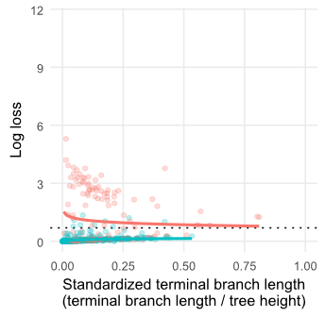
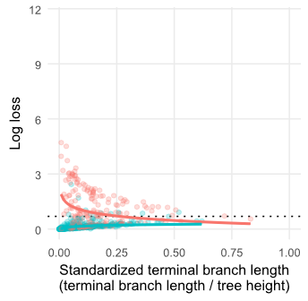
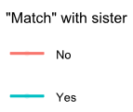
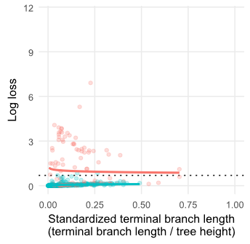
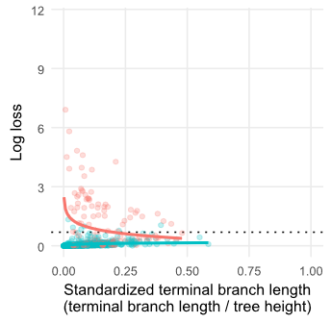
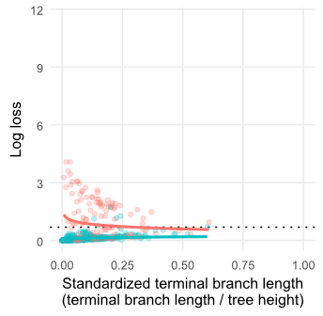
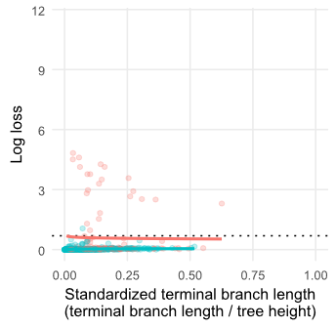
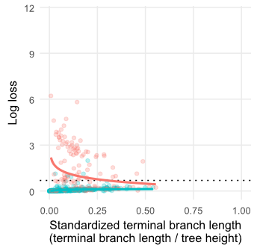
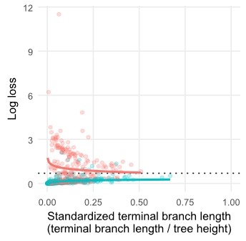
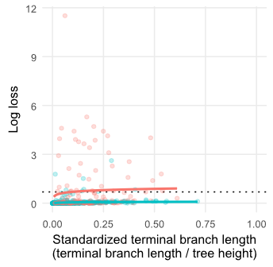
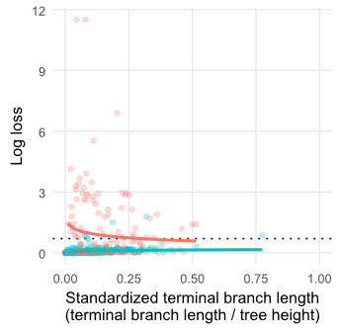
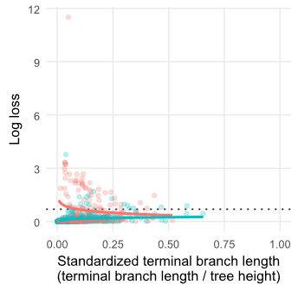
Q₁
Independent, equal rates
Low rates
Q₂
Independent, equal rates
Medium rates
Q₃
Independent, equal rates
High rates
Random
Q₄
Independent, directional rates
Low loss, Medium gain
Q₅
Independent, directional rates
Low loss, High gain
Q₆
Independent, directional rates
Medium loss, High gain
Q₇
Low dependency
Low rates
Q₈
Low dependency
Medium rates
Q₉
Low dependency
High rates
Q₁₀
High dependency
Low rates
Q₁₁
High dependency
Medium rates
Q₁₂
High dependency
High rates

