Slide 1
Predictive Maintenance Modeling with Clean & Irregular AI4I Data
By Jack Quillin, Daniel Gapper, and Daniel Calle

Slide 2

Why Predictive Maintenance Matters
Manufacturing relies on detecting failures early
Reduces downtime, cost, and scrap material
Clean data is rare and real sensor data is noisy
Companies such as Micron, a leader in DRAM and semiconductor manufacturing, employ data scientists to develop machine learning models for tasks very similar to this project, including fault detection, anomaly detection, and predictive maintenance.

Slide 3

Project Goals
Compare model performance on clean vs. irregular (noisy) datasets
1
Evaluate generalization across domains (clean to unclean, unclean to clean)
2
Test transfer learning to improve cross-domain robustness
3
Understand limitations of synthetic data
4

Slide 4

The Datasets
AI4I 2020 - Clean
10,000 rows of synthetic manufacturing sensor data
No missing values, stable sensors
AI4I-PMDI - Irregular
Adds realistic industrial noise
Sensor drift, missing values
System aging parameter
Control modes (A, B, C), different sensors monitored

Slide 5
Machine Learning Task
Supervised binary classification
Predict: Machine Failure = 0 or 1
Inputs: temperature, torque, rotational speed, wear, engineered features
Models used:
  Random Forest
  Gradient Boosting
  XGBoost
Notes:
Daniel

Slide 6
Feature Engineering
Temperature difference (process – air)
Angular velocity ω = RPM × 2π/60
Mechanical power (torque × ω)
Wear × Torque interaction
One-hot encoding of machine type & control mode
Notes:
Daniel
These were given during the documentation of datasets
Uses what data records and engineers new features (temp difference, angular velocity, ect..) which could be helpful for predicting machine failure

Slide 7
Data Splitting
Within-dataset:
Train/Test = 80/20 split
No leakage from target variable
Cross-dataset:
Match rows by product_id
Separate ID groups for:
  Training
  Fine-tuning
  Testing
Guarantees no data leakage

Slide 8
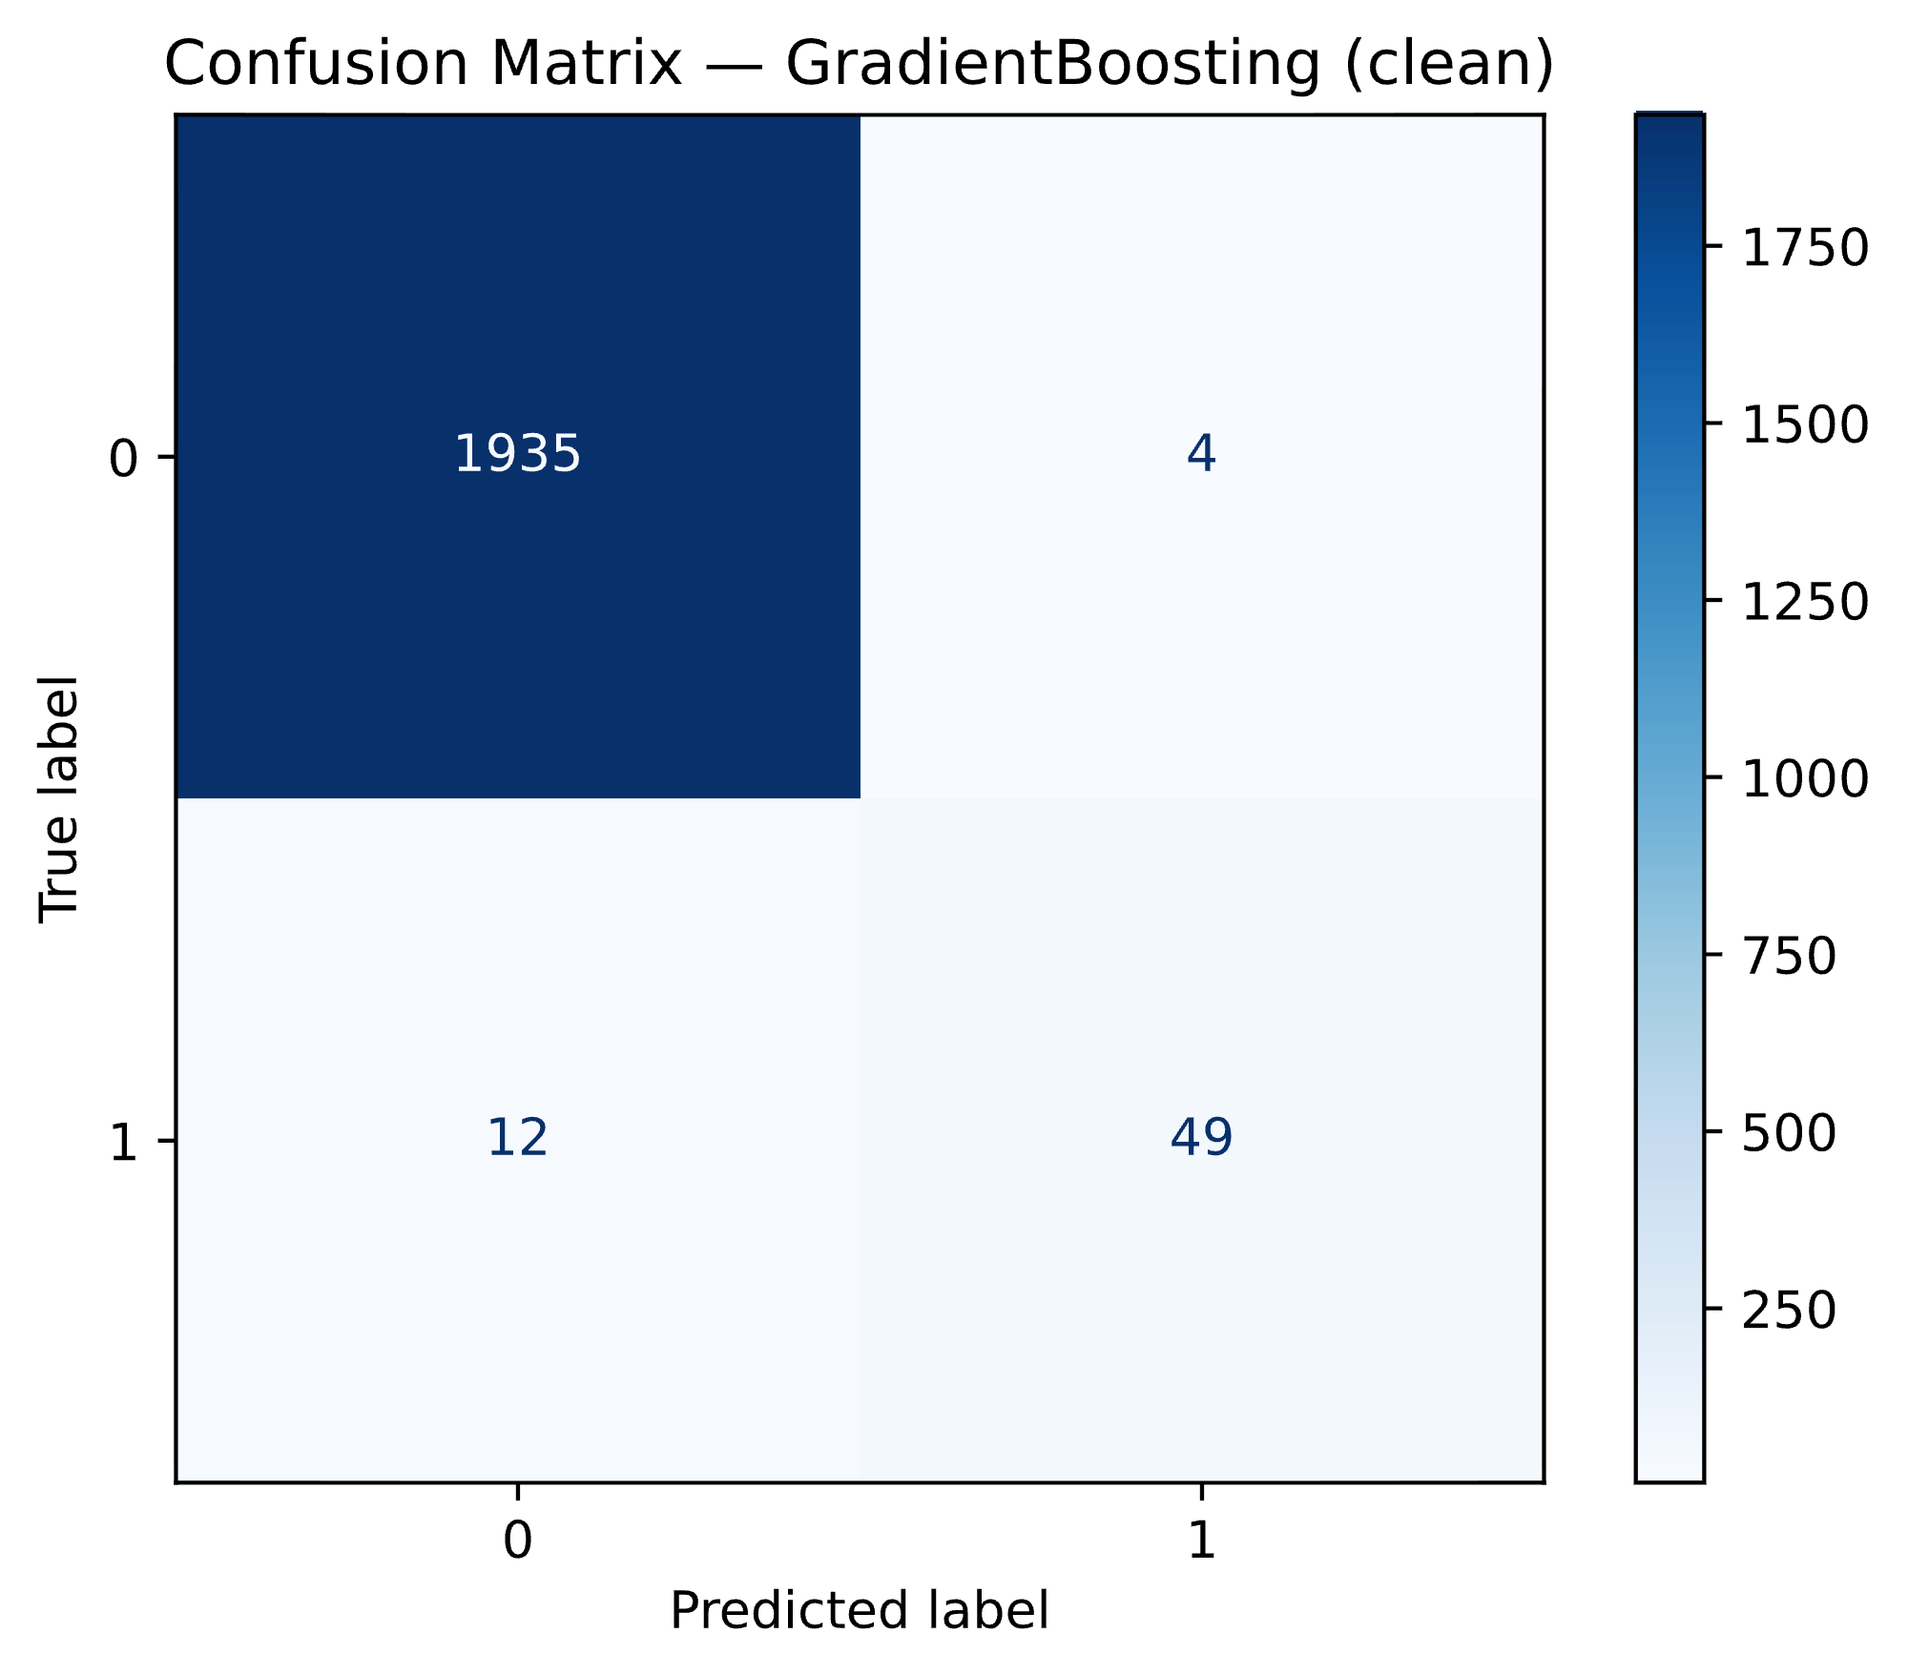

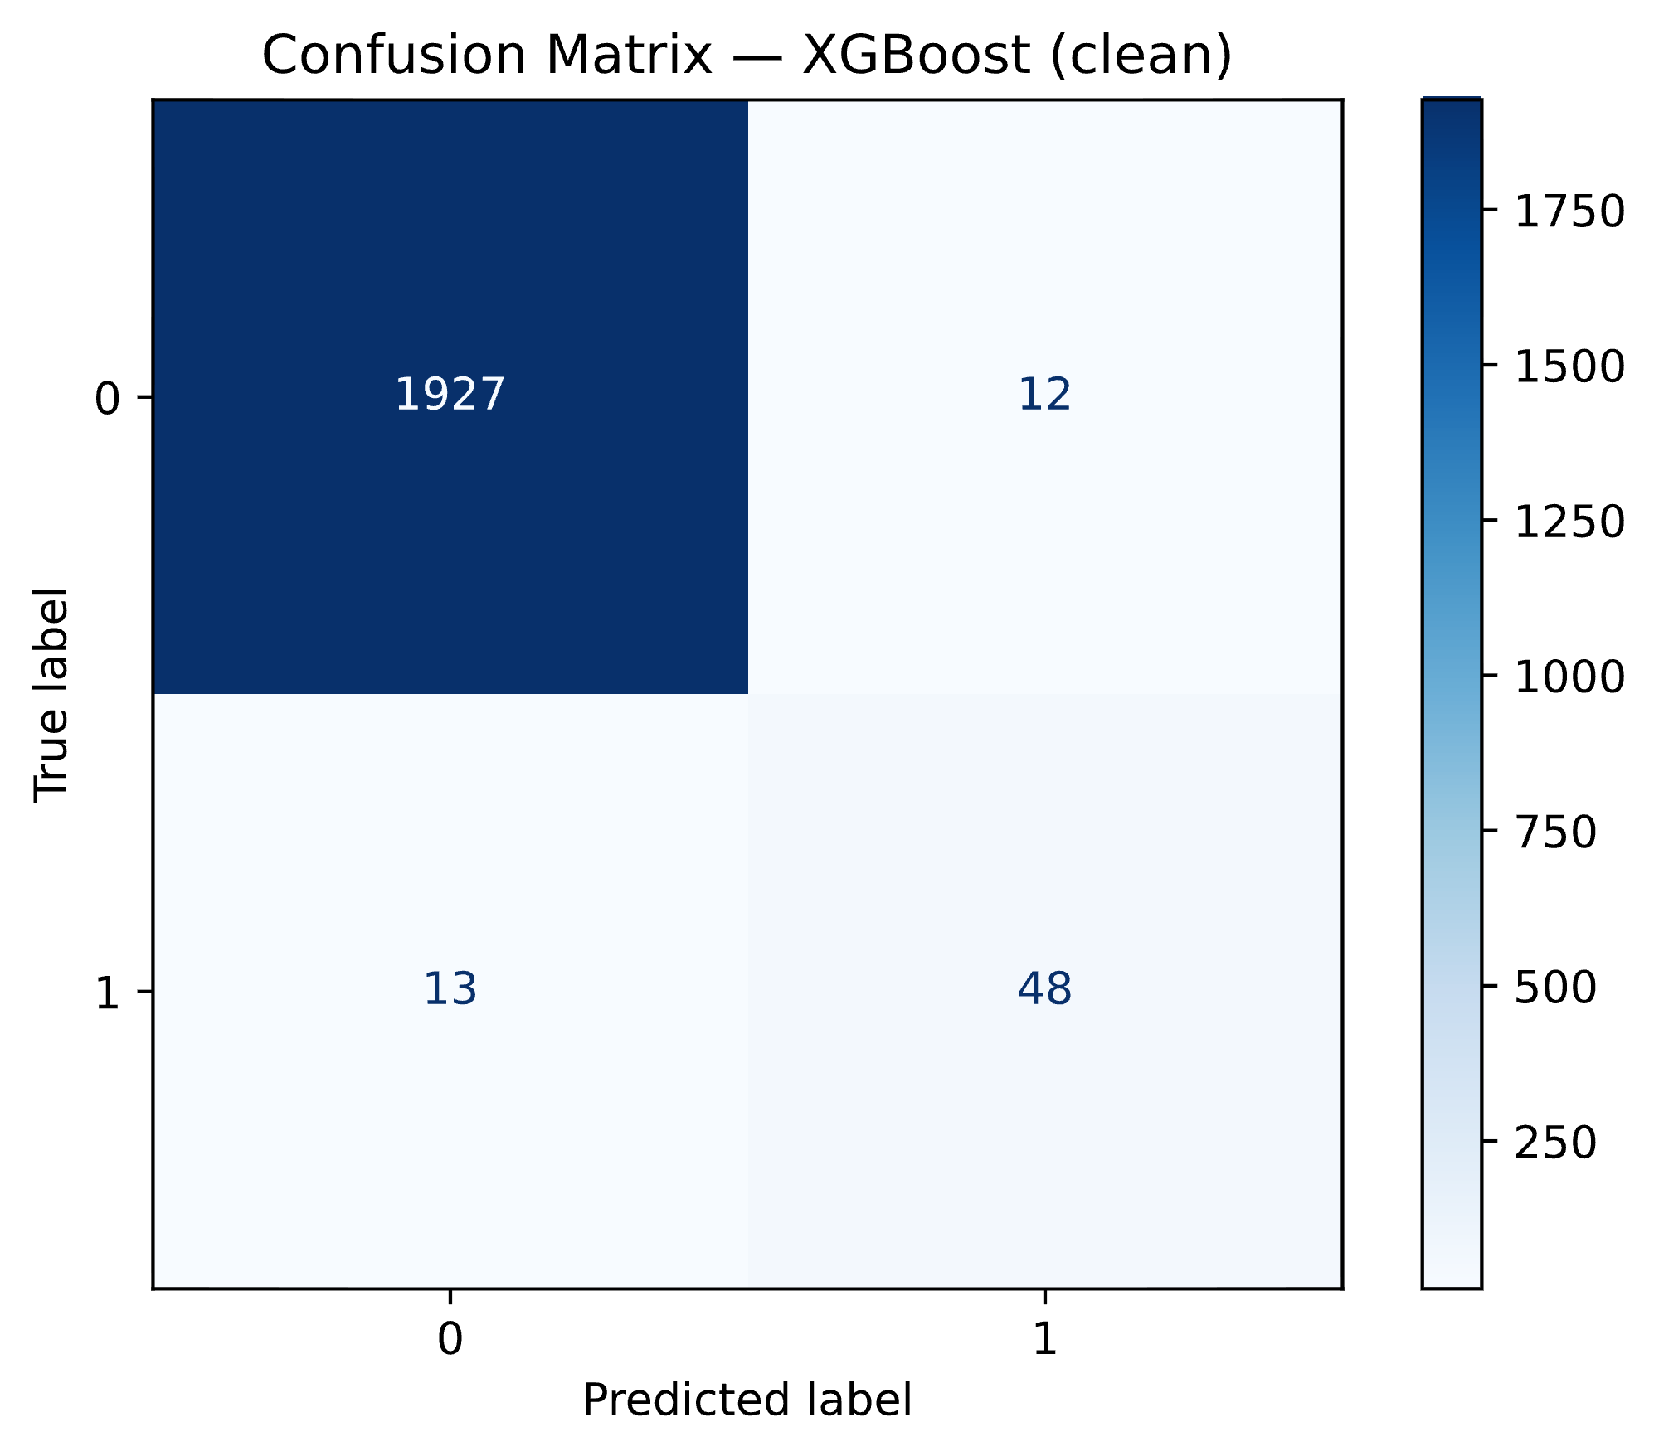

Clean Dataset Results
Notes:
Daniel
True positive/negative (got right)
False positive/negative (got wrong)
ROC AUC all strong

Slide 9
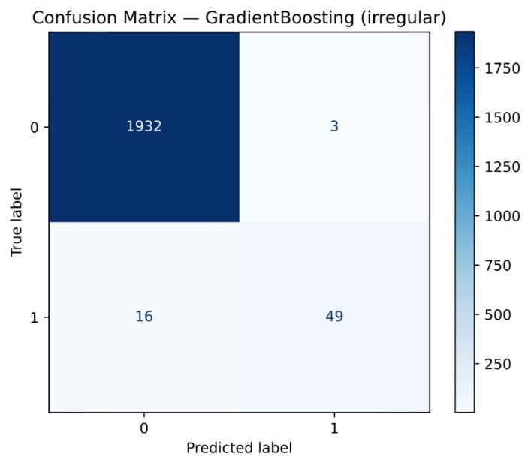



Irregular Data Results
Notes:
Daniel
True positive/negative (got right)
False positive/negative (got wrong)
ROC AUC good but not as good as clean

Slide 10
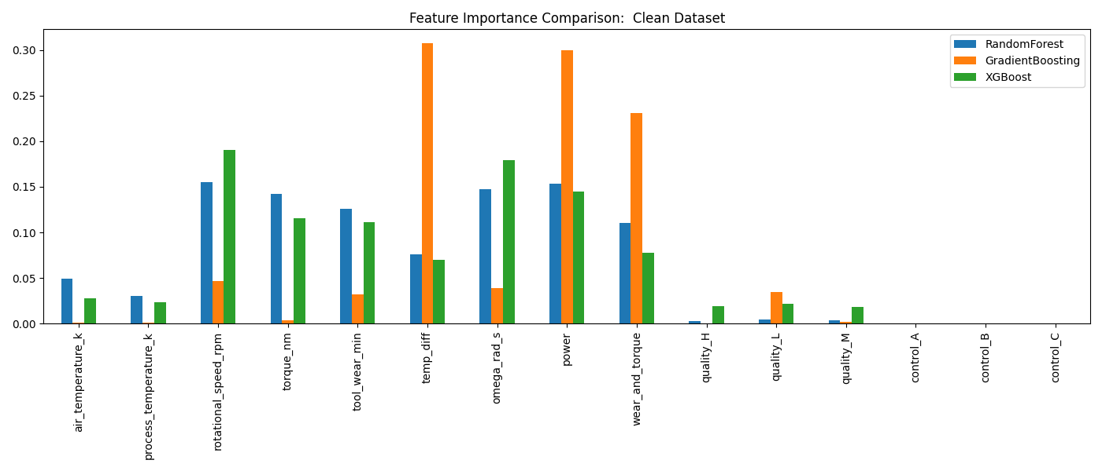
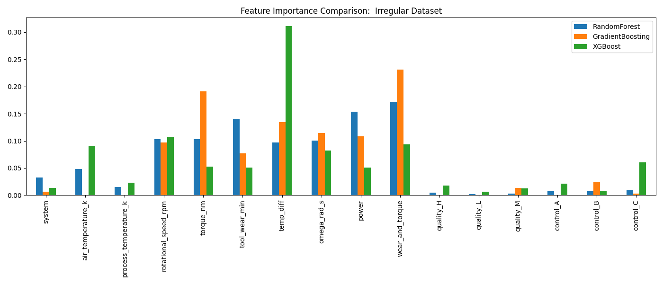
Feature Importance
Notes:
Bagging (random forest) runs parallel so doens’t learn from previous model
More level
Boosting is sequential, keeps updating
Rly prioritize what matters

Slide 11
Cross-Dataset Generalization
=== Cross-Dataset Results (All Models) ===
Experiment ROC_AUC Model
0 Train Clean -> Test Unclean (Paired Split) 0.937142 RandomForest
1 Train Unclean -> Test Clean (Paired Split) 0.959705 RandomForest
2 Train Clean -> Test Unclean (Paired Split) 0.923713 GradientBoosting
3 Train Unclean -> Test Clean (Paired Split) 0.977697 GradientBoosting
4 Train Clean -> Test Unclean (Paired Split) 0.930900 XGBoost
5 Train Unclean -> Test Clean (Paired Split) 0.947463 XGBoost

Slide 12
Transfer Learning
Stage 1: Pretrain on source dataset
Stage 2: Fine-tune on target dataset
Evaluate on both
Prevent leakage by splitting product IDs into:
  pretrain
  finetune
  test

Slide 13
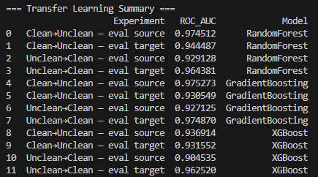
Transfer Learning Results

Slide 14
Why Transfer Learning Matters
Helps when real-world labeled data is limited
Allows synthetic to adapt to real data
Fine-tuning on a small real dataset improves robustness
Avoids starting from scratch

Slide 15
Key Takeaways
Clean data alone is not enough. Models need exposure to realistic noise
Irregular dataset improves generalization
Transfer learning is a practical bridge between synthetic and real-world conditions
Synthetic datasets are useful but not a full substitute for real data
Notes:
Daniel

Slide 16
Future Work
Add deep learning models (1D CNNs, LSTMs for temporal behavior)
Use domain adaptation techniques (CORAL, DANN, feature alignment)
Evaluate other noise types or sensor failures
Apply these concepts to real world data.

Slide 17
Thank you

