Slide 1
AI Document Audit & Knowledge Assistant System
Technical Proposal & Solution Architecture
Group 6 — FPT Software
August 2026

Slide 2
Agenda
1
Problem Statement & Customer Challenges
3 min
2
Requirements: Functional, Non-Functional, Constraints & Assumptions
2 min
3
Solution Architecture — 4+1 View Model
5 min
4
Solution Benefits
2 min
5
Estimation: Development Effort & Infrastructure Cost
2 min
6
Q&A
15 min

Slide 3
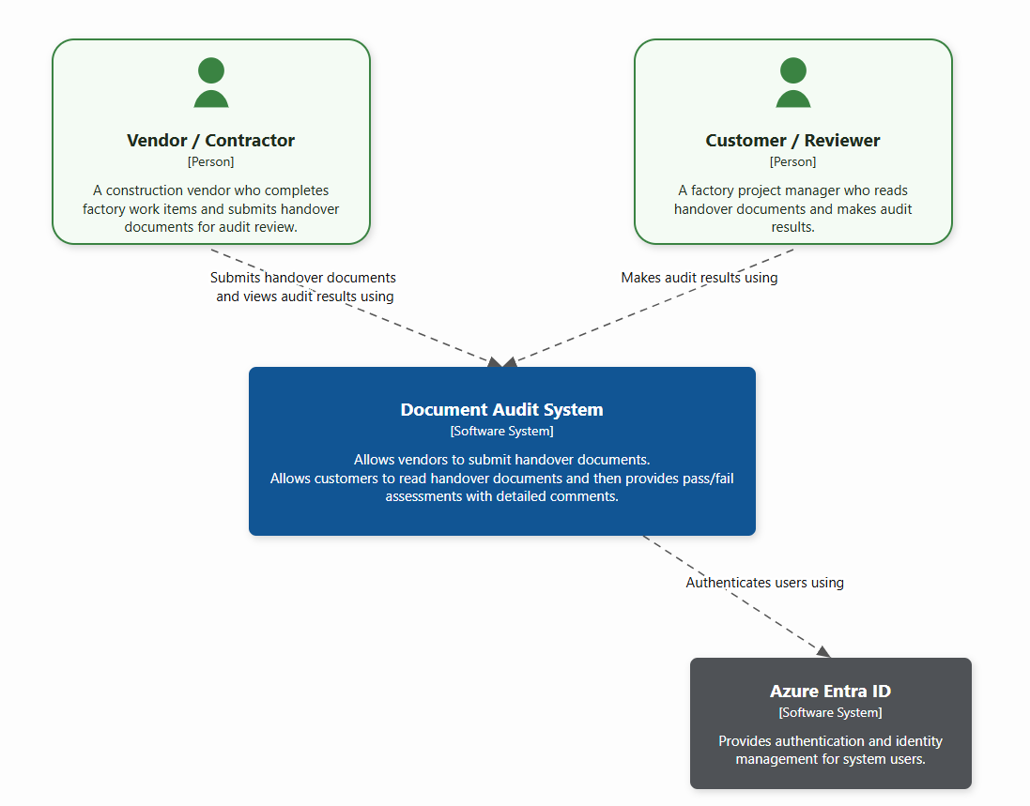
Problem Statement
What challenges does the customer face today?
Notes:
QuanNH40

Slide 4
Problem Statement
What challenges does the customer face today?
1
Limited Scope
2
No Multi-Source Ingestion
3
Weak Automation
Current system only handles document submission and review — no knowledge assistant, no discovery, no summarization.
Enterprise sources (SharePoint, Confluence, file servers, databases) are siloed — not unified for search or audit.
Completeness checks and resubmission loops require heavy manual intervention; no automated validation pipeline.
4
Heavy Manual Review
5
Missing Feedback Loop
6
No Expert Matching
Reviewers must read every handover document in full to produce audit results — extremely time-consuming.
No mechanism to learn from user corrections or improve AI quality over time.
Difficult to quickly connect users to the right subject matter expert for audit issues.
Notes:
QuanNH40

Slide 5
Functional Requirements
FR-1
User Authentication & Access Control
FR-2
Document Submission
FR-3
Document Processing
Azure Entra ID, role-based access (Vendor / Customer)
Upload handover documents from multiple enterprise sources
Extract text & structure via Azure Content Understanding
FR-4
AI Audit Generation
FR-5
Audit Review
FR-6
Audit Template Management
AI-based pass/fail assessment with detailed comments
View results, make final accept/reject decisions
Create, update, activate audit templates
FR-7
Search & Summaries
FR-8
Expert Identification
FR-9
Learning from Interactions
Natural language query with source references
Match documents to subject matter experts via HR directory
Capture feedback to improve search relevance
Notes:
QuanNH40

Slide 6
Non-Functional Requirements
NFR-1 Performance
NFR-2 Scalability
NFR-3 Availability
NFR-4 Security
Target
Target
Target
Target
First token < 2s (p95) 95% audits < 10 min End-to-end < 15 min (p99)
500 document submissions/hour 50 concurrent queries p95 latency < 3s under burst
99.9% monthly uptime RTO < 30 min, RPO < 15 min Zero silent data loss
Encrypted data in transit Sensitive fields encrypted at rest Secret never stored in code No public service exposure
Solution Approach
Solution Approach
Solution Approach
Solution Approach
Streaming + caching Two-tier retrieval + precomputation
Queue-depth autoscaling Staged pipelines
Managed, redundant services Idempotent, retryable tasks
Identity + secrets hygiene Private networking
Notes:
ThangLC9

Slide 7
Constraints & Assumptions
Constraints
Assumptions
Azure Entra ID is the mandatory identity provider
Users have valid Azure Entra ID accounts with correct organizational roles
Supported sources: SharePoint, Confluence, file servers, internal databases
Enterprise content sources are available & configured with correct permissions
Backend: Python— Frontend: JavaScript
Documents are in approved formats suitable for text extraction
Browsers: Chrome 130+ and Edge 130+
Azure AI services available with sufficient capacity
Go-live within 3 calendar months; phase variance ≤ 10%
Cloud cost cap: USD 5,000/month with alerts at 80/90/100%
Customer provides authoritative audit templates & expert directory data
No direct modification of source documents during processing
Users will review AI outputs before final accept/reject decisions
Approved file formats & configured size limits only
Notes:
ThangLC9

Slide 8
Solution Architecture — 4+1 View Model
Comprehensive architecture using the 4+1 architectural view model
+1 Use Case View
Logical View
Process View
Development View
Physical View
Use Case Diagram
System Context Diagram
Activity Diagrams 3 key workflows
Swim-lane notation
Container Diagram 4 functional zones
Deployment Diagram
Captures WHAT the system does
Captures HOW the system is structured
Captures HOW the system behaves
Captures HOW the system is built
Captures WHERE the system runs
Notes:
ThangPD17

Slide 9
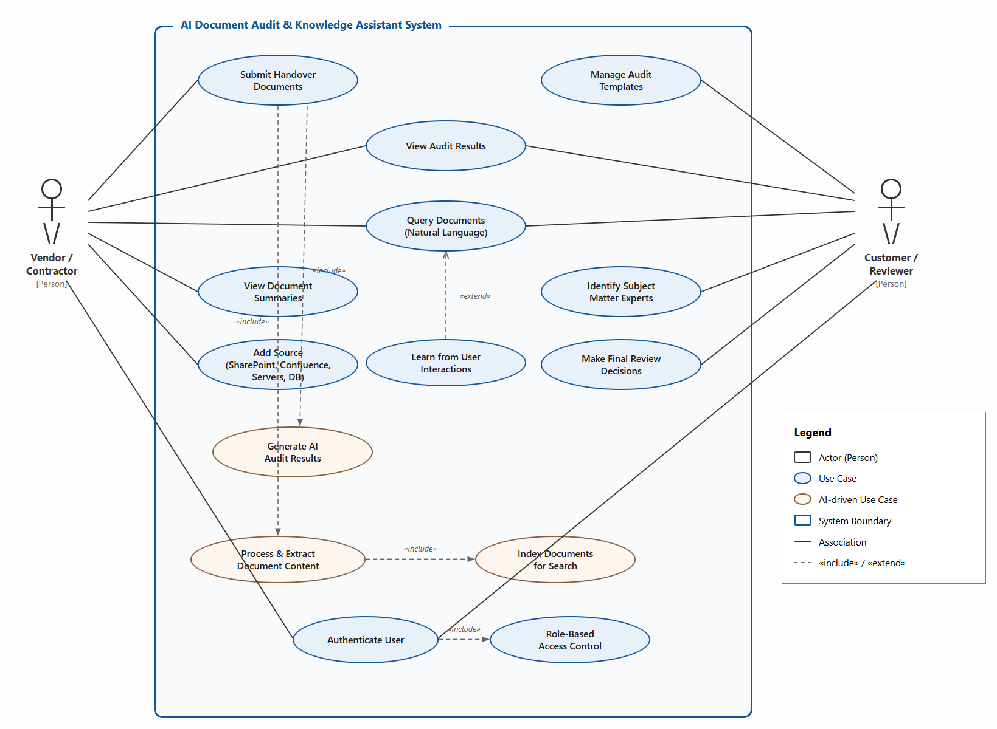
Use Case Diagram
Notes:
ThangPD17

Slide 10
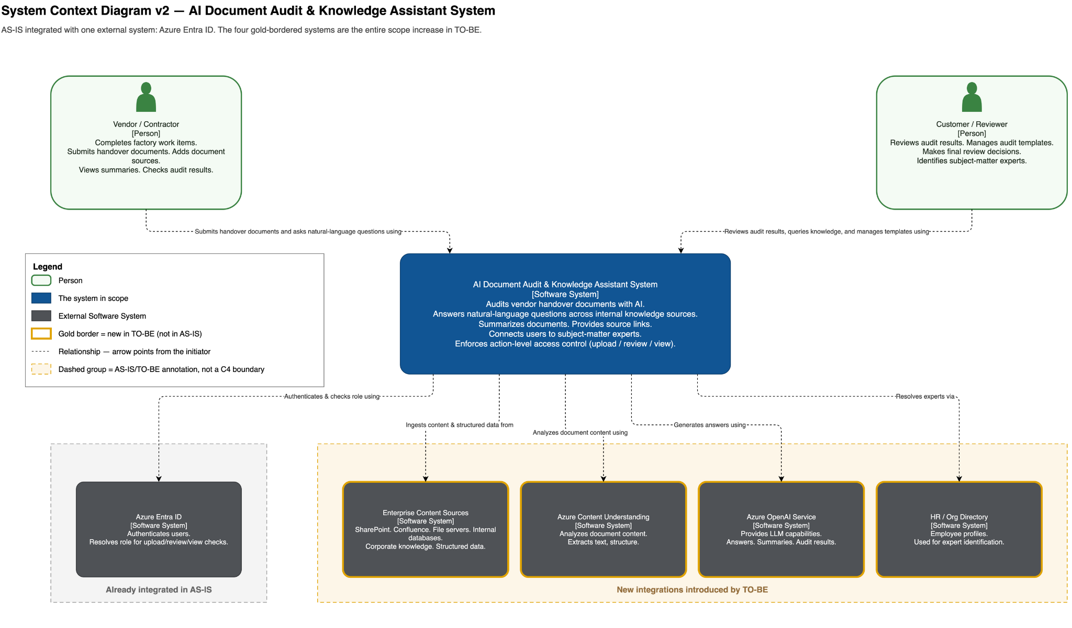
System Context Diagram
System Context Diagram
AS-IS integrated with one external system (Azure Entra ID) · the four gold-bordered systems are the entire TO-BE scope increase
Notes:
DatPT125

Slide 11
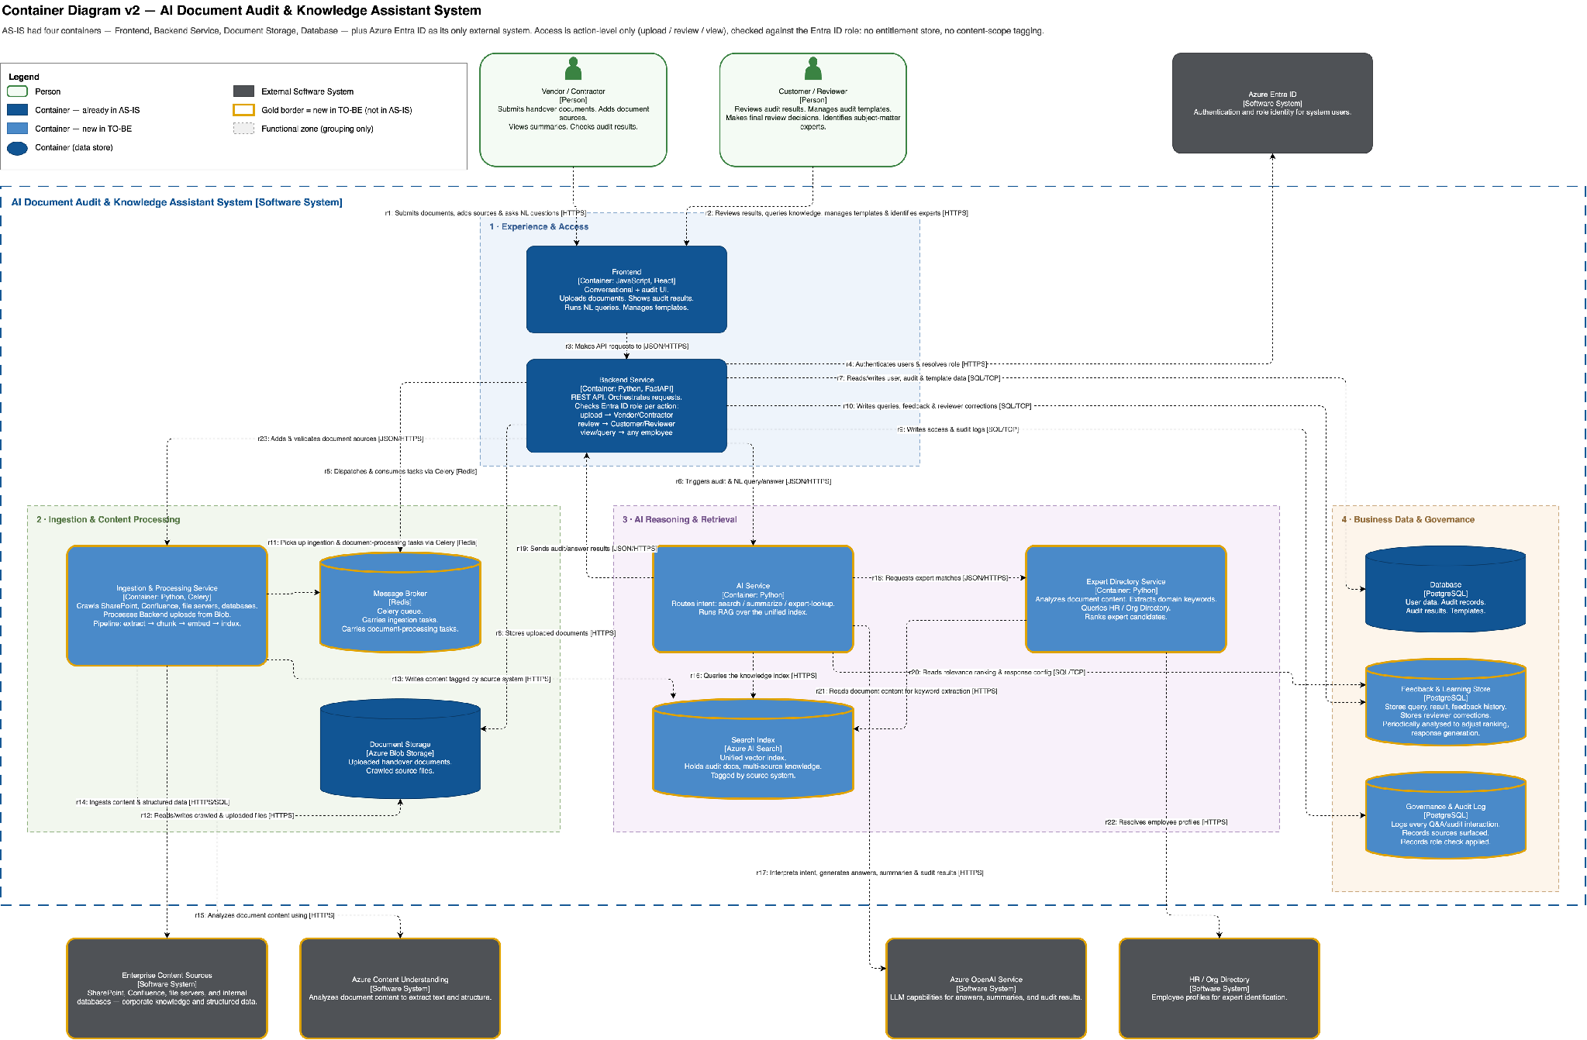
Container Diagram — Full View
Reference for walking through the end-to-end request flow
Notes:
DatPT125

Slide 12
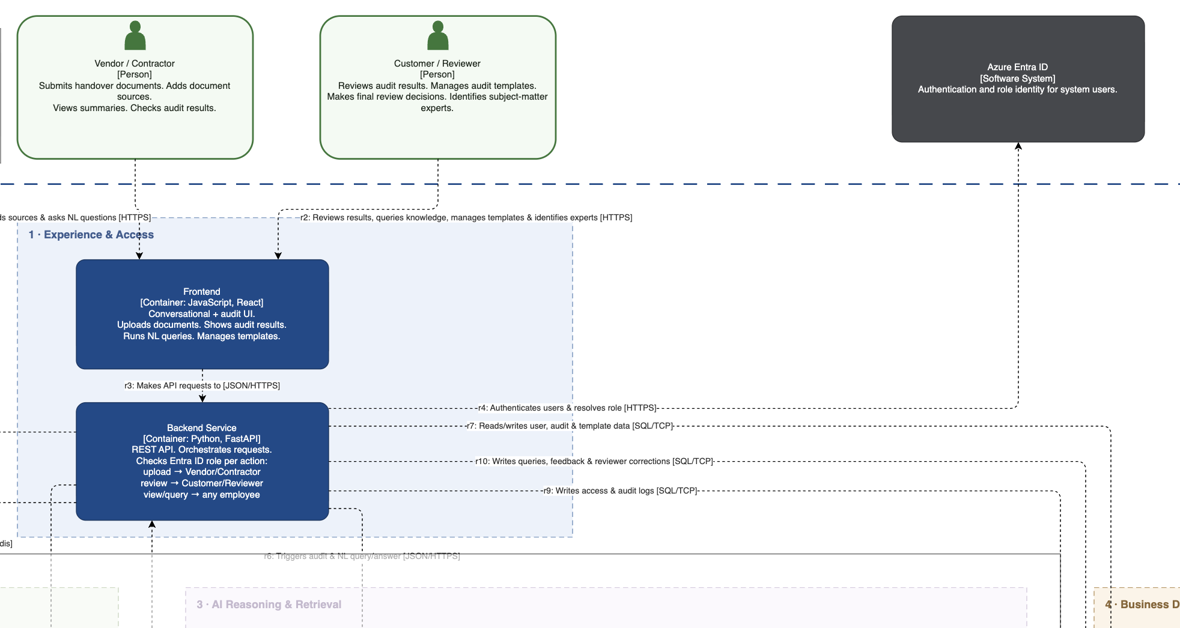
Container Diagram — Functional Zones
Follow a request across four zones · solid color = AS-IS · gold border = new in TO-BE
1 · Experience & Access
Frontend
[JavaScript, React]
Conversational + audit UI
Backend Service
[Python, FastAPI]
Orchestrates requests, checks role per action
Notes:
DatPT125

Slide 13
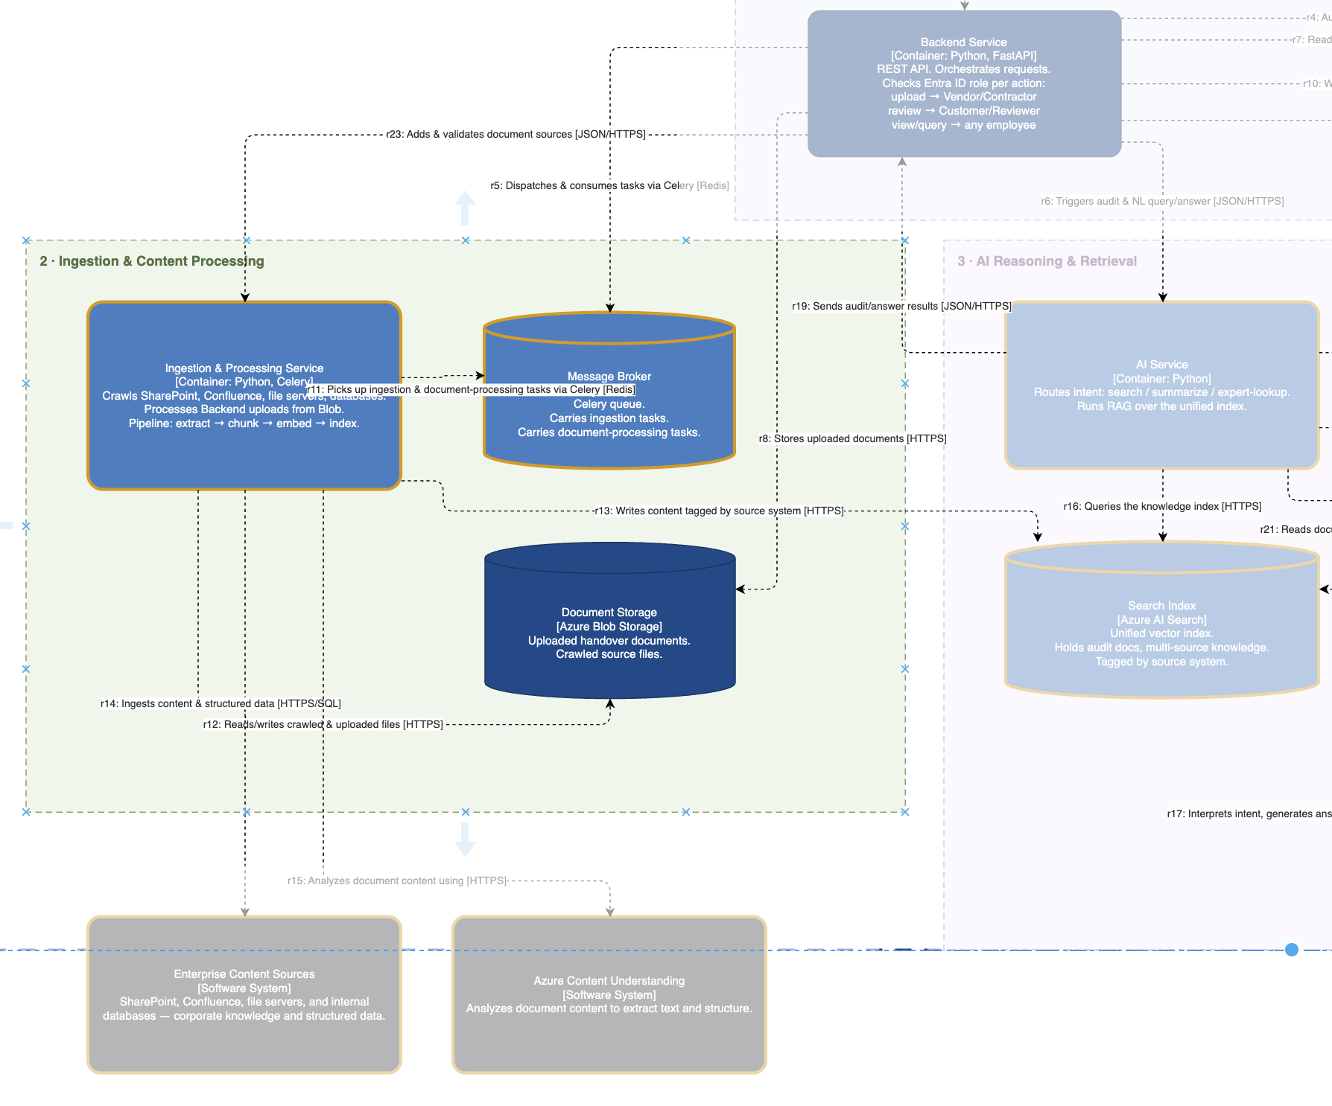
Container Diagram — Functional Zones
Follow a request across four zones · solid color = AS-IS · gold border = new in TO-BE
2 · Ingestion & Processing
›
NEW
Ingestion & Processing Service
[Python, Celery]
Extract → chunk → embed → index
NEW
Message Broker
[Redis] — carries ingestion tasks
Document Storage
[Azure Blob Storage]
Uploaded handover docs, crawled source files
Notes:
DatPT125

Slide 14
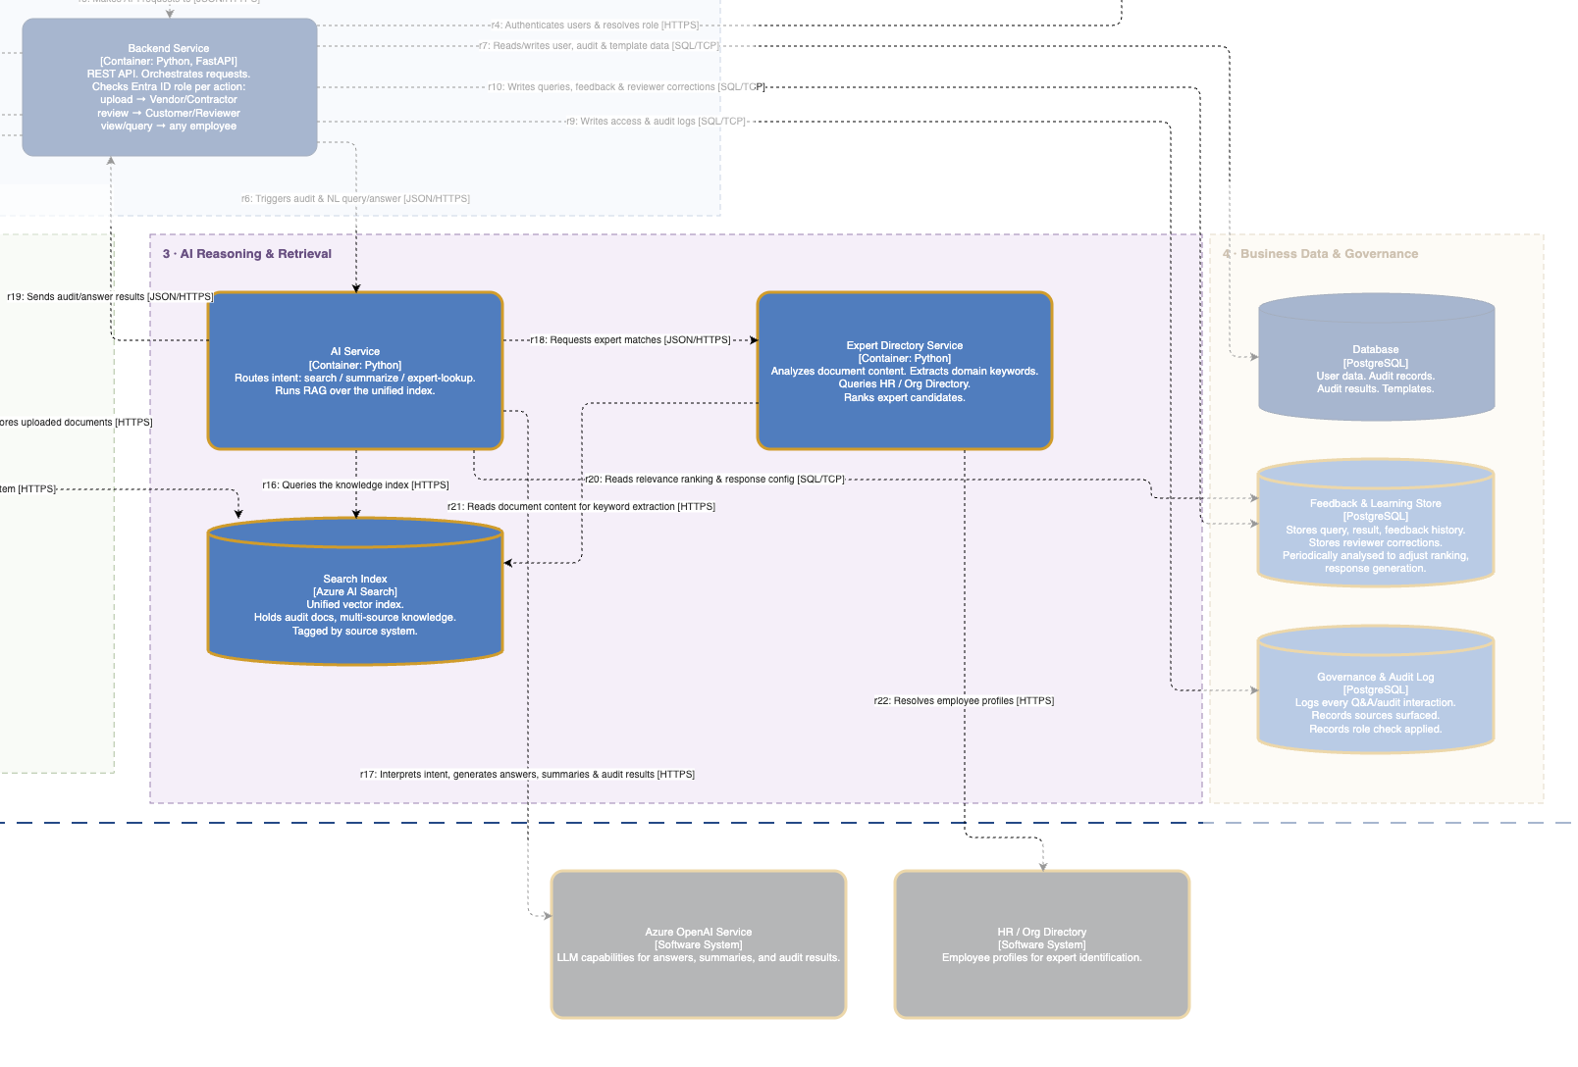
Container Diagram — Functional Zones
Follow a request across four zones · solid color = AS-IS · gold border = new in TO-BE
3 · AI Reasoning & Retrieval
1 · Experience & Access
›
›
NEW
Frontend
AI Service
[JavaScript, React]
[Python, RAG]
Conversational + audit UI
Routes intent, runs RAG over the unified index
NEW
Backend Service
Expert Directory Service
[Python, FastAPI]
[Python]
Orchestrates requests, checks role per action
Extracts keywords, ranks expert candidates
NEW
Search Index
[Azure AI Search]
Unified vector index, tagged by source system
Notes:
DatPT125

Slide 15
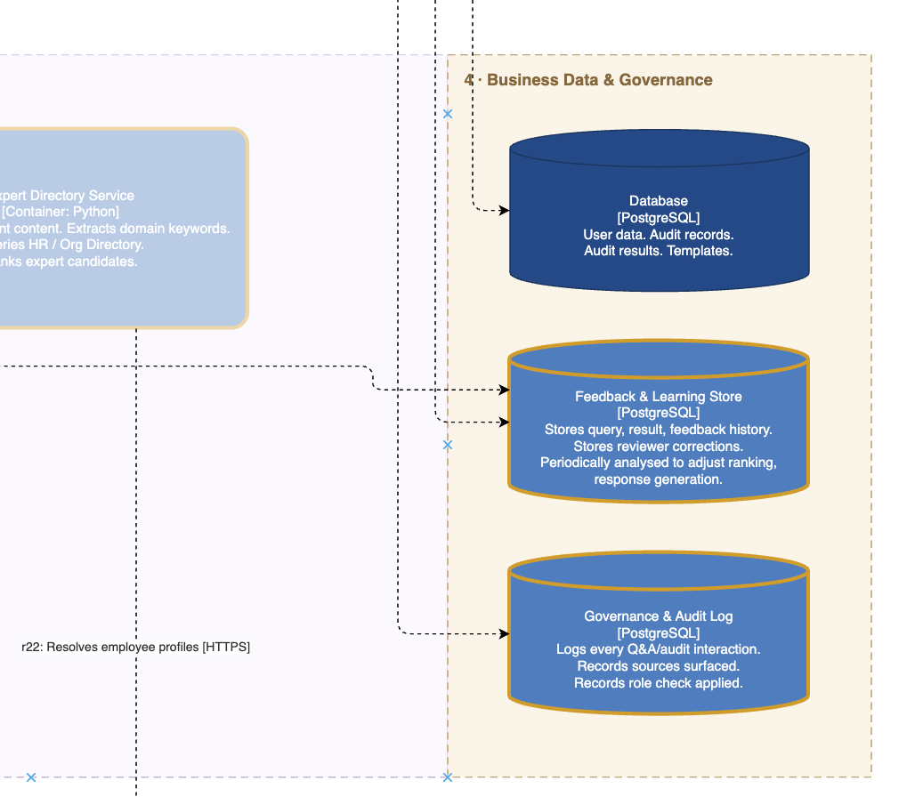
Container Diagram — Functional Zones
Follow a request across four zones · solid color = AS-IS · gold border = new in TO-BE
1 · Experience & Access
›
4 · Business Data & Governance
›
Frontend
Database
[JavaScript, React]
[PostgreSQL] — user data, audit records, templates
Conversational + audit UI
NEW
Feedback & Learning Store
[PostgreSQL] — queries, feedback, corrections
Backend Service
[Python, FastAPI]
Orchestrates requests, checks role per action
NEW
Governance & Audit Log
[PostgreSQL] — logs every Q&A / audit interaction
Also connects out to Enterprise Content Sources, Azure Content Understanding, Azure OpenAI Service, HR / Org Directory, and Azure Entra ID
Notes:
DatPT125

Slide 16
Key Activity Diagrams
3 critical workflows modeled with swim-lane activity diagrams
Flow 1: Submission → Audit
Flow 2: Reviewer Decision
Flow 3: Search, Query & Summary
Vendor prepares & submits → System validates completeness → AI extracts, audits → Notification sent
Customer reviews AI audit → Accept or Reject with evidence-based decision
Natural language query → RAG retrieval → AI-generated answer with sources
Vendor: Prepare package → Fill checklist → Submit
Customer: Receive notification → Review findings → Study evidence
User: Enter NL query
System: Log → Completeness check → [Incomplete? → Notify → Resubmit loop]
Decision: Accept → Mark approved → Write memo → Log & notify
System: Interpret → Search index → Rank & filter
System: Process → Extract content → Run AI audit → Generate report
Decision: Reject → List fixes → Vendor revises → Resubmit (→ Flow 1)
Results found → Generate summary + key points + source links
System: Notify vendor & customer
No results → Suggest related topics → Refine query loop
Notes:
AnhNH101

Slide 17
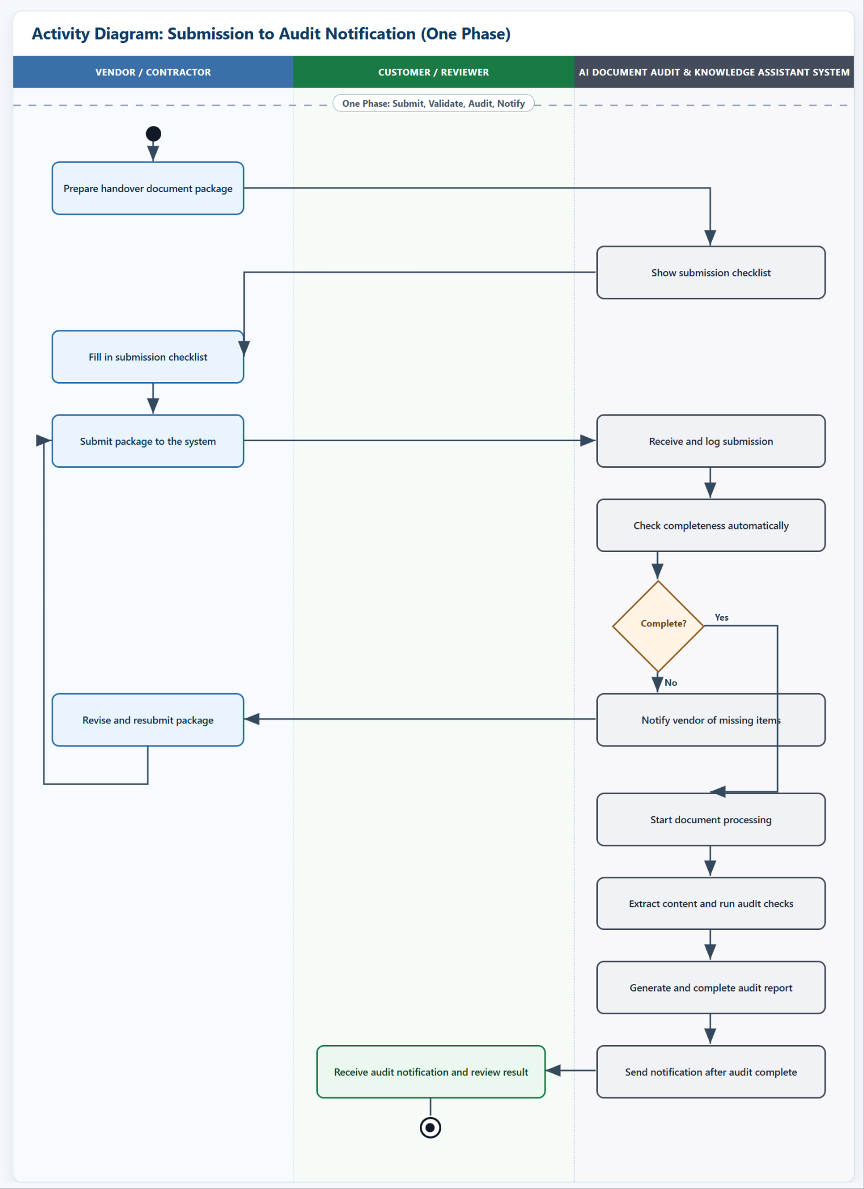
Key Activity Diagrams — Flow 1
Notes:
AnhNH101

Slide 18
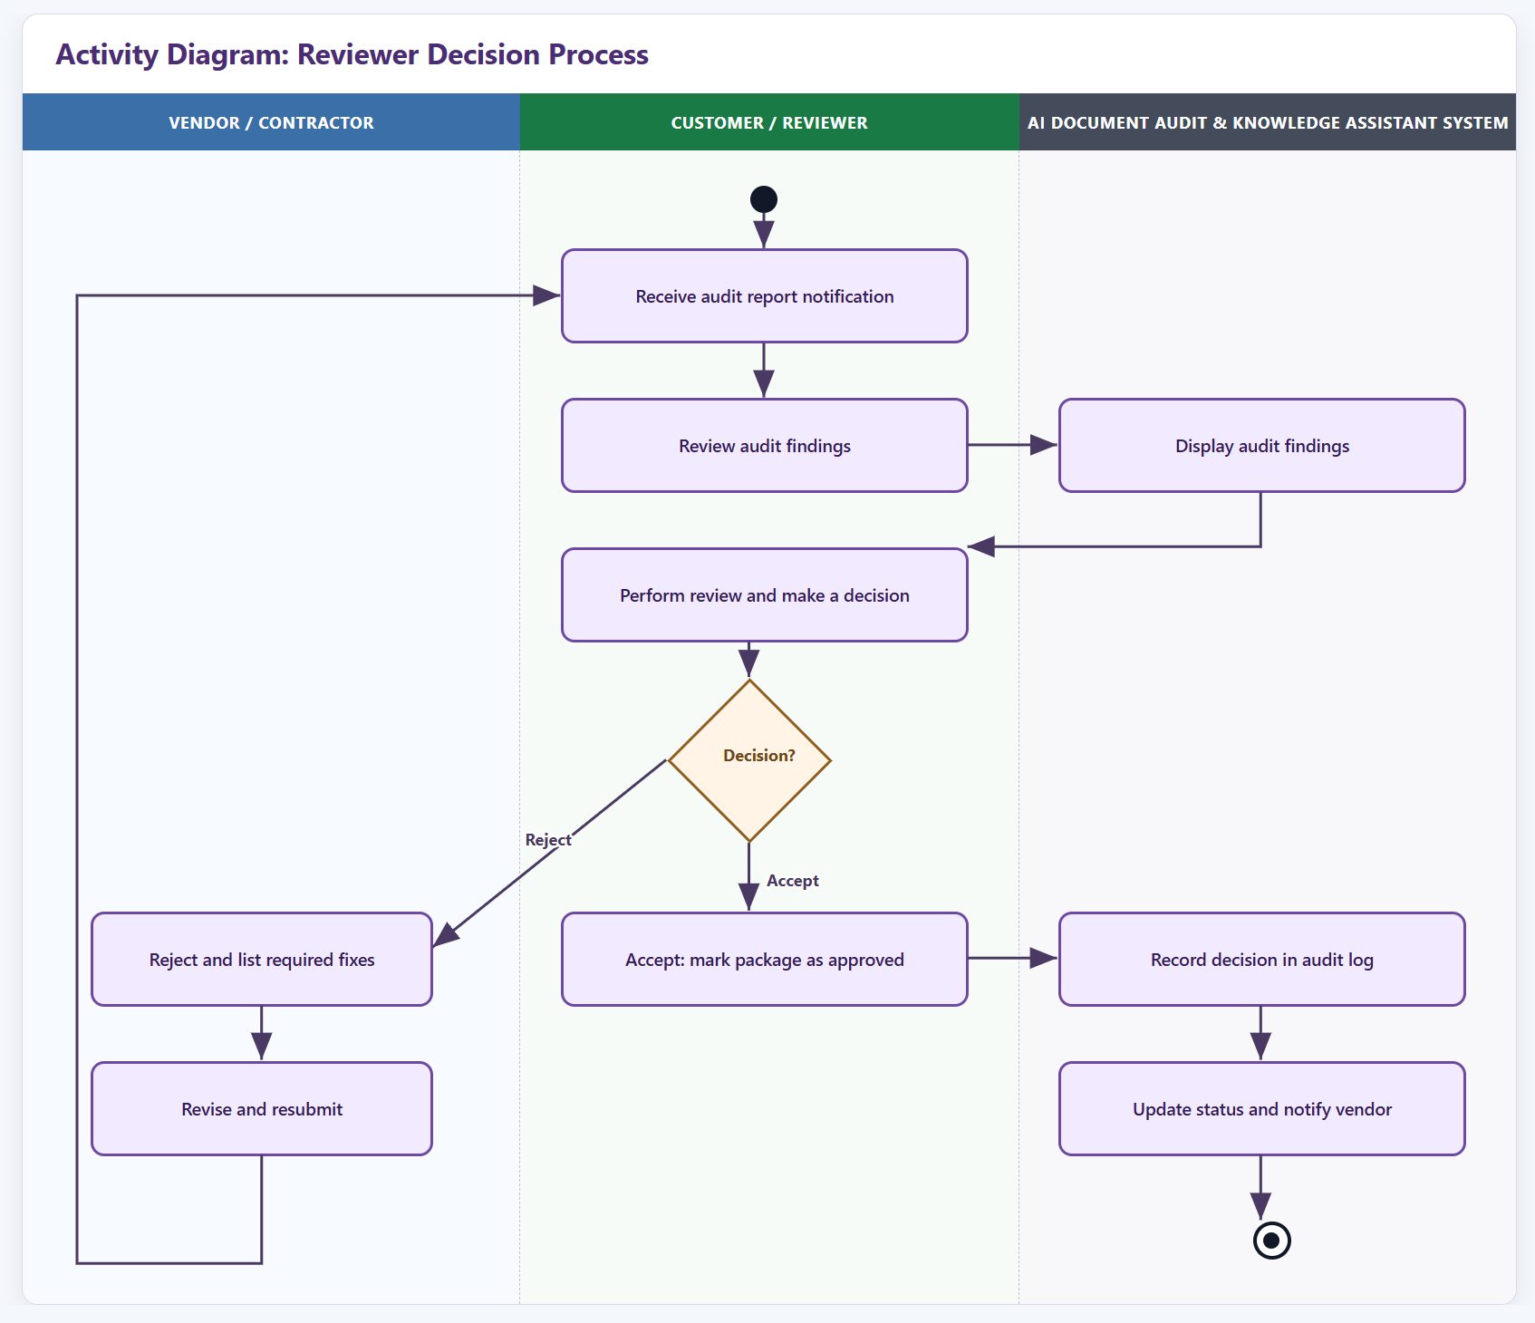
Key Activity Diagrams — Flow 2
Notes:
AnhNH101

Slide 19
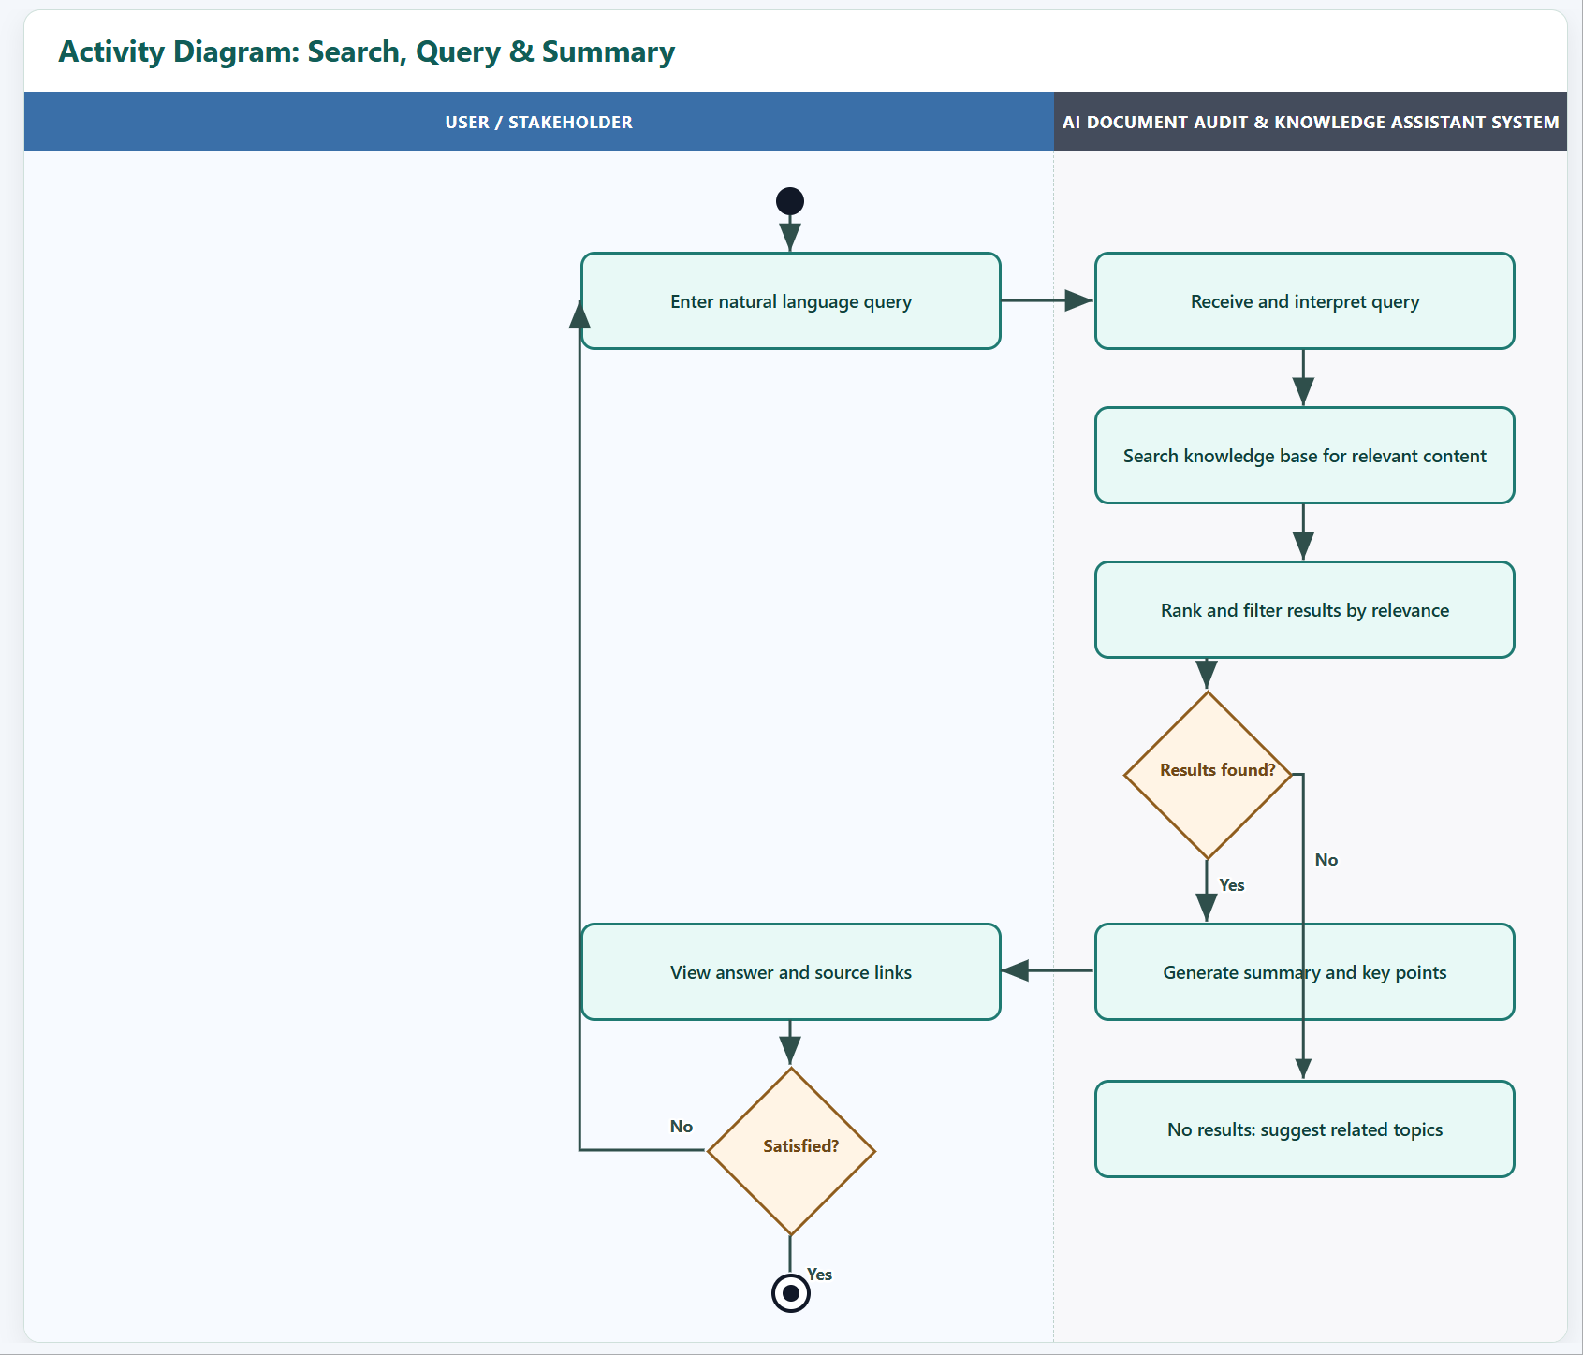
Key Activity Diagrams — Flow 3
Notes:
AnhNH101

Slide 20
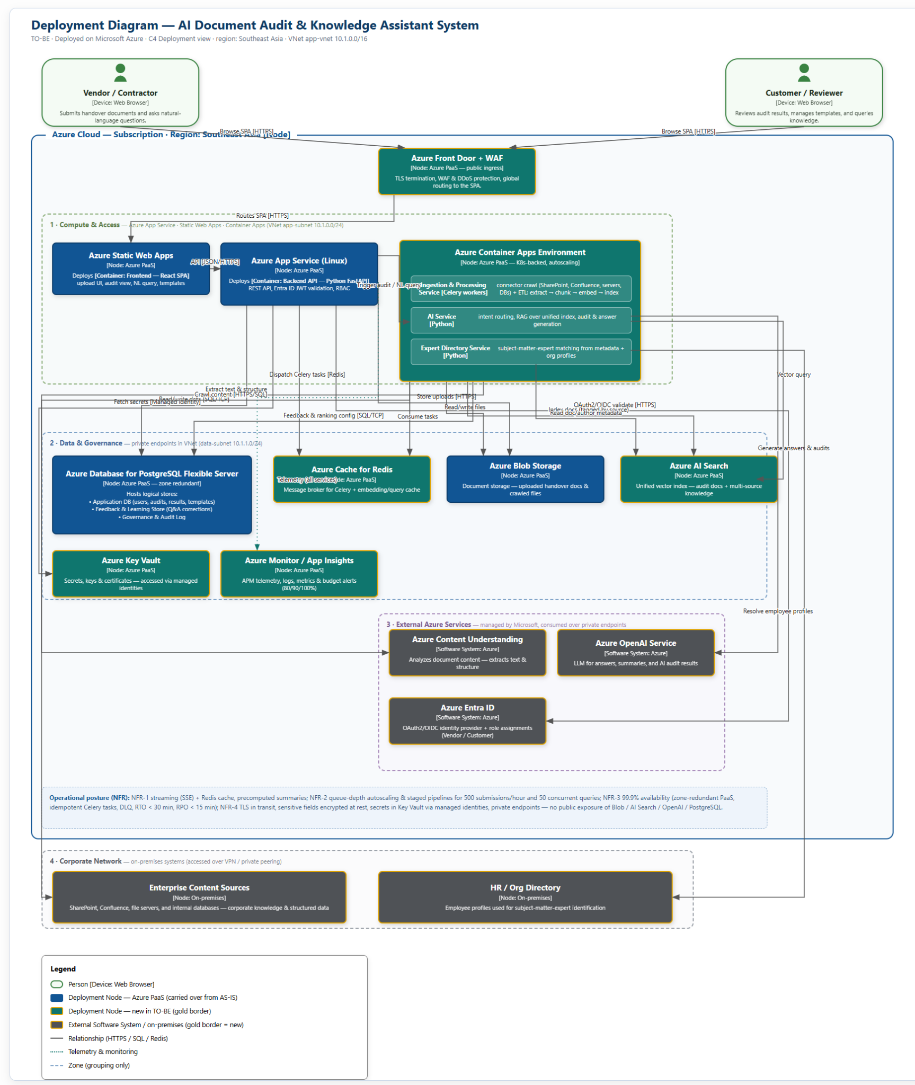
Deployment Diagram — Full View
Notes:
QuanNH40

Slide 21
Deployment Diagram
Azure Cloud · Region: Southeast Asia · VNet 10.1.0.0/16
Zone 1: Compute & Access
Zone 2: Data & Governance
App Service + Static Web Apps + Container Apps
Private endpoints in data-subnet 10.1.1.0/24
Azure Front Door + WAF (public ingress, TLS, DDoS)
PostgreSQL Flexible Server (zone-redundant) — App DB
Static Web Apps → Frontend React SPA
Azure Cache for Redis — Celery broker + query cache
App Service (Linux) → Backend API (FastAPI)
Azure Blob Storage — documents & crawled files
Container Apps → Celery workers, AI Service, Expert Service
Azure AI Search — unified vector index
Key Vault — secrets via managed identities
Azure Monitor / App Insights — APM + budget alerts
Zone 3: External Azure Services
Zone 4: Corporate Network
Managed by Microsoft, consumed over private endpoints
On-premises, accessed over VPN / private peering
Azure Content Understanding — text & structure extraction
Enterprise Content Sources (SharePoint, Confluence, file servers, DBs)
Azure OpenAI Service — LLM inference
HR / Org Directory (employee profiles)
Azure Entra ID — OAuth2/OIDC identity provider
Notes:
QuanNH40

Slide 22
Technical Stack
Technology choices aligned with Azure ecosystem and project constraints
Frontend
Backend
AI & Search
Data & Messaging
Infrastructure
Framework
Framework
LLM
Database
Networking
React (JavaScript)
Python / FastAPI
Azure OpenAI Service
Azure PostgreSQL Flexible Server
VNet + private endpoints
Hosting
Hosting
Extraction
Object Storage
Secrets
Azure Static Web Apps
Azure App Service (Linux)
Azure Content Understanding
Azure Blob Storage
Azure Key Vault
Features
Auth
Search
Cache / Broker
Edge
SPA, responsive, Chrome/Edge 130+
Entra ID JWT + RBAC middleware
Azure AI Search (vector index)
Azure Cache for Redis
Azure Front Door + WAF
Pattern
Task Queue
Monitoring
RAG — Retrieval Augmented Generation
Celery (Python)
App Insights + budget alerts
IaC
Bicep / Terraform
CI/CD
GitHub Actions / Azure DevOps
Notes:
QuanNH40

Slide 23
Solution Benefits
How TO-BE addresses every AS-IS pain point
✗ Limited Scope
✗ No Multi-Source
✗ Weak Automation
✓ End-to-end Document Intelligence
✓ Unified Enterprise Access
✓ Automated Quality Assurance
Expands beyond basic submission/review to support processing, audit, search, and knowledge assistance in one unified workflow.
Combines documents from SharePoint, Confluence, file servers, and databases into a single searchable knowledge layer.
Checks completeness, identifies gaps, and guides resubmission — reducing manual rework by catching issues earlier.
✗ Heavy Manual Review
✗ Missing Feedback Loop
✗ No Expert Matching
✓ Lower Reviewer Effort
✓ Continuous AI Improvement
✓ Faster SME Matching
AI summarizes results, surfaces risks, and lets reviewers focus on exceptions rather than repetitive document reading.
Learns from user interactions and corrections to refine future search results and audit recommendations.
Extracts domain keywords from documents and matches against HR profiles — reducing decision delays.
Notes:
QuanNH40

Slide 24
Estimation — Development Effort
Team: 5 members (1 PM, 2 Backend, 1 Frontend, 1 QA) · Timeline: 3 months
Task
Man-Days
Risk Buffers
Project Setup & Infra
16
28 Man-Days
Auth & Authorization
8
Total Man-Days
Frontend (React SPA)
56
304
Backend API (FastAPI)
46
Doc Processing Pipeline
34
Cost Per Man-Days
AI Search & Knowledge
26
$2000
Expert Identification
10
Total
Learning from Interactions
10
$608,000
Non-Functional (NFR)
26
Testing
14
Deploy, Docs & Training
18
Total
276

Slide 25
Estimation — Infrastructure Cost
Platform: Azure Cloud · Production cap: $5,000/month
Development Phase (3 months)
Production Phase (steady state)
Component
Monthly (USD)
3-Month (USD)
Component
Monthly (USD)
Azure AI Search
$120
$360
Azure AI Search (standard)
$350
Azure OpenAI (dev/test)
$900
$2,700
Azure OpenAI (production)
$2,500
PostgreSQL Flexible Server
$150
$450
PostgreSQL Flexible Server
$350
Blob Storage + Files
$35
$105
Blob Storage + Files
$120
Cache for Redis
$70
$210
Cache for Redis
$150
Monitor / App Insights
$90
$270
Monitor / App Insights
$200
Key Vault, VNet, DNS
$60
$180
Key Vault, VNet, DNS
$150
CI/CD & tooling
$80
$240
Alerting & autoscale
$100
Total
$1,505
$4,515
Total
$3,920/mo
Production: ~$3,920/month — within $5,000 cap
Development Labor
Dev Infrastructure (3mo)
Production Infra/mo
Total Project
$608,000
$4,515
$3,920
~$612,515

Slide 26
Thank You Q & A
We welcome your questions
Group 6 — FPT Software

