Slide 1
AI Document Audit
&
Knowledge Assistant System
Team 6

Slide 2
Agenda
Product Overview
Architecture Decisions
System Architecture
Infrastructure Architecture
Security, Observability, and Scaling
AWS Fit (or other providers)
Sizing & Cost

Slide 3
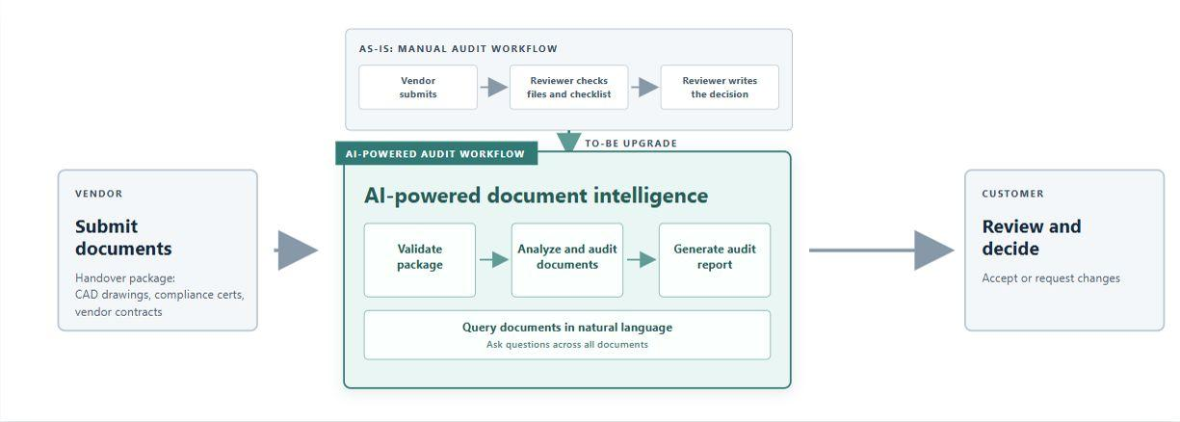
Product Overview

Slide 4
Architecture Decisions (1)
Cloud Platform: Use Azure because the customer already runs their entire system on this platform, and deploy across multiple Availability Zones in to ensure availability if one zone fails.
Technology Stack: Use Python with FastAPI for the backend because it supports rapid API development, asynchronous processing, and easy integration with AI and ETL services. Use ReactJS for the frontend to build a responsive, component-based interface with reusable UI elements and efficient state management.
Identity Platform: Use Microsoft Entra ID for managed identities because the customer already uses it as their identity platform. This avoids introducing another identity system while simplifying access management.
Secure Web Entry Path: Use layered edge protection, web application firewalling, and private application access to reduce threats and access-point failures.
Microservices: Separate services so each can scale, deploy, and recover independently.

Slide 5
Architecture Decisions (2)
Asynchronous ETL Pipeline: Use Celery to distribute long-running ETL tasks across worker processes, enabling independent scaling, automatic retries, task monitoring, and failure isolation. Combine it with idempotent tasks and a dead-letter queue to prevent processing failures from causing data loss.
Resilient Data Storage: Enable high availability (HA) to keep documents and audit records accessible during hardware, zone, or service failures. Use redundant storage, regular database backups, and point-in-time recovery to minimize downtime and prevent data loss.
Private Networking: Use private connectivity for internal services and data stores to keep traffic off the public Internet and reduce the attack surface.
Managed Document Understanding: Use a managed document-understanding service to reduce the need to build and maintain complex OCR, layout-analysis, and document-classification capabilities in-house. It provides scalable, continuously maintained processing for different document formats and improves extraction accuracy.
Human-in-the-Loop AI Decisions: Use AI to generate audit findings, while requiring customer review before final decisions are made.

Slide 6
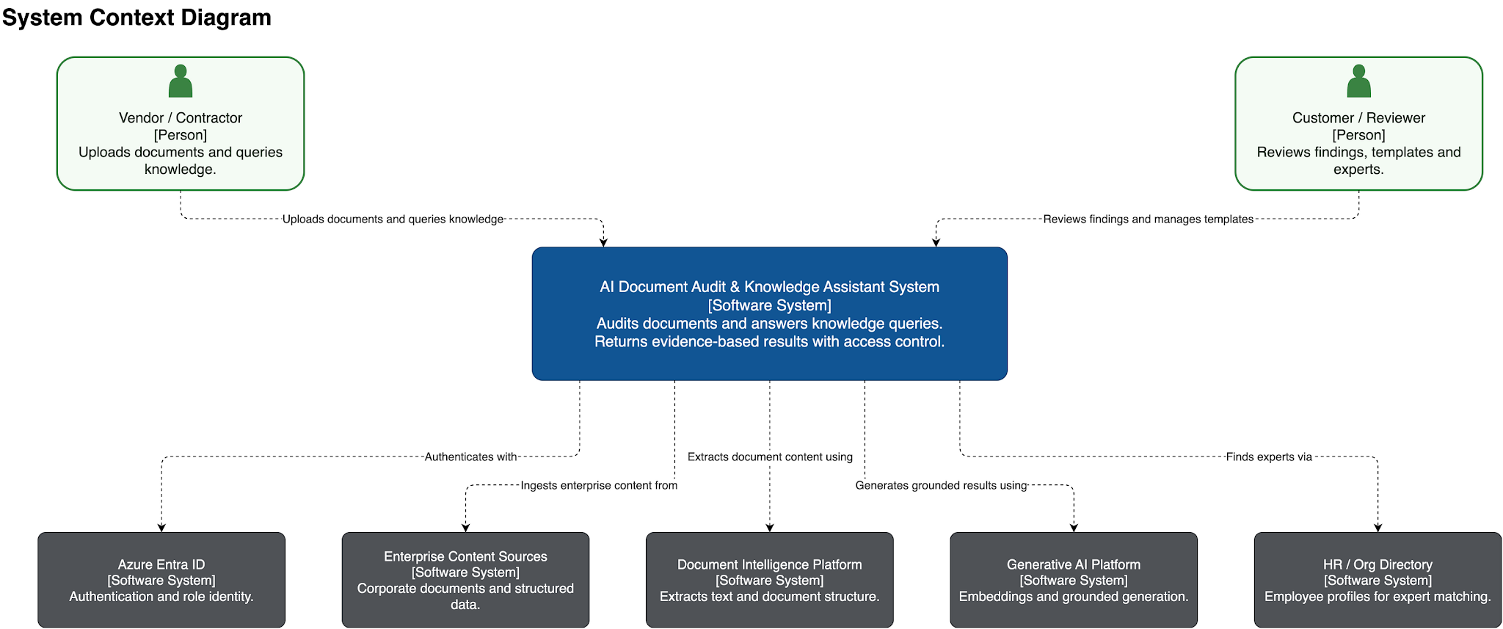
System Architecture - System Context

Slide 7
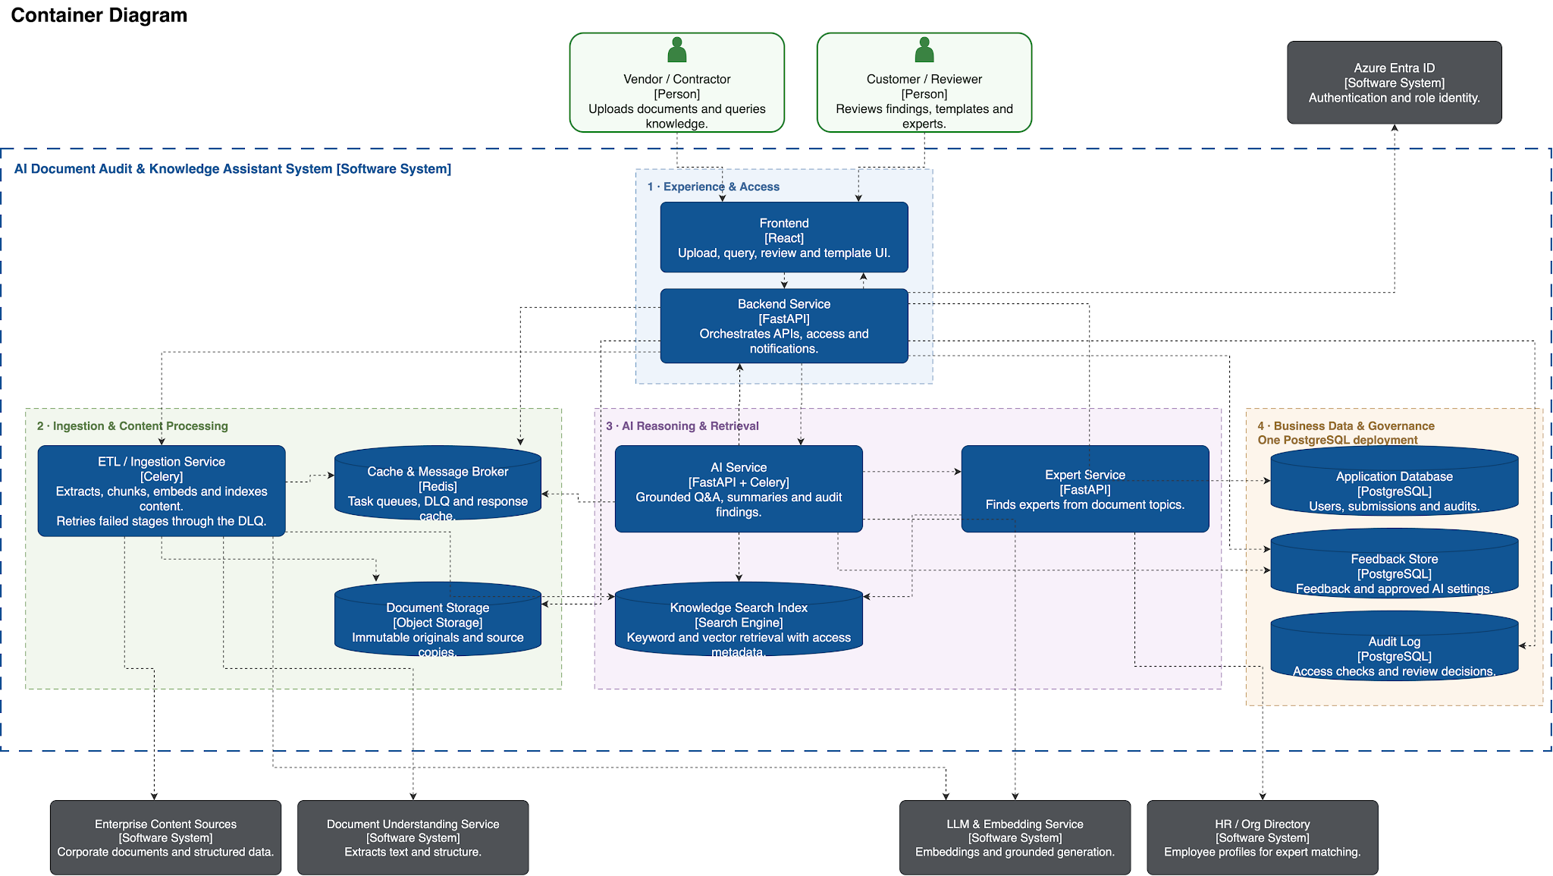
System Architecture - Container View

Slide 8
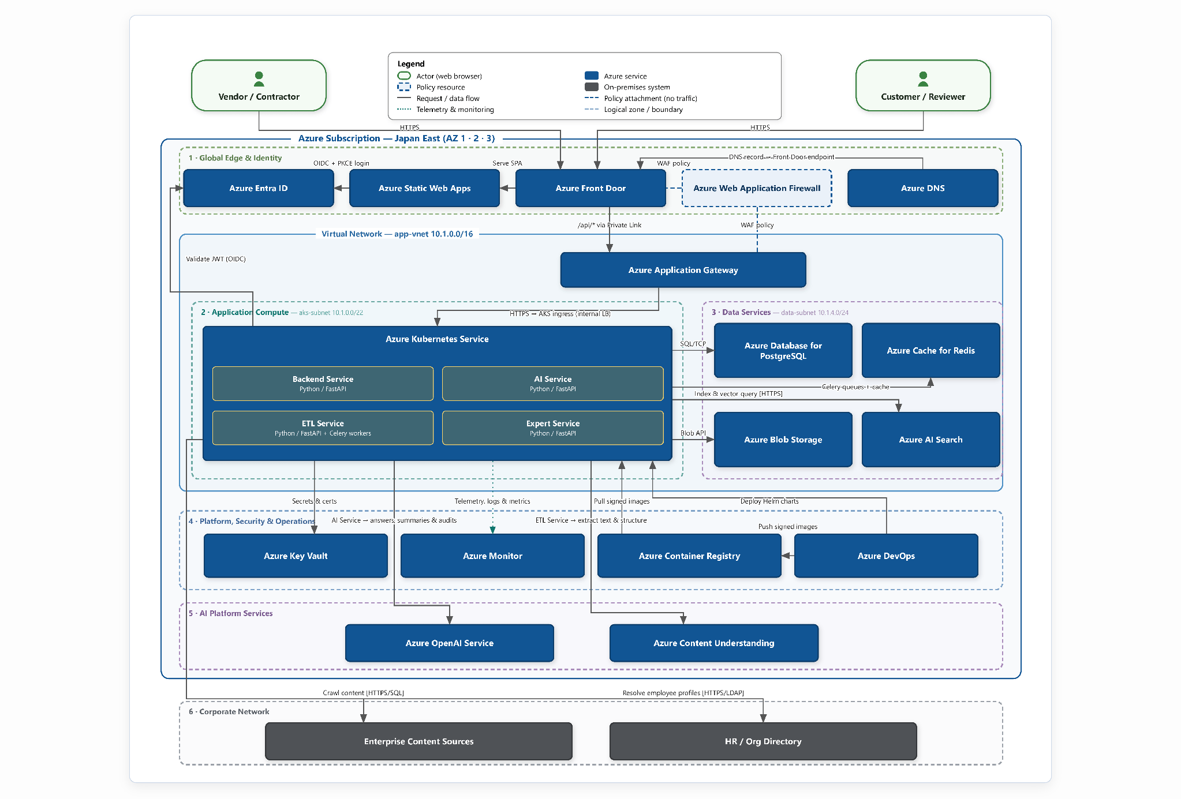
Infrastructure Architecture

Slide 9
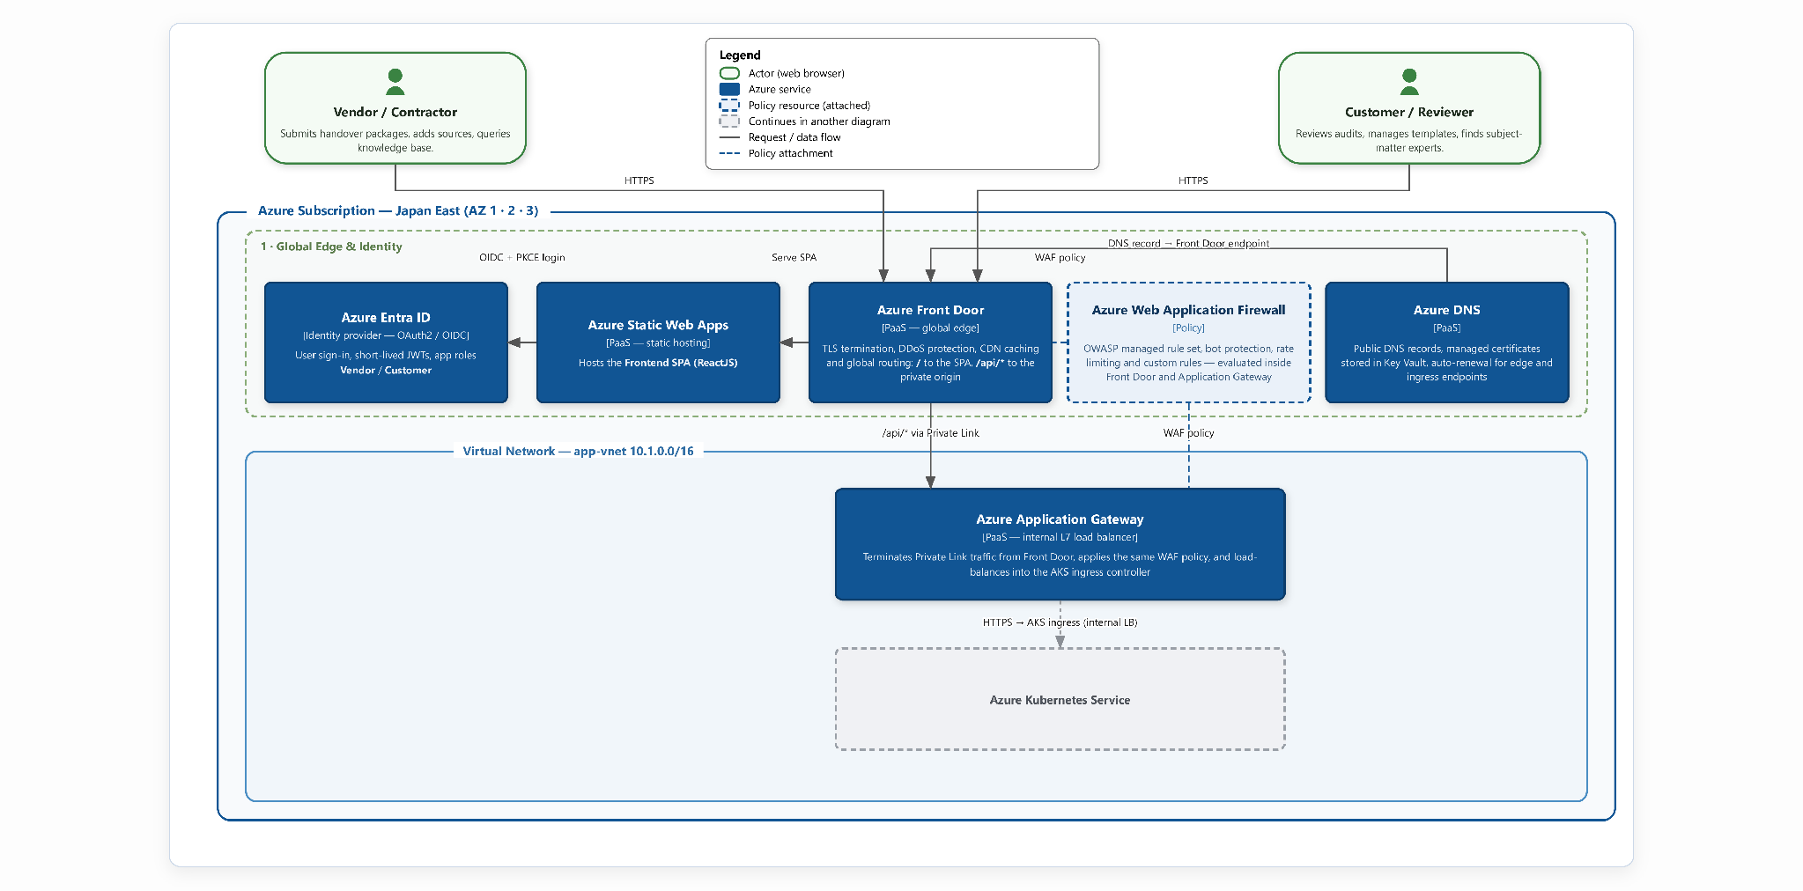
Infrastructure Architecture - Global Edge & Identity (1/4)

Slide 10
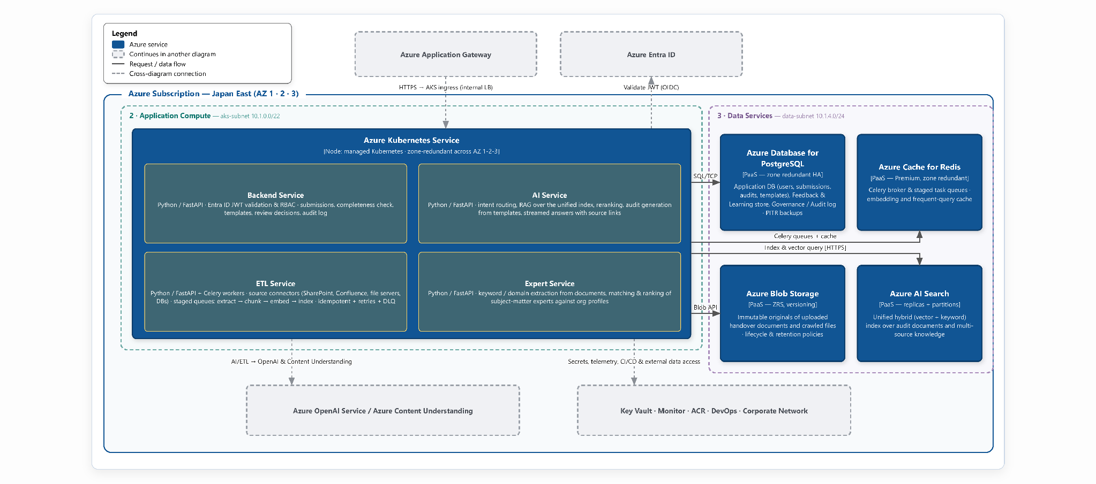
Infrastructure Architecture - Application Compute & Data Services (2/4)

Slide 11
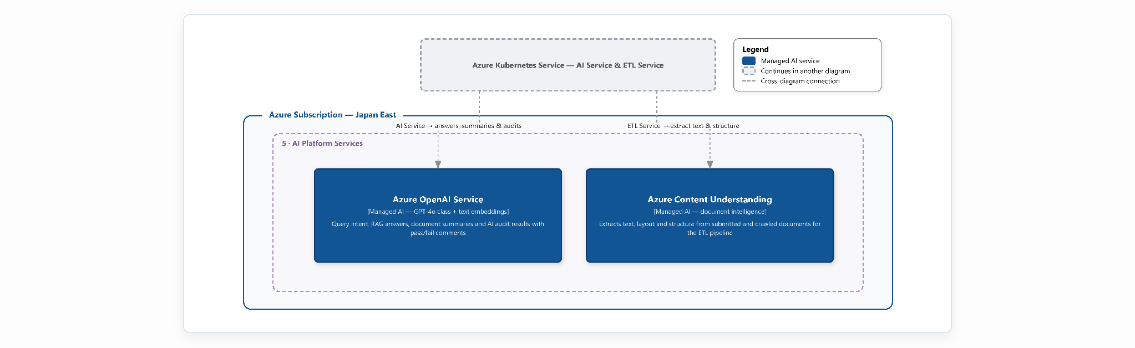
Infrastructure Architecture - AI Platform Services (3/4)

Slide 12
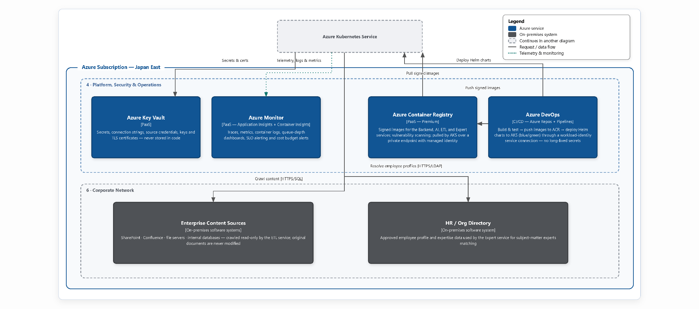
Infrastructure Architecture - Platform, Security & Operations (4/4)

Slide 13
Security, Observability, and Scaling
Security
Observability
Scaling
Entra ID and RBAC: Use Entra ID with OAuth2/OIDC sign-in. Short-lived JWTs are validated in every FastAPI dependency, and RBAC enforces Vendor and Customer scopes.
WAF-protected ingress: Apply one WAF policy across Front Door and Application Gateway, including OWASP managed rules, bot protection, rate limiting, and platform DDoS protection.
Private service connectivity: Keep application workloads in a protected private network and access documents, databases, AI services, and container images through private endpoints instead of the public Internet.
Protected data: Use TLS for data in transit, use Key Vault for secrets management, encrypt sensitive user fields at rest, and keep original documents immutable in Blob Storage under lifecycle and retention policies.
Centralized monitoring: Use Azure Monitor for traces, logs and metrics.
Operational dashboards: Track queue depth per ETL stage, audit duration, AI Search latency, token consumption, and service availability.
SLO and cost alerts: Alert when p95 query latency exceeds 3 seconds, an audit exceeds 10 minutes, the dead-letter queue is non-empty, or availability falls below 99.9%. Trigger budget alerts at 80%, 90%, and 100% of the monthly cap.
Auditable history: Store every submission, AI finding, and reviewer accept/reject decision in immutable PostgreSQL audit history with timestamps.
Independent scaling: Scale the Backend, AI, and ETL services independently based on CPU, memory, queue depth, and request volume.
Burst handling: Add pods and workers automatically during submission spikes and high query concurrency without degrading latency.
Elastic search and cache: Expand Azure AI Search replicas/partitions and Redis capacity to maintain fast retrieval under peak load.
Cost-aware scaling: Maintain a lean baseline and scale out only when needed, then scale back down during normal operating periods.

Slide 14
Azure Fit
Capability | Service | Why
CDN | Azure Front Door | Global edge caching + TLS + DDoS + WAF
Identity | Azure Entra ID | Mandatory
SPA hosting | Azure Static Web Apps | Serverless
Load balancer | Azure Application Gateway | WAF + Keep AKS off the public Internet
Container platform | Azure Kubernetes Service | More configurable scaling
Relational database | Azure Database for PostgreSQL | Fully managed + HA + PITR
Cache & Celery broker | Azure Cache for Redis | Fully managed + HA
Object storage | Azure Blob Storage | ZRS + Versioning + Policies
Vector database | Azure AI Search | Fully managed + First-party integration with AOS & ACU
LLM & embeddings | Azure OpenAI Service | Enterprise-grade + Data staying inside Azure tenant boundary
Document extraction | Azure Content Understanding | Extract text, layout and structure from mixed document formats without custom OCR
Secrets management | Azure Key Vault | Central store for secrets, keys and certs
Observability | Azure Monitor | Traces, logs, metrics dashboards and alerts in one place
Registry & CI/CD | Azure Container Registry + Azure DevOps | Mandatory
Networking | VNet + Subnet + Private Link | Keep backend, data and AI services private

Slide 15
Sizing & Cost (1)
Workload sizing
Development effort (1 PM, 2 Backend, 3 AIE, 2 Frontend, 2 QA)
Throughput
• 500 document submissions / hour
• 50 concurrent interactive queries
Latency
• First token < 2s (p95)
• Query P95 < 3s during bursts
• 95% of audits < 10min per package
• P99 end-to-end < 15 min
Resilience
• 99.9% monthly availability
• RTO < 30min · RPO < 15min · zero silent data loss
Platform footprint
• AKS zone-redundant AZ 1-2-3, four services (Backend, AI, ETL, Expert)
• AI Search sized by replicas (QPS) and partitions (index size)
• PostgreSQL zone-redundant HA + PITR
• Redis zone-redundant HA
• Blob Storage ZRS + Versioning
Task | Man-Days
Project setup & cloud infrastructure | 16
Authentication & authorization | 8
Frontend application | 56
Backend API | 46
Document processing pipeline | 34
AI search & knowledge base | 26
Expert identification | 10
Learning from interactions | 10
Non-functional requirements | 26
Testing | 14
Deployment, documentation & training | 18
Risk buffers | 28
Total | 304

Slide 16
Sizing & Cost (2)
Infrastructure cost — development (3 months)
Infrastructure cost — production (steady state)
Component | Monthly | 3 months
Azure OpenAI Service (dev + test) | 900 | 2,700
Azure Database for PostgreSQL | 150 | 450
Azure AI Search | 120 | 360
Azure Monitor | 90 | 270
CI/CD, test runner & support tooling | 80 | 240
Azure Cache for Redis | 70 | 210
Key Vault, private networking & DNS | 60 | 180
Azure Blob Storage | 35 | 105
Total (USD) | 1,505 | 4,515
Component | Monthly
Azure OpenAI Service (production inference) | 2,500
Azure Database for PostgreSQL (HA + PITR) | 350
Azure AI Search (standard tier) | 350
Azure Monitor | 200
Alerting, autoscale support & operational overhead | 100
Azure Cache for Redis (HA) | 150
Key Vault, private networking & DNS | 150
Azure Blob Storage (ZRS + Versioning) | 120
Total (USD) | 3,920

Slide 17
Q & A
Thank You

