Slide 1


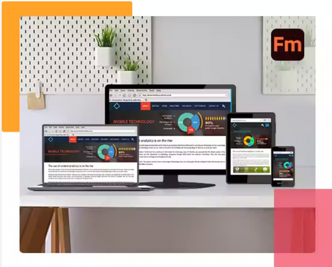
ANNEX ‘A’
ADOBE FRAMEMAKER
ADOBE FRAMEMAKER WILL ENABLE THE CREATION OF MORE INTERACTIVE AND ENGAGING MANUALS, REDUCING COMPLEXITY AND IMPROVING USER COMPREHENSION.
KEY BENEFITS
Rich media integration: Embed 3D models and videos.
Multi-channel publishing: Manuals for PCs, Tablets, Webpages.
Enhanced XML/DITA support: Creation of standardized documents.
Collaboration tools: Simplifies review and editing processes.
ESTIMATED COST
1 license - $480 (annually)
TRAINING
$750 (Per Person)

Slide 2

ANNEX ‘A’
ADOBE FRAMEMAKER
ADOBE FRAMEMAKER WILL ENABLE THE CREATION OF MORE INTERACTIVE AND ENGAGING MANUALS, REDUCING COMPLEXITY AND IMPROVING USER COMPREHENSION.
KEY BENEFITS
Rich media integration: Embed 3D models and videos.
Multi-channel publishing: Manuals for PCs, Tablets, Webpages.
Enhanced XML/DITA support: Creation of standardized documents.
Collaboration tools: Simplifies review and editing processes.
ESTIMATED COST
1 license - $480 (annually)

Slide 3

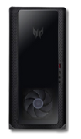

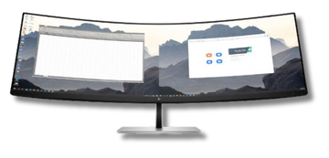
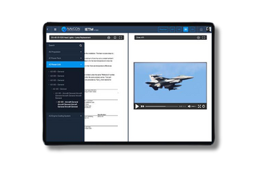
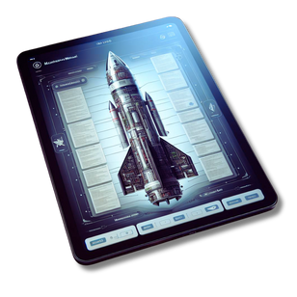
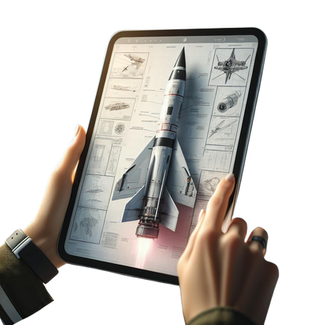
ANNEX ‘B’
EQUIPMENTS
THESE TOOLS ARE MANDATORY FOR CREATION OF ADVANCED TECHINCAL PUBLICATIONS.
Resource Type | Resource Name | Quantity | Estimated Cost
CPUs | Intel Core i7-12700F | 3 units | $500 * 3
Key Benefit: The Intel Core i7-12700F Workstation provides robust multitasking and fast processing for complex technical publishing software. | Key Benefit: The Intel Core i7-12700F Workstation provides robust multitasking and fast processing for complex technical publishing software.
Monitors | Dell UltraSharp U2720Q | 3 units | $900 * 3
Key Benefit: It offers 4K resolution and accurate color representation for precise editing and layout work. | Key Benefit: It offers 4K resolution and accurate color representation for precise editing and layout work.
Tablets | iPad 10.2" WiFi 32GB | 10 units | $160 * 10
Key Benefit: It offers access to the technical publications to the users on the field with interactive 3D simulations and video for enhanced user experience. | Key Benefit: It offers access to the technical publications to the users on the field with interactive 3D simulations and video for enhanced user experience.

Slide 4
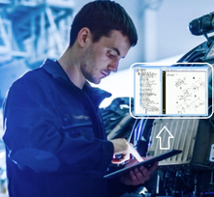
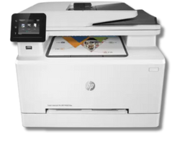
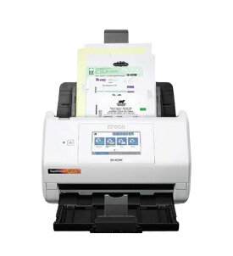
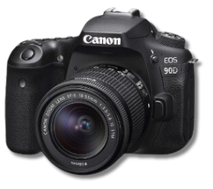
ANNEX ‘B’
EQUIPMENTS
THESE TOOLS ARE MANDATORY FOR CREATION OF ADVANCED TECHINCAL PUBLICATIONS.
Resource Type | Resource Name | Quantity | Estimated Cost
Printer | HP Color LaserJet MFP M281fdw | 2 units | $550 * 2
Key Benefit: It enables high-quality color printing and multifunctional document handling for publication proofing and distribution. | Key Benefit: It enables high-quality color printing and multifunctional document handling for publication proofing and distribution.
Scanner | Epson RapidReceipt RR-600W | 1 unit | $400
Key Benefit: It facilitates fast digitization of documents, aiding in efficient digital archive management for publications. | Key Benefit: It facilitates fast digitization of documents, aiding in efficient digital archive management for publications.
Camera | Canon EOS 90D DSLR | 2 unit | $1200 *2
Key Benefit: It captures high-resolution images essential for professional-quality visual content in technical publications. | Key Benefit: It captures high-resolution images essential for professional-quality visual content in technical publications.

Slide 5


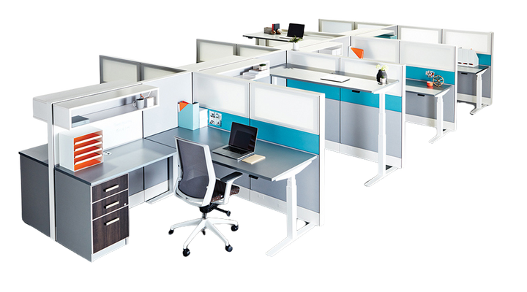
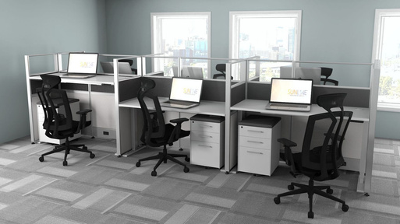


Workstation Cubicles
INGOUDE COMPANY
reallygreatsite.com

