Slide 1

Census Annual Business Survey
Racial, Sexual, and Ethnic Disparities in US Job Market
Tavianne Kemp, Jack Lynn, Stanley Perez, & Sam Wainright
July 18, 2022
Fork our GitHub now!

Slide 2

Annual Business Survey^{[1]}
Census Demographics^{[2]}
Taken from 2019
Contains business survey data regarding demographics, income, sales, ownership, and other commerce-related data
Compiled by the US Census Bureau
Taken from 2020
Contains population proportions for race, ethnicity, and gender
Compiled by the US Census Bureau
[1] US Census Bureau. (2019). Annual Business Survey (ABS). Suitland; US Census Bureau.
[1] US Census Bureau. (2020). QuickFacts. Suitland; US Census Bureau.

Slide 3
Central Questions
What demographic disparities exist in the American workforce?
What demographics are disproportionately negatively affected?

Slide 4
Census ABS
Annual Business Survey: “[P]rovides information on business ownership.”

Slide 5
Coverage
Variables concerning demographics are aggregated for confidentiality
Ethnicity
Race
Sex
Notes:
The background is useful to hold on to as we investigate these demographics

Slide 6
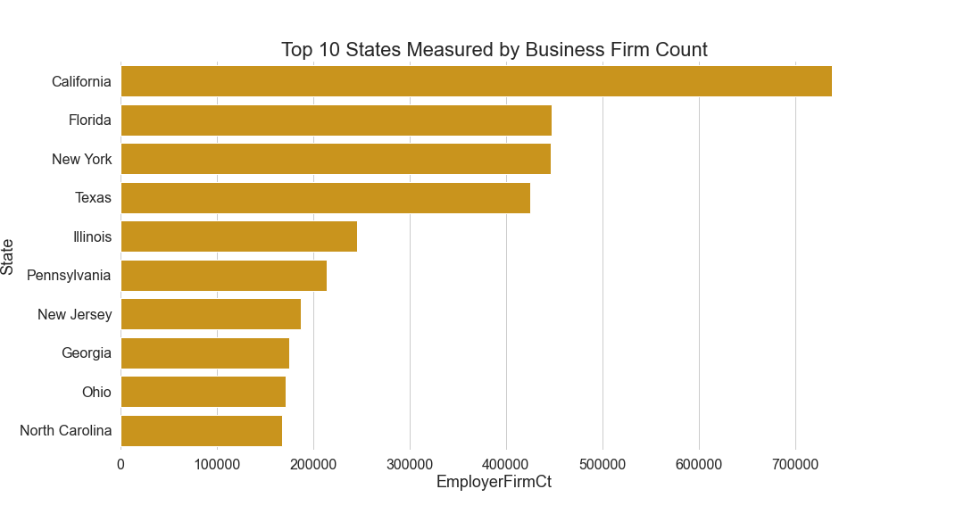
Amount of Business Firms by State
Notes:
By the census standards, a business firm is any business where the owner possesses more than 50% of the stock or equity in the business.

Slide 7
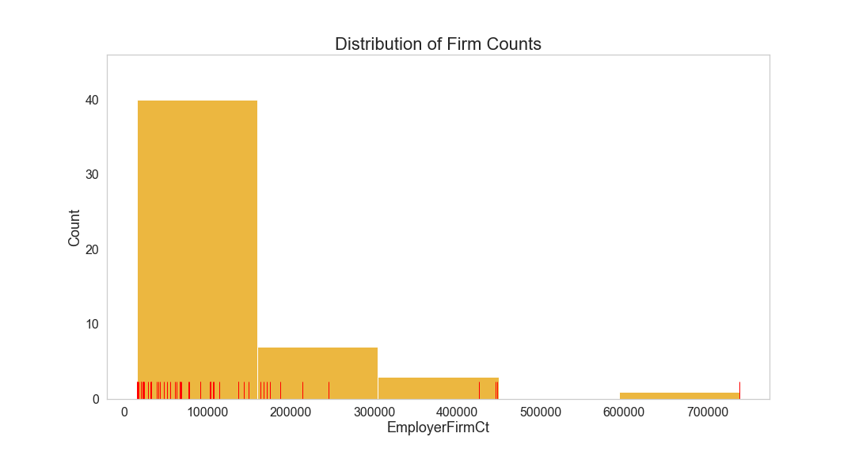
Distribution of Business Firms by State
Notes:
By state counts, the number of firms is positively skewed
The significance of a positively skewed data set is that the mean exceeds the median value;
As in the average amount is much larger than the median values.
California is the only datapoint on the far right.

Slide 8
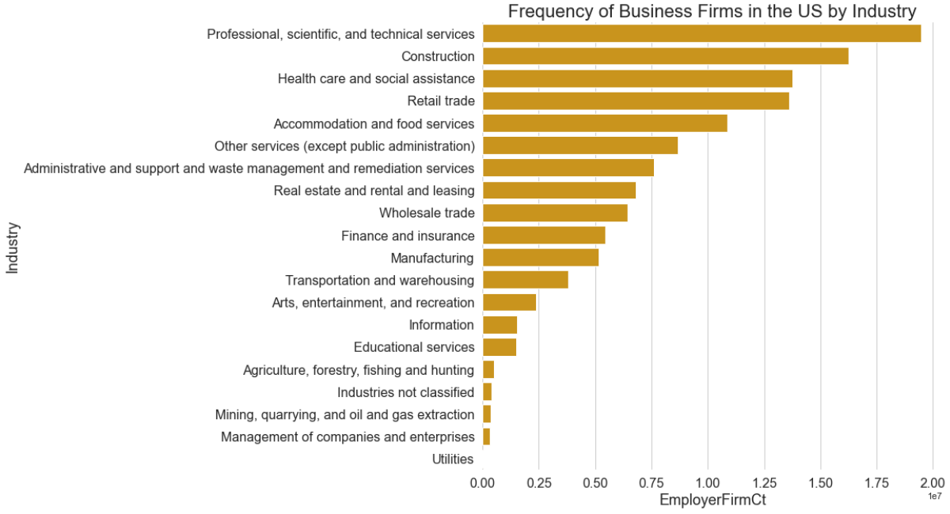
Measured Industries in the US
Notes:
Top 3: professional, scientific, and technical; construction; healthcare account for 40 % of the industry in the US. When looking at where we can make more equitable work-spaces, these industries would have the most impact.

Slide 9
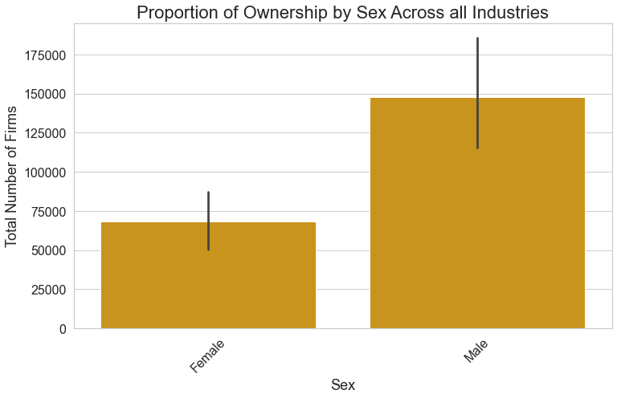
Distribution of firm ownership by sex
Amount of Firm Owners
Males own 70% more businesses in the US than women
It is unlikely that the distribution is caused by sampling errors.
Notes:
Census ABS measured the sex of the owner as either 'male', 'female', 'both equally'. In general: is one sex more prominant than another when it comes to owning a busines?
Males own more businesses in the US than women (70%). No overlap in error bars suggest that there is a significant difference where the disproportion is not likely to be caused by chance or sampling errors; different is statistically significant.

Slide 10
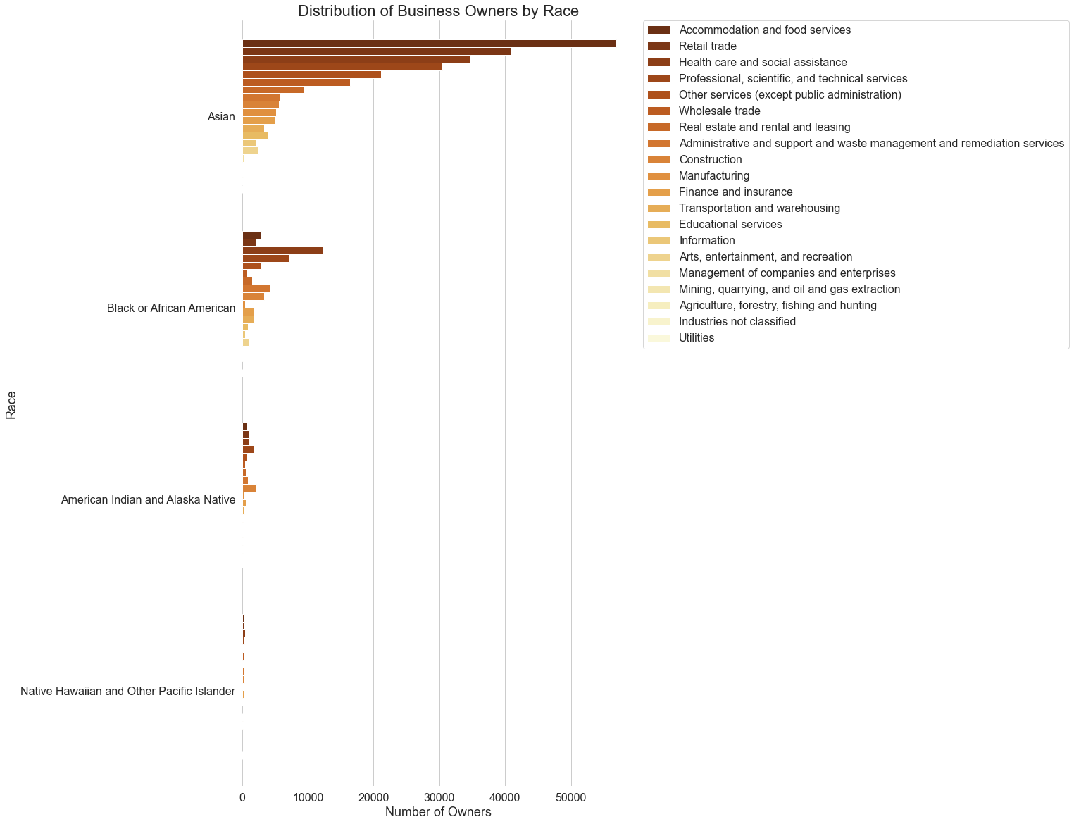
Industry ownership by Race
Race in the Industries
Removing White demographic as an outlier
The highest measure in the Asian demographic is the 7th smallest in the White
Notes:
You’ll see in a few slides how the white demographic is disproportionately larger in all industries.
So much that it made this information difficult to read, interpret, and it even sorts the data in a different order
Where the top sorted values were: professional, scientific, and technical; construction; healthcare account for 40 %, omitting White shifted it to accommodation, retail, and healthcare

Slide 11
Ethnicity
Census: “[W]hether someone is of Hispanic or Latino origin”

Slide 12
Ethnic Census Categories
Hispanic
Non-Hispanic
Equally Hispanic / Non-Hispanic

Slide 13
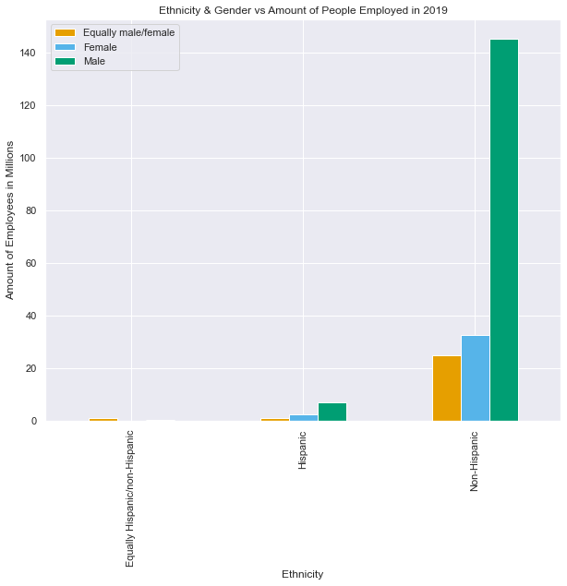
Amount of People Employed
Non-Hispanic companies are dominating the amount of people they have employed
Male-owned non-Hispanic companies lead Hispanic male-owned companies by about over 100 million employees

Slide 14
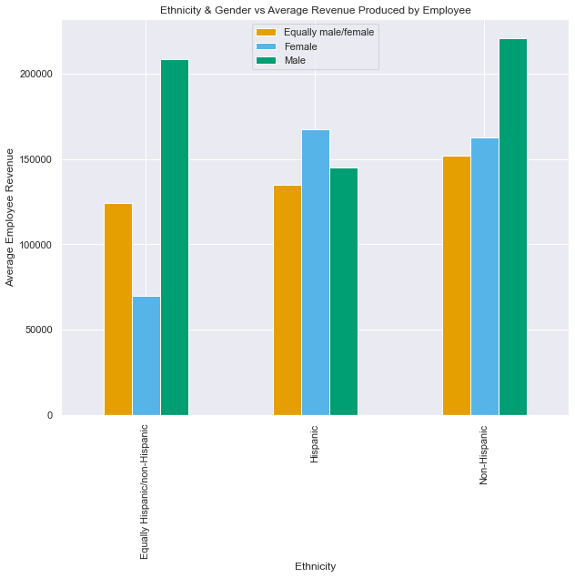
Revenue per Employee
Male non-Hispanic group leads the market in revenue generated per employee
Hispanic female companies are the 3rd best at generating revenue per employee

Slide 15
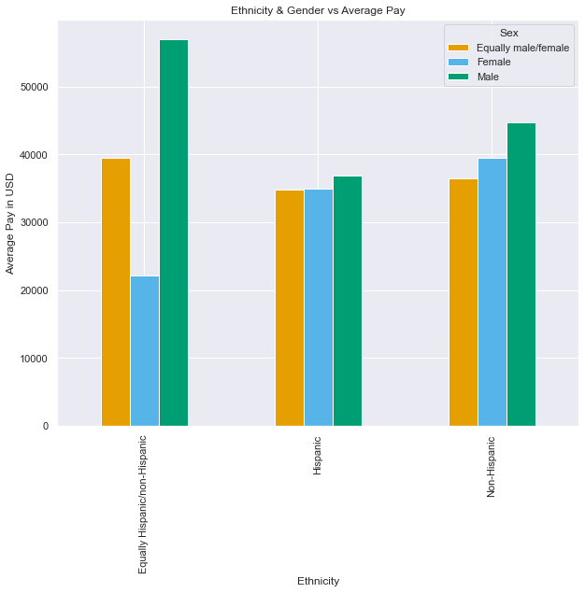
Average Employee Pay
Hispanic group throughout their sub-categories pay relatively the same
Equally Hispanic / non-Hispanic companies lead the market in terms of their Male / Equally male / female subcategories

Slide 16
Race
Census: “[A] person’s self-identification with one or more social groups”

Slide 17
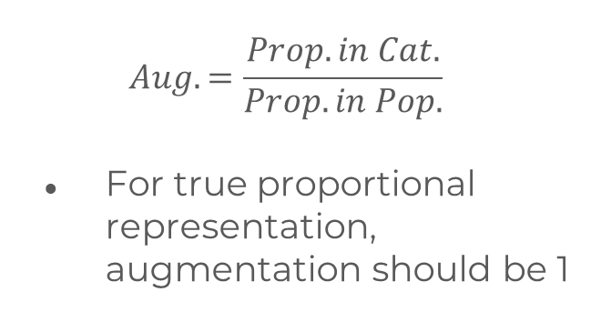
Race Census Categories
Augmentation
American Indian and Alaska Native
Asian
Black or African American
Native Hawaiian or Pacific Islander
White
$$Aug.=\frac{Prop. in Cat.}{Prop. in Pop.}$$
For true proportional representation, augmentation should be 1

Slide 18
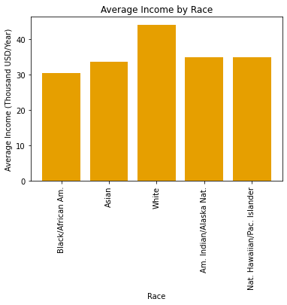
Income
White is only group with 40k+/year incomes
Black/African Am. has disproportionately low income

Slide 19
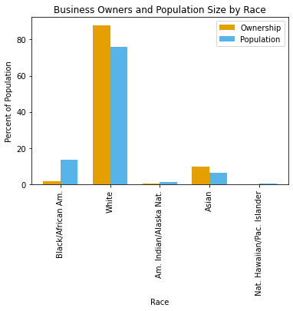
Ownership
White business owners own the vast majority of businesses
Black/African Am. is the second largest race group but has less than 2% business ownership

Slide 20
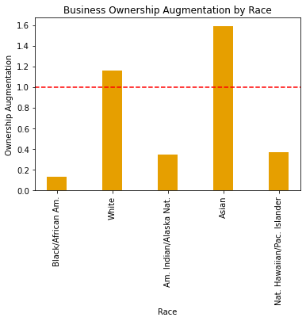
Ownership
White and Asian groups are overrepresented in business ownership
Every other group, especially Black/African Am., are far underrepresented

Slide 21
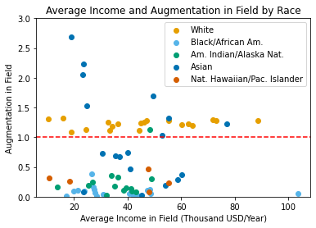
Industry
White and Asian groups are consistently disproportionally represented in most industries
White group is overrepresented in highest paying jobs

Slide 22
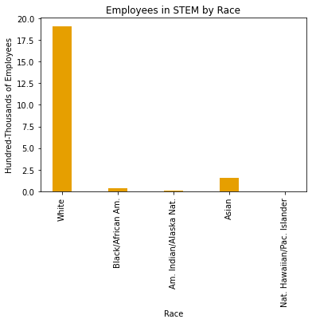
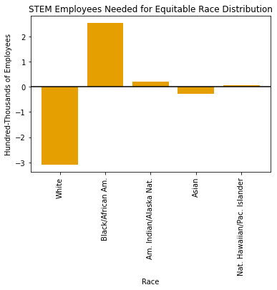
Case Study: STEM Field

Slide 23
Sex
Census: “[B]ased on the biological attributes of men and women”
(Not to be confused with gender)

Slide 24
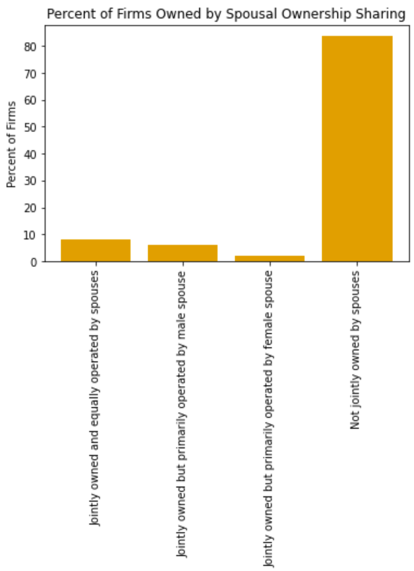
Spousal Ownership
Nearly all firms are not jointly owned by spouses.
The smallest portion are firms that are jointly owned with the female spouse being the primary operator

Slide 25
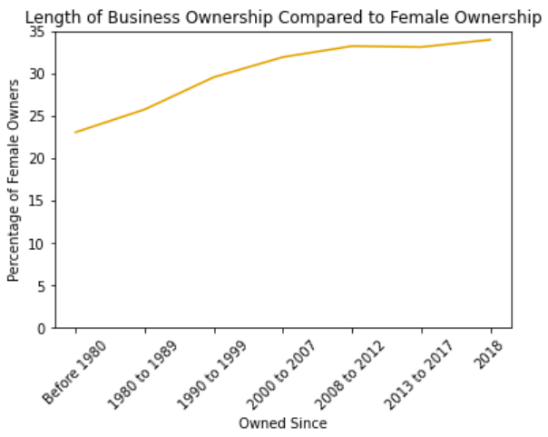
Female Ownership
The percentage of female business ownership has increased over time
Female ownership never exceeds 35%

Slide 26
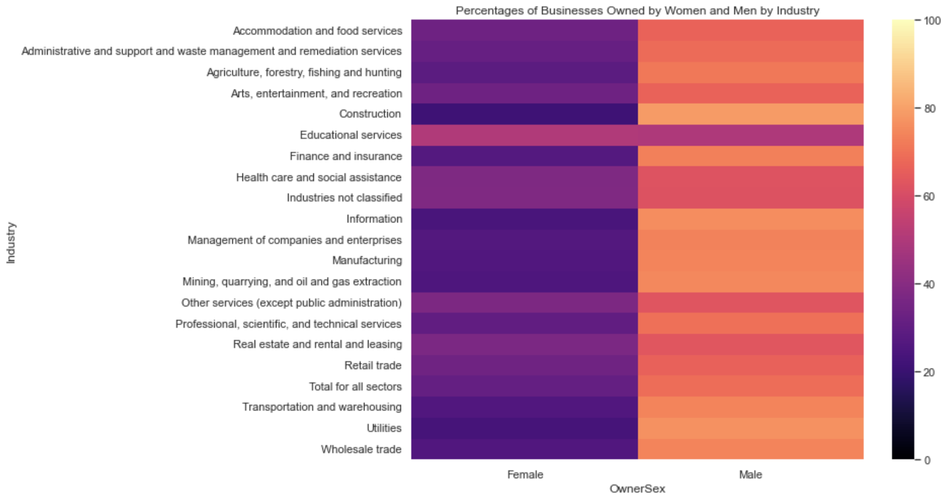
Business Ownership
In most industries, men own most businesses
Educational services is an outlier in that women appear to own slightly more businesses than men

Slide 27
Moving Forward
How do you create a more equitable workforce?
Sex
Race
Ethnicity
Loans and entrepreneurship opportunities for women
Educational opportunities for women in business
Hiring that promotes racial diversity
Loans and entrepreneurship for racial minorities
Emphasize promotion of racial minorities
Emphasis on supporting Hispanic-owned businesses through low-interest rate loans or tax incentives
Program opportunities where Hispanics are encouraged to create their own business from a young age

Slide 28
Questions?

