Slide 1
Project goal
Arbitrary Modification of
Speech Segment Durations
Build a usable system that lets a user select a region of speech and change its duration by either a scale factor or a target duration, while keeping the speech as natural and recognizable as possible.
ECE6255 Term Project - Challenge 3
Jack Newcomb | Team 9
Key idea: separate the DSP algorithm from the surrounding editing pipeline so the tool is easier to understand, test, and reuse.
Notes:
Hi everyone, this is our term project for challenge 3, arbitrary modification of speech segment durations. The main goal was to build a software system that allows a user to select a region of a speech waveform and modify its duration, either by giving a scale factor or by giving a desired target duration. The broader goal was to do this while preserving the important characteristics of the speech as much as possible, such as speaker identity, pitch character, and overall intelligibility.

Slide 2
Requirements and system support
What the assignment asked for and what the final system actually supports.
Challenge 3 required
Our system supports
Modify the duration of arbitrary speech intervals
Accept either a fixed target duration or a scale factor
Permit multiple modifications in one run
Preserve essential signal properties as much as possible
Single-edit CLI mode
Batch CSV multi-edit mode
Scale-factor edits and target-duration edits
Automated evaluation plots and metrics
Validation for malformed or overlapping edits
Not fully implemented: contour-based duration control, which we identify as future work.
Notes:
The project challenge asked for arbitrary duration modification of speech intervals. That means the user should be able to specify a start time and end time, and then either give a fixed target duration or a scaling factor for that interval. The assignment also required support for multiple modifications, and it mentioned contour-based duration control as part of the flexibility of the task. In our final implementation, we fully supported single-edit and batch multi-edit workflows, along with both scale-factor and target-duration input. We did not fully implement contour-based duration control, but we discuss it as a natural future extension.

Slide 3
System architecture
The project was organized as a modular pipeline rather than one monolithic script.
Input
WAV
Parse edit
request(s)
Extract
segment
TD-PSOLA
duration modify
Stitch
segment
Write
output
Run
evaluation
Why this structure matters
User-facing workflows
Evaluation support
It keeps file I/O, edit parsing, DSP, reconstruction, and evaluation separated so each piece can be tested or improved independently.
The same pipeline supports a direct single edit or a CSV-driven batch edit without changing the underlying DSP stage.
A separate evaluation script generates waveform and spectrogram comparisons plus summary metrics after modification.
Notes:
One of the strongest parts of the project is the overall software architecture. We designed the system as a modular processing pipeline. First, we load the input WAV file. Then we parse either a single edit request or a CSV file containing multiple edits. Next, we convert the requested time interval into sample indices and extract the selected waveform segment. That extracted segment is then passed into the duration-modification stage, which in our case is a TD-PSOLA-based (Time-Domain Pitch Synchronous Overlap and Add) method. After modification, the segment is stitched back into the original waveform, preserving the unedited regions, and the result is written to an output WAV file. We also built a separate evaluation script to generate waveform comparisons, spectrograms, and summary metrics.

Slide 4
TD-PSOLA overview
High-level view of the duration-modification method used in psola.py.
Core steps
Intuition
Detect approximate pitch marks with short-time autocorrelation
Estimate local pitch periods from mark spacing
Place new synthesis marks based on the requested duration change
Extract and window local waveform grains
Overlap-add grains into the output segment
Normalize the synthesis result
PSOLA changes duration by reusing short waveform regions aligned to the local pitch structure. For expansion, synthesis marks are spaced farther apart; for compression, they are placed closer together.
1
2
3
Pitch marks
Windowed grains
Overlap-add output
Fallback: if too few pitch marks are found, the code falls back to interpolation instead of forcing PSOLA on poor input.
Notes:
For duration modification, we used a time-domain PSOLA method, or TD-PSOLA. The main idea is to change the length of a speech segment while preserving its perceived pitch and overall naturalness as much as possible. To do that, the algorithm first analyzes the selected speech region to find approximate pitch-synchronous locations, meaning points that line up with the natural repeating structure of voiced speech. We estimate these using autocorrelation over short analysis frames, since pitch can vary over time and needs to be tracked locally rather than across the entire signal at once.
Once we have those approximate pitch marks, we refine them by shifting them toward strong nearby waveform extrema, such as prominent peaks or troughs. This helps the extracted waveform segments line up more naturally with the underlying signal and reduces discontinuities during reconstruction. From the spacing between neighboring pitch marks, we then estimate the local pitch period, which gives us the basic timing information needed for resynthesis.
Using those pitch periods, we define synthesis mark locations in the modified output. For time expansion, the synthesis marks are spaced farther apart so the segment becomes longer. For time compression, they are placed closer together so the segment becomes shorter. Around each pitch mark, we extract a short local waveform grain, apply a Hann window to taper its edges smoothly, and then overlap-add these grains at the new synthesis positions. The Hann window helps reduce artifacts at grain boundaries, while the overlap-add process reconstructs a continuous output waveform from the individual pitch-aligned segments.
Because multiple windowed grains can overlap by different amounts across the output, we also keep a synthesis-weight array and use it to normalize the final signal. This prevents unwanted amplitude changes and keeps the reconstruction more stable. Finally, if the signal is too difficult for reliable pitch-mark detection, such as when too few marks are found, the implementation falls back to simple interpolation instead of forcing a poor PSOLA result. That makes the system more robust in difficult cases and avoids severe audible artifacts.

Slide 5
Implementation and usage
The final tool was designed for straightforward command-line use.
Single-edit mode
python main.py examples/test.wav --output examples/output.wav --t1 0.20 --t2 0.40 --scale 1.5
Multi-edit mode
python main.py examples/test.wav --output examples/output.wav --csv examples/input.csv
Sample CSV
t1 | t2 | scale | target_duration
0.20 | 0.40 | 1.5
0.60 | 0.80 |  | 0.30
Design choice: in batch mode, edit times are interpreted relative to the original input timeline. Overlapping edits are rejected to keep behavior predictable.
Notes:
We also wanted the system to be practical for future use, so the framework was designed for straightforward CLI execution. In single-edit mode, the user provides an input file, an output file, the interval boundaries, and either a scale factor or a target duration. In batch mode, the user supplies a CSV file containing multiple edits. Each edit row includes t1 and t2, together with exactly one of either scale or target duration. An important design choice is that, in batch mode, edit times are interpreted relative to the original timeline, not the progressively modified one. We also reject overlapping edits so that the system behavior remains predictable and easy to reason about.

Slide 6
Evaluation methodology
We evaluated both framework correctness and speech output quality.
Software correctness
Signal and perceptual evaluation
Automated tests for segment extraction and stitching
CSV parsing and batch processing checks
Target-duration handling
Timeline remapping for multiple edits
Rejection of overlapping edit requests
Waveform comparison plots
Spectrogram comparison plots
Summary metrics: duration, RMS amplitude, peak amplitude
Listening-based assessment of intelligibility and artifacts
This matters because a speech-editing project has to be both correct as software and convincing as an audio result.
Notes:
Evaluation had to cover both software correctness and speech output quality. On the software side, we built tests for segment extraction, stitching, CSV parsing, target-duration handling, batch timeline remapping, and rejection of overlapping edits. On the signal-analysis side, we created an evaluation script that compares original and modified audio using waveform plots, spectrograms, and summary metrics such as duration, RMS amplitude, and peak amplitude. Finally, because this is a perceptual speech-processing task, listening evaluation was also important. We used that to judge intelligibility, whether the speaker still sounded like the same speaker, and whether audible artifacts such as warbling or discontinuities were introduced.

Slide 7
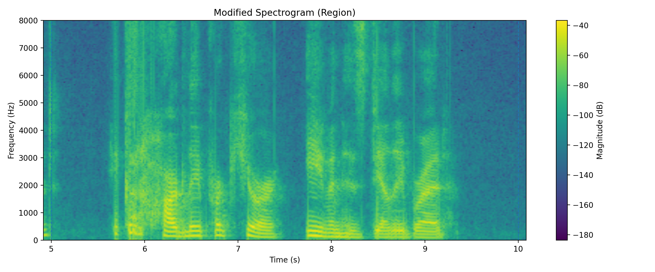
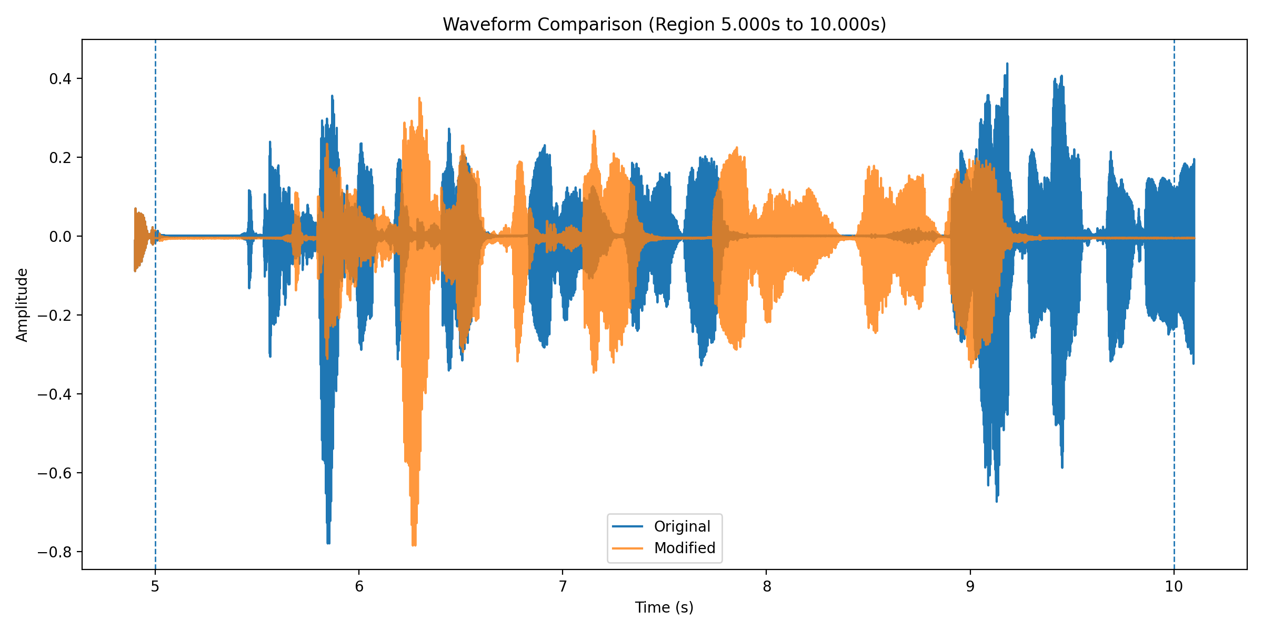
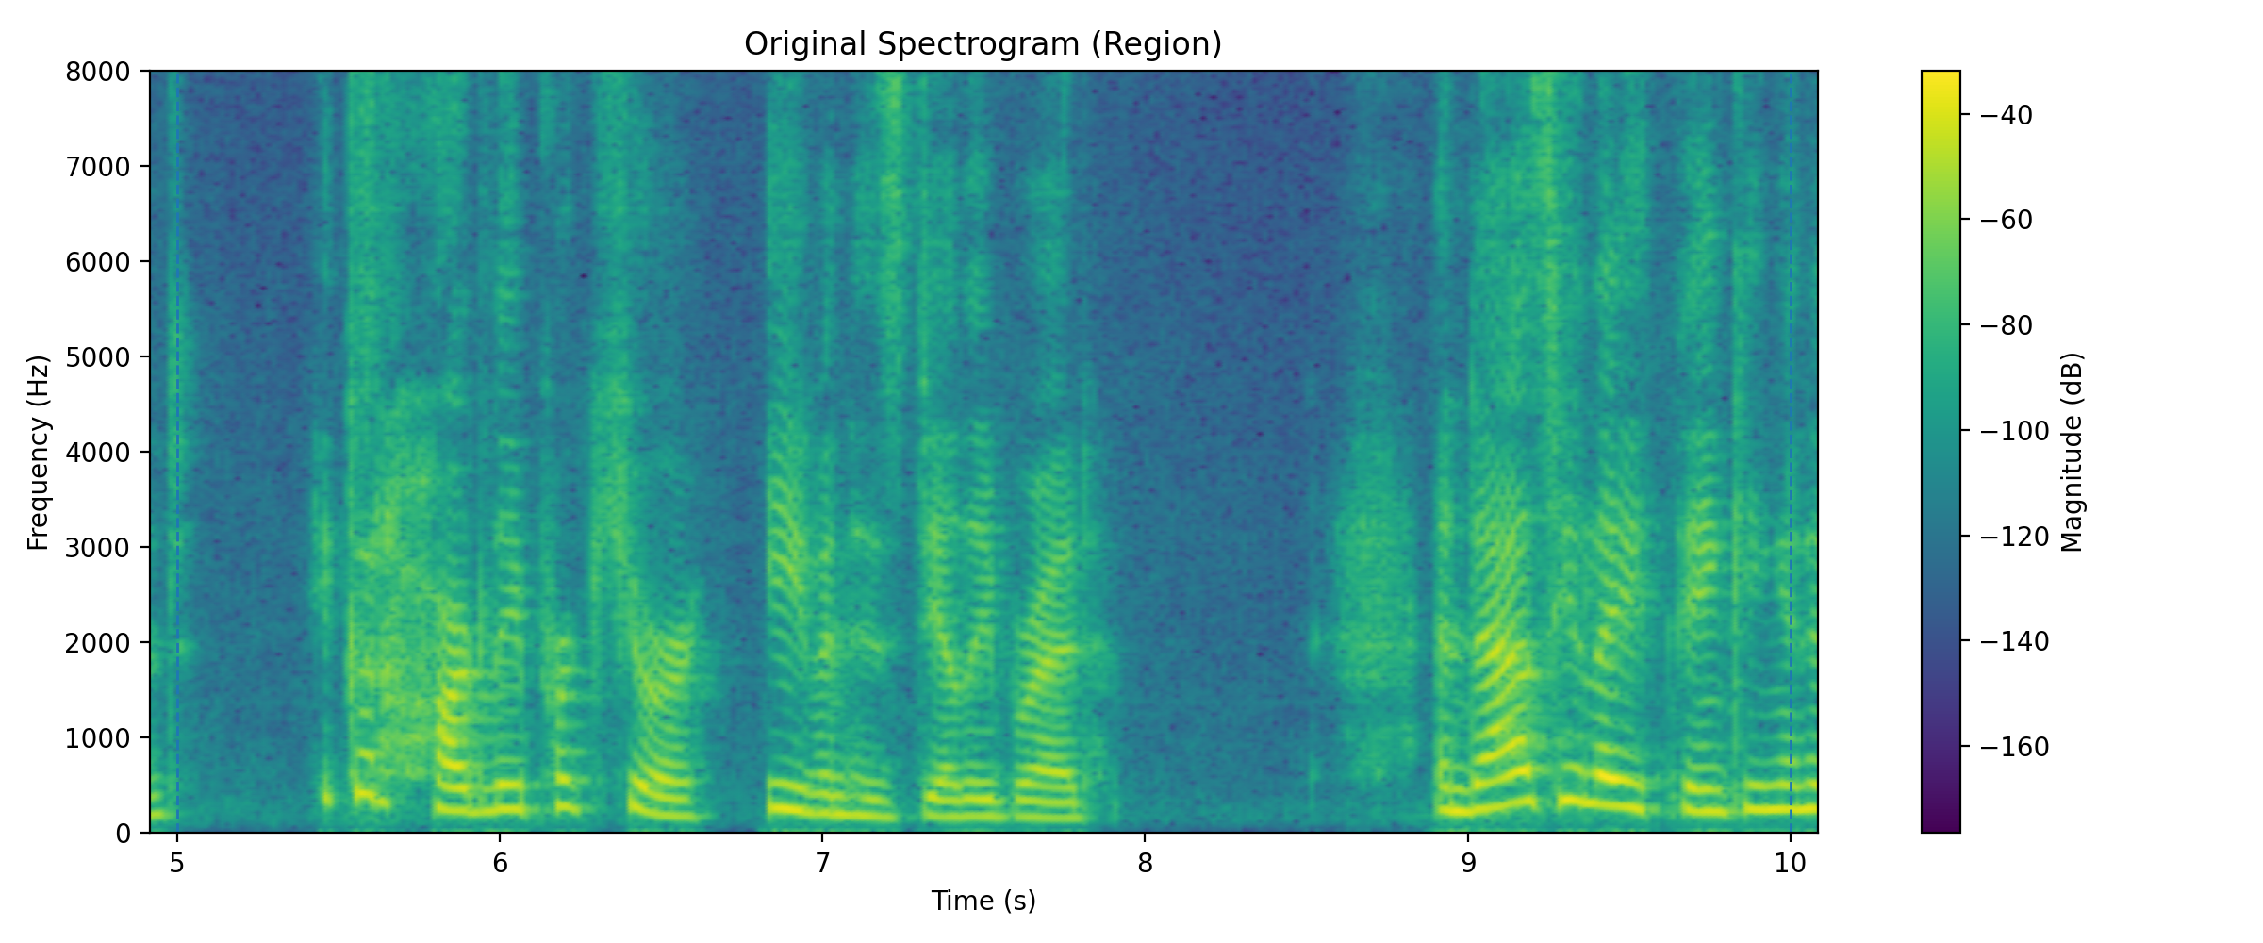
Results
Main demonstration: expand the 5 s to 10 s region by a scale factor of 1.5.
Key metrics
Original duration: 15.22 s Modified duration: 17.72 s Net increase: 2.50 s Edit interval: 5 s to 10 s Scale factor: 1.5 RMS: 0.0734 -> 0.0714 Peak: 0.7798 -> 0.7852
The file-level duration change matches the request exactly: a 5-second region scaled by 1.5 becomes 7.5 seconds, so the full signal grows by 2.5 seconds. The output remains intelligible and recognizable as the same speaker, although some roughness and warbling are still audible.
Notes:
Our main demonstration case used a speech recording of a woman reading a narrative passage. The test command applied a 1.5 times duration expansion to the region from 5 seconds to 10 seconds. At the file level, the result matched the requested modification correctly. The original signal duration was 15.22 seconds, and the modified output duration was 17.72 seconds, which is a 2.50 second increase. Since the selected region was 5 seconds long, scaling it by 1.5 increases that region to 7.5 seconds, so the net increase of 2.5 seconds is exactly what we would expect. The RMS and peak amplitude also remained relatively stable, which suggests that the algorithm changed timing without causing large global amplitude distortion. The waveform and spectrogram comparisons also show that the modified signal diverges in the edited region while still retaining the broad structure of the original speech.

Slide 8
Limitations and conclusion
What worked well, what remains limited, and where the project can go next.
Current limitations
Future improvements
Takeaway
Audible roughness and warbling remain in the edited region
Pitch-mark estimation can be fragile
Voiced/unvoiced transitions are difficult
Boundary handling could be smoother
More robust pitch-mark detection
Better reinsertion around edit boundaries
Contour-based duration control
Evaluation on more speech examples
The project achieved its main goal: a complete, modular framework for arbitrary duration modification of speech segments, with practical input modes, evaluation support, and a solid foundation for future refinement.
Notes:
To conclude, I’ll briefly show the system running on the example input. The pipeline takes the input WAV, applies the requested edit, writes the modified output, and can then generate evaluation plots and metrics. In terms of limitations, the main remaining issue is perceptual quality. The edited speech is intelligible and recognizable, but not artifact-free. A likely cause is imperfect pitch-mark estimation, especially in difficult regions or at voiced-unvoiced transitions. Smoother reinsertion and more robust pitch-mark detection would likely improve the result. A second natural extension would be contour-based duration control, which would allow the amount of expansion or compression to vary over time within the selected segment. Overall, though, the project achieved its main goal: it produced a complete, modular, and functional framework for arbitrary duration modification of speech segments, along with evaluation tooling and practical usage support for future users.

