Slide 1
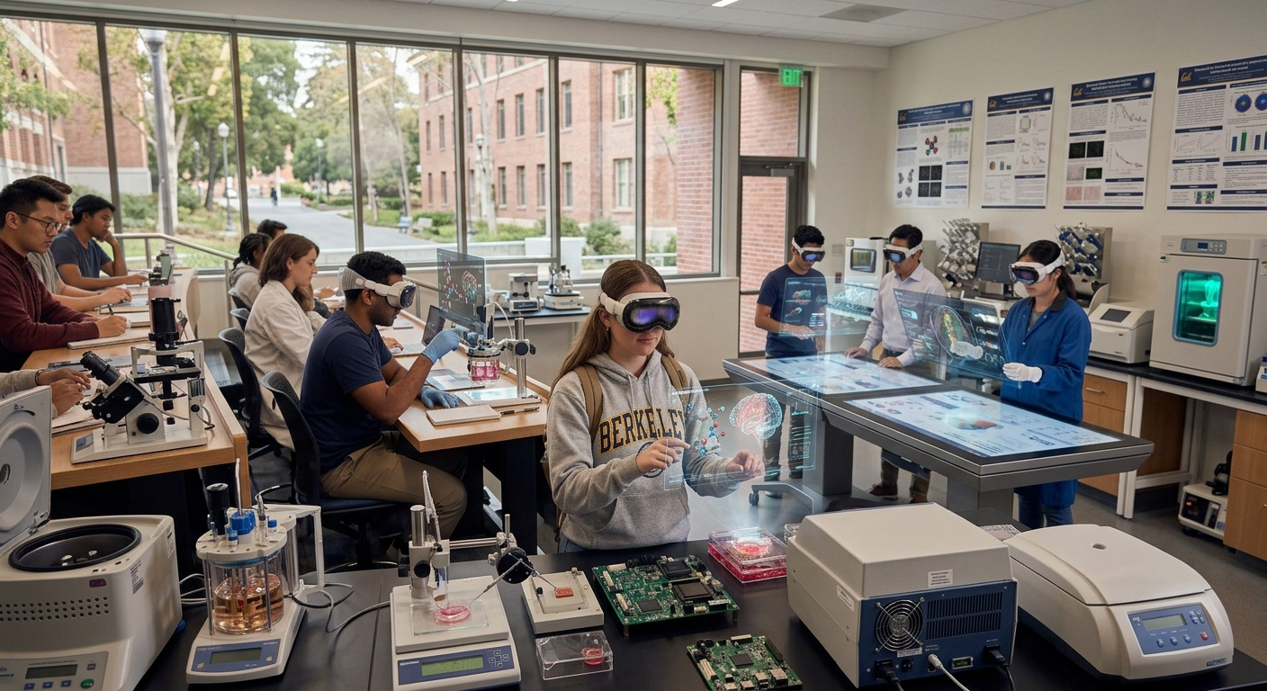
Business Thesis: University STEM & Engineering Departments will purchase Apple Vision Spatial Canvas for STEM because it transforms abstract, 3D multi-variable concepts into real-time interactive spatial models, accelerating student comprehension while reducing physical lab equipment cost
Product Architecture
Volumetric Vector Rendering: Real-time 3D simulation of Maxwell's equations, fluid dynamics, and stress tensors directly in room space.
Precision Multimodal Control: Low-latency gaze tracking and hand gesture pinching for real-time mathematical parameter tuning.
Multi-User Collaborative Workspace
Co-located Lab Sessions: Shared spatial anchors allow instructors and students to interact with identical 3D models simultaneously.
Tooling Integrations: Direct API pipelines for MATLAB, Python (NumPy/SciPy), and CAD format import/export.
Image generated with AI
Product Impact
Lab Cost Reduction: Replaces expensive physical test benches, wind tunnels, and wave tanks with software-defined digital twins sold via enterprise university seat licensing.
Team Members: Jack Newcomb

