Slide 1
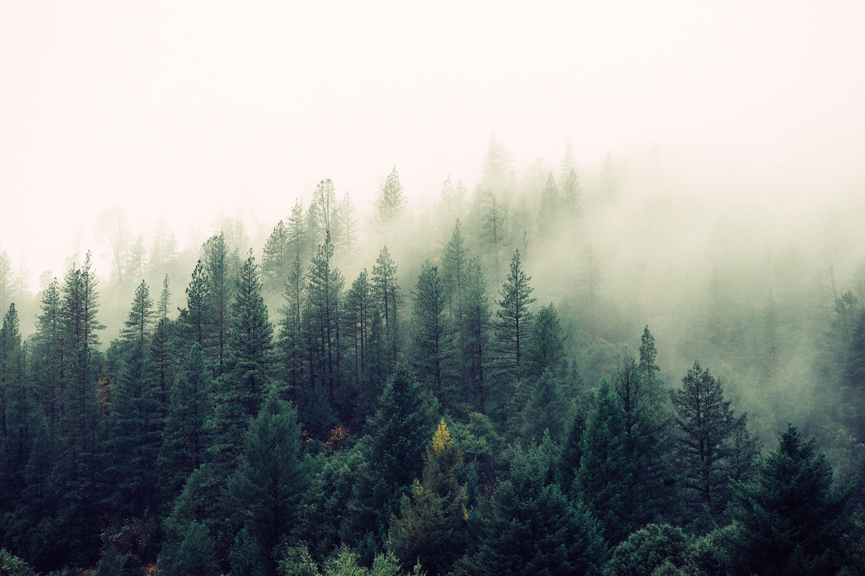
Boy scout greenery

