Slide 1
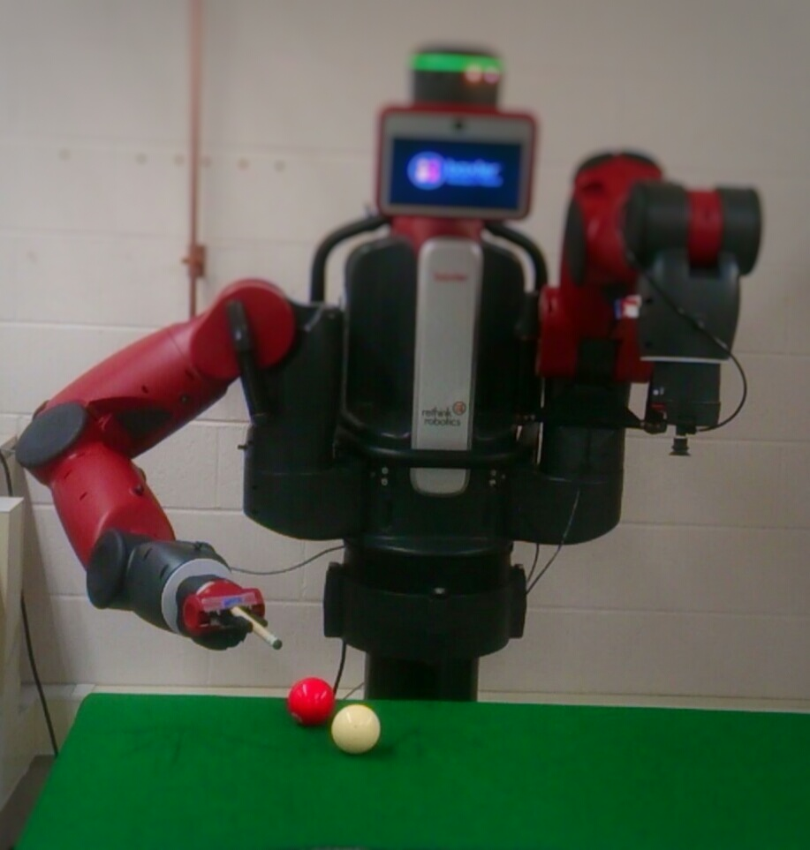

BAXTER O’ SULLIVAN
¹SHIVA KARTHIK REDDY KOYYA ²VISHNUNANDAN VENKATESH
ROCHESTER INSTITUTE OF TECHNOLOGY
INTRODUCTION
FLOW OF THE SYSTEM
Results
The game snooker/pool can be played effectively by a robot, as the robot unlike human beings has the ability to make fast complex calculations that ensure that it can angle the cue ball perfectly to strike any other colour ball such that the required colour ball is played into any desired pocket/ hole. Our project majorly consists of two stages namely analysis of the workspace using vision based sensors and interaction with the environment using baxter.
ORIENTATION
XTION
HEAD CAMERA
PointCloud
3-D voxel and Features
Alignment of Views
The xtion aligns two pointclouds i.e. a desired view with current view to achieve desired hitting orientation of the end effector , while the head camera finds the center of the two balls and calculates the slope between them to achieve the desired orientation.
Using baxter’s sensor and other vision based sensors the game of pool was successfully played .
In the process the following intermediate goals were achieved :
The desired orientation of the end effector was achieved using the baxter’s head camera.
The visual servoing was successfully done using baxtert’s hand camera.
The striking motion was achieved in a limited workspace considering the limitations of Baxter.
Find Center of Balls
Calculate slope between centers
Calculate req. angle
BAXTER ROBOT
Right Hand Camera
Find center coordinate of ball using Open CV library
SOLVE Inverse Kinematics for coordinates
Convert 2-D pixel coordinates to baxter position coordinates
Set required Joint Positions
Visual Servoing is a technique which uses vision sensors which provide feedback information that assists in controlling the motion of the robot. The visual servoing configuration eye-in-hand (baxter’s right hand camera ) was used to track the center of the ball (target) so as to align the end effector with the center of the ball.
LIMITATIONS
Fixed position of Baxter, results in a small workspace.
Force achieved was not enough the move the ball more than a few centimeters due to limited speed of baxter’s hand .
The inverse kinematics service that Baxter SDK provides is not a complete Cartesian control solution ,it is just a rudimentary solver for elementary situations.
DIVISIONS OF THE PROJECT
BAXTER ROBOT
(14 DOF)
POINT CLOUD
VISUAL SERVOING
Future Work
ROBOT OPERATING SYSTEM
(ROS)
XTION
BAXTER
Making Baxter mobile.
2.Increase hitting force using linear actuators.
3.Use ‘IK fast’ service for high performance inverse kinematics.
ROS framework was used to integrate various divisions of the project together.
References
[1]. pointclouds.org
[2]. sdk.rethinkrobotics.com
Authors Affiliations Advisor RIT RIT
a
Shiva Karthik Reddy & Vishnunandan Venkatesh
Department of Electrical and Microelectronic Engineering,
Rochester Institute of Technology, Rochester, NY -14623
Prof. Ferat Sahin

