Slide 1

BAXTER o’sullivan
¹SHIVA KARTHIK REDDY KOYYA
²VISHNUNANDAN VENKATESH
Department of Electrical and Microelectronic Engineering,
Rochester Institute of Technology, Rochester, NY -14623

Slide 2
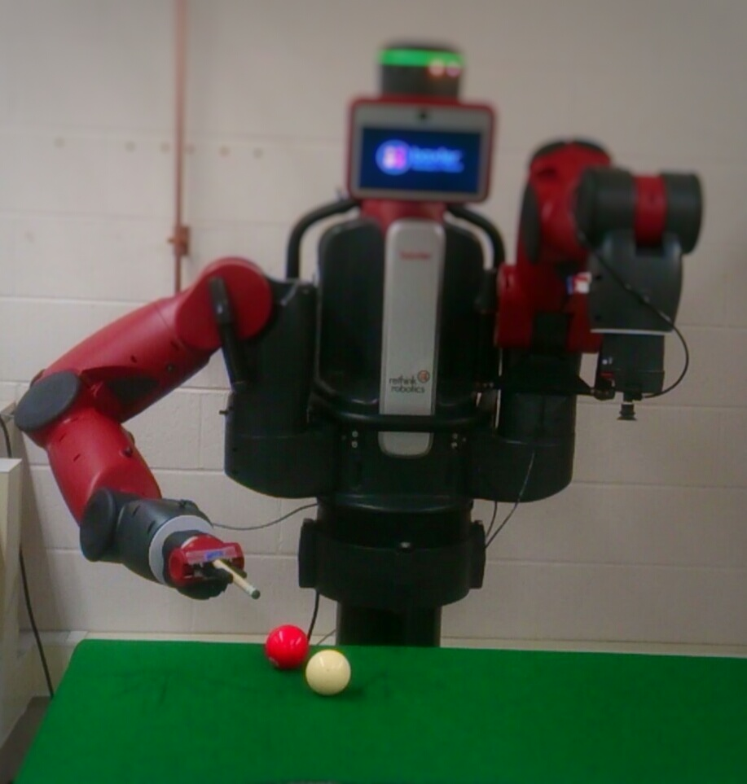
INTRODUCTION
The game snooker/pool can be played effectively by a robot, as the robot unlike human beings has the ability to make fast complex calculations that ensure that it can angle the cue ball perfectly to strike any other colour ball such that the required colour ball is played into any desired pocket/ hole. Our project majorly consists of two stages namely analysis of the workspace using vision based sensors and interaction with the environment using Baxter.

Slide 3
HARDWARE & SOFTWARE
Hardware:-
Baxter Robot (14 DOF)
Working area – Table
Pool balls
Cue Stick
Software:-
Robot Operating System(ROS)
Python
Open CV
Baxter API
C++
Pointcloud Library
ROBOT OPERATING SYSTEM
(ROS)
XTION
BAXTER

Slide 4
DIVISIONS OF THE PROJECT
BAXTER ROBOT
(14 DOF)
POINT CLOUD
VISUAL SERVOING

Slide 5
SYSTEM FLOW
PointCloud
3-D voxel and Features
Alignment of Views
ORIENTATION
XTION
HEAD CAMERA
Find Center of Balls
Calculate slope between centers
Calculate req. angle
The Xtion aligns two pointclouds i.e. a desired view with current view to achieve desired hitting orientation of the end effector , while the head camera finds the center of the two balls and calculates the slope between them to achieve the desired orientation.

Slide 6
SYSTEM FLOW
BAXTER ROBOT
Right Hand Camera
Find center coordinate of ball using Open CV library
SOLVE Inverse Kinematics for coordinates
Convert 2-D pixel coordinates to baxter position coordinates
Set required Joint Positions
Visual Servoing is a technique which uses vision sensors which provide feedback information that assists in controlling the motion of the robot. The visual servoing configuration eye-in-hand (Baxter’s right hand camera ) was used to track the center of the ball (target) so as to align the end effector with the center of the ball.

Slide 7
RESULTS
Using Baxter’s sensor and other vision based sensors the game of pool was successfully played .In the process the following intermediate goals were achieved :
1.The desired orientation of the end effector was achieved using the Baxter’s head camera.
2.The visual servoing was successfully done using Baxtert’s hand camera.
3.The striking motion was achieved in a limited workspace considering the limitations of Baxter.

Slide 8
LIMITATIONS:
Fixed position of Baxter, results in a small workspace.
Force achieved was not enough the move the ball more than a few centimeters due to limited speed of baxter’s hand .
The inverse kinematics service that Baxter SDK provides is not a complete Cartesian control solution ,it is just a rudimentary solver for elementary situations.
FUTURE WORK:
Making Baxter mobile.
2. Increase hitting force using linear actuators.
3. Use ‘IK fast’ service for high performance inverse kinematics

Slide 9
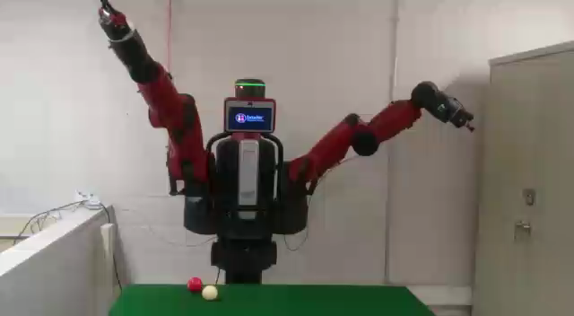

Slide 10

Thank You

