Slide 1
CEE 260D Final Presentation
Karthik Ramesh
Jack Seagrist

Slide 2
Table of Contents
Introduction
Background Research
Data Collection
Calculation Methods and Results
Conclusion & Future Work

Slide 3
Introduction

Slide 4
Inspiration
Smarter Agricultural Practices:
Planning irrigation schedules based on the soil moisture and evapotranspiration has been shown to increase productivity for growers.
Developing a model calibrated to predict soil moisture from in-situ evapotranspiration estimates.
CHALLENGE:
Complex relationship driven by several parameters discussed further.

Slide 5
Goal
Hypothesis: “By looking at the relationship between CIMIS in situ measurements and soil moisture estimate from SMAP across varying land cover regimes, we hope to identify the parameters which have the greatest influence on soil moisture and determine the underlying drivers of those relationships.”
Notes:
Jack
-We expected to see a difference in land cover types, we expected to see a clear trend

Slide 6
Background Research

Slide 7
Background Research
Several studies estimate that ET and soil moisture are correlated - evapotranspiration by calculating the potential evapotranspiration and then applying a soil moisture function obtained from remotely sensed datasets.
The evapotranspiration and soil moisture relationship has also been explored in many different capacities, such as in monsoon-dominated or water limited ecosystems.
Soil moisture varies in both the lateral and vertical directions, which can be attributed to controls from precipitation, climate, land-cover, and soil properties among other influences.

Slide 8
Background Research
In addition, it has been reported that significant variations can be seen in soil moisture in areas with wet and dry seasons.
The land cover type has a significant impact on the relationship between soil moisture anomalies and other drought indicators.
Our analysis has been constructed keeping in mind these factors gleaned from existing published material.
Notes:
These include simple indices like the percent of normal precipitation and number of days with no precipitation,
specific indices created to assess drought (such as the Palmer Drought Index and Standardized Precipitation Index [SPI]), complex models (such as the National Land Data Assimilation System [NLDAS]) which calculate soil moisture and other hydrologic variables, indices used for water supply forecasting (such as the Surface Water Supply Index [SWSI]), and indices which reflect impacts on vegetation (such as the Vegetation Health Index [VHI] and Vegetation Drought Response Index [VegDRI]) and water availability (such as groundwater well levels and streamflow).

Slide 9
Data Collection

Slide 10
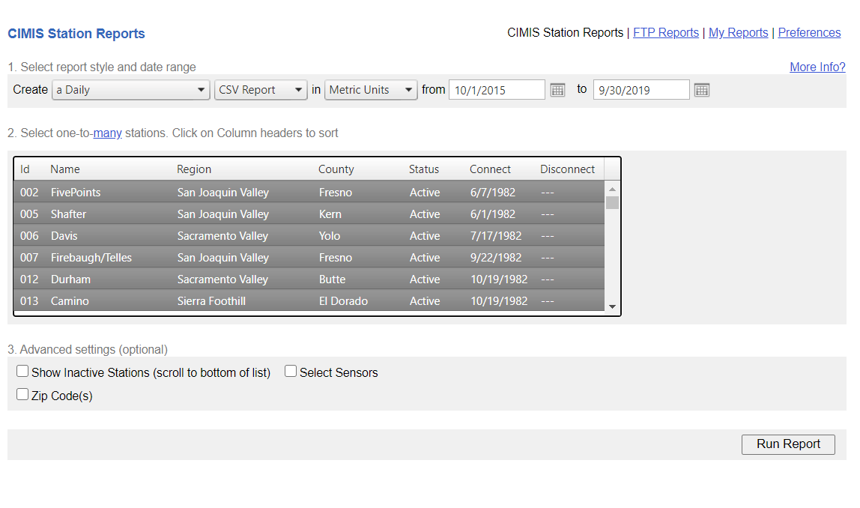
CIMIS (California Irrigation Management Information System)
140 active CIMIS stations across the state.
Downloaded in-situ estimates for ET, Net Radn, Avg Temperature, Avg Vapor Pressure, Relative Humidity and Dew point for WY 2016-2019

Slide 11
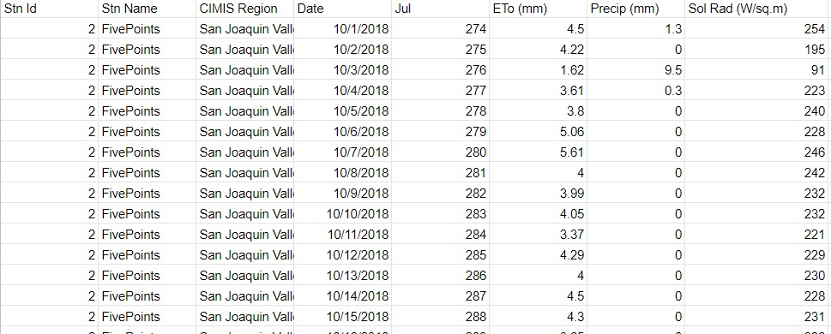
CIMIS
Downloaded ETo (mm), Net Rad (W/sq.m), Avg Vap Pres (kPa), Avg Air Temp (C) , Avg Rel Hum (%), Dew Point (C)
CIMIS uses a modified version of Penman-Monteith to compute ETo

Slide 12
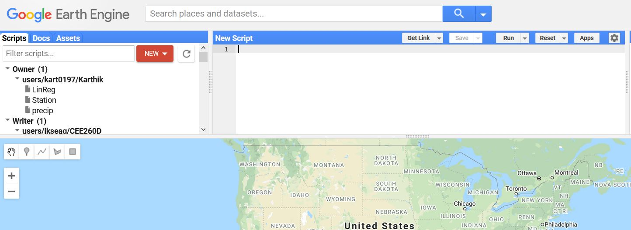
SMAP (Soil Moisture Active Passive)
Datasets from the SMAP satellite for the surface soil moisture was downloaded for the pertinent CIMIS stations using Google Earth Engine.
Earth Engine helped overcome computation and hardware hurdles with processing on the cloud.

Slide 13
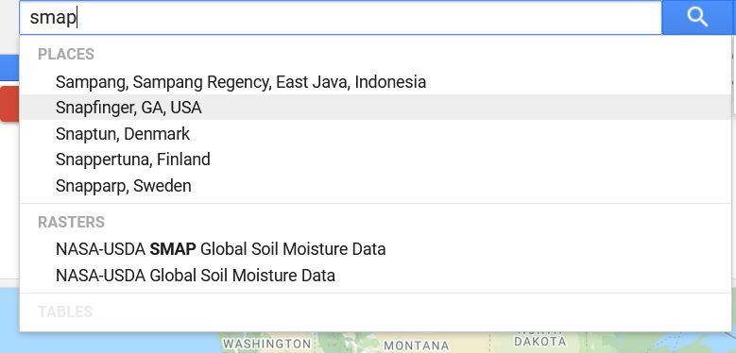
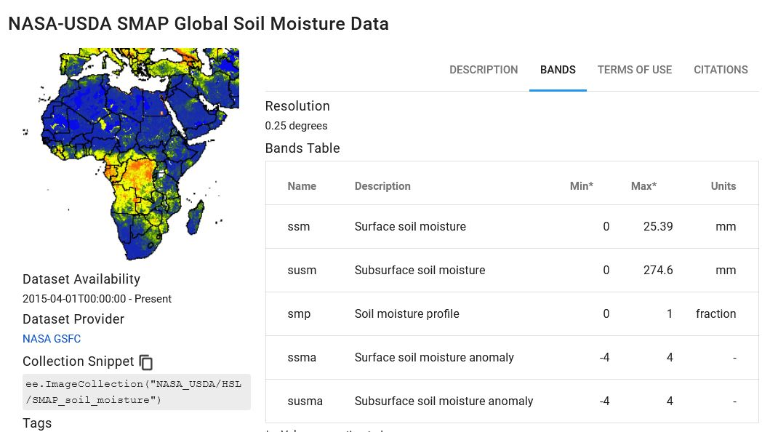
SMAP

Slide 14
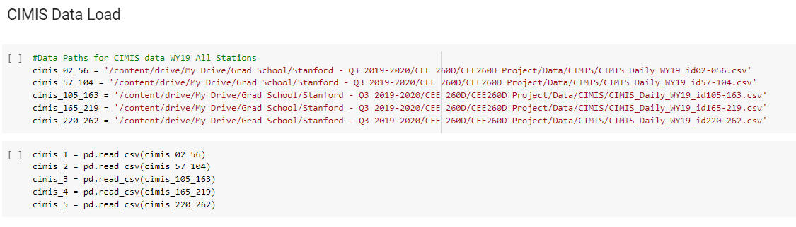
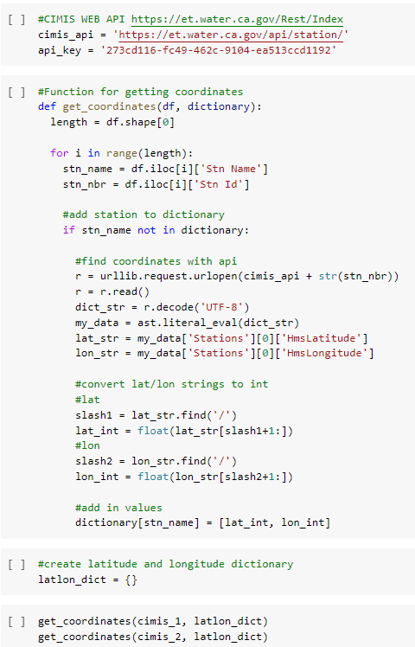
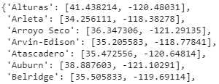
SMAP
Output
Retrieve CIMIS station coordinates to obtain SMAP data at the particular CIMIS Station

Slide 15
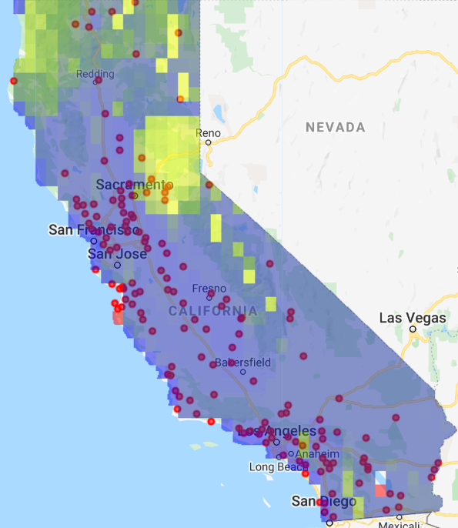
SMAP
Coordinates of active CIMIS stations
Red Dots: CIMIS Stations
Layer: SMAP Data

Slide 16
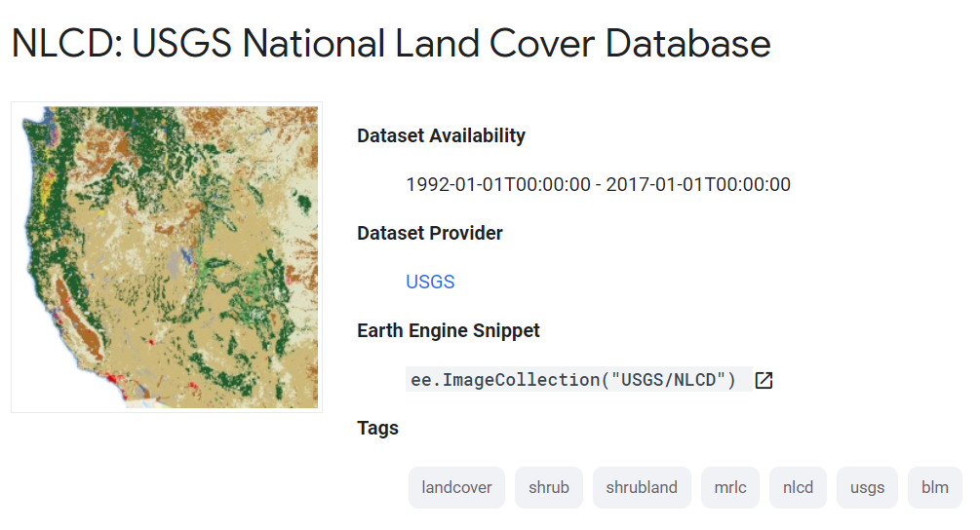
LAND COVER TYPE
No | Land cover Type
1. | Barren Land
2. | Cultivated Crops
3. | Developed, Low
4. | Developed, Medium
5. | Developed, Open Space
6. | Emergent Herbaceous Wetlands
7. | Evergreen Forest
8. | Grassland
9. | Pasture
10. | Shrub
The 140 CIMIS stations coordinates fall into one of these 10 categories of land cover classification.

Slide 17
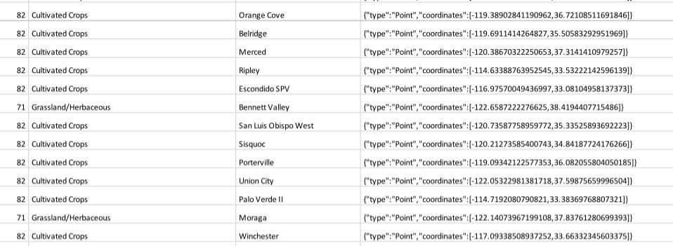
LAND COVER TYPE
Land cover classification of all CIMIS stations exported to a .csv file.

Slide 18
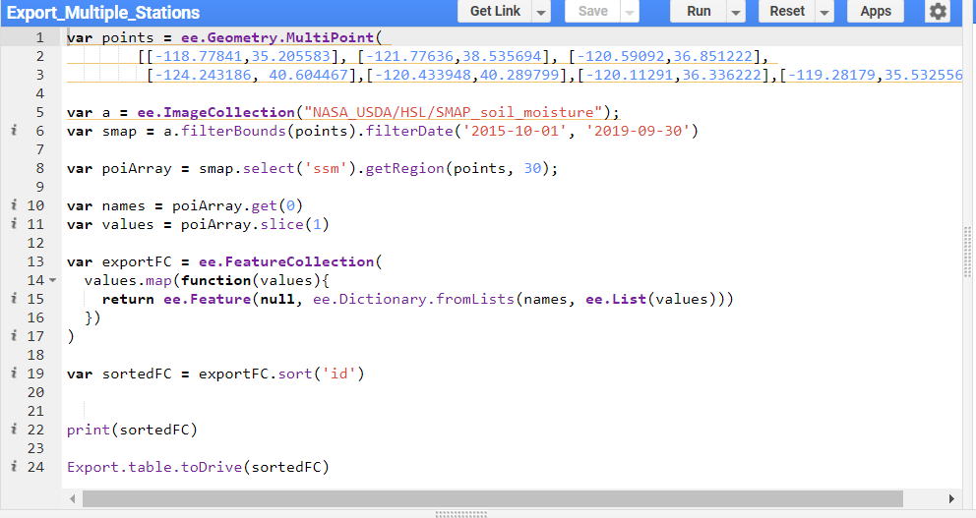
SMAP
Exporting data from Multiple Points to Drive
Stations from each land cover type were selected at random and the soil moisture data was obtained through Google Earth Engine.

Slide 19
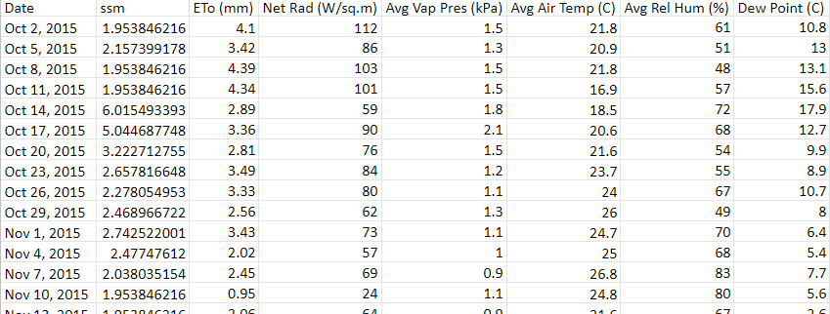
Collating Data
Since the temporal scale of CIMIS (daily) and SMAP (3 days) are different, we imported the data to python to collate them to the same time scale.
Combine the CIMIS and SMAP Data, Organize by land cover type

Slide 20
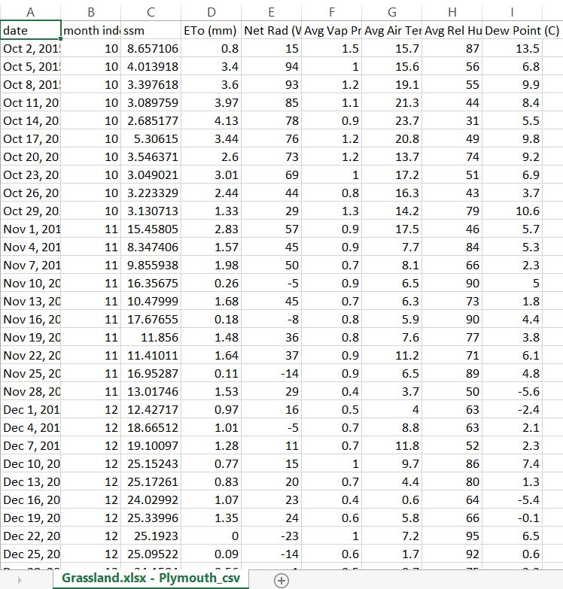
Collated Data
Data for Plymouth with the timescales matched.

Slide 21
Calculation Methods
& Results

Slide 22
Three Methods
Hypothesis: “By looking at the relationship between CIMIS in situ measurements and soil moisture estimate from SMAP across varying land cover regimes, we hope to identify the parameters which have the greatest influence on soil moisture and determine the underlying drivers of those relationships.”
Three Methods
Standard Pearson Correlation
Lag Pearson Correlation
Seasonal Pearson Correlation

Slide 23
Stations for Analysis
Land Cover Type | CIMIS Stations
Evergreen Forest | Auburn
Grassland | Plymouth, San Luis Obispo, U.C. Riverside
Pasture | Bishop, Black Point, McArthur, Santa Rosa
Shrub | Oasis, Temecula, Victorville
Cultivated | Arvin-Edison, Gilroy, Scott, Seeley, San Luis Obispo West, Woodland
Barren | Cadiz
Developed Open | Fair Oaks, San Juan
Developed Low | Pajaro, San Benito
Developed Medium | Lake Arrow, Oakland

Slide 24
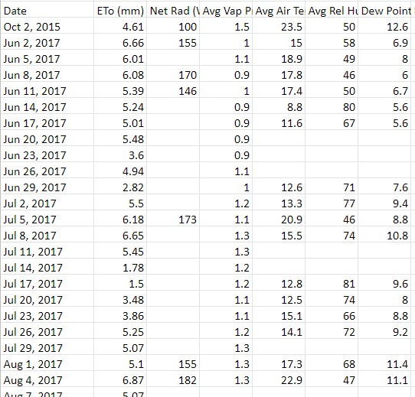
Data Challenges
Sporadic missing values in CIMIS data
Removed values from datasets, reduced total amount of data

Slide 25
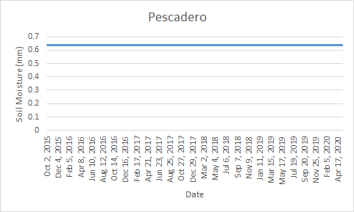
Data Challenges
Ocean effect: Found constant readings for stations close to beach (Pescadero, Long Beach) due to signals from ocean influencing SMAP readings

Slide 26
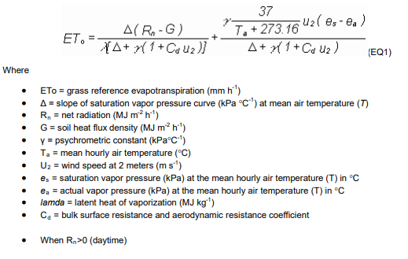
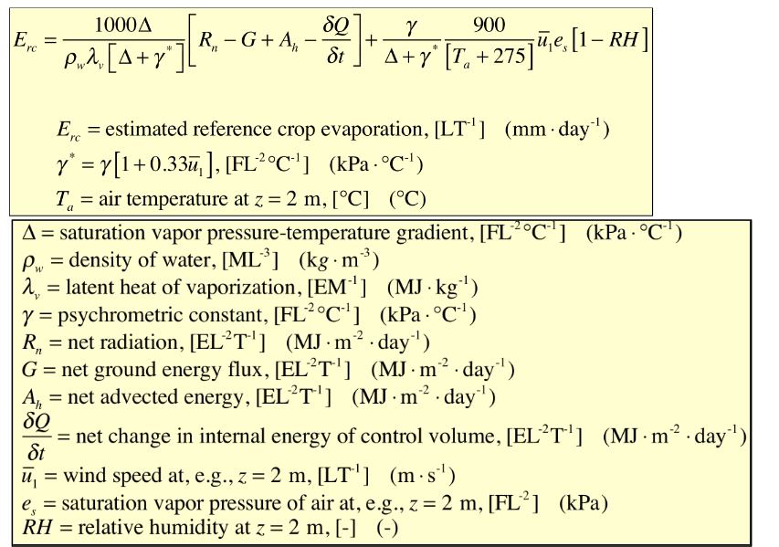
CIMIS PM Equation
Unmodified PM equation

Slide 27
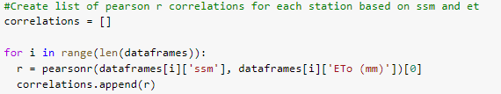
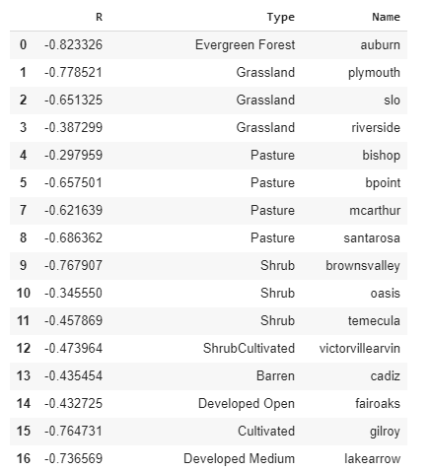
Standard Pearson Correlation
Created List of dataframes
Calculated Pearson R correlation

Slide 28
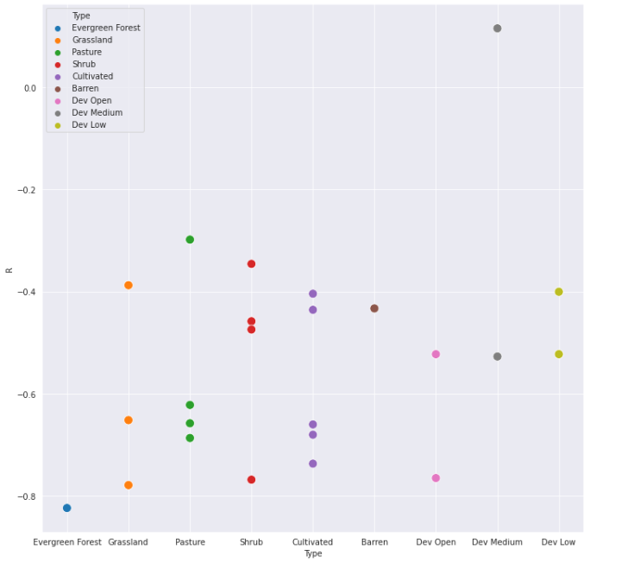
Standard Pearson Correlation (ssm vs ETo)
Correlations are negative
No apparent trend by land cover type
High variability among stations within same group

Slide 29
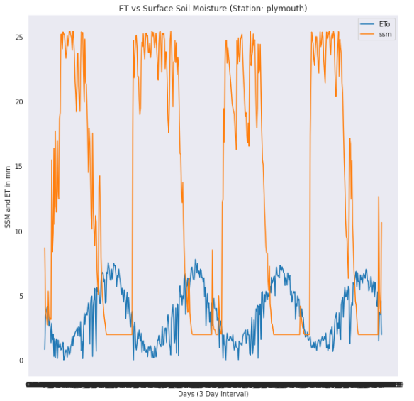
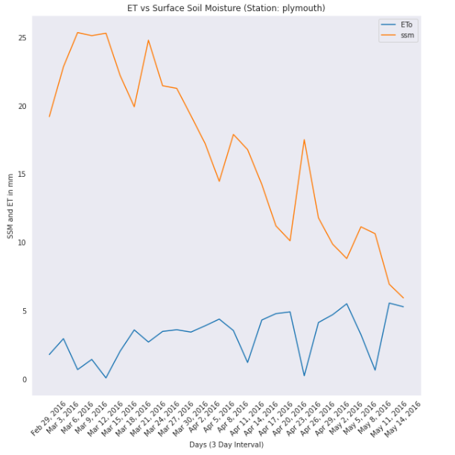
Standard Pearson Correlation
Negative correlation due to seasonal climate
Notes:
-intuitively you might think more soil moisture would mean more potential for ET, but we see with California that

Slide 30
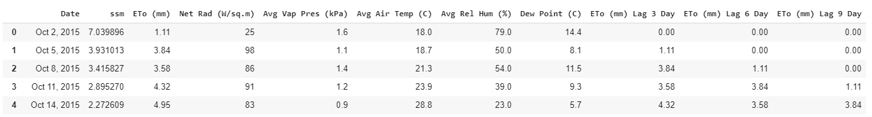
Lag Pearson Correlation
Constructed dataframes with Lag 1, 2, and 3 ET data, which is equivalent to 3, 6, and 9 day lag

Slide 31
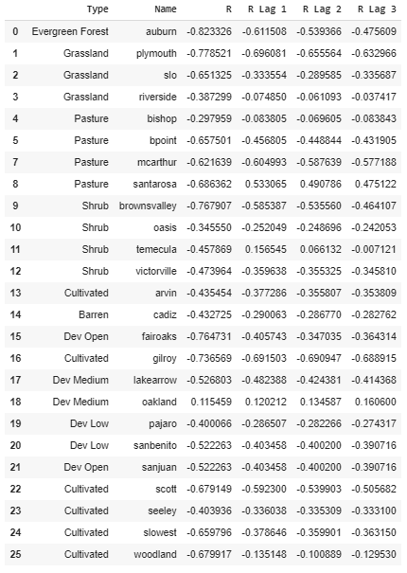
Lag Pearson Correlation
No visible improvement in R with lag analysis

Slide 32
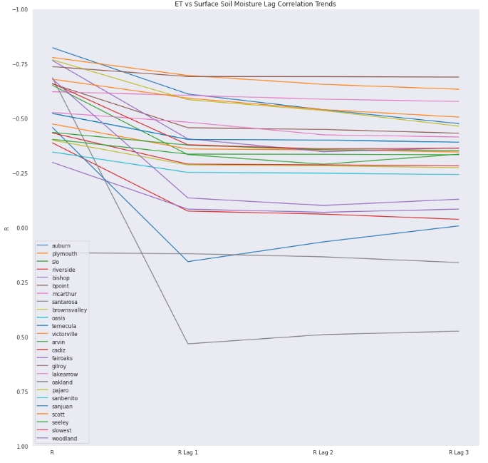
Lag Pearson Correlation
Correlations remain negative
Identified stations which went positive then decreased correlation: Santa Rosa (Pasture), Temecula (Shrub)
Developed Medium (Oakland and Lake Arrow) remain fairly constant

Slide 33
Seasonal Correlation - (ssm vs ETo)
Station | Land Cover Type | R - Winter | R - Spring | R - Summer | R - Fall
Arvin-Edison | Cultivated | -0.18 | -0.43 | -0.2 | -0.23
Auburn | Evergreen Forest | -0.58 | -0.72 | -0.64 | -0.58
Bishop | Pasture | -0.12 | -0.47 | -0.57 | -0.24
Browns Valley | Shrub | -0.42 | -0.72 | -0.6 | -0.53
Cadiz | Barren | -0.28 | -0.35 | -0.15 | -0.44
Fair Oaks | Developed - Open | -0.39 | -0.65 | -0.55 | -0.45
Lake Arrow | Developed - Medium | -0.44 | -0.48 | -0.48 | -0.4
Pajaro | Developed - Low | -0.24 | -0.47 | -0.2 | -0.22
Plymouth | Grassland | -0.27 | -0.65 | -0.74 | -0.52

Slide 34
Seasonal Correlation
Developed land cover types remain fairly constant across seasons
General trend shows correlation increasing in Spring then continual decrease through Summer and Fall until Winter

Slide 35
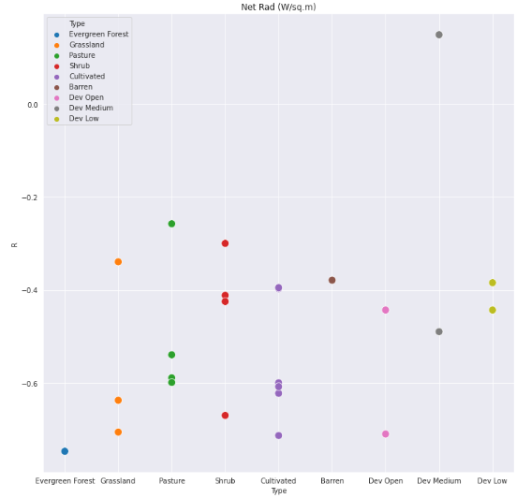
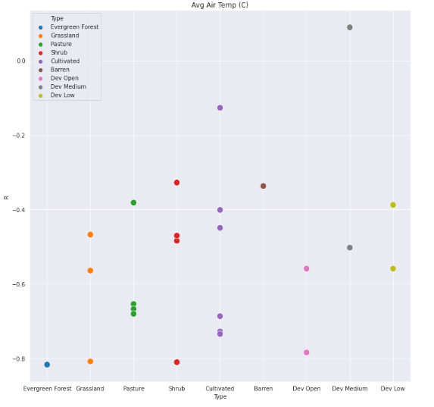
Pearson R (ssm vs Net Radiation/Avg Air temp)
Explored ssm correlation with net radiation/avg air temp
See very similar patterns to ssm vs ET

Slide 36
Conclusion & Future Work

Slide 37
Conclusions
Based on analysis, land cover does not have a definitive influence on correlation between surface soil moisture and ETo
Future Work:
Increase number of sites investigated for statistical analysis
Identify factors which may have more influence: topography, soil water retention curves, crop coefficients
Identify the effect of surface slope on Soil moisture.

