Slide 1

Note: The data and information in this document is reflective of a hypothetical situation and client. This document is to be used for KPMG Virtual Internship purposes only.
Sprocket Central Pty Ltd
Data analytics approach
[Division Name] - [Engagement Manager], [Senior Consultant], [Junior Consultant]

Slide 2
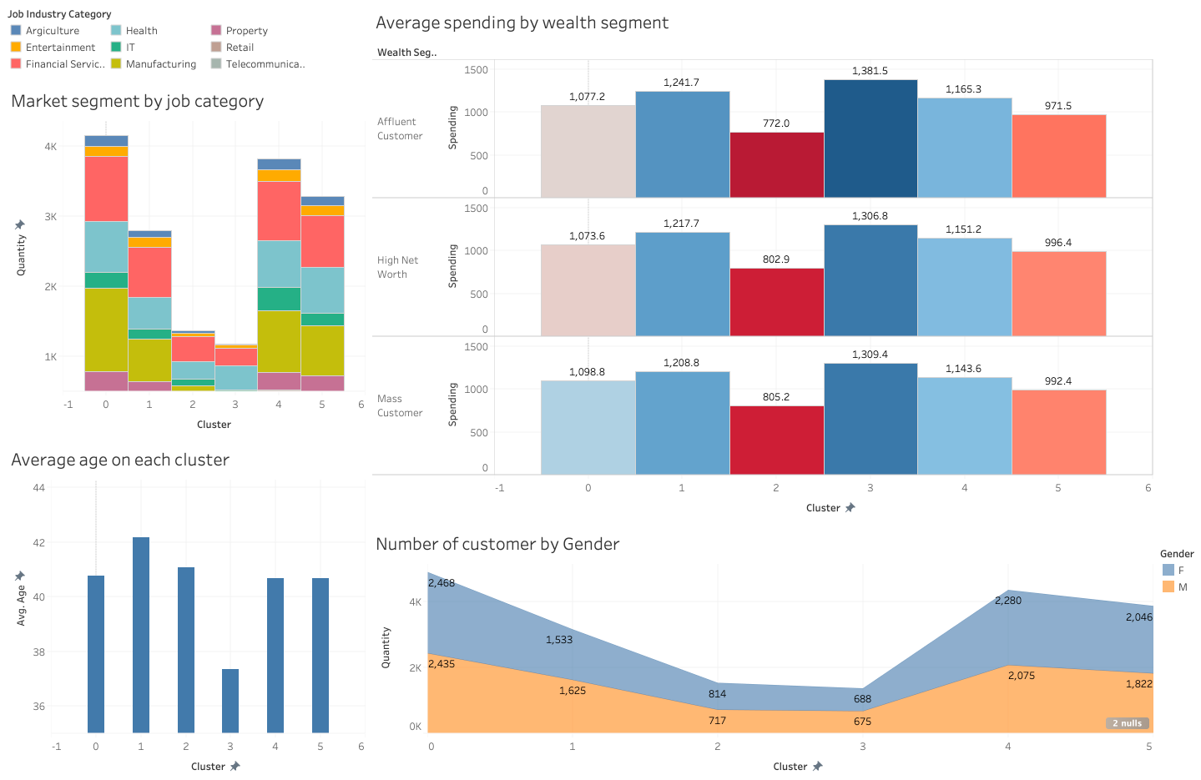
Note: The data and information in this document is reflective of a hypothetical situation and client. This document is to be used for KPMG Virtual Internship purposes only.
Who is your customer

Slide 3
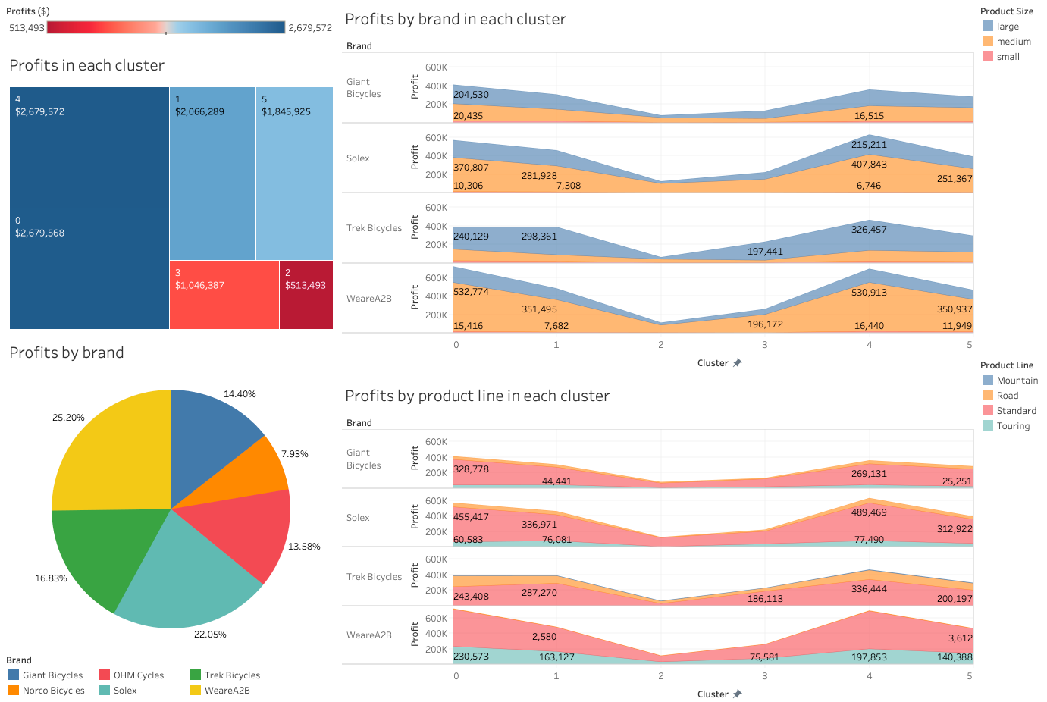
Note: The data and information in this document is reflective of a hypothetical situation and client. This document is to be used for KPMG Virtual Internship purposes only.
What did your customer buy

Slide 4
Note: The data and information in this document is reflective of a hypothetical situation and client. This document is to be used for KPMG Virtual Internship purposes only.
Target Customer
Group 4 | Female customer. Age around 40 years old. Work in Financial Service or Manufacturing. Prefer medium size WeareA2B and Solex product. Prefer standard or touring bike. Estimate profits: $869,502
Group 0 | Female customer. Age around 41 years old. Work in Manufacturing. Prefer medium size WeareA2B and Solex product. Prefer standard or touring bike. Estimate profits: $300,454
Group 1 | Male customer. Age around 42 years old. Work in Financial Service. Prefer medium size WearA2B and large Trek Bicycle. Prefer standard bike. Estimate profits: $492,730

