Slide 1

Note: The data and information in this document is reflective of a hypothetical situation and client. This document is to be used for KPMG Virtual Internship purposes only.
Sprocket Central Pty Ltd
Data analytics approach
[Division Name] - [Engagement Manager], [Senior Consultant], [Junior Consultant]

Slide 2
Note: The data and information in this document is reflective of a hypothetical situation and client. This document is to be used for KPMG Virtual Internship purposes only.
Agenda
Introduction
Data Exploration
Model Development
Interpretation

Slide 3
Note: The data and information in this document is reflective of a hypothetical situation and client. This document is to be used for KPMG Virtual Internship purposes only.
Introduction
Place headline insight or information here. This should be the most important point for this slide.
Place any information about this point here.
Place any supporting images, graphs, data or extra text here.

Slide 4
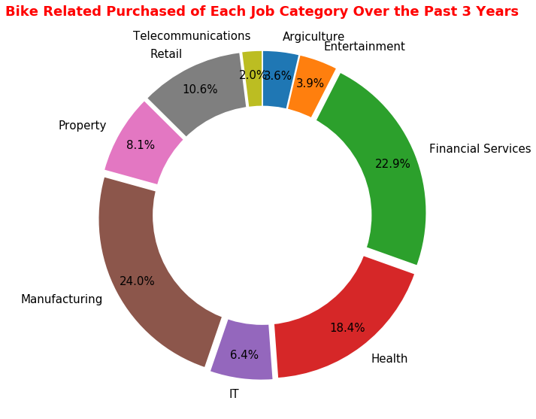
Note: The data and information in this document is reflective of a hypothetical situation and client. This document is to be used for KPMG Virtual Internship purposes only.
Data Exploration
The manufacturing, financial service, health and retail occupy 75.9% of the bike related purchased over the past 3 years.
Place any information about this point here.

Slide 5
Note: The data and information in this document is reflective of a hypothetical situation and client. This document is to be used for KPMG Virtual Internship purposes only.
Model Development
Place headline insight or information here. This should be the most important point for this slide.
Place any information about this point here.
Place any supporting images, graphs, data or extra text here.

Slide 6
Note: The data and information in this document is reflective of a hypothetical situation and client. This document is to be used for KPMG Virtual Internship purposes only.
Interpretation
Place headline insight or information here. This should be the most important point for this slide.
Place any information about this point here.
Place any supporting images, graphs, data or extra text here.

Slide 7
Note: The data and information in this document is reflective of a hypothetical situation and client. This document is to be used for KPMG Virtual Internship purposes only.
Appendix

Slide 8
Note: The data and information in this document is reflective of a hypothetical situation and client. This document is to be used for KPMG Virtual Internship purposes only.
Appendix
This is an optional slide where you may place any supporting items.

