Slide 1

Note: The data and information in this document is reflective of a hypothetical situation and client. This document is to be used for KPMG Virtual Internship purposes only.
Sprocket Central Pty Ltd
Data analytics approach
[Division Name] - [Engagement Manager], [Senior Consultant], [Junior Consultant]

Slide 2
Note: The data and information in this document is reflective of a hypothetical situation and client. This document is to be used for KPMG Virtual Internship purposes only.
Agenda
Introduction
Data Exploration
Model Development
Interpretation

Slide 3
Note: The data and information in this document is reflective of a hypothetical situation and client. This document is to be used for KPMG Virtual Internship purposes only.
Introduction
Overview on the tasks to investigate the market trends and customer behavior
Task | Description
Data Pre-processing | Drop ineffectual data such as customer first and last name. Fill the missing value by with sensible tactic, such as, conjecture the job category based on the customer’s address Clean the data by removing inaccurate data and mismatch customer id between the demographics and address dataset
Data Transformation | Transform raw data into meaningful data, for example, converting date of birth into age. Split the continuous value (e.g., age, tenture, etc.) to multiple category
Data Exploration | Study the data distribution (i.e., who is your customer and why does your customer buy) Develop and train clustering models such as, KMeans and Hierarchical to help segment the market
Feature Engineering | Add sensible features into the dataset to increase the model accuracy on estimating the customer behavior. For example, obtain the price variation by subtracting the list price and standard cost.
Model Development | Develop and train regression models such as, Random Forest Regression to predict the future trends of each market segment

Slide 4
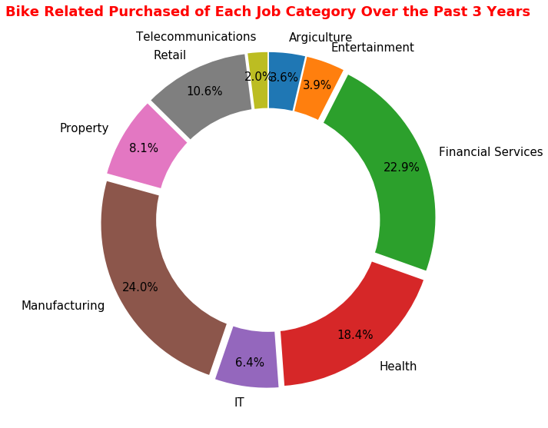
Note: The data and information in this document is reflective of a hypothetical situation and client. This document is to be used for KPMG Virtual Internship purposes only.
Data Exploration
The manufacturing, financial service, health and retail occupy 75.9% of the bike related purchased over the past 3 years.
Majority of customer came from New South Wales due to high percentage of national manufacturing in that state [Source: Parliament of Australia].
Female has a higher purchase rate over the past three years.
Standard class and medium size product has the highest sales over the past 3 years.

Slide 5
Note: The data and information in this document is reflective of a hypothetical situation and client. This document is to be used for KPMG Virtual Internship purposes only.
Model Development
Combination of clustering models and regression models to determine the customer behavior and trends.
Objectives | Train KMeans clustering model to group the customer with similar behavior and psychographics Train RandomForestRegressor model to predict the future trends of each group
Details: | Kmeans start by randomly initialize multiple center points on the dataset. The center points will be train to move towards area with dense population. With this model, it aid in discovering the relationship between each features of the customer. Thus, providing insight on the market segmentation. With the market segmentation, a regression models such as Random Forest Regressor could be train to estimate the future trend of each segment. For example, the regression model could be use to estimate the amount of customer willing to spend on bike accessory in the next 2 years.

Slide 6
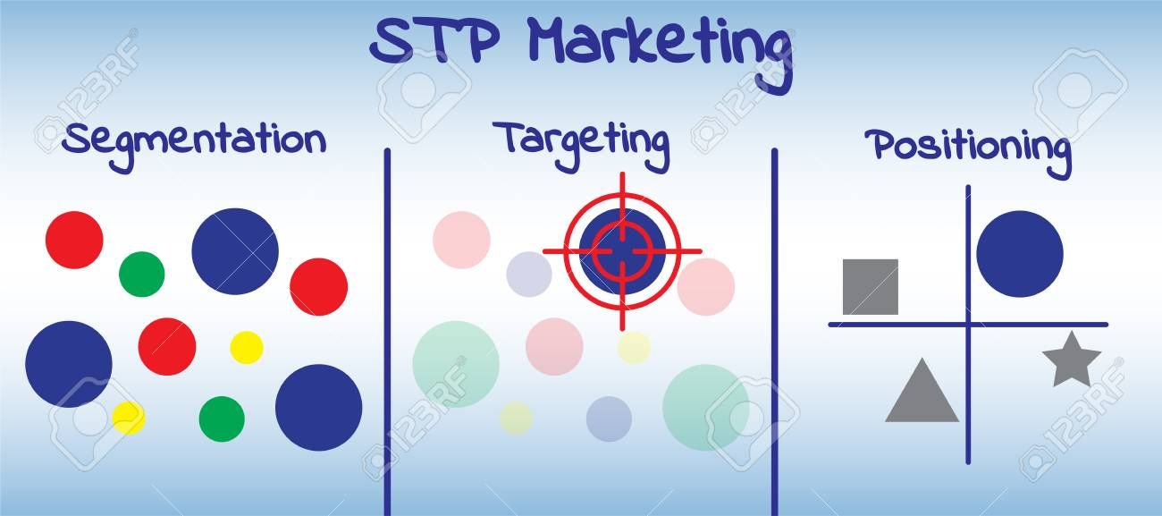
Note: The data and information in this document is reflective of a hypothetical situation and client. This document is to be used for KPMG Virtual Internship purposes only.
Interpretation
Utilize the Segmentation, Targeting and Positioning (STP) marketing strategies to interpret the customer behavior and market trends
Segmentation | Identify the significant features that affect the market. Determine who is our customer and why does the customer buy.
Targeting | Locate the segments which can provide significant boost in the market. Pinpoint the cluster which has the highest sales over the past three years.
Positioning | Estimate the profits of each segment. Rank each customer based on the amount willing to spend in the future.

