Slide 1
Osteoporosis
Strategies for Screening and Intervention
March 2, 2005
Steven R. Brown, MD
Family Physician,
Whiteriver Indian Health Service
Roy Teramoto, MD, MPH
Maternal Child Health Consultant
Phoenix Area Indian Health Service

Slide 2
Definition
A skeletal disorder characterized by compromised bone strength predisposing to an increased risk of fracture.
NIH Consensus Statement 2000

Slide 3
Diagnostic Criteria
Bone mineral density (BMD) 2.5 standard deviations below the mean bone mineral density of healthy, young, white women
(T-score of -2.5) or
Fracture in the absence of significant trauma in a postmenopausal woman
World Health Organization working group 1992

Slide 4
Diagnostic Criteria
Osteopenia – BMD 1 to 2.5 standard deviations below the mean (T-score -1.0 to -2.5)
Unclear clinical value – wide range of fracture risk found among women in this category

Slide 5
Gold Standard
Central DEXA scan for bone mineral density, BUT true “gold standard” is fracture/fracture rates for public health purposes.

Slide 6
Epidemiology
Rates vary among racial and ethnic groups
Data is best established for Caucasian females
Limited data available regarding osteoporosis and fracture rates in American Indian and Alaska Natives
Data suggests that they are at least as great a problem as for the general population

Slide 7
Epidemiology
National Osteoporosis Risk Assessment (NORA)
Study of peripheral osteoporosis
screening
1708 “Native American” women – risk
of fracture over life of the study was the
same as that of “white” women

Slide 8
Epidemiology
Small study in the Sac and Fox Nation of Oklahoma
Lower BMD in postmenopausal
women as measured by central
DEXA than that reported for “white”
women
The effect of aging on bone mineral metabolism and bone mass in Native American Women, J Am Geriatr Soci 1998; 46:
1418-22

Slide 9
Hip Fracture Risk by Race/Ethnicity
Relative Hazard (95% Confidence interval)
White 1.00 (referant)
African American 0.54 (0.41-0.72)
Native American 0.89 (0.59-1.34)
Hispanic 0.91 (0.72-1.15)
Asian 0.41 (0.21-1.79)

Slide 10
Epidemiology
Review of hip fractures at Alaska Native Medical Center
Higher fracture rates than reported for white US women during the periods of 1979-1989 and 1996-1999
Incidence of hip fracture in Alaska Inuit people, Alaska Med; 2001, 43: 2-5

Slide 11
Risk Factors for Osteoporosis (AI/AN)
Low calcium intake
Sedentary lifestyle
Issues with body mass index
Smoking
Osteoporosis in Native Americans, IHS Provider 2002;
94: 94-101

Slide 12
Clinical Risk Factors for Hip Fracture
Skeletal
  History of maternal hip fracture (RR=2.0)
  Age, per 5 year (RR=1.5)
  Current cortisone use (RR=1.57)
  Current smoking (RR=1.14 - 2.1)
  Low Body Mass Index (BMI >30 has RR 0.16 of having osteoporosis)
  Race (African-American RR= 0.54)

Slide 13
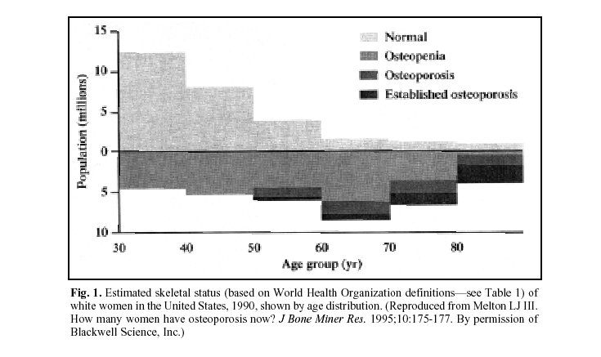
Skeletal status by age

Slide 14
Clinical Risk Factors for Hip Fracture
Use of anticonvulsant drugs (RR=2.8)
Serious long-term conditions thought to increase fracture risk such as hyperthyroidism or malabsorption

Slide 15
Clinical Risk Factors for Hip Fracture
Non-skeletal
  Poor vision (RR=1.5)
  Inability to rise from chair (RR=2.1)
  Benzodiazapine use (RR=1.6)
  Fall in the previous year (RR=1.6)
  Self-rated health status of fair/poor (RR=1.79)

Slide 16
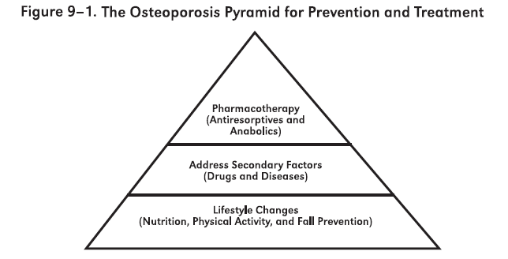
The Osteoporosis Pyramid¹

Slide 17
Risk Factors for Falls
Risk Factor Mean RR-OR
Muscle weakness 4.4
History of falls 3.0
Gait deficit 2.9
Balance deficit 2.9
Use assistive device 2.6
Visual deficit 2.5
From: Guidelines for the Prevention of Falls in Older Persons, Journal of the American Geriatric Society 49:664-672, 2001

Slide 18
Approach to Older Persons as Part of Routine Care (Not Presenting After A Fall)
All older persons who are under the care of a health professional (or their caregivers) should be asked at least once a year about falls.
All older persons who report a single fall should be observed as they stand up from a chair without using their arms, walk several paces, and return (i.e., the “Get Up and Go Test”). Those demonstrating no difficulty or unsteadiness need no further assessment.
From: Guidelines for the Prevention of Falls in Older Persons, Journal of the American Geriatric Society 49:664-672, 2001

Slide 19
Approach to Older Persons as Part of Routine Care (Not Presenting After A Fall)
Persons who have difficulty or demonstrate unsteadiness performing this test require further assessment.
From: Guidelines for the Prevention of Falls in Older Persons, Journal of the American Geriatric Society 49:664-672, 2001

Slide 20
Approach to Older Persons Presenting with One or More Falls or Have Abnormalities of Gait and/or Balance, or Who Report Recurrent Falls
Older persons who should have a fall evaluation performed:
Present for medical attention because
of a fall
Report recurrent falls in the past year
Demonstrate abnormalities of gait and/or
balance.

Slide 21
Approach to Older Persons Presenting with One or More Falls or Have Abnormalities of Gait and/or Balance, or Who Report Recurrent Falls
Fall Evaluation
Should be performed by a clinician with appropriate skills and experience
May necessitate referral to a specialist (e.g., geriatrician).

Slide 22
Approach to Older Persons Presenting with One or More Falls or Have Abnormalities of Gait and/or Balance, or Who Report Recurrent Falls
Fall evaluation
Assessment that includes the following:
  A history of fall circumstances
  Medications
  Acute or chronic medical problems
  Mobility levels
  Examination of vision
  Examination of gait, balance and lower extremity joint
  function

Slide 23
Approach to Older Persons Presenting with One or More Falls or Have Abnormalities of Gait and/or Balance, or Who Report Recurrent Falls
Examination of basic neurological function
  Mental status
  Muscle strength
  Lower extremity peripheral nerves
  Proprioception
  Reflexes
  Tests of cortical, extrapyramidal, and
    cerebellar functions

Slide 24
Approach to Older Persons Presenting with One or More Falls or Have Abnormalities of Gait and/or Balance, or Who Report Recurrent Falls
Assessment of basic cardiovascular status including heart rate and rhythm
  Postural pulse and blood pressure
  If appropriate, heart rate and blood
    pressure responses to carotid
    sinus stimulation.

Slide 25
Approaches Demonstrating Benefit
Muscle strengthening and balance retraining
Professional home hazard assessment and modification
Stopping or reducing psychotropic medication
NEJM 348: 42-9, 2003; NEJM 331: 821-7, 1994
Note: Optimal duration or intensity of these approaches have not been defined

Slide 26
Hip Protectors/Pads
Hip protectors reduce the risk of hip fracture for elderly individuals who live in nursing homes and residential care facilities, as well as those in supported living at home
The generalization of the results beyond this high risk population is unknown

Slide 27
Hip Protectors/Pads
One study found that 41 patients would need to be offered treatment with a hip protector to prevent one hip fracture over the course of one year (NEJM 343: 1506-13; 2000)
Hip protectors may be a reasonable and cost-effective option for patients at high risk of falls.

Slide 28
Hip Protectors/Pads
Randomized controlled trial among women over 70 living in the community found that hip protectors offered no significant reduction in the risk of hip fracture (Birks -Osteoporos Int 2004, Mar 3)
Compliance rates were quite low (about 30%)
Need for more acceptable, easy-to-use devices that can protect fragile bones

Slide 29
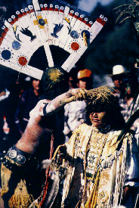
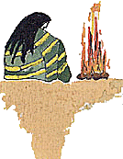

Slide 30
The Third Level of the Pyramid: Medical Interventions
Bisphosphonates
  Alendronate
  Risedronate
Calcium + Vitamin D
Calcitonin
Estrogen
Selective estrogen receptor modulator (Raloxifene)
Teriparatide (recombinant human parathyroid hormone)

Slide 31
POEM vs. DOE
POEM: Patient Oriented Evidence that Matters
  Hip and Vertebral Fractures
DOE: Disease Oriented Evidence
  Bone Density

Slide 32
Intervention: Alendronate
In postmenopausal women with osteoporosis does alendronate compared to placebo reduce hip and vertebral fractures?
Answer: Good evidence based on randomized, controlled trials…

Slide 33
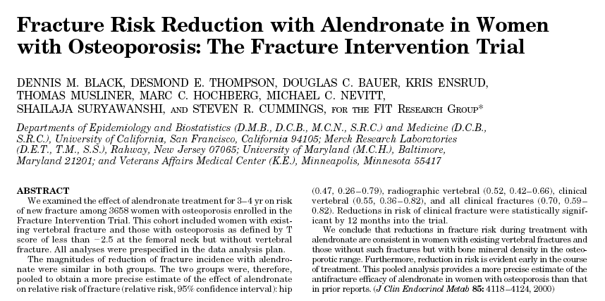
Treatment of Osteoporosis:
The Fracture Intervention Trial² (FIT)

Slide 34
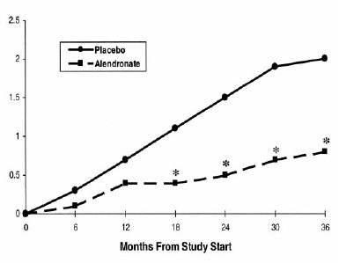

FIT: Hip fracture
Population: 3658 white women age 55-80 with osteoporosis (femoral-neck T-score <-2.5 or existing vertebral fracture.)
* = achieved statistical significance

Slide 35
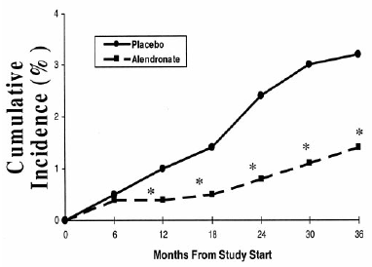
FIT: Vertebral Fracture
Population: 3658 white women age 55-80 with osteoporosis (femoral-neck T-score <-2.5 or existing vertebral fracture.)
* = achieved statistical significance

Slide 36
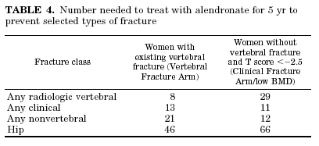
FIT: Number Needed to Treat (NNT)

Slide 37
Alendronate: Harms
“Esophagitis, esophageal ulcers and esophageal erosions, occasionally with bleeding and rarely followed by esophageal stricture or perforation, have been reported in patients receiving treatment with alendronate sodium. In some cases these have been severe and required hospitalization.”³
One RCT found that when taken correctly, there was no significant difference in esophagitis with alendronate versus placebo⁴
From the SG: “appears to be safe and effective for up to 10 years.”

Slide 38
Interventions
Calcium and Vitamin D
In mobile elderly women in nursing homes does Calcium and Vit D compared to placebo reduce hip fracture?
Yes, quite impressively.
The NNT at 3 years to prevent one hip fracture in this population is 25.
NNT at 18 months to prevent one hip fracture is 50.

Slide 40
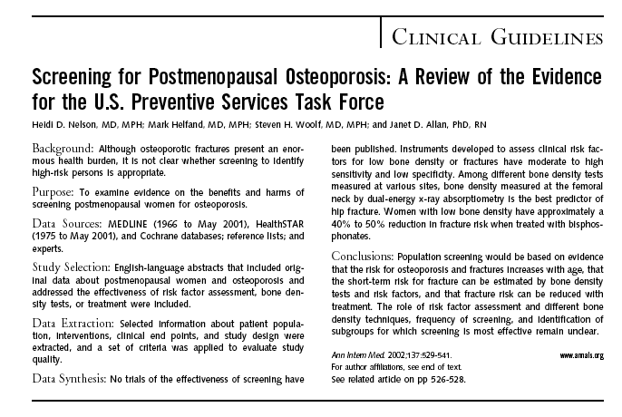
Ref 5

Slide 41
Key Question #1 in the analytic framework from the USPSTF ⁵
Does screening for osteoporosis using risk factor assessment or bone density testing reduce fractures?
USPSTF answer: “We identified no studies about the effectiveness of screening in reducing osteoporotic fractures.”
Therefore: “Recommendations about screening need to rely on evidence that risk factor assessment or bone density testing can adequately identify women who could ultimately benefit from treatment.”

Slide 42
Risk Factor Screening
Osteoporosis Risk Assessment Instrument (ORAI)⁶ is one of two validated risk factor assessment tools given a “good” quality rating by the USPSTF⁵
95 % sensitive and 41 % specific for detecting hip or lumbar spine BMD T-score <-2.5.

Slide 43
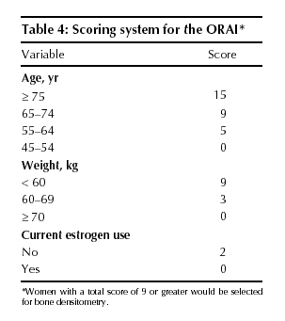
Risk Factor Screening
ORAI scoring⁶

Slide 44
Radiologic Screening Methods
DXA (dual energy x-ray absorptiometry)
  Hip
  Spine
Peripheral Densitometry (DXA or SXA)
  Distal radius
  Calcaneus
  Finger
Quantitative Computed Tomography
  Spine
Quantitative Ultrasound
  Calcaneus
  Tibia

Slide 45
“Looking to the future…” ¹

Slide 46
Radiologic Screening Methods
1996 BMJ meta-analysis⁷ showed all measuring sites had similar predictive abilities for fracture.
  RR 1.5 (CI 1.4-1.6) for 1 SD decrease in BMD for age (Z-score) except:
    Measurement at spine for vertebral fractures: RR 2.3 (CI 1.9-2.8)
    Measurement at hip for hip fractures: RR 2.6 (CI 2.0-3.5)
Notes:
RR of 1.5 = 50%increase in risk, RR of 2 is double risk

Slide 47
Screening Methods
As stated by the USPSTF: “the probability of receiving a diagnosis of osteoporosis depends on the choice of test and site.”
USPSTF: “the likelihood of receiving a diagnosis of osteoporosis also depends on the number of sites tested.”
National Osteoporosis Risk Assessment⁸:
  the probability of having osteoporosis varied from 3.4% (heel ultrasound) to 13.5% (finger DXA) depending on site tested and method of testing.
  Odds of osteoporosis by site tested: Heel ultrasound OR 0.79, DXA at forearm or finger OR 2.86, 4.82.

Slide 48
Screening Methods
Again from the USPSTF: “DXA is considered the gold standard because it is the most extensively validated test against fracture outcomes.”
Randomized, controlled trials, such as FIT, use femoral neck DXA to identify patients with osteoporosis that might benefit from therapy.

Slide 49
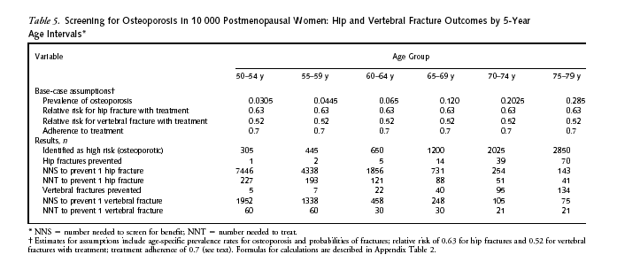
Number needed…

Slide 50
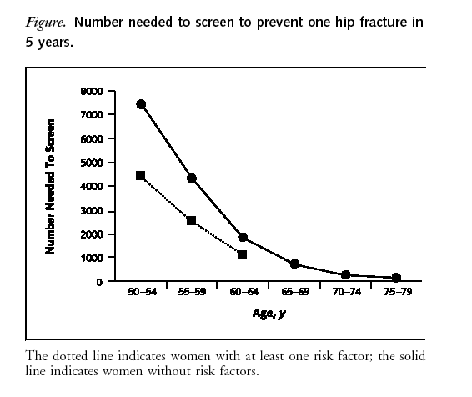
Number needed to screen⁵

Slide 51
Screening Methods: Ultrasound
EPIDOS ⁹: 1996 prospective study of 5662 elderly women with 115 hip fractures in average follow-up of two years
Patients had calcaneal ultrasound (Lunar Corp.) and femoral DXA
Relative risk of hip fracture for 1 SD reduction
  in ultrasound attenuation at heel 2.0 (CI 1.6-2.4)
  in hip BMD 1.9 (CI 1.6-2.4)
Author conclusions: Calcaneal ultrasound “predicts the risk of hip fracture as efficiently as DXA.”

Slide 52
Screening Methods: Ultrasound
The 1997 Study of Osteoporotic Fractures Research Group¹⁰ followed 6189 women over 65 for an average of 2 years
54 hip fractures
Calcaneal quantitative ultrasound (Walker-Sonix) and hip and calcaneal DXA were performed
Relative risk of hip fracture for 1 SD reduction
  In heel ultrasound attenuation 2.0 (1.5-2.7)
  In hip BMD 2.6 (1.9-3.8)
Author conclusion: “the strength for the association between BUA and fracture is similar to that observed with bone mineral density.”

Slide 53
An ultrasound study in primary care¹¹
200 women age 60-69 in British general practice had DXA and heel ultrasound (Sahara) and risk factor screening
Ultrasound T-score <1.7 SD (lowest quartile) compared to a “gold standard” of osteoporosis on DXA yielded
  sensitivity of 71% and specificity of 83%
  PPV of 45% and NPV of 94%
  16.3 % of patients had osteoporosis
Including risk factor screening
  Sensitivity 90%, specificity 38%
  PPV 22%, NPV 95%

Slide 54
A Public Health Approach to a Fracture Prevention Program at Your Service Unit
Why?
  It will help your patients “live long and live well.”
  October 2004: “The intent of this Surgeon General’s Report is to serve as a catalyst for the development of a public health approach to promoting bone health.”
  The Surgeon General urges: “implement a comprehensive, systems-based approach to promoting bone health.”
  2002-2011 Decade of Bone and Joint
  Healthy People 2010
    “reduce the number of individuals with osteoporosis and hip fractures…”
  HEDIS, GPRA

Slide 55
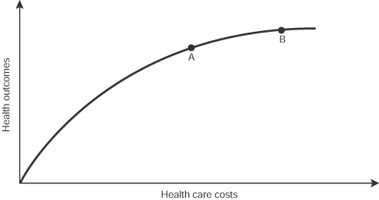
Outcomes and Cost/Effort
Designing an approach at your Service Unit

Slide 57
Designing a Fracture Prevention Approach at your Service Unit
Avoid pitfalls
  No screening program
  Not identifying and treating the highest risk individuals
  Not appropriately utilizing cost/effort
  Focusing on unproven technologies if DEXA is available
  Remember the pyramid

Slide 58
Fracture Prevention Program: Avoiding Pitfalls
Pitfall #1: No screening program

Slide 59
Fracture Prevention Program: Avoiding Pitfalls
Pitfall #2: Not identifying and treating the highest-risk individuals
  Consider secondary osteoporosis (e.g. ESRD, rheumatoid arthritis, steroid use)
  Treat patients with fragility fractures (the “sentinel event”)
    Only 22-24% of patients with fractures treated in two recent studies
    A recent controlled trial showed improved treatment after fracture with faxed reminders to physicians (still only 40%).
    Do not delay treatment for imaging
  Screen women over 75 and frail elderly first

Slide 60
Fracture Prevention Program: Avoiding Pitfalls
Pitfall #3: Not appropriately utilizing cost and effort
  Do not prioritize screening young, well-nourished, otherwise healthy, women.
  Initiate population screening no earlier than 65 years of age

Slide 61
Number needed to screen⁵

Slide 62
Fracture Prevention Program: Avoiding Pitfalls
Pitfall #4: Focusing on unproven technologies if DEXA is available

Slide 63
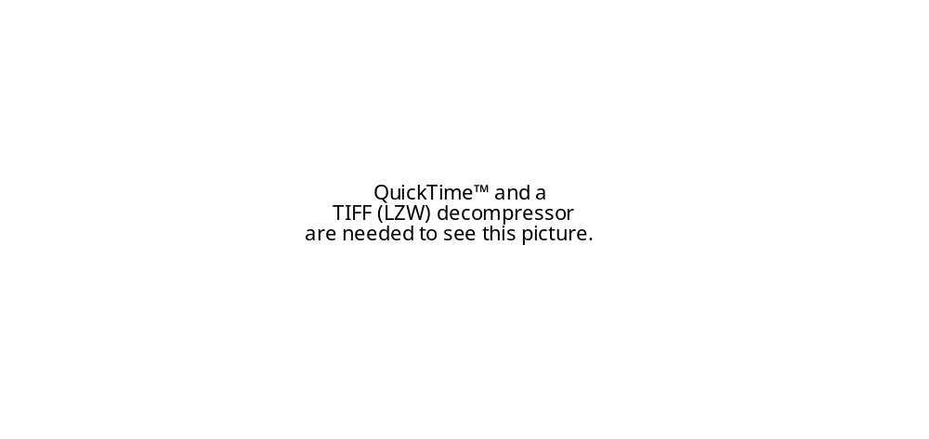
Fracture Prevention Program: Avoiding Pitfalls
Pitfall #5: Remember the Pyramid! (and don’t invert it.)
  Use Calcium
    NNT in some populations 25

Slide 64
“When so many hours have been spent in convincing myself that I am right, is there not some reason to fear I may be wrong?”
- Jane Austen

Slide 65
References
US Dept of HHS. Bone health and osteoporosis: A Report of the Surgeon General. Rockville, MD: HHS, Office of the Surgeon General, 2004.
Black DM, et al. Fracture risk reduction with alendronate in women with osteoporosis: The fracture intervention trial. J Clin Endocrinol Metab 2000;85:4118-4124.
Mosby’s Drug Consult 2003, accessed on mdconsult.com 12/1/03
Bruyere O, et al. Fracture prevention in postmenopausal women. Clinical Evidence 2003; 9. BMJ Publishing Group.
Nelson HD, et al. Screening for postmenopausal osteoporosis: a review of the evidence for the USPSTF. Ann Intern Med 2002;137:529-41.
Cadarette SM, et al. Development and validation of the Osteoporosis Risk Assessment Instrument to facilitate selection of women for bone densitometry. CMAJ 2000;162(9):1289-1294.
Marshall D, Johnell O, Wedel H. Meta-analysis of how well measures of bone mineral density predict occurrence of osteoporotic fractures. BMJ 1996;312:1254-59.
Siris ES, et al. Identification and fracture outcomes of of undiagnosed low bone mineral density in postmenopausal women. Results from the National Osteoporosis Risk Assessment. JAMA 2001;286:2815-2822.

Slide 66
References
Hans D, et al. Ultrasonographic heel measurements to predict hip fracture in elderly women: the EPIDOS prospective study. Lancet 1996;348:511-514.
Bauer DC, et al. Broadband ultrasound attenuation predicts fractures strongly and independently of densitometry in older women. Arch Intern Med 1997;157:629-634.
Hodson J, Marsh J. Quantitative ultrasound and risk factor enquiry as predictors of postmenopausal osteoporosis: comparative study in primary care. BMJ 2003;326:1250-1251.

