Slide 1
Achieving Cultural Competence
A Guidebook for Providers of Services to Older Americans and Their Families

Slide 2
Achieving Cultural Competence
Overview of the Aging Network

Slide 4
DHHS
AoA
Eldercare Locator
AoA Website
Nat’l Aging Info Center
State Units on Aging
Area Agencies on Aging
Information and Assistance Programs
HCBS Case
Management
Aging Information
and Assistance
Senior Center
Info Programs
Pension
Counseling
Health Insurance
Counseling
Nutrition
Counseling
Legal
Hotlines
Medicare Anti-Fraud
Advocacy
Long-Term Care
Ombudsman

Slide 5
Information and Counseling
General I&R Services
Specialized Counseling Services
State Health Information Programs
Medicare+Choice
Life Course Planning
Long Term Care
Home & Community-based
Services
Medicaid Home and
Community-based Waivers
State Funded Programs
Older Americans Act
Programs
Healthy Aging
Health Promotion
Nutrition
Transportation
Employment
Volunteerism
AoA’s Service Delivery
Systems
Elder Rights & Services
Elder Abuse Prevention
Adult Protective Services
Long-Term Care Ombudsman
Legal Services
Senior Medicare Patrol

Slide 6
Achieving Cultural Competence
Dayton, S.; Pearce, M.L.; Hashimoto, S.; Dixon, W.J.: and Tomiyasu. U. l%9. A controlled
clinical trial of a diet high in unsaturated fat in preventing complications of atherosclerosis.
What is Culture?

Slide 7
Challenges
How do we as professionals work with individuals from diverse cultures and with perspectives different from our own?

Slide 8
What is Culture?
  The shared values, traditions, norms,
  customs, arts, history, folklore, and institutions of a group of people.

Slide 9
Why Consider Culture?
Helps us to understand the values, attitudes and behaviors of others
Helps us to avoid stereotypes and biases that can undermine our efforts
Plays a critical role in the development and delivery of services that are responsive to the needs of the recipient

Slide 10
Factors that Influence Culture
  Age
  Gender
  Geography
  Socio-economic status
  Educational attainment
  Individual experiences
  Place of birth
  Length of residency in the U.S.

Slide 11
Cultural competence can help
to better meet the needs of diverse
aging populations.

Slide 12
Definition of Cultural Competence
Cultural competence is a set of cultural behaviors and attitudes integrated into the practice methods of a system, agency, or its professionals, that enables them to work effectively in cross cultural situations.

Slide 13
Two Dimensions of Cultural Competence
Surface Structure: Use people, places, language, music, food, and clothing familiar to and preferred by the target audience.
Deep Structure: Involves sociodemographic and racial/ethnic population differences and the influence of ethnic, cultural, social, environmental and historical factors on behaviors.

Slide 14
Cultural Competence
Checklist for Success
Makes the environment more welcoming and attractive based on
clients cultural mores
✓ Avoid stereotyping and misapplication of scientific knowledge
✓ Include community input at the planning and development stage
Use educational approaches and materials that will capture the
attention of your intended audience
✓ Find ways for the community to take the lead
Adapted from material developed by the National Center for Cultural Competence, Georgetown University Child
Development Center

Slide 15
Cultural Competence
Checklist for Success.
Be an advocate - strike a balance between community priorities
and agency mission
✓ Understand there is no recipe
✓ Hire staff that reflect client population
✓ Understand cultural competency is continually evolving
Be creative in finding ways to communicate with population
groups that have limited English-speaking proficiency
Adapted from material developed by the National Center for Cultural Competence, Georgetown University Child
Development Center

Slide 16
Barriers to Service Access
Structural Barriers: lack of health care insurance, high out-of-pocket expenses, lack of transportation, language difficulties.
Cultural Barriers: Characteristics of minority groups, such as styles of interaction and expectations.

Slide 17
Research on Cultural Competence
Existing Research: health care service utilization, Census data, National Center for Health Statistics, new survey and data collection.
Research Needs: utilization data for other services, interaction between socioeconomic status of minority groups and service utilization

Slide 18
Achieving Cultural Competence
Why is Cultural Competence Important?
Demographics

Slide 19
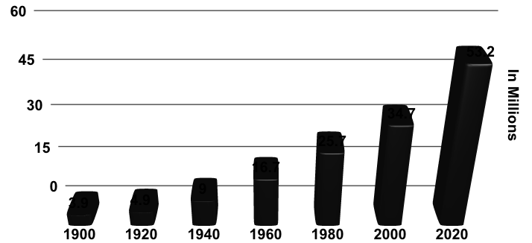
Growth in 65+ Population
1900 - 2020
In Millions
Source: U.S. Bureau of the Census. (1993). Population Projections of the United States by Age, Sex, Race, and Hispanic Origin:
1993 to 2050, Current Population Reports, P25-1104.

Slide 20
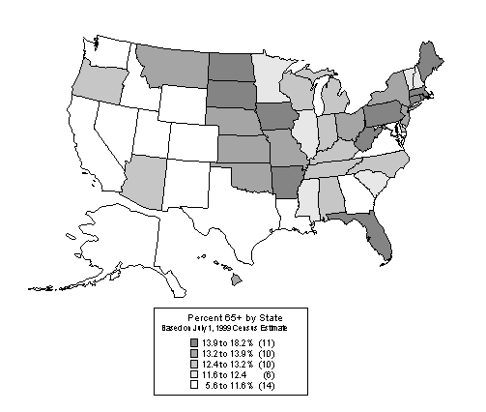
Persons 65+ as a Percentage of Total Population, 1999

Slide 21
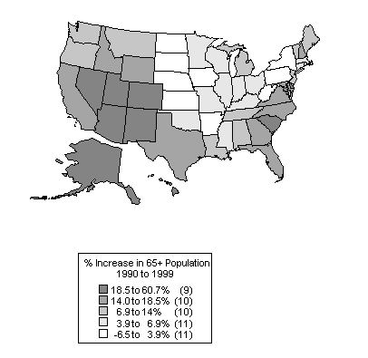
Percentage Increase in 65+: 1990 to 1999

Slide 22
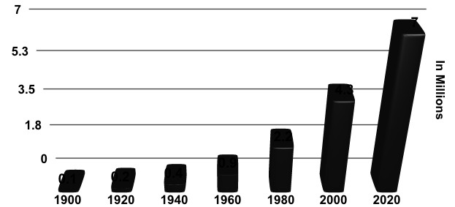
Growth in 85+ Population
1900 - 2020
In Millions
Source: U.S. Bureau of the Census. (1993). Population Projections of the United States by Age, Sex, Race, and Hispanic Origin:
1993 to 2050, Current Population Reports, P25-1104.

Slide 23
Minority groups
as a proportion of the U.S. population
    1970 16 percent
    1998 27 percent
    2050 50 percent

Slide 24
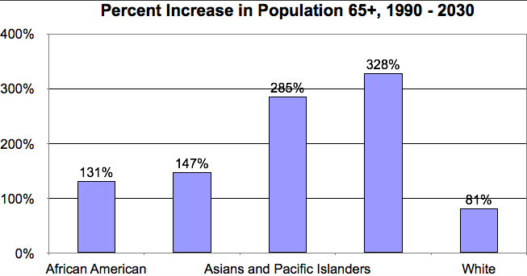

Slide 25
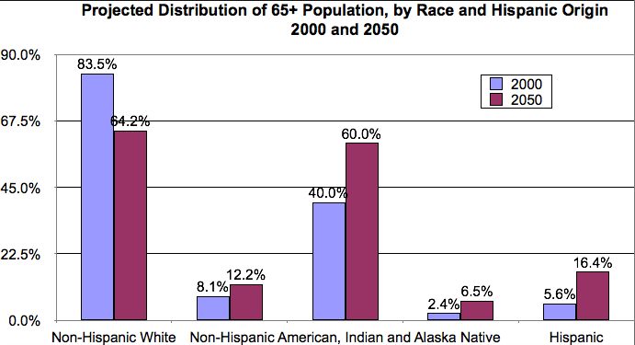

Slide 26
Achieving Cultural Competence
Why is Cultural Competence Important?
Racial and Ethnic Disparities

Slide 27
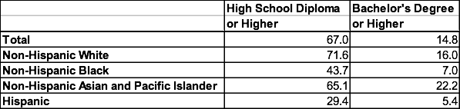
Education Level
Percentage of the 65+ Population with a High School Diploma or Higher or a Bachelor’s Degree or Higher, by Race and Hispanic Origin, 1998

Slide 28
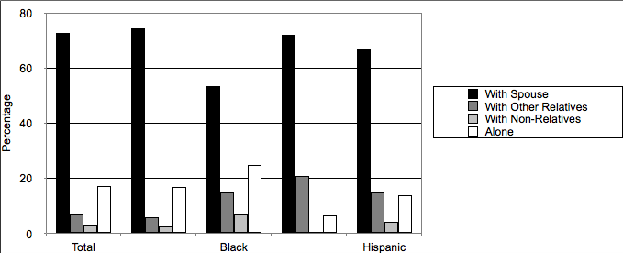
Living Arrangements – Older Men

Slide 29
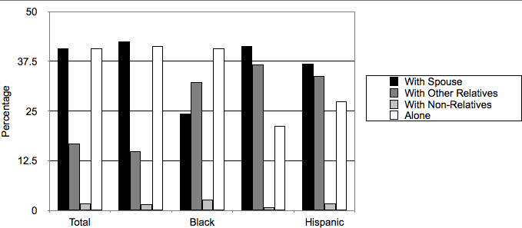
Living Arrangements – Older Women

Slide 30
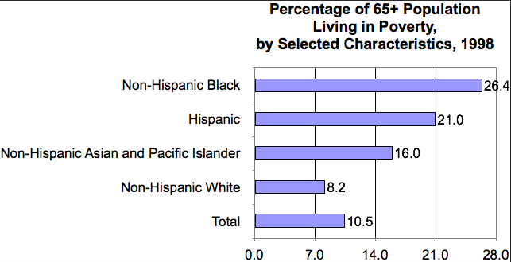
Poverty

Slide 31

Life Expectancy
Life Expectancy by Age Group and Race, in Years, 1997

Slide 32
Health Disparities: Examples
Native Hawaiians have one of the poorest health profiles of any ethnic group in the United States. (Mokuau et al., 1995)
The death rate for all cancers is 30 % higher for African Americans than for Whites. (Healthy People 2010)
Hispanics living in the United States are almost twice as likely to die from diabetes than are non-Hispanic Whites. (Healthy People 2010)
The rate of diabetes for this population group is more than twice that for Whites.
(Healthy People 2010)

Slide 33
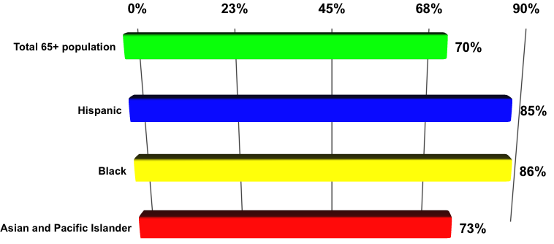
No Pneumococcal Vaccination Persons 65+ by Ethnicity
Unknown
(Non-institutionalized population)
Source: Centers for Disease Control and Prevention. (1995). Healthy People 2000: Statistical Notes, 1995 Midcourse Review (updated).

Slide 34
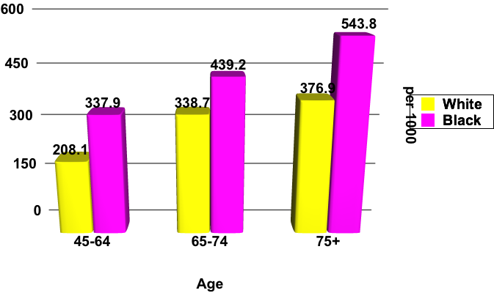
Prevalence of Hypertension
Source: Vital & Health Statistics: Current Estimates from the NHIS, 1994, Page 86

Slide 35
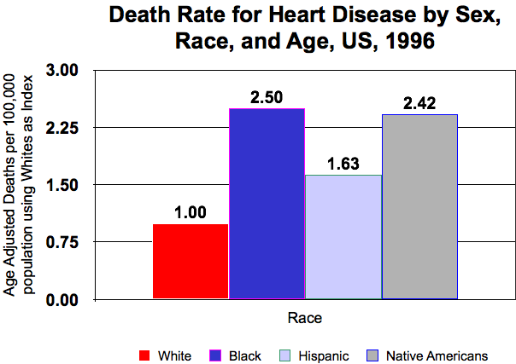
Source: Health, United States, 1999 with Health and Aging Chartbook, p. 141 - 143.

Slide 36
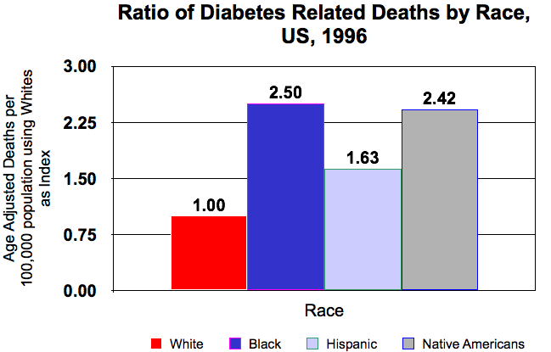
Source: Health, United States, 1999 with Health and Aging Chartbook, p. 141 - 143.

Slide 37
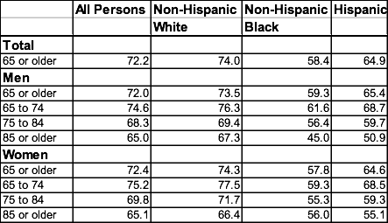
Self-Rated Health Status
Percentage of Persons Who Reported Good to Excellent Health by Age, Sex, Race and Hispanic Origin, 1994-1996

Slide 38
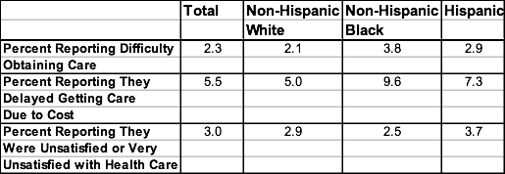
Access to and Satisfaction with Health Care
Percentage of 65+ Medicare Beneficiaries Reporting Access to and Satisfaction with Health Care, by Race and Hispanic Origin, 1998

Slide 39
Achieving Cultural Competence
What are Culturally Appropriate Programs and Services?

Slide 40
Warmth, Empathy, and Genuineness
Warmth: acceptance, liking, commitment, and unconditional regard.
Empathy: the professional’s ability to perceive and communicate, accurately and with sensitivity, the feelings of the client and the meaning of those feelings.
Genuineness: openness, spontaneity, congruence, the opposite of “phoniness.”

Slide 41
Culturally Congruent Behaviors
Appreciation and Respect for Cultural Differences
Cultural Competence
Core Fundamental Beliefs: Warmth, Empathy and Genuineness

Slide 42
Principles of Cultural Competence
Values and Attitudes
Be knowledgeable about cultural differences and their impact on attitudes and behaviors.
Be sensitive, understanding, non-judgemental, respectful.
Be flexible and skillful in responding and adapting to different cultural contexts and circumstances.

Slide 43
Principles of Cultural Competence
Communication Styles
Spend time listening to needs, views and concerns of the community.
Use the language and dialect of the people you serve.
Use communication vehicles that have value and use by your target audience.

Slide 44
Principles of Cultural Competence
Community/Consumer Participation
Get to know the community, its people, its resources to identify strategies for service delivery.
Establish partnerships and relationships with key community resource people.
Report back the results of your initiatives to groups, individuals that help you in the process.

Slide 45
Principles of Cultural Competence
Physical Environment
Create culturally, linguistically friendly interior design, pictures, posters, and art work to make facilities more welcoming.
Display material and information with recognizable props that hold significance, value, and interest for your target audience.
Put props in the hands of people that will maximize their distribution, circulation.

Slide 46
Principles of Cultural Competence
Policies and Procedures
Mission statement must articulate principles and rationale for culturally competent service delivery.
Develop structures to assure community participation in planning, delivery, and evaluation of services.
Institute procedures to recruit, retain, and train a diverse and culturally competent workforce.

Slide 47
Principles of Cultural Competence
Population-Based Service Delivery
Appreciate the importance of culture while avoiding stereotypes.
Understand the socio-political influences that shaped your consumers’ attitudes, beliefs and values.

Slide 48
Principles of Cultural Competence
Training and Professional Development
Provide informal opportunities like “brown bag lunches” for staff to explore their attitudes, beliefs and values.
Recognize that cultural sensitivity occurs on a continuum.
Provide specialized training for interpreters.

Slide 49
5 Essential Organizational Components for Cultural Competence
Value diversity.
Develop capacity for cultural self-assessment.
Understand the dynamics of the interaction between cultures.
Institutionalize cultural knowledge.
Adapt service delivery based on an understanding of cultural diversity.

Slide 50
The 3 M’s
Macro: Policies, laws, and regulations (Title VI of the Civil Rights Act, Executive Orders, Healthy People 2010, Older Americans Act, accrediting organizations)
Mezzo: Community-based involvement in the design, delivery of programs, services.
Micro: Prepare service professionals to interact effectively, appropriately with individuals from diverse cultures.

Slide 51
Characteristics of Culturally Competent Service Delivery
Available: Availability of services refers to the existence of health services and bicultural/ bilingual personnel.
Accessible: Accessibility is contingent on factors such as cost of services, the hours of service provision, and the geographic location of a program.
Acceptable: Acceptability is the degree to which services are compatible with the cultural values and traditions of the clientele.

Slide 52
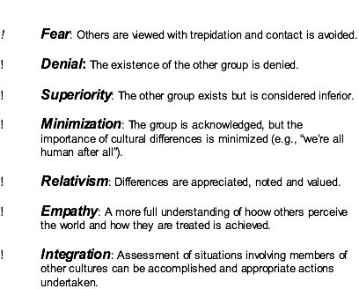
The Cultural Sensitivity Continuum

Slide 53
Principles of Interpreter Services
Use qualified interpreters who have passed qualification standards and completed interpreter education programs.
Do not use family members, friends, young children or youth to interpret.
Do not rely on untrained workers or employees to interpret.
Minimize the use of telephone language lines to times when it is absolutely necessary.

Slide 54
“Culturally competent practice is a long-term developmental process. Proficiency is not achieved after a brief workshop.”
(Tripp-Reimer, 1999)

Slide 55
Achieving Cultural Competence
People Profiles

Slide 56
People Profiles - Age
Chieko, a 70 year old foreign-born elder recently brought to the U.S. by her family.
Lisa, a fourth generation Asian American elder was has lived in the U.S. her whole life.
Unique personal histories that shape their interaction with service providers.
Chieko delays seeking care for heart trouble due to confusion over health care system, language difficulties, transportation difficulties, and fear.
Lisa is more savvy about the U.S. health care system and navigates it more successfully.

Slide 57
People Profiles - Education
Joe, an 85 year old African American, was diagnosed with hypertension 15 years ago.
Joe exhibits dramatic fluctuations with his blood pressure due to noncompliance with prescribed treatment regimens.
Joe’s physician is unaware of the effects of using the word “hypertension” versus “high blood pressure” among African American elders.
Using the term “high blood pressure” will more likely lead to better compliance.

Slide 58
People Profiles - Gender
Husan, a 60 year old Asian American, with limited command of the English language.
During a routine clinical exam, Husan reverts to a passive stereotypical Asian female personality in order to avoid embarrassment from asking questions about her condition.

Slide 59
People Profiles -
Geographic Location
Juanita, a 68 year old Latina, who lives in San Diego County. Juanita has lived in a predominantly Latino neighborhood since coming to the U.S. in her thirties.
Juanita consults with “curanderos” about her health concerns and crosses the border back to Mexico to purchase pharmaceutical products.
Because of her geographic location, Juanita is able to live in the U.S. without having to acculturate into American culture and learn English.

Slide 60
Program Profile –
Ethnic Dietician
A county-based Area Agency on Aging provides funds for an ethnic dietician. The dietician conducted focus groups with several minority elder groups. The result is a program that offers culturally appropriate meals that may be adaptations of some traditional production techniques. In addition, the dietician is preserving and adapting traditions plus including new knowledge to improve the lives of older county residents.

Slide 61
Program Profile –
Bilingual/Bicultural Program
An Area Agency on Aging developed a successful bilingual, bicultural program for Hispanic elders. The AAA trained Hispanic elders to serve as community ambassadors. The elders teach the staff about the Hispanic culture. The result is culturally acceptable and accessible services such as long term care and caregiver support.

Slide 62
Laws
Title VI of the Civil Rights Act of 1964
The Older Americans Act

Slide 63
Executive Orders
Improving Access to Services for Persons with Limited English Proficiency
Historically Black Colleges and Universities
Hispanic Serving Institutions
Tribal Colleges and Universities
Increasing Participations of Asian American and Pacific Islanders in Federal Programs

Slide 64
Healthy People 2010
The nation’s disease prevention agenda.
Identifies significant opportunities to improve health and focuses on special populations.
AoA’s targeted efforts to address minority elder health disparities in three areas:
    Diabetes
    Cardiovascular disease
    Adult immunization

