Slide 1

C270 DevOps Essentials Project
RP Marketplace – DevOps Implementation using Git, Docker, Jenkins & Ansible
Prepared by: Jason/Oliver/Thomas/Cecelia/Kaject

Slide 2
Problem Statement
CC
Background: Republic Polytechnic students often rely on external platforms such as Carousell or Telegram groups to buy and sell second-hand items. These platforms are not designed specifically for RP students and present several challenges.
Existing Problem:
No verification that buyers and sellers are RP students
Communication and transactions are handled outside the platform.
Lack of a centralized marketplace dedicated to the RP community.
Proposed Solution: To address these issues, our team developed RP Marketplace, a web-based application exclusively for Republic Polytechnic students. The system allows verified students to securely buy and sell second-hand items while providing a structured and user-friendly marketplace.

Slide 3
Visual for the PS
CC
Existing Situation
Our Solution
❌ Carousell
Anyone can register
General marketplace
Scattered listings
External communication
✅ RP Marketplace
Only RP students
RP community only
Centralised listings
Built-in marketplace

Slide 4
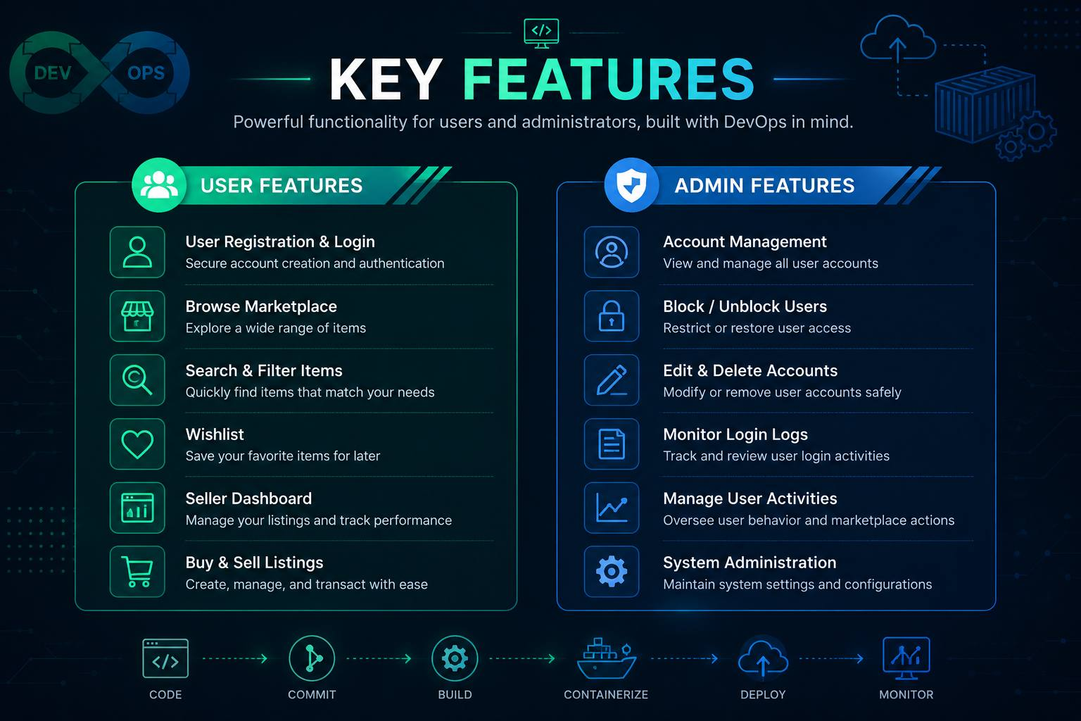
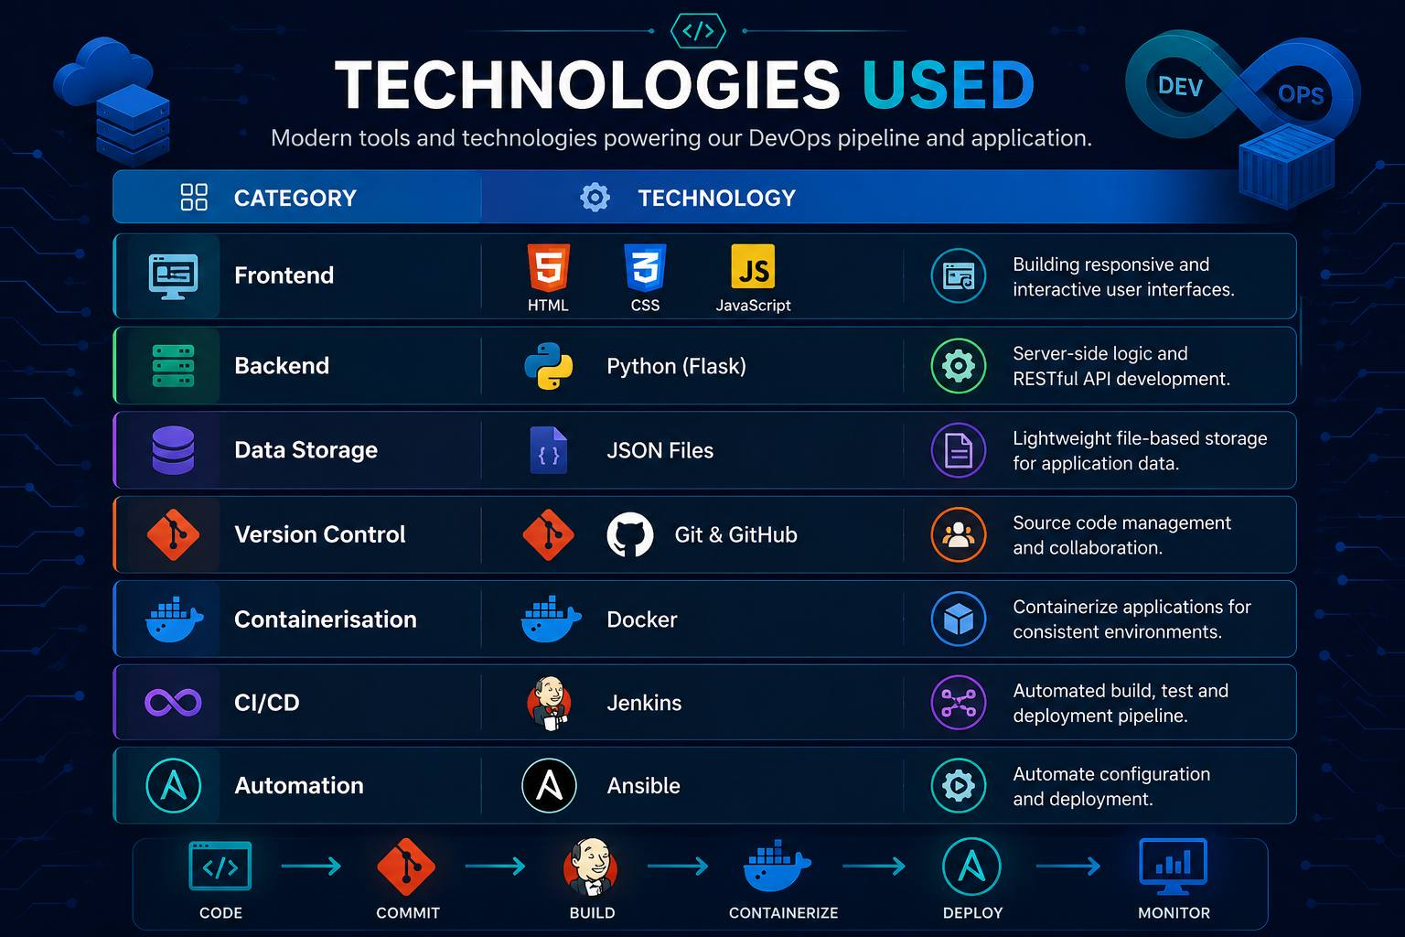
Project Overview
Tho
Objective: Develop a secure web application that enables Republic Polytechnic students to buy and sell second-hand items within the RP community while applying DevOps practices for automated deployment.

Slide 5
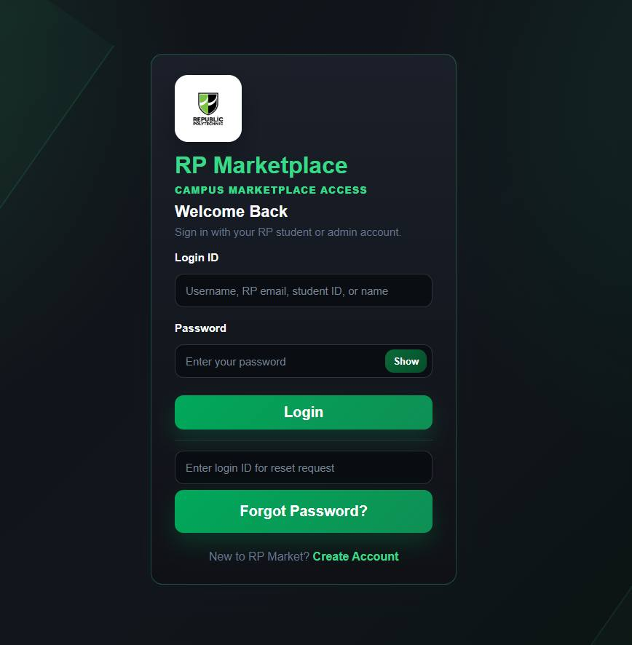
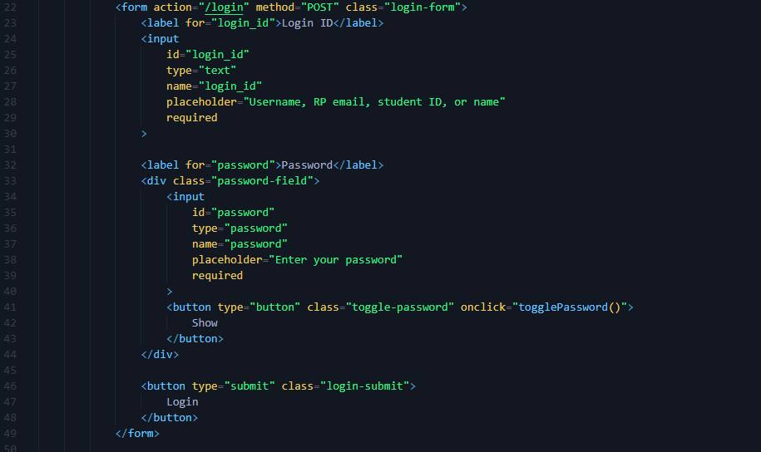
Jas
Jason Feature (Login)
Login form→ frontend/templates/user/login.html

Slide 6
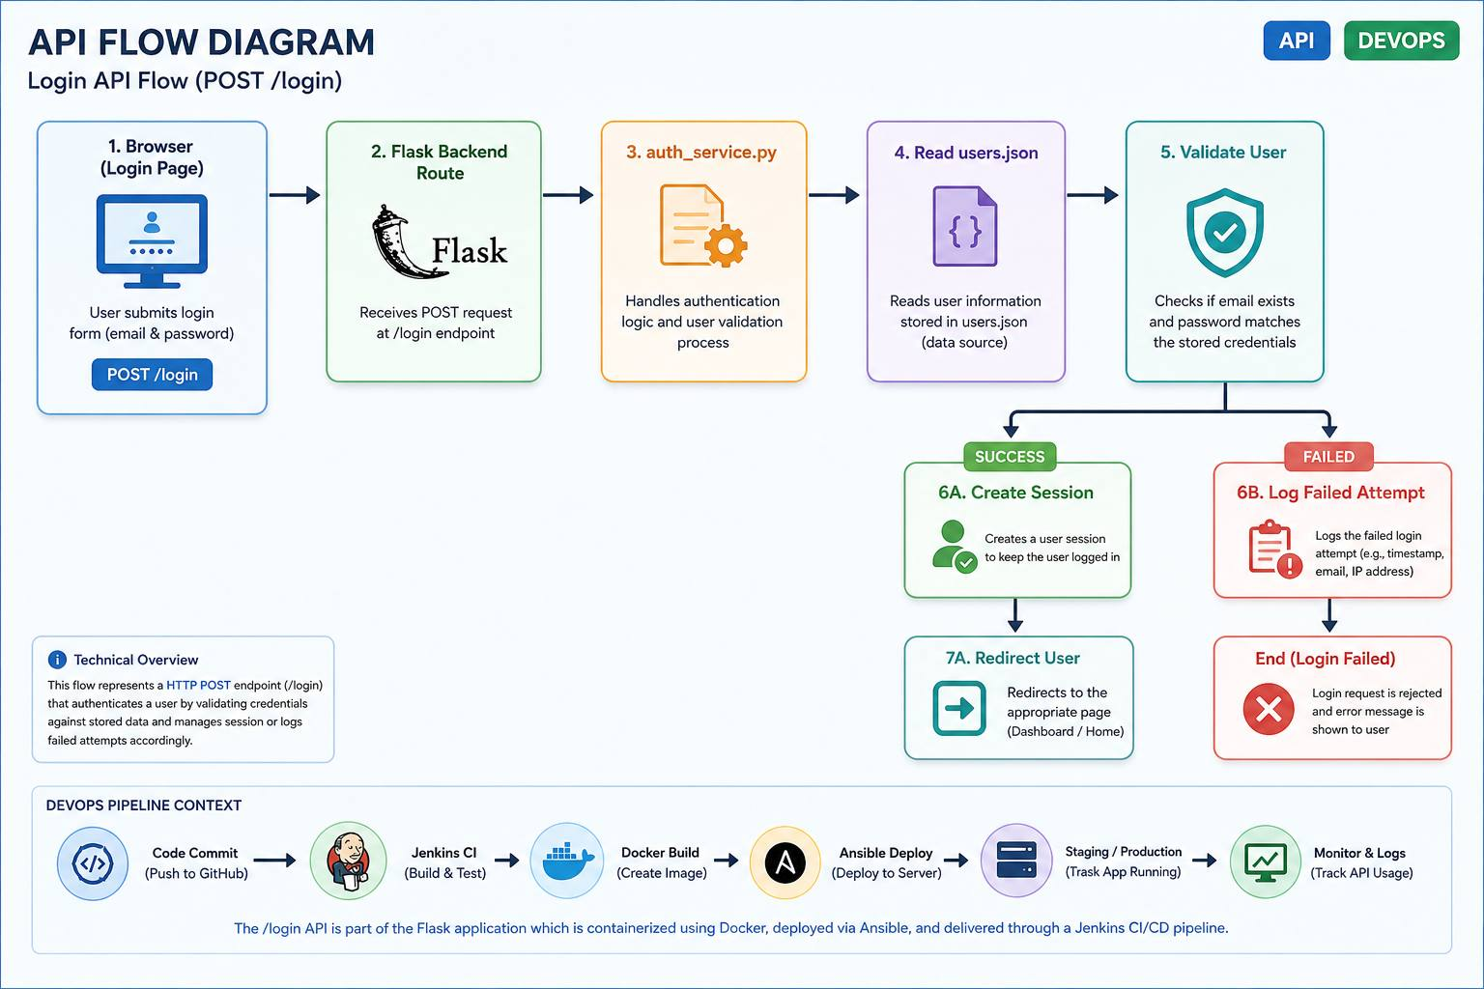
Jas

Slide 7
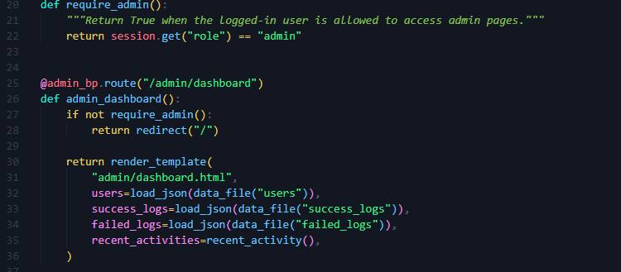
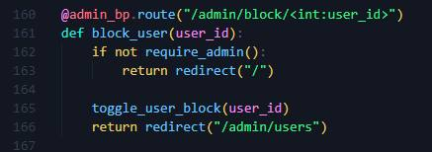
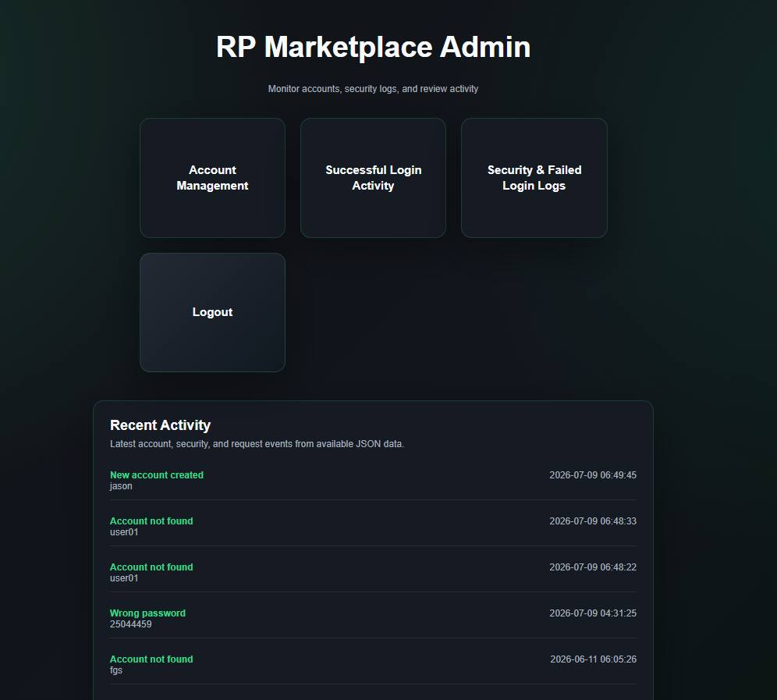
Jason Feature (Admin)
Jas

Slide 8
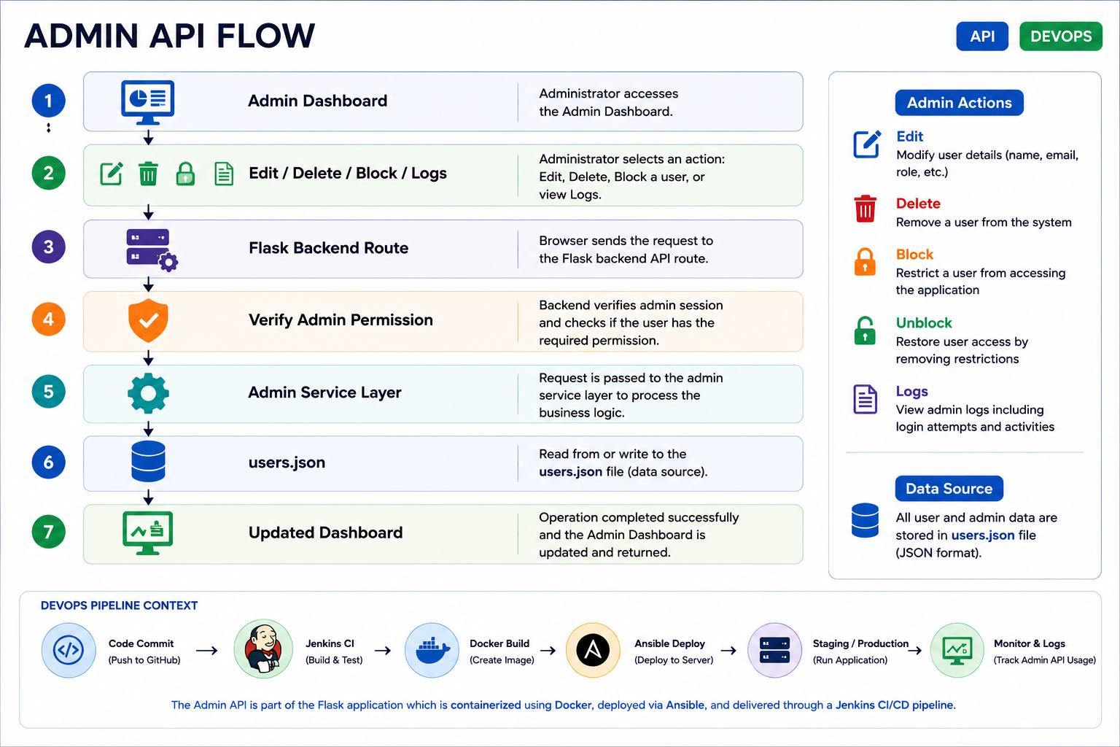
Jas

Slide 9
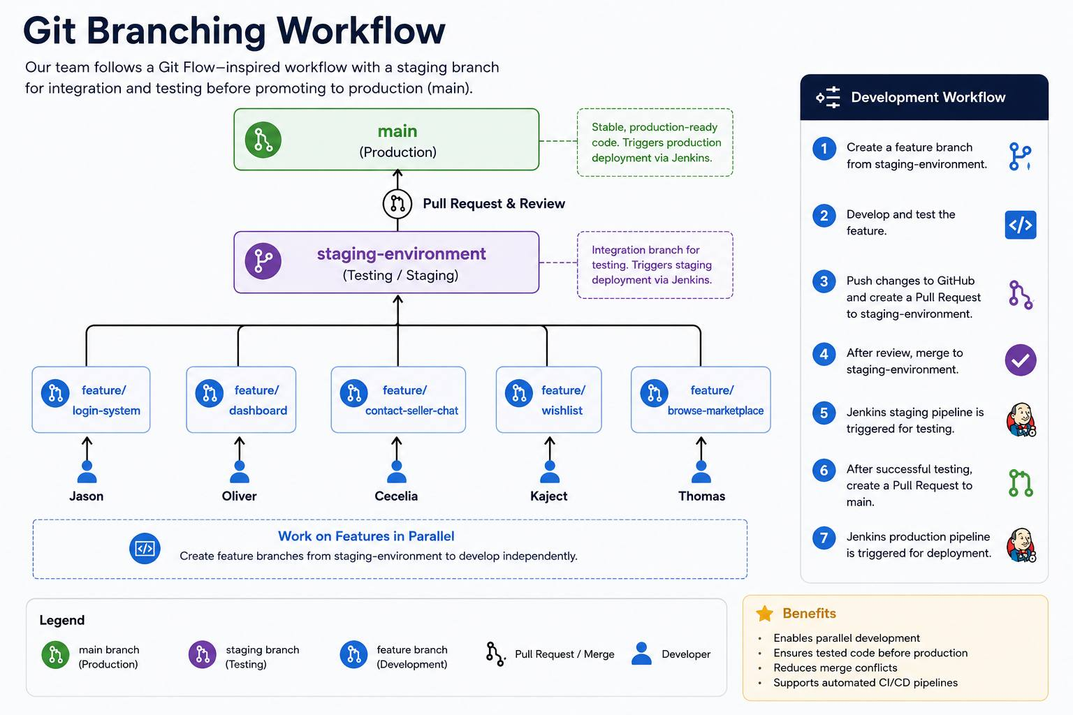
Git Branch Strategy & Team Collaboration
Jas
Objective: To enable multiple team members to work on different features simultaneously while maintaining a stable and deployable codebase.

Slide 10
Team Contribution for Features.
Jas
Name: | Feature
Jason | Login, Admin, Seller Request
Oliver | Seller Dashboard
Cecelia | Contact Seller Chat
Thomas | Browse Marketplace
Kajet | Wishlist

Slide 11
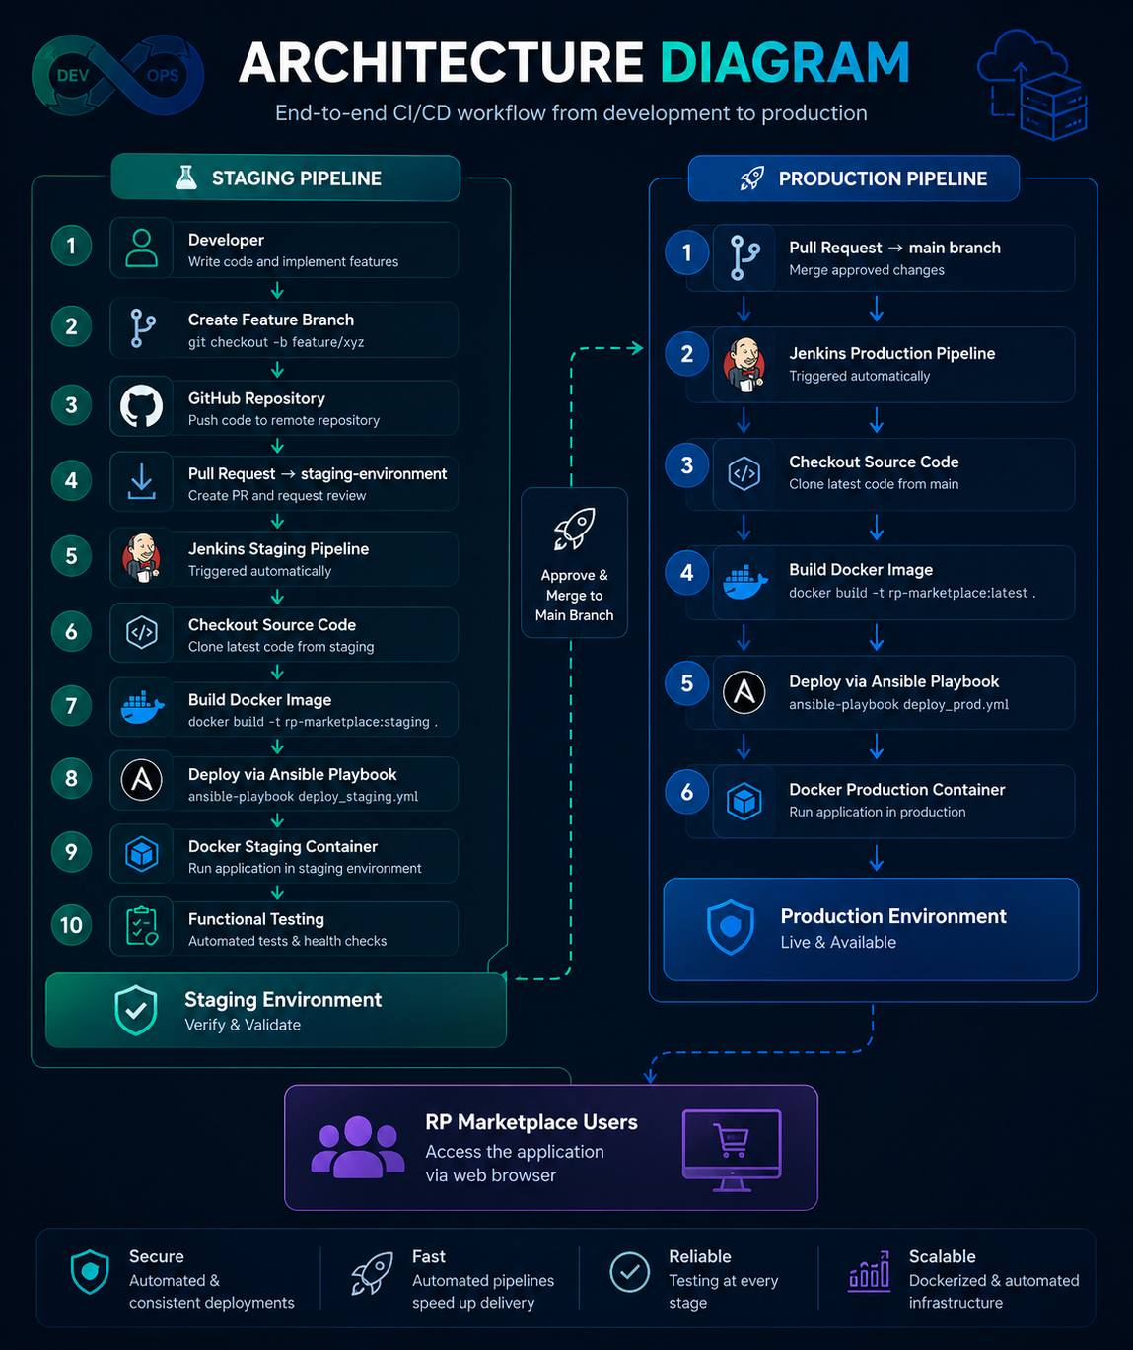
Jas

Slide 12
Docker Containerisation
Oli
Purpose: Docker packages the RP Marketplace application together with all its dependencies into a portable container, ensuring the application runs consistently across different environments.
Ports Columns: 0.0.0.0:5000 → 80/tcp
Means? → This container use Port Mapping. It binds port 5000 on the actual computer (host) to port 80 inside the Docker container

Slide 13
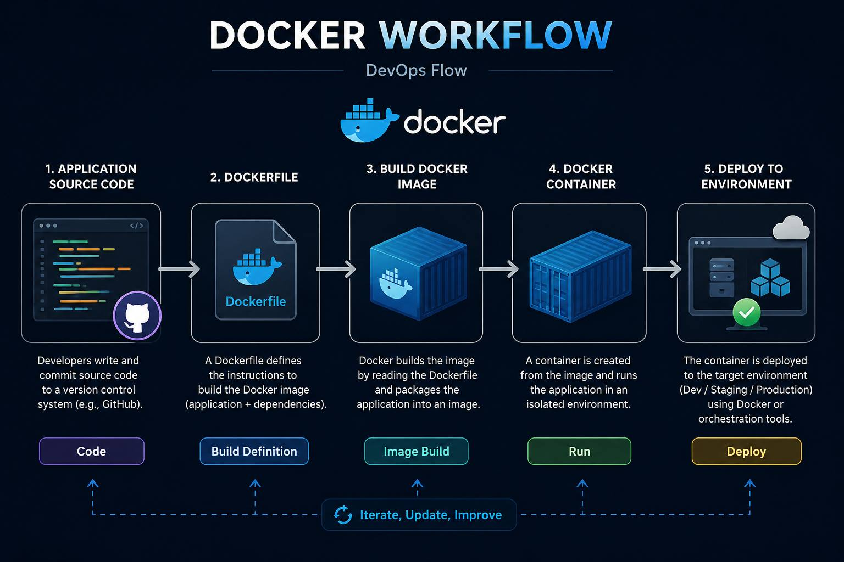
Oli

Slide 14
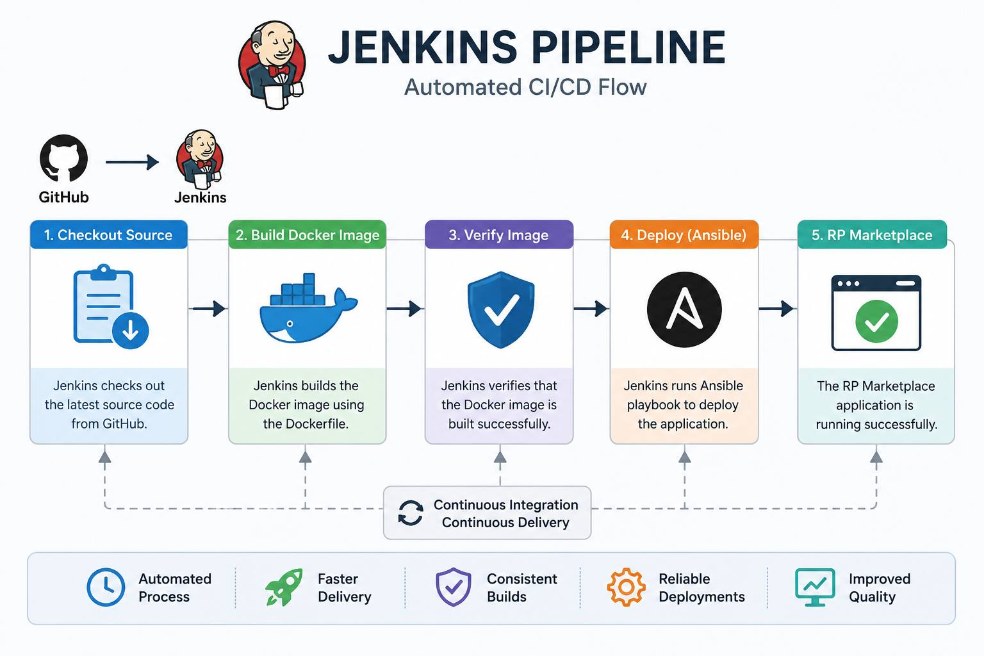
Jenkins CI/CD Pipeline
Jas
Purpose: Jenkins automates the build and deployment process whenever code is merged into the repository, eliminating manual deployment and ensuring a consistent workflow.

Slide 15
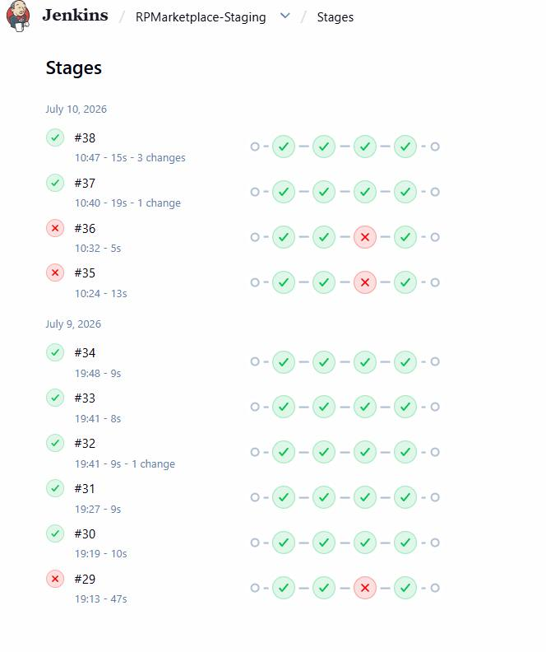
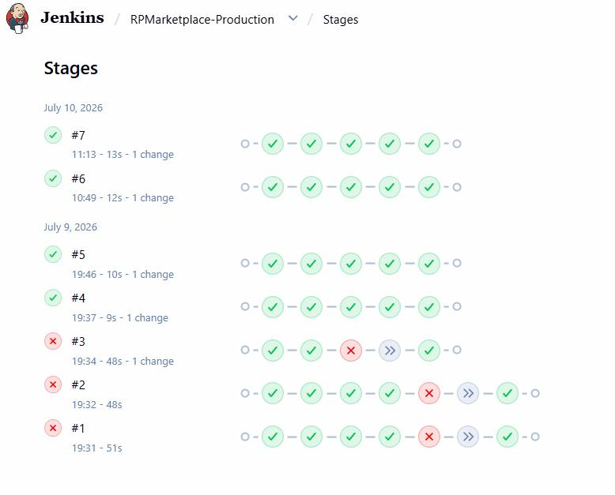
Jas
RPMarketplace-Production
Take a example of #7
Checkout SCM (Command used to clone or download the source code
Checkout Source Code
Deploy to Production (releasing to user)
Confirm Production URL (testing, verifying, approving)
Post Action (A block of step that execute automatically after a pipeline finishes)
RPMarketplace-Staging
Take a example of #38
Checkout SCM (Command used to clone or download the source code
Checkout Source Code
Deploy to Staging with Ansible
Post Action (A block of step that execute automatically after a pipeline finishes)

Slide 16
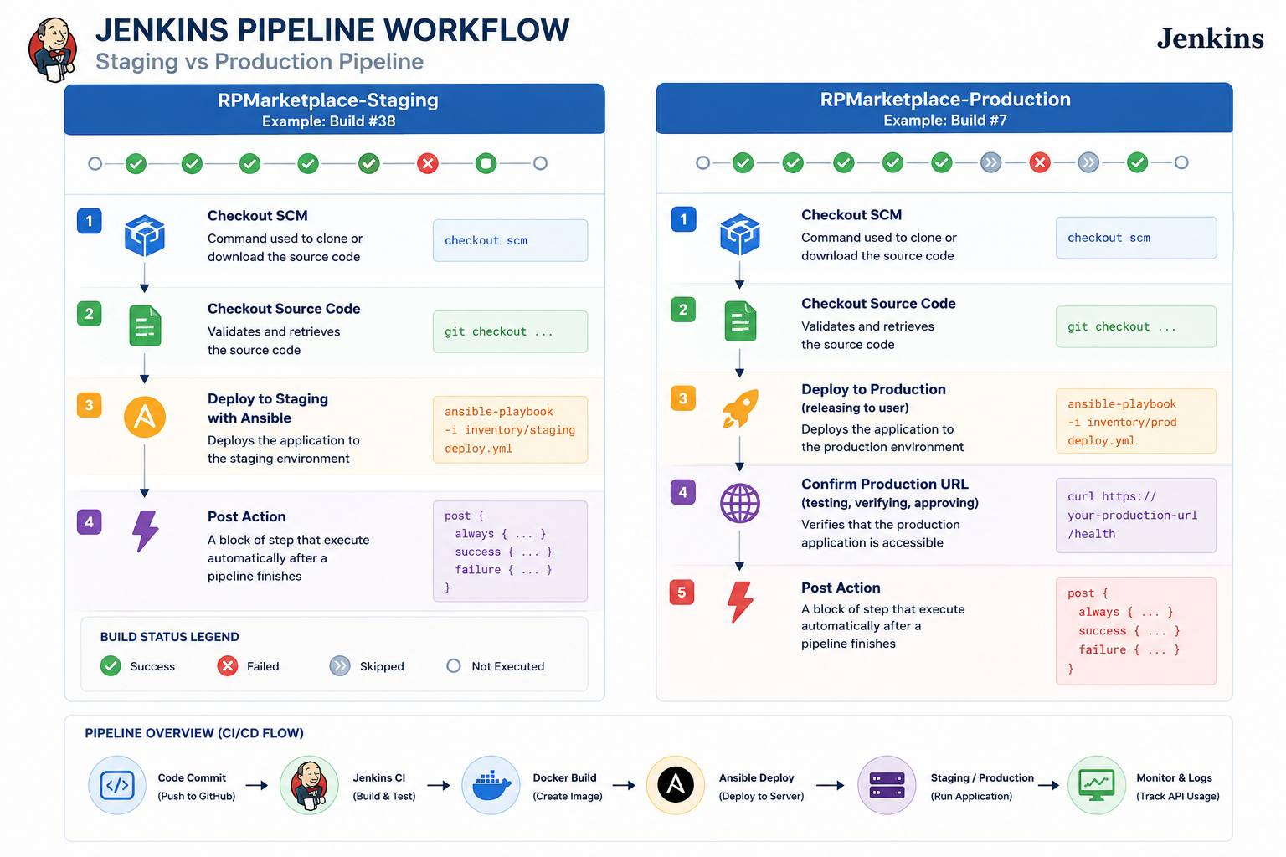
Jas

Slide 17
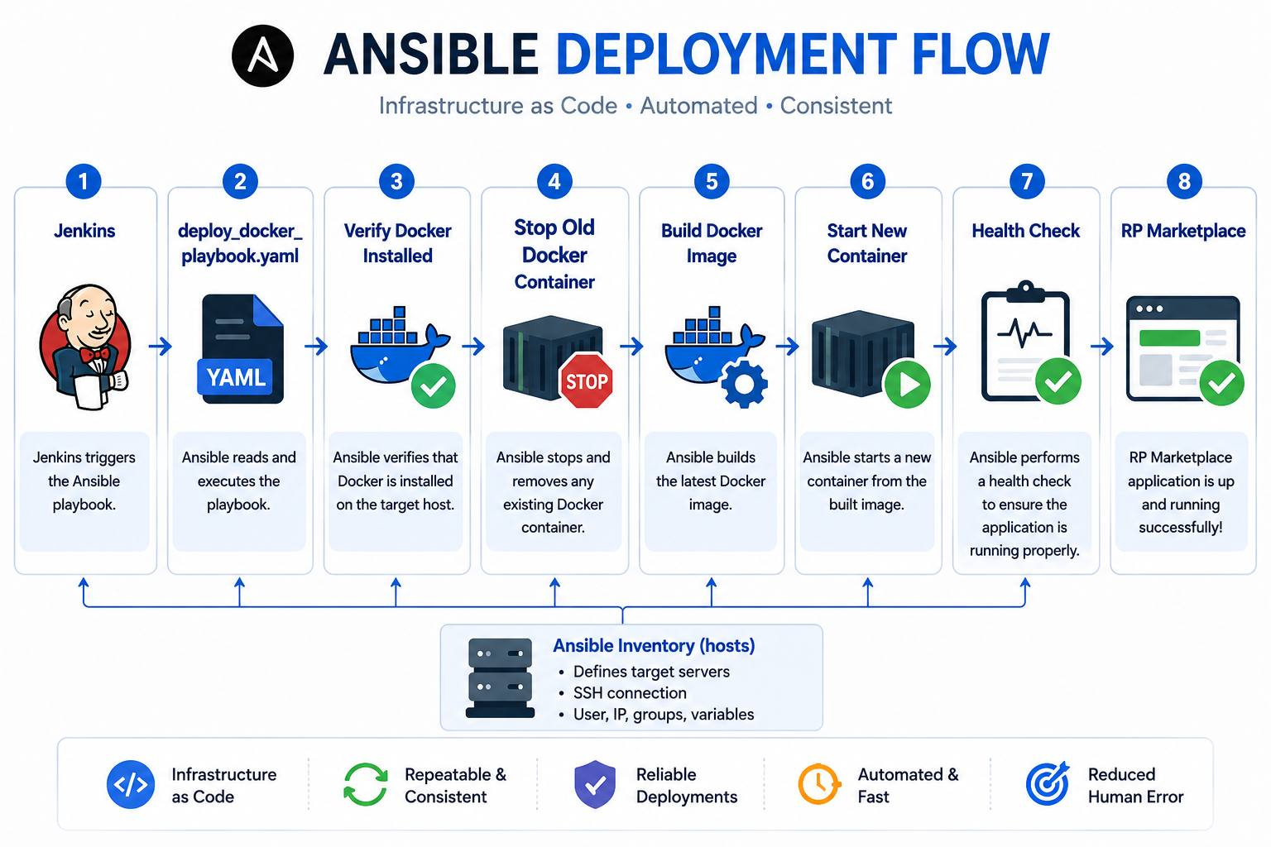
Jas

Slide 18
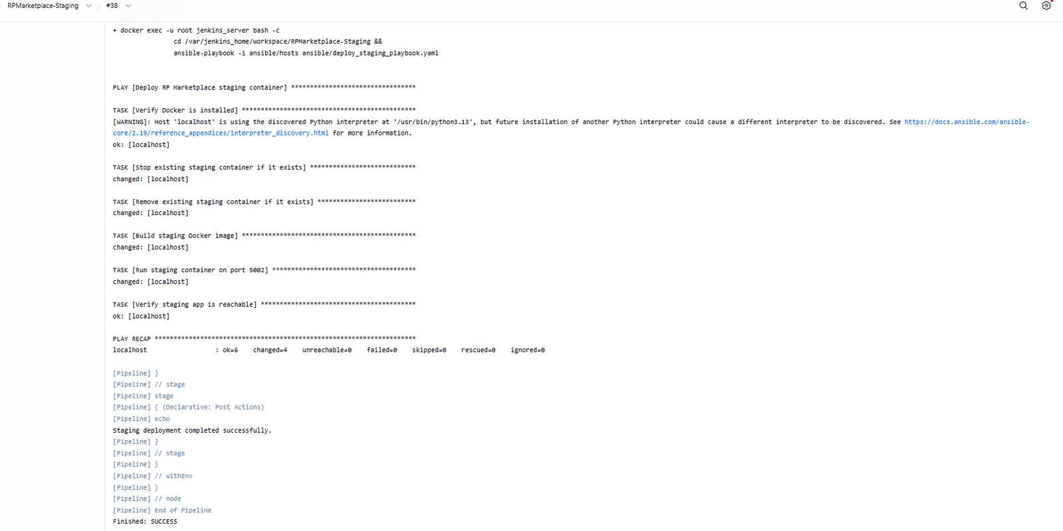

Slide 19
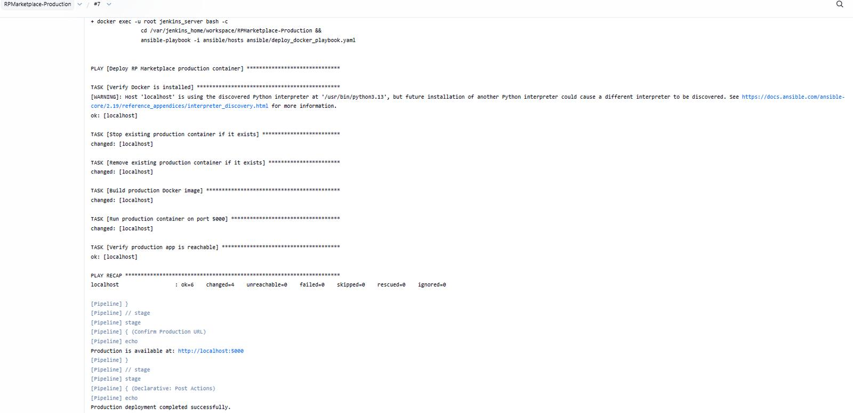

Slide 20
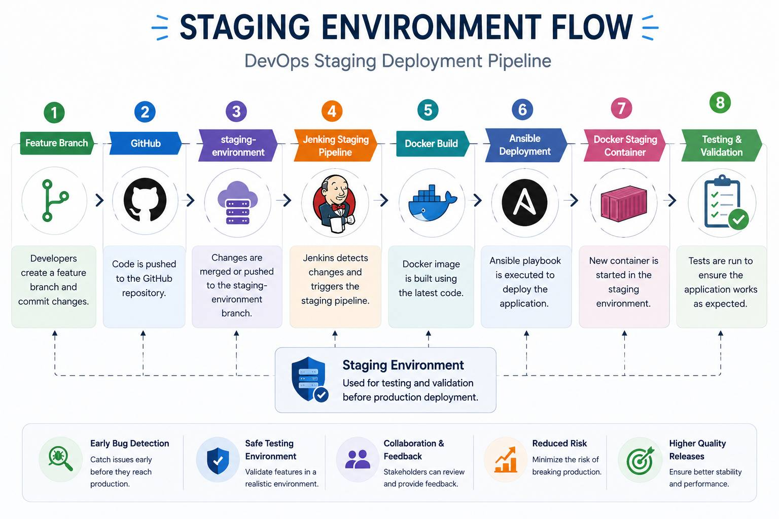
Hak

Slide 21
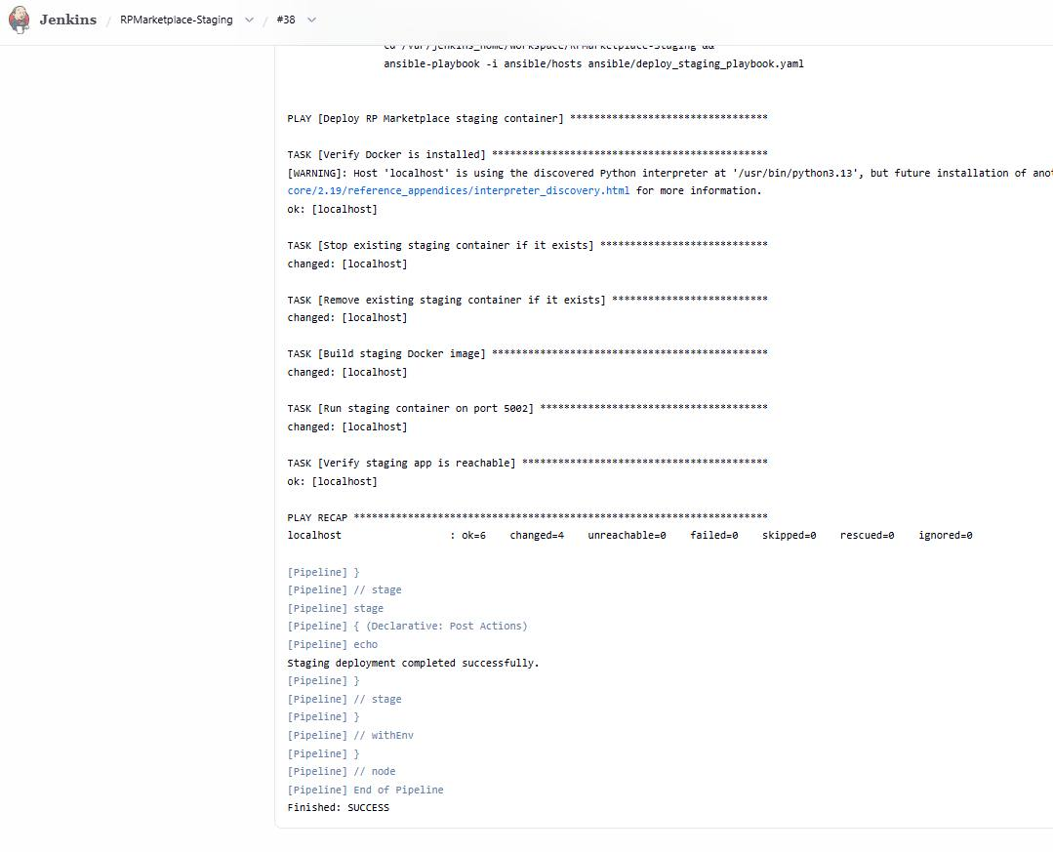
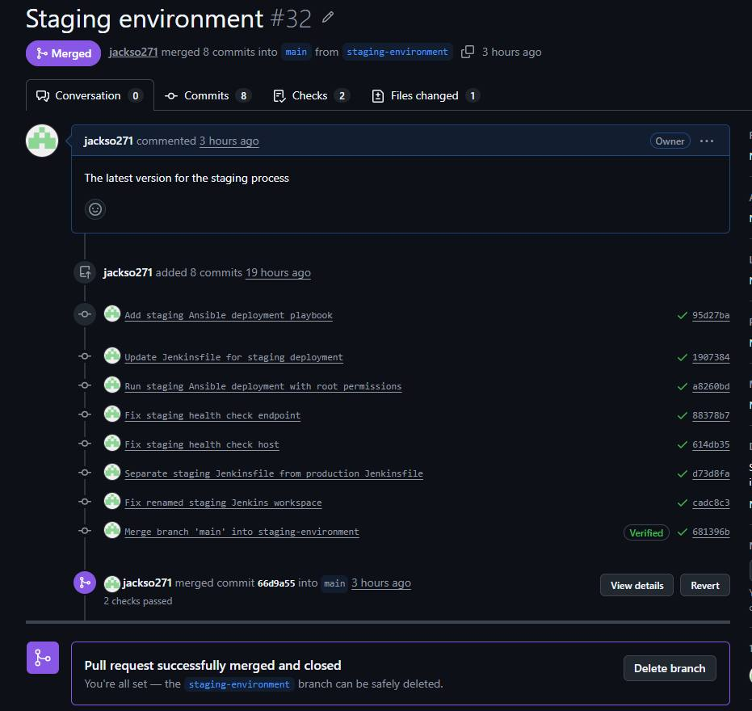
Evidence that it runs
Hak

Slide 22
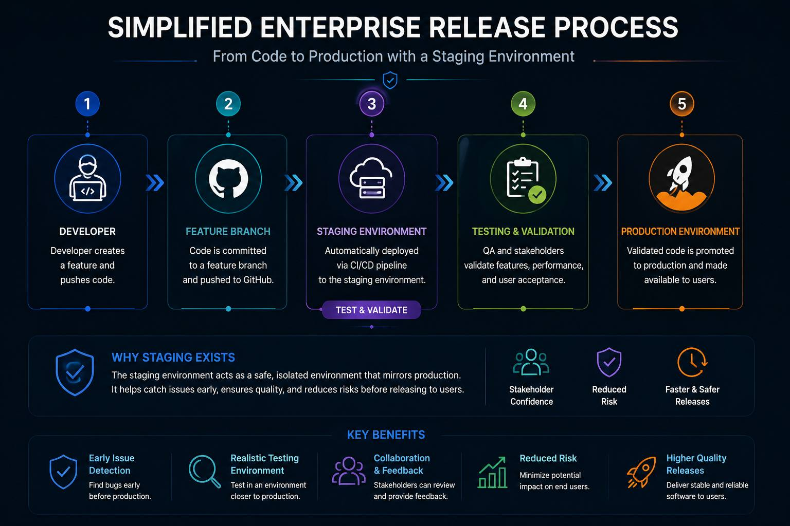
Kaj

Slide 23
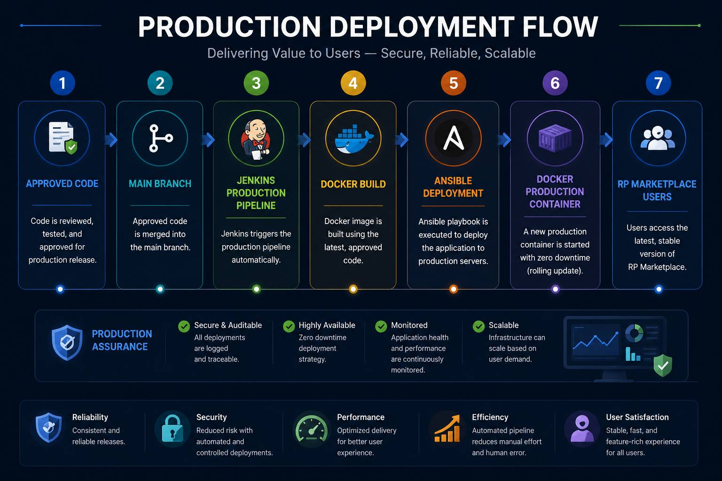
CC

Slide 24
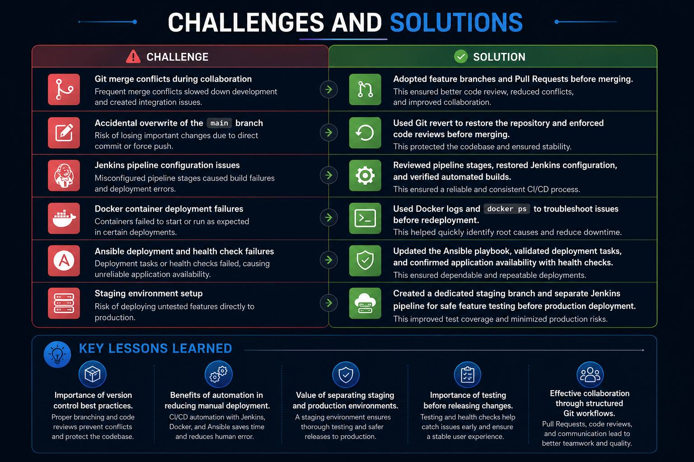
Jas

Slide 25
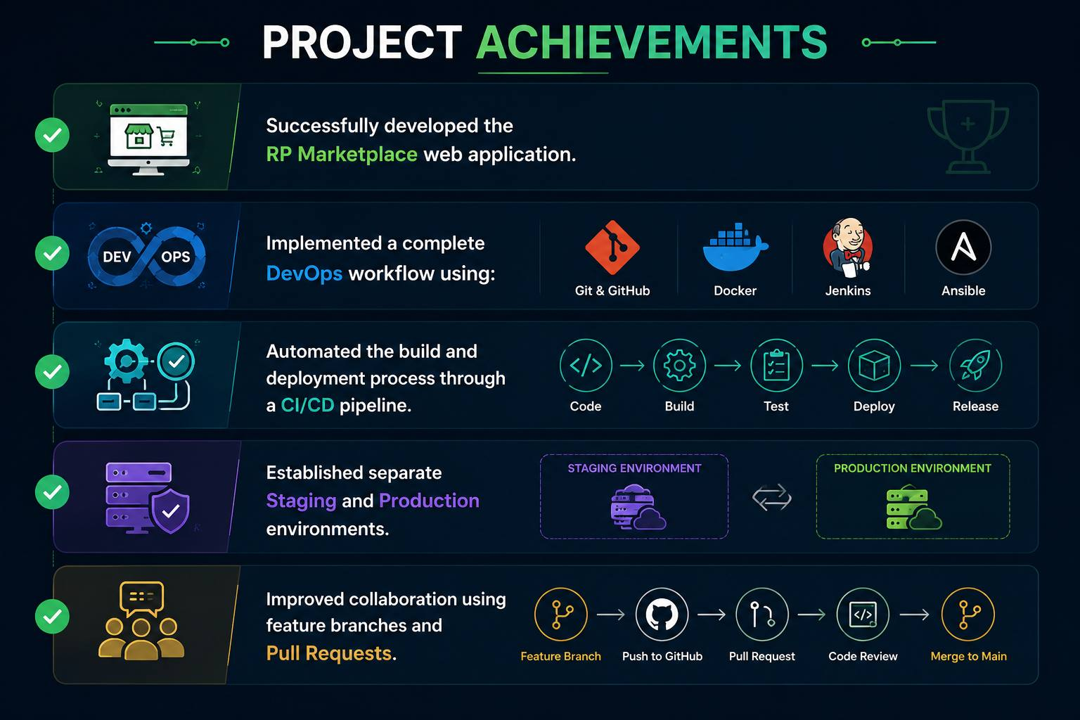
Conclusion & Lessons Learned
Tho

Slide 26
What have we learned from DevOps?
Kaj
Throughout this project, we gained valuable experience in both software development and DevOps practices.
Technical Skills:
Git version control and branch management
Docker containerisation
Jenkins CI/CD automation
Ansible deployment automation
Troubleshooting deployment issues
Soft Skills:
Team collaboration
Communication
Problem-solving & Planning and task coordination

Slide 27
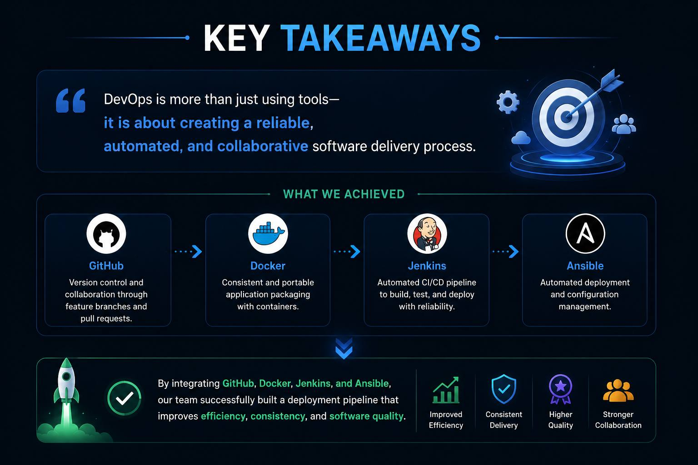
Oli

Slide 28
