Slide 1
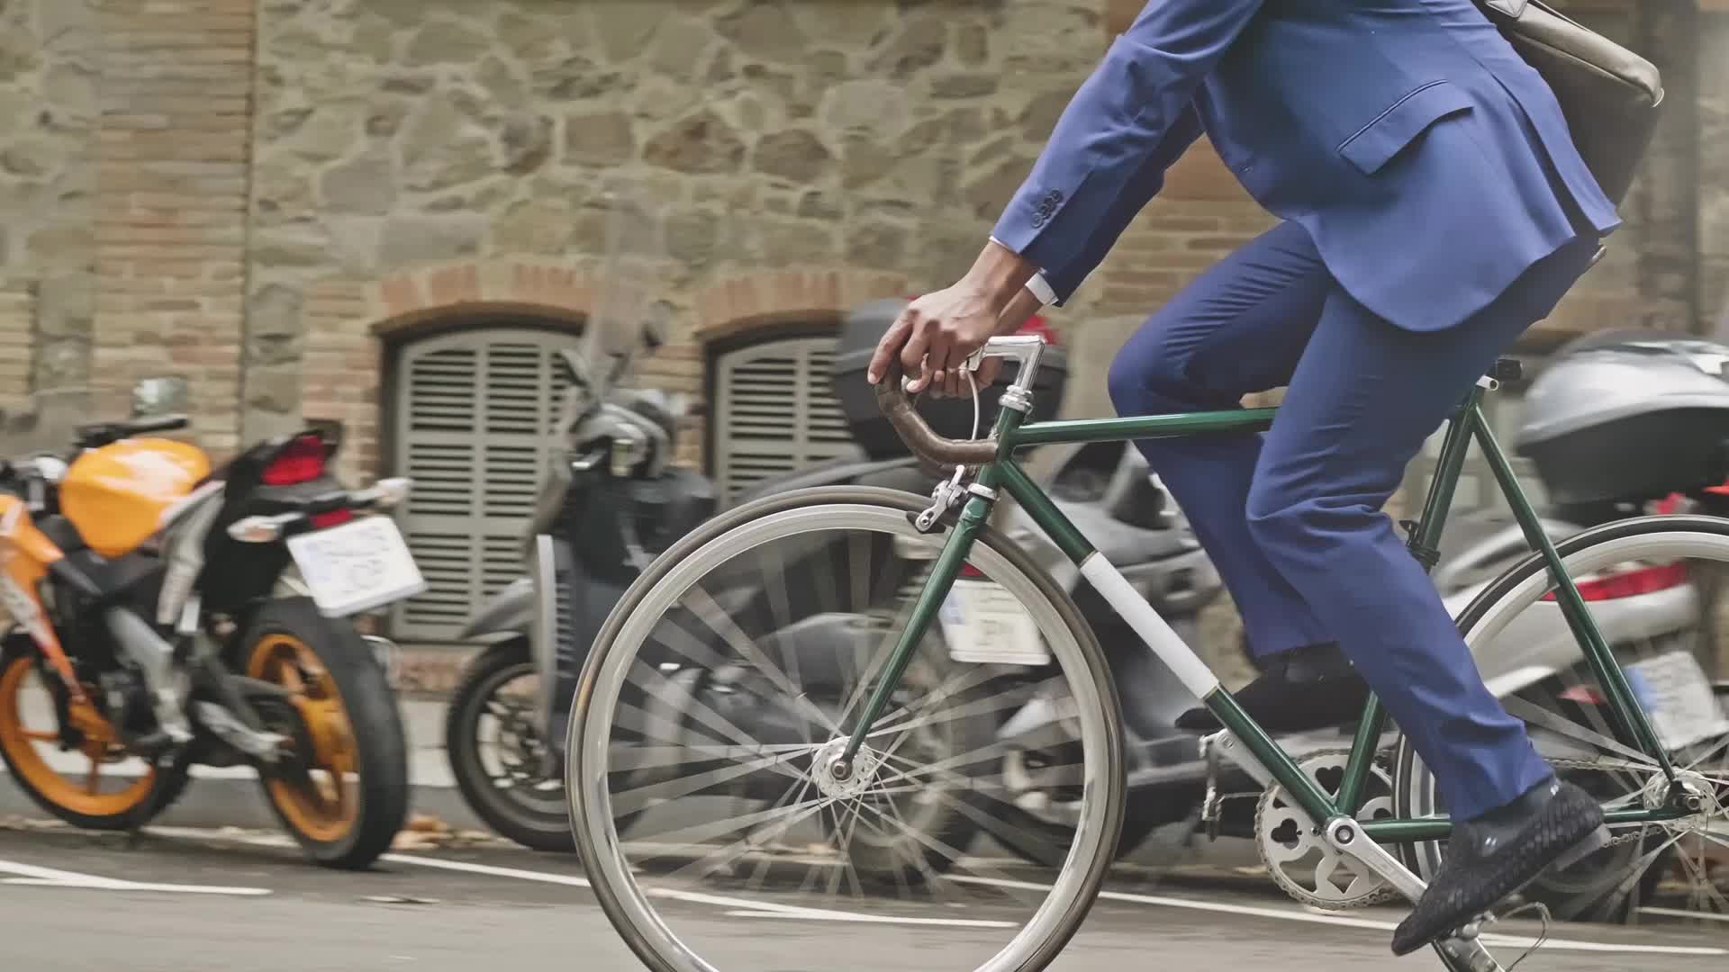
HOW DO ANNUAL MEMBERS AND CASUAL RIDERS USE CYCLISTIC BIKES?
February 2022
Derek Jackson

Slide 2
Goals for today
Share an overview of rideshare data by member type
Examine trends number of and length of ride times
Discuss findings

Slide 3
Data Sources
Divvy trip data for the last 12 months (Feb 2021 – Jan 2022) was obtained from https://divvy-tripdata.s3.amazonaws.com/index.html

Slide 4
Data Manipulation
Cleaned and analyzed data using R
Added date columns to better break down the data
Took out location data columns to focus more on how each rider uses Cyclistic bikes

Slide 5
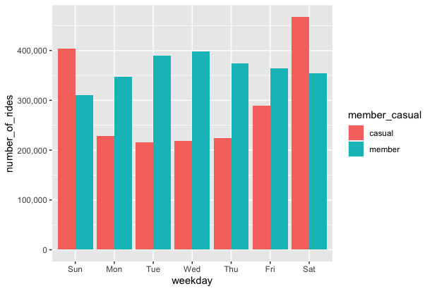
Number of rides
Members take more more rides than casual riders as a whole
Members also ride more on weekdays while casual riders take more rides on weekends

Slide 6
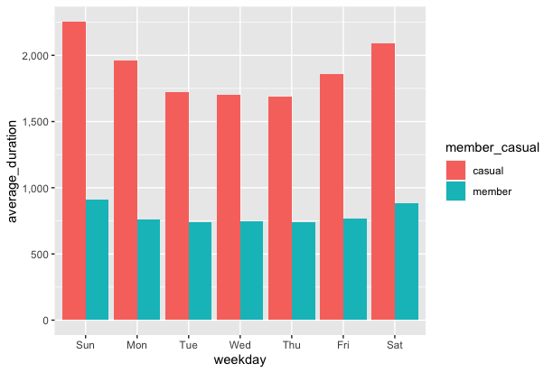
Average duration (in secs) of rides
Casual riders ride for longer amounts of time on everyday of the week and the weekends breed longer ride times for each membership group

Slide 7
Solutions
Heavy marketing toward casual riders, especially on weekends, to convert them into annual members
Converting more casual riders to annual members will also drive more steady revenue
There are far more opportunities to convert riders to annual members in the months leading up to summer, especially June or July months, because there is much more activity and longer rides during those months
The marketing should focus more on casual rider conversion

