Slide 1

CareerU^{I}p
Resume Builder & Learning Companion
Batch 4
Guide : D.Sreedhar
K.Devi Sankruthya 207Z1A0571 K.Jackson 207Z1A0573 N.Goutham 207Z1A05B4

Slide 2





The proposed application is a career development tool that assists individuals in various aspects of their professional growth.
Features include resume building, college searching, coding contest information, learning roadmaps, and skill performance analysis.
The resume builder feature offers pre-designed templates for quick and easy resume creation.
The college search feature allows users to search for colleges based on preferences such as rank and location.
The coding contest information feature provides details on upcoming and happening coding contests around the world.
The learning roadmap feature provides a list of learning resources for different programming languages and tools, and allows users to track their progress.
The skill performance analysis feature assesses users' skills and provides personalized feedback on areas for improvement.
Abstract

Slide 3



Many people may not be familiar with the best practices for creating an effective resume, such as the appropriate format, style, and content to include and it is time- consuming
Problem Statement
Need for a single platform that offers a range of tools to help users build their career
It can be challenging for students to stay updated on coding contests and other opportunities to develop their skills

Slide 4



There are websites that creates Resume online. Websites like zety.com, resume.io etc
Existing System
Many coding contests are held daily in multiple platforms but there is no such platform which provides the coding contests information
There are websites like collegefinderindia.com, careerindia.com helps the user in finding colleges. Websites like roadmap.sh and techgig.com provides roadmaps and provides tests to check the user's skill performance
But there is no platform that provides all these features at one place

Slide 5


The System provides resume-builder, coding-contest
information, skill performance analyser ,roadmaps for learning
Proposed System
new skills , finding colleges based on student rank and preferences all at one place.
The student can fulfill all their needs at one place they can take guidance from roadmaps to learn any new skill and also can take test and know how good they are in the choosen field.
The student can also check which contests are happening around the platforms.

Slide 6
Software Requirementes
Internet explorer version >= 6
Google chrome version >= 4
Mozilla FireFox version >=2

Slide 7

Hardware Requirementes
Processor : Recommended i3 Gen 5 or above
Memory : Minimum 4GB
Internet
Graphic card

Slide 8
Personalized guidance
Advantages
Time-saving
Easy access to learning resources
Career-focused
Competitive edge

Slide 9




User Management Module
Resume Builder Module
Modules
College Search Module
Coding Contest Information Module Learning Roadmap Module
Skill Performance Analysis Module Admin Module

Slide 10
Registration
Login
Coding Contest information
Skill Performance
Resume Builder
Road Maps
Test
College Search
Result
Manual
Track Progress
Result
Result
Automated
Exit or Download

Slide 11

User Management Module
Responsible for user registration, login, and authentication
Manages user profiles and preferences.
Handles account settings and password management
Resume Builder Module
Provides functionality for creating and editing resumes.
Offers pre-designed resume templates for easy customization.
Includes features such as inputting information,automatically adding the completed course as skill and previewing the resume.

Slide 12

College Search Module
Allows users to search for colleges based on criteria such as rank, location, and program offerings.
Provides detailed information about colleges, including admission requirements, campus facilities, and contact details.
Coding Contest Information Module
Integrates with external APIs or databases to fetch information about coding contests. Displays upcoming contests, deadlines, rules, and registration details.

Slide 13
Learning Roadmap Module
Presents a structured learning path.
Allows users to track their progress and mark completed resources.
Suggests personalized learning paths based on user preferences and skill levels.
Skill Performance Analysis Module
Evaluates users' skills in various programming languages and tools. Provides personalized feedback and recommendations for improvement.
Tracks skill development over time and allows users to set goals and monitor progress.

Slide 14
Admin Module
Enables administrators to manage user accounts, access control, and system settings.
Allows administrators to view and analyze user data.

Slide 15
System Design

Slide 16
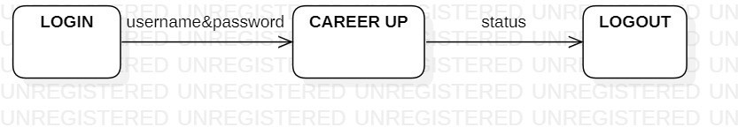
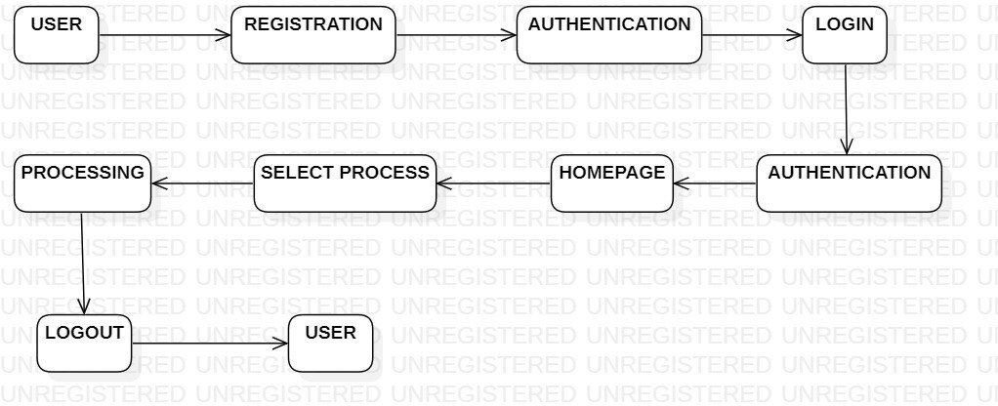
Data Flow Diagram
Level 0
Level 1

Slide 17
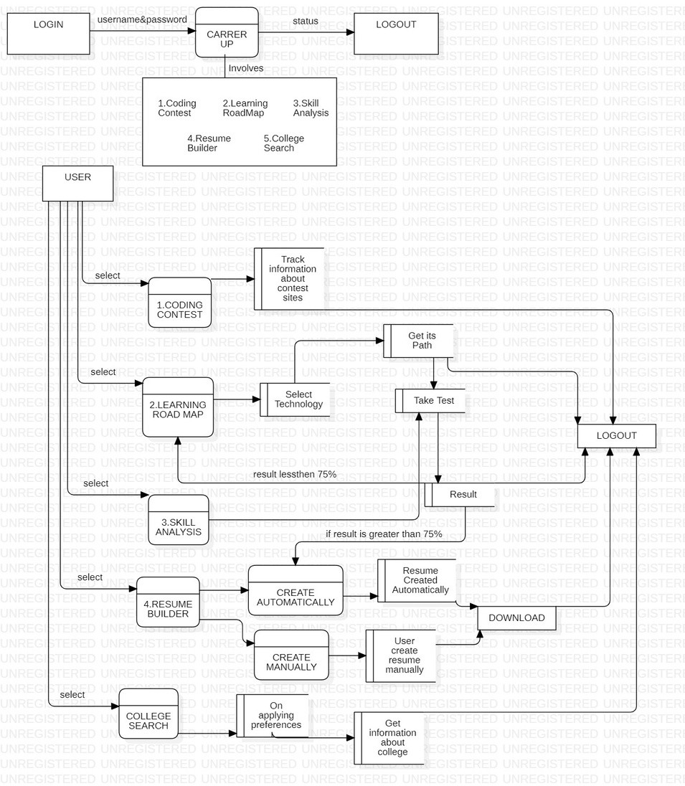
Data Flow Diagram
Level 2

Slide 18
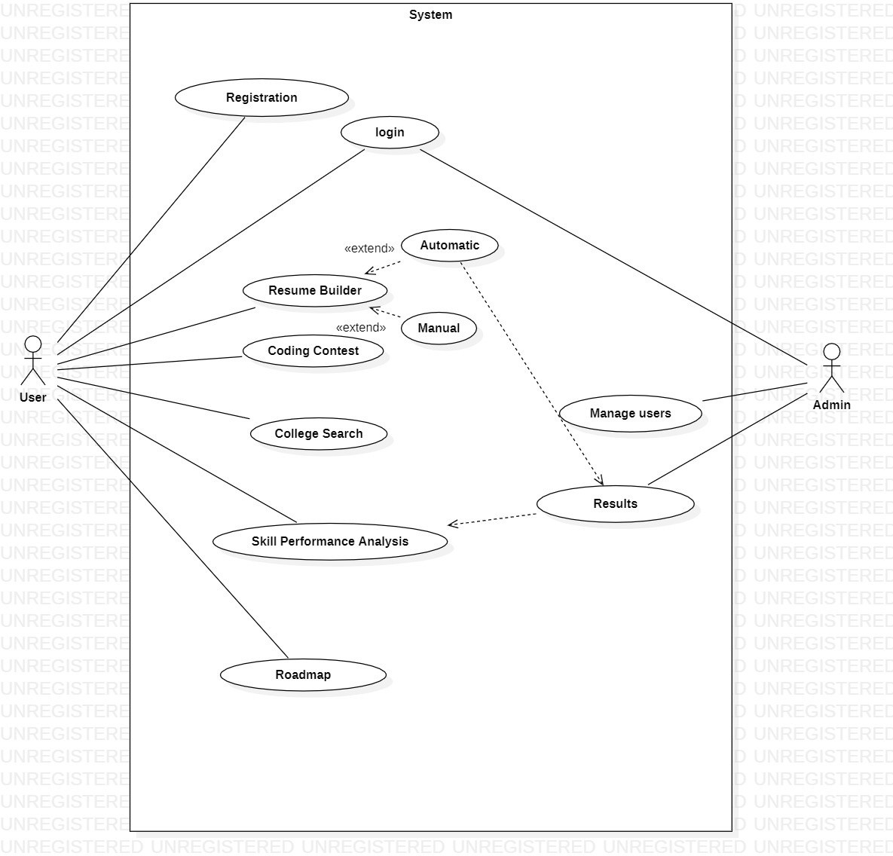
Usecase Diagram

Slide 19
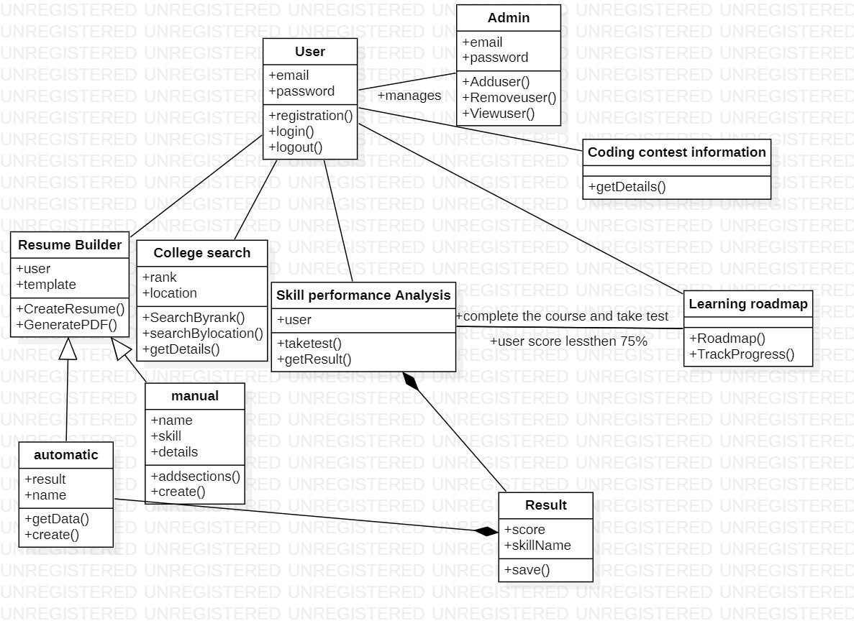
Class Diagram

Slide 20
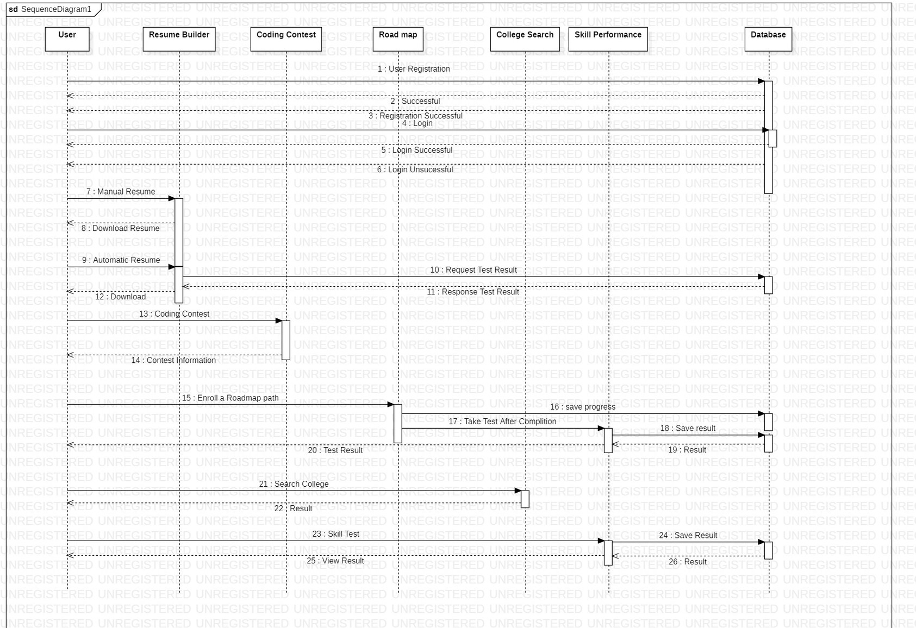
Sequence Diagram
: Registration Successful
: Registration Unsuccessful
26
25

Slide 21
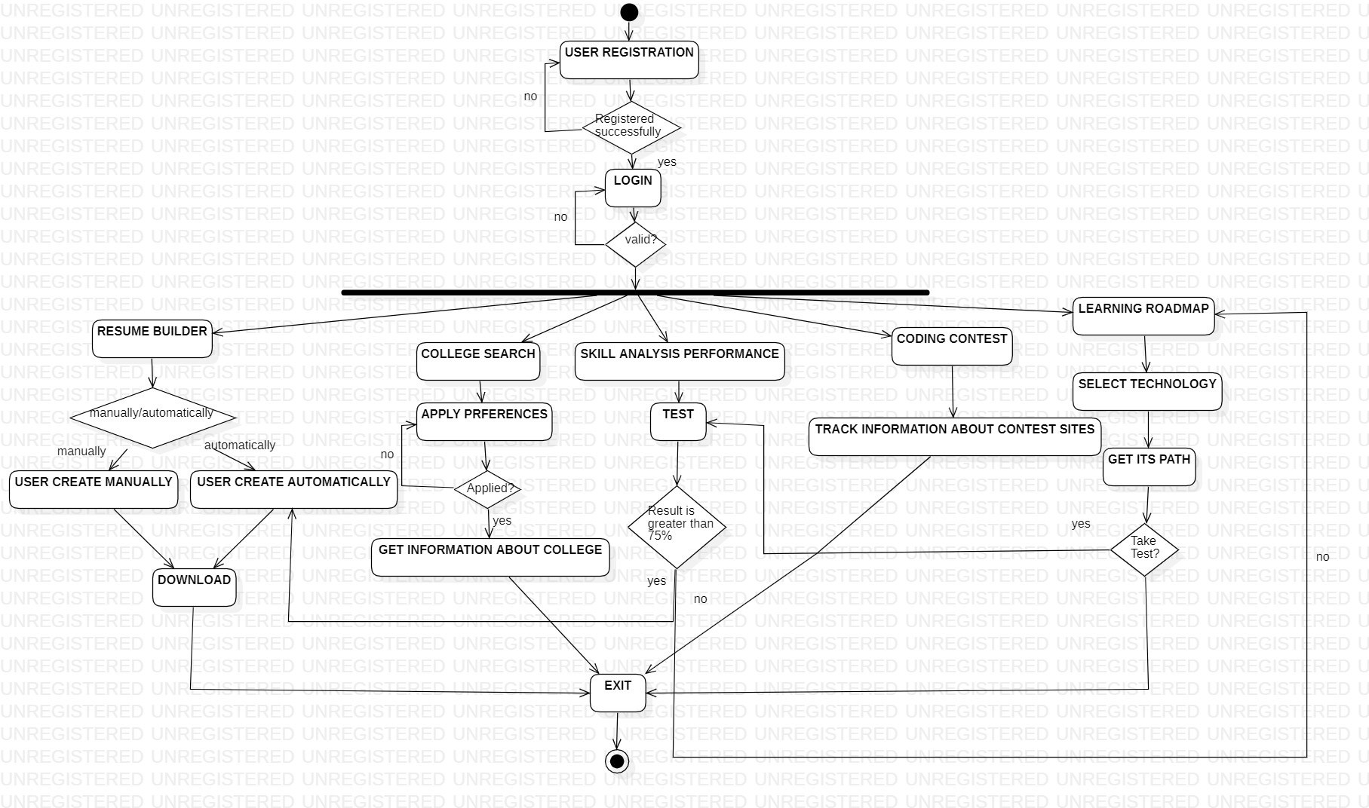
Activity Diagram

Slide 22
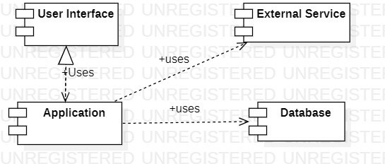
Component Diagram

Slide 23
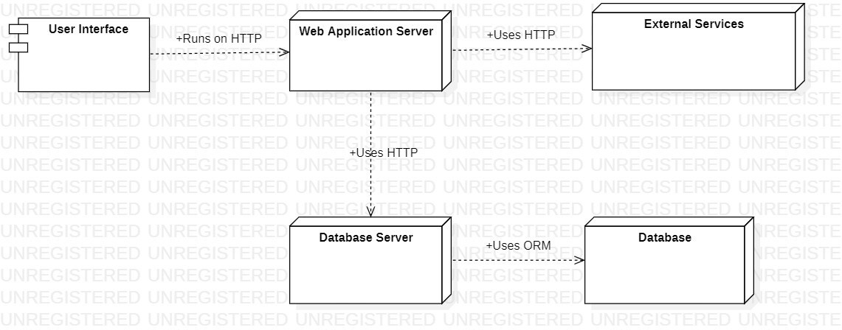
Deployment Diagram

Slide 24
In conclusion, the proposed web application is a valuable tool for individuals seeking to develop their careers and educational goals. Its features, including resume building,
college searching, coding contest information, learning
Conclusion
roadmaps, personalized resources.
and skill performance analysis, guidance and easy access to
provide learning
Despite potential disadvantages, the web offers a comprehensive solution for
application career and
educational planning.

Slide 25

Thank You

