Slide 1


Group
Weekly Meeting
Chuck Huang
2023/12/14
Confidential, for Group internal use only

Slide 2
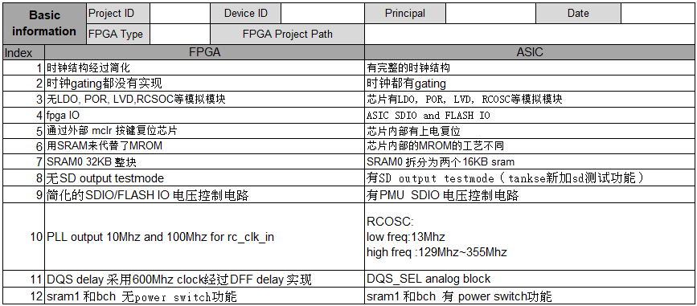
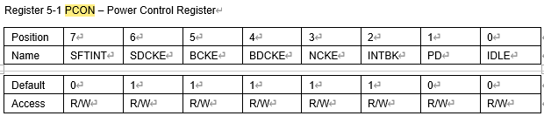
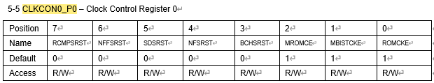
ASIC vs. FPGA
No SRAM1 control bit on spec. (HW designer will fix it)
BCH need software reset (CLKCON0_P0[3]) after PWR gating switch

Slide 3
Overall Operation Loop
System initial
SD initial
FE
READY_FOR_DATA = 1
default
Read task
Gen CMD Write task
Idle task
Security erase/erase task
Pro CSD task
FTL
bCallWriteLBA
n
write_data_from_hs_buf_to_flash
BE
clr_sd_read_data_flag

Slide 4
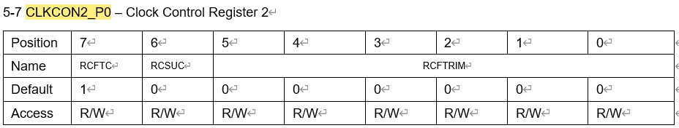
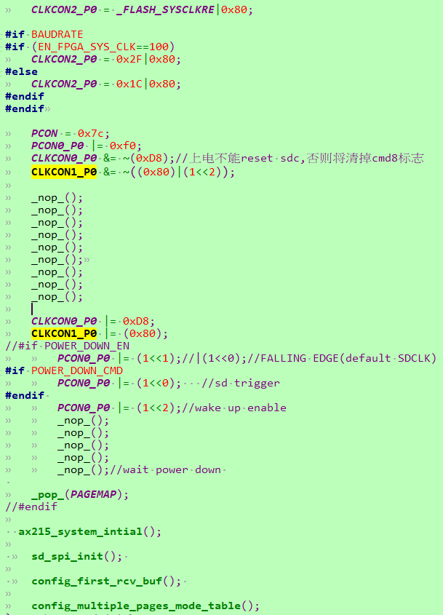
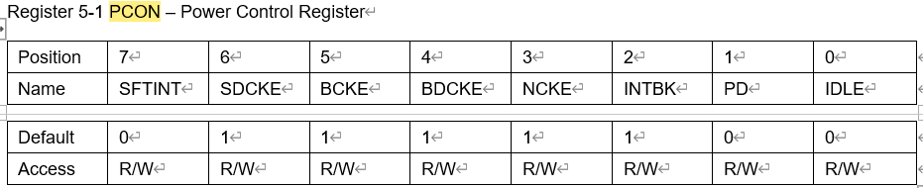
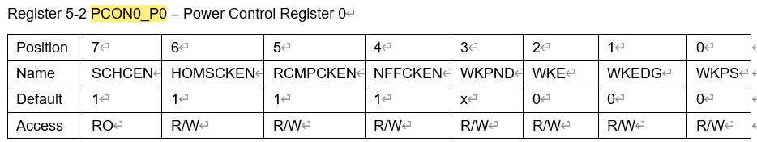
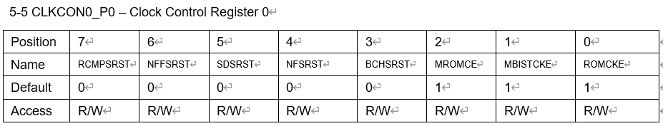
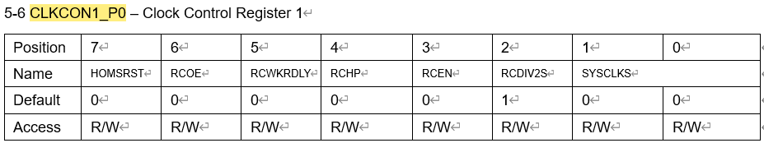
System Initial
(No SRAM1 control as mentioned before)
0 = Group 0 (SDCLK)
1 = Group 1 (SDCMD)
100MHz = 10ns (i.e., near 90ns)
UART, timer initial

Slide 5
Is Ready to Sleep?
512
sd_ready_for_nf_buf_cnt == 0
SD_HS_CACHE_BUF_CNT
(0x5000 @ SRAM0)
virtual_sd_data_buf_cnt == 0
rcv_data_state == HS_RCV_DATA_IN_IDLE
1024
page
write_hs_data_to_flash_state == W_HS_DATA_TO_FLASH_IDLE
BUFFER_START_ADDR
(0x6080 @ SRAM0)
Virtual Buffer
SD_VIRTUAL_BUF_CNT
(SLC block)
write_virtual_sd_buf_data_to_nf_state == W_VIRTUAL_SD_BUF_DATA_TO_NF_IDLE
16
44
!bMulWriteTask && !bSingleWriteTask
wait_for_enter_sleep_mode

Slide 6
Buffer Collection (Cont’d)
Buffer Name | Serve | Size | Count | Address | Location | Key Word | Note
Virtual | SD | SLC page | 44 (maximum) | SLC block | NAND | SD_VIRTUAL_BUF_CNT | Need 44 pages?
Cache | FTL | 512B | 3~9 (??) | 0x5000 | SRAM0 | SD_VIRTUAL_BUF_CNT | Performance bottleneck?
Nand Flash | BE | 1024B | 16 | 0x6800 | SRAM0 | BUFFER_START_ADDR

Slide 7
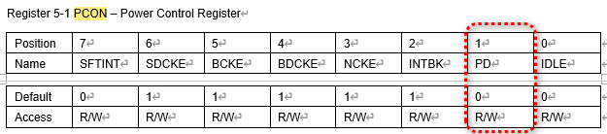
Power Down Process
!WKPND && Idle
Y
Disable timer ISR
Do not slow down clock frequency
!WKPND && Idle &&
CMD_IDX != ERR_40
Y
Low power enable
Disable RC
Clear wake up pending
PD = 1
Wake up end process
Clear wake up pending
Enable timer ISR

Slide 8


Group
Thank you
Confidential, for Group internal use only

