Slide 1
PMA 274 Support Services Contract
Industry Day
Southern Maryland Higher Education Center
27 Aug 10

Slide 2
Agenda
0800 Introductions
0805-0820 Opening Remarks Mr. Dave Wooten/ Jessica Flynn
0820-1020 PMA-274 Support James Sperbeck
Services Requirements
1020-1040 Break
1040-1120 Office of Small Business Ken Carkhuff
Programs
1120-1200 Questions and Answers Jessica Flynn/ James Sperbeck

Slide 3
Disclaimer Statement
The remarks today by Government officials involved in the PMA-274 Presidential Helicopters Program Office support services procurement should not be considered a guarantee of the Government’s course of action in proceeding with the acquisition. The information shared today reflects current Government intentions and is subject to change based on a variety of circumstances, including internal and external comments. The formal solicitation, when issued, is the only document that should be relied upon in determining the Government’s requirements.

Slide 4
Welcome and Ground Rules
Primary Purpose – Provide information regarding PMA-274 Presidential Helicopters Program Office requirement.
All attendees must sign-in.
Please silence cell phones and pagers.
No recording.
This is an Informational Briefing only.
Performance requirements as contained in the Performance-Based Statement of Work (PBSOW) are presented as a summary, the details are in the SOW and the solicitation Request for Proposal.
Presentation and a list of attendees will be posted on the SeaPort-e Bid Event website.

Slide 5
Proposed Procurement Strategy
SEAPORT-E MAC TASK ORDER
FIVE YEAR PERIOD OF PERFORMANCE
  Base year plus 4 option years
CPFF and FFP LABOR CLINS (w/Cost CLINS for ODC’s)
ESTIMATED SCHEDULE
  RELEASE SOLICITATION – Mar 11
  PROPOSALS DUE – Apr 11
  ESTIMATED AWARD – 01 Nov 11 (includes 30 day transition period)

Slide 6
PMA-274 Organization Chart
Program Manager
PMA-274
Principal Deputy Program Manager
PMA-274A
Executive Assistant
Functional Leaders
In-Service IPT Co-Leads
Adv Capabilities IPT
VXX IPT Co-Leads
Business Manager
BFM Team Lead
PMA-274I
IPTL
PMA-274X
Contracts Div. Head
PMA274I
DIPTL
PMA-274X
Operations Officer
Director of Logistics
Executive Assistant
Operations Officer
APMSE Class Desk
APML
Executive Assistant
Operations Officer
Acquisition Manager
Technical Director
Air Vehicle IPT
Avionics IPT
TD IPT Lead 1
TD IPT Lead II
Security Manager
APM T&E
Baseline Mgmt/CM Lead
Cost Team Lead
Training IPT
Training IPT
Information Assurance
COMSEC Officer
Physical Security Officer
Legal Counsel
APMSE - Class Desk
APML
APMSE - Class Desk
APML
VH-60 Class Desk
DAPML
Deputy Class Desk
Principal DAPML
Facility Manager
Public Affairs Officer
IM/IT Manager
VH-3D Class Desk
Military
EOB
NAWC
Contractor Support

Slide 7
PBSOW Background
VH mission:
  Provide safe and timely transportation for the President and Vice President of the United States, members of the President’s Cabinets, and Foreign Dignitaries as directed by the White House Military Office (WHMO).
PMA-274 is responsible for:
  Life-cycle management of the existing In-Service fleet (VH-3D and VH-60N).
  Development of the VXX program to replace the In-Service fleet.
  Leadership, expertise and all encompassing support to transform user requirements into affordable, timely and effective solutions.

Slide 8
PBSOW Scope
Perform tasks to support execution of acquisition programs:
  Program Office
    Tasks support both the In-Service and VXX IPTs
  In-Service IPT
    Tasks in the Sustainment phase to implement upgrades and modifications
  VXX IPT
    Tasks in the Technology Development (TD) phase and very early in the Engineering and Manufacturing Development (EMD) phase
Tasks to be performed are in the areas of:
  Program Management
  Acquisition Management
  Technical
  Administrative

Slide 9
Program Office PBSOW Requirements Summary
Security and Facility Management
  Security services include
    Visitor Control Desk (VCD)
      Manned from 0600 – 1800 by two VCD personnel, Monday through Friday, except holidays.
    Physical Security
    Security Response Team (SRT)
      24 hours/day, 365 days/year protection for the Presidential Helicopter Support Facility Complex (including hangar) which is a Level III restricted area in accordance with the Navy Physical Security and Law Enforcement Program, OPNAVINST 5530.14E.
      SRT tasks/functions are “Mission Essential” and are required to be performed in the event of reduced operations aboard the Naval Air Station Patuxent River under non-life threatening situations as directed by the PMA 274 Physical Security Officer.
      Wear appropriate seasonal uniforms during the execution of their tasks/functions (included in ODC).
  Facility Management services include managing alterations, repairs, and preventative maintenance programs for PMA 274 facilities.

Slide 10
Program Office PBSOW Requirements Summary (cont.)
Technical Services
  Integrated Data Environment (IDE)
    Execute Information Management (IM) and Information Technology (IT) requirements to support acquisition programs.
    Perform/support identification, development, and incorporation of IM/IT requirements to upgrade/improve PMA 274 information systems.
    Conduct/support analyses/reviews to provide assessments/status of contractor and industry partner information systems for DoD and DON compliance.
    Support/perform procurement and maintenance of IM and IT hardware, software and services.
    Provide Microsoft SharePoint© 2007 services that enable the development, implementation and improvement of business tools.
      A “Primary” site owner
      Site administration/developer personnel

Slide 11
Program Office PBSOW Requirements Summary (cont.)
Technical Services (cont)
  Provide services to support additional software applications, tools and technologies
  Support incorporation of existing software applications/IT tools into the IDE
Administrative Services:
  Executive Assistant (EA) services for:
    Program Manager/Deputy Program Manager
    Technical Director

Slide 12
In-Service IPT PBSOW Requirements Summary
Program Management
  Provide services that support development of plans and execution of tasks to achieve successful acquisition decisions.
  Develop and modify In-Service program documentation
Acquisition Management
  Provide services to support Procurement Initiation Documentation (PID) development and execution tracking.
  Provide data management services
Technical Services
  Support program reviews, System Engineering Technical Reviews (SETR), Technical Interchange Meetings (TIMS) and conferences.
  Support the PMA-274 Risk Management process
  Provide Configuration Management (CM) services
  Be familiar with all aspects of generally accepted industrial manufacturing, production and quality assurance techniques.
Administrative Services (FFP)
  Provide services to support the In-Service IPT Co-Leads.

Slide 13
VXX IPT PBSOW Requirements Summary
Program Management
  Provide services that support development of plans and execution of tasks to achieve successful acquisition MS decisions.
  Provide services to develop/modify VXX MS A and B documentation
Acquisition Management
  Provide services to support VXX IPT PID development and execution tracking.
  Provide data management services
Technical Services
  Support program reviews, System Engineering Technical Reviews (SETR), Technical Interchange Meetings (TIMS) and conferences
  Support the PMA-274 Risk Management process
  Provide services to review VXX IPT documentation to ensure CM elements are properly integrated
  Be familiar with all aspects of generally accepted industrial manufacturing, production and quality assurance techniques
Administrative Services (FFP)
  Provide services to support:
    VXX IPT Co-Leads
    Two Technology Development IPT Leads

Slide 14
Security PBSOW Requirements Summary
Program Security: Implement and maintain security procedures to safeguard controlled unclassified and classified information
  Implement, and maintain an OPSEC program (CDRL A004)
Personnel Security: Ensure personnel, prior to starting work, have a minimum of Department of Defense (DoD) National Agency Check (NAC), or have an equivalent.
    Positions requiring a Secret clearance shall have current clearance at time of contract award.
    Positions requiring a Top Secret clearance shall have a current clearance at time of award. In lieu of a current Top Secret clearance, an Interim Top Secret is authorized.
    Positions requiring Yankee White access level shall have a current Yankee White access level or be able to obtain a favorable Yankee White approval.

Slide 15
Security Clearance/Access Level PBSOW Requirements Summary (cont.)
Position | Secret Clearance | Top Secret Clearance | Yankee White Access Level
Security Response Team (13) |  | X | X
Production Manager |  | X | X
Manufacturing Engineer |  | X | X
Information Assurance Analyst |  | X
Information Security Analyst |  | X
All Others | X

Slide 16
Security PBSOW Requirements Summary (cont.)
Information Assurance (IA): exercise “due diligence” and “due care” in the protection of PMA 274 information and information systems.
  Ensure personnel requiring access to Government information systems complete and submit a SAAR-N form and obtain a Common Access Card (CAC).
  Support Certification & Accreditation efforts for PMA 274 information systems for accreditation decisions.
  Complete and document annual Information Assurance training
  Protect contractor owned and operated networks/information systems that process, store, display, manipulate, and/or transmit Unclassified data.
  Use DoD Public Key Infrastructure to encrypt transmissions of Controlled Unclassified Information, over non-secure electronic mail (e-mail) (e.g. not connected to the NMCI network through Broadband Unclassified Remote Access System/Virtual Private network).
  Ensure IA and IT personnel are properly trained and certified

Slide 17
Other PBSOW Requirements Summary
Navy-Marine Corps Intranet (NMCI)
  Perform the tasks to order, track, issue and manage NMCI hardware, software and services for contractor personnel.
Travel
  Travel to various locations within, and outside, the continental United States.
Personnel
  Submit Personnel Gain/Loss Report for all employees (including sub-contractors) (CDRL A006).
Performance Self-Assessment
  Perform monthly performance self-assessment using the Quality Assurance Surveillance Plan criteria (CDRL A007).

Slide 18
Other PBSOW Requirements Summary (cont.)
Material Purchases
  Provide/procure materials/services including but not limited to office supplies, software, and uniforms for personnel assigned to the Security Response Team.
Work Locations
  Work is primarily at Naval Air Station Patuxent River, Maryland (98%). Program Manager is the only off-site position.
Facilities
  Contractor provides facilities off-site personnel
  Government provides facilities for on-site personnel
Government Furnished Materials/Equipment/Information (GFM/E/I)
  No GFM/E/I is anticipated

Slide 19
Unique PBSOW Requirements Summary
Continuity of Operations
  Perform mission essential contractor services identified in SOW paragraph “5.4.3.c Security Response Team” during:
    a situation where PMA-274 personnel are unable to occupy their normal facilities either through localized acts of nature, accidents, technological, attack-related emergencies or situations that disrupt normal operations
    a situation where access to NAS Patuxent River is restricted to Mission Essential personnel.
  Develop a Continuation of Mission Essential Contractor Services Plan (CDRL A005)
    Plan shall identify provisions for the acquisition of necessary personnel and resources for continuity of operations for up to 30 days

Slide 20
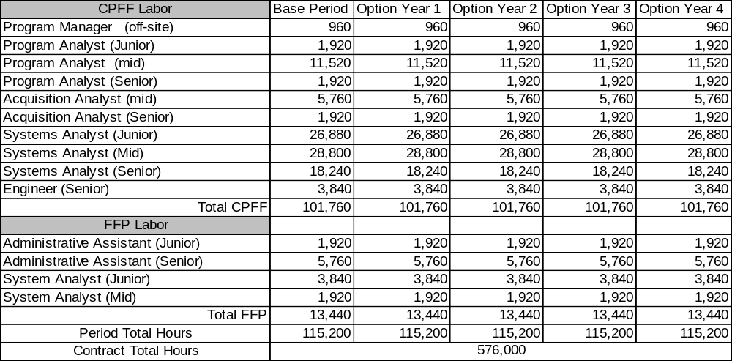
Historical Labor Category/Man Hours Estimate

Slide 21
Deliverables PBSOW Requirements Summary
List of Deliverables
  CDRL A001- Monthly Meeting Agenda
  CDRL A002- Monthly Status Report
  CDRL A003- Funds and Man-Hour Expenditure Report
  CDRL A004- Operational Security Plan (OPSEC)
  CDRL A005- Continuation of Mission Essential Contractor Services Plan
  CDRL A006- Personnel Gain/Loss Report
  CDRL A007- Performance Self-Assessment

Slide 22
Question and Answers
Questions previously submitted will be addressed today.
Questions submitted today or later should be submitted to Taynelle McCloud, Contract Specialist, at the following email address: taynelle.mccloud@navy.mil and answers may be posted to the SeaPort-e Bid Event website.
NAVAIR’s points of contact are:
  Ms. Jessica Flynn, PCO, (301) 757-2521
    jessica.t.flynn@navy.mil
  Ms. Taynelle McCloud, (301) 995-2516
taynelle.mccloud@navy.mil

