Slide 1
From Reviews to Recommendations: Sentiment Analysis for Movies (NB vs. BERT, with a Recommender Extension)
Beiwei Niu, Chengshun Zhao
Notes:
I will introduce why sentiment analysis is useful, how three papers shape my plan, and how I will evaluate methods and ship a tiny recommender extension.

Slide 2
Agenda (10 minutes total)
Background & Why this topic (5 min)
Pain point → reading overload; why sentiment helps
What prior work says (3 papers) and the gap
Methodology & Future Work (5 min)
Data, models, metrics, and baseline
Planned analyses, risks, and timeline
Notes:
I will follow the required 5+5 structure. First five minutes: the motivation, background, and why this topic, anchored by three papers that map the solution space from classical NB to contextual BERT and on to a recommender linkage. The next five minutes: my methodology—datasets, splits, models, metrics, baselines, ablations—and a concrete three‑week plan with risks and mitigations.

Slide 3
Problem & Motivation
Massive volume of user reviews → hard to digest quickly
Sentiment analysis = fast signal for decision making (viewers, studios, platforms)
Movies domain is well-studied and data-rich → good for reproducible student research
Notes:
We face an information‑overload problem. Platforms host millions of reviews, but readers care about a fast, trustworthy signal. Sentiment analysis compresses long texts into actionable polarity. In the movie domain, data is abundant and publicly accessible—ideal for a reproducible student project. The research promise is to measure the quality‑speed trade‑off rigorously and then convert that signal into something users and platforms can use.

Slide 4
Related Work (1): NB + TF–IDF/Count
Paper: Danyal et al. (2024), Social Network Analysis & Mining
Uses Naive Bayes with TF–IDF and Count Vectorizer
Simple, fast, strong baseline for text classification
Limitation: bag-of-words ignores context and word order
Notes:
This figure from Paper 1 illustrates the classical pipeline: tokenization, vectorization (Count or TF‑IDF), and a simple probabilistic classifier like Multinomial Naive Bayes. I use this as my fast, transparent baseline. The point to notice is that each token is treated independently—great for speed, but limited on context and negation. In my work, I will tune n‑grams, stopwords, and max_features to approach the best reported baseline while maintaining low latency.

Slide 5
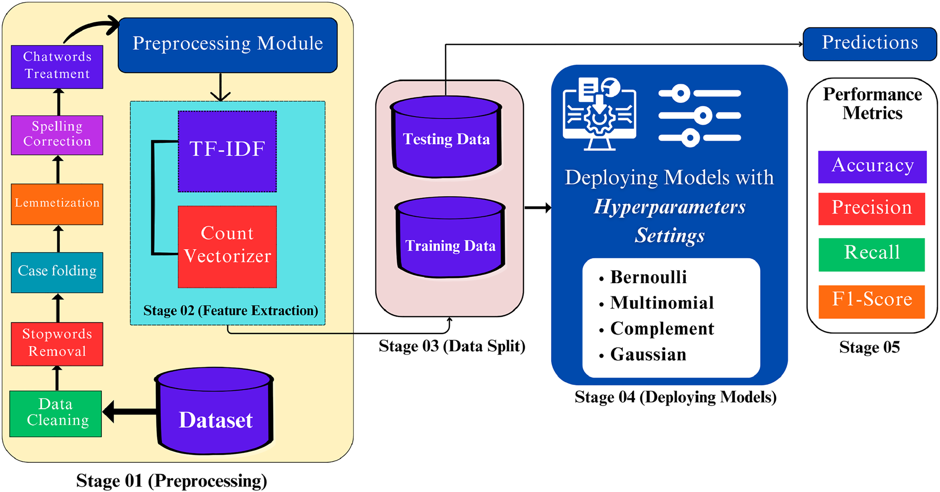
Related Work (2): BERT for Sentiment
Contextual embeddings capture nuance & long-range dependencies
Often outperforms classical models
Cost: training/inference time; I will measure latency & quality
Figure from Paper 1
Notes:
I will fine-tune BERT-base or use DistilBERT if compute is tight.

Slide 6
Related Work (3): Sentiment → Recommenders
Paper: Sarhan et al. (2024), JESIT
Integrates VADER-based sentiment with ML (SVM, NB)
Datasets: TMDB5k + Reviews
Idea: use sentiments in a hybrid recommender to improve user satisfaction
Notes:
This figure from Paper 3 shows how sentiment features feed a recommender. The core idea is to blend content similarity with a sentiment score so that highly similar yet poorly‑reviewed items move down the ranking. My extension will implement a simple content‑based ranker that weights similarity by predicted sentiment, and I’ll compare its top‑k precision with a vanilla content‑based baseline.

Slide 7
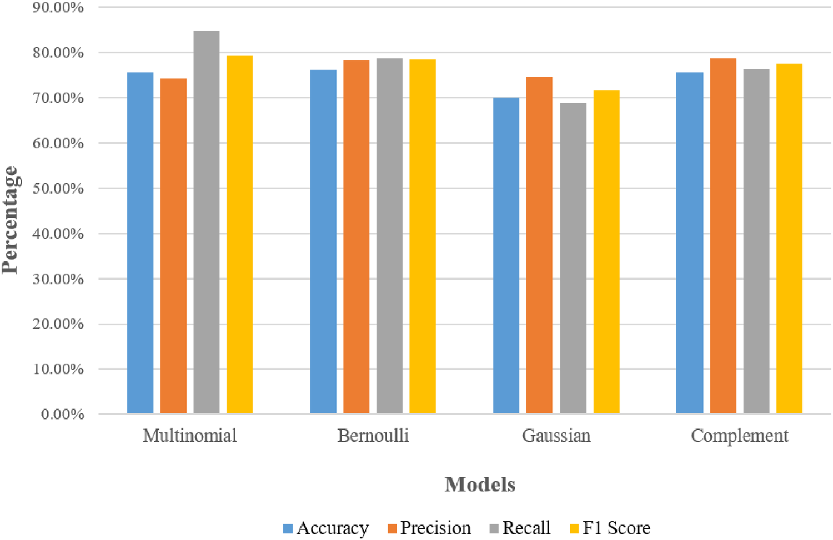
Gap → My Research Questions
How far can tuned NB+TF-IDF go vs. BERT?
Does VADER help as feature or tie-breaker?
How to convert classifier outputs into a simple recommender?
Figure from Paper 1
Notes:
I will keep the design minimal so each question is testable within the timeline.

Slide 8
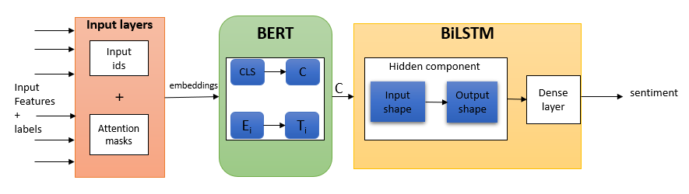
Data & Preprocessing (planned)
Public datasets: IMDB 50k, TMDB Reviews
Stratified 80/10/10 split with fixed seed; tune on valid set
Minimal cleaning: lowercase, de-dup, remove leakage; binary + 3-class if neutral
Figure from Paper 2
Notes:
I will save split indices and seeds so results are reproducible.

Slide 9
Models
Baseline: NB + TF-IDF (sweep uni/bi-grams, vocab, alpha)
Deep: BERT-base or DistilBERT with early stopping
Lexicon: VADER as small feature or vote to steady edge cases
Extension: similarity × sentiment to down-rank poorly-reviewed items
Notes:
I will track Macro-F1 and latency together and keep the extension explainable.

Slide 10
Evaluation Plan
Primary: Macro-F1; also Accuracy, optional ROC-AUC
Baselines: majority, VADER-only, tuned NB
Ablations: stopwords on/off, uni vs. bi-grams, vocab sizes
Log time/epoch & per-review latency; small error gallery
Notes:
I will pair metrics with latency to show the quality–speed trade-off.

Slide 11
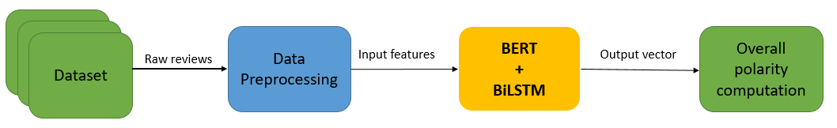
Risks & Mitigations
Imbalance/domain shift → stratified split, Macro-F1; monitor labels
Compute limits → DistilBERT, shorter seq_len, gradient accumulation
Noisy text → de-dup & validation rules
Overfitting → early stopping; optional k-fold for NB
Figure from Paper 2
Notes:
I will also checkpoint best models and keep seeds fixed for reproducibility.

Slide 12
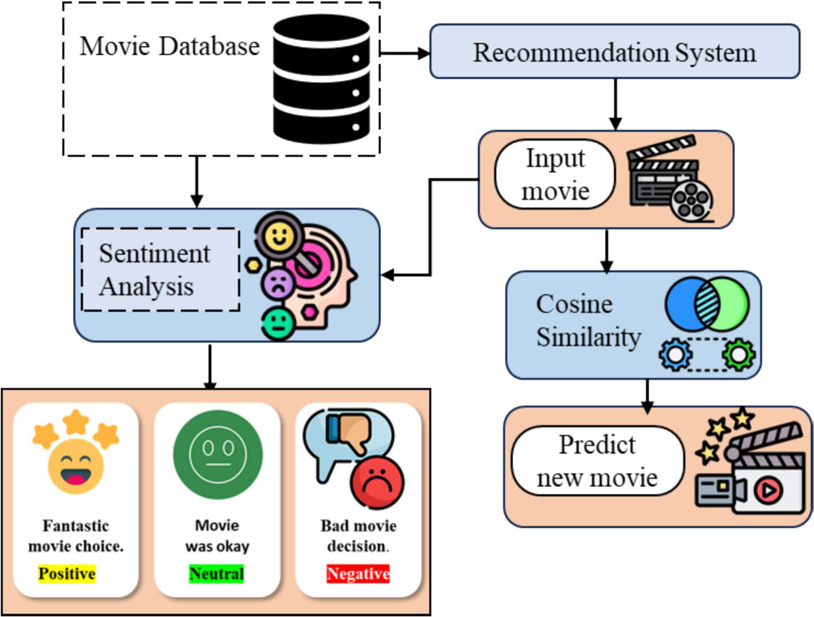
Future Work & Milestones
Week 1: finalize dataset + NB baseline with metrics & latency
Week 2: BERT fine-tuning + error analysis
Week 3: VADER-hybrid + mini recommender demo; evaluate top-k
Figure from Paper 3
Notes:
Deliverables: short report, clean notebook, final PPT+notes, optional tiny demo UI; include seeds & split indices.

