Slide 1

Engineering Design Exercise 4 -- Typography
Speaker: Po-Chuan Chen

Slide 2

Oldstyle
Modern
Slab serif
San serif
Script
Decorative

Slide 3
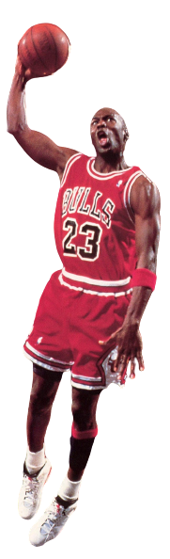




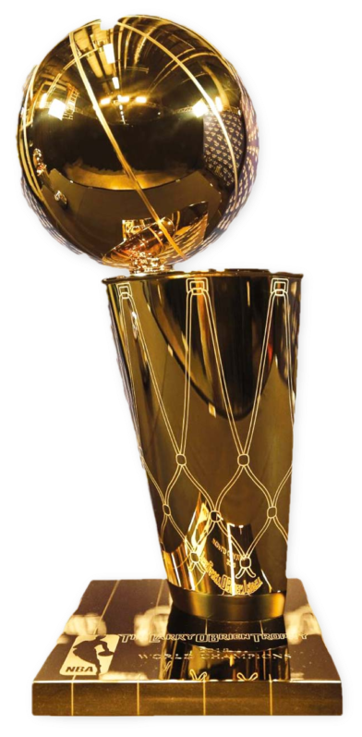

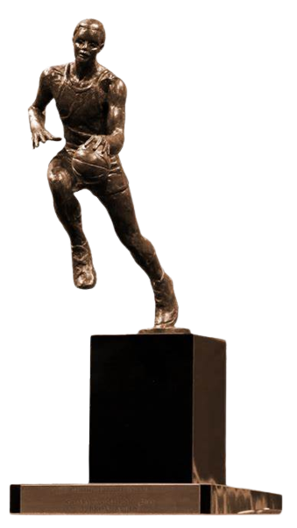

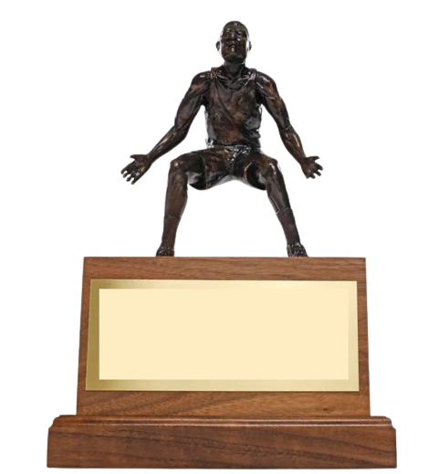

1981-1984
1984-1993
1994
1994-1998
2001-2003
Olympic gold medal ×2
1st Team ×11
1st Defensive Team ×9
Rookie of the Year
Scoring Leader 10 times
Steals Leader 3 times
Slam Dunk Contest 2 times
× 6
× 6
× 5
× 3
× 1
× 14

