Slide 1


Engineering
Design
Exercise 5 -- Color
Speaker: Po-Chuan Chen

Slide 2

#EC311F
#114B63
#00AAA1

Slide 3

#3E97C8
#FED98C
#81A15E
#E55523
#DEDFE1

Slide 4
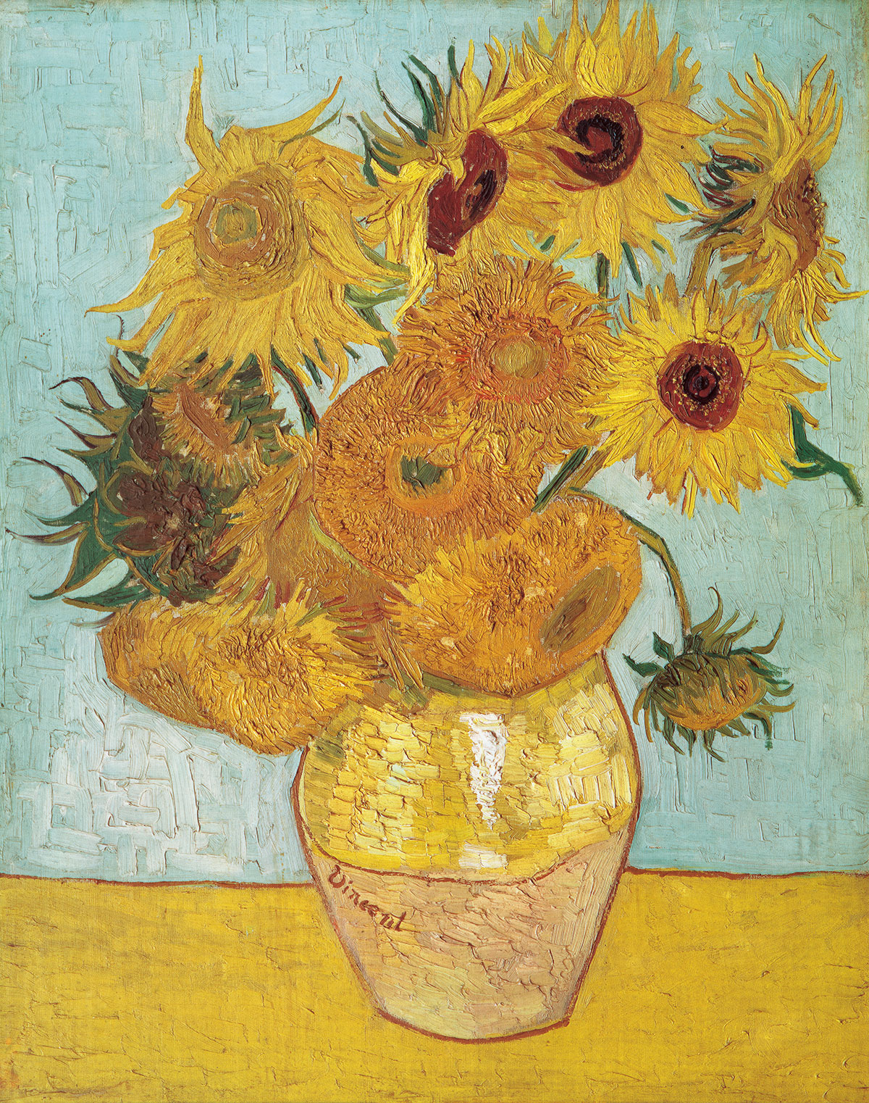
#ACCCC8
#B9722A
#E1C03F

