Slide 1
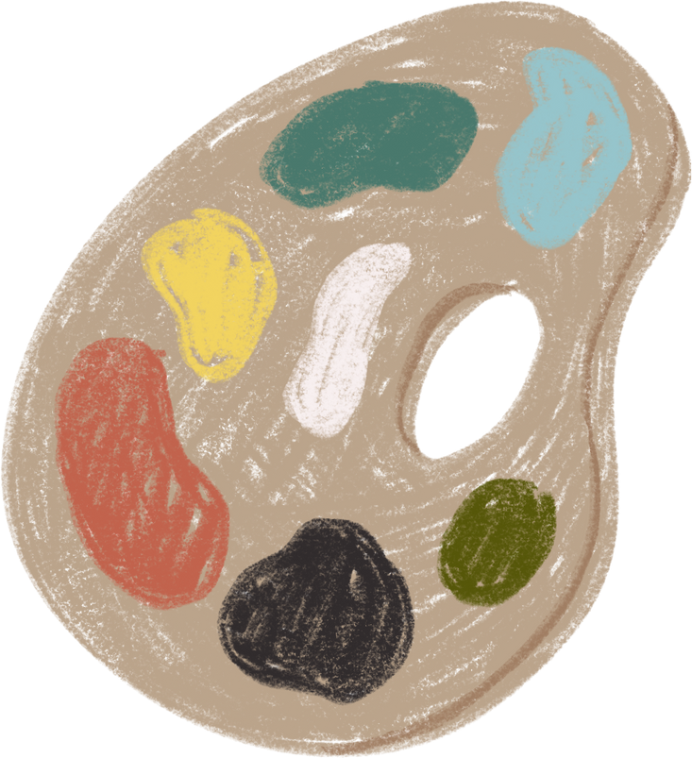


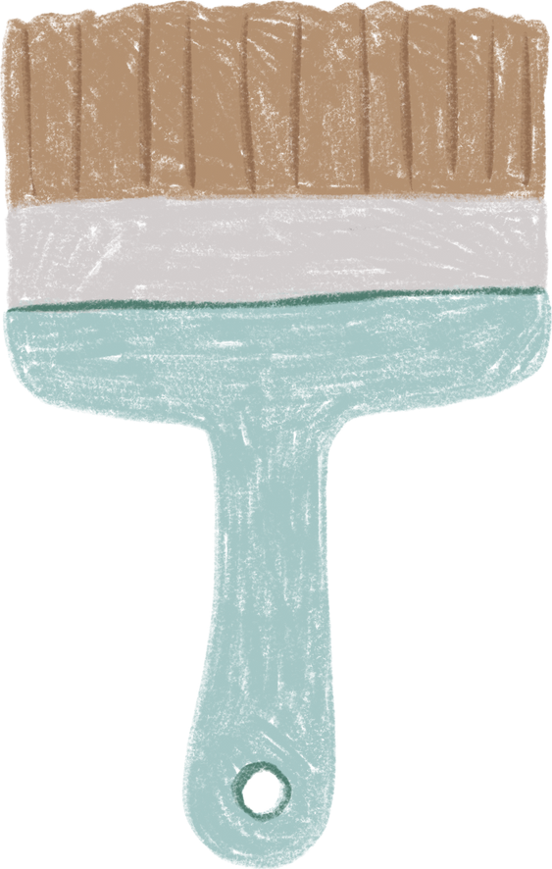
Engineering design Exercise 6 -- Shapes
Speaker: Po-Chaun Chen

Slide 2
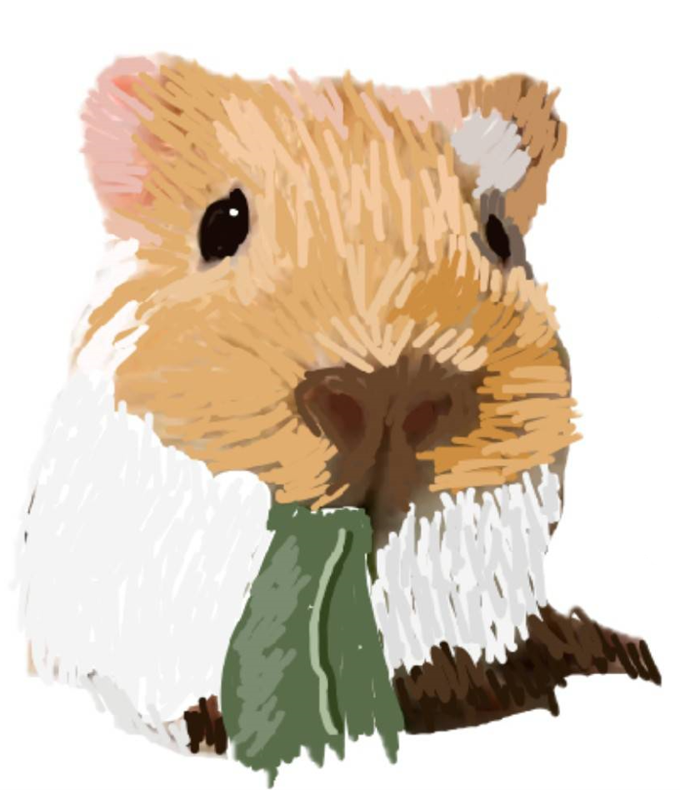
Guinea pig
Original painting by myself
Result

