Slide 1
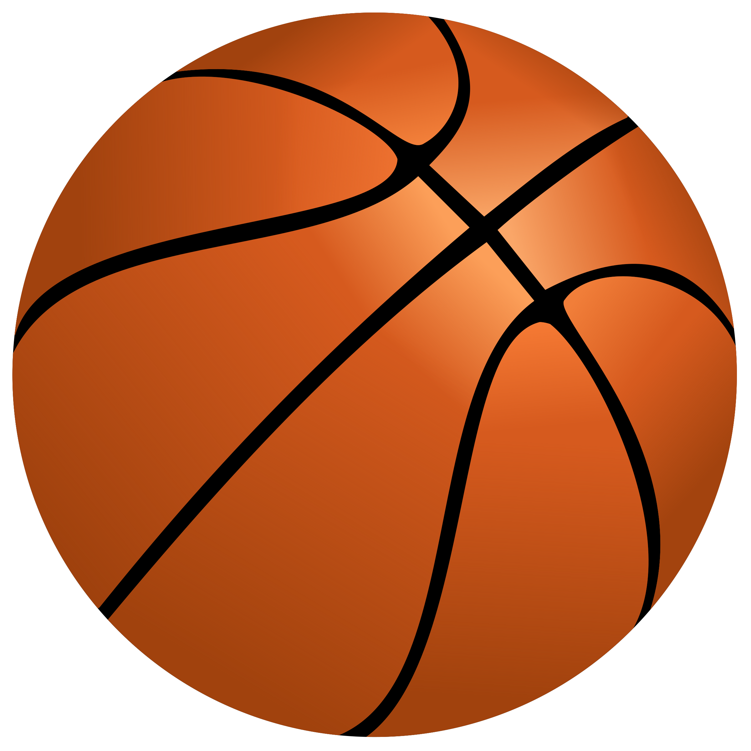
Engineering Design Exercise 3
Speaker: Po-Chuan Chen

Slide 2
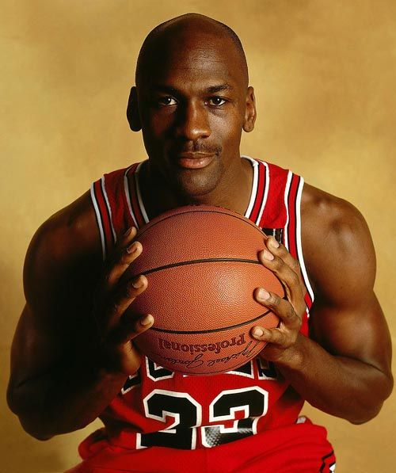
The article discusses the life and career of Michael Jeffrey Jordan, an American former professional basketball player and successful businessman. Jordan is widely regarded as one of the greatest basketball players of all time, with a career that includes multiple NBA championships and numerous accolades.
Born in 1963 in New York City, Jordan moved to North Carolina with his family in 1968. He attended Emsley A. Laney High School in Wilmington, where he initially struggled to make the varsity basketball team due to his height. However, he persevered, grew taller, and eventually became a standout player, earning a spot on the varsity team and averaging over 25 points per game in his final two high school seasons. He was recruited by several colleges and ultimately chose the University of North Carolina.
Jordan's basketball career took off when he joined the Chicago Bulls in 1984 as the third overall draft pick. He quickly became a star, known for his scoring ability and defensive prowess. His leaping ability earned him the nicknames "Air Jordan" and "His Airness." Jordan won multiple NBA championships with the Bulls, retired briefly to play Minor League Baseball, and returned to lead the Bulls to more titles.
Throughout his career, Jordan accumulated numerous awards, including six NBA Finals MVP awards, ten scoring titles, five MVP awards, and many more. He set several NBA records, including career scoring averages. He was also a key player for the United States national team, winning four gold medals in international competitions.

Slide 3
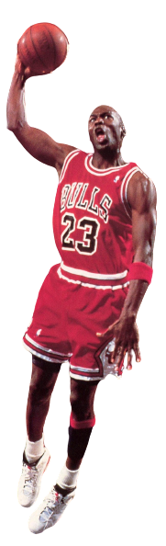
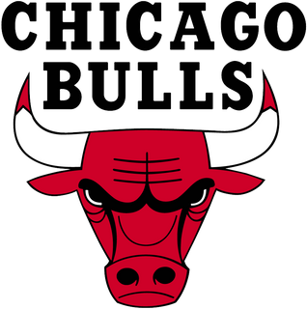


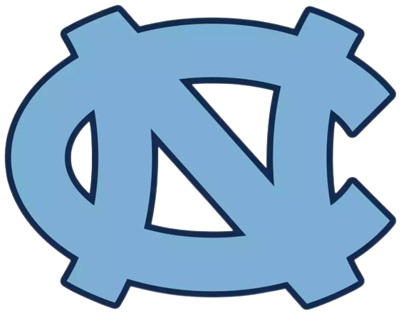
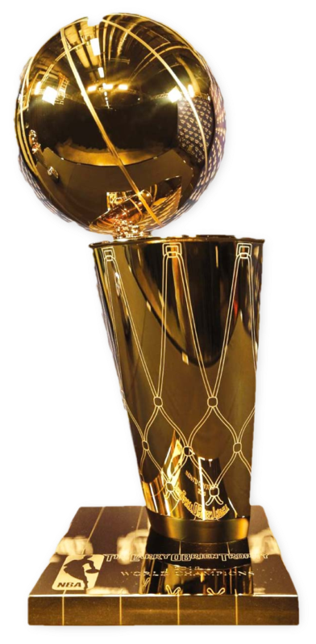
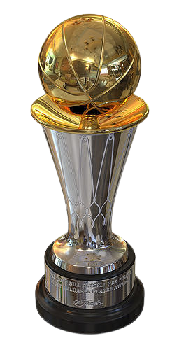
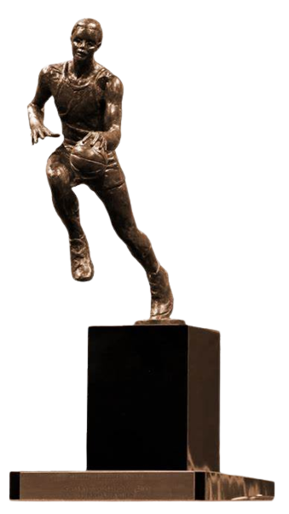
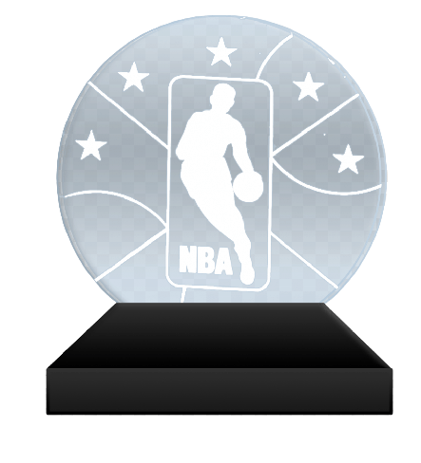
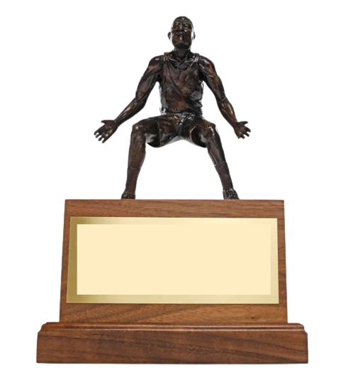
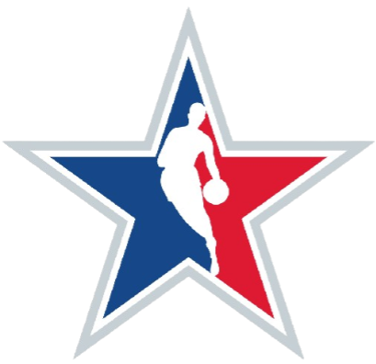
1981-1984
1984-1993
1994
1994-1998
2001-2003
Olympic gold medal ×2
1st Team ×11
1st Defensive Team ×9
Rookie of the Year
Scoring Leader 10 times
Steals Leader 3 times
Slam Dunk Contest 2 times
× 6
× 6
× 5
× 3
× 1
× 14

