Slide 1

Entity and Relation Extraction in Biomedical Domain
Group member: Xu Tao, Jackson Codispoti, Yuhang Jiang, Yue Li
Instructor: Muhammad Abu Bakar Siddique
CS685: Natural Language Processing with Deep Neural Networks
Final project

Slide 2

Outline
Introduction
Research problem
Methodology
Entity Model
Relation Model
End to end Model
Evaluation & Results
Conclusion

Slide 3
Introduction
Named Entity Recognition (NER) and Relation Extraction (RE) in Biomedical domain
Apply existing joint approach using BERT-style models and finetune
State-of-the-art approaches:
Structured prediction
Multi-task learning
Two tasks cast into unified framework
Globally optimized
Jointly decoded at inference time
Builds separate models for entity recognition and relation extraction
Optimized with parameter sharing

Slide 4
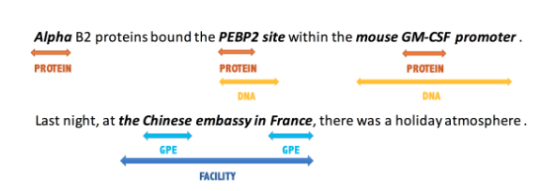
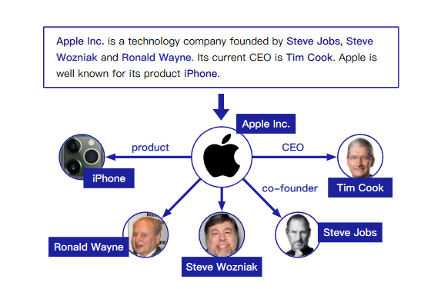
Research Problem
Named Entity Recognition
Find spans in text representing semantic class
Relation Extraction
Extract semantic relation between spans in text
Combine both in end-to-end pipeline approach
Named Entity Recognition example [2]

Slide 5

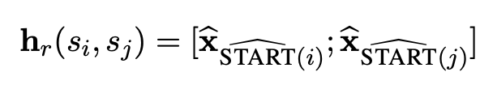
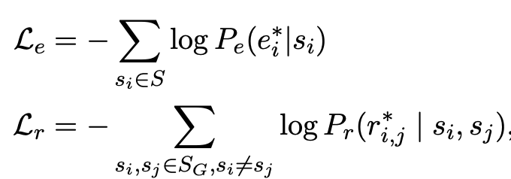
Methodology
A pipeline approach - PURE[1] which contains two encoders built on top of deep pre-trained language models:
- Entity model span representation
- Relation model span-pair
Training & inference for both entity model and relation model
[1] A Frustratingly Easy Approach for Entity and Relation Extraction
Notes:
Transfer learning is method where a model developed for a task is reused as a starting point for a model on a second task.

Slide 6
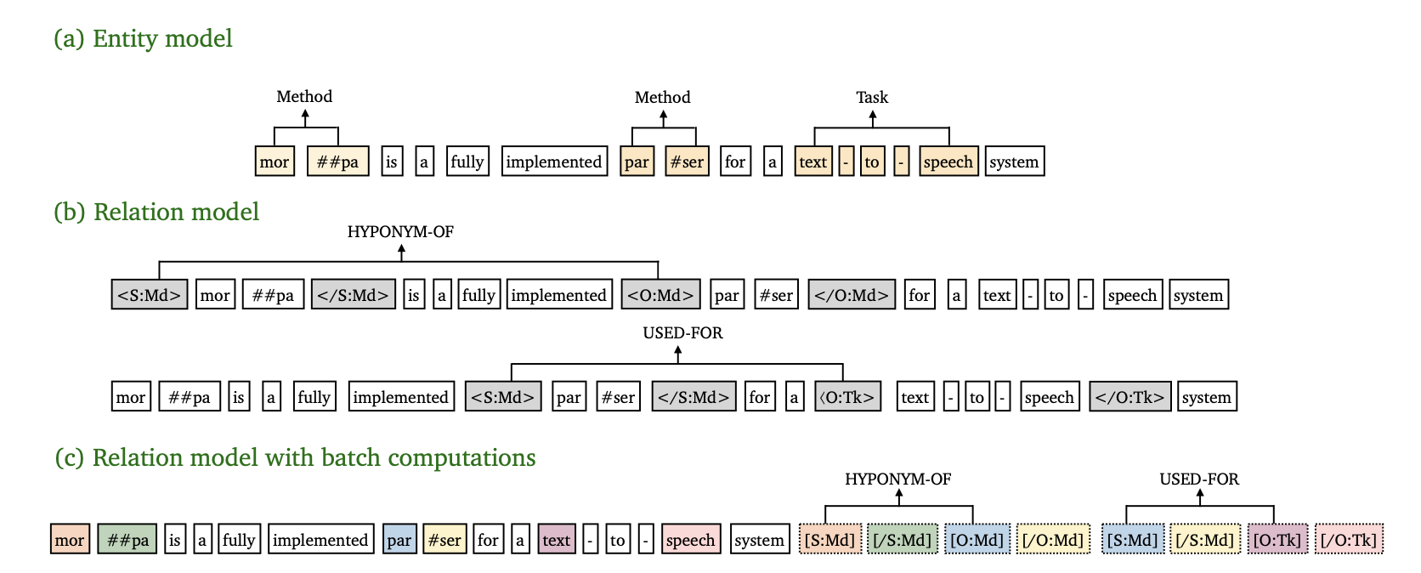
Example
Notes:
Before driving into the formal representation of the simpleTOD language model, let’s take a look of the high level intuitive picture on a concrete example.

Slide 7
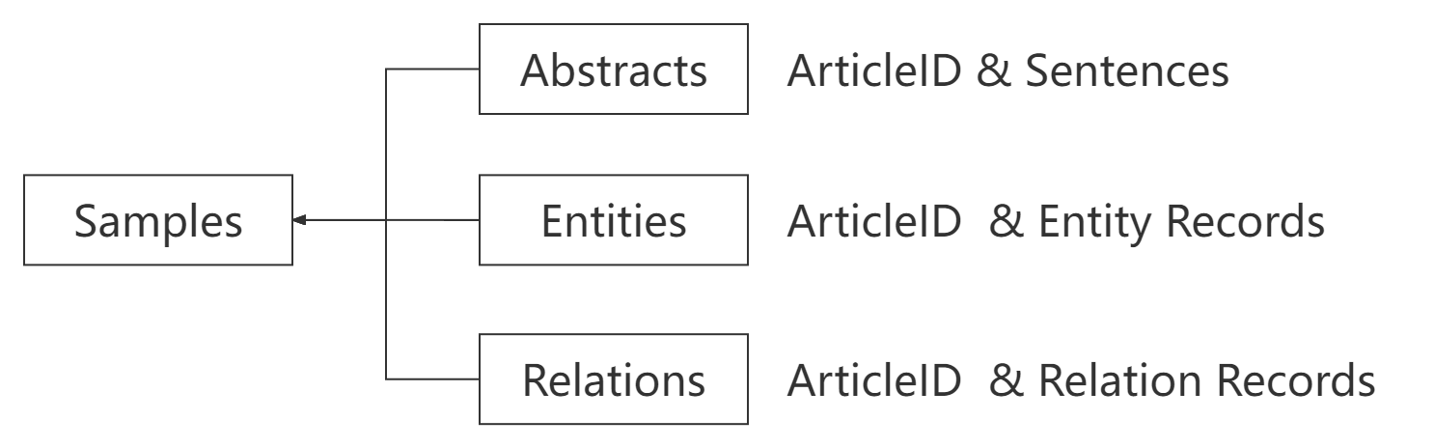
Evaluation - Dataset
Original Chemprot Dataset
1,820 PubMed(citations for biomedical literature) abstracts with entity and relation records.
1,020 abstracts for training.
800 abstracts for testing.
To use them in PURE, we need to transfer them into another form.
Abstracts, entity and relation records are stored in separate tsv files.

Slide 8
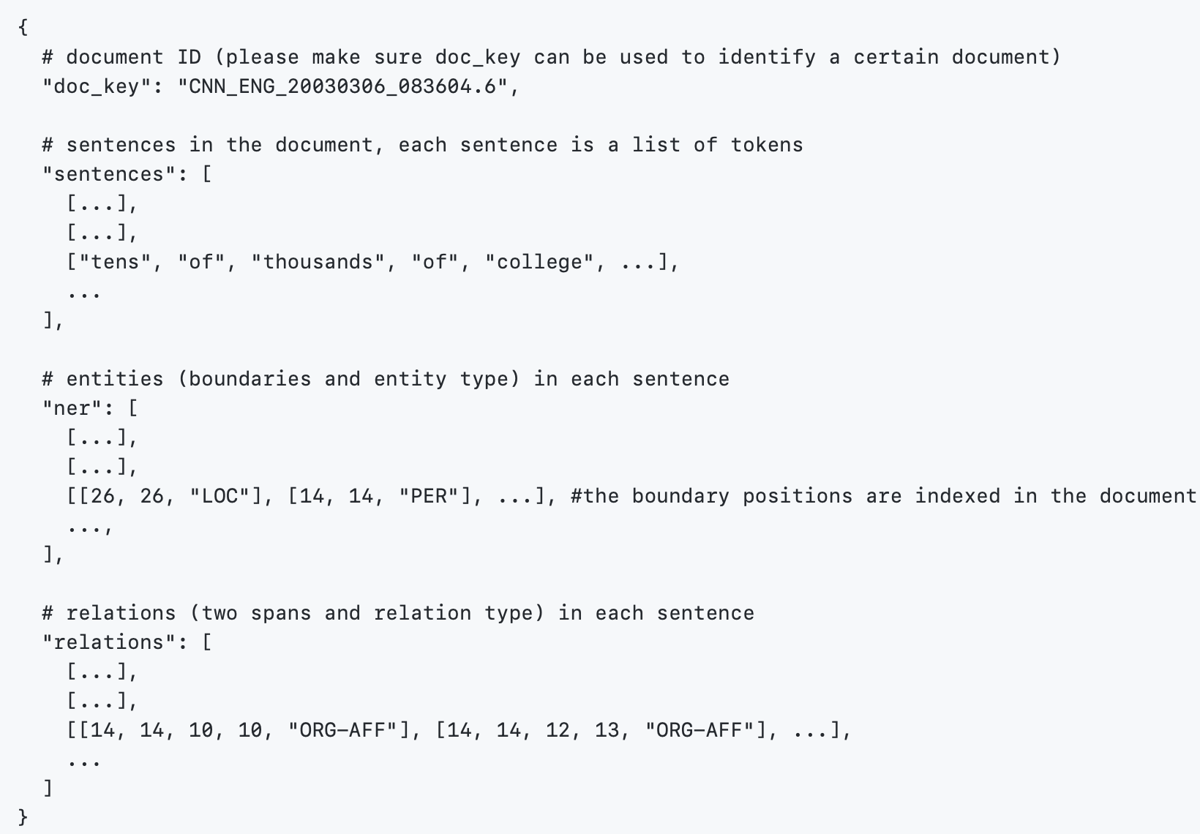
Evaluation - Dataset
Chemprot for PURE
We use spaCy Tokenizer to preprocess the dataset:
1. Tokenize sentences.
2. Parse records, mark entities
and relations in sentences
and locate them.
Finally, Chemprot is transferred to JSON form that could be used in PURE.
Preprocessed data structure:

Slide 9
Evaluation - Metrics
Evaluation Object | metrics | description
Named Entity Recognition | F1 | A predicted entity is considered as a correct prediction if its span boundaries and the predicted entity type are both correct
Relation Extraction | Boundaries evaluation (Rel) | a predicted relation is considered as a correct prediction if the boundaries of two spans are correct and the predicted relation type is correct
 | strict evaluation (Rel+) | both predicted entity and relation are correct
Table 1: Evaluation Metrics

Slide 10
Evaluation - Results
Encoder | Entity (F1) | Rel (F1) | Rel+ (F1)
BERT | 85.8 | 48.3 | 48.3
Bio-BERT | 88.4 | 52.3 | 52.3
Sci-BERT | 89.8 | 53.2 | 53.2
Table 2: results in end-to-end setting with three different encoders
Baseline

Slide 11
Conclusion
We are the first one applying the end-to-end pipelined approach on the biomedical dataset Chemprot, and observed following from the reference paper[1] and the experiments:
The contextual representations for the entity and relation models essentially capture distinct information, sharing their representation hurts performance.
It is crucial to fuse the entity information at the input layer of the relation layer.
Leveraging cross-sentence information is useful in both tasks.
The performance ranking from the experimentation
scibert > biobert> bert
[1] A Frustratingly Easy Approach for Entity and Relation Extraction ​

Slide 12
We are a team …
Task | Member(s) | outcome
literature investigation, Project reference paper identification | Yuhang Jiang | Reference paper: “A Frustratingly Easy Approach for Entity and Relation Extraction” State-of-the-art models: BERT, SCI-BERT, BIO-BERT
Dataset preparation | Yuhang Jiang, Yue Li | Preprocessed chemprot dataset to adapt the model
Runtime environment preparation in LCC | Jackson Codispoti | Initialized the runtime environment and resolved the library dependency issue
Model training and evaluation | Xu Tao | Obtained the performance results for bert, scibert, biobert
Table 3: Task contributions

Slide 13
Entity and Relation Extraction in biomedical domain Thank you!
Group member: Xu Tao, Jackson Codispodi, Yuhang Jiang, Yue Li
Instructor: Muhammad Abu Bakar Siddique
CS685: Natural Language Processing with Deep Neural Networks
Final project

