Slide 1
Python Virtual Environments
SURP 2026 Python Bootcamp
Ohio State Astronomy
Slides by: Jackson Datkuliak

Slide 2
So how do I install Python packages?
For research, you will probably use Anaconda to setup your Python environments. Anaconda is easy to use and share with other researchers.
For quick setup and small projects, I prefer to use Python’s built in tool, `venv`
If you don’t have a Python environment with NumPy, you will want to set one up with venv for todays group challenge.

Slide 3
What’s a virtual environment?
A Python virtual environment is a directory that contains it’s own Python interpreter and set of installed packages.
You can have on version of Python with some packages in one venv, and another version of Python with some other packages in another venv.
Makes it easy to switch between versions of Python and packages for different projects.

Slide 4
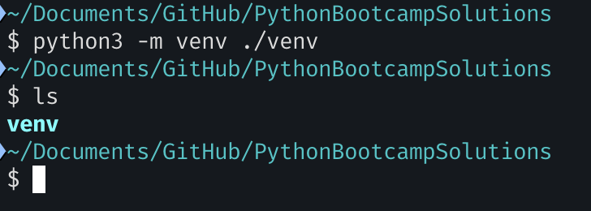
Creating a Virtual Environment
To start, create a virtual environment with the command
`python3 –m venv ./venv`
This will create a folder called “venv” in your current directory that contains the virtual environment. You can call it whatever you want, doesn’t have to be “venv”.

Slide 5
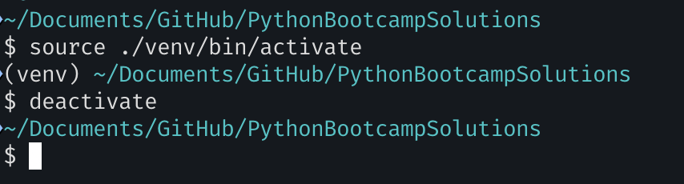
Activating/Deactivating Virtual Environments
Use the command
`source ./venv/bin/activate` to activate the virtual environment. You should see a (venv) in the terminal prompt.
Enter `deactivate` to stop using the virtual environment.
You will have to reactivate the virtual environment if you close your terminal.

Slide 6
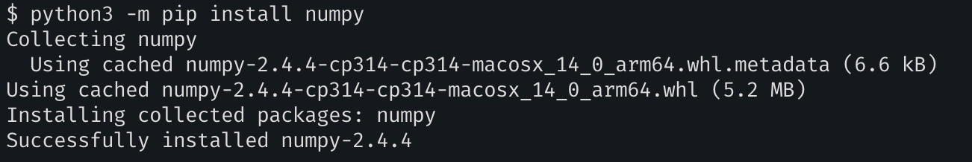
Install packages
Use the command:
`python3 –m pip install <packages>` to install packages into the virtual environment with pip.

Slide 7
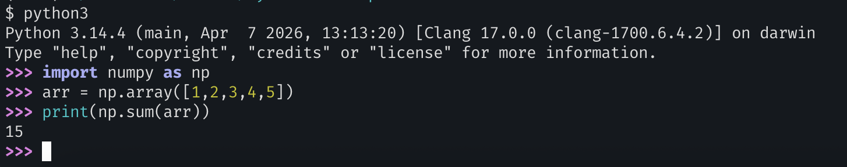
Done!
You can now import those packages and use them in your Python code!

