Slide 1
Introduction
SURP 2025 Python Bootcamp
Ohio State Astronomy
Slides by: James W. Johnson, Liam Dubay, and Jackson Datkuliak

Slide 2
Hello!
We’d like to introduce ourselves
Tawny Sit (5th year grad)
Jack Roberts (6th year grad)
Jackson Datkuliak (5th year undergrad)

Slide 3
Format
Emphasis on hands-on experience and group coding
There will be some slides, but not many
Slides from previous years are available as a reference
Start by going through a guided Jupyter notebook
Exercises are included, but won’t be graded – this isn’t a course
Ask us if you have questions at any time!
Each day will have a group coding challenge
Notes:
Mention that today we are going to focus on getting everyone setup with Python. Then we will will do the group challenge, and exercises after if we have time.

Slide 4
Format
Material is very condensed to fit into five sessions – mastery of these skills will come over time, even beyond this summer.
I will go through some of the slides quickly, so we don’t expect you to get everything right away. You can always review them later.
Notes:
In the past, students have started to notice the usefulness of the concepts covered in the later sessions around July – mind them and you’ll be thanking yourself later.

Slide 5

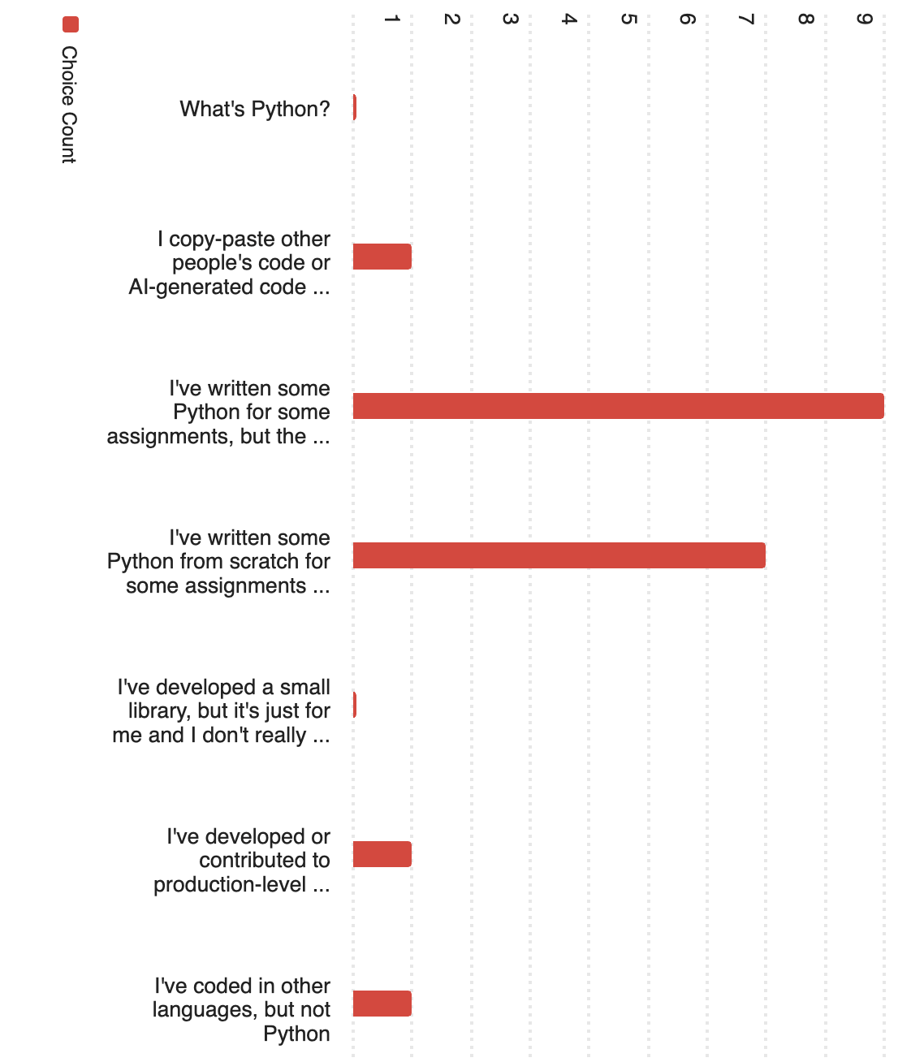
Survey Responses
Q1: How would you describe your skill level in Python?
A wide range of skills, but most have experience in Python
We’re aiming to get you familiar with the most important parts of Python for astronomy research
Notes:
Ask how many people have done python coding for:
Undergraduate research
School/class project
Personal projects/for fun

Slide 6
Survey Responses
Most have used libraries like matplotlib and numpy
Mostly solo coding experience
Range of comfort levels on basic Python syntax (if/else, loops, functions)
Most use Jupyter notebooks and are not super comfortable with the terminal
Lots of experience with other languages, especially C/C#/C++
Most have not opened a FITS file
Notes:
We will provide some notebooks to learn and review material, but many of the exercises and group challenges are best done in text files. I encourage everyone to practice using text files in this bootcamp, since most of you are less familiar with that way of coding.
Ask who the person that responded they have written shell scripts before is. Have that person help guide people through Bashlandia

Slide 7
Survey Responses
New material:
For many of you: the terminal, object-oriented programming, FITS files
For about half of you:
How to import your own code from elsewhere in your computer (packaging may be new to some)
Some of the material is either impossible or quite difficult when coding in a notebook. I advise all of you to use this bootcamp as practice for working in text files.
Notes:
I’ll show them how to download the course material after we talk about terminal commands.

Slide 8
Additional Learning Material
Those of you new to Python – we strongly advise going through some of this ahead of tomorrow’s session, which will be a crash course
Python Foundation’s Beginner’s Guide: https://www.python.org/about/gettingstarted/
https://www.learnpython.org/ - There is also an iOS app for this
Codecademy: https://www.codecademy.com/learn/learn-python-3
Notes:
1) Developed Python and a good start for a refresher or new to Python, 2) LearnPython is an app and website and a good way to learn syntax and get it running, 3) CodeAcademy is a great tool too, plenty of resources

Slide 9
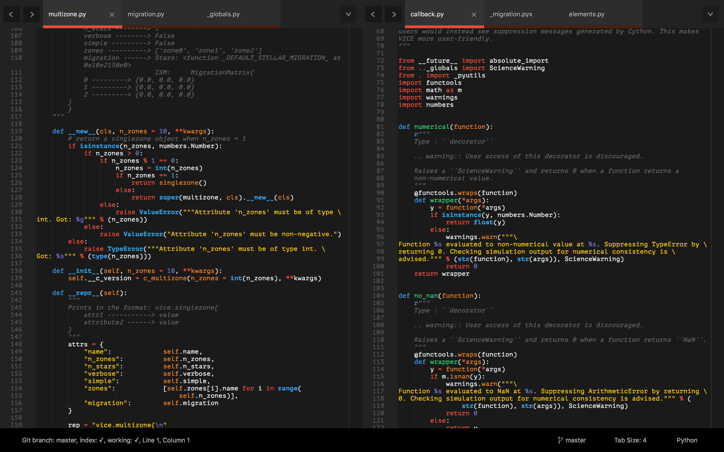
Tools: An IDE
Integrated Development Environment (IDE) – can edit & run code, organize projects
Examples: PyCharm, Spyder, VSCode
I recommend VS Code
https://code.visualstudio.com/
Free, lots of plugins, supports Jupyter notebooks too!
Notes:
I recommend VS code because its lightweight and it has a huge number of extensions that add functionality for many programming languages and development environments. It also integrates really well with WSL if you are on Windows.

Slide 10
Tools: A Text Editor
Differs from an IDE – all they do is open, create, edit, and save plain text files
Lots of options – some run right in the terminal (Emacs, VIM, nano)
I recommend using VS Code for a GUI text editor and vim or nano for a command line editor.
Notes:
As mentioned before, a text editor is a useful tool when coding with Python as not everything can be done in notebooks. If you’ve ever written a file that ends in .py, that’s a python text file while notebooks typically end in .ipynb. IDE’s differ from notebooks in that they will provide you with debugging and other language features while a Jupyter notebook is just running your code. IDE’s are sometimes built specifically for one programming language. Whereas with other text editors, you can use multiple languages.

Slide 11
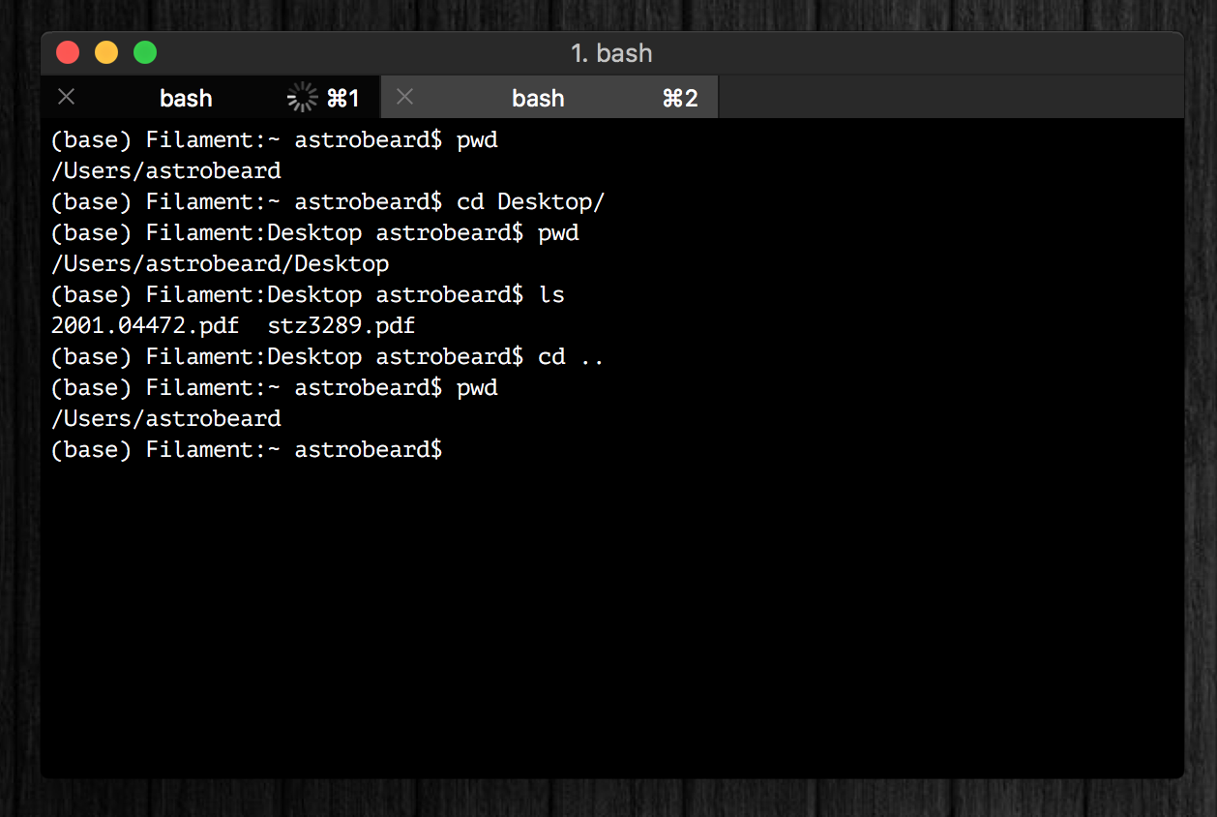
Tools: A Terminal
I recommend iTerm2 for MacOS and the Windows Terminal for Windows
https://www.iterm2.com/
https://apps.microsoft.com/detail/9n0dx20hk701
Think of the terminal as an alternative to having a graphical user interface (the desktop)
Tip: you can run python line-by-line in a terminal using interactive Python shell (python or ipython)
Notes:
The default MacOS terminal is bad, iTerm2 allows you to have different terminal tabs and switch between them with keybinds.

Slide 12
Tools: A Terminal
If you’re running Windows, you will need to install WSL (Windows Subsystem for Linux), which will give you a Linux terminal and allow you to install Linux programs on your computer.
Linux has a steep learning curve to begin with, but gets easier as you get more comfortable.
Talk to me if you need help with this!
Notes:
We’ll sit down at the end of this session with anyone running windows and help them set up the Windows Subsystem for Linux (WSL)

Slide 13
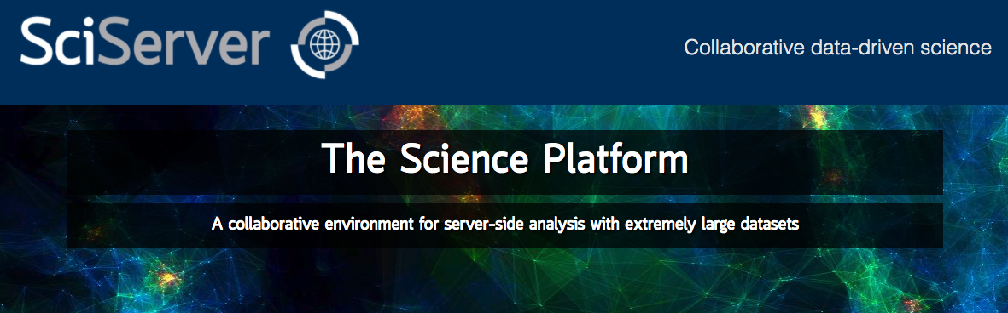
Tools: Cloud Computing
Allows you to run python on a remote server
SciServer is a popular platform across many STEM fields:
https://www.sciserver.org/
In the long run you should choose the tools that you’re most comfortable with
Notes:
We won’t be using this in the bootcamp but is a good tool to use. It’s an example of a cloud-computing server, meaning that when you run a notebook on SciServer, instead of it being ran by your computer, it’s being ran by their own server. You will probably user SciServer or OSC in your research or in an astronomy class at some point.

Slide 14

If You Haven’t Already
https://www.anaconda.com/products/individual
This will install Python, Anaconda, and Jupyter Notebooks
Make sure you install it in WSL if you have a Windows computer!
Latest version of python: 3.14.5
Most libraries now require >= 3.11
Usually* you want to install one major version below the latest for best package compatibility
Python 2.7 is deprecated
Talk to us if you need to use it, for now just don’t install that version
Notes:
Emphasize that python 2.7 is deprecated (no longer supported) because the number of stubborn researchers still using it is surprisingly high. If given code that runs on 2.7, they should come talk to us.
If you haven’t already, you’ll need to get Python. We won’t be going over Python itself today, but this is just so you guys have some time to get familiar with the tools around programming and have time to download and install your platform of choice. If you don’t know if you have Python, go to this link and it will install Python, Anaconda and Jupyter Notebooks for you. I use Anaconda to get to Jupyter Notebooks and Spyder, so it’s kind of like a main menu of all the different ways you can run Python. We will talk more in depth about Anaconda and things you can do with it later in the bootcamp course. Python 2.7 and below are deprecated, which means the programmers who run Python do not offer support or code for any versions older than Python 2.7. So, again, this website will let you download Python if it’s not already installed and update it if your machine has it pre-installed with the latest version of Python.
Note: If you have a Windows machine, you should be able to install anaconda in your WSL environment and still have the full graphical user interface. Software development is typically a lot easier to manage on Linux than Windows, so I strongly recommend that you figure out how to get anaconda setup in a Linux environment now to save yourself trouble later.

Slide 15
Goals
What we’ll aim to cover:
How to use a terminal
Review of the basics: control structures, data types, functions, import, etc.
How to read documentation
We will talk about how AI/LLMs play into this
Third-party libraries: NumPy, AstroPy and matplotlib
How to import your own code, and how to set up a directory tree to organize it
Classes: how to make new objects
Inheritance and Composition
Some basic software engineering principles (i.e. good habits)

Slide 16
Resources
Do use:
The reference notebooks and slides
Your groupmates and peers
The bootcamp facilitators
Coding forums, e.g. Stack Overflow
Can be hit or miss honestly
Your research advisor(s)
Don’t use:
ChatGPT, Copilot, or other AI code generators. You will not learn anything if you rely on these tools while you are learning. We will talk more about how to use LLMs effectively later.
Notes:
This bootcamp is for YOU – there are no grades, no penalty if you don’t get through all the material. We want to start developing good habits that you will rely on the rest of your career.
Note on LLMs: They can be incredibly useful for programming once you know you way around Python, but you need to be the software engineer. Do not vibe code research projects. The companies pushing AI/LLMs can often afford to have mistakes in their code. We as scientists cannot.

Slide 17
Monday Motivation
Every expert coder was once a novice.
You can’t improve your coding practices without first criticizing what you once thought was great code.
Since we’re not professional developers, scientists have to actively create and foster good coding habits if they want them. Being early career researchers, you have the option to make this decision now. It will only become more difficult to do this.

Slide 18
Today’s Plan
Slides: context, terminal, github
Get into groups – all experience levels in each group
Install Anaconda (unless you already have a Python install you can use)
Make sure you have a way to edit text files and Jupyter notebooks
Either an IDE or combination text editor and web browser
Windows users: install WSL
or find a friend with a UNIX terminal
Download course material (small intro to git)
git clone https://github.com/jacksondatkuliak/PythonBootcamp2026
Group challenge: terminal quest!
Individual exercises (as time allows)

