Slide 1
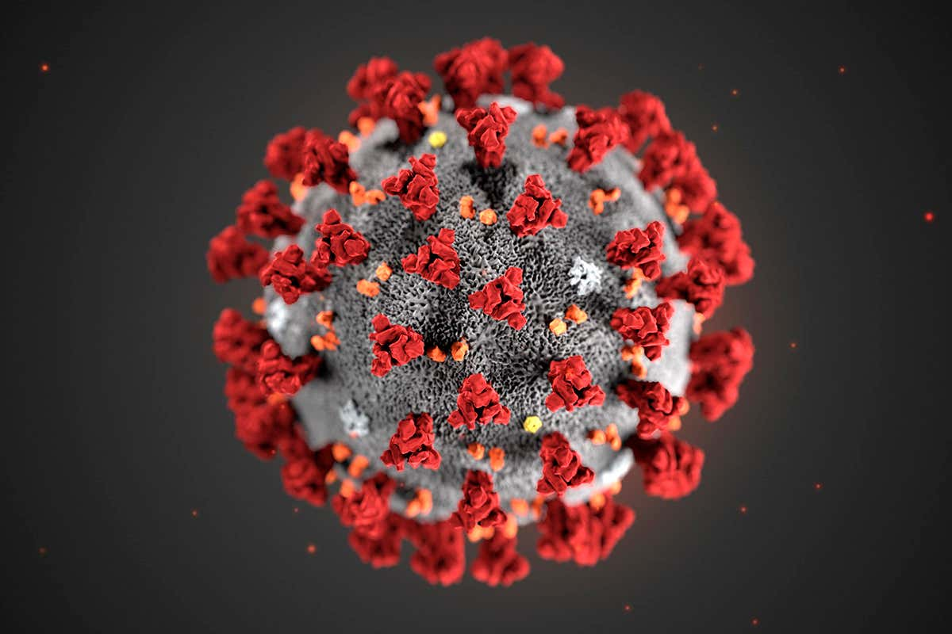
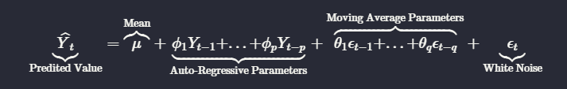
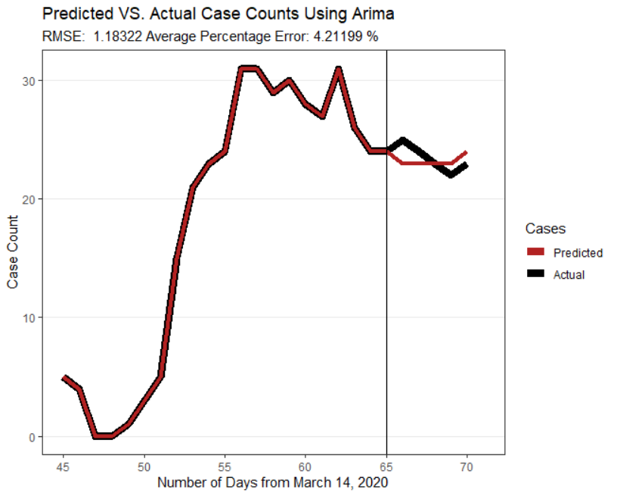
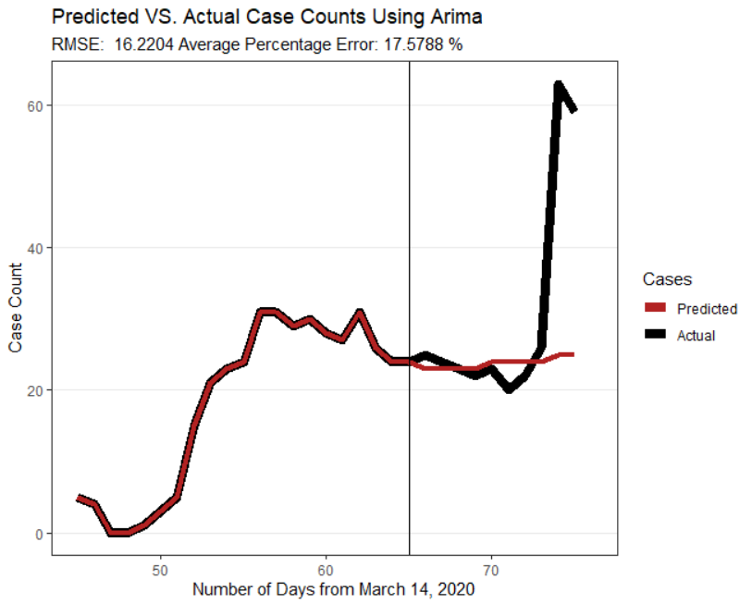
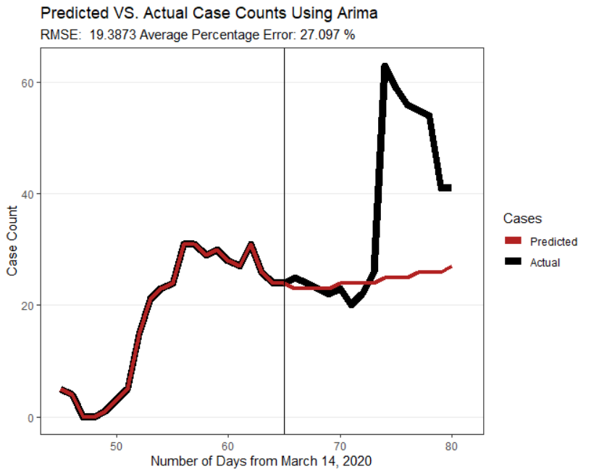
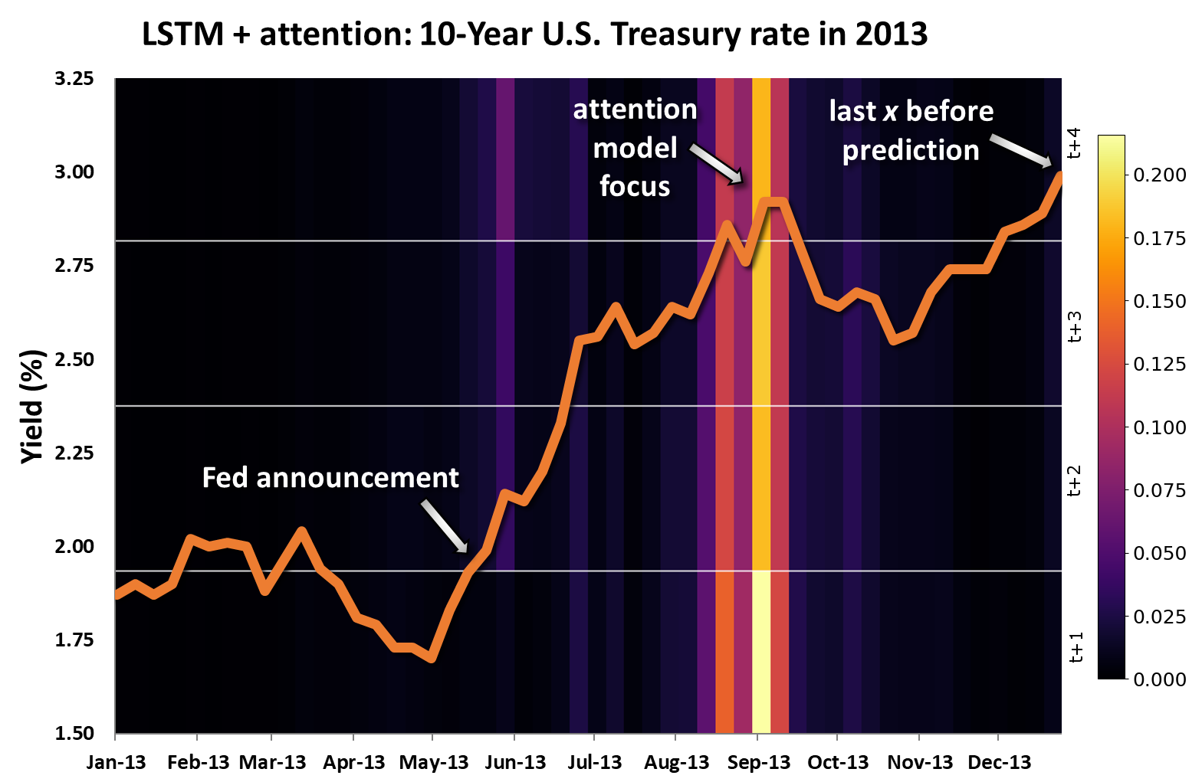
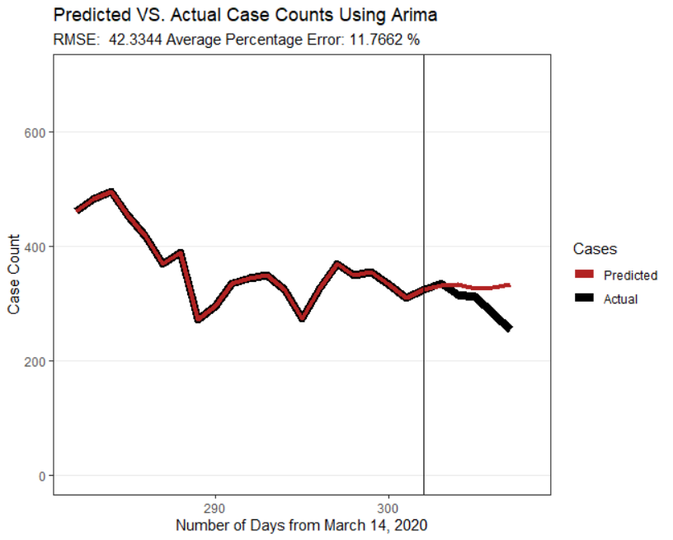
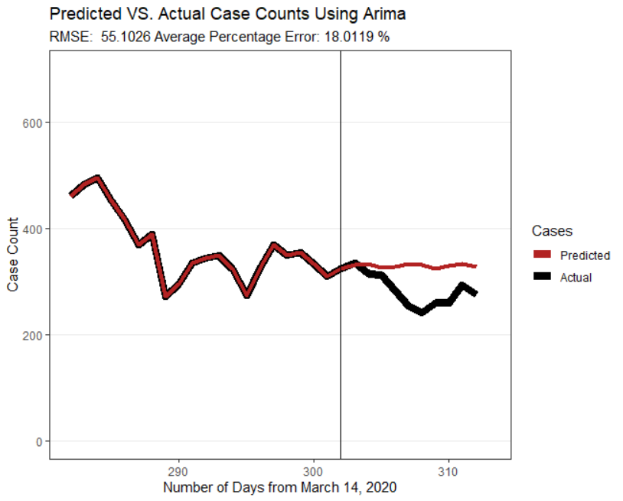
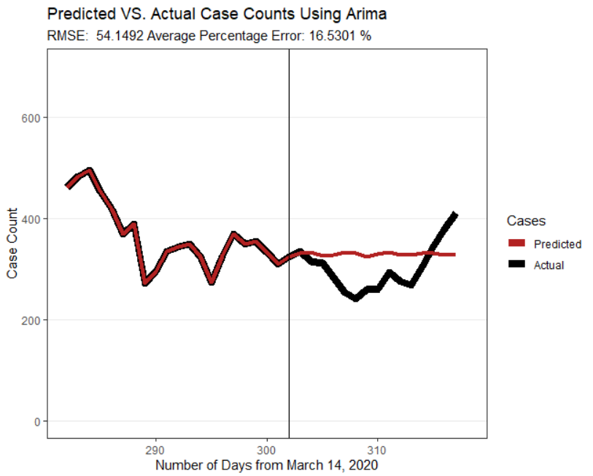
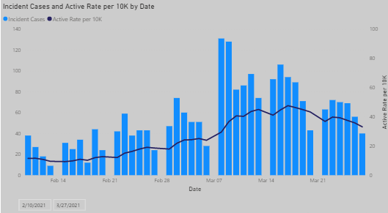
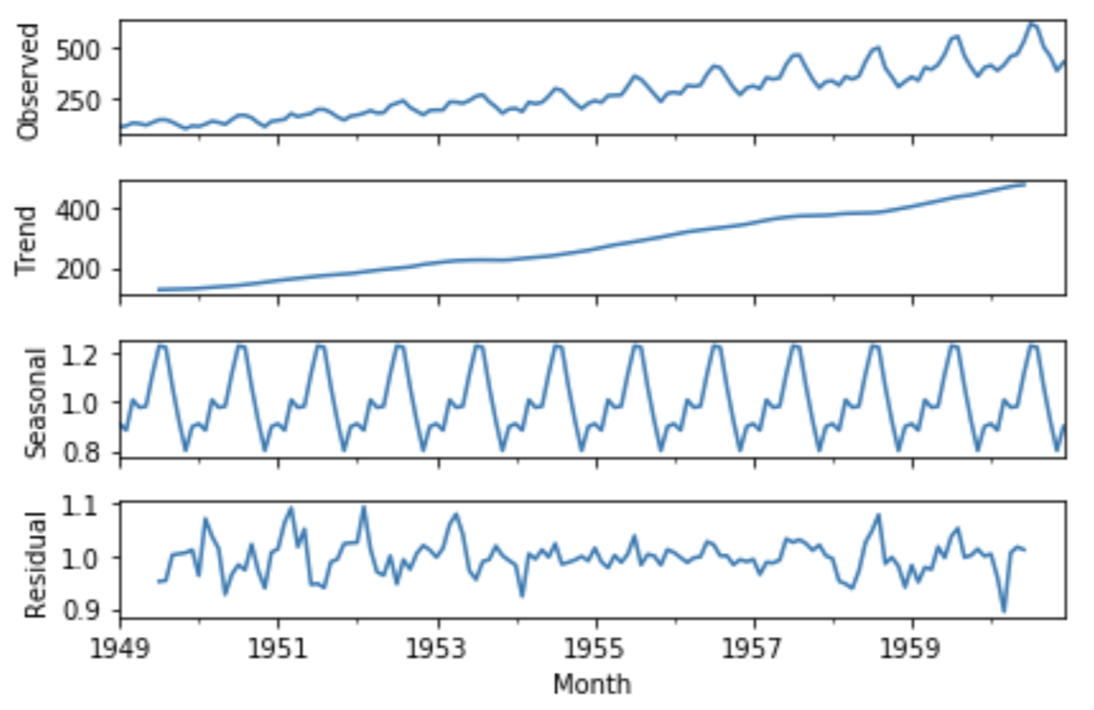
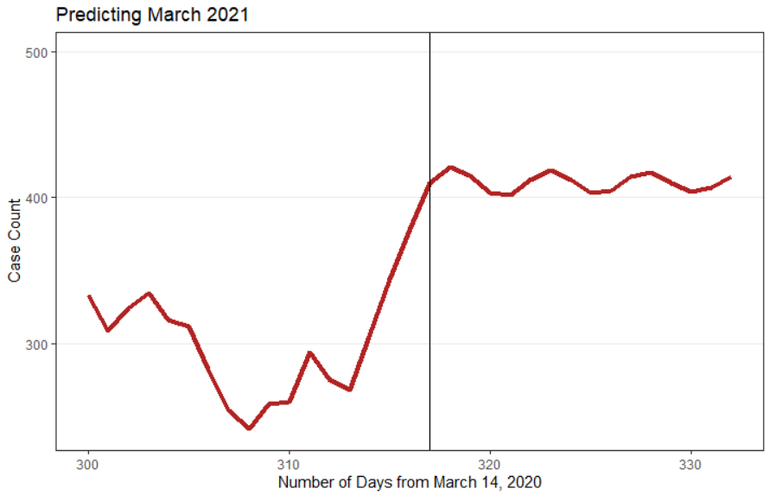
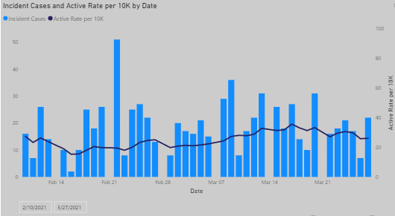
Time Series Modeling with COVID-19
Jackson Dial
Introduction/Abstract
Forecast/Validation
Conclusions
Given the recent outbreak of SARS-CoV-2, or more commonly known as COVID-19, it was of interest to utilize statistical modeling techniques to predict or forecast the number of active cases of the disease in the Eastern Idaho Public Health District.
It was hypothesized that the number of cases on a given day under EIPH supervision (or active cases) could be predicted based on the past number of cases that were observed. The selected method was to use ARIMA regression modeling, which mathematical model is given by the following, in general terms:
The time series analysis was run entirely within RStudio, using data provided by the Director of EIPH, Gary Rackow. ARIMA models are typically evaluated based on an AIC value, or a log-likelihood. These values are insightful, but I chose to use a different method, more of a validation of the model instead of an evaluation. To do this, I could only predict the number of cases on a given day that was already known. The timespan that was used is from March 14, 2020 (when the first case was reported in EIPH) through February 27, 2021 (when the data was last pulled from the EIPH database).
Below are plots showing the ARIMA prediction models and the accompanying error. This model used 65 days to ‘train’ the model, and then predicts the next 5, 10, and 15 days.
An ARIMA model has a lot of potential to forecast a given variable, but as anyone who has checked the weather knows, it is never guaranteed that your model will be correct or even accurate. I believe a weakness of ARIMA is that you can only use two variables; the one you are predicting and time. This is limiting in a way, because variables such as our case counts of COVID-19 are not likely to be singularly independent. The variable is probably correlated with another, which means if you can implement this into your model, it will have more predictive power.
There are of course means of accomplishing models that incorporate many different variables. One such model that I also explored is called a Recurrent Neural Network. This model falls closer to what are called “black-box” models, because they are rather complex, and understanding the mathematics behind them is not necessarily fit for an undergraduate senior project. A particular area of interest with these kinds of RNNs is a parameter called ‘attention’. Though there is not yet specific implementation of this in common machine learning libraries, it is a hot-topic right now in the field of ML. It is essentially what parts of the data that the model will pay the most attention to. It is shown by the plot below:
Though some of the ARIMA models do seem to fit the actual trends rather well, having less than 5% error for a 5 day prediction, there are many other factors to consider before we trust an ARIMA model to predict case counts of COVID-19. There are also exponential smoothing models, which have been shown to predict better than some ARIMA models in certain situations. Whatever method is chosen, it is important to validate your models on already known data. Though most of your models will output values sch as the AIC or log-likelihood, these values are not as intuitive as a percentage error on known data, especially in most business and healthcare applications.
To build a model, you must first create a time series (ts) object from your data, which is in turn fed into one of various ARIMA functions:
Objectives
The goal of this project is to accurately predict the number of active cases in EIPH. It was of interest to use an approach similar to some machine learning algorithms, where a model is fit on only a portion of the entire data, then that model is used to predict the next few known, but unknown to the model, observations. This provides a more involved approach to the modeling process.
In the above code, there are 3 parameters that are used in the ARIMA model. To determine these, you begin by finding d, the differencing term. This is the number of differences needed to make the series stationary. A term with d=2 is computed by:
These plots show predictions for the same 5, 10, and 15 day period, but are using all the available data; 302 days:
Once d is determined, the p and q terms can be determined by observing the ACF and PACF plots, respectively.
Time series is a rather complex field of forecasting, as can be observed by the plots below. These are the 4 major components of a time series, and each must be considered when building a model.
There has recently been a surge in cases in EIPH, particularly in Bonneville and Jefferson counties, and despite only having data through February 27, I wanted to see how my model would stack up against actual unknown data. The plots on the right were obtained directly from EIPH’s website, and show the case counts for 2 different counties; Bonneville (top) and Madison (bottom). These counties were selected because they are the two most populous counties in EIPH. Though it must be considered that my plot is for all EIPH, it still appears to be an okay visual fit between the two counties shown.
Acknowledgements/References
Garrett Saunders, Ph.D.
https://www.itl.nist.gov/div898/handbook/pmc/section4/pmc442.htm
https://people.duke.edu/~rnau/411arim.htm
https://otexts.com/fpp2/arima.html
https://www.tensorflow.org/tutorials/structured_data/time_series#recurrent_neural_network

