Slide 1
Nucleus Detection and Segmentation
Team member: Jiahua Li , Bingling Fu

Slide 2
Background
We’ve all seen people suffer from diseases like cancer, heart disease, chronic obstructive pulmonary disease, Alzheimer’s, and diabetes. Identifying the cells’ nuclei is the starting point for most diseases analyses because most of the human body’s 30 trillion cells contain a nucleus full of DNA, the genetic code that programs each cell.

Slide 3
Dataset
This dataset contains segmented nuclei images. The images were acquired under a variety of conditions and vary in the cell type, magnification, and imaging modality (brightfield vs. fluorescence).
Within the training set folder are two subfolders: 1. images contains the image file. 2. masks contains the segmented masks of each nucleus. This folder is only included in the training set. Each mask contains one nucleus. Masks are not allowed to overlap.

Slide 4
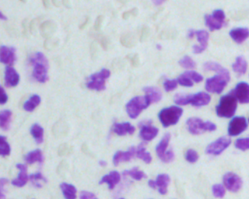
Image
Images folder contains the image file.

Slide 5


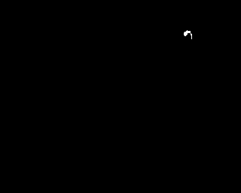
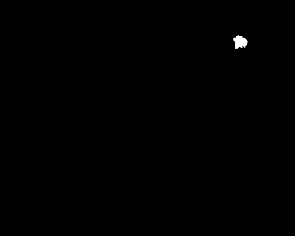
Masks
Masks folder contains the segmented masks of each nucleus. This folder is only included in the training set. Each mask contains one nucleus. Masks are not allowed to overlap.

Slide 6
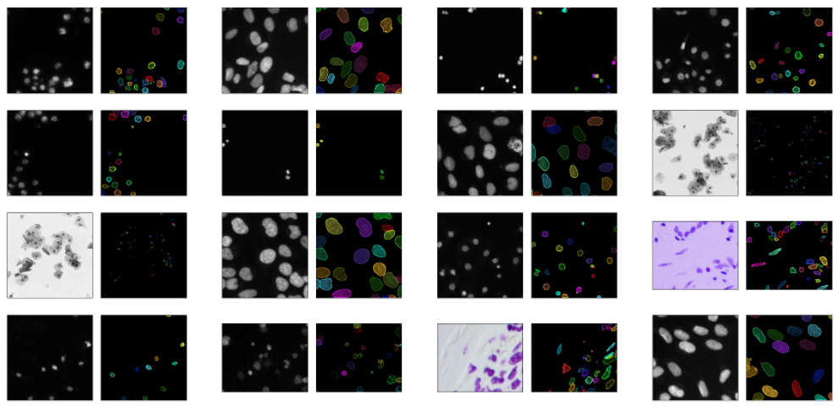

Slide 7
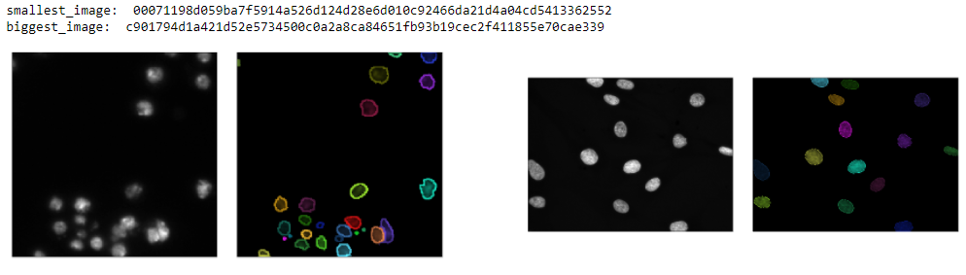
Image Size
Smallest image
Biggest image

Slide 8
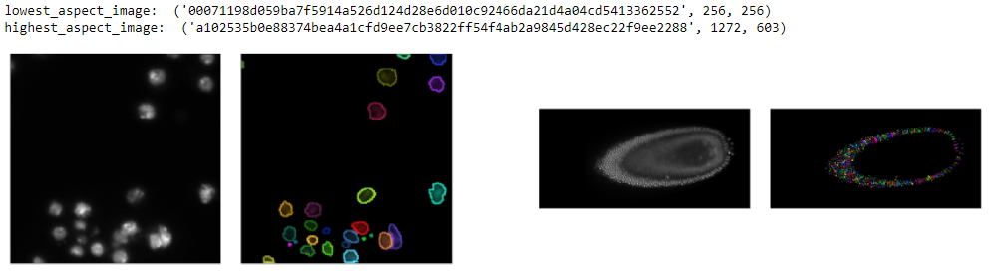
Image Size
Lowest aspect image
Highest aspect image

Slide 9
Resize image
IMG_WIDTH = 128
IMG_HEIGHT = 128

Slide 10
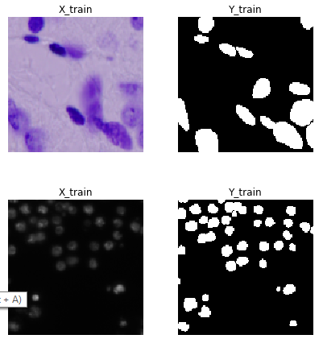
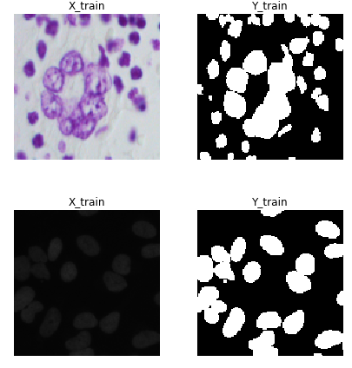
Show image

Slide 11
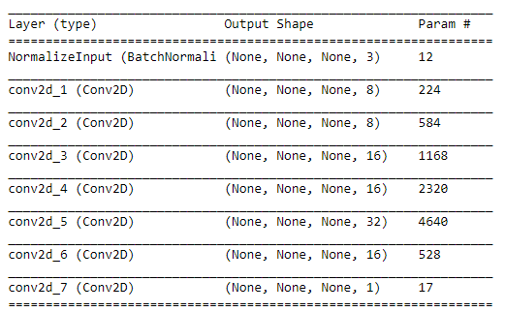
Simple CNN

Slide 12
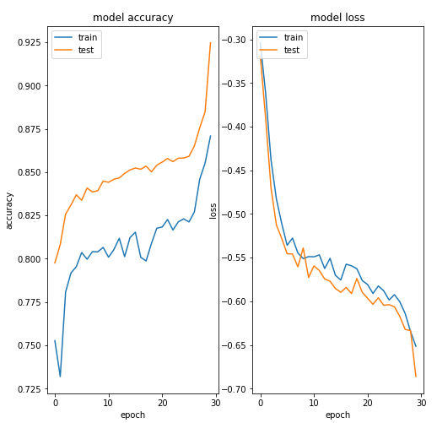
Model accuracy & Model loss

Slide 13
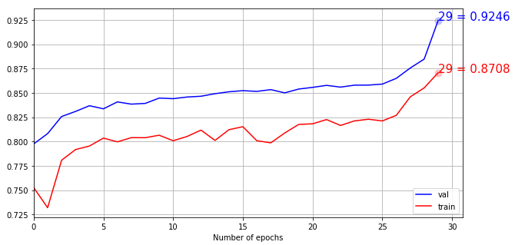
Model accuracy

Slide 14
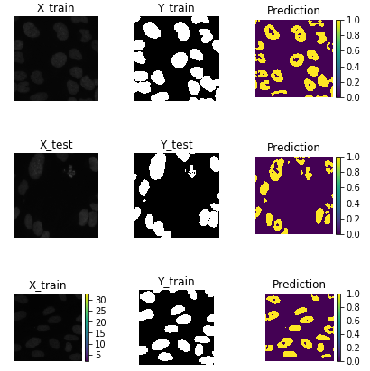
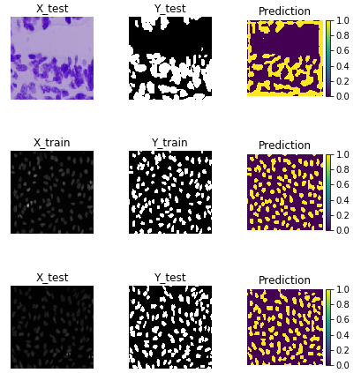
Prediction Result of Training Set

Slide 15
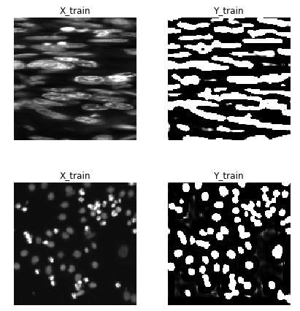
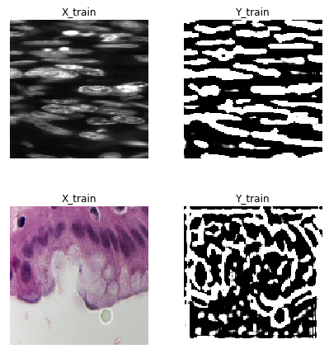
Prediction Result of Testing Set

Slide 16
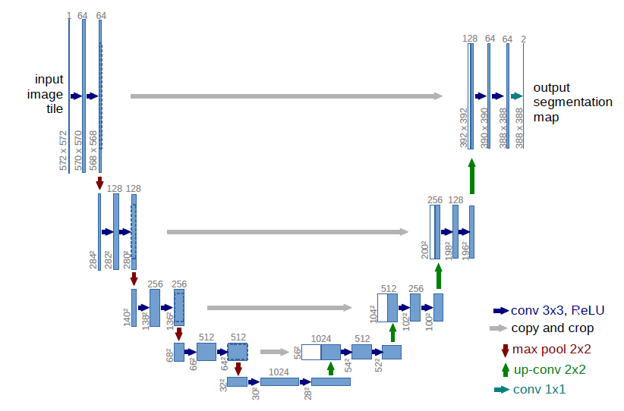
U-net CNN
The architecture of U-net CNN consists of a contracting path to capture context and a symmetric expanding path that enables precise localization. We show that such a network can be trained end-to-end from very few images and outperforms the prior method.

Slide 17
U-net CNN
Capture context
Precisely localize
Contracting path
Expanding path

Slide 18
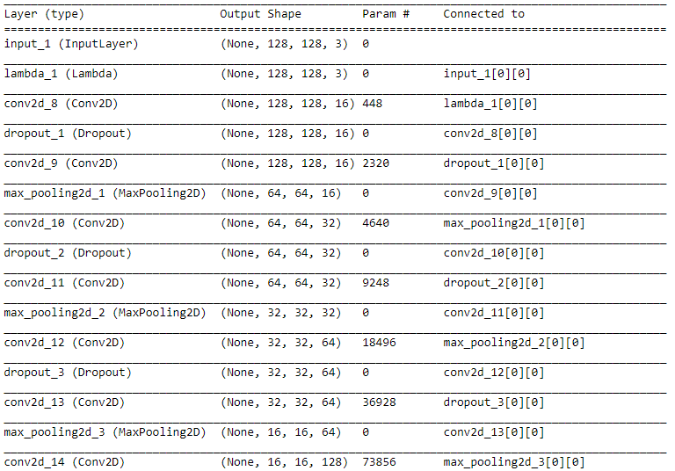
U-net CNN
a contracting path to capture contex

Slide 19
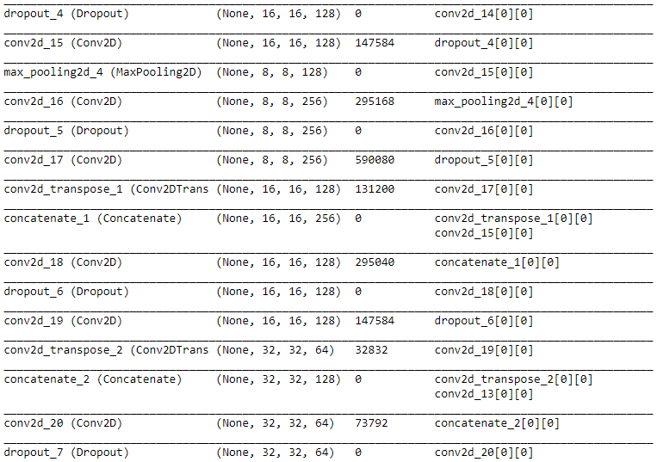
U-net CNN
a symmetric expanding path that enables precise localization

Slide 20
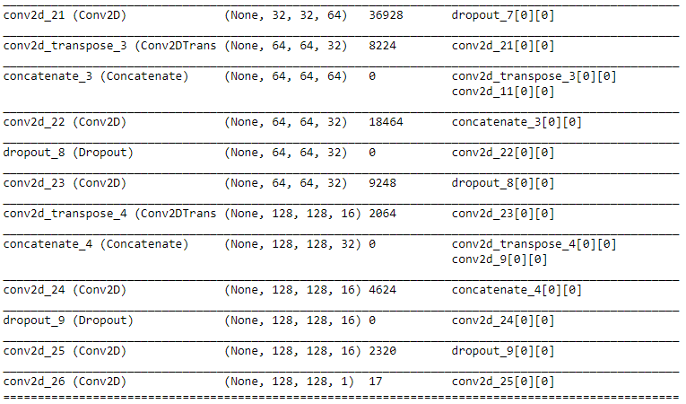
U-net CNN
a symmetric expanding path that enables precise localization

Slide 21
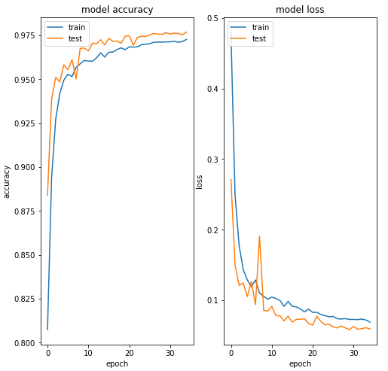
Model accuracy & Model loss

Slide 22
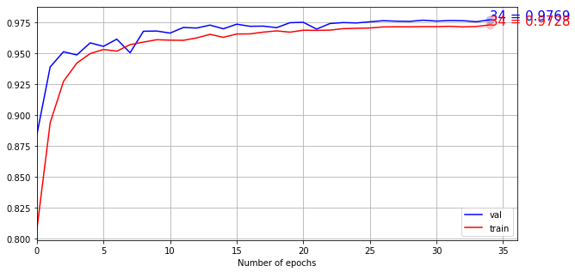
Model accuracy

Slide 23
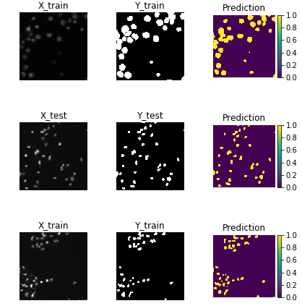
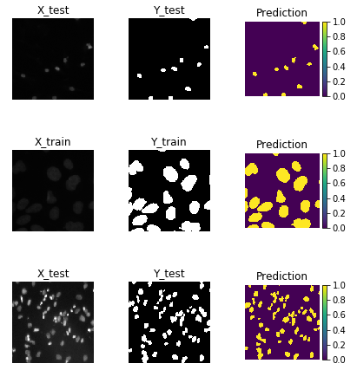
Prediction Result of Training Set

Slide 24
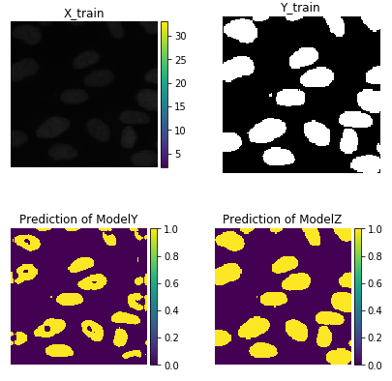
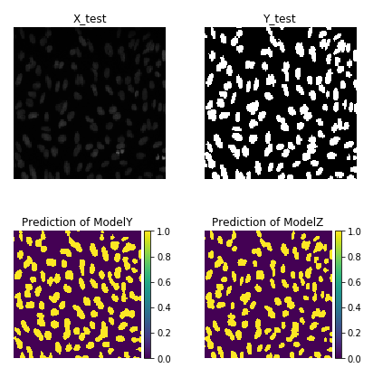
Compared Prediction Result of Both Models

Slide 25
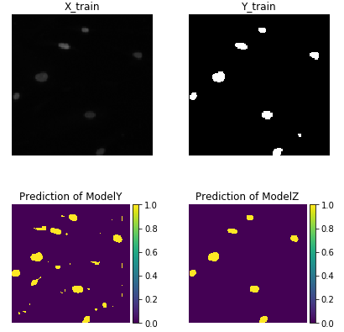
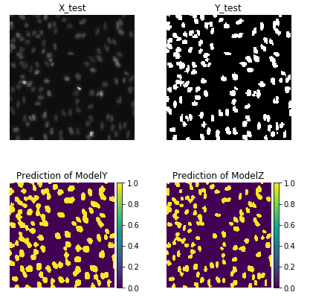
Compared Prediction Result of Both Models

Slide 26
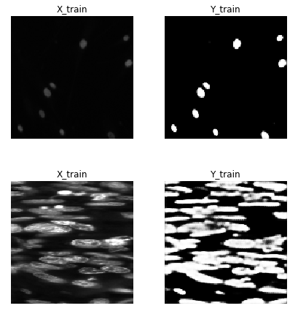
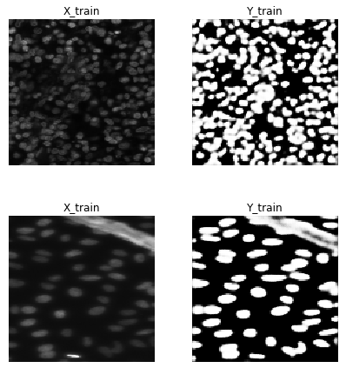
Prediction Result of Testing Set

Slide 27
Next Steps and Thoughts
By increasing the dataset, we can further improve the accuracy of model. We can add more functions, like counting the number of cells in one image.

Slide 28
Thank You!

