Slide 1
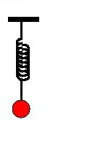
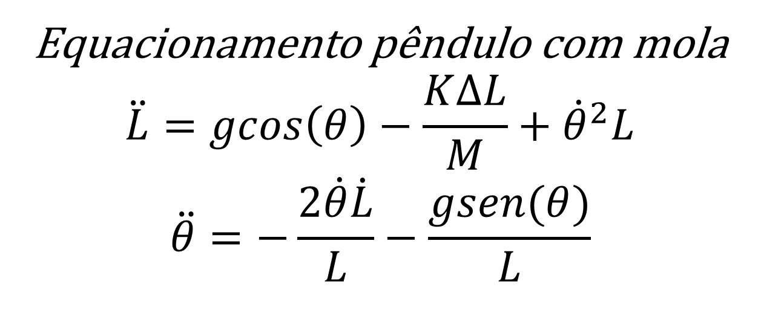






Equacionamento pêndulo com mola
$$\ddot{L}=gcos\left(θ\right)−\frac{K∆L}{M}+{\dot{θ}}^{2}L$$
$$\ddot{θ}=−\frac{2\dot{θ}\dot{L}}{L}−\frac{gsen(θ)}{L}$$
$$K$$
$$L$$
$$θ$$
$$M$$
$$\ddot{L}=g −\frac{K∆L}{M}$$
$$\ddot{θ}=−\frac{gθ}{L}$$
Simplificações
$$\dot{θ}≅0$$
$$sen\left(θ\right)≅θ$$
$$\cos\left(θ\right)≅1$$

