Slide 1
Lir analysis

Slide 2
Notes on processing in subsequent analyses:
expanded ilir 6mers to 7mers
reduced screening motifs to 7mers
removed duplicate 7mers from lir central test set, ilir set, and screening sets (binders and nonbinders)
removed 7mers from screening sets that are present in ilir set
removed 7mers from screening sets that were present in both nonbinder and binder sets

Slide 3
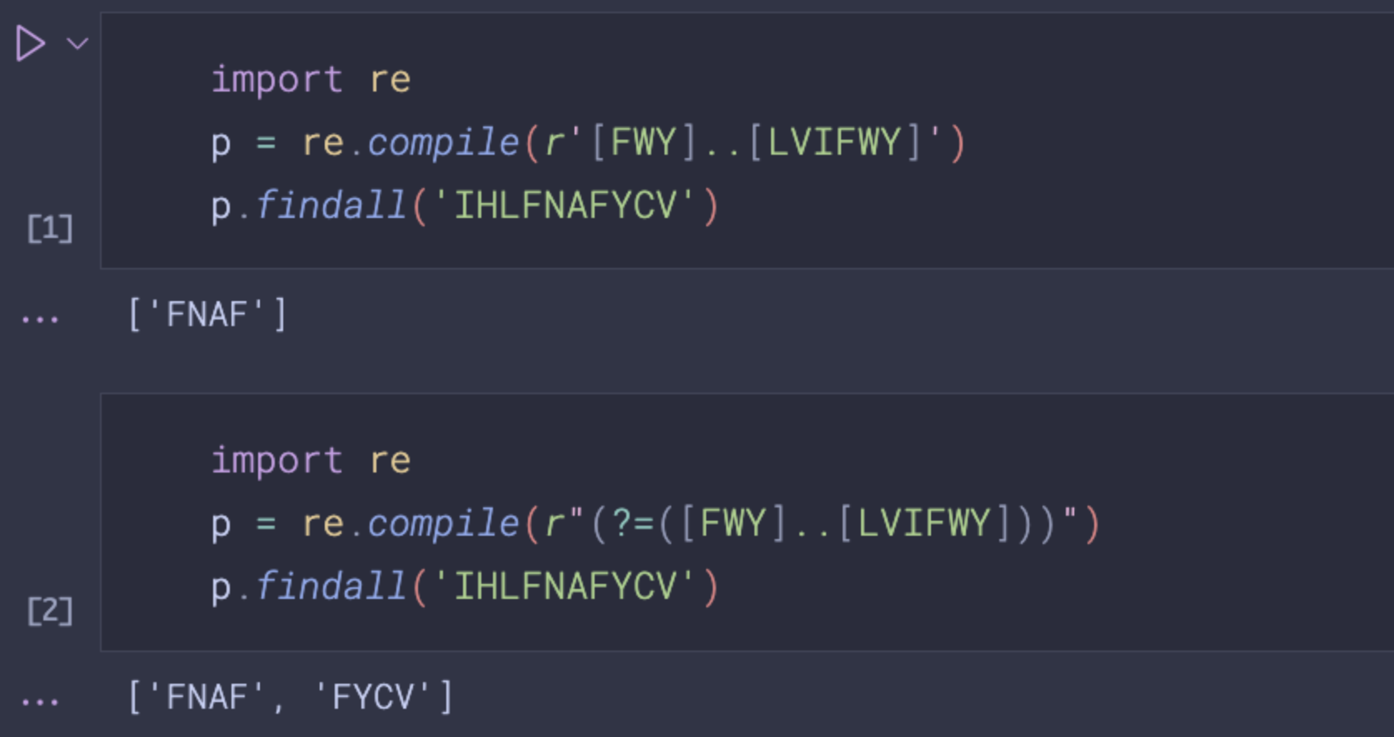
issue with how python handles regexes
IHLFNAFYCV
initial dataset would find 1 motif (FNAF)
should probably be 2 motifs (FNAF + FYCV)
If not 2 motifs, then how do you choose which one to use?
lookahead group
For the starting dataset, when overlapping motifs were present, only the first (N-term) motif was counted

Slide 4
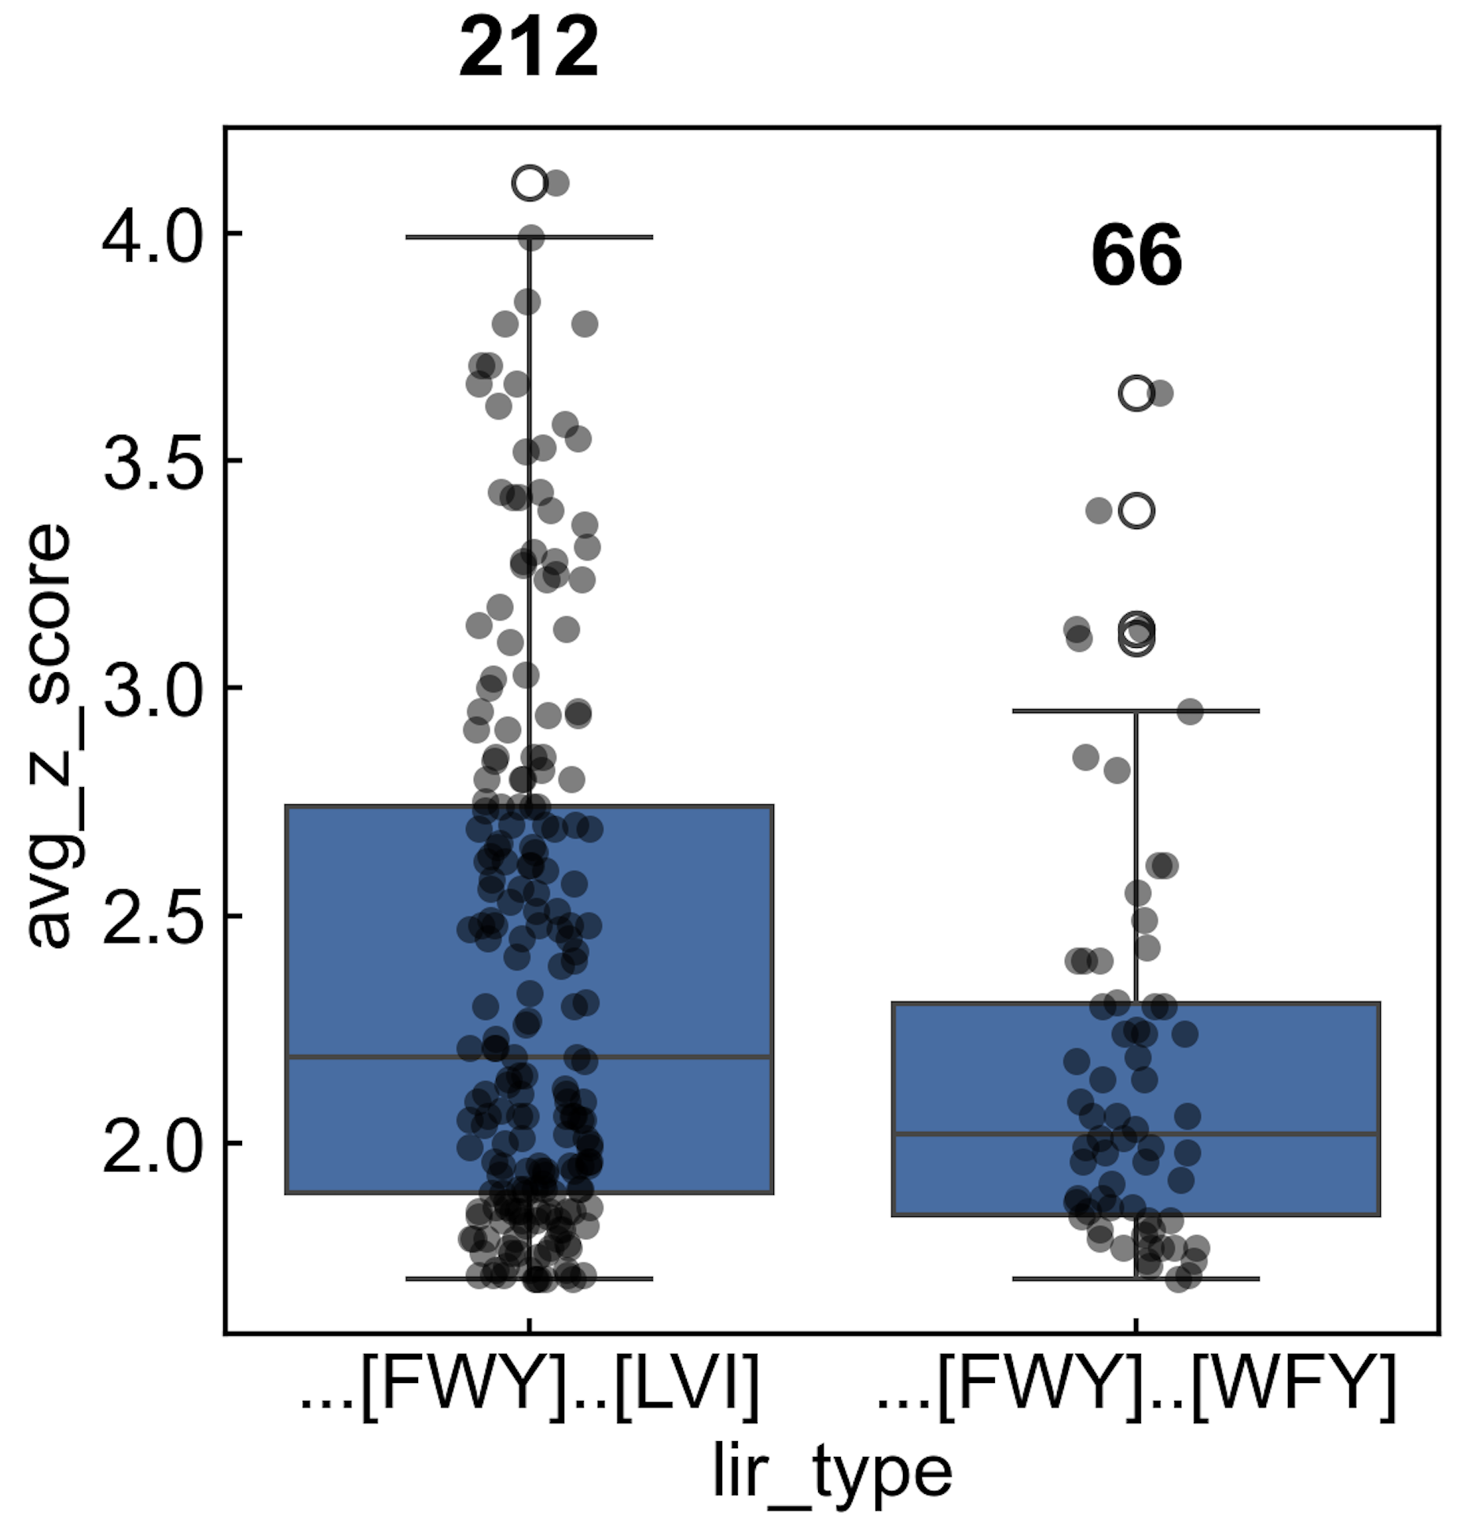
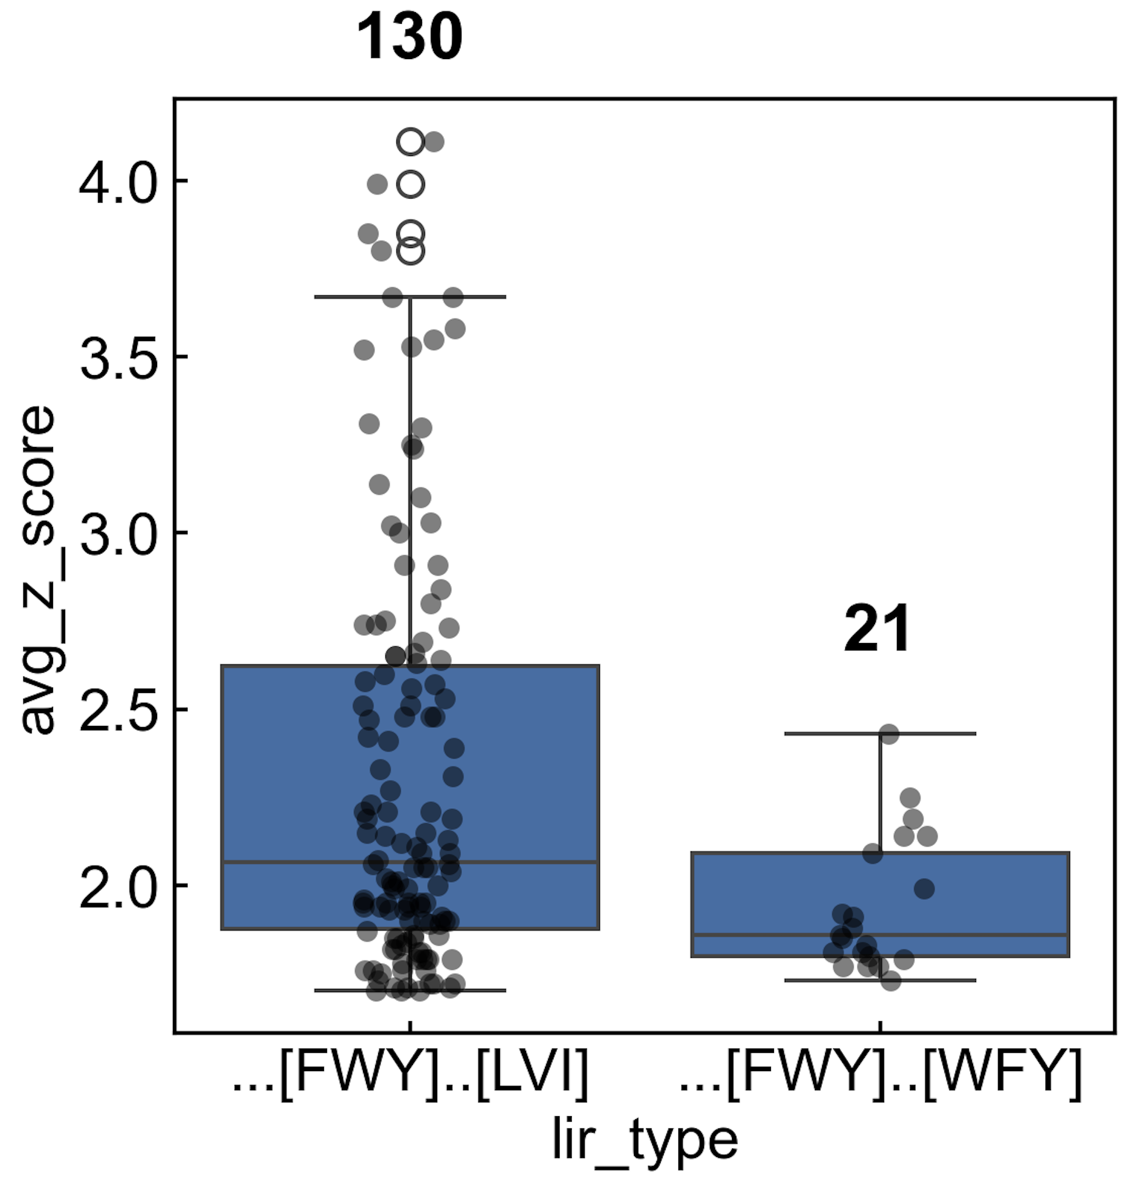
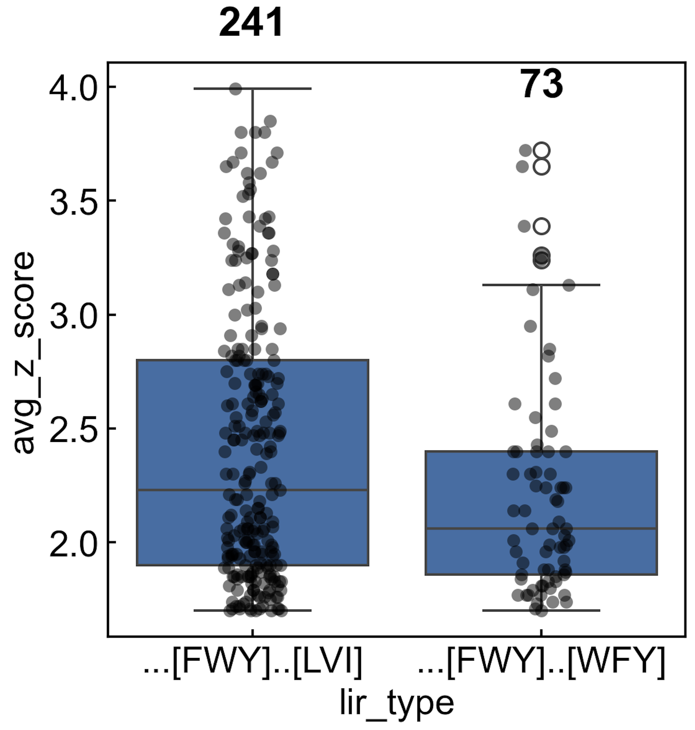
Dataset summary
V1 – overlapping motifs were not accounted for in regex definition
There is no rationale I can think of to justify using this set? only v2 or v3 make sense to me
V2 – removed any sequences with >1 motif
V3 – split all motif matches into separate 7mers

Slide 5
V2 – removed any sequences with >1 motif

Slide 6
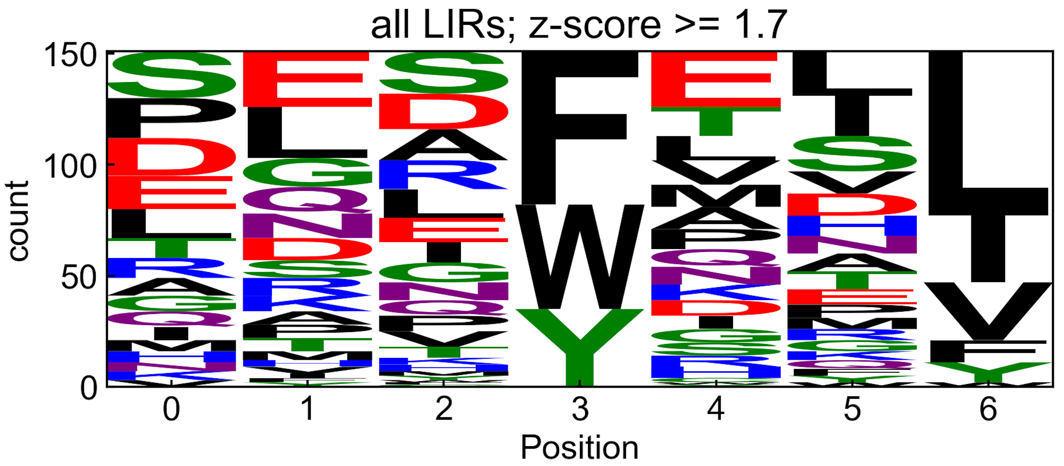
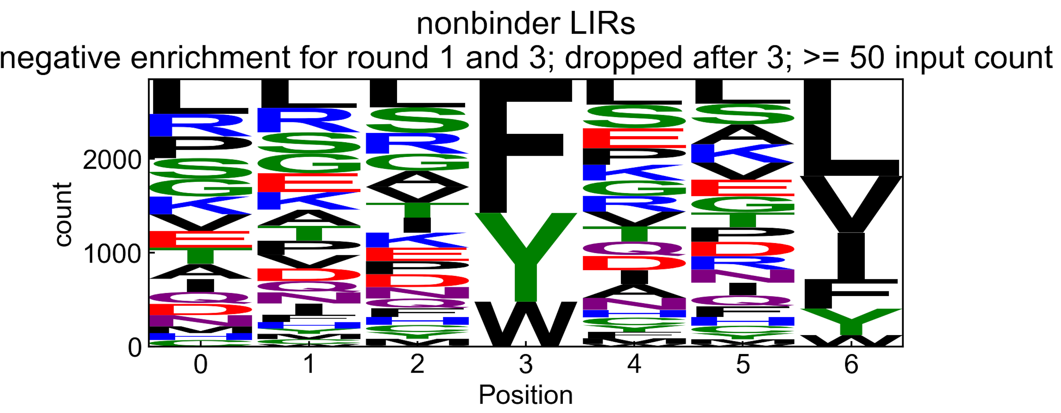
V2 – removed any sequences with >1 motif
screen binders
(z-score > 1.7)
screen nonbinders
(dropped out after round 3)

Slide 7
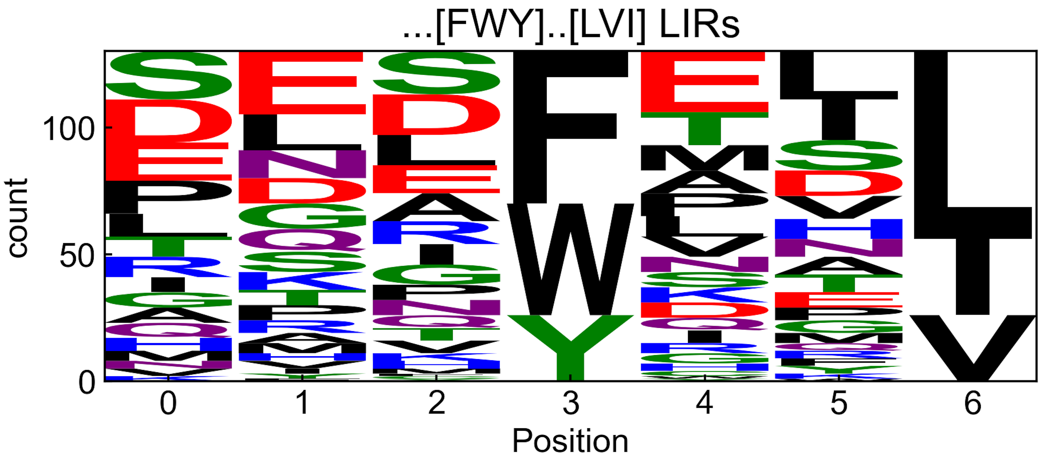
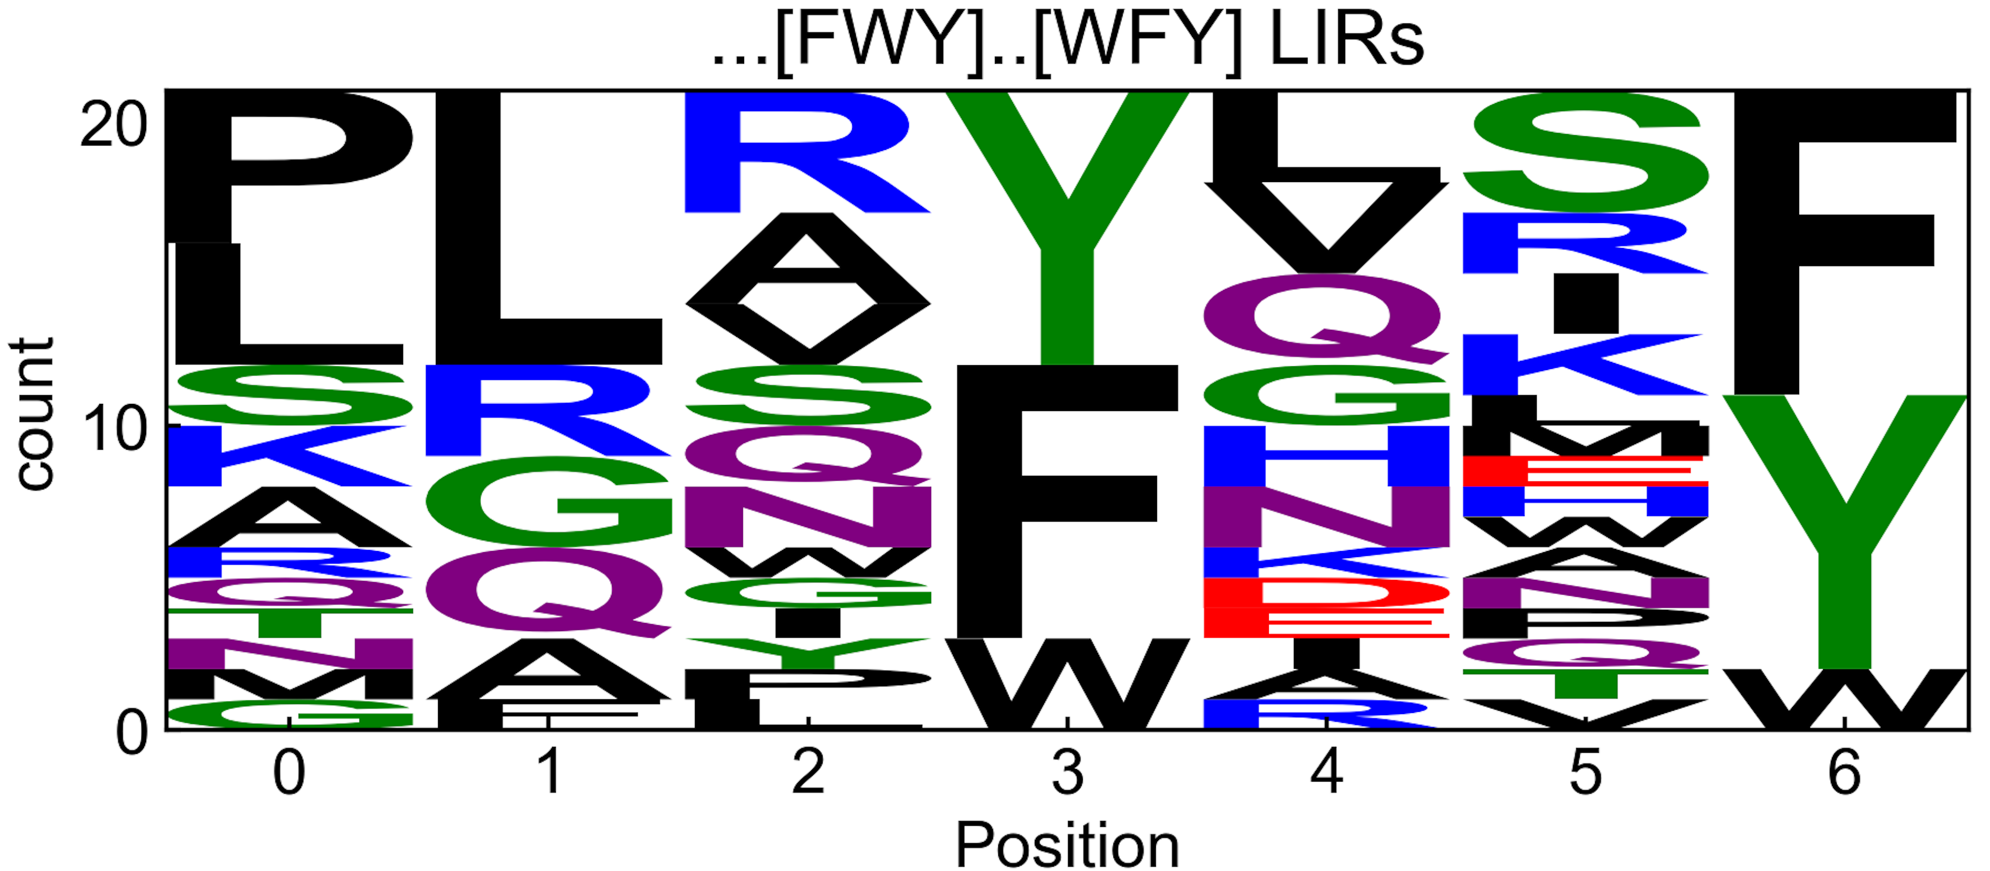
V2 – removed any sequences with >1 motif
screen binders
screen binders

Slide 8
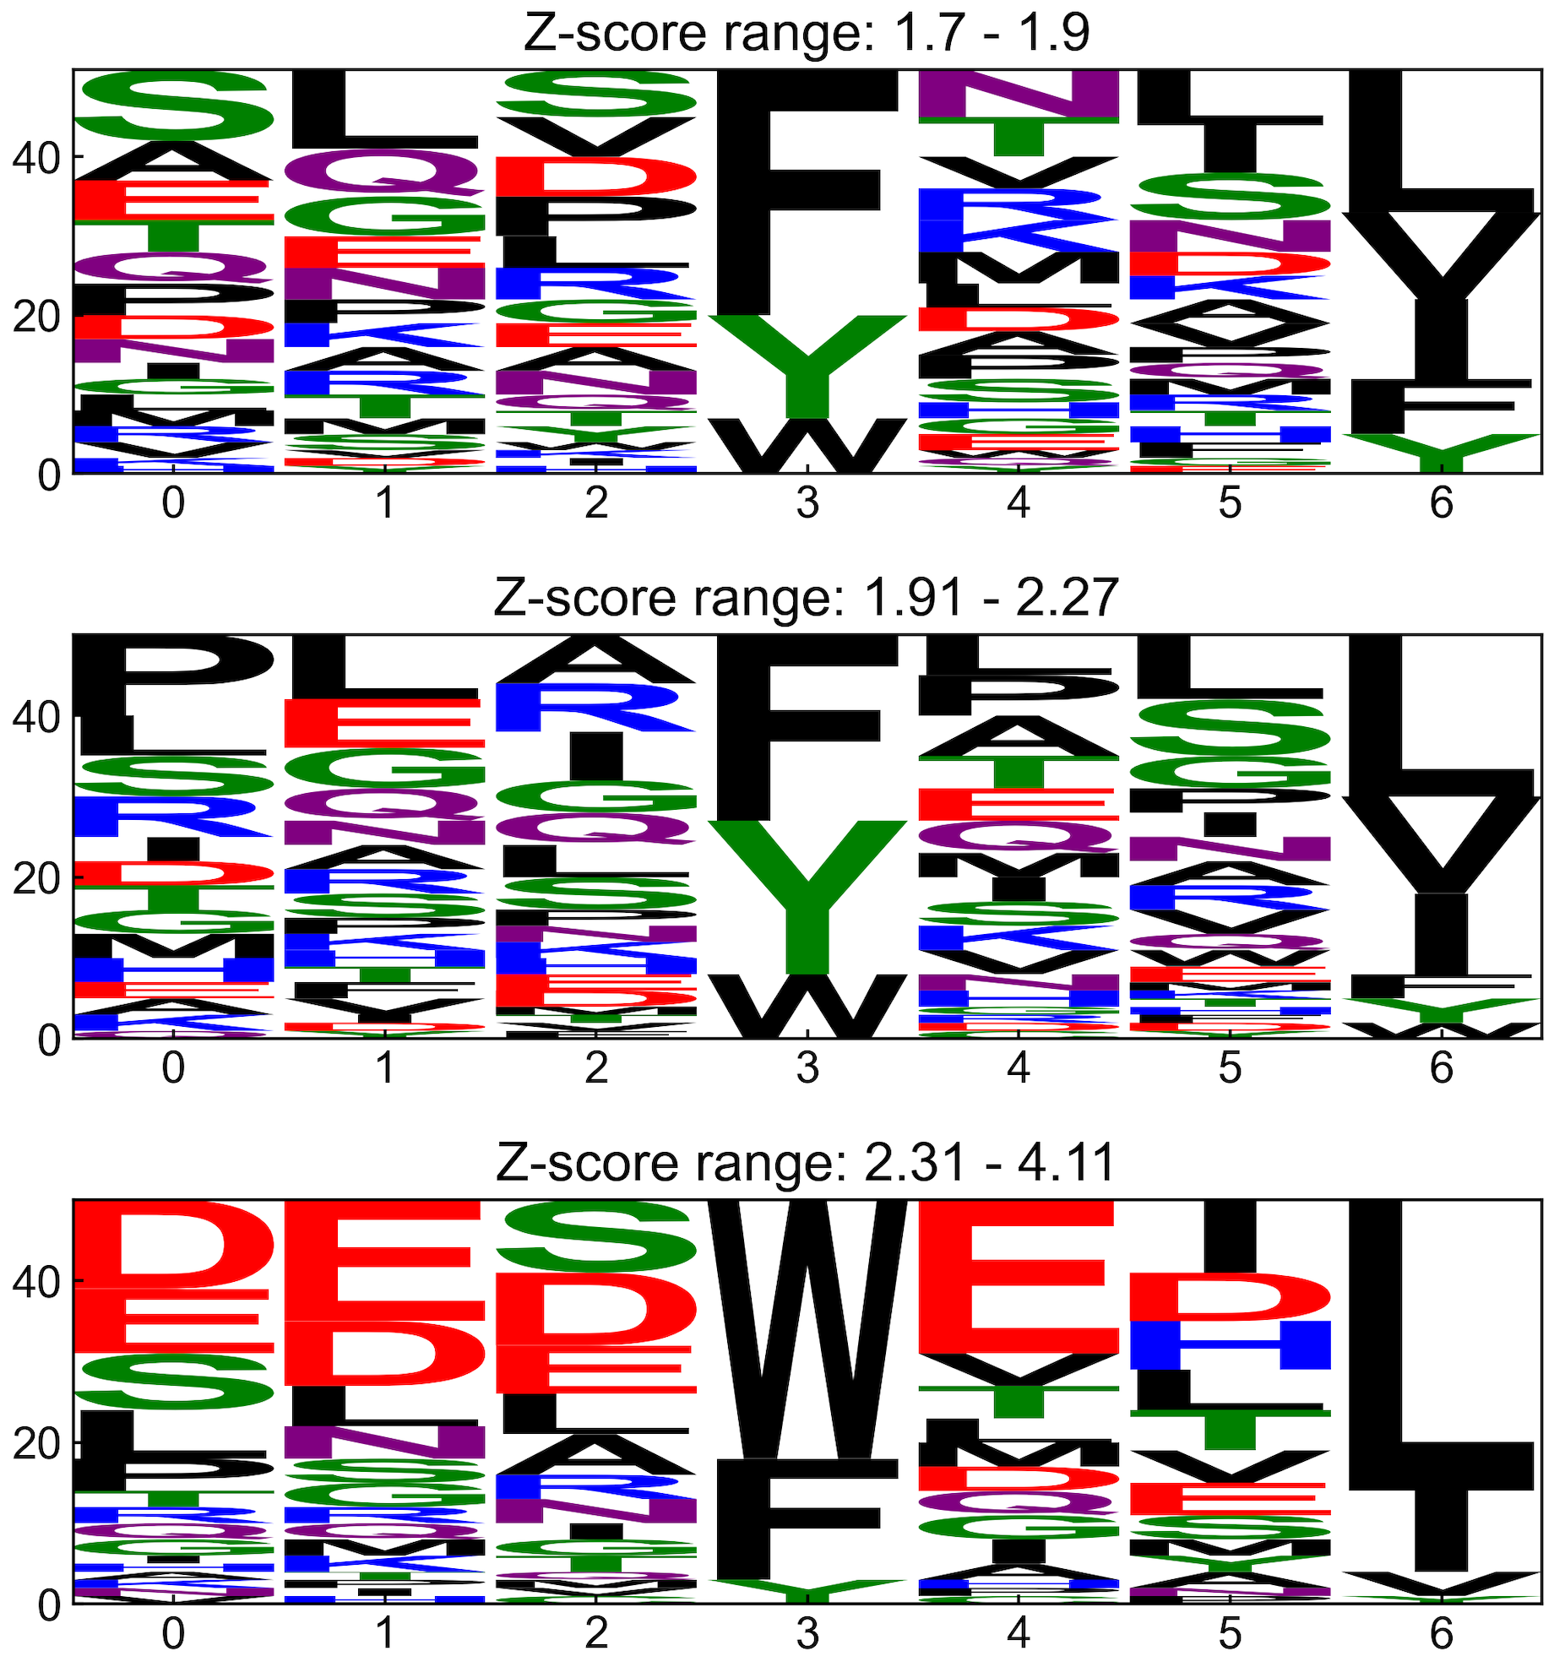
V2 – removed any sequences with >1 motif
screen binders

Slide 9
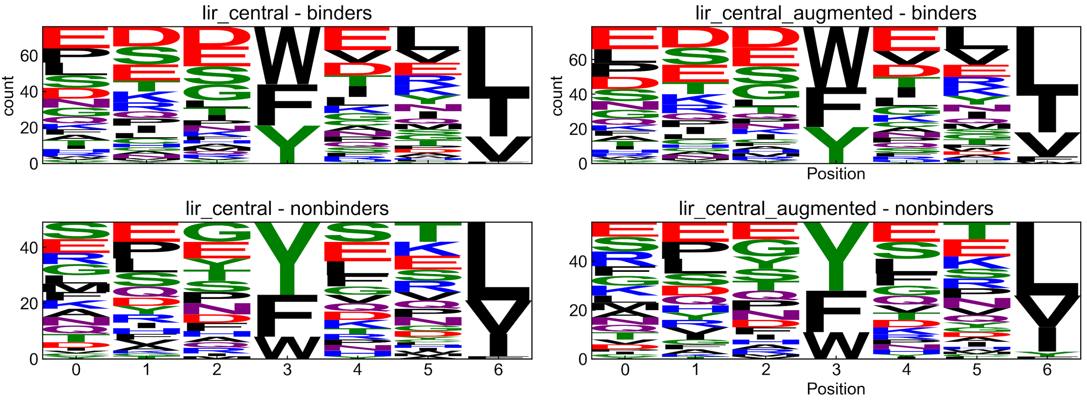
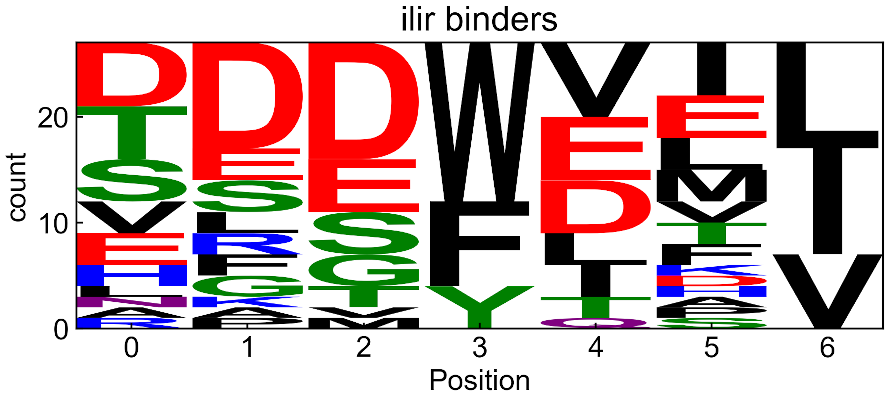
V2 – removed any sequences with >1 motif
screen

Slide 10
V2 – removed any sequences with >1 motif
experiment 1
[FWY]xx[LVI] test
lir central
(binders and nonbinders)
= training set
ilir
= test set
[FWY]xx[LVI]
sequences
[FWY]xx[LVI] PSSM
(212)
“train”
(binders)
screening data
recombine
PSSMs from different
z-score ranges
“train”
(binders)
[FWY]xx[FWY]
sequences
[FWY]xx[FWY] PSSM
all binders (PSSM)
(66)
[FWY]xx[FWY] test
(binders and nonbinders)

Slide 11
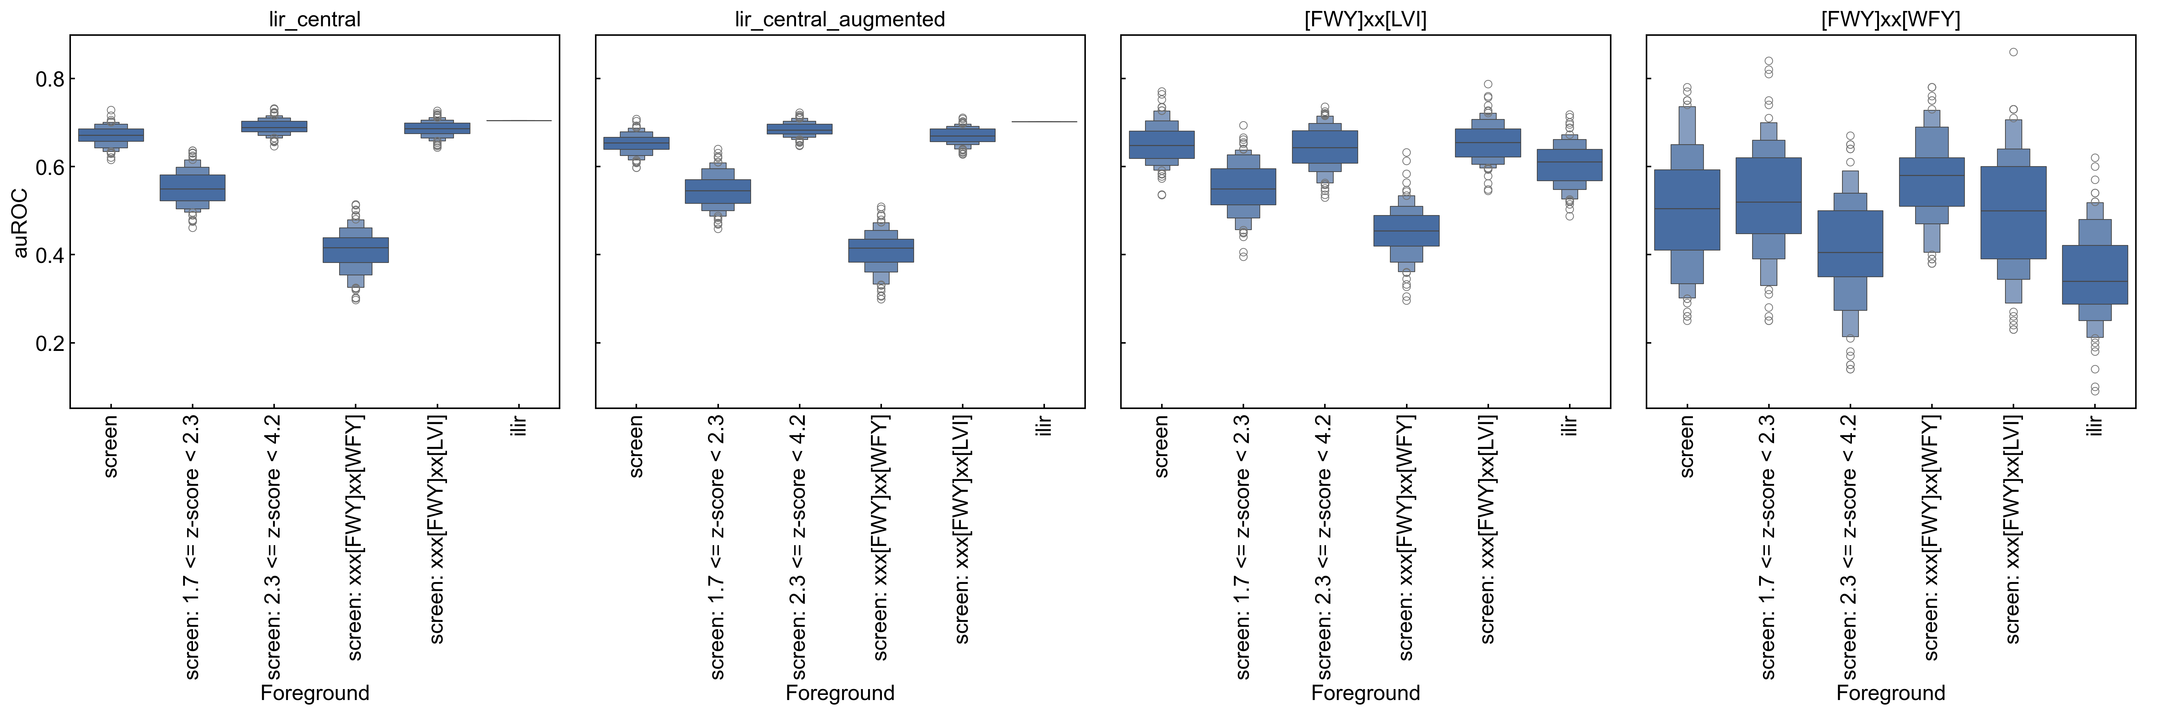
V2 – removed any sequences with >1 motif
experiment 1
binders (z-score >= 1.7)
matching motif [FWY]xx[LVI]
binders (z-score >= 1.7)
matching motif [FWY]xx[FWY]
test sets
z-score >= 1.7
matching the motif shown
all binders
(z-score >= 1.7)

Slide 12
V2 – removed any sequences with >1 motif
experiment 2
lir central
= training set
= test set
ilir
screening nonbinders
test set
screening data
binders from different
z-score ranges
1.7 <= z-score <= 4.2
1.7<= z-score <= 2.0
”train”
PSSM
all binders
2.0 <= z-score <= 2.5
2.5 <= z-score <= 4.2
all binders (PSSM)

Slide 13
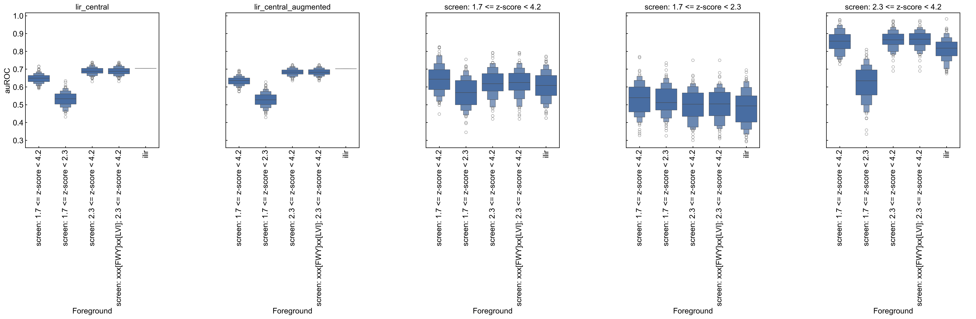
V2 – removed any sequences with >1 motif
experiment 2
test sets
all binders
all binders

Slide 14
V3 – split all motif matches into separate 7mers

Slide 15
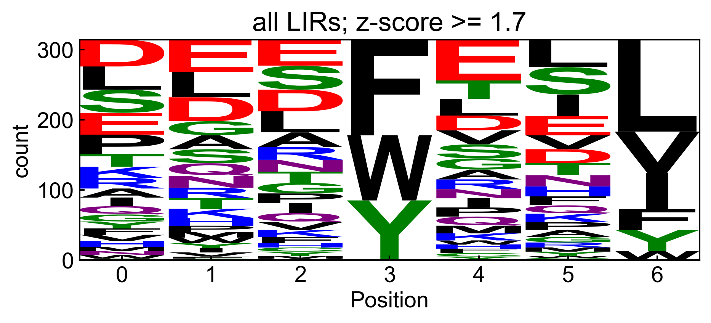
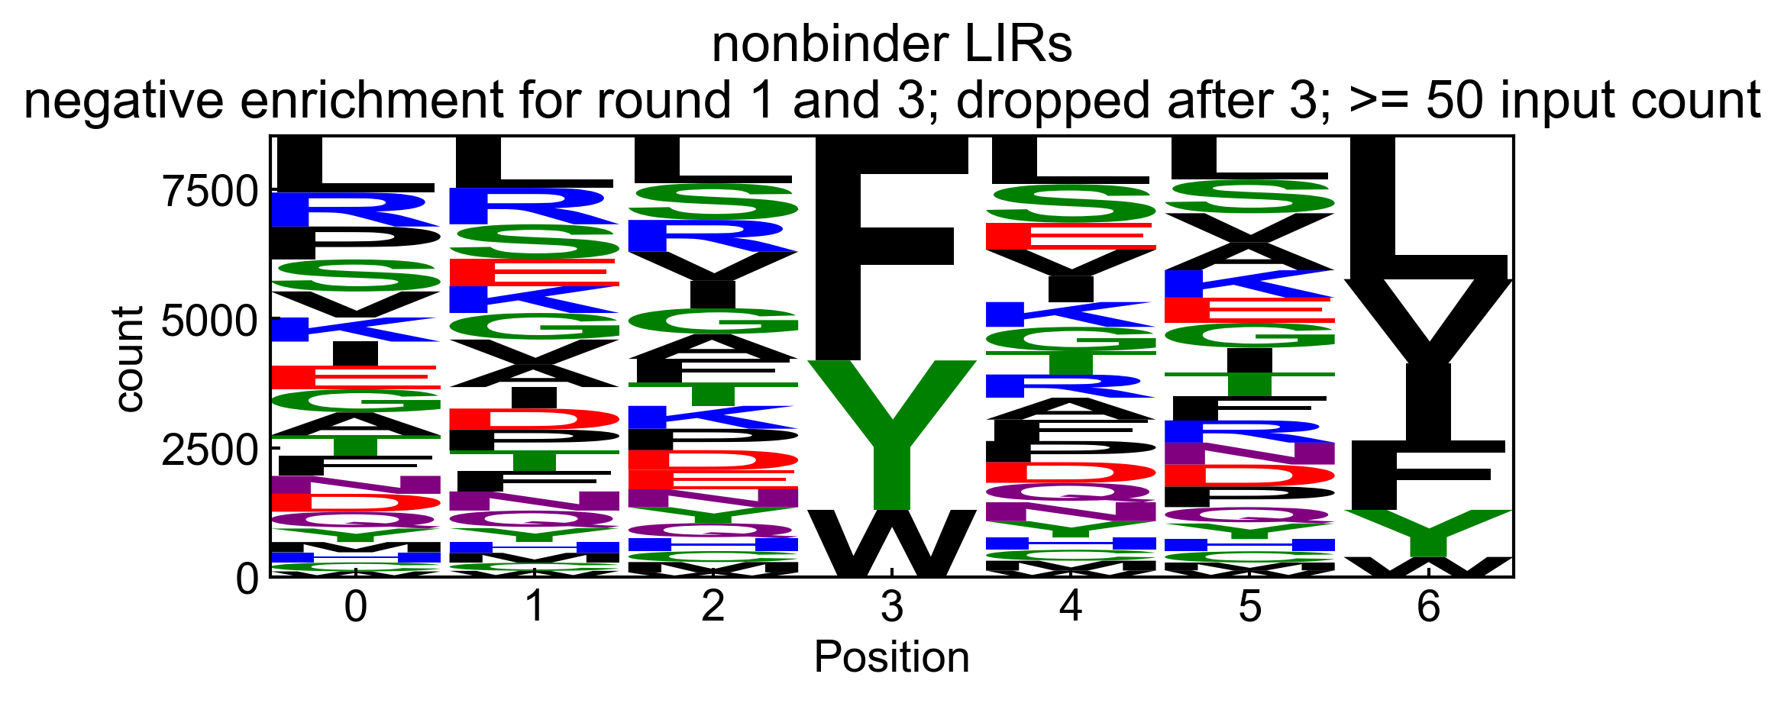
V3 – split all motif matches into separate 7mers
screen binders
(z-score > 1.7)
screen nonbinders
(dropped out after round 3)

Slide 16
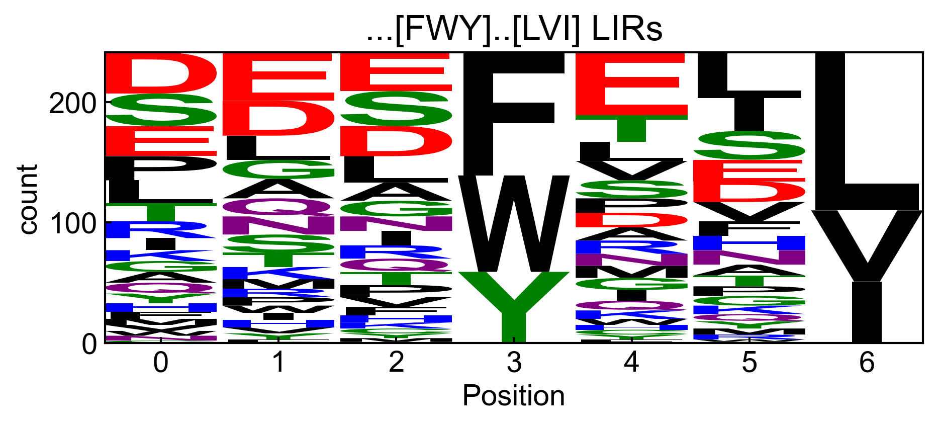
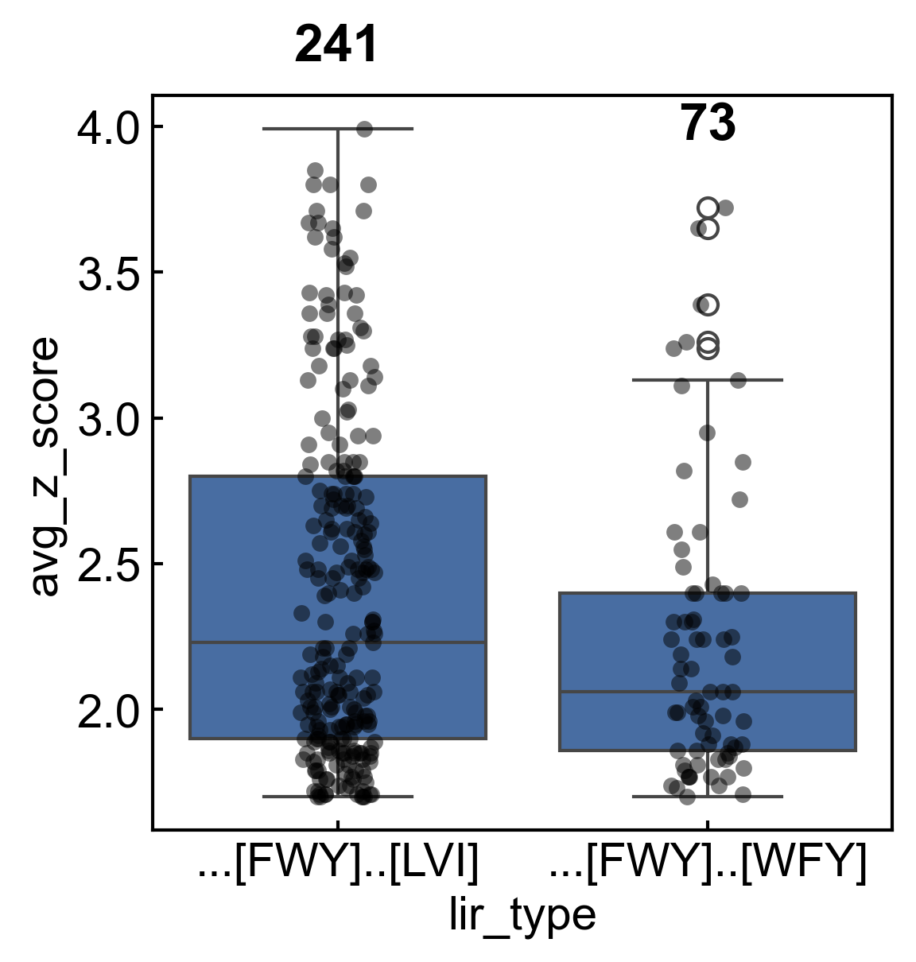
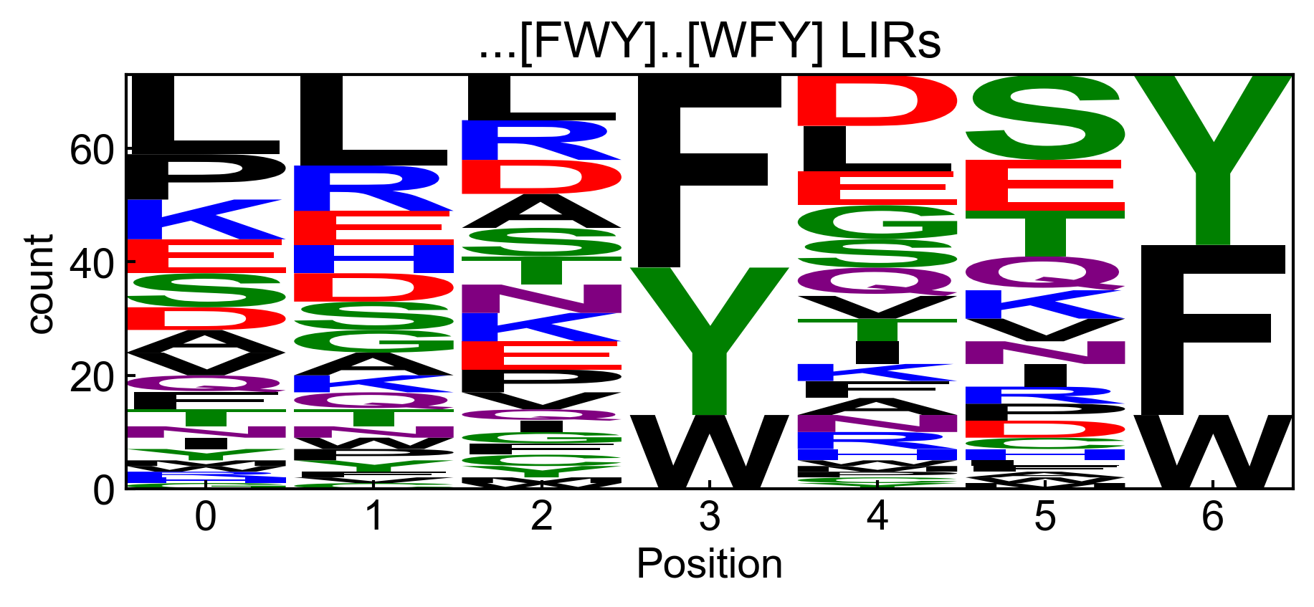
V3 – split all motif matches into separate 7mers
screen binders
screen binders

Slide 17
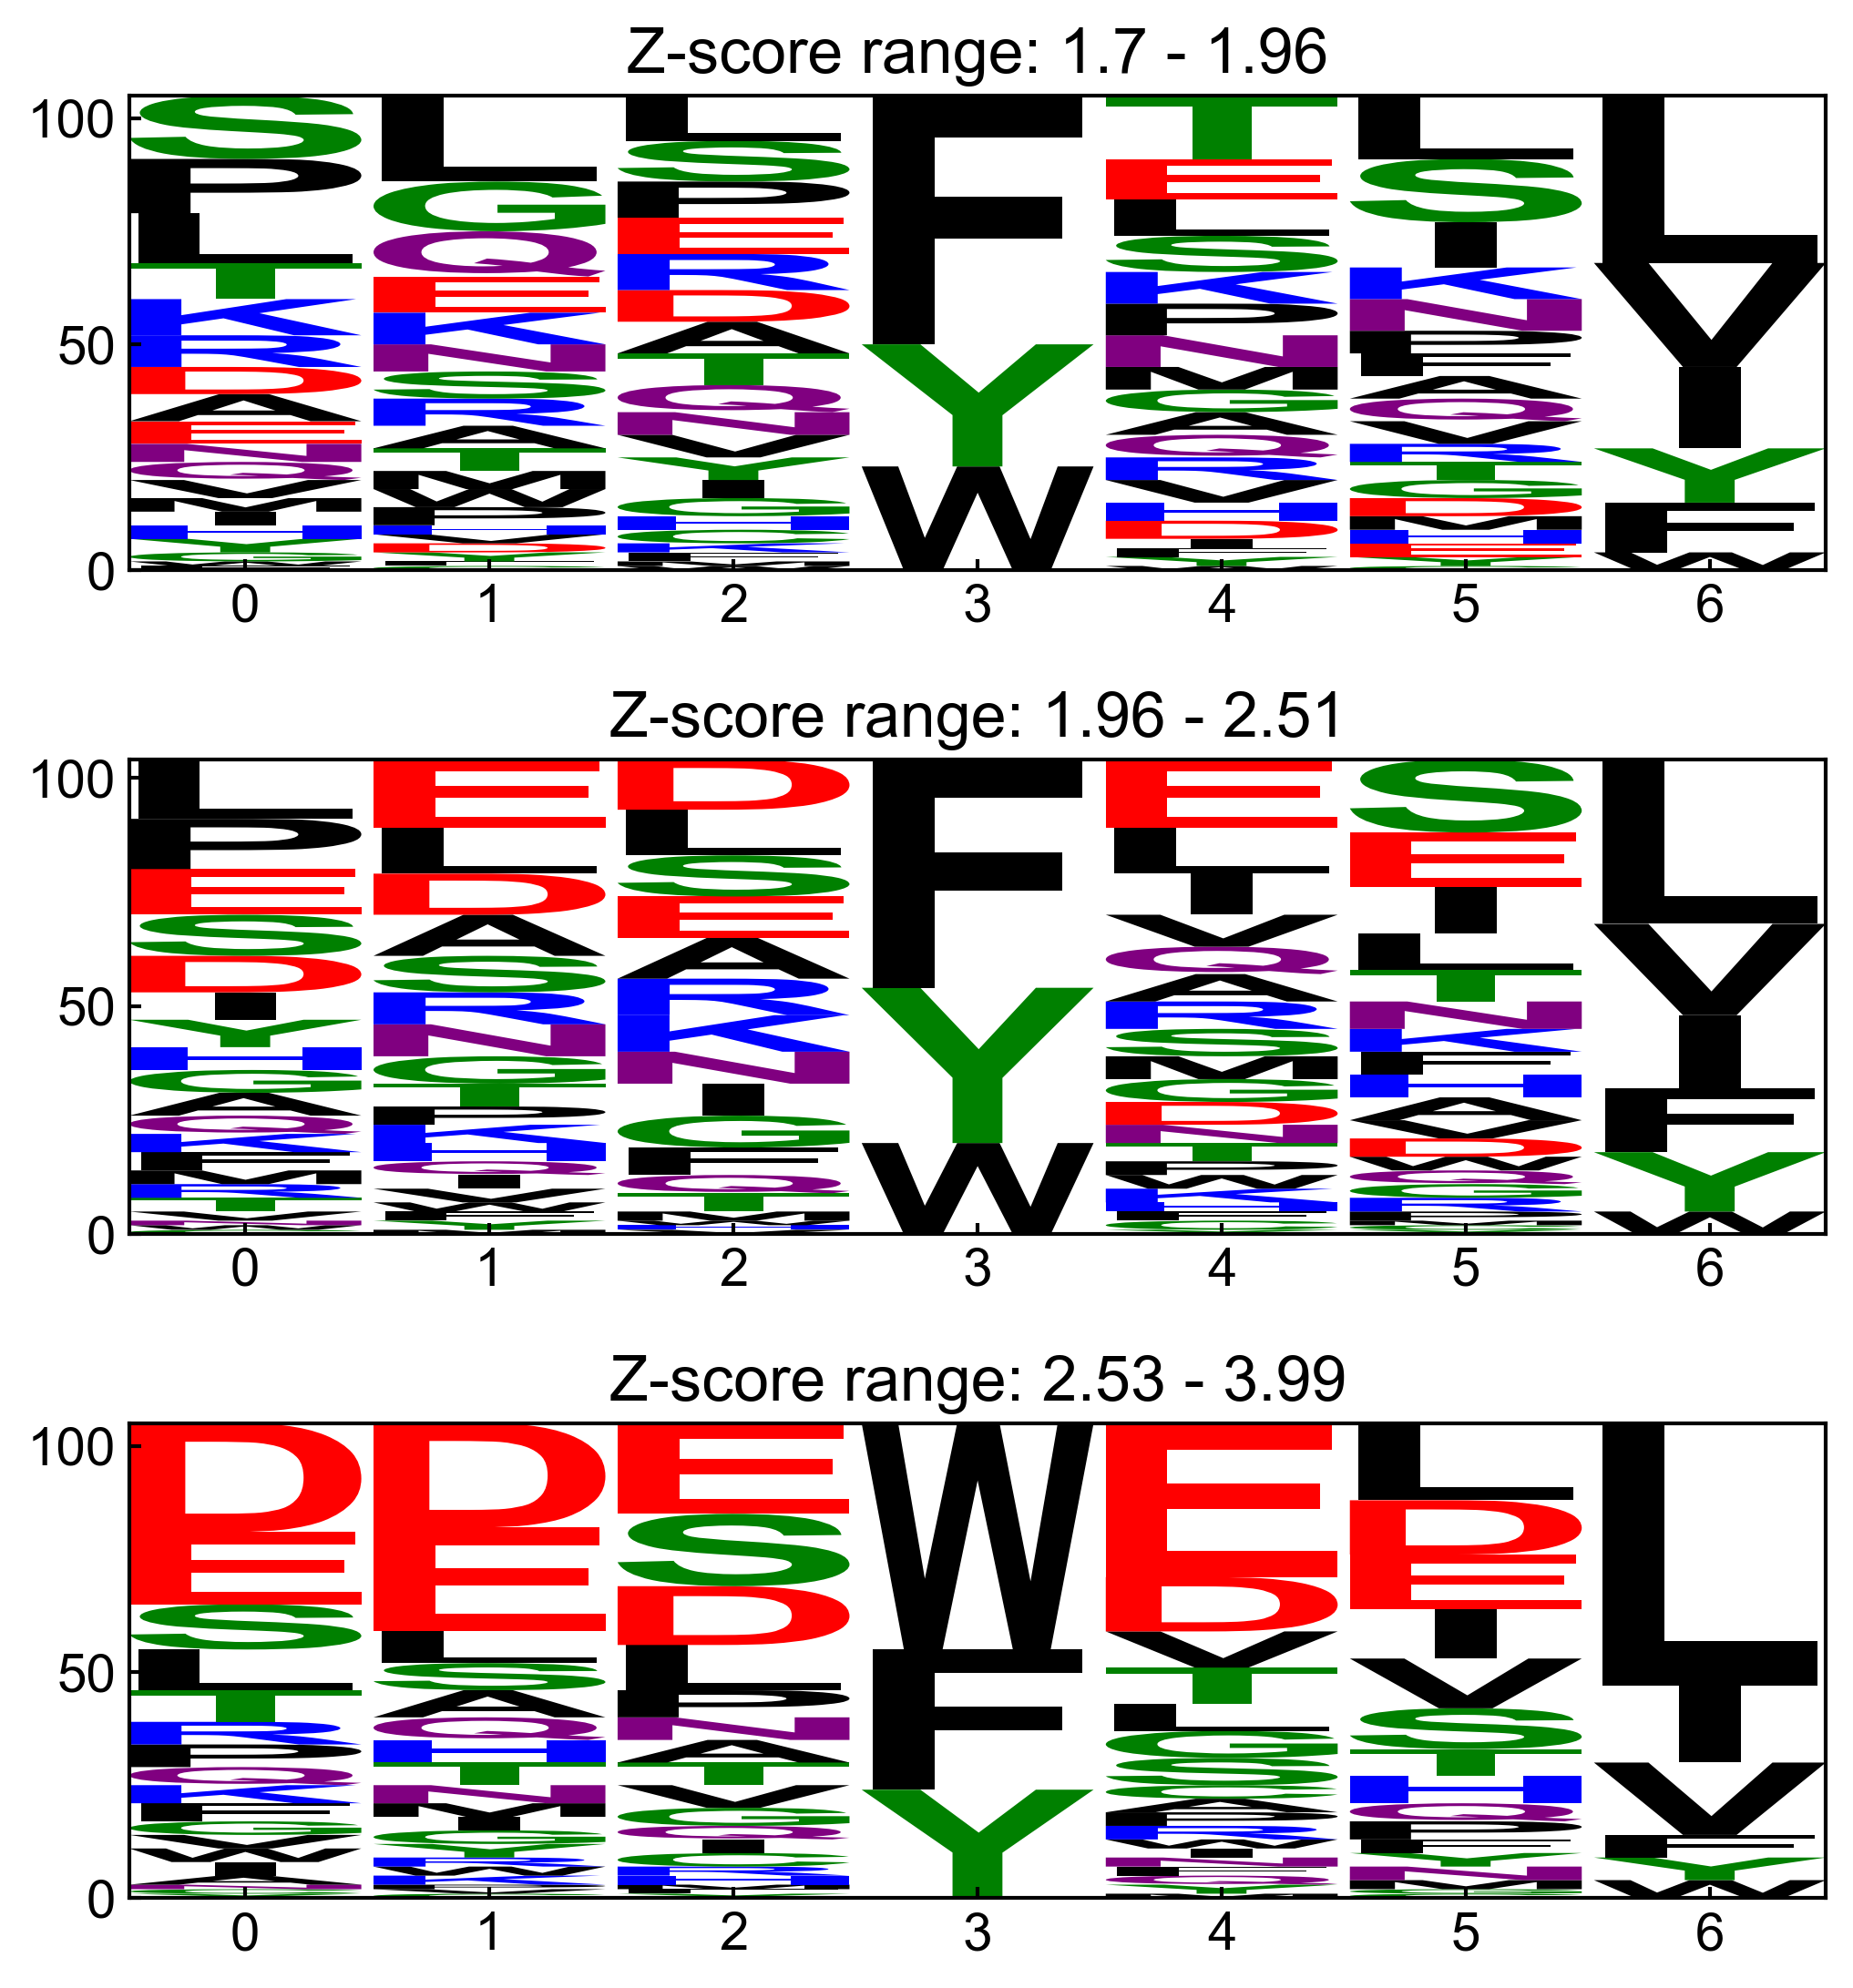
V3 – split all motif matches into separate 7mers
screen binders

Slide 18
V3 – split all motif matches into separate 7mers
screen

Slide 19
V3 – split all motif matches into separate 7mers
experiment 1
[FWY]xx[LVI] test
lir central
(binders and nonbinders)
ilir
= training set
[FWY]xx[LVI]
sequences
[FWY]xx[LVI] PSSM
= test set
(212)
“train”
(binders)
screening data
recombine
PSSMs from different
z-score ranges
“train”
(binders)
[FWY]xx[FWY]
sequences
[FWY]xx[FWY] PSSM
all binders (PSSM)
(66)
[FWY]xx[FWY] test
(binders and nonbinders)

Slide 20
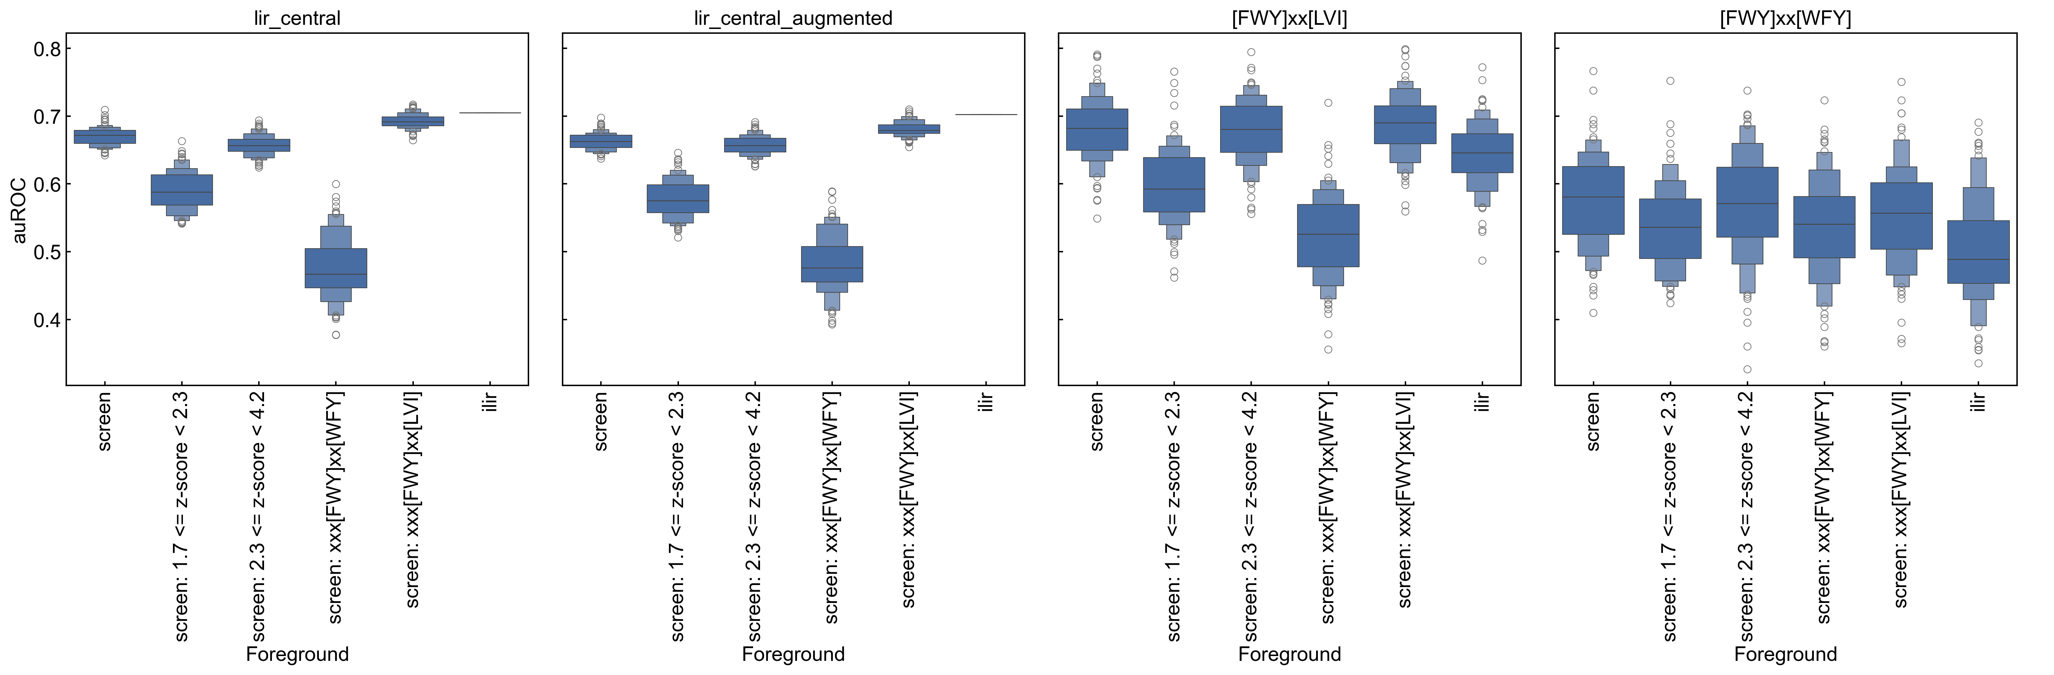
V3 – split all motif matches into separate 7mers
experiment 1
binders (z-score >= 1.7)
matching motif [FWY]xx[FWY]
test sets
binders (z-score >= 1.7)
matching motif [FWY]xx[LVI]
z-score >= 1.7
matching the motif shown
all binders
(z-score >= 1.7)

Slide 21
V3 – split all motif matches into separate 7mers
experiment 2
lir central
= training set
= test set
ilir
screening nonbinders
test set
screening data
binders from different
z-score ranges
1.7 <= z-score <= 4.2
1.7<= z-score <= 2.0
”train”
PSSM
all binders
2.0 <= z-score <= 2.5
2.5 <= z-score <= 4.2
all binders (PSSM)

Slide 22
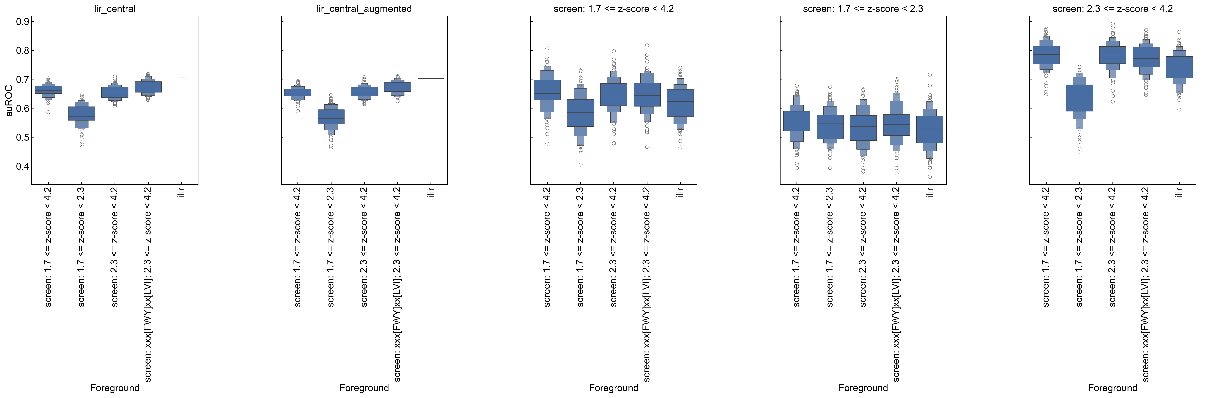
V3 – split all motif matches into separate 7mers
experiment 2
test sets
all binders
all binders

