Slide 2
frequencies

Slide 3
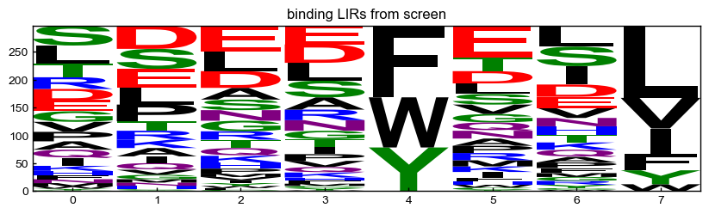
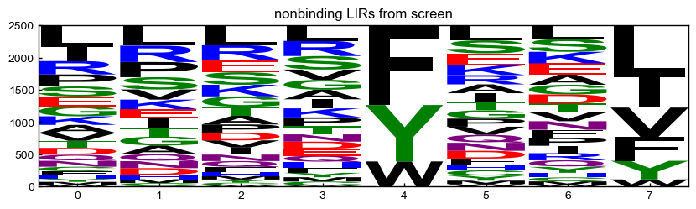
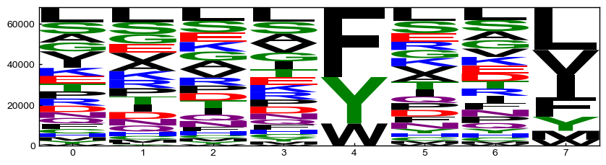
screening hits
Jen’s defined binders
(z-score > 1.7)
Jen’s defined nonbinders
(dropped out after round 3?)
LIRs in input library
(everything with >100 reads in input library)

Slide 4
screening hits
Jen’s defined binders
(z-score > 1.7)
Jen’s defined nonbinders
(dropped out after round 3?)
LIRs in input library
(everything with >100 reads in input library)

Slide 5
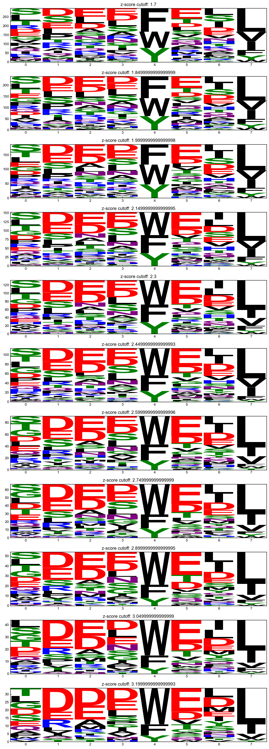
screening hits
all binders w/ z-score > cutoff

Slide 6
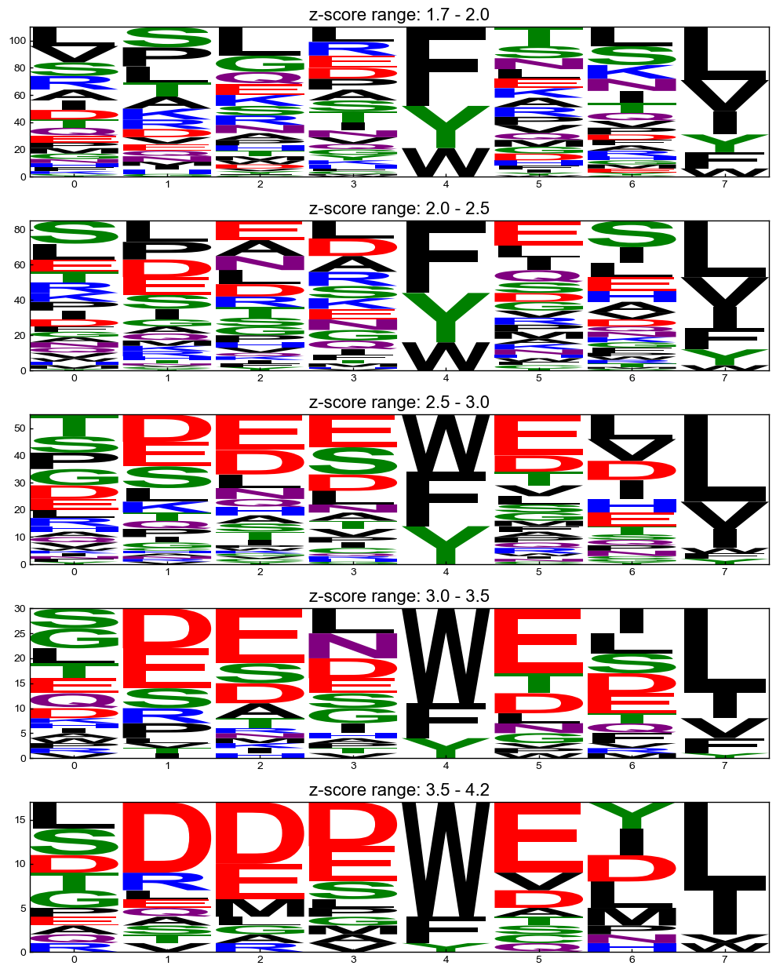
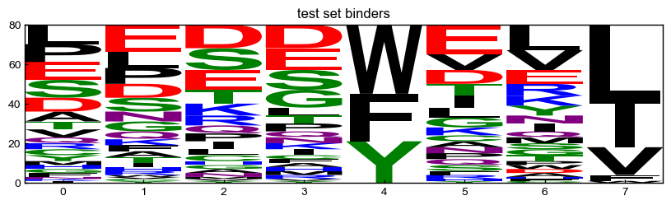
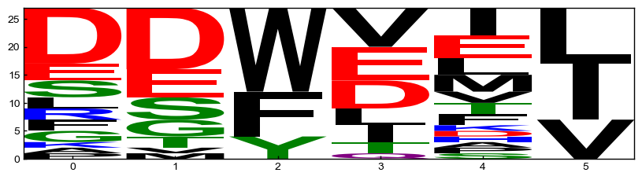
screening hits
z-score ranges
Lir central - augmented
Test set
iLIR motifs
(previously annotated binders)

Slide 7
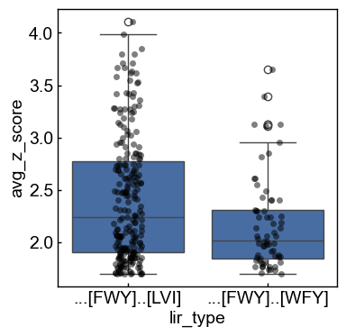
212
66

Slide 8
iLIR
iLIR motifs

Slide 9
iLIR
iLIR motifs
top binders
from screen

Slide 10
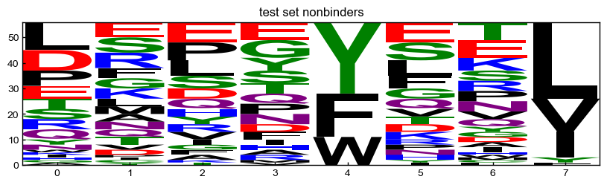
Test set – Lir central motifs matching regex + peptides from the screen tested by BLI?

Slide 11
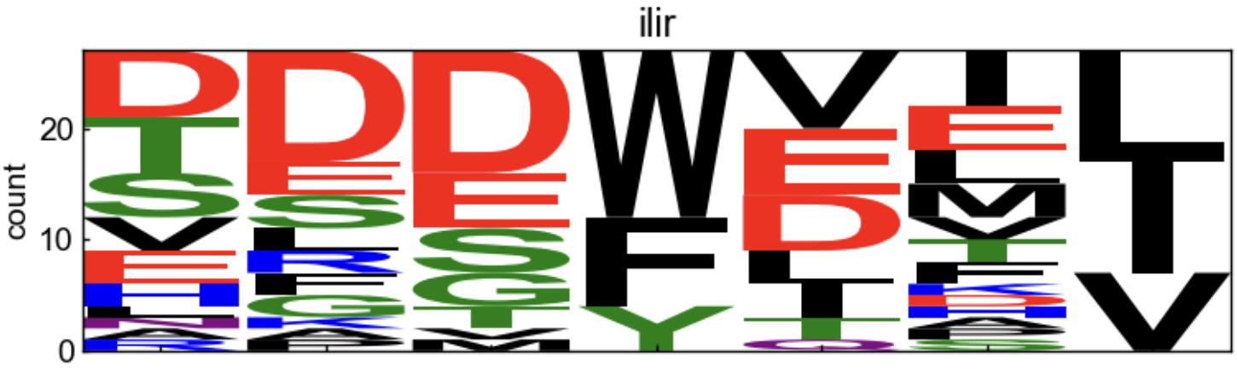
iLIR motifs
By eye, it looks like the iLIR motif would do better on the test set
I don’t think it would matter what backgrounds were used or what type of matrix
But this isn’t necessarily a bad thing. The results might suggest that prior motif definitions are too restrictive and miss many sequences that bind

Slide 12
PSSMs and their performance

Slide 13
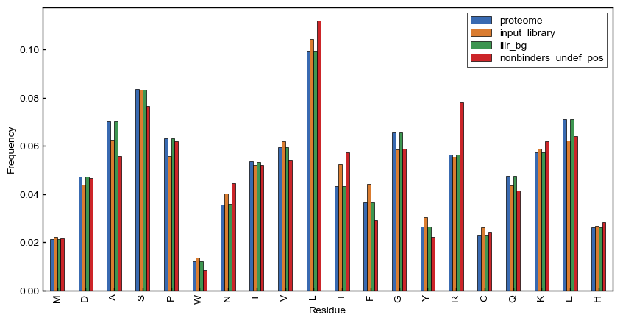
Background frequencies
I saw really weird artifacts when using “position specific backgrounds”, so I decided to use just residue frequencies for backgrounds

Slide 14
if no pseudocounts were used and a residue had a frequency of 0,
the weight (log2(fg/bg)) was set to 0
counts less than this were set to 0
Foreground sets
background sets
pseudocounts
low count cutoff
0
0
screen binders
proteome
2
screen binders
weighted by z-score
0.1
iLiR provided background
nonbinders from screen
(only undefined positions averaged together)
1
5
screen binders with z-score>2.4
10
10
iLiR binders
screen input library
Did a “grid screen” of all these parameters, scoring
each pssm against the lir central + BLI peptides composite benchmark from Jen

Slide 15
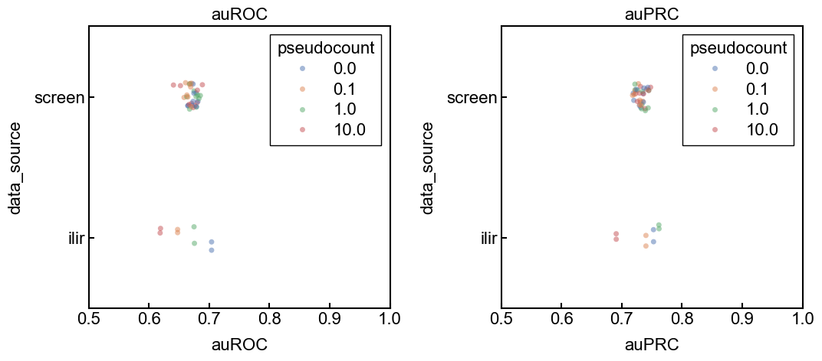
See the giant table for the results.
But the take away is that iLir usually wins and the technical details of the pssm contruction don’t have too much of an impact

Slide 16
screening hits
z-score ranges
Test set
Lir central - augmented
iLIR motifs
(previously annotated binders)

Slide 17
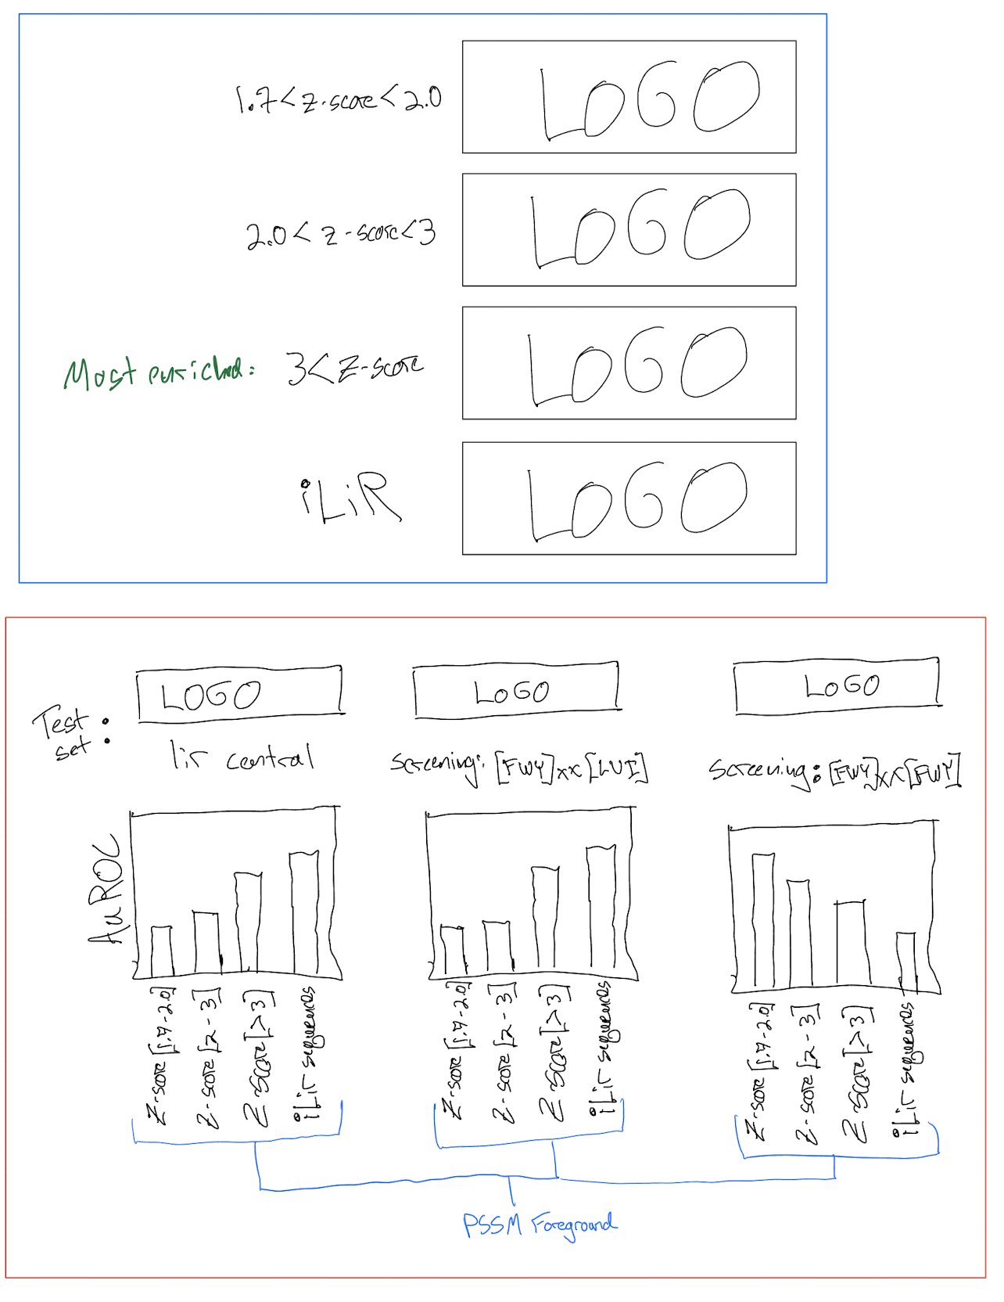

Slide 18
test
(binders and nonbinders)
[FWY]xx[LVI]
sequences
[FWY]xx[LVI] PSSM
(212)
“train”
(binders)
screening data
recombine
PSSMs from different
z-score ranges
“train”
(binders)
[FWY]xx[FWY]
sequences
[FWY]xx[FWY] PSSM
all binders (PSSM)
(66)
test
(binders and nonbinders)

Slide 20
best results for screen
$++++++++++++++++++++++++++++++++++++++$
Best parameters (auROC):
foreground screen_all_binders_weighted
background proteome
low_count_mask 0
pseudocount 10.0
auROC 0.688616
auPRC 0.747892
data_source screen
Name: 27, dtype: object
--------------------------------------------
Best parameters (auPRC):
foreground screen_z_score_above_2_4
background proteome
low_count_mask 2
pseudocount 0.0
auROC 0.684375
auPRC 0.759333
data_source screen
Name: 43, dtype: object
best results for ilir
$++++++++++++++++++++++++++++++++++++++$
Best parameters (auROC):
foreground ilir_binders
background proteome
low_count_mask 0
pseudocount 0.0
auROC 0.703906
auPRC 0.752702
data_source ilir
Name: 63, dtype: object
--------------------------------------------
Best parameters (auPRC):
foreground ilir_binders
background proteome
low_count_mask 5
pseudocount 0.0
auROC 0.701004
auPRC 0.784967
data_source ilir
Name: 65, dtype: object
best results for psiblast
$++++++++++++++++++++++++++++++++++++++$
Best parameters (auROC):
foreground screen_all_binders-psiblast
background proteome
low_count_mask 0
pseudocount 0.0
auROC 0.679018
auPRC 0.73332
data_source psiblast
Name: 75, dtype: object
--------------------------------------------
Best parameters (auPRC):
foreground ilir_binders-psiblast
background proteome
low_count_mask 0
pseudocount 0.0
auROC 0.667634
auPRC 0.74562
data_source psiblast
Name: 77, dtype: object

Slide 21
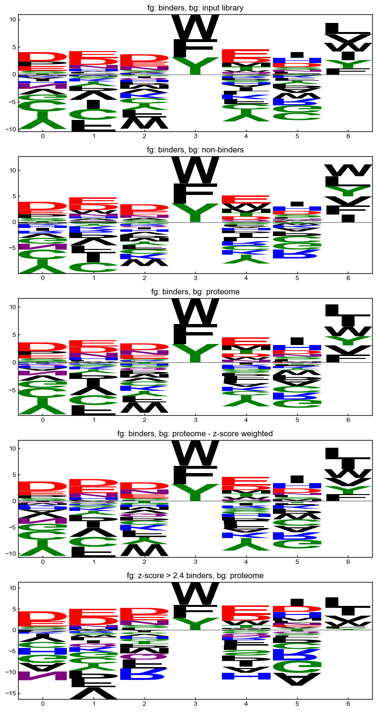
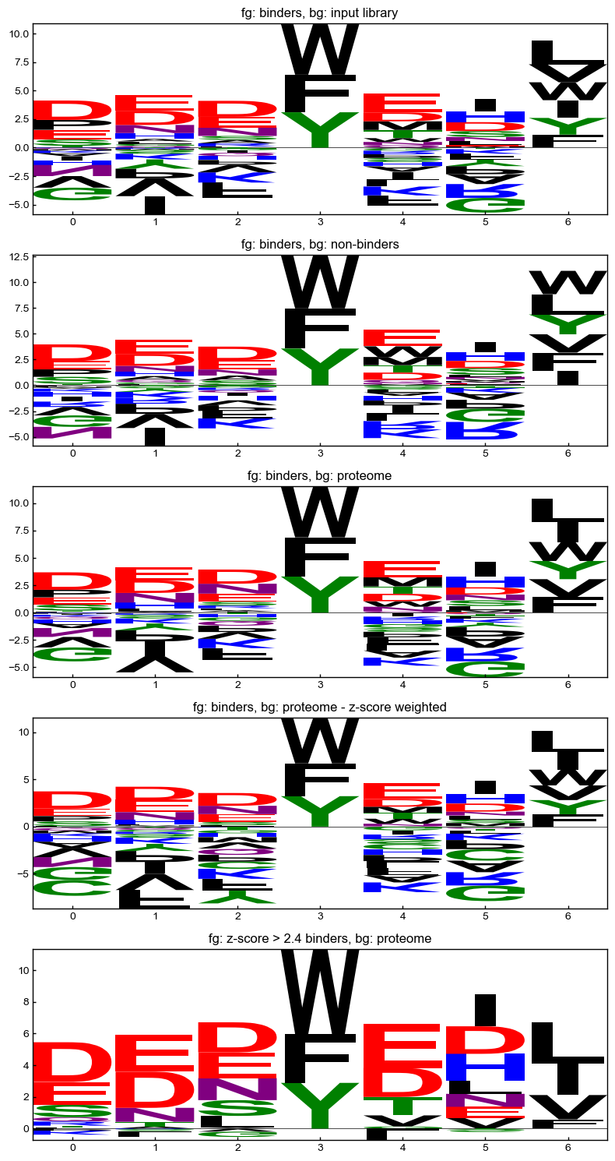

Slide 22
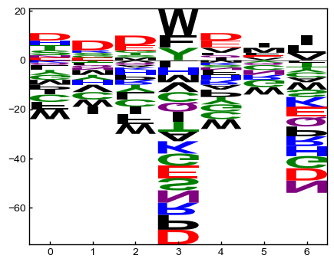
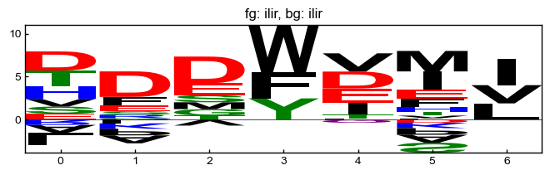

psi blast
weights

Slide 23
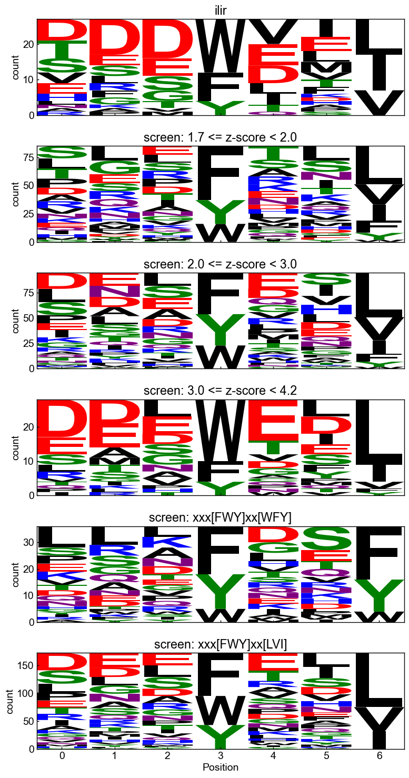
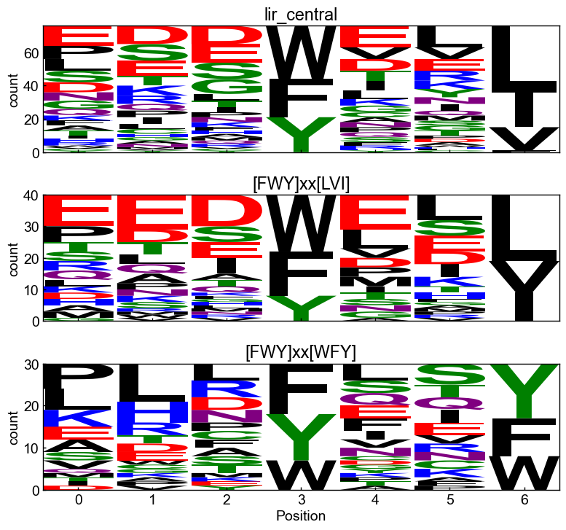
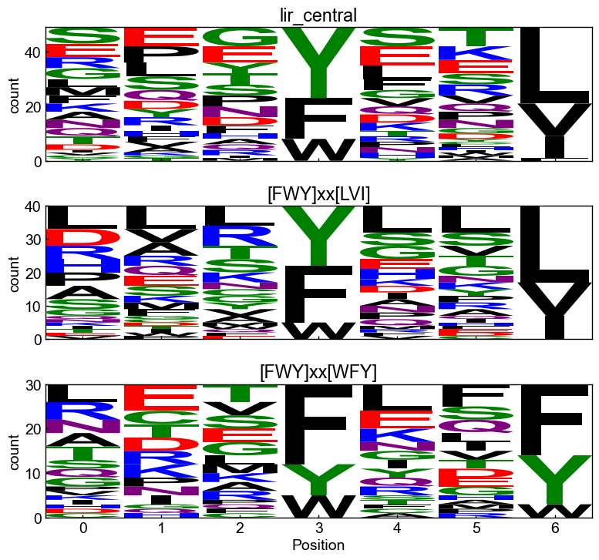
Test sets
binders
nonbinders

Slide 24
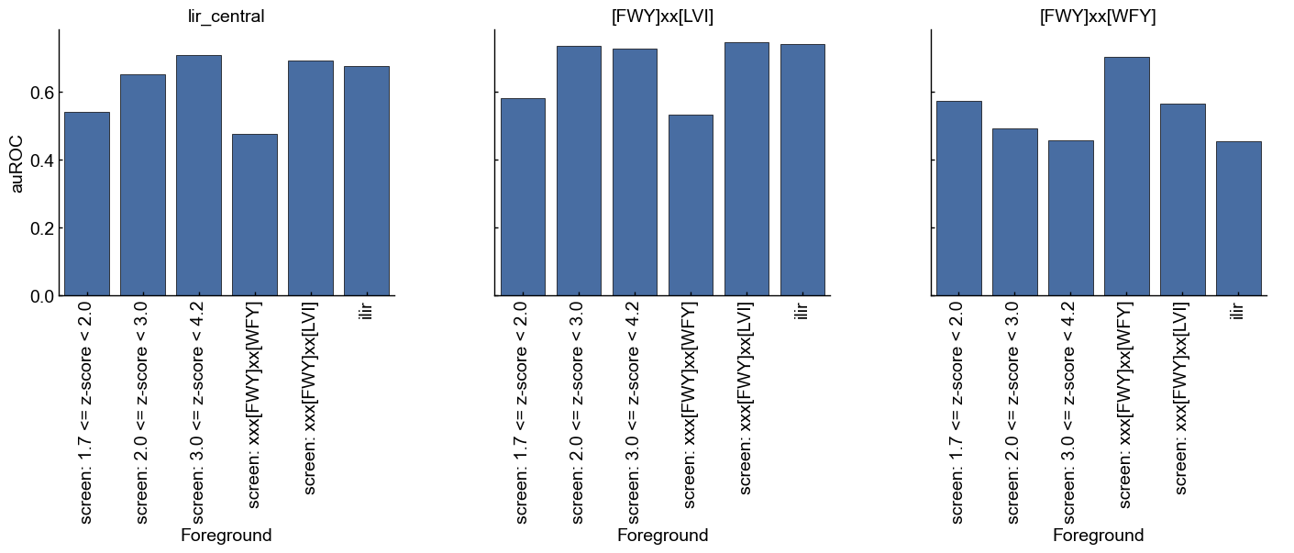

Slide 25
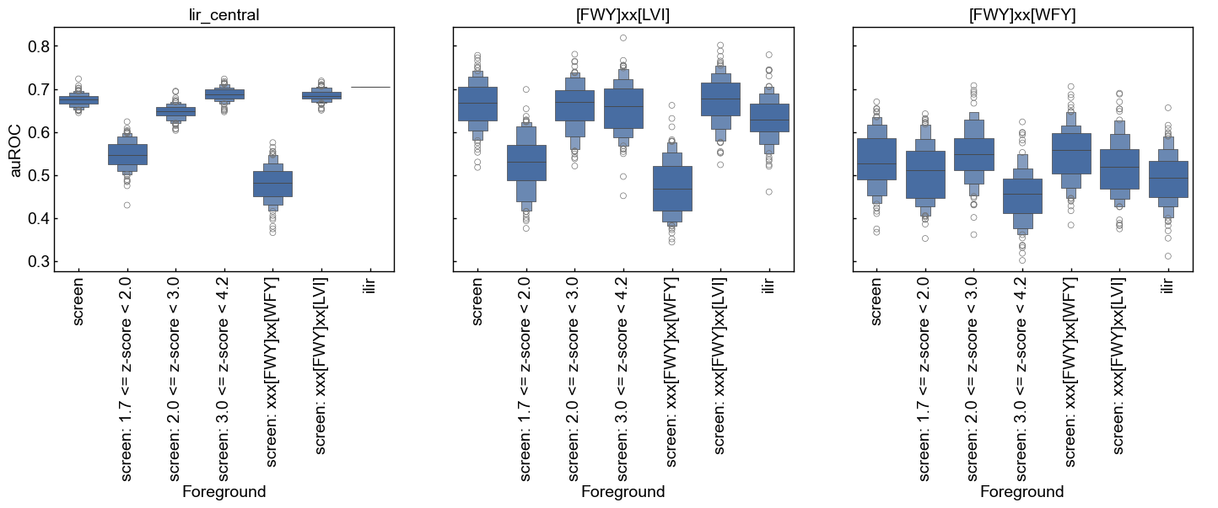

Slide 26
screening nonbinders
test set
screening data
binders from different
z-score ranges
”train”
PSSM
all binders (PSSM)

Slide 27
