Slide 1
Residue frequencies

Slide 2
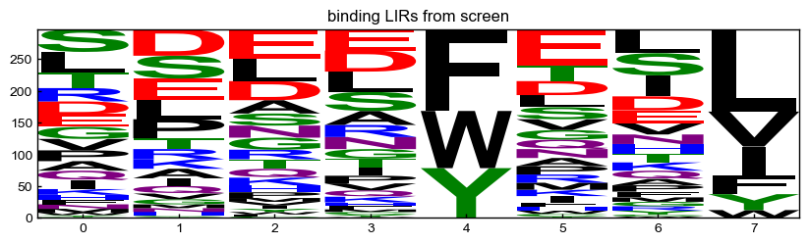
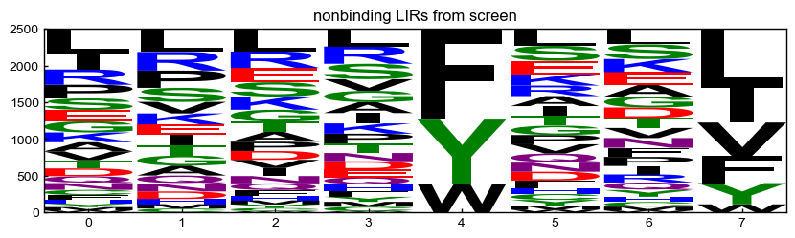
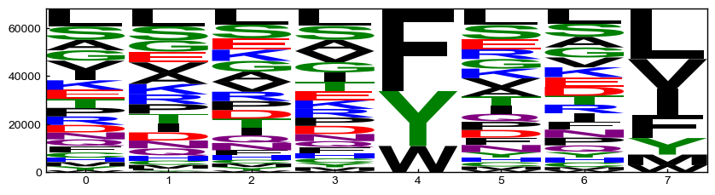
screening hits
Jen’s defined binders
(z-score > 1.7)
Jen’s defined nonbinders
(dropped out after round 3)
LIRs in input library
(everything with >100 reads in input library)

Slide 3
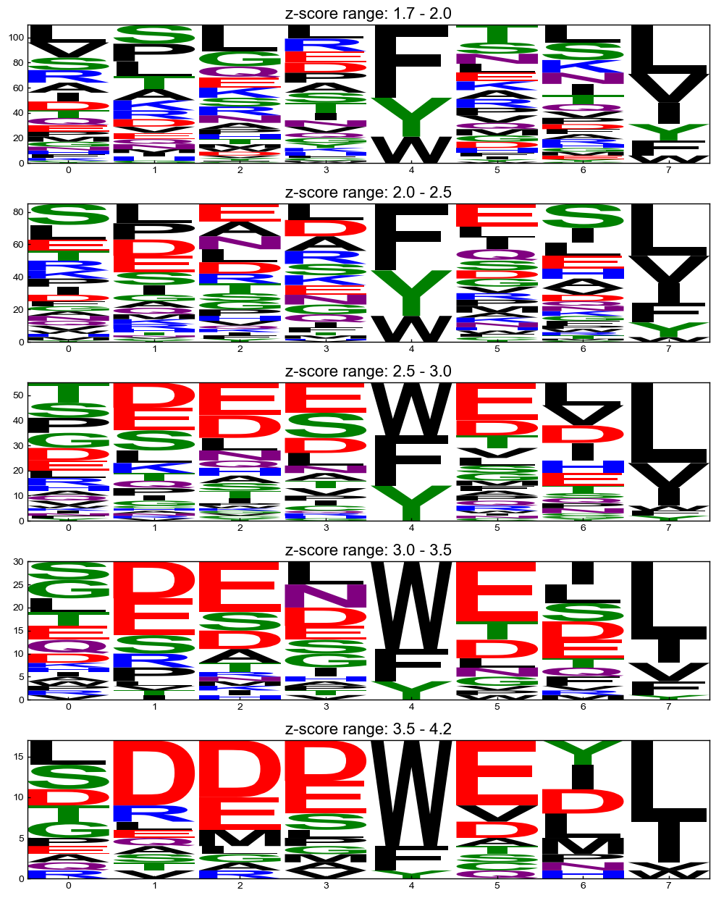
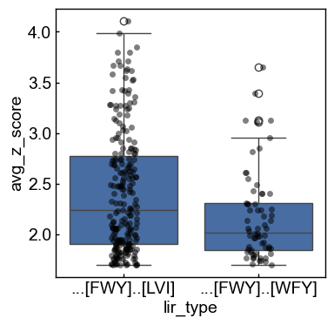
screening hits
z-score ranges
212
66

Slide 4
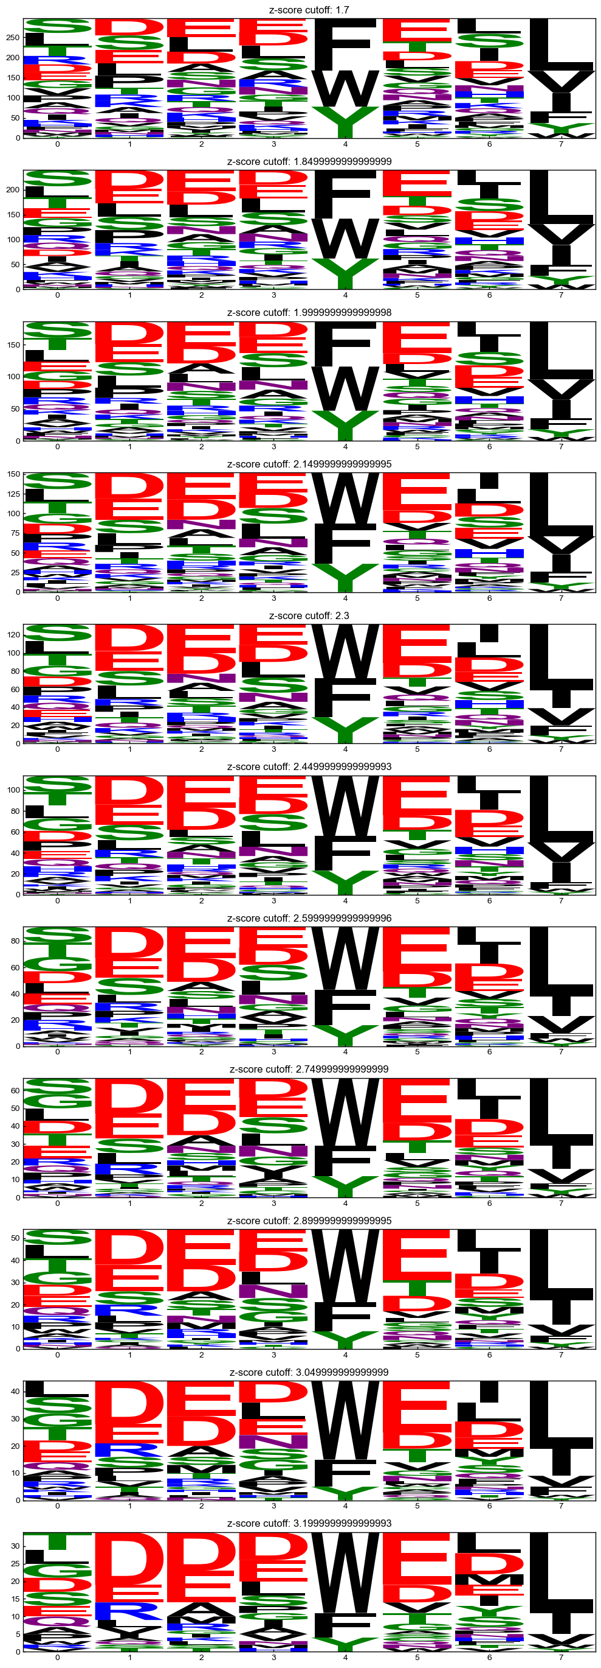
screening hits
all binders w/ z-score > cutoff

Slide 5
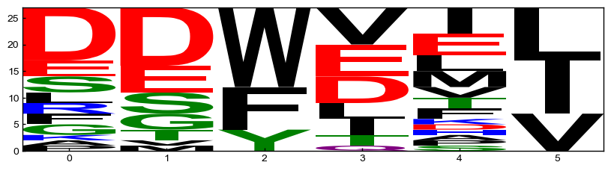
iLIR
iLIR motifs
(previously annotated binders)
iLIR is just an older set of LIRs used to make a PSSM-based LIR searching web server
There was no overlap between iLIR and LIR central in the files that Jen sent me

Slide 6
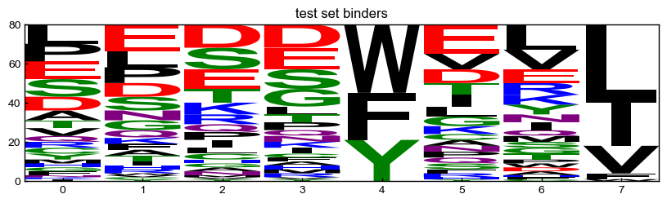
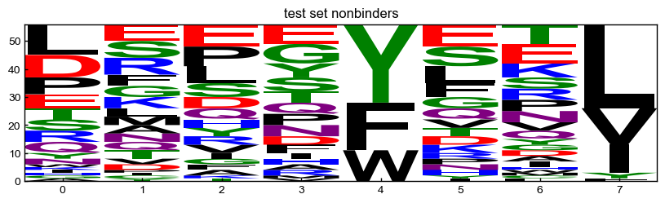
Test set – Lir central motifs matching regex + peptides from the screen tested by BLI

Slide 7
screening hits
z-score ranges
Lir central - augmented
Test set
iLIR motifs
(previously annotated binders)
Notes:
By eye, it looks like the iLIR motif would do better on the test set
I don’t think it would matter what backgrounds were used or what type of matrix
But this isn’t necessarily a bad thing. The results might suggest that prior motif definitions are too restrictive and miss many sequences that bind

Slide 8
PSSMs and their performance

Slide 9
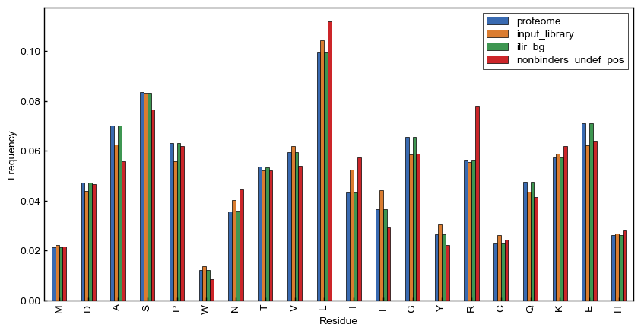
Background frequencies
I saw really weird artifacts when using “position specific backgrounds”, so I decided to use just residue frequencies for backgrounds

Slide 10
Notes on processing in subsequent analyses:
expanded ilir 6mers to 7mers
reduced screening motifs to 7mers
removed duplicate 7mers from lir central test set, ilir set, and screening sets (binders and nonbinders)
removed 7mers from screening sets that are present in ilir set
removed 7mers from screening sets that were present in both nonbinder and binder sets

Slide 11
if no pseudocounts were used and a residue had a frequency of 0,
the weight (log2(fg/bg)) was set to 0
counts less than this were set to 0
Foreground sets
background sets
pseudocounts
low count cutoff
0
0
screen binders
proteome
2
screen binders
weighted by z-score
0.1
iLiR provided background
nonbinders from screen
(only undefined positions averaged together)
1
5
screen binders with z-score>2.4
10
10
iLiR binders
screen input library
Did a “grid screen” of all these parameters, scoring
each pssm against the lir central + BLI peptides composite benchmark from Jen

Slide 12
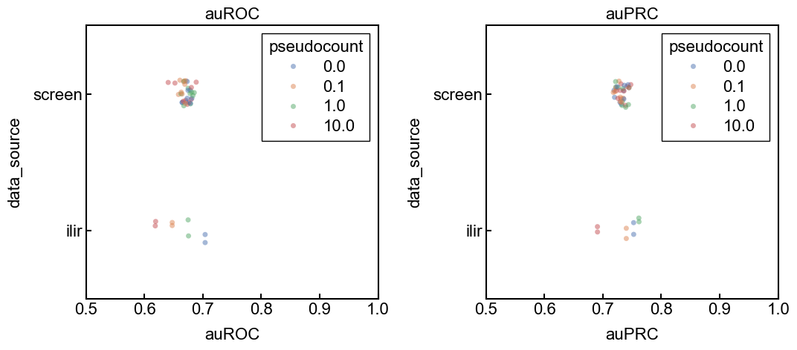
This is a sampling of the results. See the giant table for all.
But the take away is that iLir usually wins and the technical details of the pssm contruction don’t have too much of an impact on performance

Slide 13
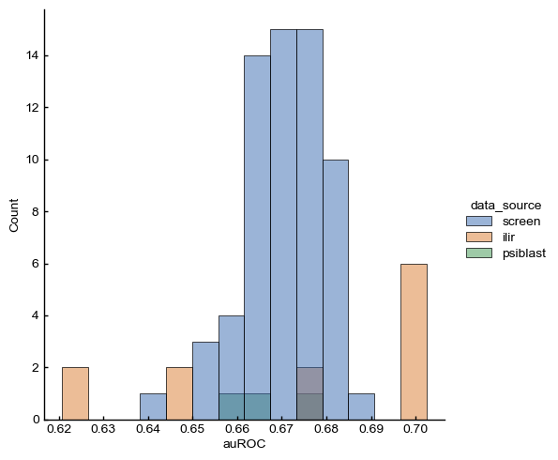

Slide 14
test
(binders and nonbinders)
[FWY]xx[LVI]
sequences
[FWY]xx[LVI] PSSM
(212)
“train”
(binders)
screening data
recombine
PSSMs from different
z-score ranges
“train”
(binders)
[FWY]xx[FWY]
sequences
[FWY]xx[FWY] PSSM
all binders (PSSM)
(66)
test
(binders and nonbinders)

Slide 15
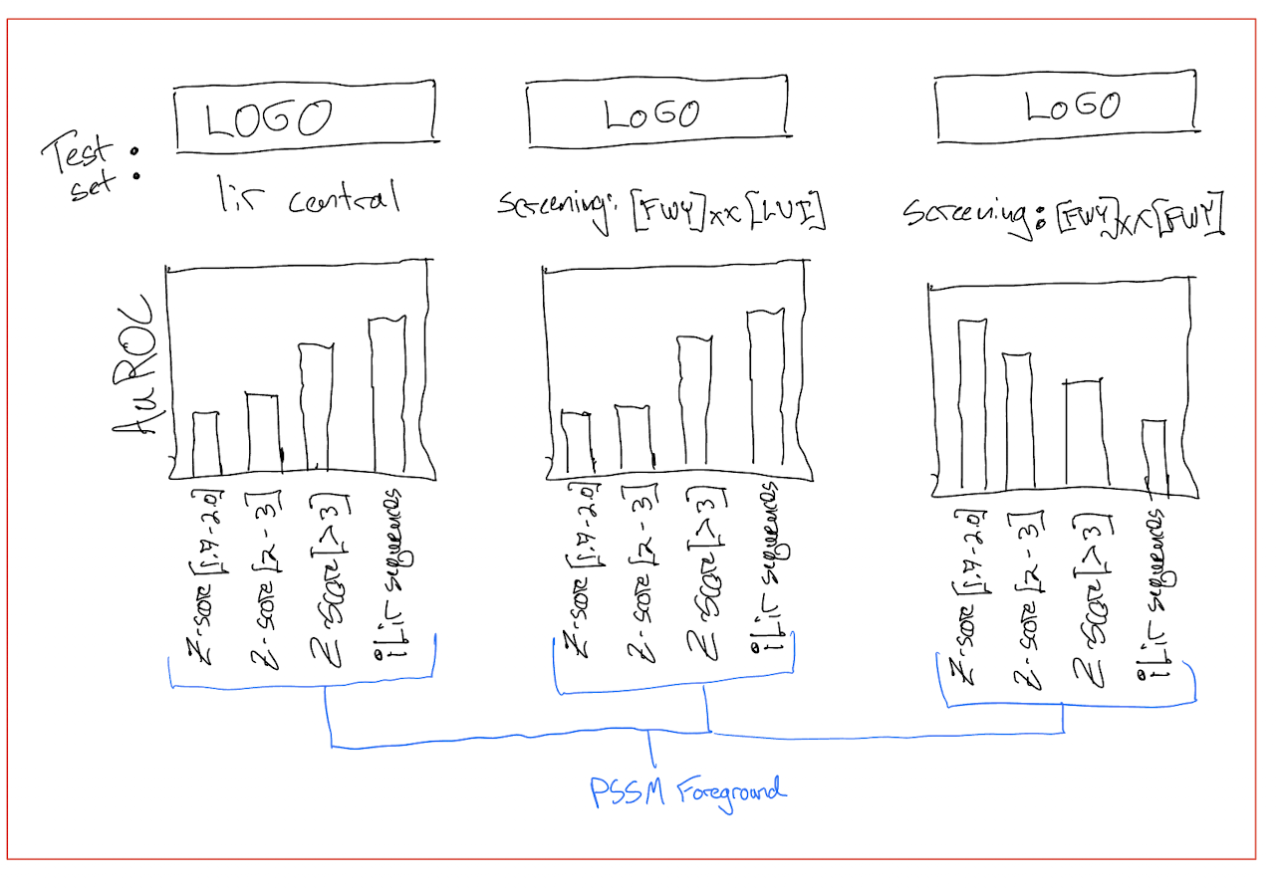

Slide 16
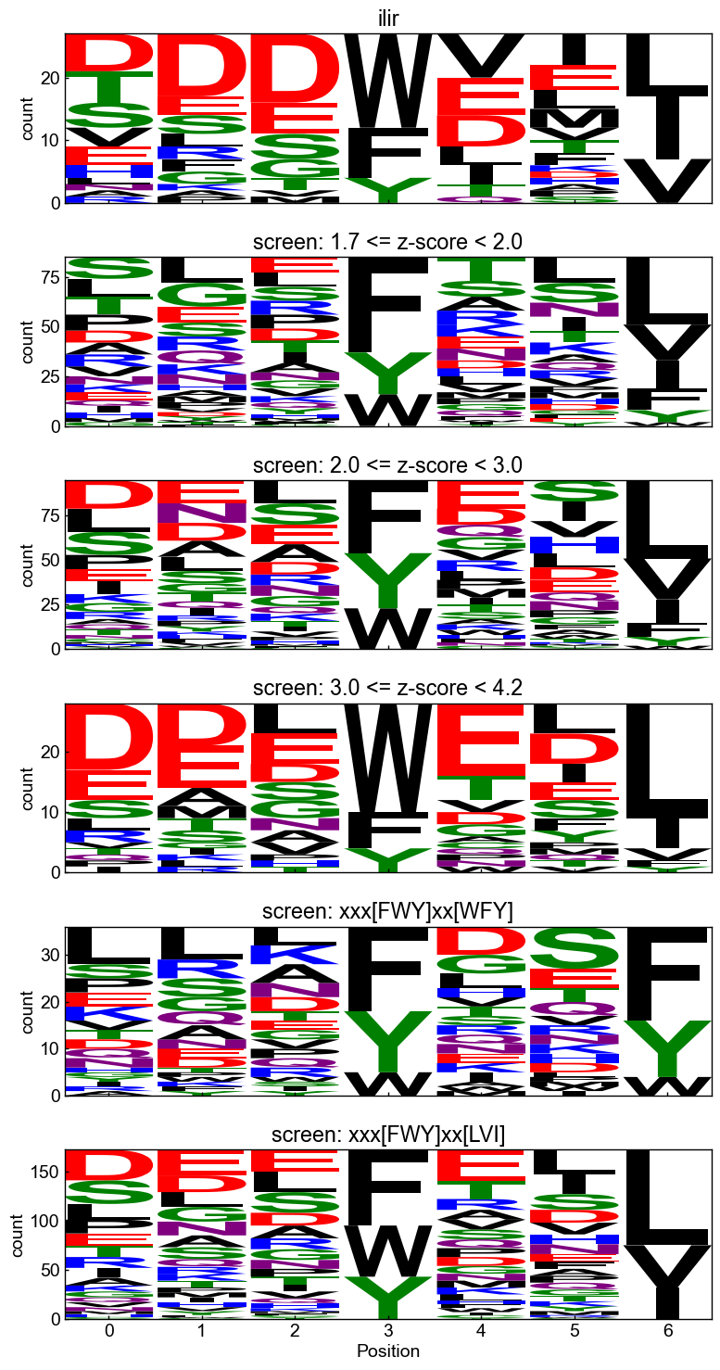
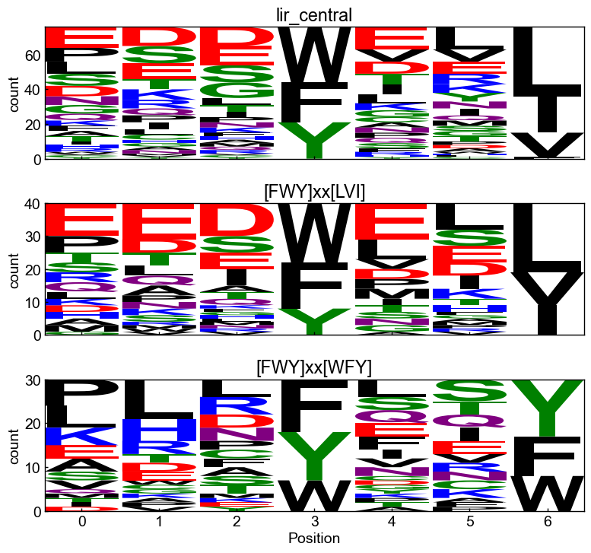
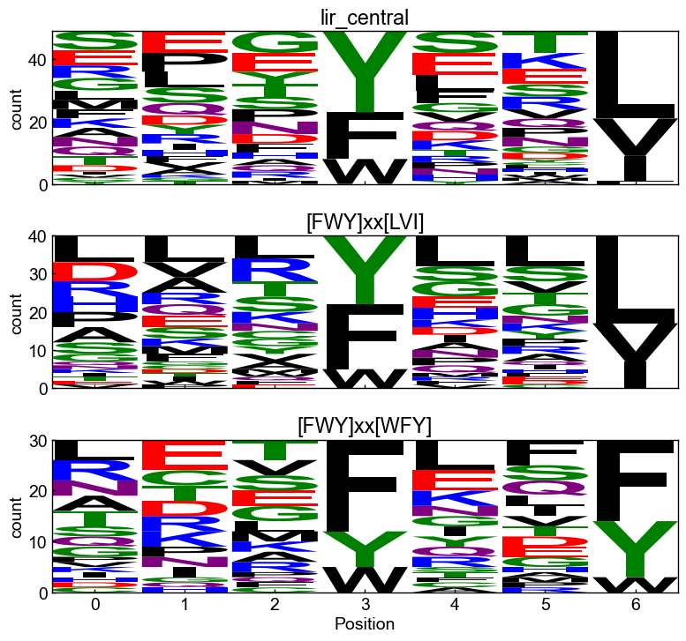
Test sets
binders
nonbinders

Slide 17
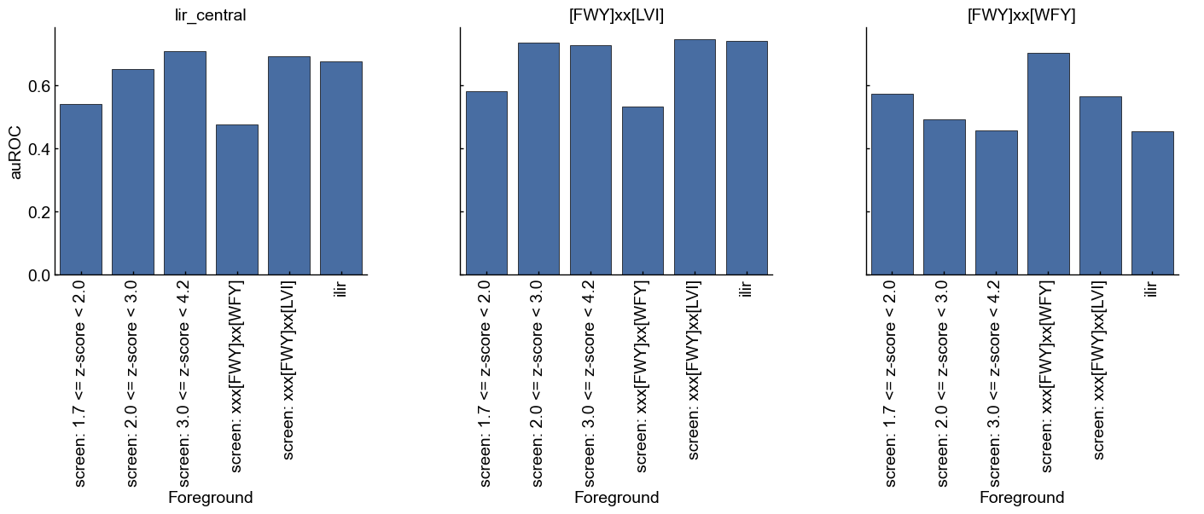

Slide 18
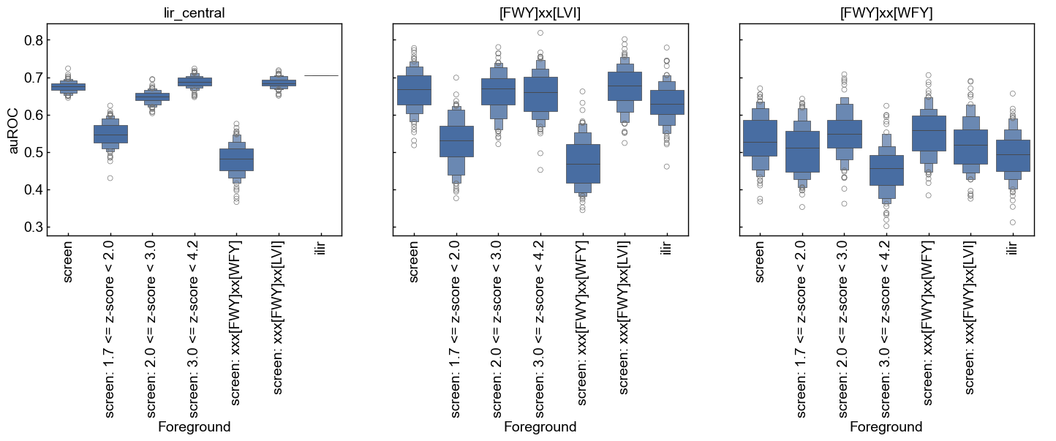

Slide 19
screening nonbinders
test set
screening data
binders from different
z-score ranges
”train”
PSSM
all binders (PSSM)

Slide 20
