Slide 1
Benchmark
Eukaryotic Linear Motif (ELM) database
Search human proteome
motif
e.g. [FWYL]PXΦP
Background motif matches (mostly false positives)
Experimentally verified motif matches (true positives)
# false positives (FP) >> # true positives (TP)

Slide 2
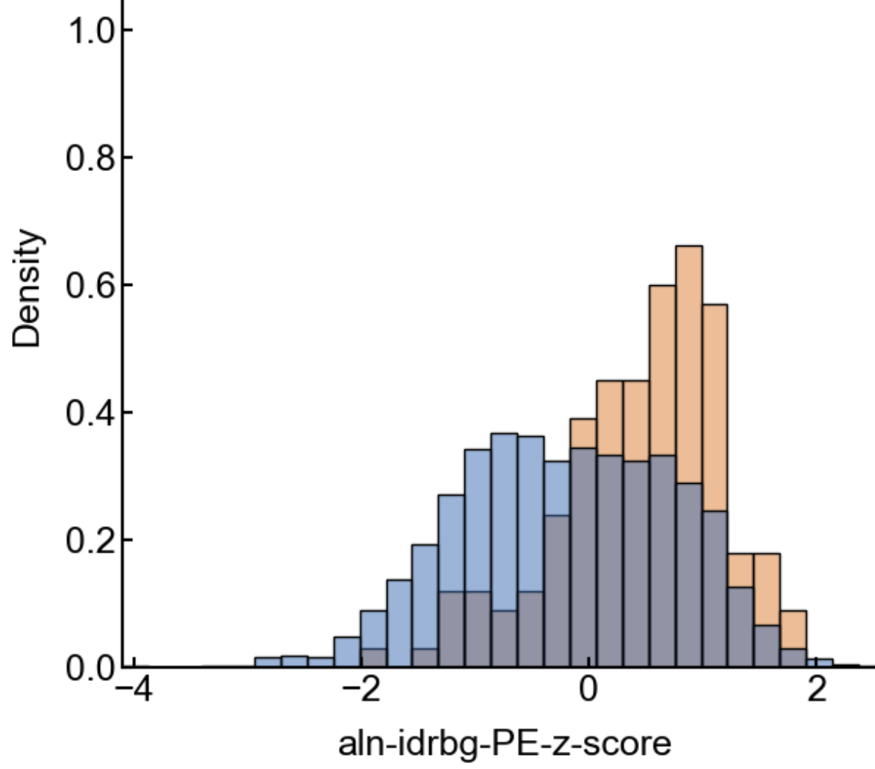
Benchmark
True positives
Experimentally verified motif matches
Calculate conservation score
MSA
-or-
Pairwise k-mer
Background motif matches (mostly false positives)
False positives
Quantify score’s ability to separate TP vs FP
Conservation score

