Slide 1
Software Development
“ Best Useful Practices”
Jeremy Hopple

Slide 2
Be Agile!
It’s not a process
It’s way of life

Slide 3
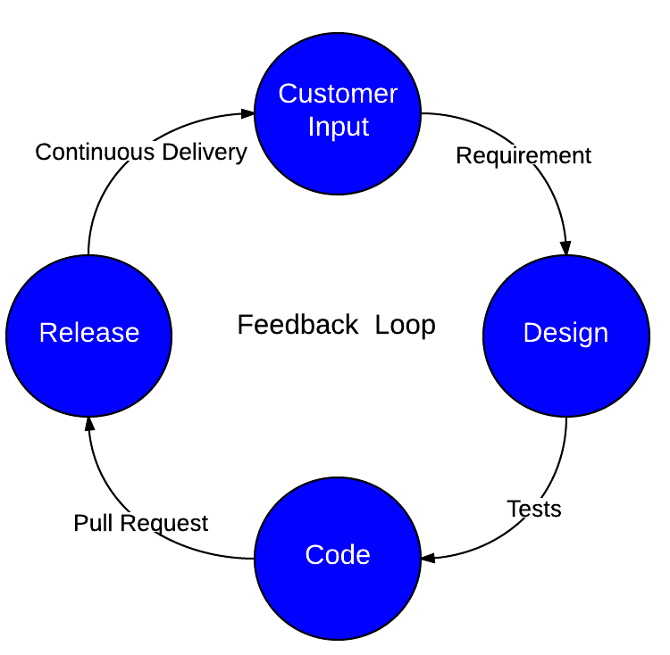
Iterate, Iterate, Iterate

Slide 4
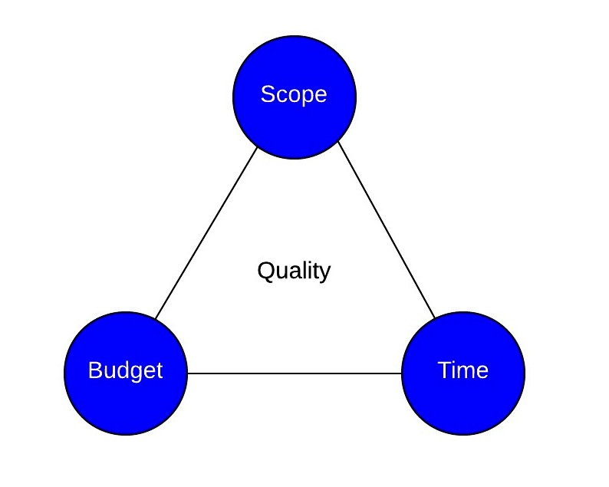
Do what matters
“The best programmers aren’t the ones with the best skills, they are the ones that can determine what just doesn’t matter” – Basecamp
“Build half a product, not a half-assed product” - Basecamp

Slide 5
Tests: Validate your Design
Have automated test coverage
Consider Test-driven Developement

Slide 6
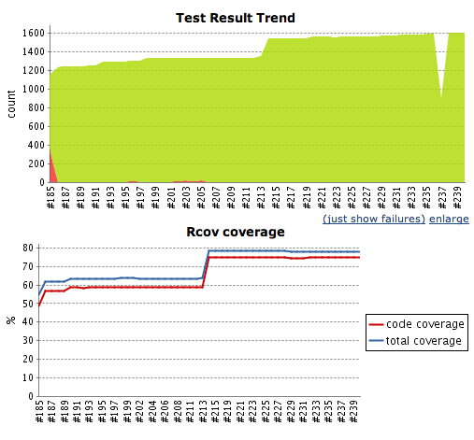
Coverage

Slide 7
TDD
Changes your thinking about a problem
Changes the way you code

Slide 8
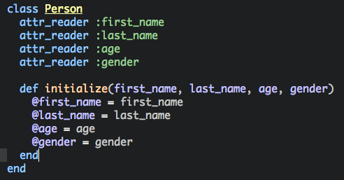

Slide 9
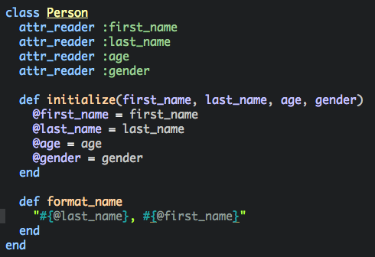

Slide 10
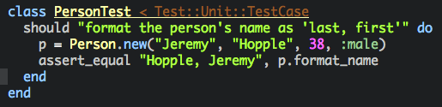

Slide 11
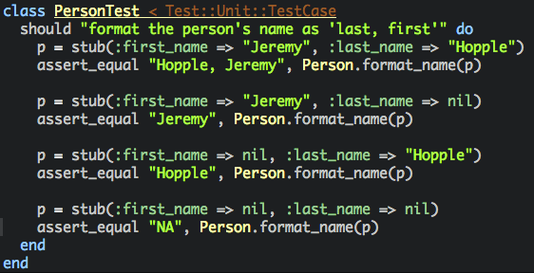

Slide 12
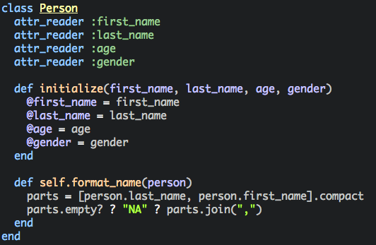

Slide 13
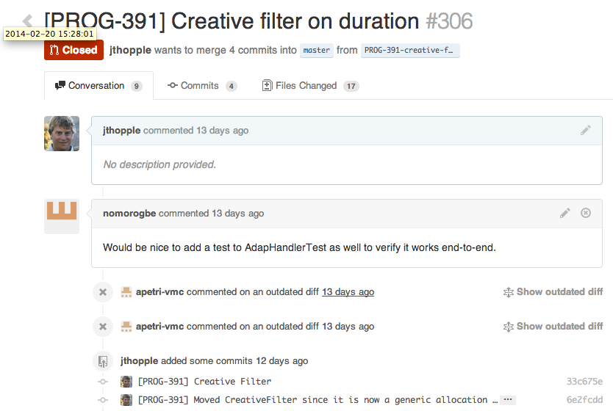
Review: Pull Request

Slide 14

Deploy Often
Strive for continuous delivery
Release ceremony is the root of evil.

Slide 15
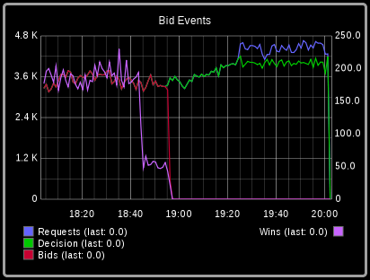

Measure Anything, Everything
http://codeascraft.com/2011/02/15/measure-anything-measure-everything/
Statsd
Graphite

