Slide 1

Plan Your Fleet
City of Atascadero Kickoff
March 5th, 2026
Presented by
Jackson Flynn

Slide 2

Agenda
Introductions
Advanced Clean Fleets Overview
Fleet Electrification Timelines
GHG Emissions Reductions
Incentives
Questions & Additional Data Needs
Next Steps

Slide 3

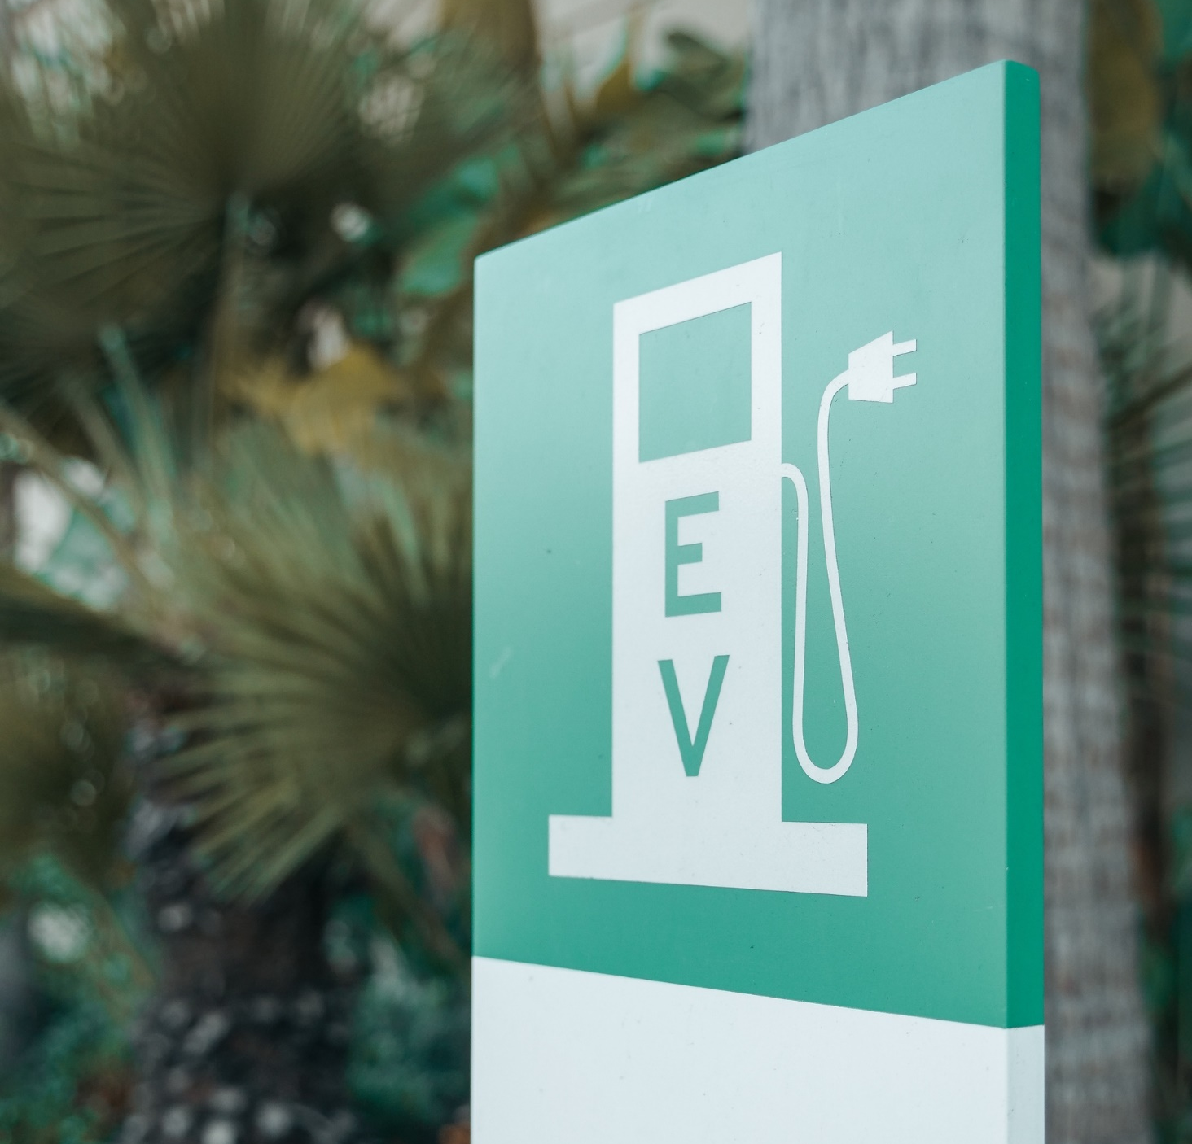
California Air Resource Board (CARB)
Advanced Clean Fleets and what that means for you:
Starting 2024, 50% of medium- and heavy-duty truck, van, and bus purchases must be ZEV
Starting 2030, 100% of medium- and heavy-duty truck, van, and bus purchases must be ZEV
Limited exceptions

Slide 4

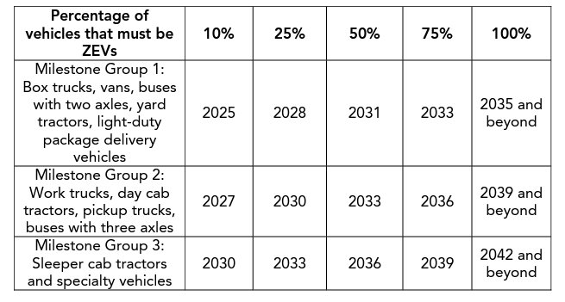
ACF Compliance Electrification Scenarios
The City may pursue one of two timelines:
ZEV Purchase Schedule (default)
50% of medium- and heavy-duty vehicle purchases beginning in 2024 must be ZEVs
100% of medium- and heavy-duty vehicle purchases beginning in 2030 must be ZEVs
ZEV Milestone Option (see table)

Slide 5
Advanced Clean Fleets Exemptions
State and Local Government Agency Exemptions:
ZEV Unavailability
Daily Usage
Infrastructure Construction Delay
Backup Vehicle <1,000 miles per year
Mutual Aid Vehicle
Streamlined ZEV Purchase Exemption List: Bucket truck (Class 5), water truck (Class 5-8), vacuum truck (Class 8) (Expiration Date TBD)
Other Potential Configurations: Bucket truck, boom truck, dump truck, flatbed truck, stake bed truck, front-loader refuse compactor truck, sideloader refuse compactor truck, rear-loader refuse compactor truck, refuse roll-off truck, service body truck, street sweeper, tank truck, tow truck, water truck, car carrier truck, concrete mixer truck, concrete pump truck, crane, drill rig, vacuum truck (Expiration Date TBD)
Excluded from Fleet Requirements:
School buses
Transit buses
Military tactical vehicles
Vehicles awaiting sale
Emergency vehicles*
Dedicated snow removal vehicles
Historical vehicles
Heavy cranes
Two-engine trucks and workover rigs
Vehicles subject to Mobile Cargo Handling Equipment regulation
https://ww2.arb.ca.gov/sites/default/files/barcu/board/books/2022/102722/22-14-1pres.pdf
https://ww2.arb.ca.gov/sites/default/files/barcu/regact/2022/acf22/acffroa1.pdf
https://ww2.arb.ca.gov/applications/streamlined-zev-purchase-exemption-list
*Authorized emergency vehicles as defined in California Vehicle Code Section 165

Slide 6
Key Findings
We are studying 113 vehicles from the City's fleet.
100% of the City’s fleet can be replaced with EVs or PHEVs currently on the market, based on preliminary analysis.
The City’s emergency response vehicles are exempt from California Air Resource Board’s (CARB) Advanced Clean Fleets (ACF).
Adhering to the City’s existing replacement schedule, 100% fleet electrification is achievable by 2040.

Slide 7
ACF Compliance Electrification Scenarios ZEV Purchase Schedule (default)

Slide 8
GHG Emissions Reduction Scenarios

Slide 9
Incentives and Other Support
3CE Charge Your Fleet
Maximum $150,000 per site
Up to $100,000 per DC Fast installation, not to exceed 75% of cost
Up to $5,000 per Level 2 port installation, not to exceed 75% of project costs
PG&E EV Fleet Program
Incentives and rebates, site design and permitting, construction, and maintenance and upgrades
Provides additional electrical service, some contribution to charging infrastructure; dedicated EV charging meter
Optony can assist with application preparation for EV Fleet
Funding availability is limited as the program is approaching maximum enrollment

Slide 10
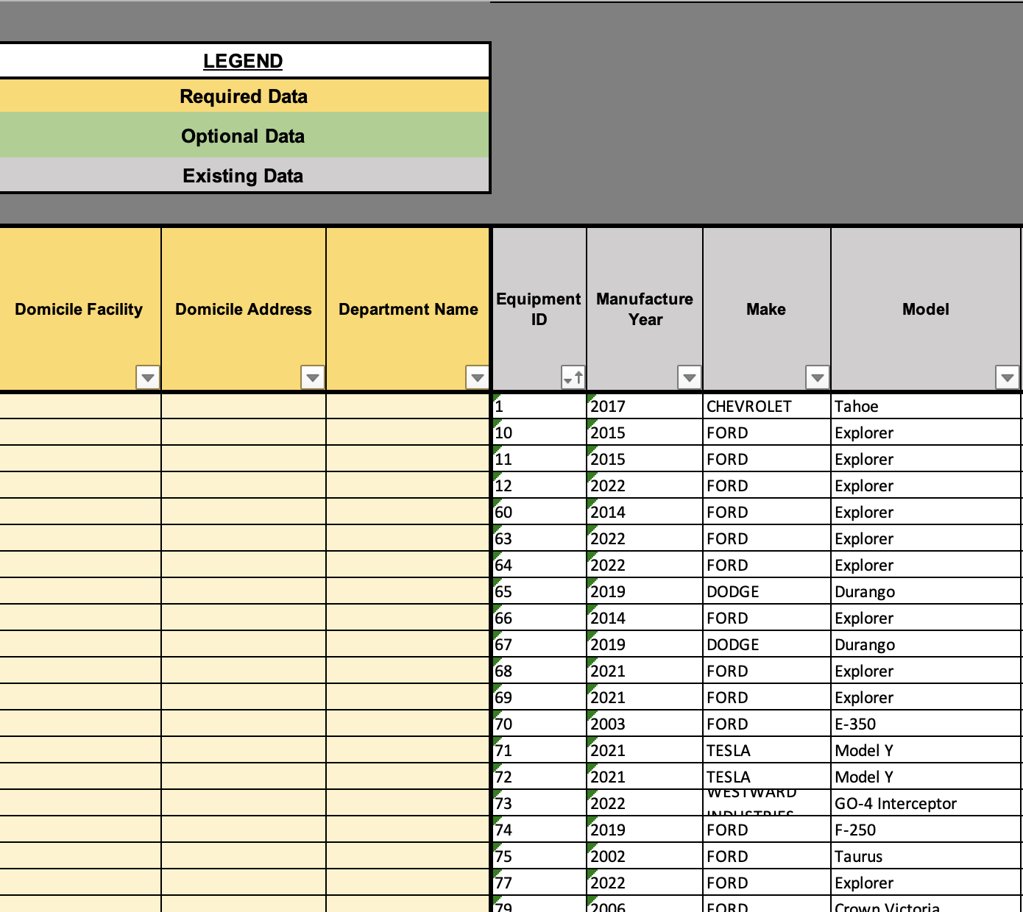
Data Needs
Fleet Data
Departments
Domicile Facility
Domicile Address
Any high priority sites of EV chargers?

Slide 11
Next Steps
Update Fleet Replacement Plan Modeling
Perform Load Analysis
Present Updated Results
Select Priority Domicile
Site Designs for Priority Domicile
Charging Optimization Modeling
Research and Recommendations for Project Funding
Final Presentation

Slide 12
Contact us:
Judi Young
Senior Customer Accounts Manager, 3CE
JYoung@3CE.org
Natalie Hanson
Director of Energy Programs, Optony
Natalie.Hanson@OptonyUSA.com

Slide 13
Appendix

Slide 14
Total Cost of Charging Infrastructure
Notes:
Heavy truck replacement in 2036 (also a few other LD & MD vehicles)

Slide 15
Annual Marginal EV Total Cost of Ownership
Notes:
Heavy truck replacement in 2036 (also a few other LD & MD vehicles)

