Slide 1




Product & Process Review
Supplier member since 2012
East – Lexington, NC | West – Provo, UT

Slide 2
Agenda
• Company history & locations
• Flex Trim™ product overview
• Flex Trim™ advantages
• Applications
• Material details & upgrades
• Stock items & stock list
• Production-ready profiles
• Made-to-Match process
• Bullnose & tight radii
• What you need to order
• How to measure
• Installation
• Website tools & resources
• Warranty, returns & values
Flex Trim™ · Carter Millwork, Inc.

Slide 3
01 COMPANY
History & locations
Family-owned. Two coasts. Industry leaders in flexible moulding.

Slide 4
The industry leaders in flexible moulding
• Carter Millwork, Inc. unites Flex Trim™, Carter Millwork, Ultra-Flex, Zago, Flexible Moulding International, and Flexgrain
• Second-generation, family-owned — Lexington, North Carolina
• Hands-on management; we never make a promise we cannot keep
• Largest flexible moulding supplier — primary goal is to be the best
• AWI supplier member since 2012
• Trusted from multi-million-dollar estates to historic church restorations
Flex Trim™ · Carter Millwork, Inc.

Slide 5
Our legacy of innovation
1963
Ultra-Flex Moulding established — original inventor of flexible moulding (Escondido, CA).
Jan 2009
Acquires Flexible Moulding International → Flex Trim West. Matt & Kacey Anderson lead West.
1985
Flex Trim™ established in Rancho Cucamonga, CA and Garner, NC.
Apr 2012
Acquires Ultra-Flex; consolidates into Utah facility.
1993
Zago Flexible Mouldings established in Newark, NJ.
Mar 2014
Acquires Flexgrain; consolidates into North Carolina.
Feb 1995
Carter Millwork founded in Linwood, NC by Ned and Sally Carter.
Jul 2014
Acquires Zago; consolidates into North Carolina.
Jul 1999
Flexible Moulding International founded in Provo, UT by Theron Anderson.
Apr 2017
Relocates to larger Lexington, NC facility.
Jan 2007
Second-generation Greg and Alan Carter purchase Carter Millwork.
Jan 2021
Greg Carter assumes sole ownership.
Nov 2008
Acquires Flex Trim™; production moves to North Carolina.
Jan 2025
Third-generation Jackson Carter joins — engineering focus on manufacturing & digital workflows.
Flex Trim™ · Carter Millwork, Inc.

Slide 6
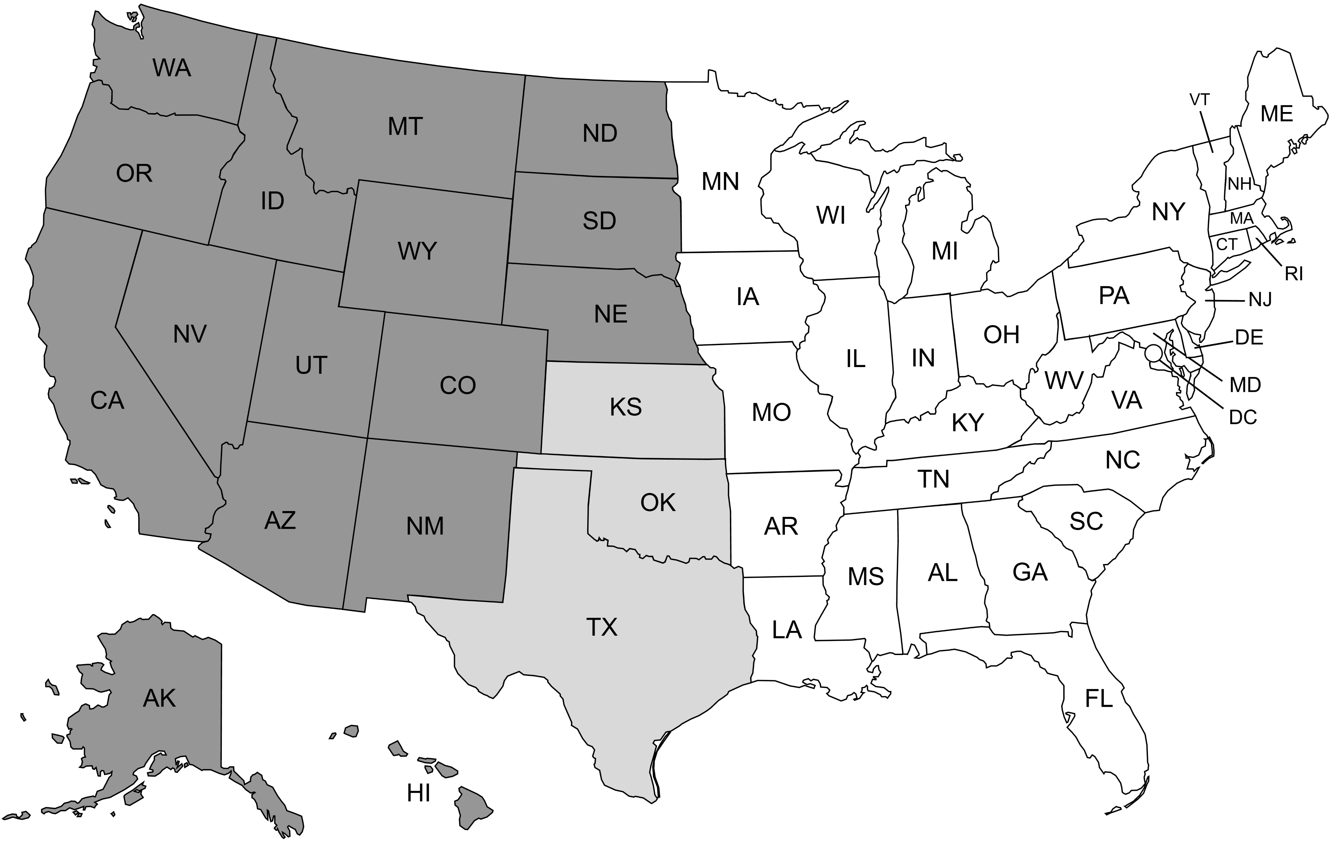

Service coverage by state
Two-coast manufacturing — shorter lead times, local support
Served by both NC and UT facilities
Served by NC facility
Served by UT facility
Flex Trim East
Flex Trim West
117 Cedar Lane Drive, Lexington, NC 27292
(800) 861-0734
orders@carterflex.com
support@carterflex.com
533 South 500 West, Provo, UT 84601
(877) 877-4595
orders@flextrim.com
Flex Trim™ · Carter Millwork, Inc.

Slide 7
02 PRODUCT
Flex Trim™ overview & advantages

Slide 8
Flex Trim™ product overview
The look of custom wood at a fraction of the cost
• Polyurethane flexible moulding for places rigid wood cannot bend
• Replicates complex profiles, decorative accessories, and wood grain
• Flex Trim™ = original polymer resin blend — default for most jobs
• Paint-grade always; many profiles stainable
• Interior & exterior (with exterior coating) · Lifetime warranty
• 250+ stock · 40,000+ tooled profiles · Made-to-Match
Flex Trim™ · Carter Millwork, Inc.

Slide 9









The Flex Trim™ advantage
Decades of trusted expertise
Value-engineered with a
lifetime warranty
Interior & exterior compatible
Going back to 1963, we consolidated the knowledge of six companies into one trusted brand.
Generally faster than radiused wood, costs up to 70% less, and allows quick on-site adjustments.
Indoor use, or exterior with an exterior finish coating.
Impact-resistant & chip-proof
Moisture & rot proof
Insect proof
Hard polyurethane resists dents and is chip-proof.
Resists water absorption; will not warp or decay.
Resin-based material that naturally repels insects.
Easy to install
Stainable & paintable
PFAS & VOC free
Cuts, nails, and glues with standard wood millwork tools.
All product is paintable; stain-grade reproduces wood species grain.
Manufactured without PFAS or VOCs.
Flex Trim™ · Carter Millwork, Inc.

Slide 10
The Flex Trim™ advantage
Product overview layout
Decades of
trusted expertise
Going back to 1963, we consolidated the knowledge of six companies into one trusted brand.
Value-engineered with a
lifetime warranty
Generally faster than radiused wood, costs up to 70% less, and allows quick on-site adjustments.
Interior & exterior
compatible
Indoor use, or exterior with an exterior finish coating.
Impact-resistant &
chip-proof
Hard polyurethane resists dents and is chip-proof.
Moisture & rot
proof
Resists water absorption; will not warp or decay.
Insect
proof
Resin-based material that naturally repels insects.
Easy to
install
Cuts, nails, and glues with standard wood millwork tools.
Stainable &
paintable
All product is paintable; stain-grade reproduces wood species grain.
PFAS &
VOC free
Manufactured without PFAS or VOCs.
Flex Trim™ · Carter Millwork, Inc.

Slide 11
03 APPLICATIONS
Where Flex Trim™ is used
Image boards — add or swap photos as needed.

Slide 12
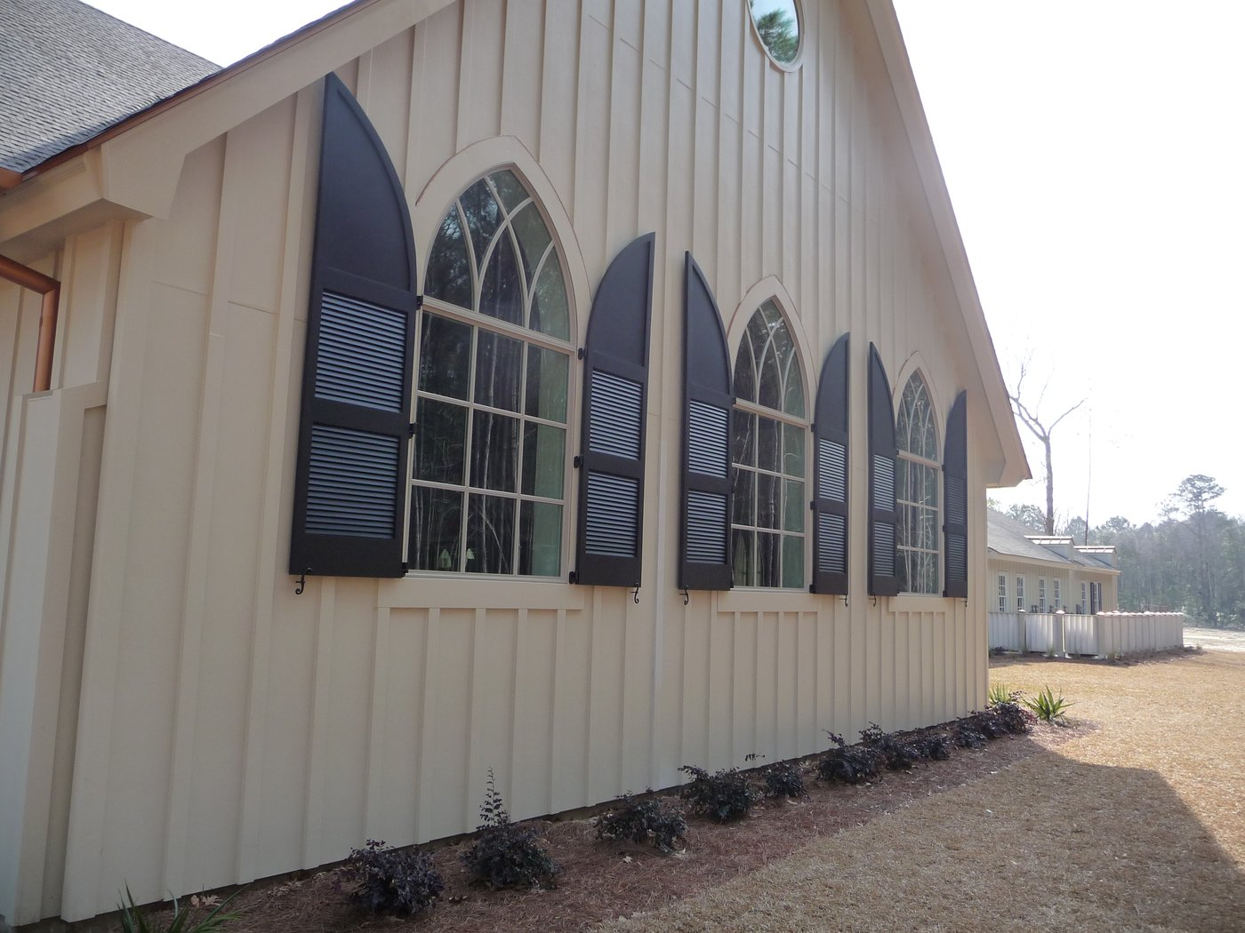


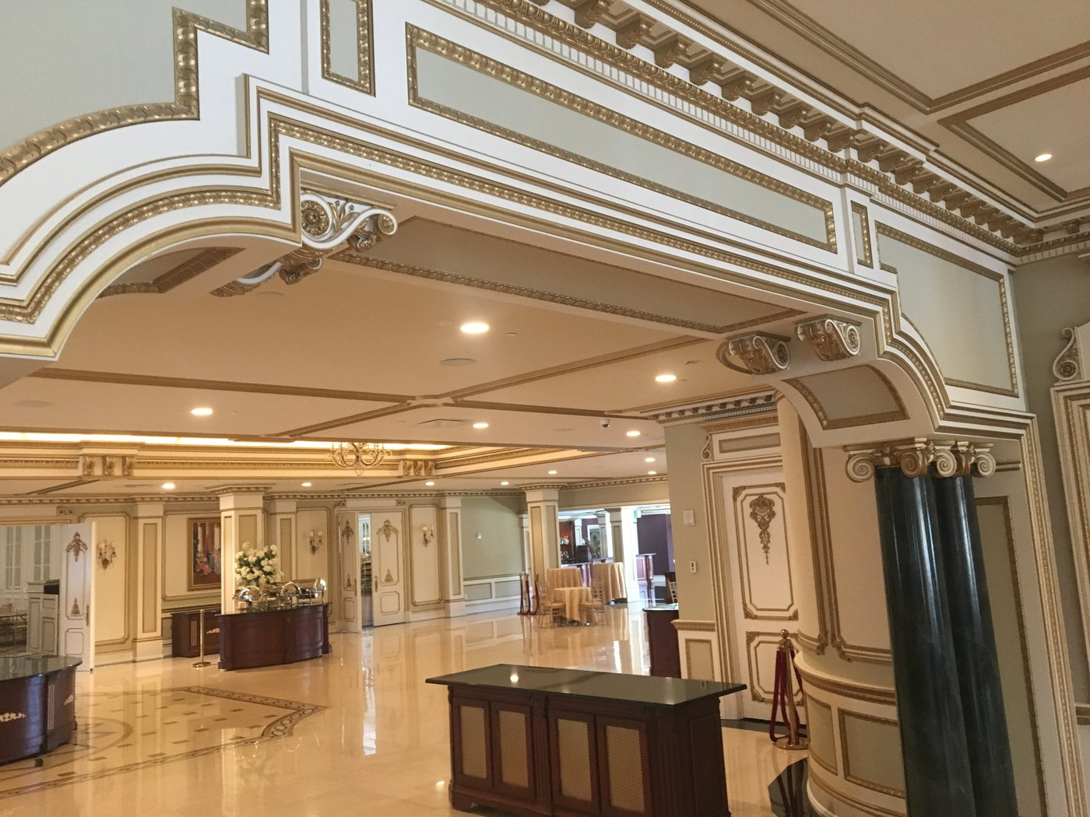
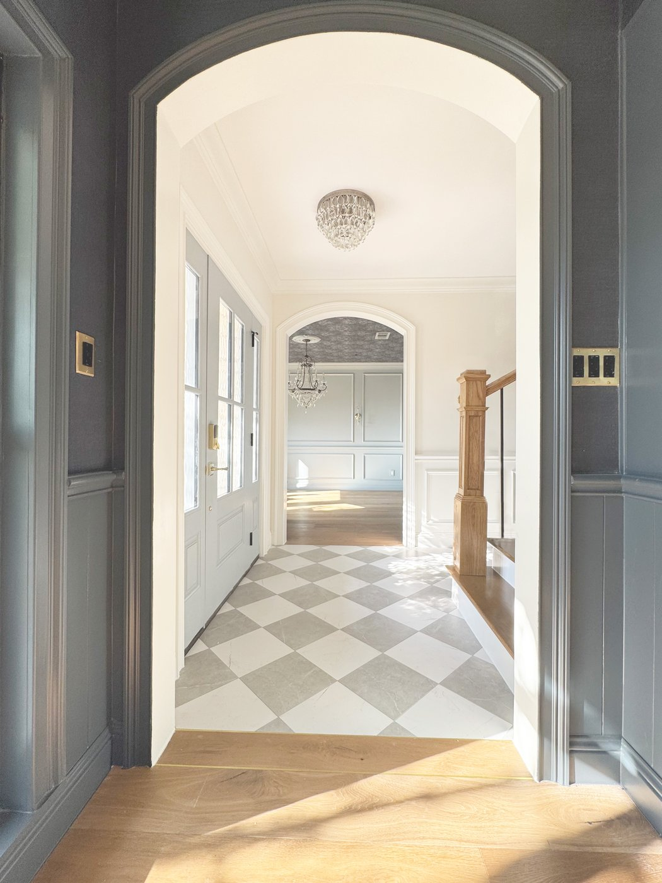

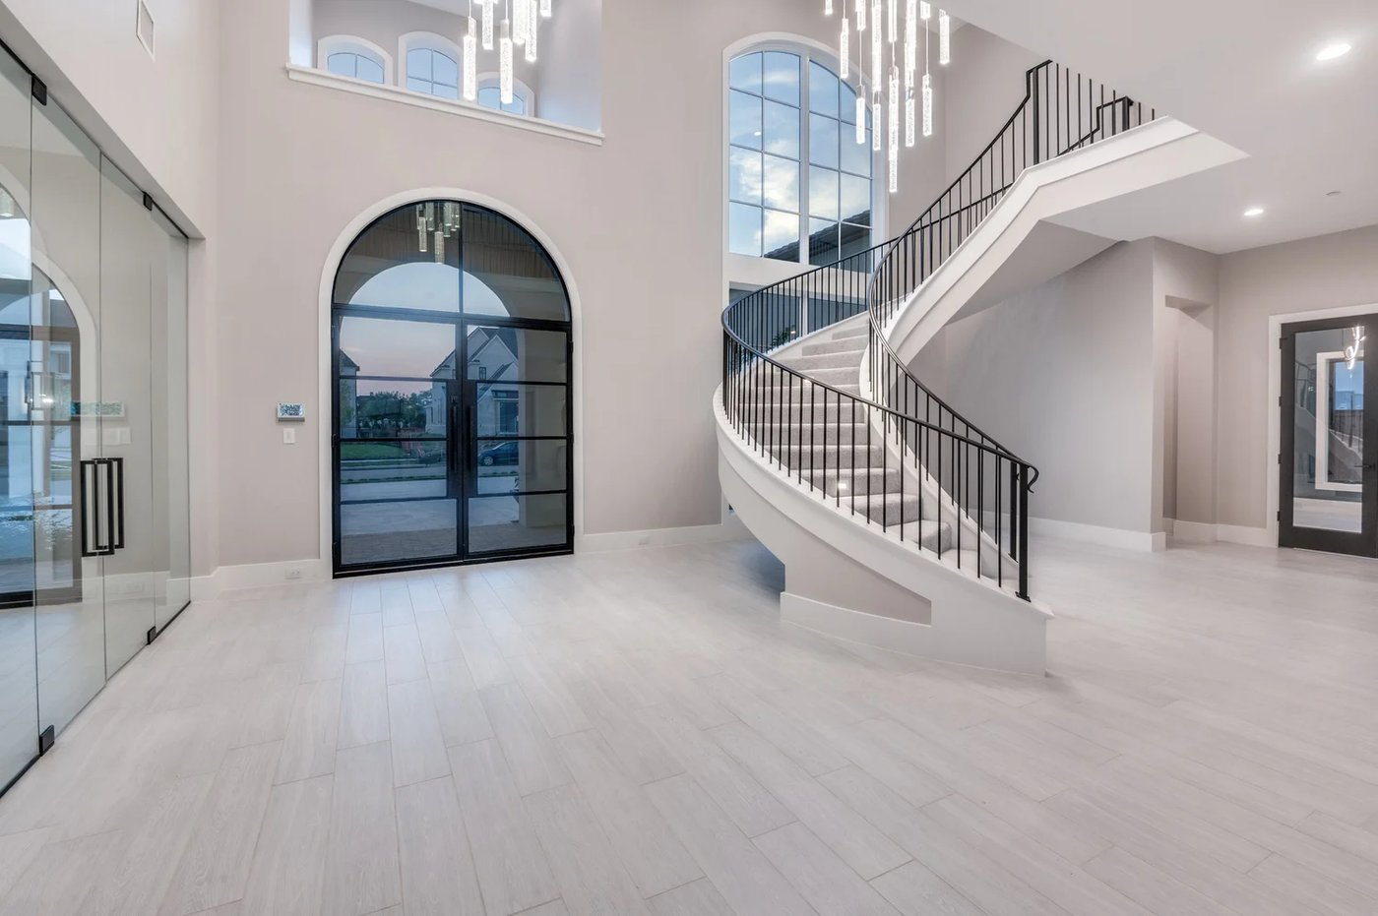
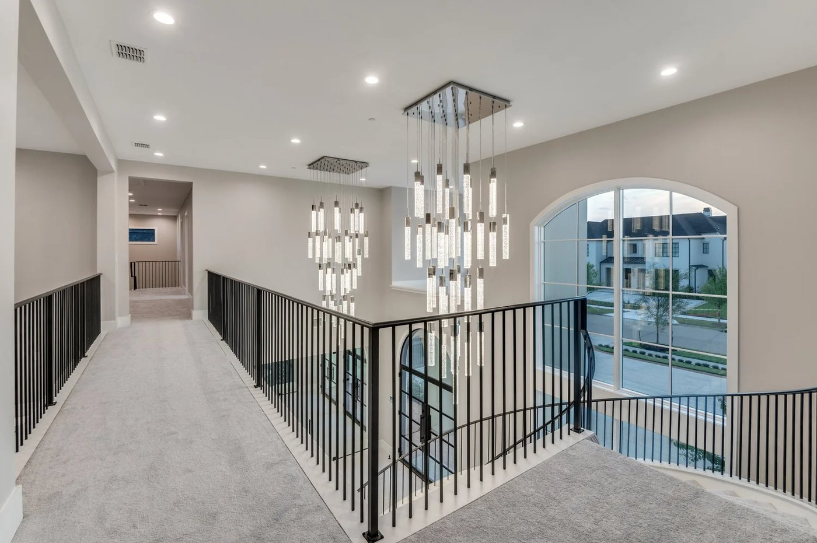
Arched & radius casing
Pre-bent casing for arched doorways and round windows
Flex Trim™ · Carter Millwork, Inc.

Slide 13
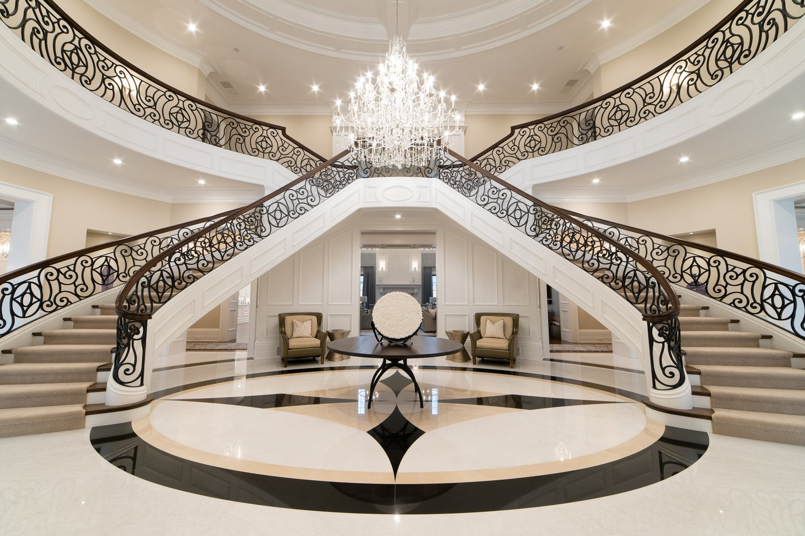
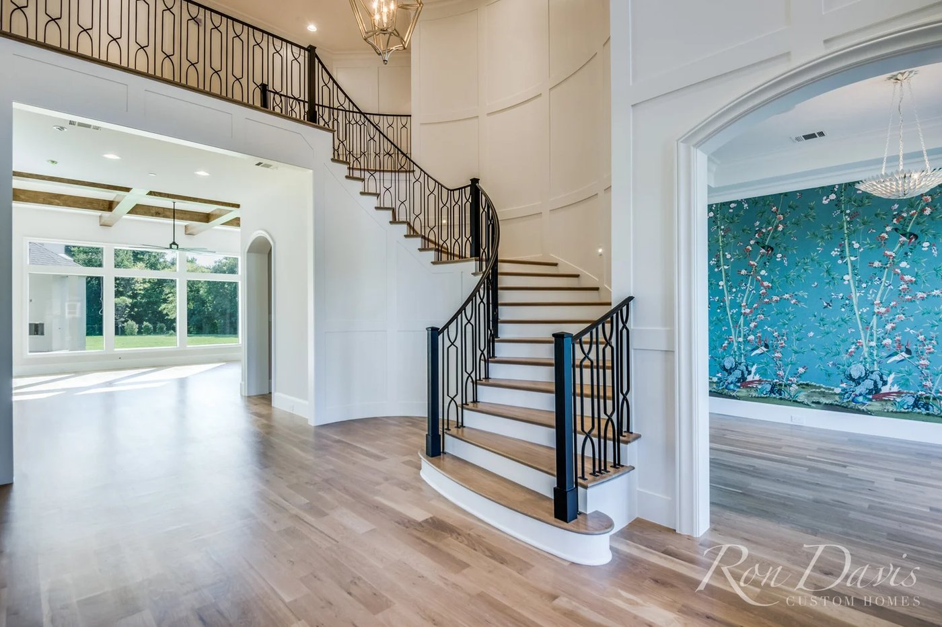

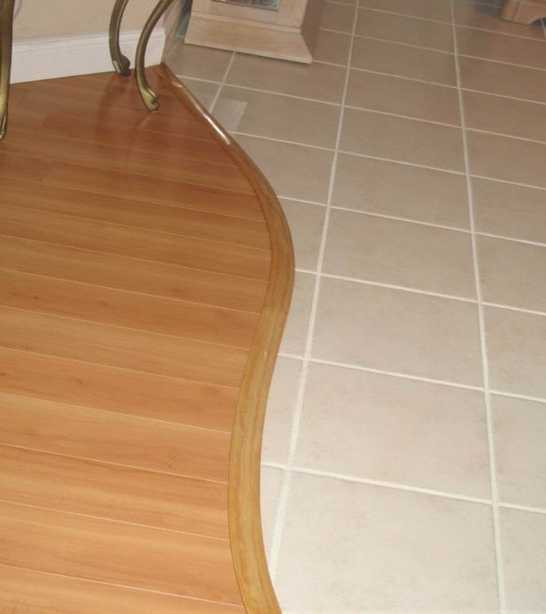
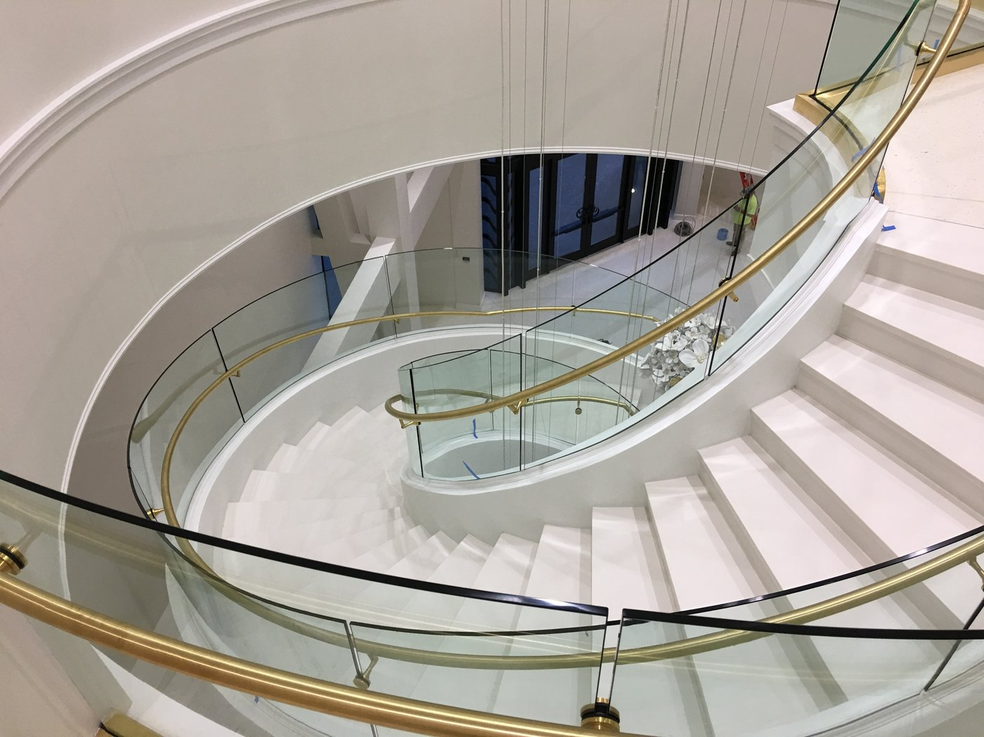
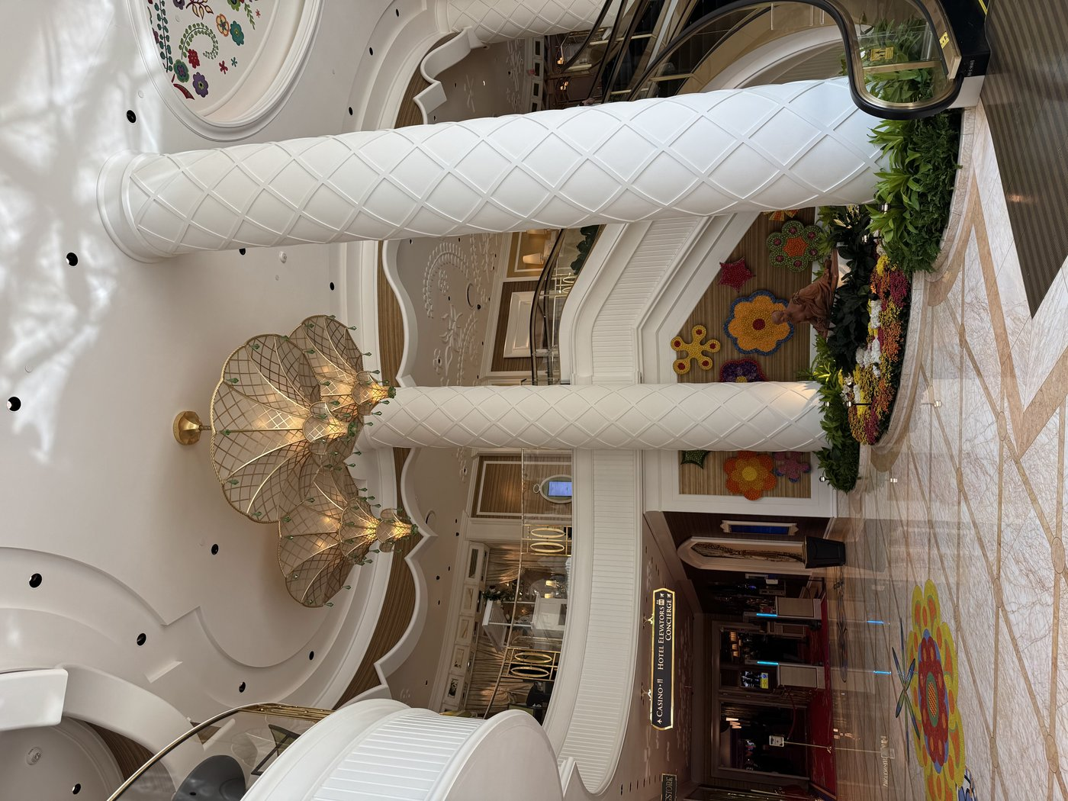
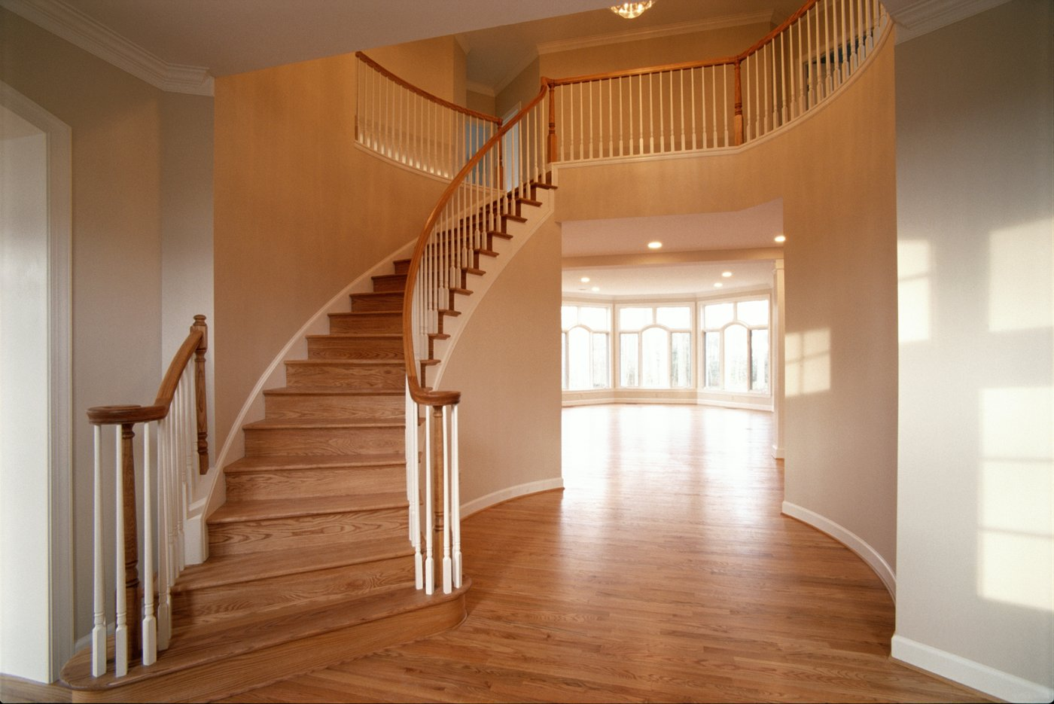

Curved walls
Flexible base, chair rail, and crown for staircases and radius walls
Flex Trim™ · Carter Millwork, Inc.

Slide 14
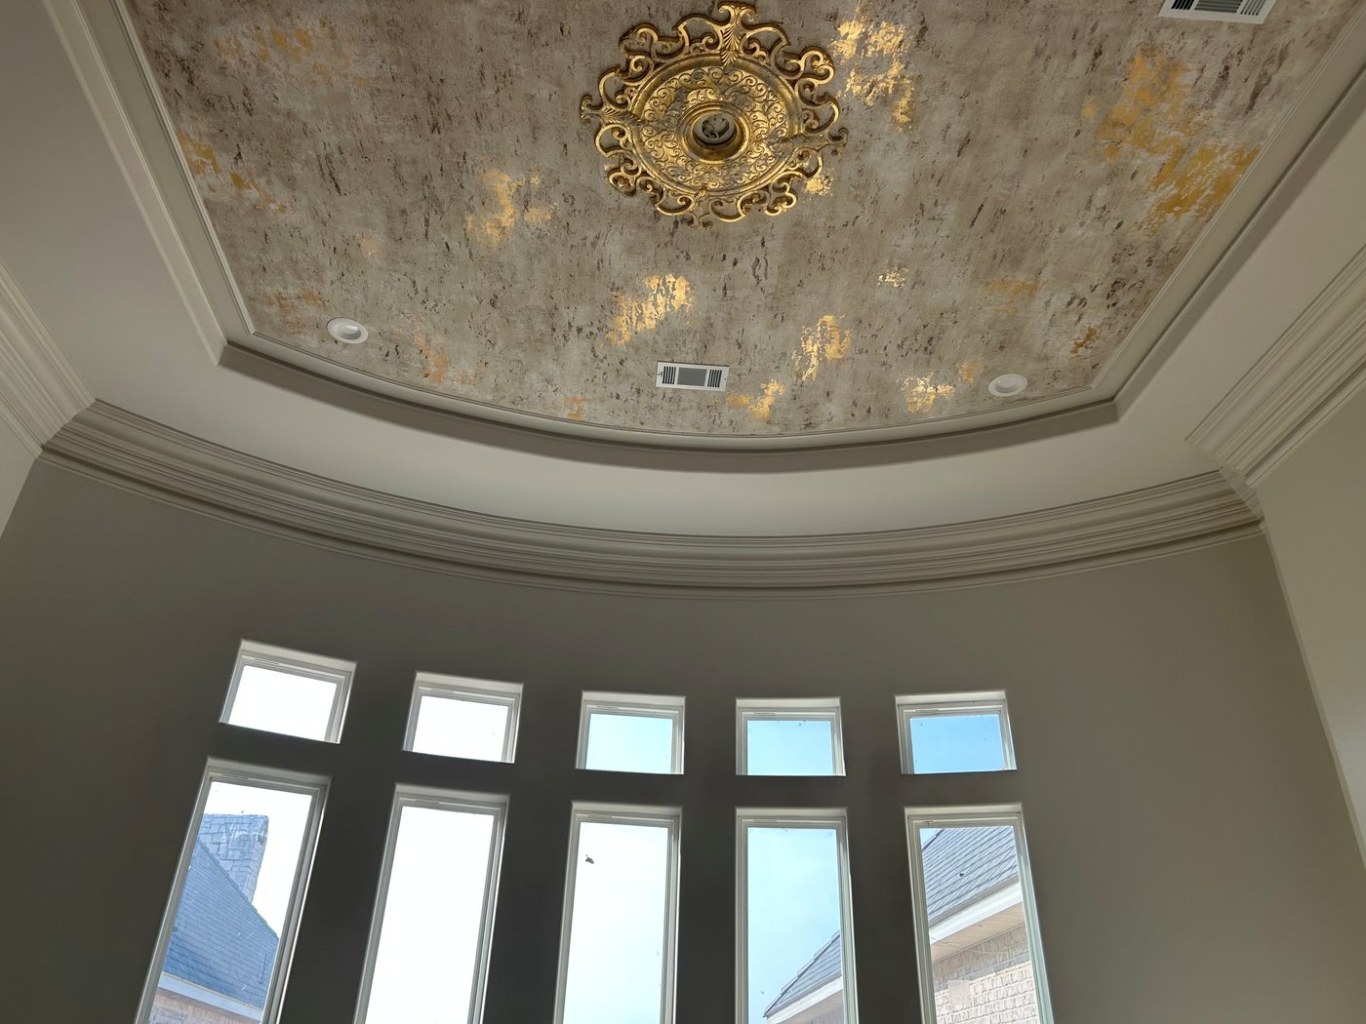
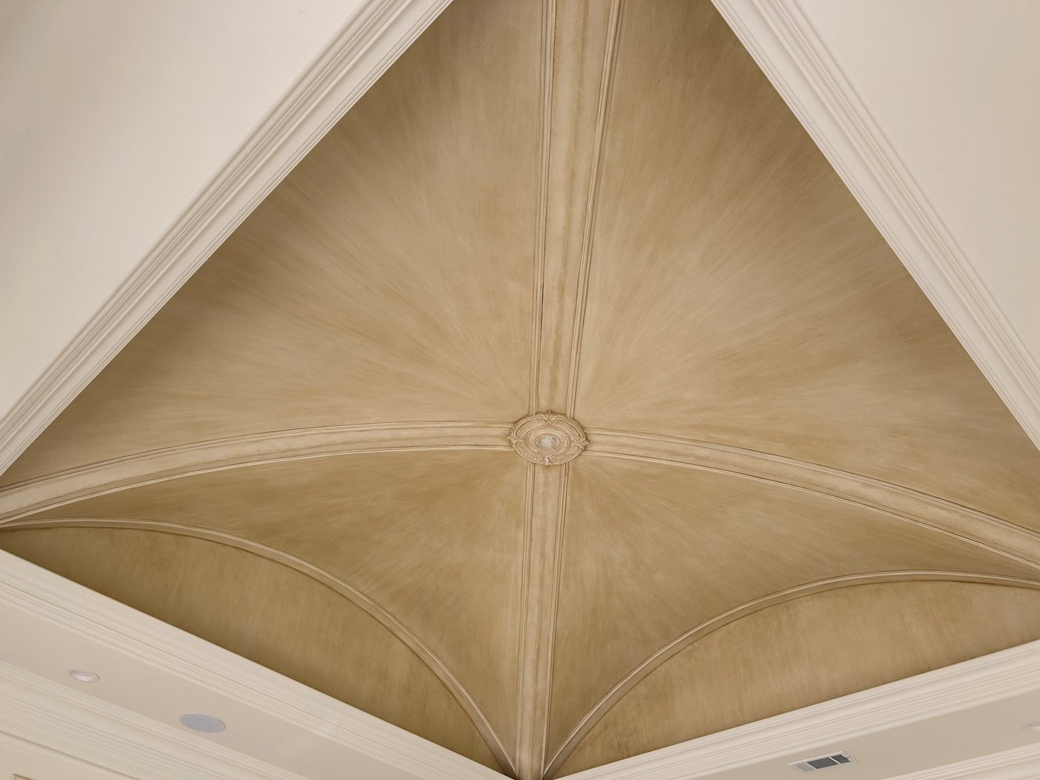
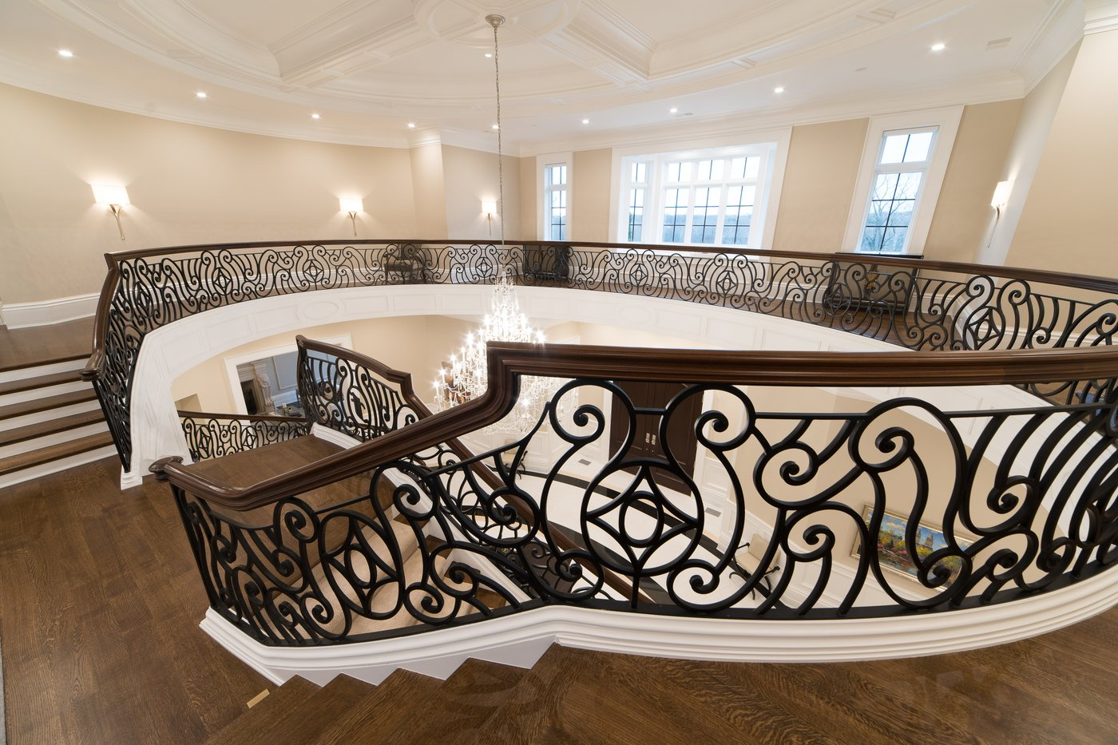

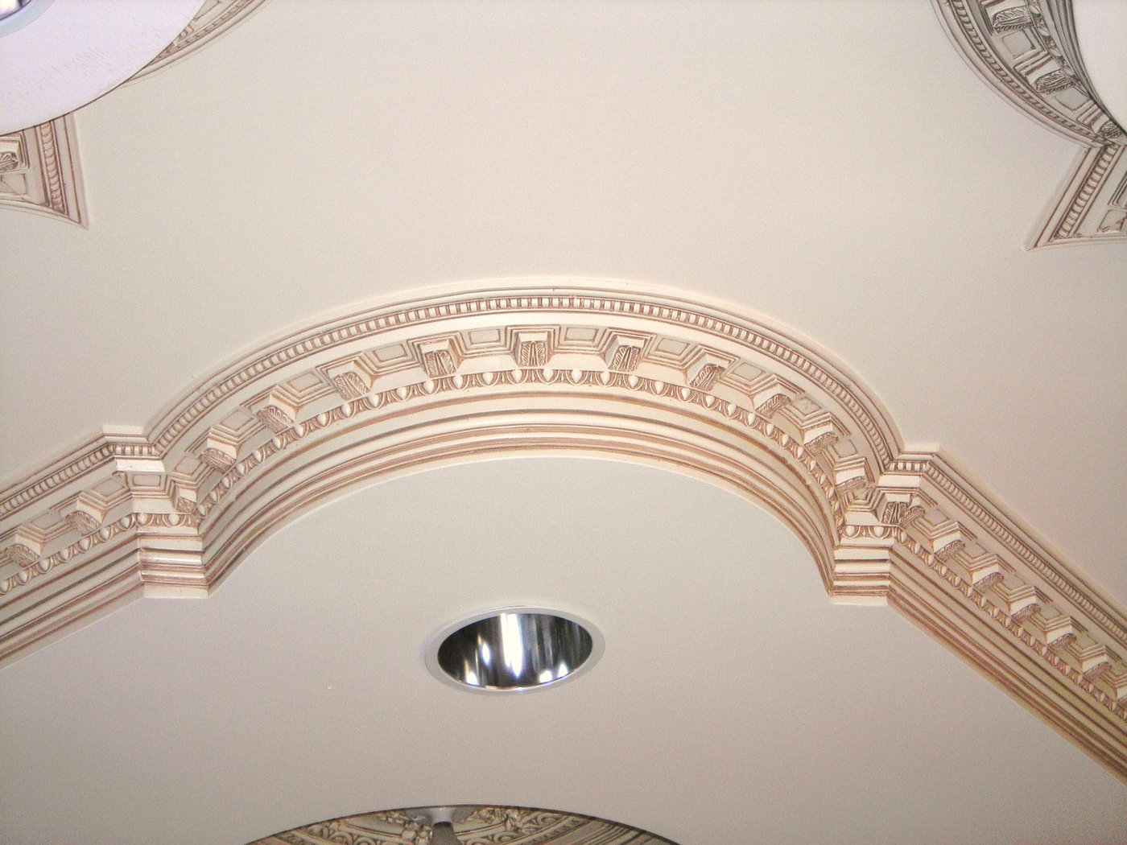
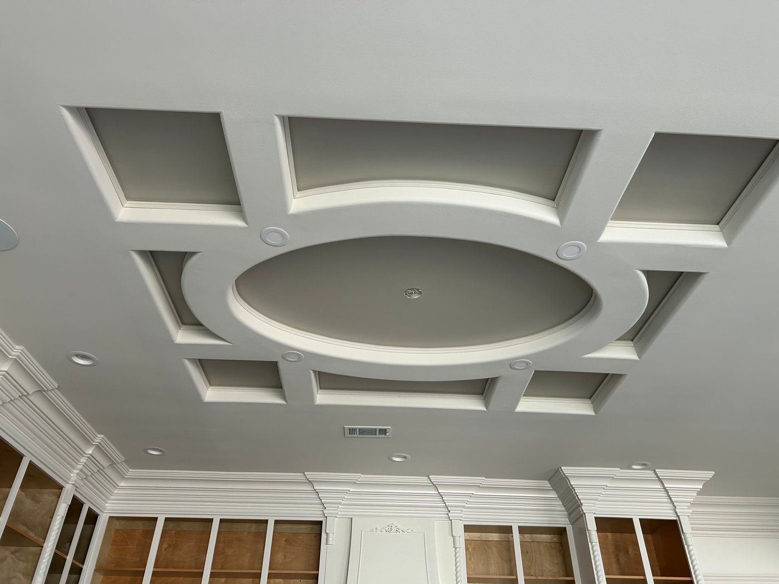
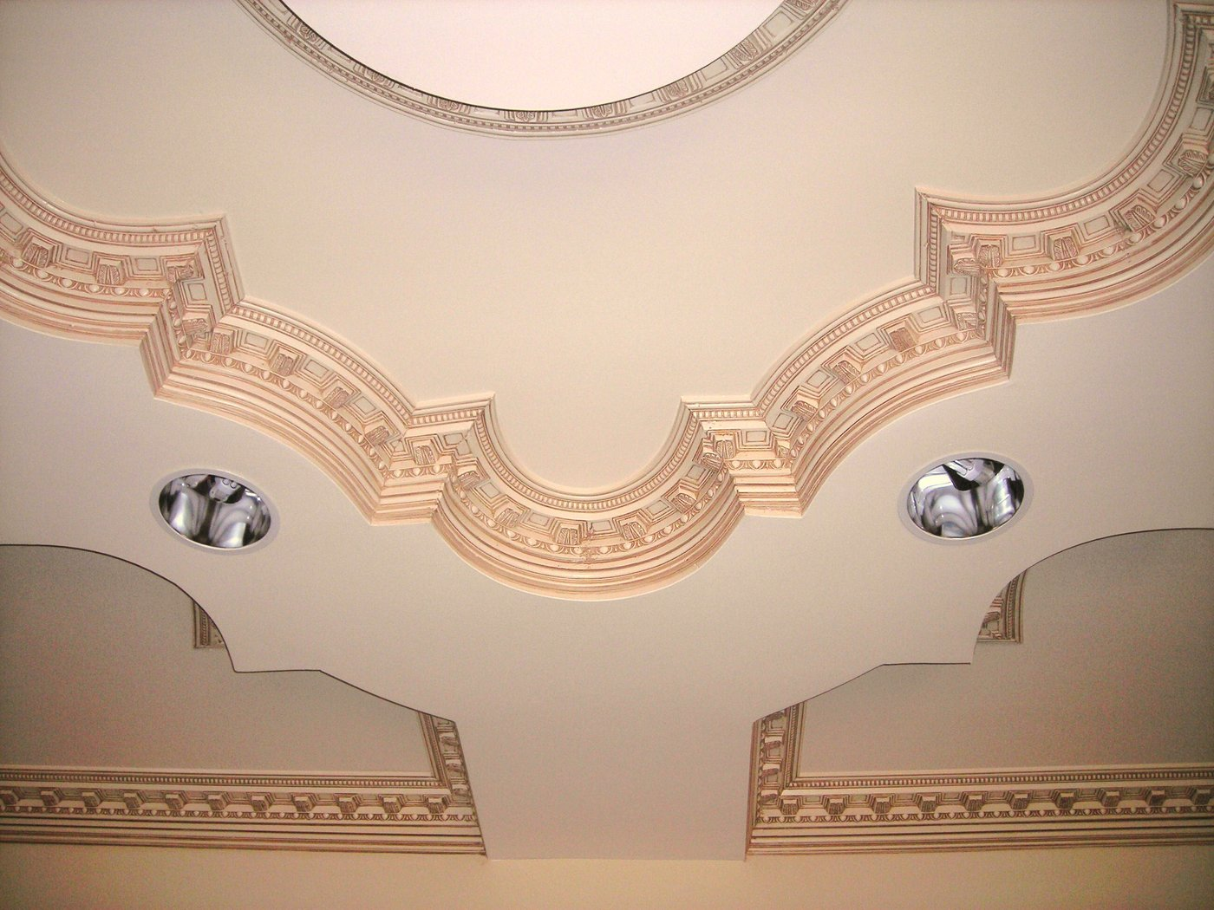
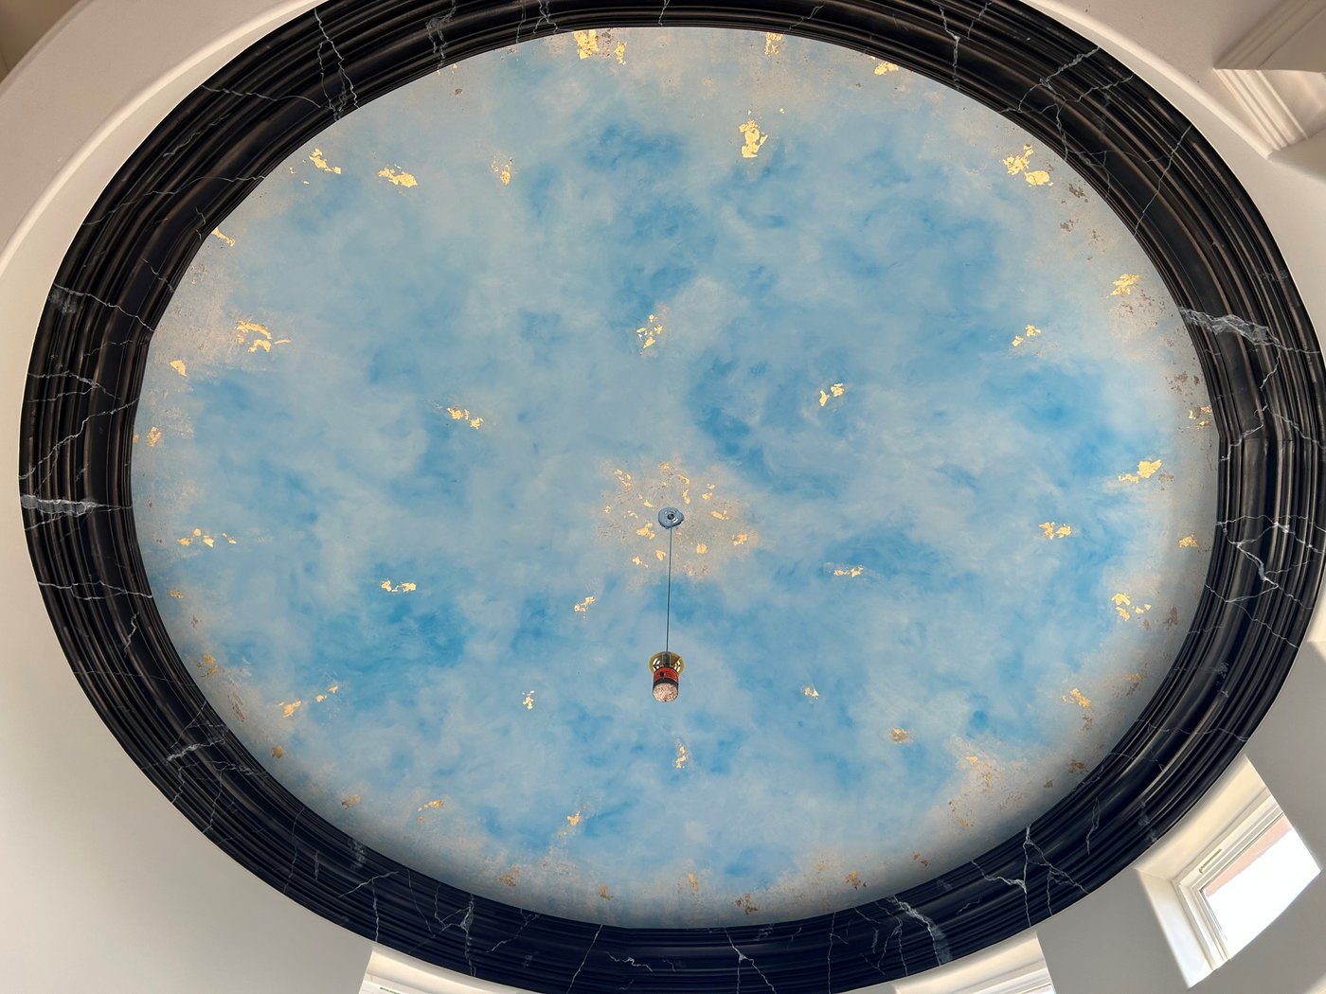
Vaulted & domed ceilings
Pre-bent crown for changing pitches, barrel vaults, and domes
Flex Trim™ · Carter Millwork, Inc.

Slide 15
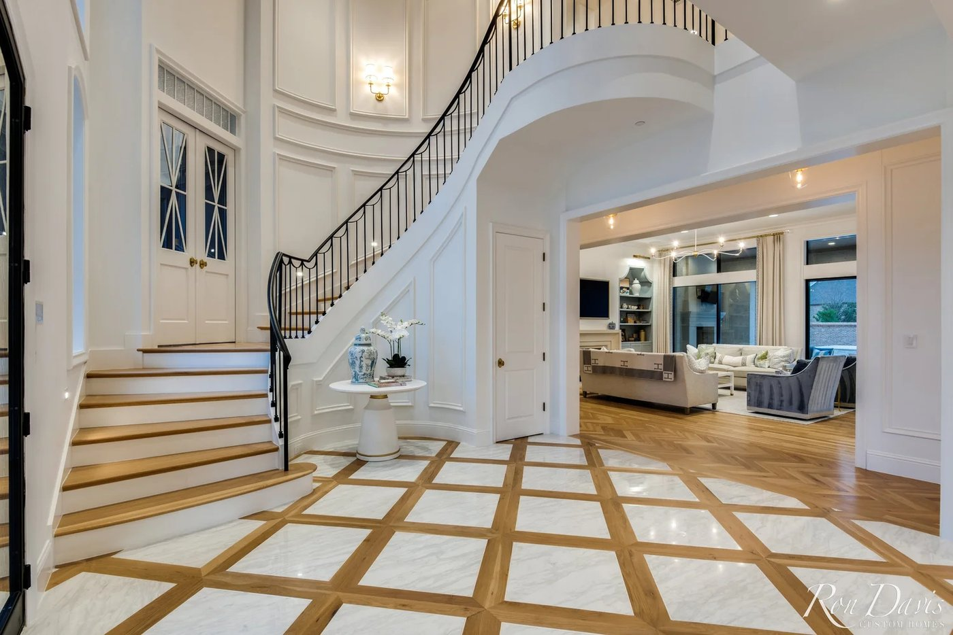
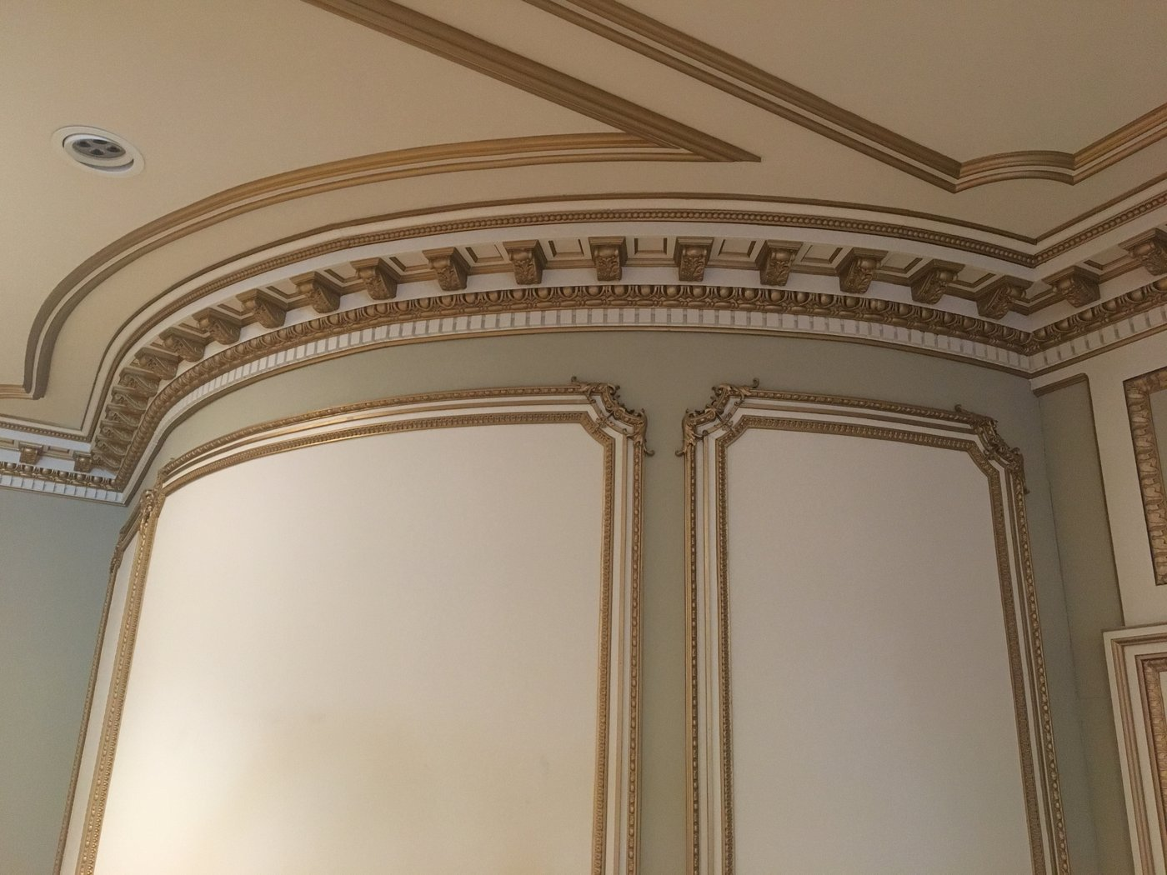

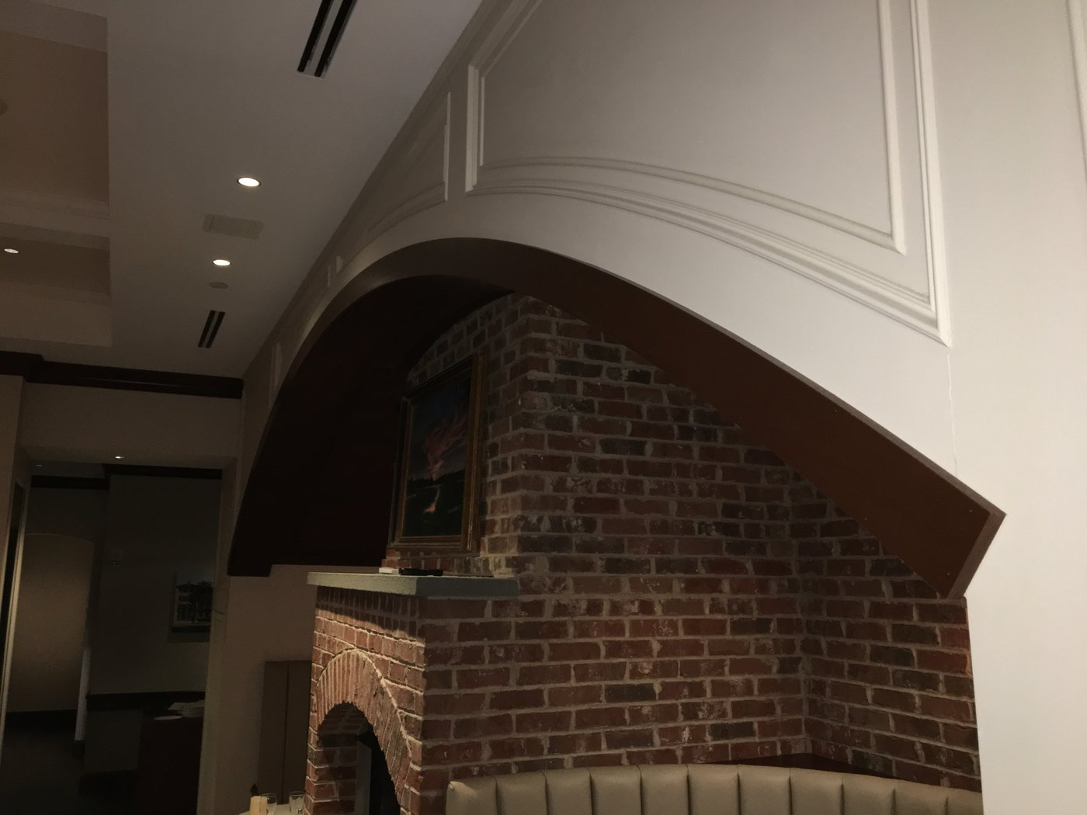
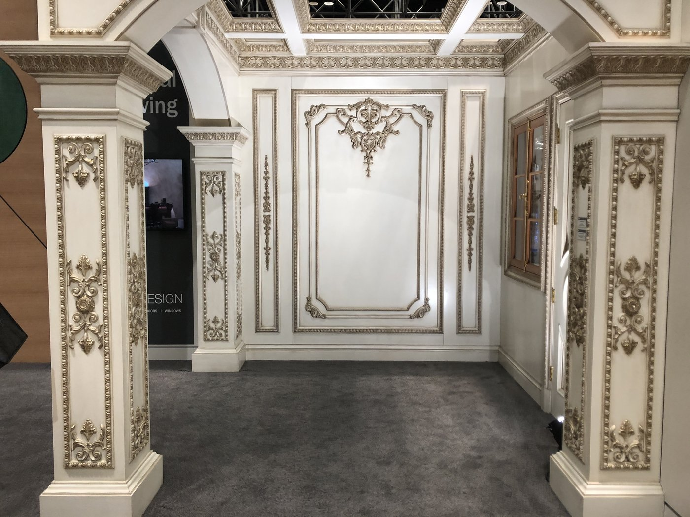
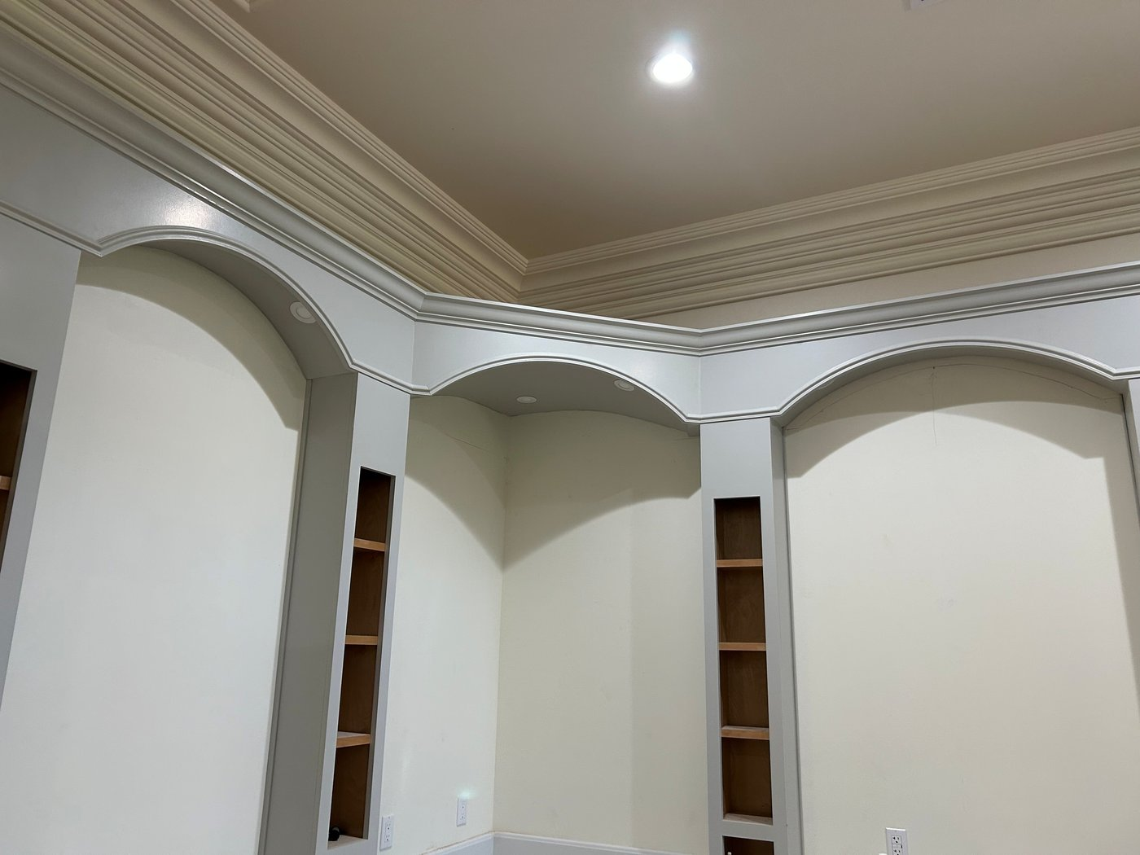
Decorative applied mouldings
Panels, curved wainscoting, geometric applied details
Flex Trim™ · Carter Millwork, Inc.

Slide 16
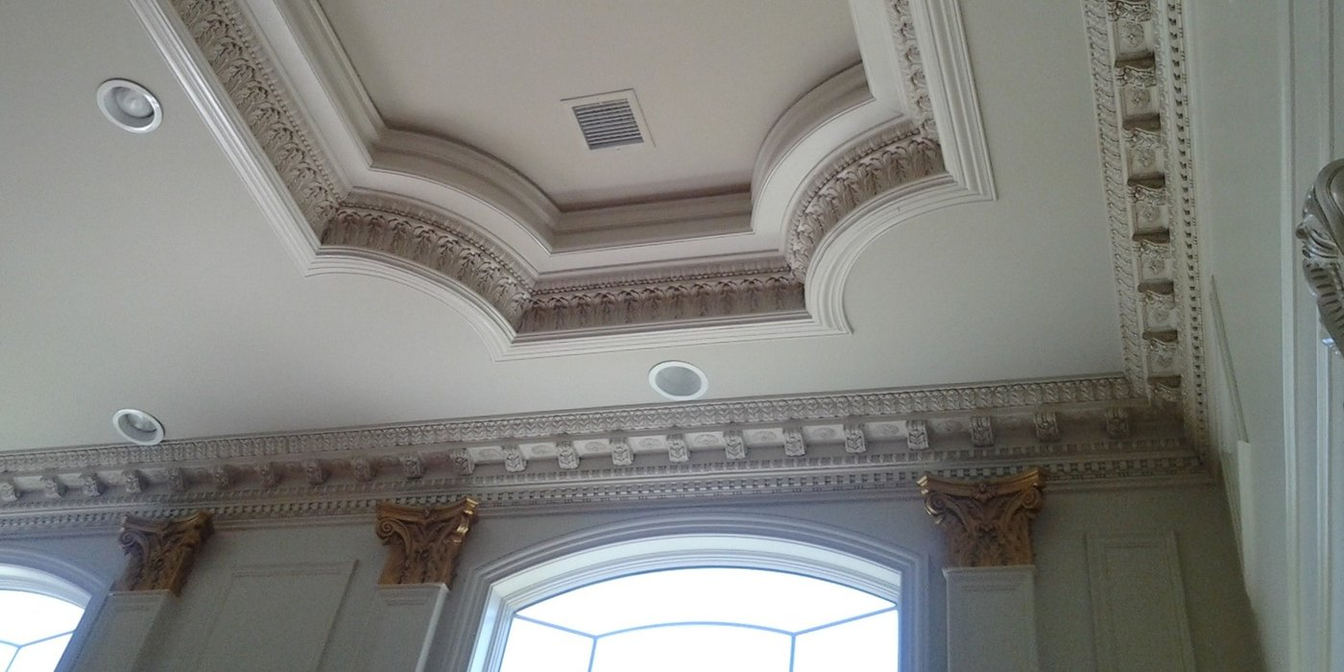
Historical reproductions
Match antique / hard-to-find profiles and accessories
Add image
Add image
Add image
Add image
Add image
Add image
Add image
Flex Trim™ · Carter Millwork, Inc.

Slide 17
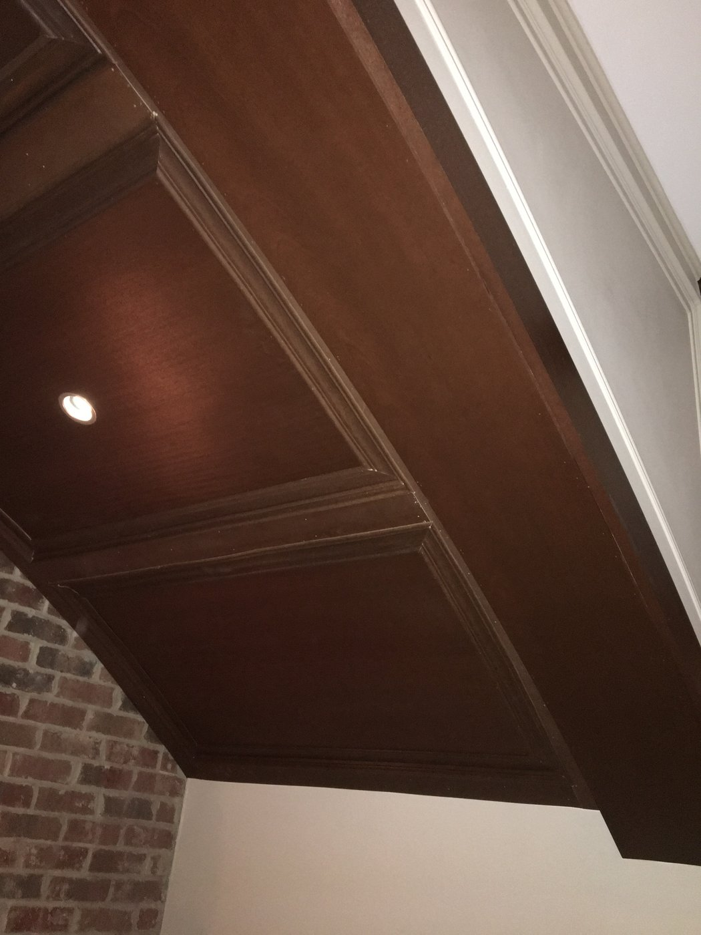
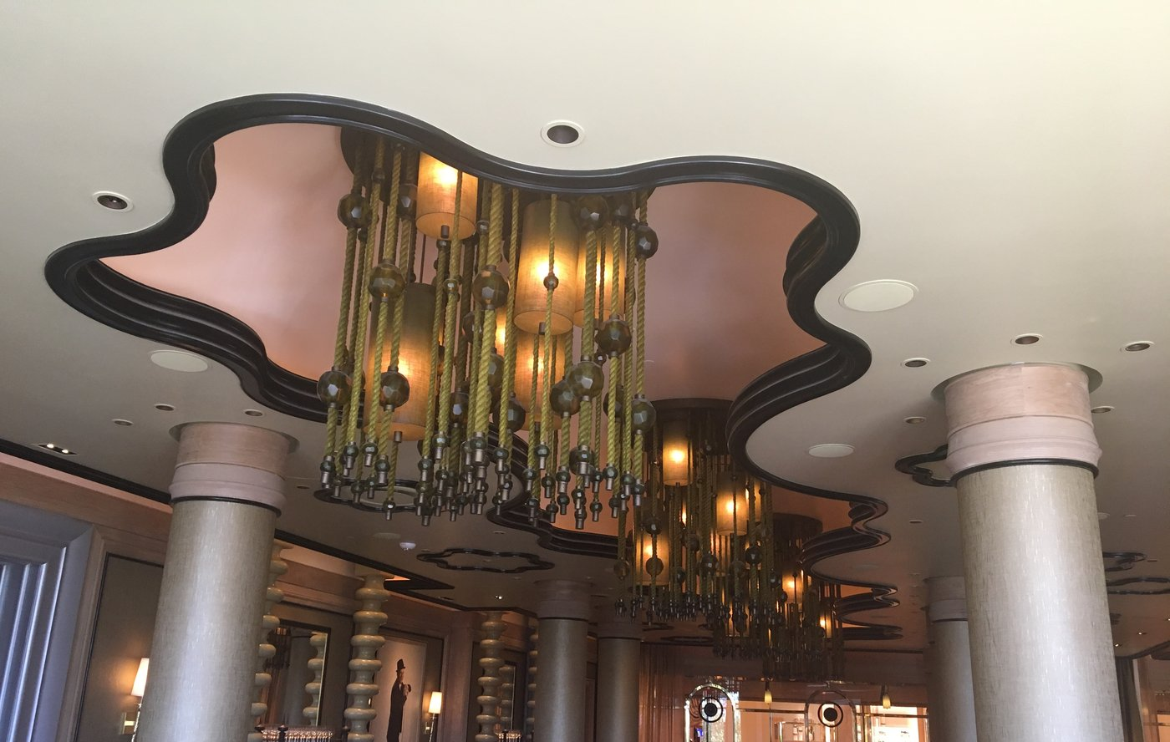
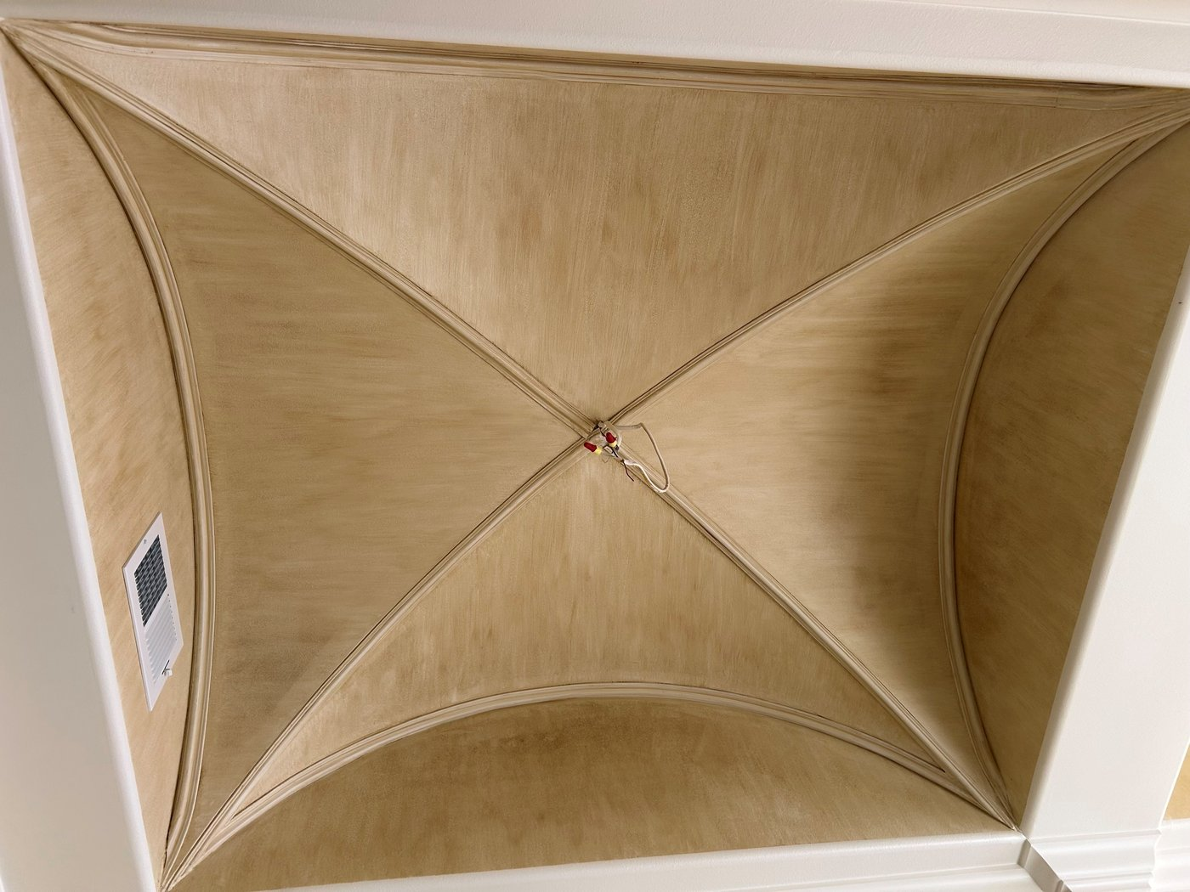
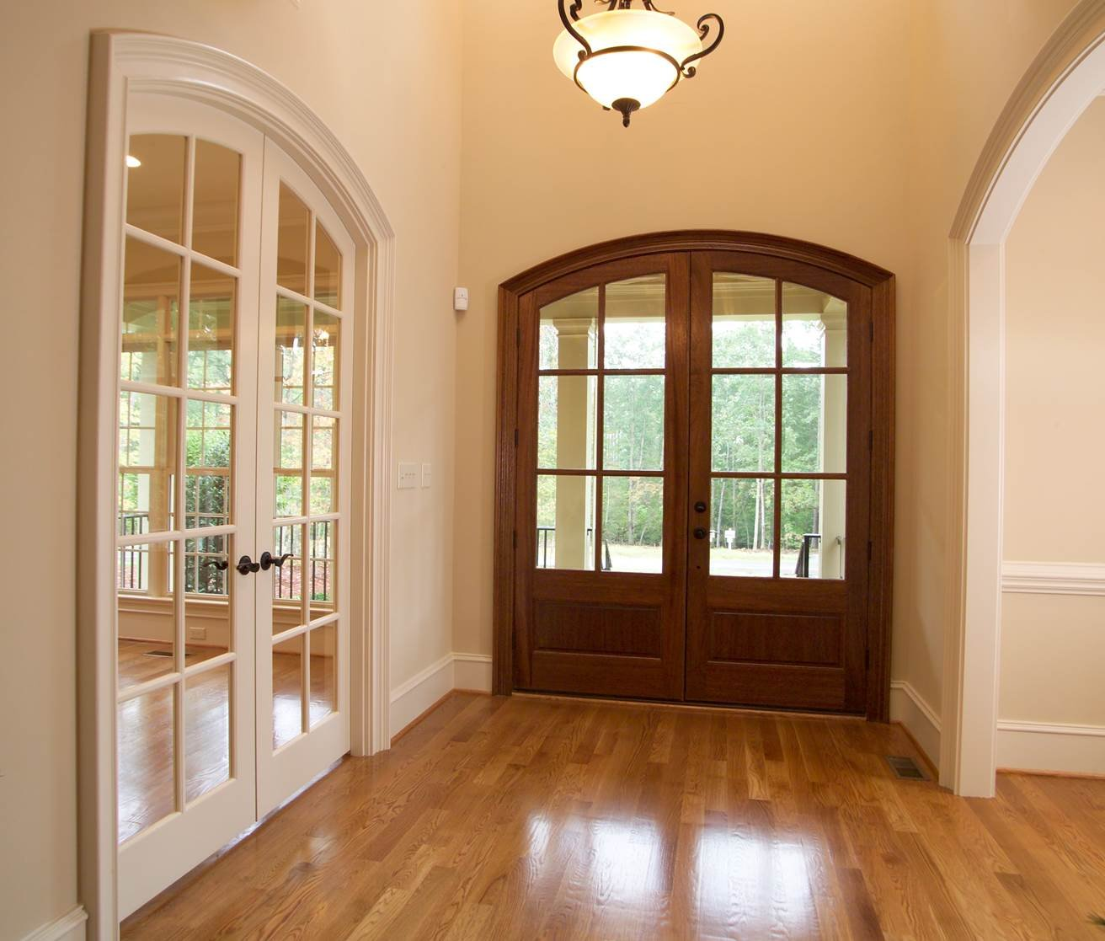
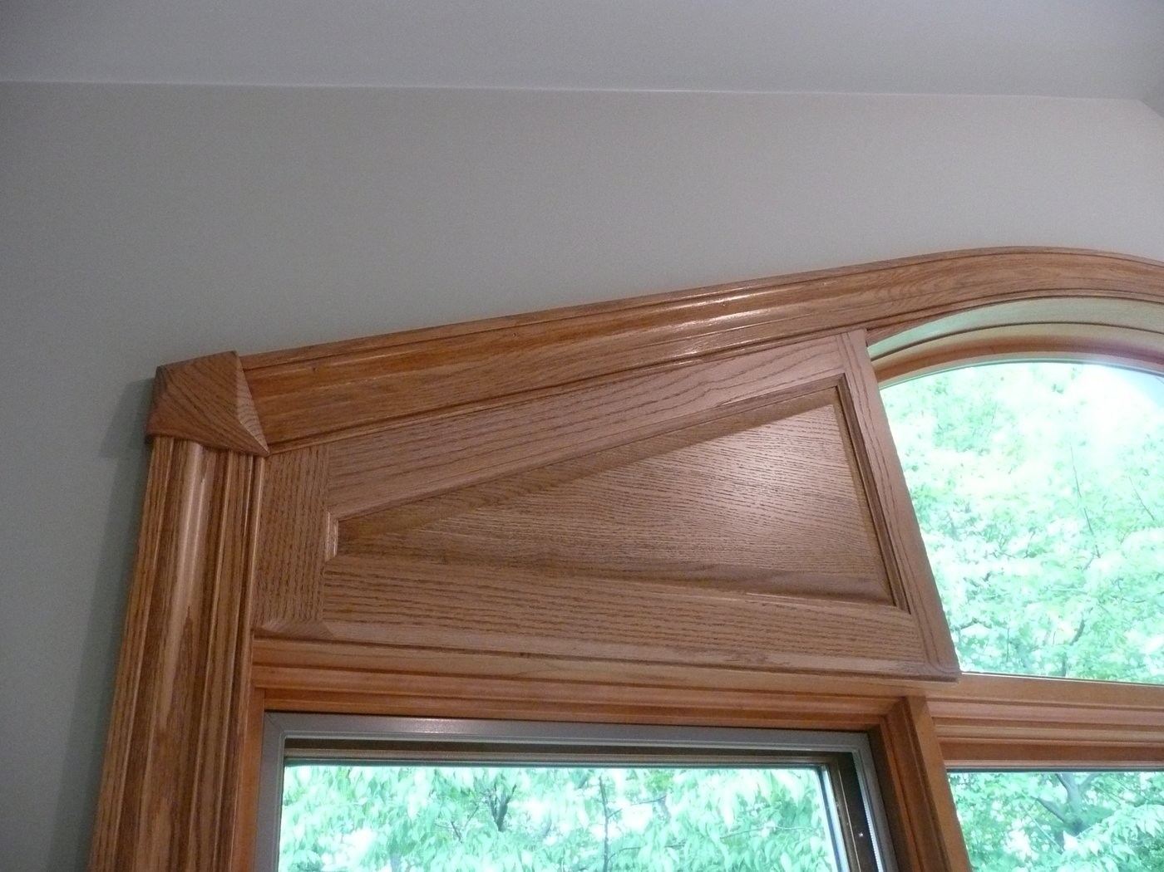
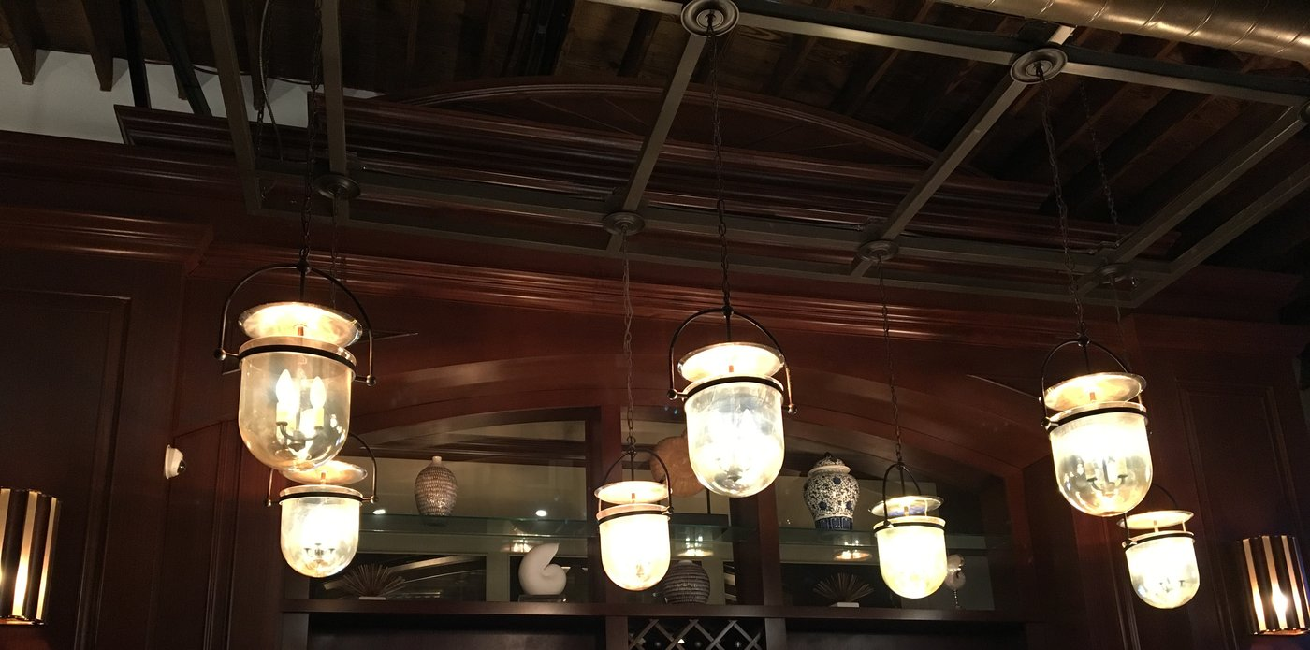
Stained Flex Trim™
Stain-grade installs showing species grain
Flex Trim™ · Carter Millwork, Inc.

Slide 18




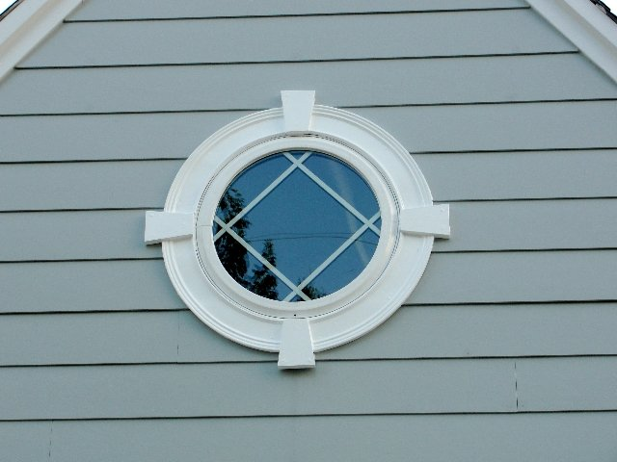
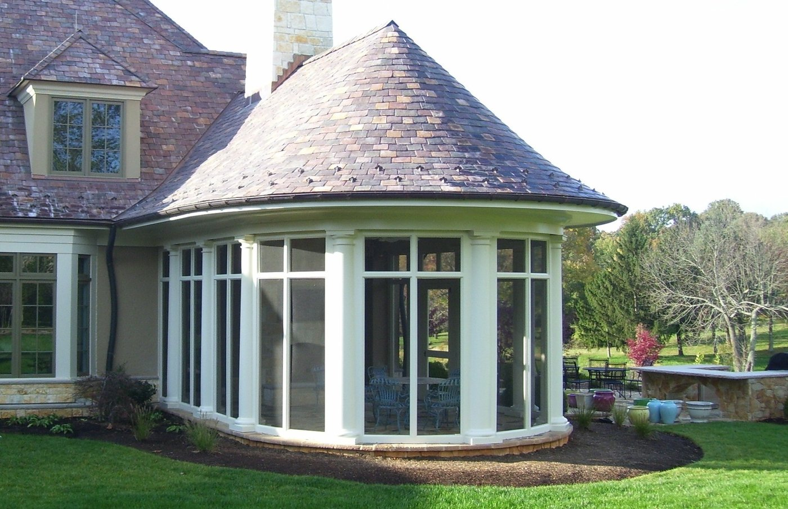
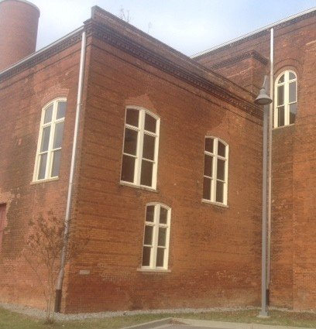
Outdoor installations
Exterior trim with proper exterior coating
Flex Trim™ · Carter Millwork, Inc.

Slide 19
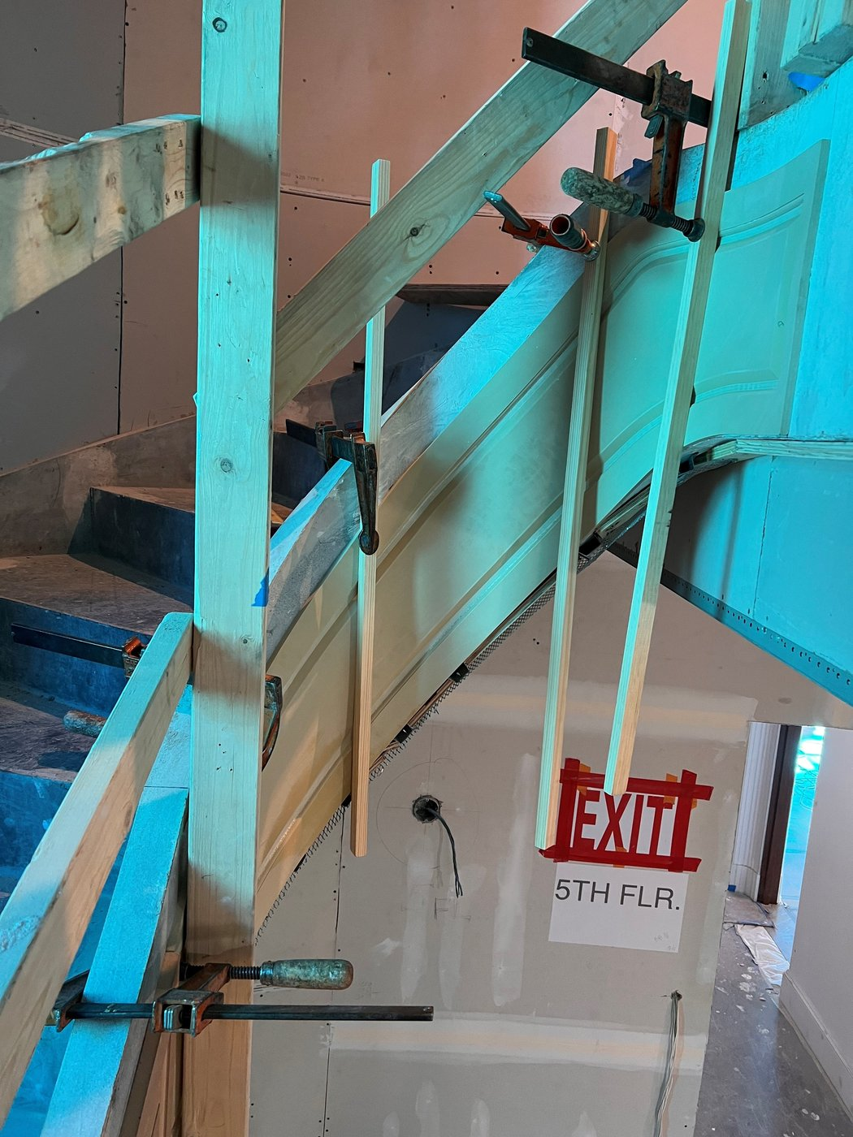
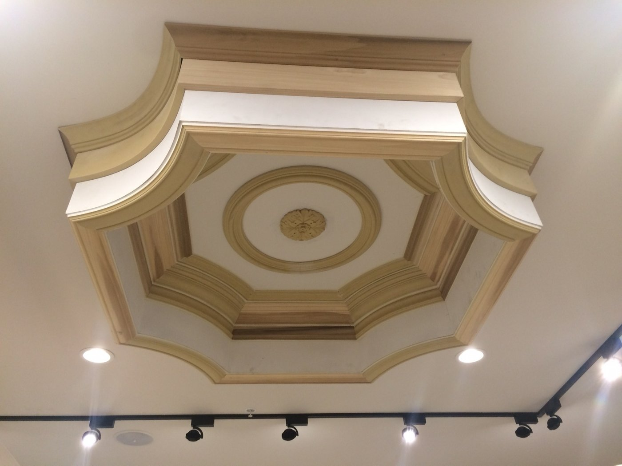

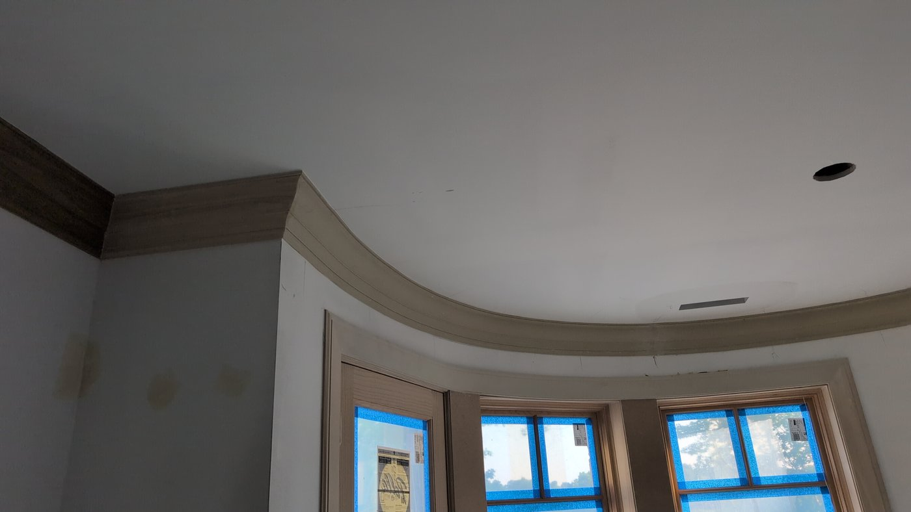

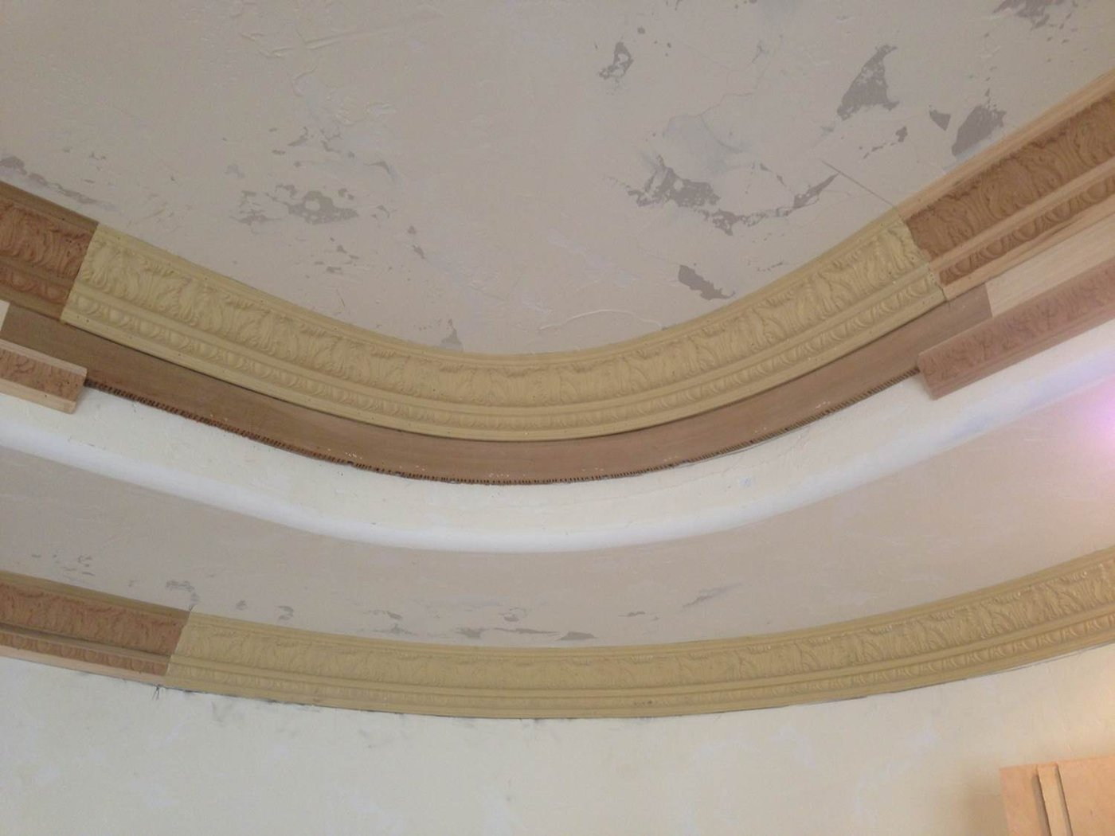
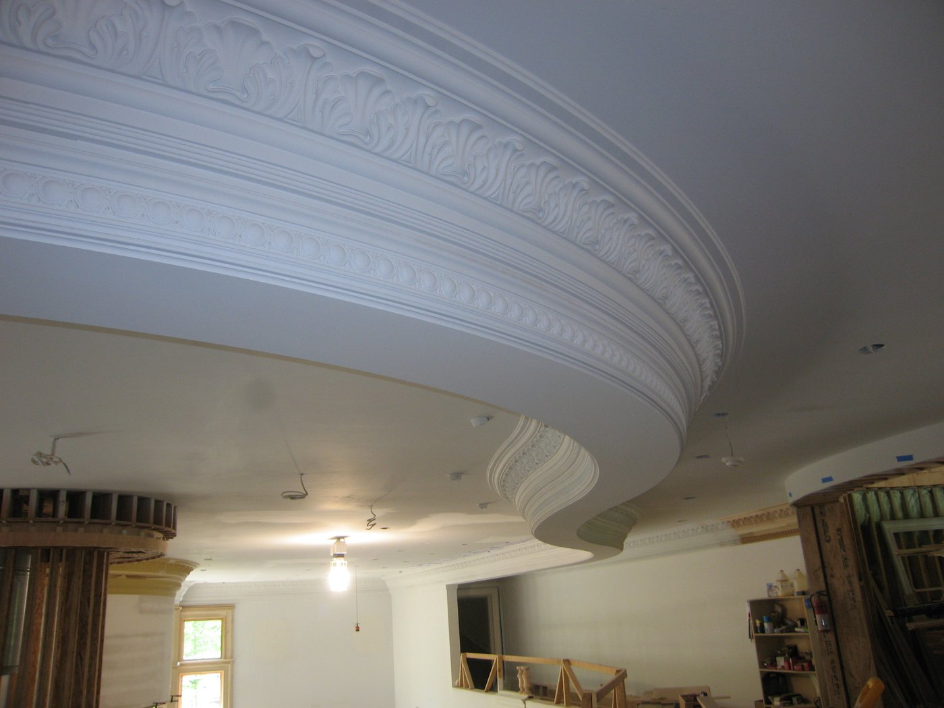
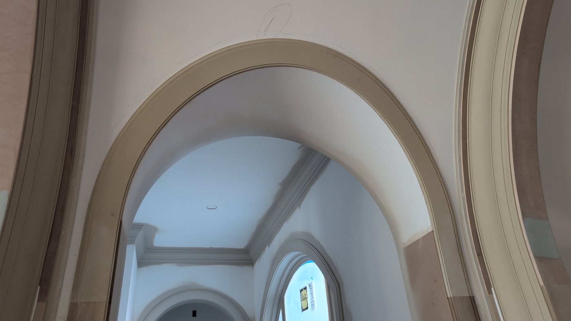
On the job site
Install context and field conditions
Flex Trim™ · Carter Millwork, Inc.

Slide 20
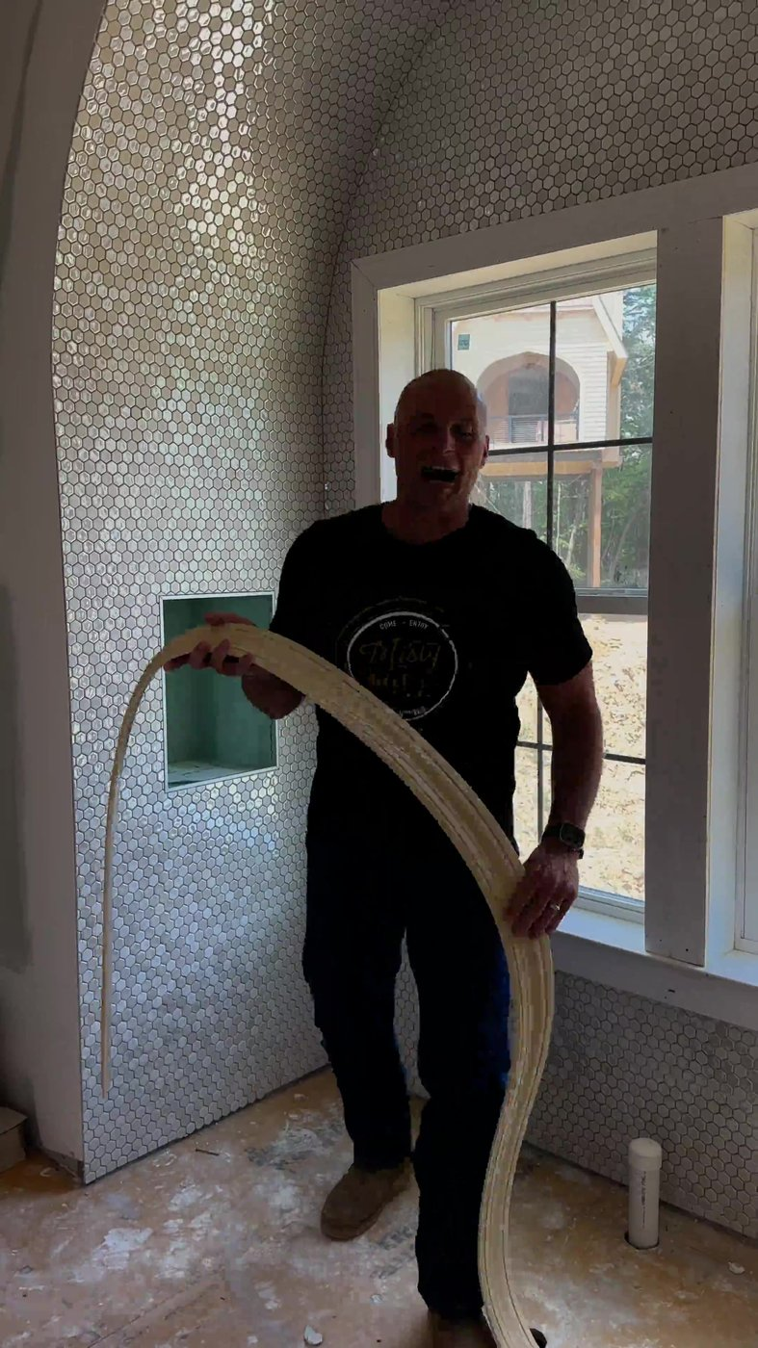
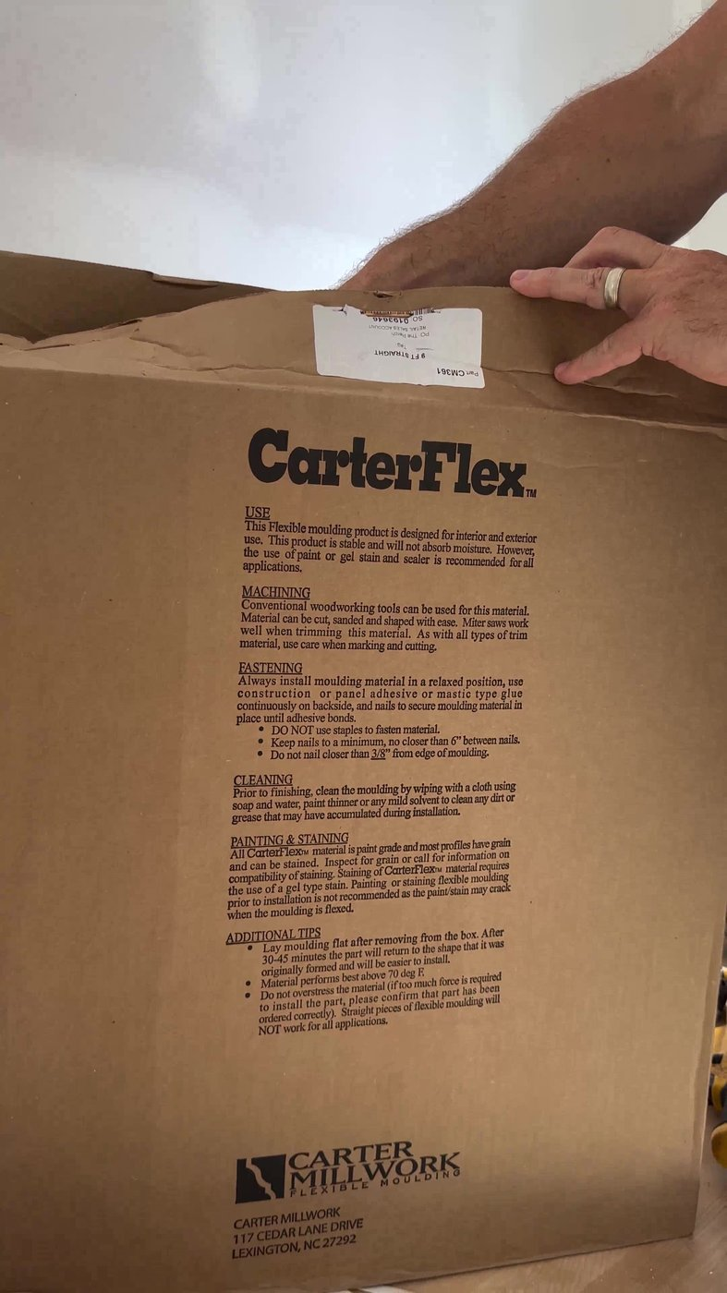
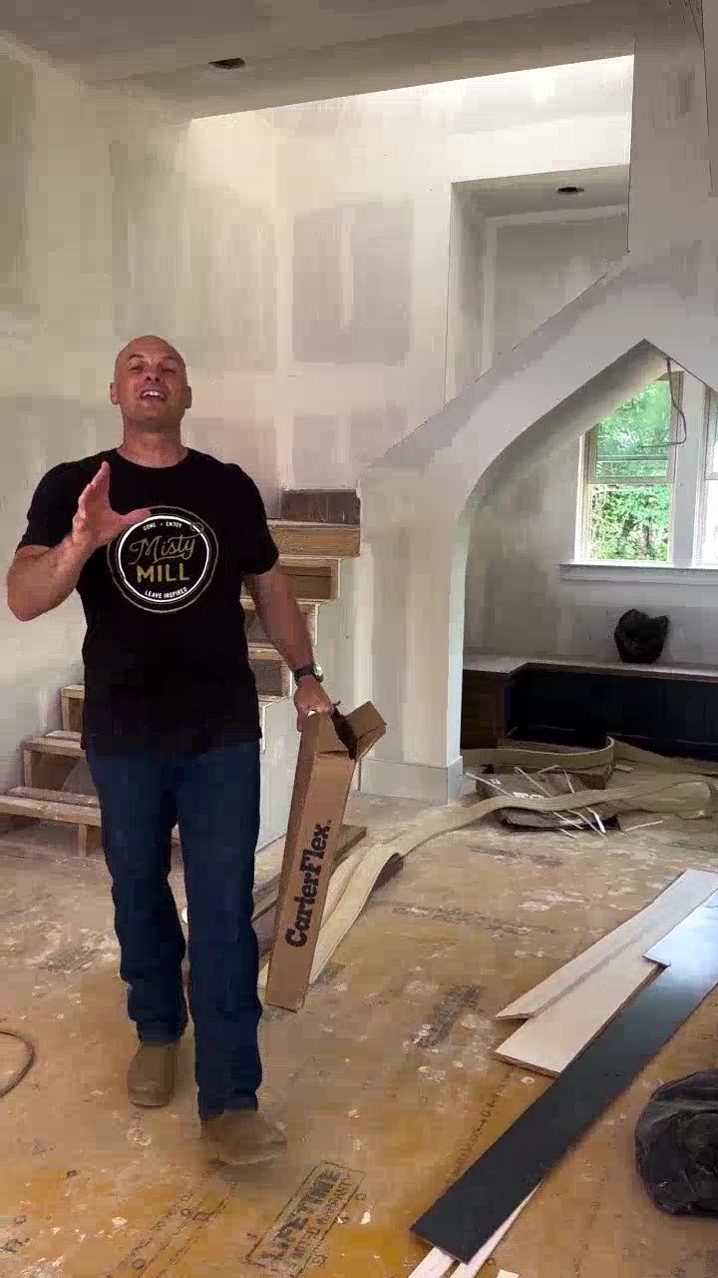
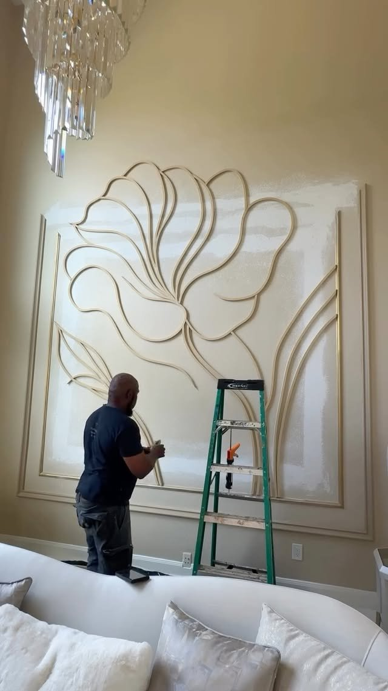

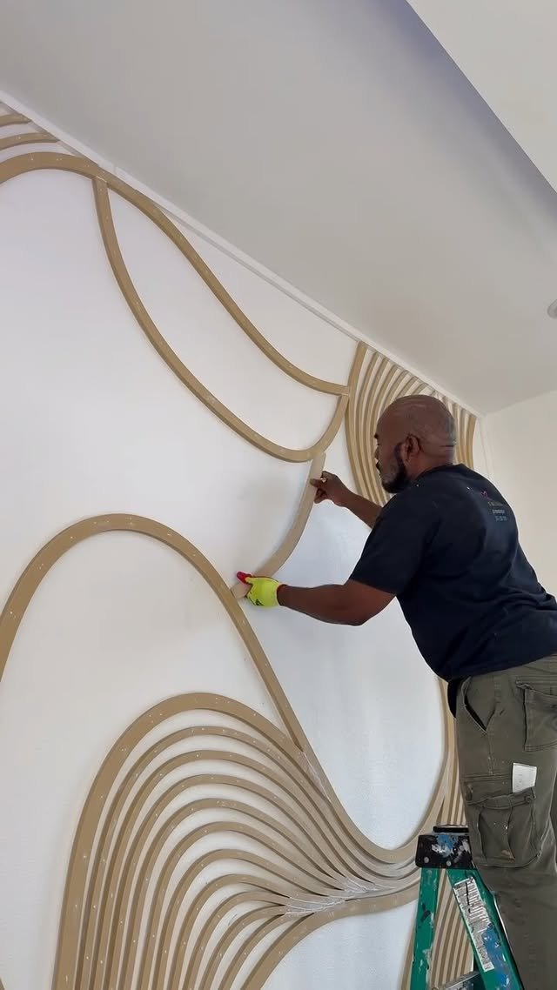
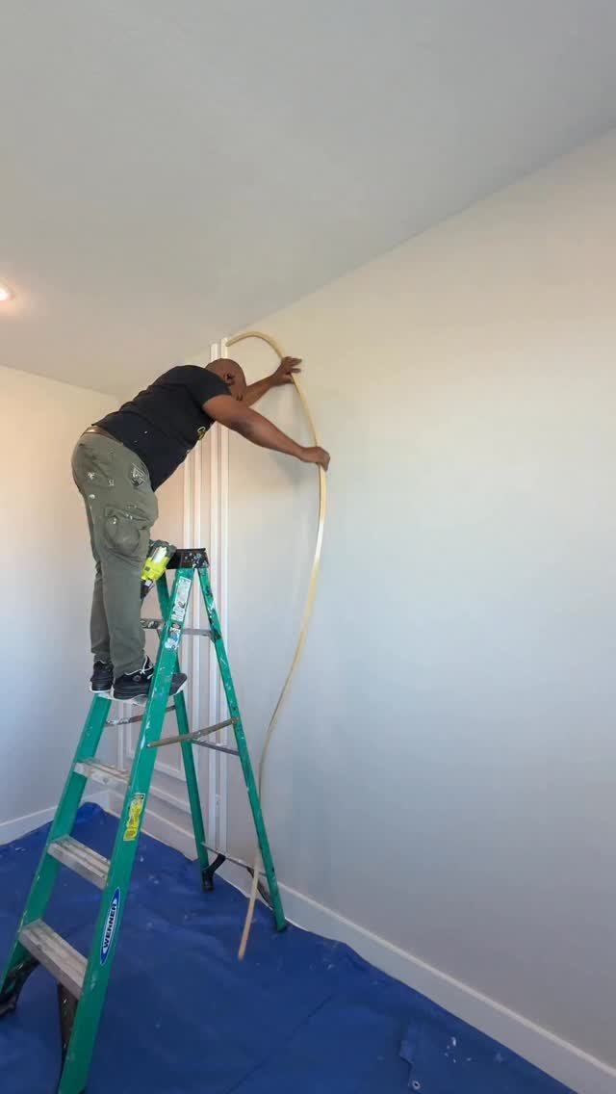
Featured projects
Standout and creator / media features
Add image
Flex Trim™ · Carter Millwork, Inc.

Slide 21
04 MATERIALS
Material details & upgrades
Choose the formulation that fits the job.

Slide 22
Material details
Flex Trim™ base material
• Flex Trim™ — original polymer resin / polyurethane blend
• Default choice for most applications
• Durable, consistent, cost-effective
• Paint-grade; many stainable
• Interior & exterior rated · NC & UT · Lifetime warranty
• Specialized upgrades:
• Zzz Flex® — max flexibility
• Ultra-Flex — 40–50% lighter (UT)
• Ultra-Fire Flex — ASTM E84 Class B (UT)
• Machinable S4S — mill short straight runs (UT)
• Xtrulinear® — continuous 12'–500' spools
Flex Trim™ · Carter Millwork, Inc.

Slide 23





Specialized material upgrades
Additional flexibility
Reduced weight
Commercial fire ratings
Enhanced machinability
Extended lengths
Zzz Flex®
Ultra-Flex
Ultra-Fire Flex
Machinable S4S
Xtrulinear®
Premium elastomer composite for intricate patterns, tight radii, and cold-weather climates.
40–50% lighter syntactic polyurethane. Pre-primed, back-sanded for glue adhesion.
ASTM E84 Class B fire-rated moulding for commercial builds.
Mill short straight custom runs on conventional woodworking equipment.
Continuous 12'–500' on a spool — fewer joints, less waste.
Available NC & UT · Xtrulinear capable
Manufactured exclusively at our Utah plant.
Manufactured exclusively at our Utah plant.
Manufactured exclusively at our Utah plant.
Available from NC and UT plants.
Flex Trim™ · Carter Millwork, Inc.

Slide 24
Zzz Flex®
Additional flexibility
Premium elastomer composite for intricate patterns, tight radii, and cold-weather climates.
Available NC & UT · Xtrulinear capable
• Highest flexibility rating in the family
• Best for small / intricate patterns, tight radii, cold climates
• Available as Xtrulinear® extended lengths
• Lifetime warranty
Flex Trim™ · Carter Millwork, Inc.

Slide 25
Ultra-Flex
Reduced weight
40–50% lighter syntactic polyurethane. Pre-primed, back-sanded for glue adhesion.
Manufactured exclusively at our Utah plant.
• Syntactic polyurethane — 40–50% lighter than standard Flex Trim™
• Pre-primed for finishing · back-sanded for glue adhesion
• Indoor or outdoor · not available as extended lengths
• Lifetime warranty
Flex Trim™ · Carter Millwork, Inc.

Slide 26
Ultra-Fire Flex
Commercial fire ratings
ASTM E84 Class B fire-rated moulding for commercial builds.
Manufactured exclusively at our Utah plant.
• ASTM E84 tested — Class B flame spread
• Confirm application / specification with our team
• Tech docs available in Resources
• Lifetime warranty
Flex Trim™ · Carter Millwork, Inc.

Slide 27
Machinable S4S
Enhanced machinability
Mill short straight custom runs on conventional woodworking equipment.
Manufactured exclusively at our Utah plant.
• Thickness ½"–2" · Width 1¾"–16" · Length 8'–12'
• Paint grade only · bending style 1 only for recommended curved uses
• Cannot generally be used for radius casing, crown, or style 2 bends
• Machines like MDF; carbide preferred; feed 15–30 fpm
Flex Trim™ · Carter Millwork, Inc.

Slide 28
Xtrulinear®
Extended lengths
Continuous 12'–500' on a spool — fewer joints, less waste.
Available from NC and UT plants.
• Flex Trim™ or Zzz Flex® · 12' to 500' on a spool
• Typically ~30% premium · ships LTL / pallet only
• Straight pieces only — style 2 cannot be spooled
• Oversized profiles / lengths may be coiled in a box
Flex Trim™ · Carter Millwork, Inc.

Slide 29
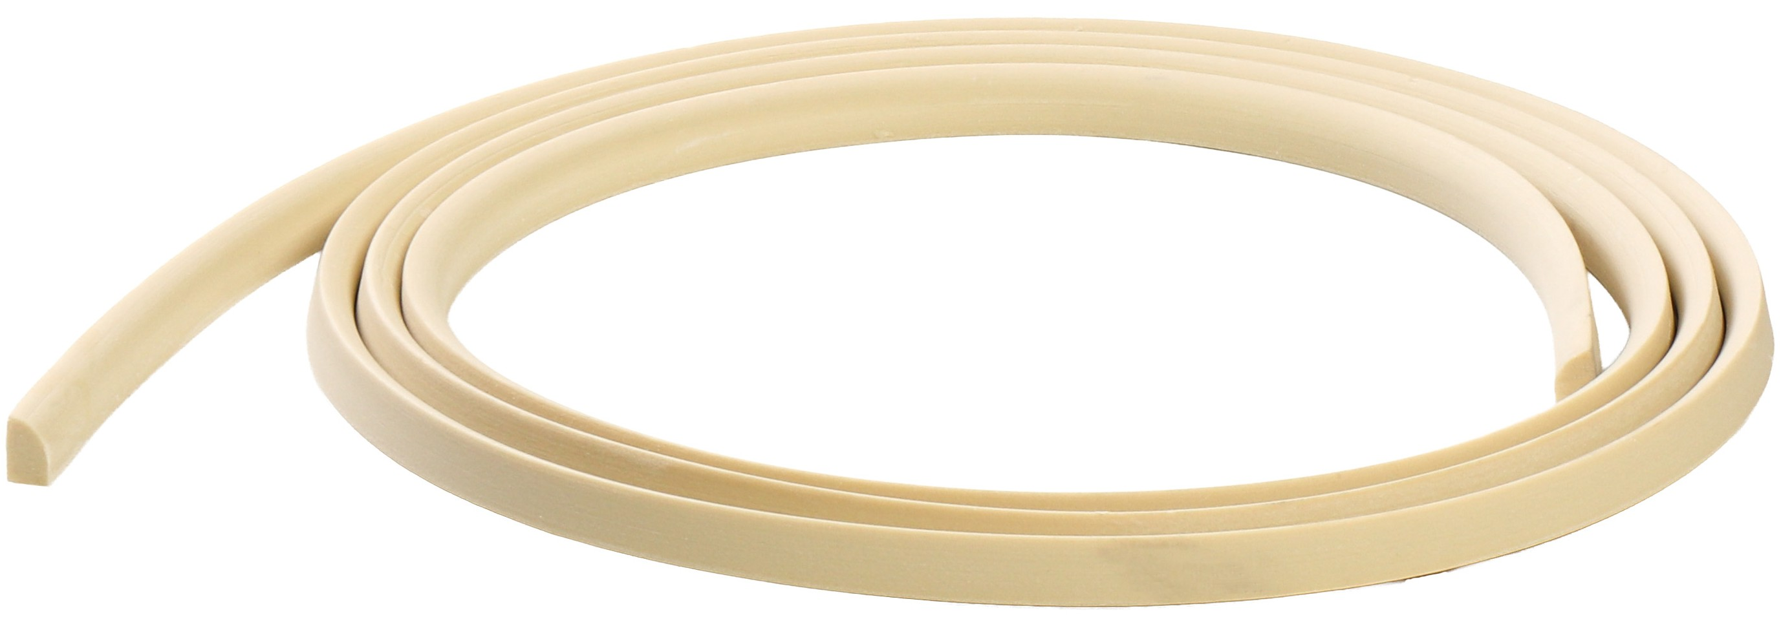
Xtrulinear® spool capacity
Approximate feet per spool by profile size
500'
250'
100'
75'
¾" × ¾"
½" × 2"
¾" × 2¼"
¾" × 3½"
Flex Trim™ · Carter Millwork, Inc.

Slide 30




Material comparison
Flexibility
Paintability
Stainability
N/A
Lightweight
Machinability
Moisture & insect
Interior & exterior
Extended lengths
✓
✓
N/A
N/A
N/A
Plant
NC & UT
NC & UT
UT
UT
UT
Warranty
Lifetime
Lifetime
Lifetime
Lifetime
Lifetime
Basic
Standard
Premium
Elite
Flex Trim™ · Carter Millwork, Inc.

Slide 31
Stainable Flex Trim™
Grain, finish, and handling
• Mold process reproduces stain-grade wood species / grain from the sample
• Grain is surface-only (embossed)
• Finish with heavy-bodied gel stain only, then clear coat
• Do not sand stain-grade — removes grain permanently
• Cannot invent or change grain from a sample / existing mold
• We supply raw unstained flex; customer chooses stain color
• Example grains: Knotty Alder, Mahogany, Maple
• Gel on resin dries slower than wood — fully dry before next coat
• Contact us for available stain-grade profiles
Flex Trim™ · Carter Millwork, Inc.

Slide 32
05 CATALOG PATHS
Stock · Profiles · Made-to-Match

Slide 33
Stock items
250+ configurations ready to ship
• 250+ part configurations on the shelf for immediate shipping
• Usually ships within 24 hours of receiving the order
• Categories: Back band · Base · Base cap · Brick mould · Casing · Chair rail · Corner & cove · Crown · Flat stock / S4S · Miscellaneous · Panel mould · Rake · Shoe & quarter round · Stop
• Browse online or use the printable stock list (Carter Millwork Stock List.pdf)
Flex Trim™ · Carter Millwork, Inc.

Slide 34
Stock browser & printable stock list
• Website: Products → Browse stock items
• Filter by moulding section / configuration
• View part details, bending notes, and order paths
• Printable PDF: Carter Millwork Stock List.pdf
• Also under Resources → Stock list
• Keep a copy on the truck / in the showroom
Flex Trim™ · Carter Millwork, Inc.

Slide 35
Production-ready profiles
40,000+ tooled profiles for custom applications
• Growing library of 40,000+ tooled profiles ready for custom production
• Catalog / website shows a fraction of available profiles
• Lead times: existing mold ≤ ~2 weeks · new mold ≤ ~3 weeks
• Browse by moulding type — 40+ types from Apron to Tongue & groove
Flex Trim™ · Carter Millwork, Inc.

Slide 36
Profile browser — moulding types
• Website: Products → Browse / select profiles
• Search by moulding type, dimensions, and keywords
• Apron, Astragal, Back band, Base, Base cap, Bed mould, Brick mould, Bullnose, Cabinet lip mould, Casing, Chair rail, Chair rail backer, Chamfer, Corner, Cove, Crown, Crown backer, Decorative, Dentil, E1E, E2E, Flat stock, Frieze, Half-round, Hand rail, Mantle, Miscellaneous, Mullion, Panel mould, Pencil mould, Picture mould, Quarter round, Rake, Rope, Screen bead, Shoe, Solid back crown, Stool, Stop, Tongue & groove
Flex Trim™ · Carter Millwork, Inc.

Slide 37
Made-to-Match
Copy your unique or historic profile
• 1. Send rigid moulding (any material)
• 2. We create a precision custom mold
• 3. We ship matching flexible parts
•
• If checking inventory first, provide:
• To-scale drawing or tracing · thickness & width
• Supplier + profile name · wood species / material
• Physical model generally required (except simple flats)
• Max part length = mold / model length · standard mold 12 ft
• Packages > 8 ft may ship as joined pieces; stain shows splice
• Also copies accessories (corbels, carvings, etc.)
• Lead times: stock 24 hrs · existing ≤2 wks · new ≤3 wks
Flex Trim™ · Carter Millwork, Inc.

Slide 38
Bullnose corners & tight radii
• Virtually no radius limitations via alternative tooling — down to a “zero” radius miter cut
• Tight-radius items are paint grade only (finish like primed poplar)
• Requires special tooling — discuss with Flex Trim before quoting or ordering
• Straight pieces should never be used for bullnose corners
• Warranty excludes bullnose / tight-radius ordered as straight pieces
Flex Trim™ · Carter Millwork, Inc.

Slide 39
06 ORDERING
What you need to order

Slide 40
Who is ordering?
Architects / designers
Contractors / builders
Dealers / distributors
Specify profiles, radii, materials; catalog, drawings, quote request
Install-ready parts via dealers & online; pin nails + polyurethane adhesive
Stock + custom programs; East/West order contacts
Homeowners
Existing customers
Shared outcome
Buy via dealers / online retailers (availability varies)
Reorder by part # / account; order status tool
~70% less than traditional machined radiused wood millwork
Flex Trim™ · Carter Millwork, Inc.

Slide 41
Bending styles
Style #1 — Straight pieces
Style #2 — Pre-bent
Bent “long-ways” against the thin dimension (like a belt).
Examples: base, base cap, base shoe, chair rail, jamb.
Flexibility depends on thickness × width.
Bent “sideways” against the wide dimension (like a rainbow).
Examples: casing, crown, crown ceiling backer.
Typical min radius ≈ 3× profile width (up to ~3½" wide).
Flex Trim™ · Carter Millwork, Inc.

Slide 42
Ordering — casing & pre-bent parts
• Regular radius (half-round, eyebrow): no template — width & rise or length & radius
• Irregular (oval, elliptical): physical template required
• Default orientation: thick edge out — specify if thick edge in
• Default bend: entire piece to radius; miter where straight trim begins/ends
• Straight legs optional but must be requested; stock half-rounds ship without legs
Flex Trim™ · Carter Millwork, Inc.

Slide 43
Ordering — radius crown
• Specify ISR (concave; bottom longer) or OSR (convex; top longer)
• Provide wall radius, ISR/OSR, backer offset, profile locations; sketch helpful
• Straight-radius-straight corners: prefer quarter-circle with legs disclosed up front
• Curved ceilings: tudor ski-slope looks OSR but is ISR; dormer/barrel vault look ISR but are OSR
Flex Trim™ · Carter Millwork, Inc.

Slide 44
Quote request essentials
• Applications: Doorway, Window, Baseboard, Crown, Panel/Chair Rail, Accessory, Other
• Arch styles: Half-round, Eyebrow, Elliptical, Radius Corners, Gothic, Straight, Other, Curved Wall
• Components: Casing, Jamb, Back Band, Brick Mould, Stop, Other
• Per profile: part #, thickness, width, painted/stained, grain, sides
• Crown: ISR / OSR
• Contact: Business, Location, Name, Email, Phone, account Y/N
• Printable forms: Arc & Straight · Crown
• Lead times: stock 24 hrs · existing mold ≤2 wks · new mold ≤3 wks
Flex Trim™ · Carter Millwork, Inc.

Slide 45
07 MEASURE
How to measure

Slide 46
How to measure — what we need
1 of 3
• Provide radius, length, and shape — plus any straight legs
• Regular arcs: dimensions enough to quote and produce
• Irregular curves: dimensions for quote; template required to order
• Printable gauges (Actual / 100%): Radius Gauge · Bullnose Corner Radius Gauge
Flex Trim™ · Carter Millwork, Inc.

Slide 47
How to measure — radius casing
2 of 3
• Shapes: Half-round · Eyebrow · Quarter round · Elliptical · Circle · Oval
• Elliptical & Oval: dimensions to quote; template to order
• Circles = two half-rounds · Ovals = top and bottom halves
Flex Trim™ · Carter Millwork, Inc.

Slide 48
How to measure — crown, corners & tight spots
3 of 3
• ISR / OSR crown and corners — measure width, rise, radiused length
• Bullnose: straight edge or printable bullnose gauge
• Minimum radius check: fold paper to 5.5" width; measure rise from center to curve
Flex Trim™ · Carter Millwork, Inc.

Slide 49
08 INSTALL
Installation

Slide 50
Installation — prepare & machine
• Unroll / relax; verify profile
• Warm to ~80°F — never open flame
• Clean with mineral spirits or soap & water
• Flat mounting surface required
• Paint / stain only after installation
• Standard woodworking tools
• Router: shallow passes
• Prefer slower blade speeds
• Never sand or shape stain-grade
Flex Trim™ · Carter Millwork, Inc.

Slide 51
Installation — fasten & finish
• Floating crown: blocking every 4–8"
• Adhesive: PL Premium Max (or equivalent) — never wood glue
• Pin nails preferred; never staples
• Don’t force into place
• Bondo-like fillers; standard caulk for seams
• Any int/ext paint except pre-catalyzed epoxy
• Stain: gel only + clearcoat
• Install videos on the website
Flex Trim™ · Carter Millwork, Inc.

Slide 52
09 WEBSITE
Tools & resources

Slide 53
Length & radius calculator
• Shapes: Eyebrow · Half-round · Elliptical · Full circle · Oval · Radius-only crown
• Inputs: Width / Height / Rise / Diameter / Straight Legs
• Outputs: required length (+ optional exact / radius)
Add calculator screenshot
Flex Trim™ · Carter Millwork, Inc.

Slide 54
Check order status
• Required: billing ZIP
• Plus: sales order # or PO #
• 6-digit SO numbers padded to 7
• East: (800) 861-0734
• West: (877) 877-4595
• Add order-status screenshot
Flex Trim™ · Carter Millwork, Inc.

Slide 55
Resources
Brochure
Carter Millwork Brochure.pdf
Catalog
Carter Millwork Catalog.pdf
Stock list
Carter Millwork Stock List.pdf
Technical data
Product Data Sheet · MSDS · LEED · Prop 65
Order forms
Arc & Straight · Crown
Radius gauges
Radius Gauge · Bullnose Corner Radius Gauge
Fire / rating docs
Ultra-Fire Class B · Ultra-Flex Class C · Flex Trim fire-rated
Flex Trim™ · Carter Millwork, Inc.

Slide 56
10 POLICIES
Warranty & returns

Slide 57
Limited lifetime warranty
• Manufacturing defects in materials / workmanship for the lifetime of the product
• Non-transferable; original installation only
• Remedy: replace or refund purchase price — no labor
• Claim within 60 days of discovering defect
• orders@carterflex.com · (800) 861-0734
• Key exclusions:
• Ellipticals ordered as eyebrow arcs
• Bullnose / tight-radius ordered as straight
• Style 2 / crown ordered straight without approval
• Painted/stained before install; sanded before stain
• Staples / incompatible adhesives
Flex Trim™ · Carter Millwork, Inc.

Slide 58
Returns
• Contact before shipping anything back — RMA required
• Stock (unused + resellable): return freight + 25% restocking
• Custom: not eligible; rare case-by-case → freight + 30–50% if approved
• Manufacturing defects → limited lifetime warranty
Flex Trim™ · Carter Millwork, Inc.

Slide 59
11 CLOSING
Our values

Slide 60
Our values
• We grow carefully — never promise what we cannot deliver
• Goal: not the biggest — the best
• Treat people the way you want to be treated
• Do the right thing the first time, and do it on time
• If you make a mistake, fix it immediately
• Say what you are going to do, and do what you say
• Nothing falls into “it’s not my job”
Flex Trim™ · Carter Millwork, Inc.

Slide 61
Message from the CEO
What we are most proud of is hearing from customers that we are among their best suppliers — that when they place an order with us, it arrives on time and the parts are right the first time. And if we do make a mistake, we jump through hoops to make it right.
Our objective is to stay out of sight and out of mind from the moment an order is placed until the customer is ready to place the next one.
We never make a promise we cannot keep.
— Greg Carter, CEO · Carter Millwork / Flex Trim™
Flex Trim™ · Carter Millwork, Inc.

Slide 62
Thank you
Let’s specify the next curve together.
Flex Trim East
Lexington, NC
(800) 861-0734
orders@carterflex.com
Flex Trim West
Provo, UT
(877) 877-4595
orders@flextrim.com
flextrim.com · Made in USA · AWI Supplier Member

