Slide 1
The Exemplar
Choose your own Backstory
A Psychological Type Test Game
Kimberly Jackson - SID: 0332
CIST2742 - CRN: 20389

Slide 2
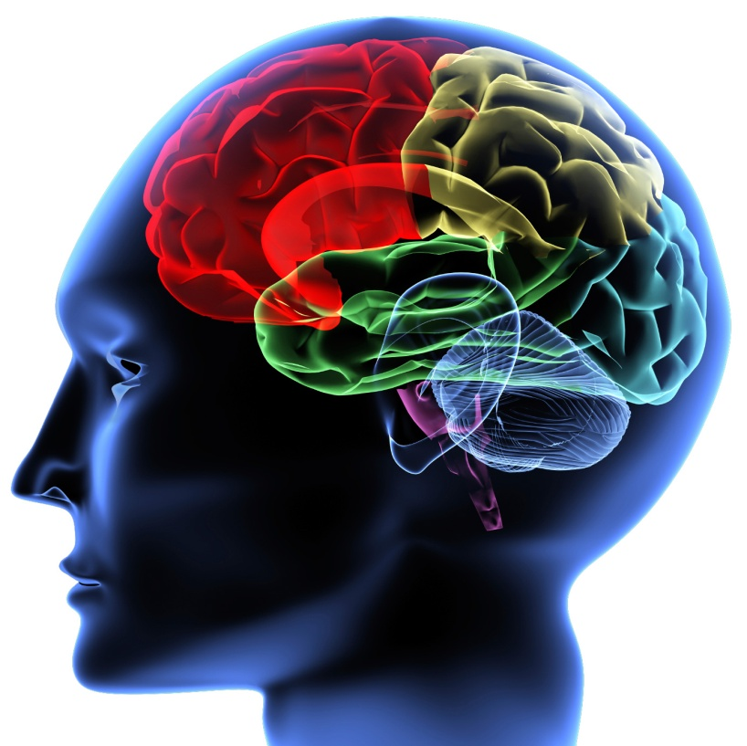
Objectives
Make psychological typing tests easier to take
Make psychological testing more accurate
Create a fun and engaging experience that anyone could enjoy

Slide 3
Manifesto
Psychological Type testing normally takes a great deal of time to complete. There are over 40 or 50 questions that the proctor asks or the tested responds to on their own. Because psychology on this level is not an exact science, because people are more likely to skew the results based on wanting to make themselves look better or worse depending on the question, the tests have a certain degree of inaccuracy.
Instead, if the tested is put into a situation where they are unaware they are being typed, there is a higher chance that they will answer honestly. This will reduce the degree of inaccuracy by a large margin, making the test itself provide more accurate results.

Slide 4
Methodology
1
One of the most famous typing test on the market today is the Myers-Briggs Type Indicator. It utilizes 4 different scales, each containing 2 different alignments for each.
Extraverted/Introverted
Sensing/Intuition
Thinking/Feeling
Judging/Percieving
This allows for 16 possible outcomes based on which category has a dominant trait among other factors. Due to this sheer quantity, not all outcomes have been provided a personalized story ending. Instead, the end will feature a reading out of the type to the player, which can then be interpreted by a professional.

Slide 5
Methodology
2
Another personality type indicator is Jung’s Color Types. This one is much less well known, but it only have 4 possible outcomes.
Blue
Green
Red/Orange*
Yellow/Gold*
Because this allows for only 4, it is possible to personalize the outcomes based on what the player achieves the most points in.
*Internet research gave me a couple different colors for these two. Not sure why.

Slide 6
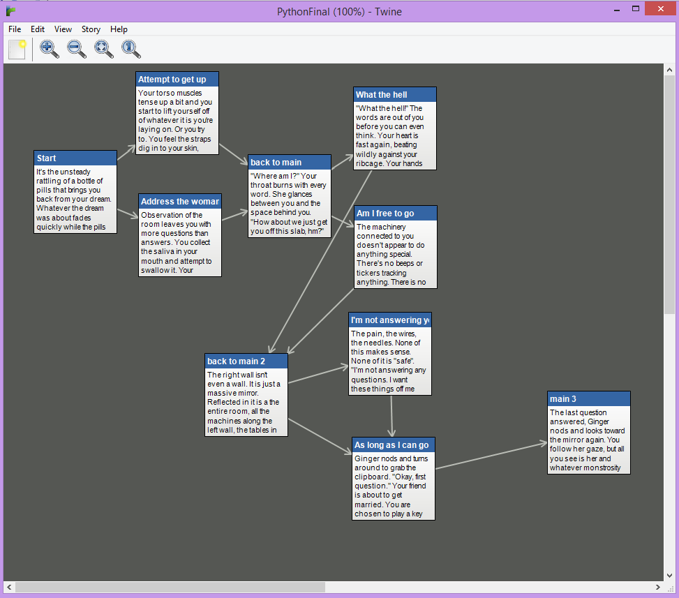
Execution

Slide 7
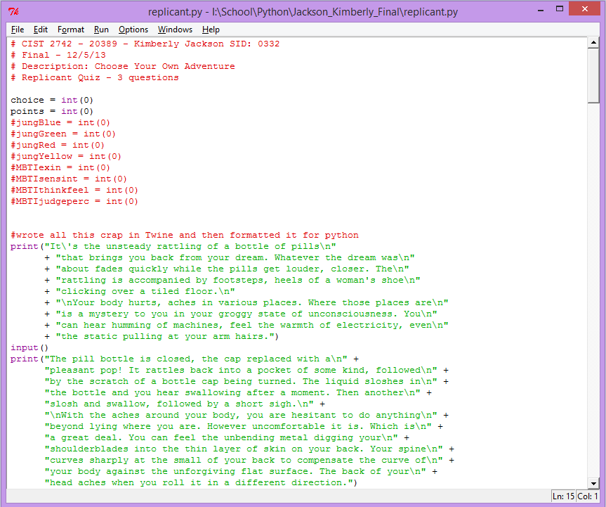
Programming

