Slide 1

G2M Case Study
Virtual Internship
12-Oct-2022

Slide 2
Background –G2M insight for Cab Investment firm
XYZ is a private equity firm in US. Due to remarkable growth in the Cab Industry in last few years and multiple key players in the market, it is planning for an investment in Cab industry.
Objective : Provide actionable insights to help XYZ firm in identifying the right company for making investment.
The analysis has been divided into four parts:
Data Observation
Modify data’s format and forecast profit and number of trips for each cab type
Finding the factors that affect the profit for each cab company
Recommendations for investment

Slide 3
Data Exploration
60 Features( including 17 derived features)
Timeframe of the data: 2016-01-31 to 2018-12-31
Total data points :355,032
Assumptions:
Outliers are in Location’s state columns after the separation of City and State.
Profit of rides are calculated keeping other factors constant and only
Price_Charged and Cost_of_Trip features used to calculate profit.
customer_data['customer_id'] = transaction_data['customer_id’]
transaction_data['transactoin_id']= cab_data['transaction_id’]
cab_data['city'] = city_data['city’]
it will be easier and more efficient for me to EDA if I join these 4 tables above
profit = Price_charged – cost of trip
Cab_Data.csv
Customer_ID.csv
Transaction_ID.csv
City.csv
StormEvents.csv
Merged_data

Slide 4
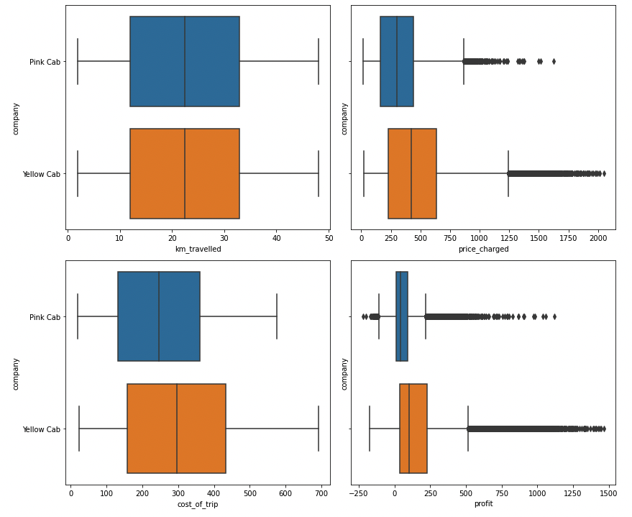
Profit Analysis
Visualization of profit
what is the profit could be made for each trip?
- what factors related to the amount of profit?
Profit fits in a gaussian distribution but with high number of outliers, Yellow cab's profit is significantly higher than pink cab; Pink cab had some profit loss.
Cost trip fits in a uniforom distribution which means all outcomes are mostly alike, Yellow cab's cost is little bit higher than pink cab.
Price charged fits in a gaussian distribution which skewed to the right, Yellow cab charged more than pink cab.
Km travelled fits in a uniform distribution, it means both of these two companies having almost same and constant travelled distance.

Slide 5
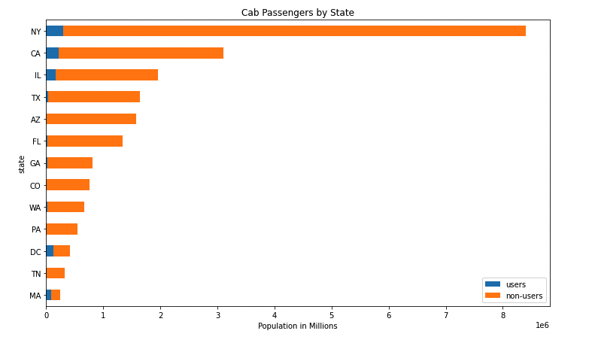
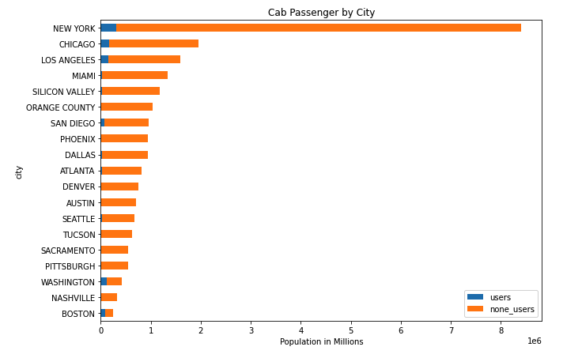
Profit Analysis
Visualization by demographic, population, users
NY has the highest number of users, followed by CA and IL
New York city has the highest number of users, then Chicago and Los Angeles

Slide 6
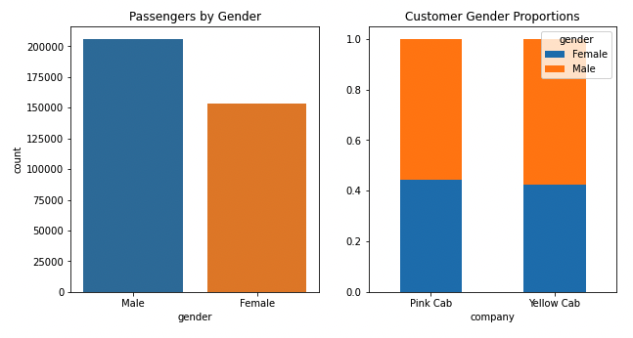
Profit Analysis
Visualization by customer gender, company
The number of Male customers are larger than Female customers
But for both company, Female customers' proportion is little larger than Male

Slide 7
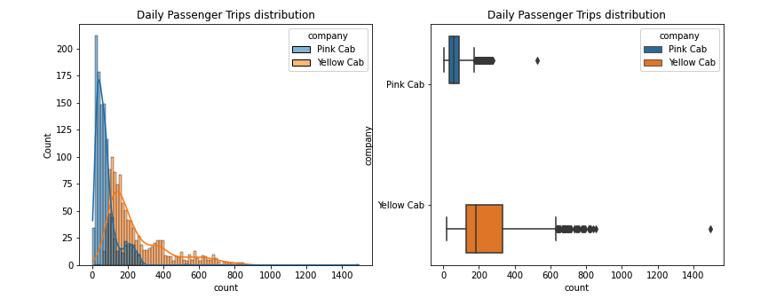
Profit Analysis
Visualization by daily trips count, company, different time windows
Yellow cab has higher median trip counts than pink cab
Extremally high trip counts are rare, we can conclude these as outliers for our analysis

Slide 8
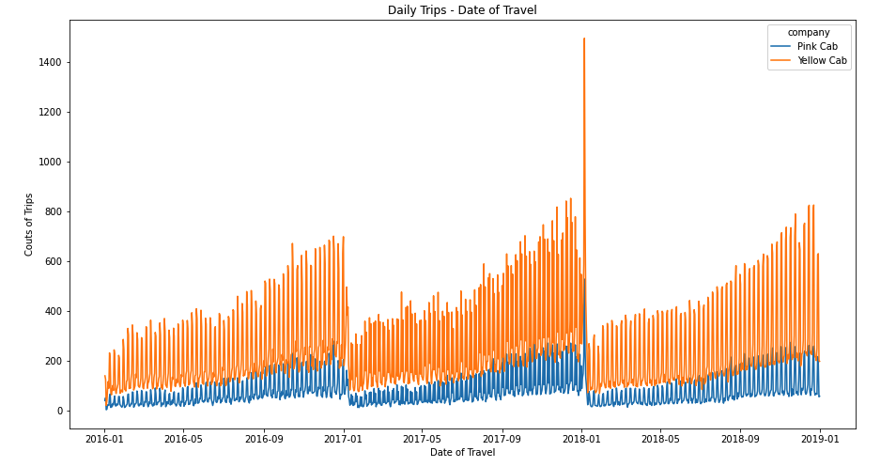
Profit Analysis
Visualization by daily trips count, company, different time windows
Yellow Cab has higher trip counts overall between 2016-01 to 2019-01
For both cab company, count of trip between every Nov to Jan was boosted significantly
The seasonality effect and holiday effect might be important factors to cause this increasment of trip demand
For 2018-01, both compnay reached their highest trip count

Slide 9
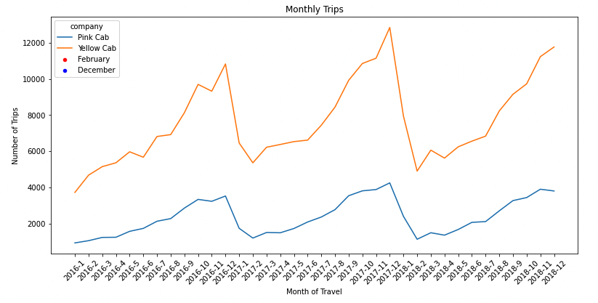
Profit Analysis
Visualization by daily trips count, company, different time windows
It is true that the end of every year, both compnay will reach their trip counts' Local Maximum
Then, Feb of every year, both company will reach their trip counts' Local Minimun

Slide 10
Hypothesis
Why Yellow Cab make more profit than Pink Cab, but its cost of trip, price charged are also higher than Pink cab?
Yellow Cab might have some luxury services for the customers
Luxury Car burned mor fule than a normal car in a normal service
Pink Car loosing profit might related to the bad services
Because of pink car's low price and low cost of trip, their might offer normal services all the time, some of these normal services might serving with drivers' bad attitude, smelly car environment.
1. Higher price charged will lead to Higher service and higher profit
2. Higher Income customer will lead to higher Profit
3. Longer distances will lead to higher profit
4. Lower loss will lead to higher Profit
5. Weather will affect profit for each company

Slide 11
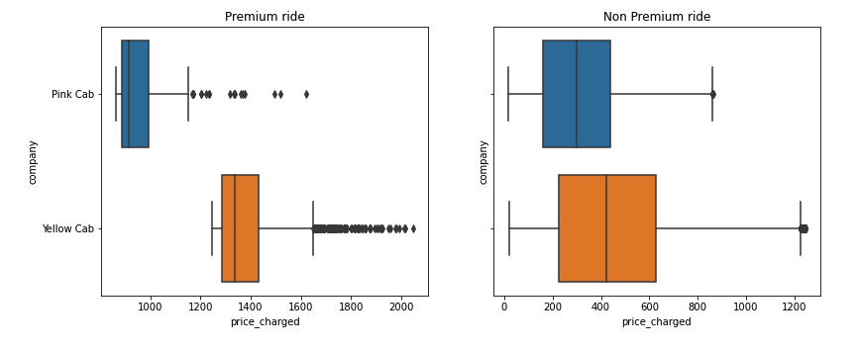
1. Higher price charged will lead to Higher service and higher profit
Preimum Ride: Yellow Cab charged more than Pink Cab
Non Premium Ride: Yellow Cab also charged more than Pink Cab
Premium rider has wider range of price than Non premium ride

Slide 12
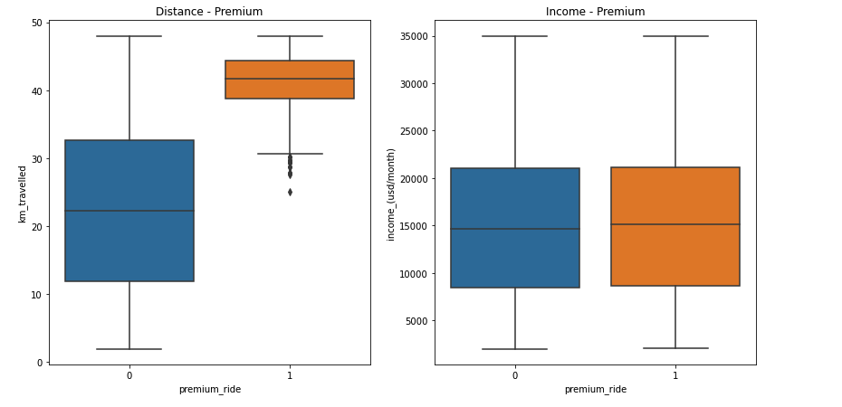
2. Higher Income customers will lead to higher profit
Distance-Premium: Premium_ride has longer distance than non_premium ride
Income-Premium: Both of premium and non premium customer almost have the same income distribution
The income hypothesis is rejected

Slide 13
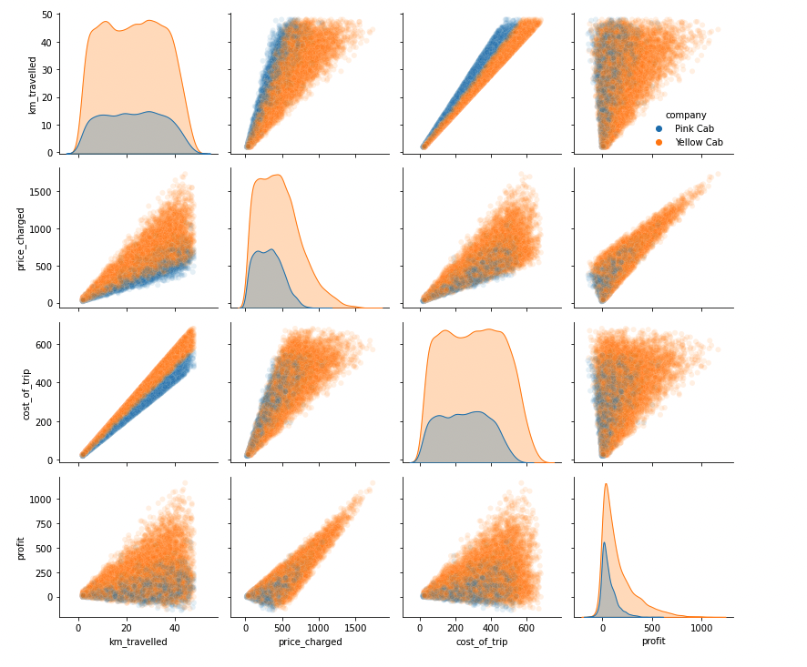
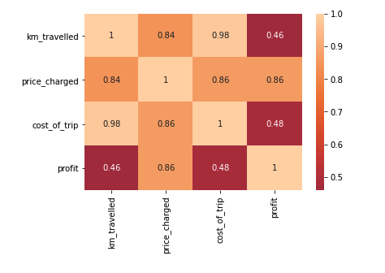
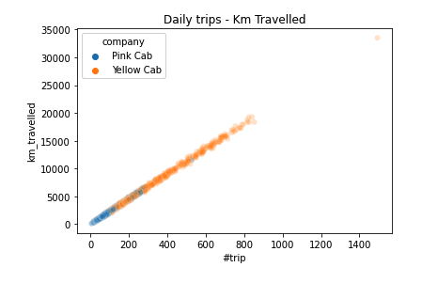
3. Longer distances travelled leads to higher profit
For yellow cab, the higher price_charged the higher profit gained.
However, the distribution went down with the increasment of price_charged and profie.
Pink cab has poor distribution in higher price_charged and profit
all factors are correlated
km_travelled is highly related to price_charged and cost_of_trip
price_charged is highly related to profit
cost_of_trip is highly related to price_charged
Km travelled and # of trip are highly correlated
both of these factors could determine companies' loss, revenue and profits

Slide 14
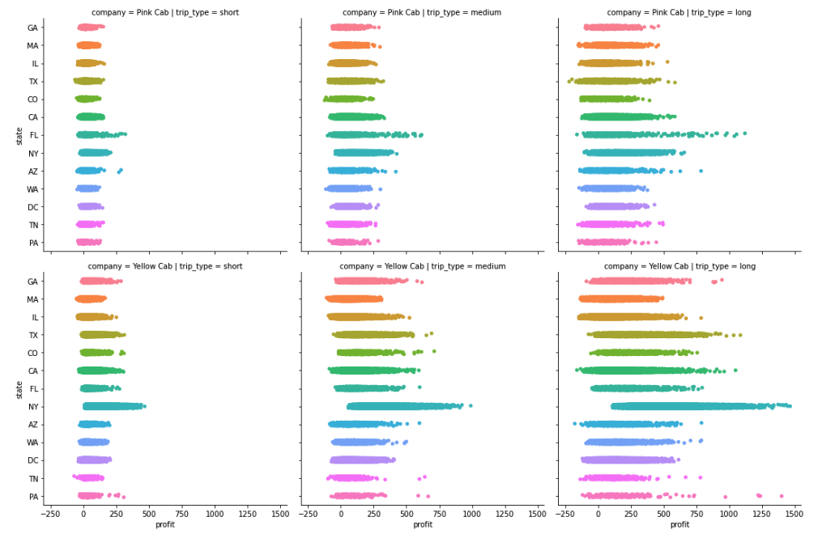
3. Longer distances travelled leads to higher profit
there is a higher probability of making high profits when the trip duration is long across all states.

Slide 15
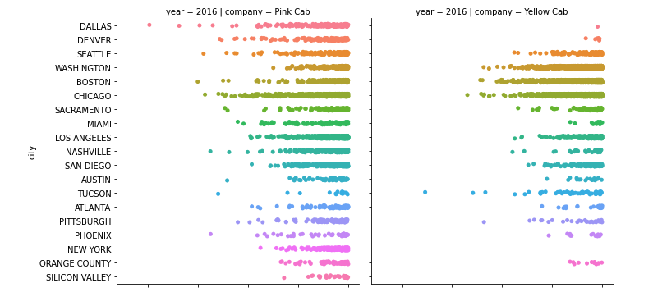
4. Lower loss will lead to higher profit

Slide 16
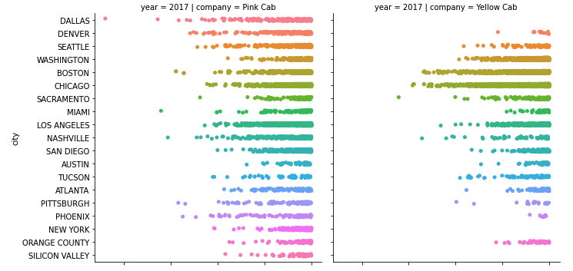
4. Lower loss will lead to higher profit

Slide 17
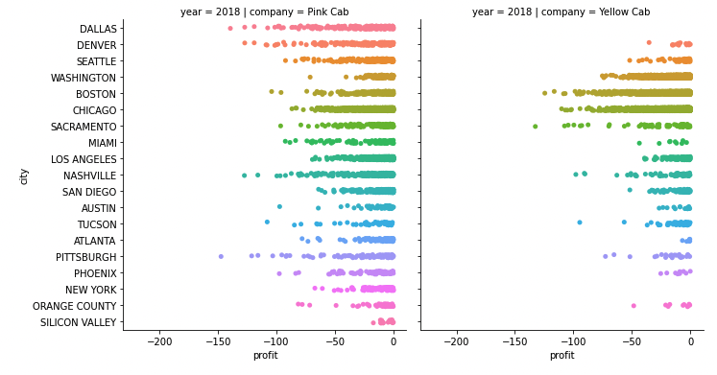
4. Lower loss will lead to higher profit
for all years, Pink Cab has higher frequency of lossing money than Yellow Cab
Pink Cab's money lossing is a siginificant factor of causing the lower profit

Slide 18
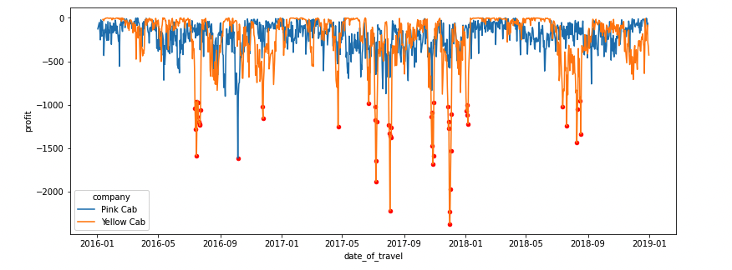
4. Lower loss will lead to higher profit
Yellow cab has some flucuation of lossing frequency, however, during regular time, the frequency of moeny loosing is low
Pink cab also has some flucuation of lossing frequencey, but lossing more money constanly compare to pink cab

Slide 19
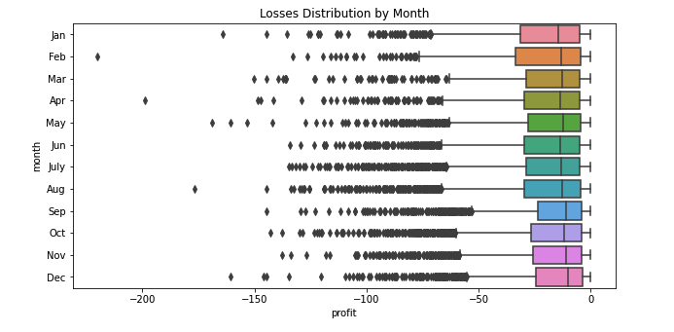

4. Lower loss will lead to higher profit
P-value <= alpha ---> reject Null Hypothesis
The above tests signifies that the median losses differs across months and that losses are higher during some particular months.
Null Hypothesis: Monthly profit's median are equal for all the group
Alternative Hypothesis: There is atleast one month's profit are different from other months

Slide 20
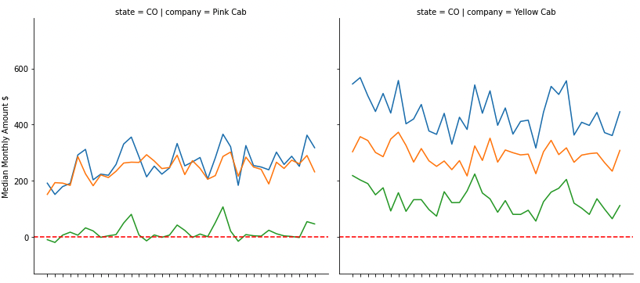
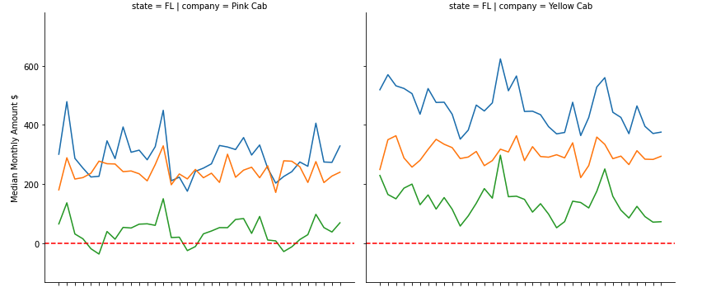
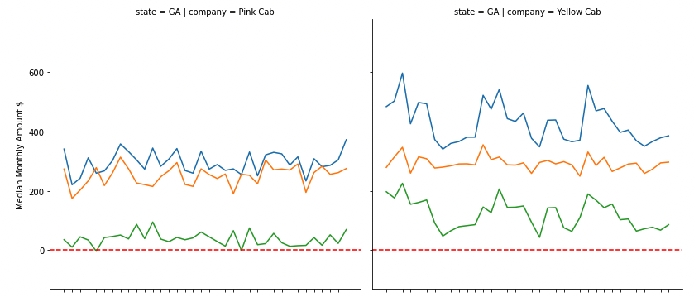
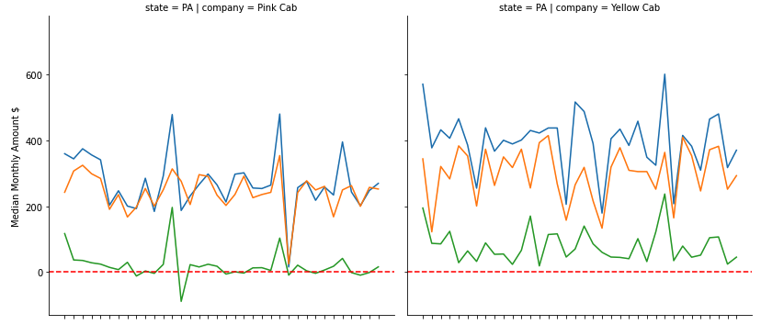
4. Lower loss will lead to higher profit

Slide 21
4. Lower loss will lead to higher profit
Left Side: Pink Cab / Right Side: Yellow Cab
Blue Line: avg price charged for trips over time
Orange Line: cost of trips over time
Green Line: change of profits over time
Red Line: Any part of green line below red line, will represent the part of lossing profit
Across all state, Yellow Cab has higher cost of trips
Across all state, Pink Cab has lower price charges than Yellow Cab
In State PA/Yellow cab, the profits and cost of trip are acrossed
For the state of New York, which has the highest Cab passengers compared to any other states, Yellow Cab has the highest Cab Fares compared to Pink Cab during the same time-line. Yellow Cab's profit is significantly higher in New York compared to any other state. Both Cab companies makes median losses during time periods across all states. This is more frequent for Pink Cab in states such as Colorado, Florida, Georgia, Illinois, Massachusetts, Pennsylvania, Tennessee, Texas and Washington. For Yellow Cab, there are barely any months making median losses. This could signify that Yellow Cab perform better across all states and any losses it makes from non-profit trips will be easily offsetted by the amount of profit it makes.

Slide 22
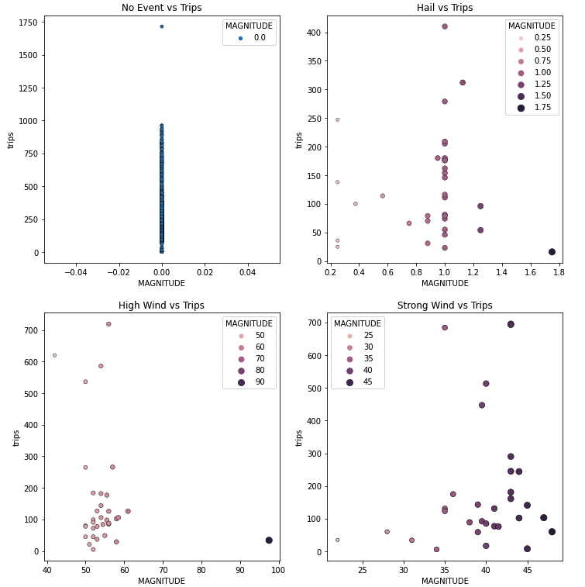
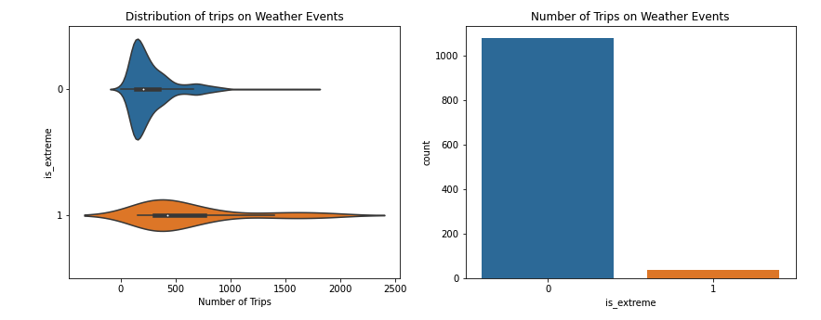
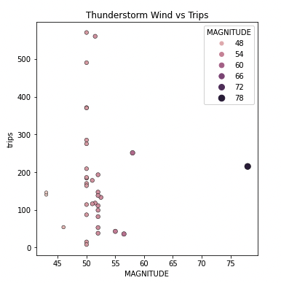
5. Weather will affect profit
On normal weather events, the distribution of trips are high.
However during extreme weather, the trips are still constant, another hand, the distribution is low

Slide 23
Recommendations
We have evaluated both the cab companies on following points and found Yellow cab better than Pink cab:
Higher Price – Higher Service - Higher Prodit: Yellow cab has more money charged to customers for both Premium ride and Non-Premium ride than Pink Cab, it also leads to more profit that they could gain than Pink Cab
Higher income customer – Higher profit: Distance-Premium: Premium_ride has longer distance than non_premium ride; Income-Premium: Both of premium and non premium customer almost have the same income distribution. The income hypothesis is rejected
Longer distance -> Higher profit: Pink cab has poor distribution in higher price charged and longer distance travelled, it means customer density for Pink cab is low. For yellow cab, the higher Km_travelled the higher profit gained. Km travelled and # of trip are highly correlated, both of these factors could determine companies' loss, revenue and profits. Yellow cab’s average profit per KM is almost three times the average profit per KM of the Pink cab.
Loss - Profit: Across all state, Yellow Cab has higher cost of trips
Across all state, Pink Cab has lower price charges than Yellow Cab
In State PA/Yellow cab, the profits and cost of trip are crossed
For the state of New York, which has the highest Cab passengers compared to any other states, Yellow Cab has the highest Cab Fares compared to Pink Cab during the same time-line. Yellow Cab's profit is significantly higher in New York compared to any other state. Both Cab companies makes median losses during time periods across all states. This is more frequent for Pink Cab in states such as Colorado, Florida, Georgia, Illinois, Massachusetts, Pennsylvania, Tennessee, Texas and Washington. For Yellow Cab, there are barely any months making median losses. This could signify that Yellow Cab perform better across all states and any losses it makes from non-profit trips will be easily offsite by the amount of profit it makes.
CONCLUSION: Based on all features I observed, Yellow Cab are better than Pink Cab for investment

Slide 24
Thank You

