Slide 1


GrES - Research Group on Software Engineering http://www.inf/ufpr.br/gres

Slide 2
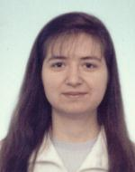

Professors
Professors
Prof. Silvia R. Vergilio (DInf, UFPR)
Prof. Aurora Pozo
(DInf, UFPR)
Prof. Maria Cláudia F. P. Emer
(PPGInf, UTFPR – Federal Technological University of Paraná)

Slide 3
Professors
Mains Research Interests
Software Testing:
  testing tools and criteria; testing planning; test data generation; debugging and fault localization; software reliability modeling; selection and prioritization of test cases.
Search Based Software Engineering:
  search based algorithms: GP, GA, PSO, NSGA-II, etc;
  optimization problems: software testing, reliability, planning, and software design.

Slide 4
Main Projects
Test of parallel software in the context of message passing environments
Design and validation of Software Product Lines
Search Based Testing – test data generation and experimental studies
Search Based Design – optimization focusing modularity
Financial Support :
CNPq: Productivity grant numbers: 303761/2009-1 and 306608/2009-0 and Universal Project grant numbers: 472510/2010-0 and 481397/2009-4.
Fundação Araucária: project numbers: 8092 and

Slide 5
Professors
Test of parallel software in the context of message passing environments
  Development of a tool named ValiPar (instanced for MPI and PVM.
  Test of WS compositions using BCEL
Collaborations: Paulo Souza, Simone Souza, Adenilso Simão (USP - São Carlos)
UDESC (Santa Catarina)
Notes:
Specific test criteria

Slide 6
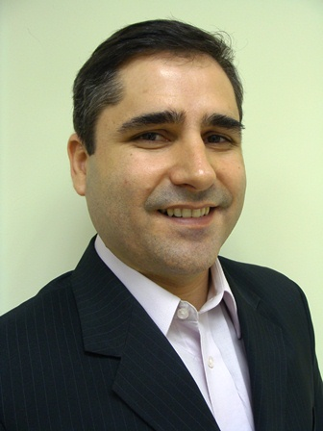
Professors
Current research: extension for embedded systems, grid and could computation
PhD Student :
Luis Carlos Camargo
(starting date 2011)
Notes:
Specific test criteria

Slide 7
Professors
2) Design and Validation of Software Product Lines.
  Evaluation of different strategies for SPL testing.
Collaborations: Marcos Quinaia (UNICENTRO, Guaruapuava- PR)
Notes:
Specific test criteria

Slide 8
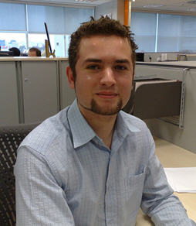
Professors
Current research:
coverage test criteria and tools
Masther Student :
Johnny Maikeo Ferreira
(starting date 2011)
Notes:
Specific test criteria

Slide 9
Professors
3. Search Based Testing – test data generation and experimental studies
  Test data generation for object and aspect oriented software considering Java bytecode.
  Test data generation using multi-objective optimization
Collaborations: Márcio E. Delamaro, Marcos Chaim (USP), Eliane Martins (UNICAMP), Auri Vincenzi (UFG), Arilo Cláudio (UFAM), Paulo M. Bueno (CTI)
www.pantaneiro/ead.ufms.br/sites/gadget
Notes:
Specific test criteria

Slide 10

Professors
  Current research:
- integration test orders with multi-objective algorithms for object and aspect oriented sw.
- fault prediction in aspect-oriented sw
Masther Student :
Wesley K. G. Assunção
(starting date 2010)
Notes:
Specific test criteria

Slide 11
Professors
3. Search Based Design – improvements in the software design focusing modularity and other quality attributes.
Collaborations: Alessandro Garcia (PUC-RIO), Paulo Masiero (USP São Carlos), Itana Gimenez (UEM-PR).
Notes:
Specific test criteria

Slide 12


Professors
  Current research:
- aspect mining through multi-objective clustering algorithms.
Masther Student :
Edison K. Fillus (starting date 2010)
- software architecture optimization
PHd Student :
Thelma E.C. Lopes (starting date 2010)
Notes:
I think Thelma is working in a commom topic and will be soon qualifying. I chosen
her to present her research. I think she can take more benefits from the presentation.
About other research themas I think we can talk later if you are interested.

