Slide 1
Assessment, Modified Arrangements, and Academic Honesty
General Information

Slide 2
Assessment
This course has the following components:
3 practical assignments:
Individual Assignment 1, worth 5%.
Group Assignment 2, worth 15%.
Group Assignment 3, worth 15%.
Groups: three to four (3-4) students.
2 spotlight videos (each 15%) and 2 essays (each 15%); Use the sheet linked at https://myuni.adelaide.edu.au/courses/64872/pages/spotlight-talks-and-essays to record your choices.
Online quizzes, worth 5%.
You are expected to participate in all activities, attend lectures and submit your assignments on time.
The quizzes were introduced in 2018, in reaction to student feedback. Benefits:
Testing has shown to increase long-term knowledge retention.
You engage with the material, and you get feedback. ☺

Slide 3
Expectation: How much time to invest?
The university expects you to put in 12 hours per week for a 3-credit course: https://www.adelaide.edu.au/policies/669/?dsn=policy.document;field=data;id=977;m=view
Example: How much time should you invest for each group assignment/report/video/…? Well, each is worth 15% of your course mark - this is equivalent to a rough time equivalent of 20-25 hours, if we consider that 13 weeks of 8-10 hours make up 100% of your course mark

Slide 4
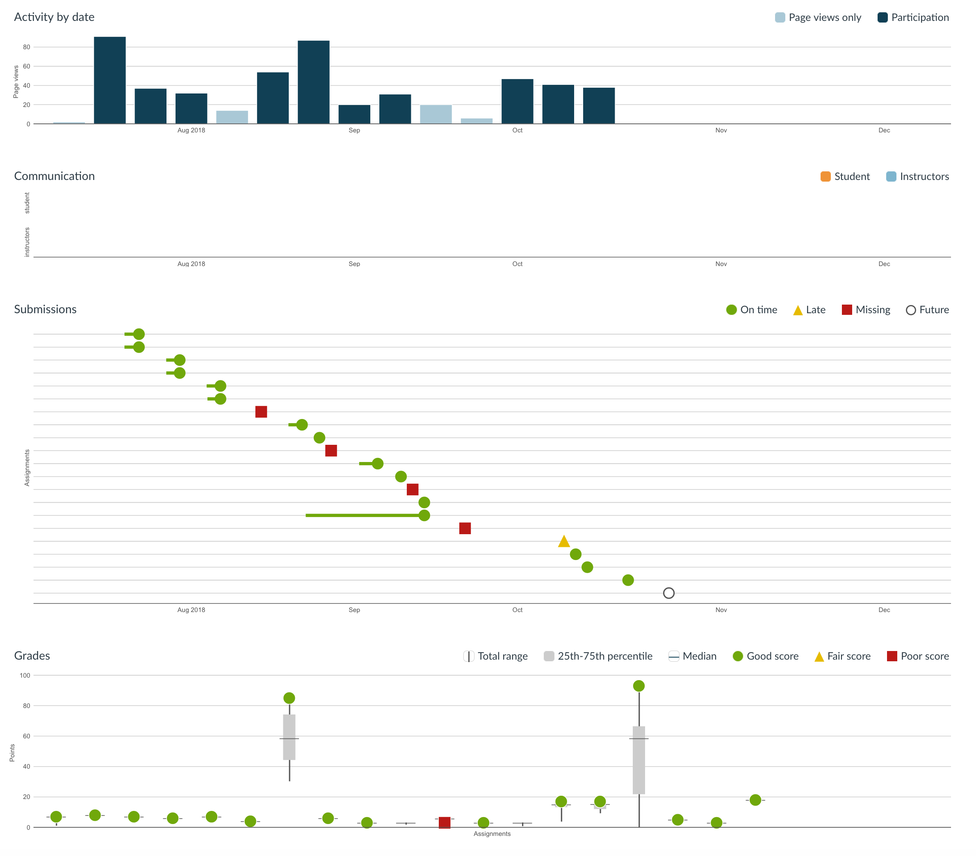
A student in the 2018 edition:

Slide 5
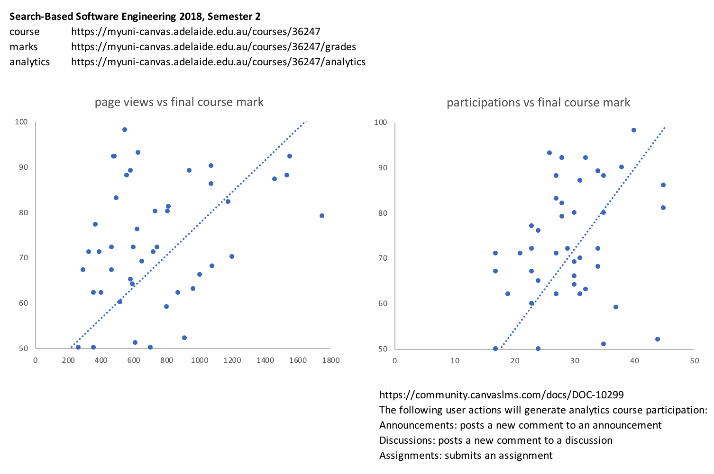
Interaction with the material vs final course marks (2018 edition)

Slide 6
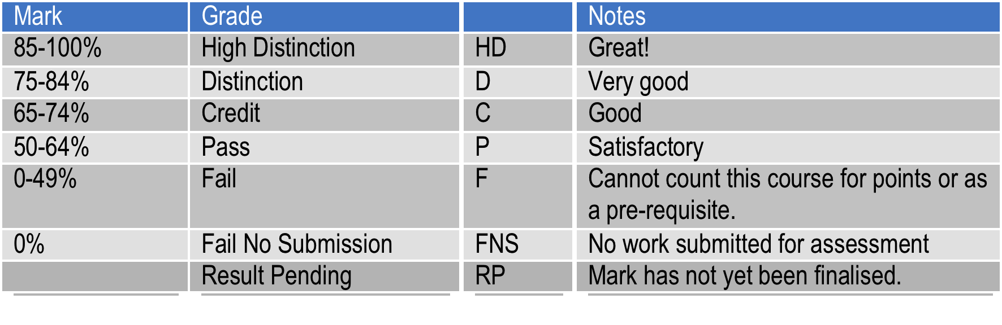
Grades
If you see an RP on your transcript, it means that your mark is not currently available. If you don’t know why, you should contact your course coordinator.

Slide 7
Minimum Performance
No more than 3 assessment components can have the minimum performance hurdle.
A component with a hurdle must have at least 20% weighting, and at most 60% weighting.
Different assignments cannot be grouped into a single assessment component with a hurdle, with the exception of lab work, practicals or assignments that are intended for continuous assessment (mainly in 1st year courses).
Cumulative weightings for assessment components with hurdles cannot be more than 60%.

Slide 8
Minimum Performance
The following assessment components will attract the minimum performance hurdle.
Written examination, worth XX%.
XX practical assignments, :
Assignment 1, worth XX%.
…
Assignment XX, worth XX%.
Tutorials, worth XX%.
Lecturers – delete where appropriate.

Slide 9
Example 1 – COMP SCI 1XXX
Course components:
Written examination, worth 40%.
Practical 1
…
Practical 10
Workshop, worth 10%
Tutorials, worth 30%.
Components with hurdles:
Written examination, worth 40%
10 practicals, worth 20%
Continuous assessment
worth 20%

Slide 10
Example 2 – COMP SCI 3XXX
Course components:
Written examination, worth 50%.
Assignment 1, worth 20%.
Assignment 2, worth 20%.
Tutorials, worth 10%.
Components with hurdles:
Assignment 1, worth 20%
Assignment 2, worth 20%

Slide 11
Minimum Performance
On each component with a hurdle, you are required to achieve at least 40% of the marks allocated in the component.
If your mark for any component with a hurdle is less than 40% of the allocated marks for that component, and your overall mark is greater than 45 F, your overall mark will be reduced to 45 F.
To pass the course, you must obtain a passing mark overall and achieve at least 40% of the available marks in components with a hurdle.

Slide 12
Courses with multiple codes
A single course may include students enrolled in different course codes (UGRD, PGRD, etc.).
The assessment requirements for students at the postgraduate level will be higher than that for undergraduates.
The different requirements may take the form of extra coursework or different exam papers.

Slide 13
Late submission policy
You should hand your coursework in on time.
If you hand in your work late, your mark will be capped, based on how many days late it is.
up to 1 day late — mark reduced to 75%, marks below 75% not affected.
up to 2 days late — mark reduced to 50%, marks below 50% not affected.
up to 3 days late — mark reduced to 25%, marks below 25% not affected.
More than 3 days late — mark is reduced to 0.
If you handed in something on time, and it is worth more than something that you handed in late, you will get the higher mark.
Start early… and hand in early!

Slide 14
Repeating Students
Students who repeat a course are expected to attempt all of the aspects of the course again. This includes making fresh attempts at all coursework assessment items.
You may apply to the course coordinator to have your previous work counted but this is not usually granted.
Make sure that you attend all of the lectures, do all of the work and study hard for the exam – you don’t want to get stuck repeating the same course over and over.

Slide 15
Modified arrangements

Slide 16
Assignment extensions
Extensions will not be granted for circumstances including minor ailments; travel, employment, family, customary, sport or leisure commitments; problems with balancing workloads; normal exam stress or anxiety.
If you think your situation is exceptional, contact your course coordinator ASAP, who will then consult the Head of School.
Students who deliberately submit false or fraudulent documentation may be referred to the Student Misconduct Tribunal.
You will normally only receive an extension equivalent to the number of days covered by your documentation. Don’t expect to get an extra week because you lost a day.

Slide 17
Additional assessment
For Level 1 course:
If your final result is 40-49, an additional assessment (assignment, exam) is automatically granted.
lecturers – if you specified any assessments as mandatory in your course outline you should add:
If you completed all mandatory assessments.
In the case where an additional exam is granted, the better of the primary or additional exam results is used to calculate your final grade.
If any kind of additional assessment is granted your overall result for the course is capped at 50P.
You must make yourself available during the additional assessment period.

Slide 18
Additional assessment
For Level 2 and above courses:
If your final result is 45-49, additional assessment (assignment, exam) is automatically granted.
lecturers –if you specified any assessments as mandatory in your course outline you should add:
If you completed all mandatory assessments.
In the case where an additional exam is granted, the better of the primary or additional exam results is used to calculate your final grade.
If any kind of additional assessment is granted your overall result for the course is capped at 50P.
You must make yourself available during the additional assessment period.

Slide 19
Additional assessment
For Level 2 and above courses:
If your final result is 45-49, additional assessment (assignment, exam) is automatically granted.
In the case where an additional exam is granted, the better of the primary or additional exam results is used to calculate your final grade.
If any kind of additional assessment is granted your overall result for the course is capped at 50P.
You must make yourself available during the additional assessment period.

Slide 20
Replacement exams
Replacement exams will not be granted for circumstances including minor ailments; travel, employment, family, customary, sport or leisure commitments; problems with balancing workloads; normal exam stress or anxiety.
Students granted a replacement exam are not eligible to sit the primary exam.
Students who sit the primary exam will not be eligible to apply for a replacement exam unless a major issue arose during the exam.
Students must make themselves available during the replacement exam period.
Notes:
Emphasise that they have to make sure they are still in Adelaide during the supp period. This is the only second chance they will get, and if they are not here, and they need a supp, they will have to repeat the subject.

Slide 21
Replacement exams (cont.)
Students will not be entitled to an additional assessment if they have already sat a replacement exam, i.e., no supps on supps.
Students granted a deferred replacement exam will not be eligible to sit the primary exam or the replacement exam (only under exceptional circumstances will a deferred replacement exam be granted).
The University must notify students of the outcome of their replacement exam applications within 3 business days (if you already sat the primary exam, do not bother applying for a replacement exam).
Notes:
Emphasise that they have to make sure they are still in Adelaide during the supp period. This is the only second chance they will get, and if they are not here, and they need a supp, they will have to repeat the subject.

Slide 22
Replacement exams (cont.)
Students who deliberately submit false or fraudulent documentation may be referred to the Student Misconduct Tribunal.
For the full policy on Modified Arrangements, see:
https://www.adelaide.edu.au/policies/3303
Notes:
Emphasise that they have to make sure they are still in Adelaide during the supp period. This is the only second chance they will get, and if they are not here, and they need a supp, they will have to repeat the subject.

Slide 23
Additional/Replacement exam dates
Go to the University Examinations Site for information on Additional/Replacement exams:
http://www.adelaide.edu.au/student/exams/

Slide 24
Academic honesty policies

Slide 25
Academic Honesty Policies
The University has strict policies prohibiting students from presenting other people’s work as their own, whether that of students or from outside the University.
You may not copy code from another student or give another student your code to copy from, unless specifically authorised to do so by a staff member.
You may not copy code from anywhere else, without permission.
If caught, you may receive zero for the assignment, zero for the course or be expelled.
We don’t give you assignment work just to keep you busy, we do it to develop your understanding and ability to apply important techniques.
If you don’t do the work yourself, you won’t be able to do it in the examination and you won’t be able to do it in the work force.
Full policy available at the university webpages.

Slide 26
Violations to policy
Plagiarism
Using another person’s ideas, designs, words or works without appropriate acknowledgment.
Collusion
Another person assisting in the production of an assessment submission without the express requirement, or consent, or knowledge of the assessor.

Slide 27
Violations to policy
Plagiarism
Using another person’s ideas, designs, words or works without appropriate acknowledgment.
Collusion
Another person assisting in the production of an assessment submission without the express requirement, or consent, or knowledge of the assessor.
1. Do not submit any work or part thereof which is not yours.
2. Do not submit any work for which you have received unfair assistance.

Slide 28

Example 1
I had finished my assignment, and a classmate was asking for help. Since I am a kind person, I
Gave the classmate a copy of my code (or part thereof).

Slide 29

Example 1
I had finished my assignment, and a classmate was asking for help. Since I am a kind person, I
Gave the classmate a copy of my code (or part thereof).
Posted my solution on an online forum for his/her reference.

Slide 30

Example 1
I had finished my assignment, and a classmate was asking for help. Since I am a kind person, I
Gave the classmate a copy of my code (or part thereof).
Posted my solution on an online forum for his/her reference.
Allowed the classmate to have a look at my code on paper/screen.

Slide 31



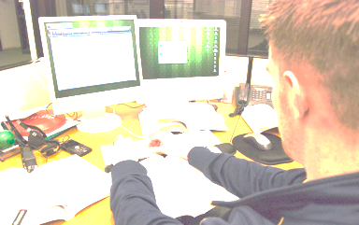
Example 1
I had finished my assignment, and a classmate was asking for help. Since I am a kind person, I
Gave the classmate a copy of my code (or part thereof).
Posted my solution on an online forum for his/her reference.
Allowed the classmate to have a look at my code on paper/screen.
http://neatoday.org/wp-content/uploads/2012/12/teencheating.jpg, http://ukrdengi.com/wp-content/uploads/2018/02/Cheating-on-Online-test-1024x642.jpg, https://static.makeuseof.com/wp-content/uploads/2017/02/Free-Collaboration-Tools-Featured-670x335.jpg

Slide 32
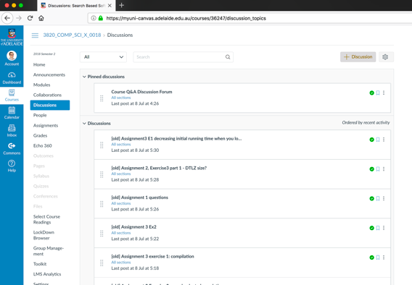

Example 2
I had finished my assignment, and a classmate was asking for help. Since I am a kind person, I
Gave a few high-level tips to my classmate.
Discussed high-level concepts regarding the assignment with my classmate.
Use the official course forum to discuss!!!
https://breakdownstructureblog.files.wordpress.com/2017/10/slide-collaborative.jpg

Slide 33
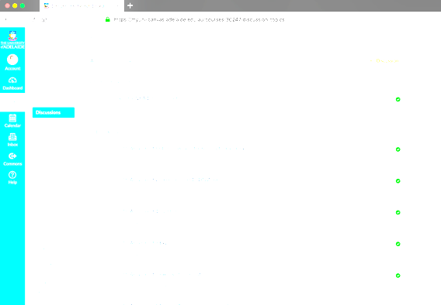


Example 2
I had finished my assignment, and a classmate was asking for help. Since I am a kind person, I
Gave a few high-level tips to my classmate.
Discussed high-level concepts regarding the assignment with my classmate.
Use the official course forum to discuss!!!

Slide 34
Example 3
My good friend/housemate/brother/twin and I are taking the same course. We have always worked together. When doing the assignment, we
Exchanged solutions to verify/compare our answers.

Slide 35
Example 3
My good friend/housemate/brother/twin and I are taking the same course. We have always worked together. When doing the assignment, we
Exchanged solutions to verify/compare our answers.
Divided the assignment work amongst ourselves to speed up progress.

Slide 36
Example 3
My good friend/housemate/brother/sister/twin/… and I are taking the same course. We have always worked together. When doing the assignment, we
Exchanged solutions to verify/compare our answers.
Divided the assignment work amongst ourselves to speed up progress.
Sat side-by-side and looked at each other’s answers when doing the assignment.

Slide 37

Example 3
My good friend/housemate/brother/sister/twin/… and I are taking the same course. We have always worked together. When doing the assignment, we
Exchanged solutions to verify/compare our answers.
Divided the assignment work amongst ourselves to speed up progress.
Sat side-by-side and looked at each other’s answers when doing the assignment.

Slide 38
Example 4
The assignment seems to be the same as the one given last year. I contacted my friend who took the course last year and got a copy of his solution.
Keep in mind: Your project supervisor is likely to remember what a student has achieved last year.

Slide 39
Example 5
The assignment seemed to be similar to another given at a different university. So, I
Copied and submitted the model answers available at that university’s website.
Took parts of the model answers and integrated them into my solution.

Slide 40
Example 6
I studied at a school/college/university where doing ______________ is acceptable. So I assumed doing this at the University of Adelaide is also acceptable.

Slide 41
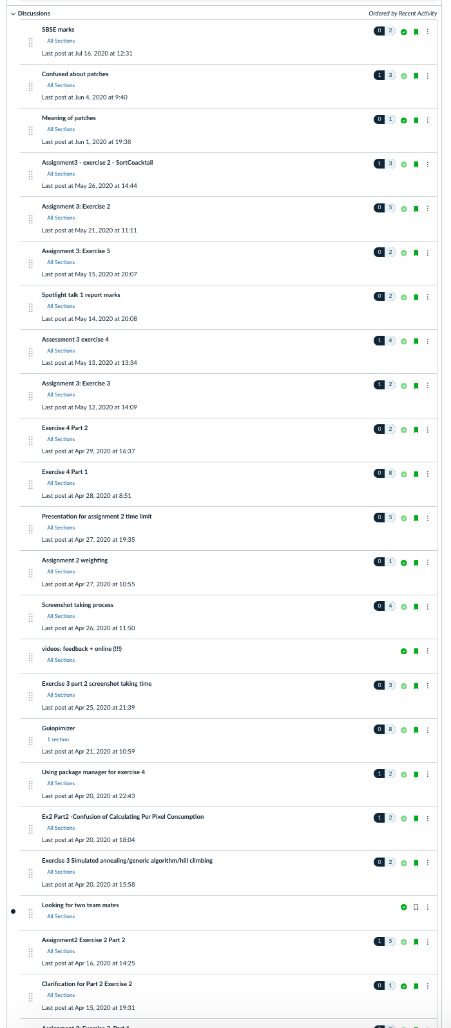
How to avoid plagiarism & collusion?
Use the official course forum to discuss!!!
If you get stuck, seek help from the lecturer or tutor rather than copying from someone else.
Starting your work early will help you to avoid getting stuck at the last minute.
When in doubt, ask your lecturer!

