Slide 1
Lab1 Use C to write a convolutional layer

Slide 2
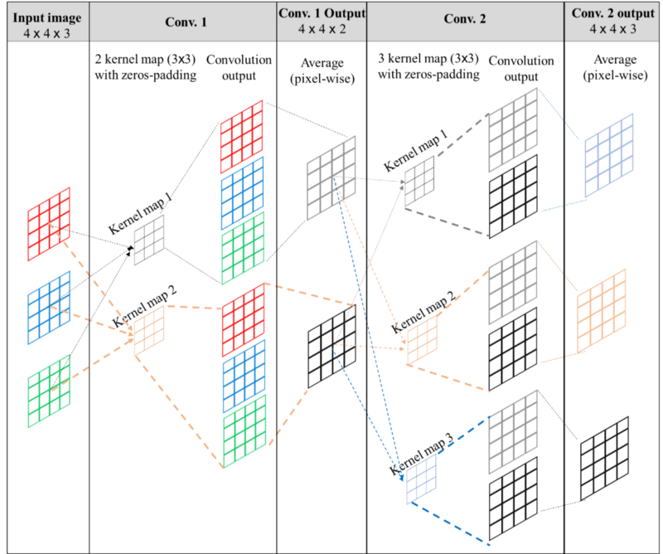
Convolution

Slide 3
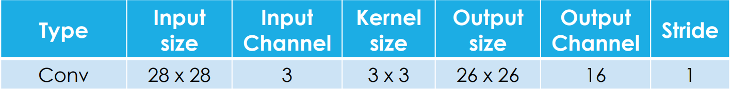
Convolutional Layer Parameter
The bit number of iFMAP and kernel will be 16 bits and will be expressed in hex number.

Slide 4
iFMAP & Kernel
Lab1/Data/
input_'n'.txt => n for channel number
weight_'i'_'j'.txt => i for channel number and j for filter number

Slide 5

Data
The bit number of iFMAP and kernel will be 16 bits and store in hex number.
The bit number of oFMAP should be 32 bits and store in hex number
Please log out your output feature map and name to output_ans_'n'.txt => n for channel number

Slide 6
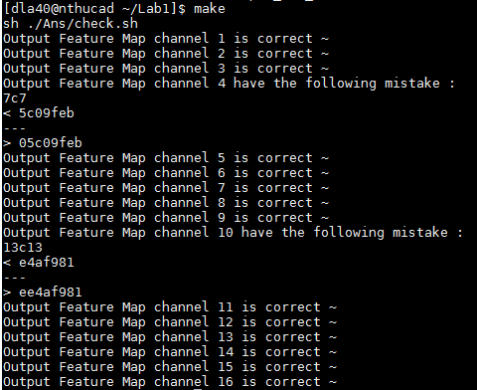
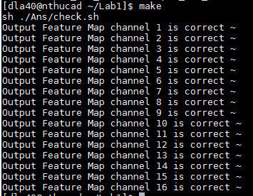
Testbench
You can use makefile to check your answer

Slide 7
Requirements
The deadline is first week of July
You need to come to 733 and demo your program to me

