Slide 1
Responsive Web Design

Slide 2
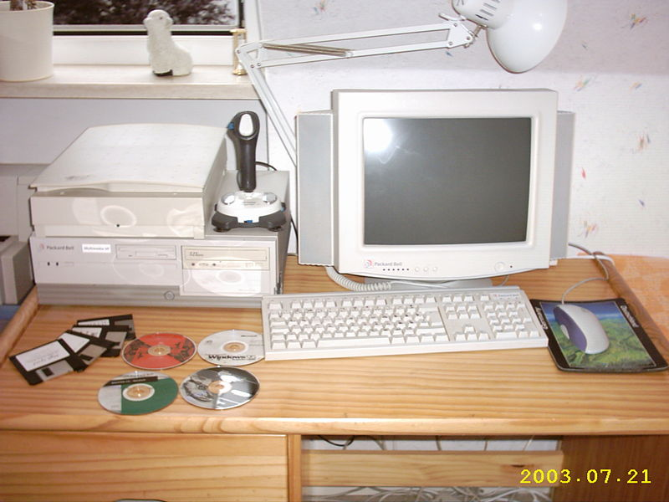

Slide 3
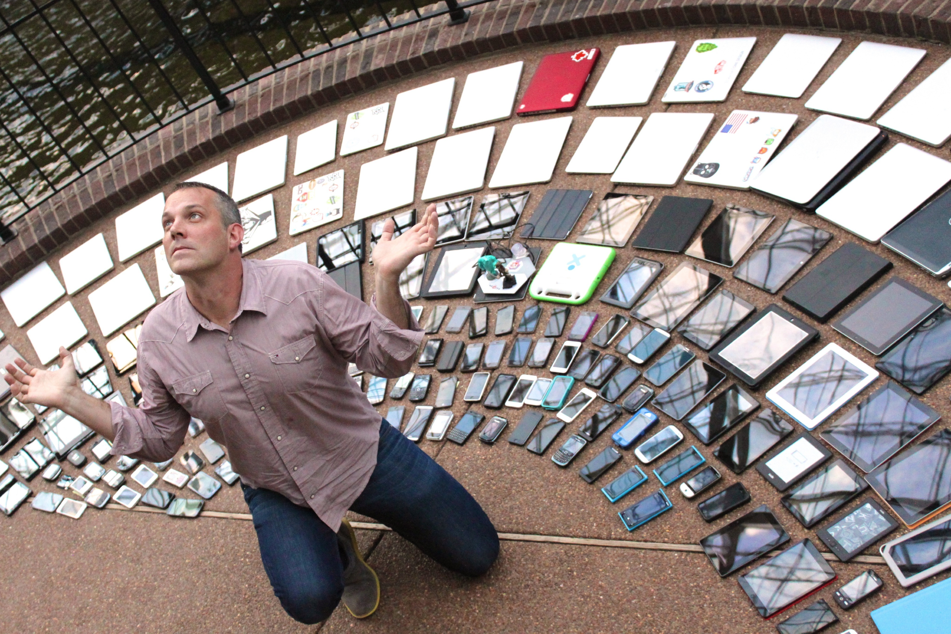
Creative Commons BY 2.0 by lukew - https://www.flickr.com/photos/lukew/

Slide 4
Motivation
Lots of devices now accessing the web
Global % Mobile > Desktop
Lots of different screen sizes and resolutions
How do we ensure our content looks good on every screen?
Notes:
25-30% US users are mobile-first or mobile-only

Slide 5
Screen Size & Bandwidth
Laptops
Large screen size
Home “Broadband” sometimes isn’t
Phones & Tablets
Smaller screen sizes
Sometimes on fast wi-fi or 5G connection

Slide 6
Interaction
Touch vs. Keyboard/Mouse
Zoom/Scaling
Sensors
Output

Slide 7
meta name=“viewport”
Use a meta tag inside our page head to tell browsers to scale content nicely for the screen size
<meta name="viewport" content="width=device-width, initial-scale=1.0">
Don’t forget this tag when creating websites!

Slide 8
Relative Sizing
Use relative sizes rather than absolute, wherever possible
width = 75%;
instead of:
width = 400px;

Slide 9
Media Queries
media queries allow us to choose which CSS to use depending on the properties of the device accessing the page
@media(min-width: 600px) {
body {
width: 60%;
margin: auto;
}
}

Slide 10
Media Query Rules
attribute | use
min-width: value | applies for any browser with width above value
max-width: value | applies for any browser with width below value
min-height: value | applies for any browser with width above value
max-height: value | applies for any browser with width below value
orientation=portrait | applies for any browser with height greater than or equal to width
orientation=landscape | applies for any browser with height less than the width

Slide 11
Applying Media Queries
Two methods:
adding media queries inside our css files
by loading different css files depending on a query

Slide 12
body {
width: 60%;
margin: auto;
}
h1 {
font-size: 2em;
}
@media(max-width: 600px) {
body {
width: 100%
}
h1 {
font-size: 1.2em;
}
}
Notes:
this is not a mobile-first approach!

Slide 13
<html>
<head>
<link rel=“stylesheet” media=“(min-width: 600px)” href=“min-600.css”>
<link rel=“stylesheet” media=“(max-width: 600px)” href=“max-600.css”>
<link rel=“stylesheet” media=“(orientation: landscape)” href=“landscape.css”>
<title>Media Example</title>
</head>
<body>
<p>Hello World!</p>
<p>Hello something else!</p>
</body>
</html>
Notes:
this is not a mobile-first approach!

Slide 14
Breakpoints
What size should we use to swap styles?
These are our ‘breakpoints’
DON’T choose breakpoints based on device sizes
Devices change!
Do choose breakpoints based on content

Slide 15
Choosing Breakpoints
Create your design. Make it look awesome
Change the browser size until it stops looking awesome
You’ve just found one of your breakpoints!

Slide 16
Responsive Images
Provide different image depending on the size required
Varied solutions with differing levels of support
check srcset attribute and <picture> element

Slide 17
Design Process
No ‘one-size’ fits all design process
Find your own workflow/process
many tutorials/examples online
see the useful links collection!

Slide 18
Wireframing
Plan content layout using boxes
Software or hand sketching
Allows thought about website layout and usability
Before code!
Don’t be afraid to iterate…

Slide 19
CSS Grids
Currently a popular concept in web-design
Design based on a ‘grid’
Specify column sizes, have HTML elements cover multiple columns

Slide 20
CSS Frameworks
Many frameworks available to simplify CSS
Often include a grid layout to design around
Provide responsive support
Can include fonts/typography, icons, GUI elements, …

Slide 21
Mobile First
Work within limitations of device
Take advantage of device abilities
Remove unnecessary content
Focus on key content and functions

Slide 22
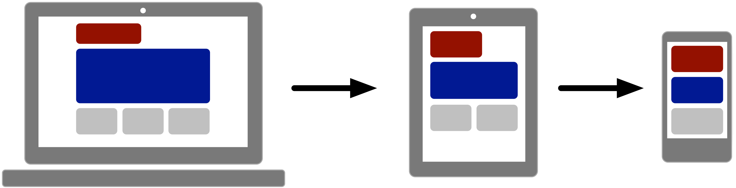
Graceful Degradation

Slide 23
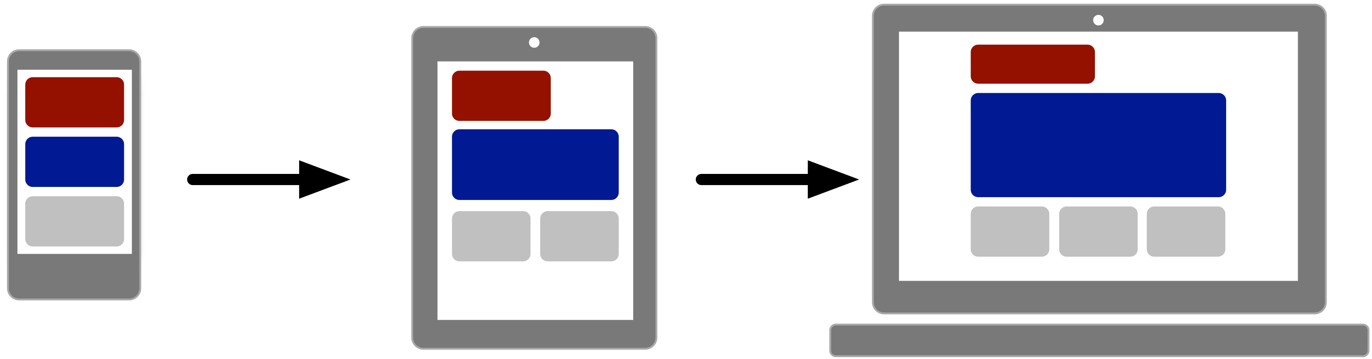
Progressive Enhancement

