Slide 1
EEE 414: Electrical Service Design
Project Presentation by Group 2
Section- A1
Muzakkir Ahmed
1906002
Neha Rahman
1906003
Rowatul Rafi
1906016
Dibbo Dey
1906019
Tareq Mahmud
1906024
Md Abdullah
1806025
Mithon Rahman
1906028
Presented to and Supervised by,
Mrinmoy Kundu,
Lecturer, BUET
Md Nure-Alam-Dipu,
Adjunct Lecturer, BUET

Slide 2
Outline
Summary
Design steps
Floor Plan
Fittings and Fixture
Calculation of fixture and fittings
Conduit Layout
Diagrams
MDB, ESDB
Transformer and Generator Calculations
Lightning Protection System (LPS)

Slide 3
1. Summary / Abstract
Integrated Design: Aligning electrical planning with architectural design ensured optimal conduit placement and equipment layout within home units.
Automated Formulas: Tabulated breaker and wire rating values alongside room specifications allowed for flexible adjustments to formulas, streamlining the design process.
Efficient Software: Utilizing AutoCAD 2024, the project efficiently visualized and executed complex circuit diagrams, enhancing design clarity and precision.

Slide 4
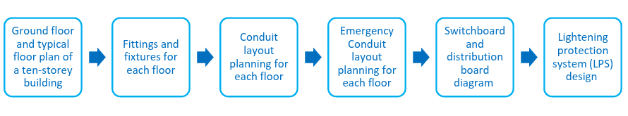
2. Design Steps

Slide 5
Floor Measurements Considerations
Each unit of 1200+ sqft size
2 units
Lift
Stairs
Ground floor
Basement
Roof

Slide 6
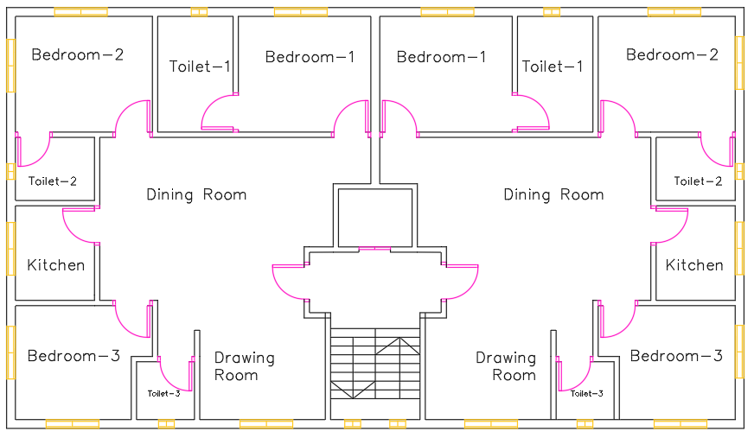
3. Floor Plan (Typical)
5th Floor Plan as Sample
Total area -> 70 feet x 40 feet = 2800sqft

Slide 7
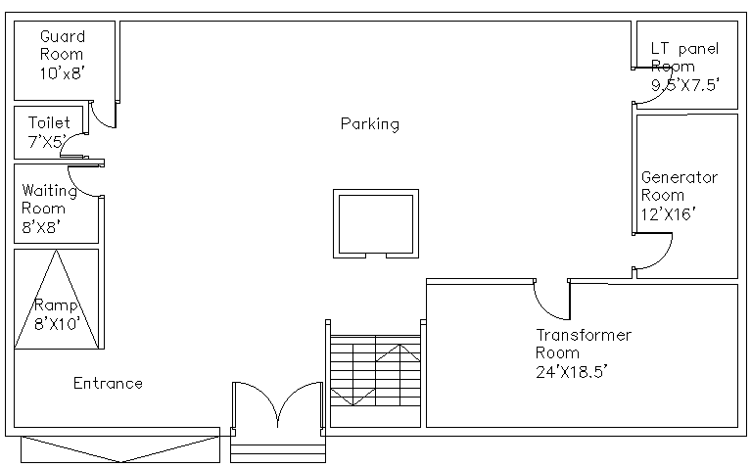
3.Floor Plan (Ground)

Slide 8
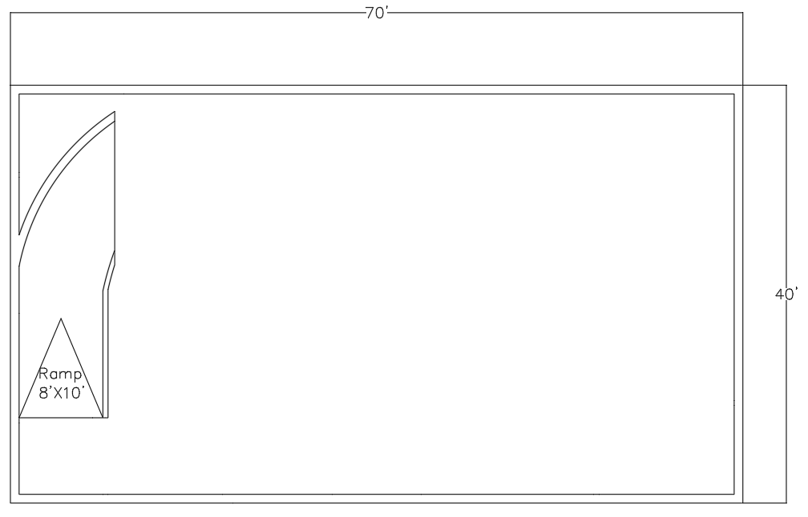
3.Floor Plan (Basement)

Slide 9
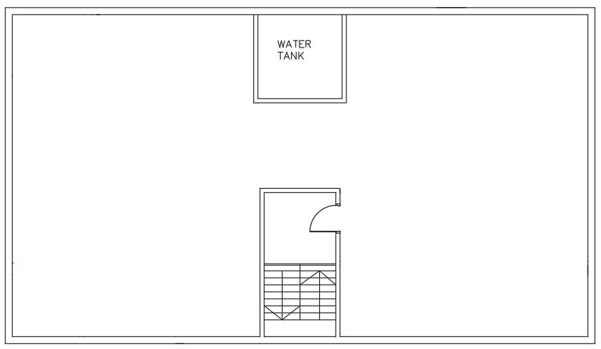
3. Floor Plan ( Roof plan )

Slide 10
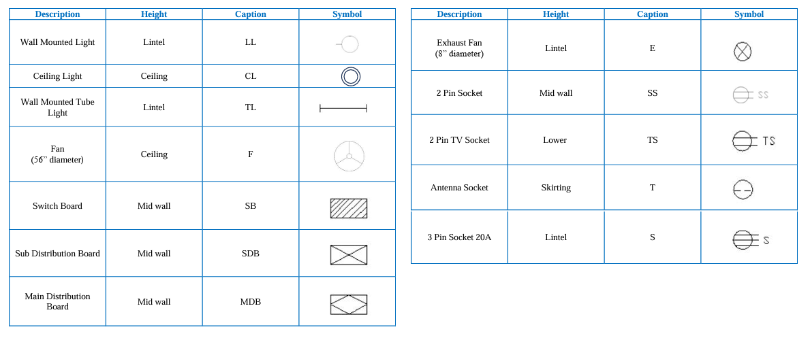
4. Fittings and Fixtures

Slide 11
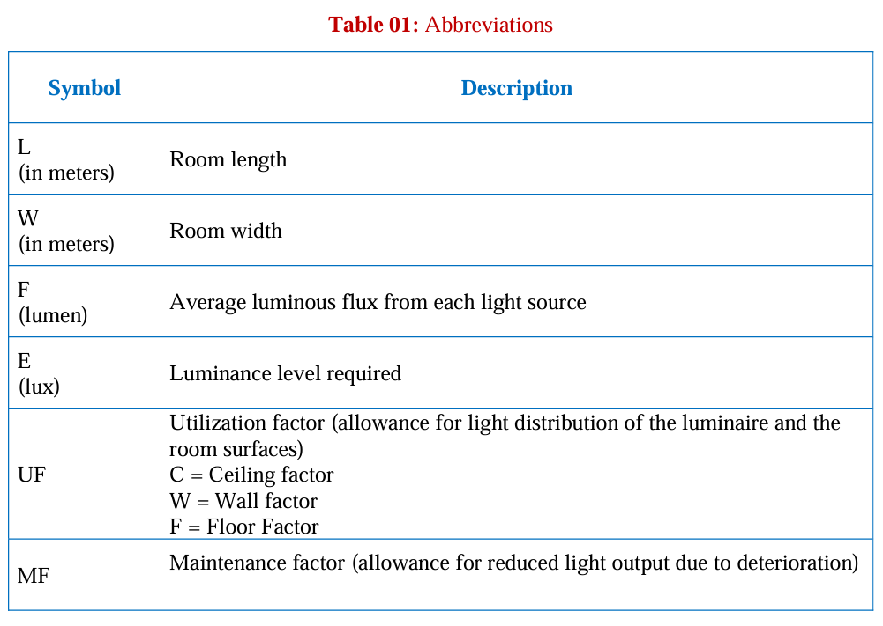
5. Calculation of Fixtures and Fittings

Slide 12
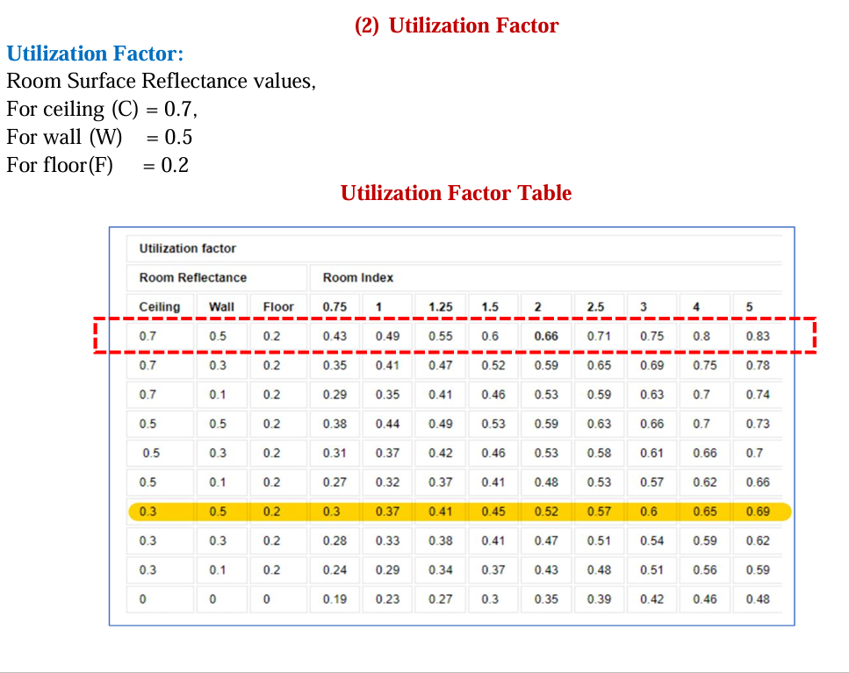
5. Calculation of Fixture and Fittings (UF chart)

Slide 13
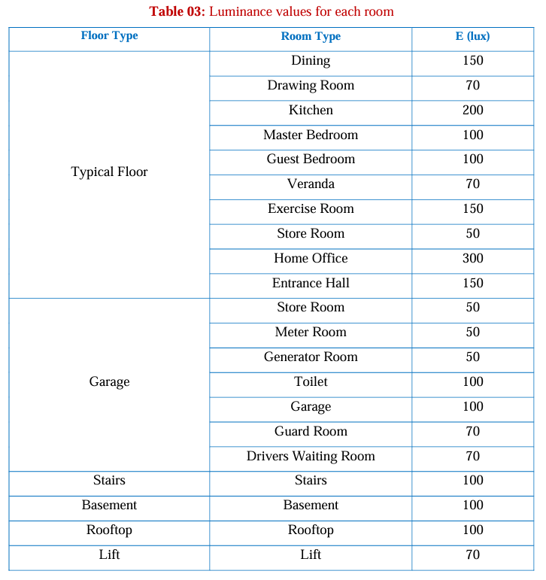
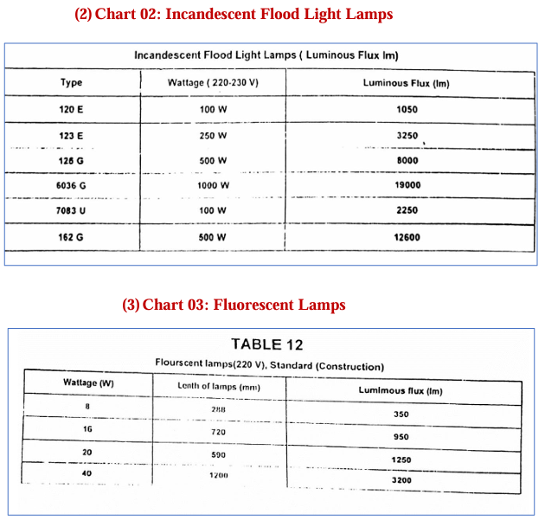
5. Calculation of Fixture and Fittings (Finding E and F)

Slide 14

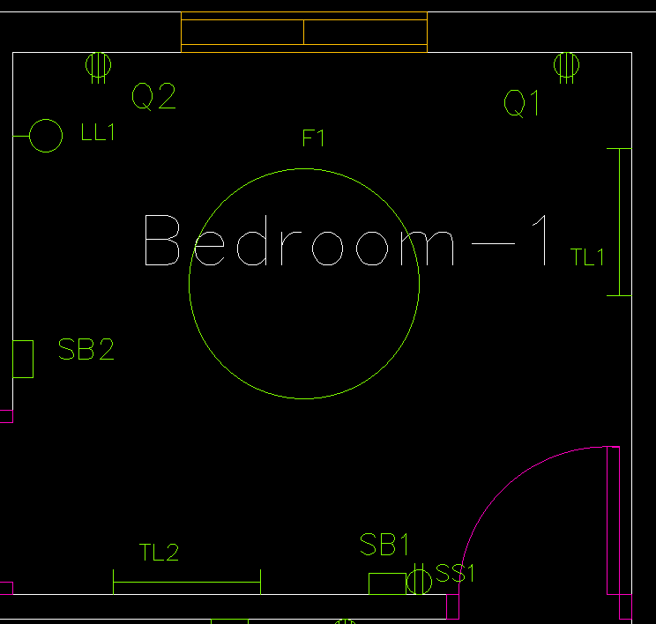

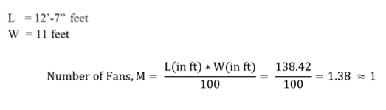
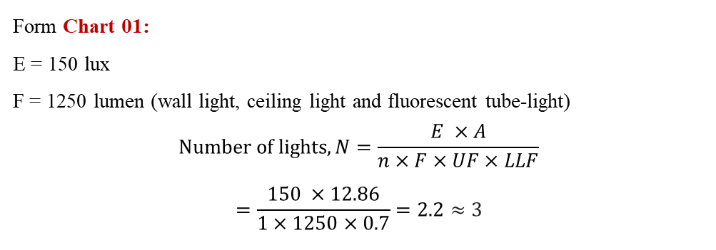
5. Calculation of Fixture and Fittings (Number of lights and fan calculation)
UF*LLF =0.7
For Bedroom 1
Form Chart 01:
E = 150 lux
F = 1250 lumen (wall light, ceiling light and fluorescent tube-light)
$$Number of lights, N=\frac{E ×A}{n×F×UF×LLF}$$
$$=\frac{150 ×12.86}{1×1250×0.7}=2.2≈3$$

Slide 15
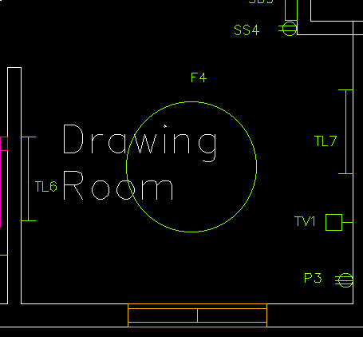
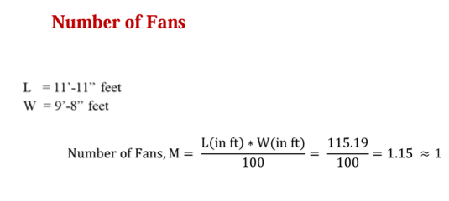

5. Calculation of Fixture and Fittings (Number of lights and fan calculation)
For Drawing Room
Form Chart 01:
E = 150 lux
F = 1250 lumen (wall light, ceiling light and fluorescent tube-light)
$$Number of lights, N=\frac{E ×A}{n×F×UF×LLF}$$
$$=\frac{150 ×10.7}{1×1250×0.7}=1.83≈2$$

Slide 16
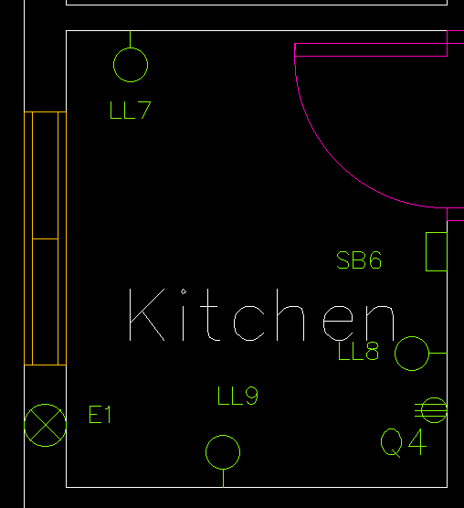

5. Calculation of Fixture and Fittings (Number of lights and fan calculation)
For Kitchen
Form Chart 01:
E = 300 lux
F = 1250 lumen (wall light, ceiling light and fluorescent tube-light)
$$Number of lights, N=\frac{E ×A}{n×F×UF×LLF}$$
$$=\frac{300 ×6.271}{1×1250×0.7}=2.15≈3$$
L = 7.5 feet
W = 9 feet

Slide 17
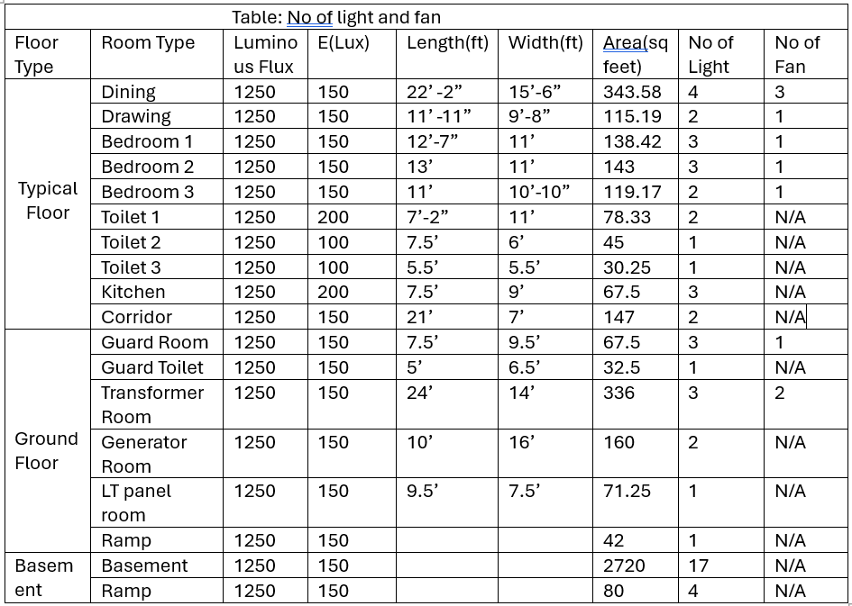
5. Calculation of Fixture and Fittings (Final Table)

Slide 18

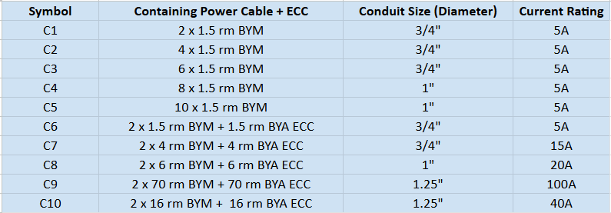
6. Conduit Planning

Slide 19

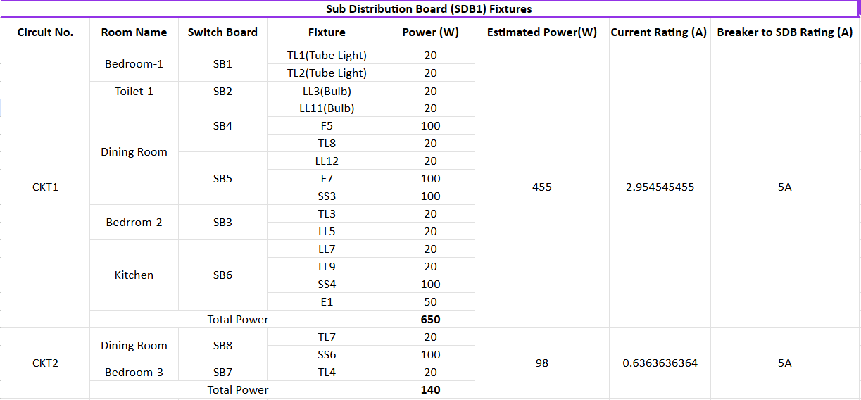
6. Conduit Planning

Slide 20
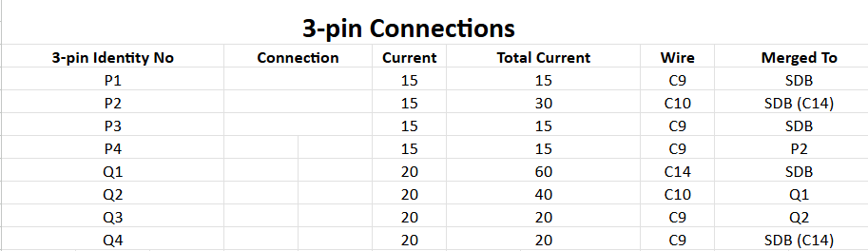
6. Conduit Planning
Chart-02: SDB-1 Power Circuits Summary

Slide 21
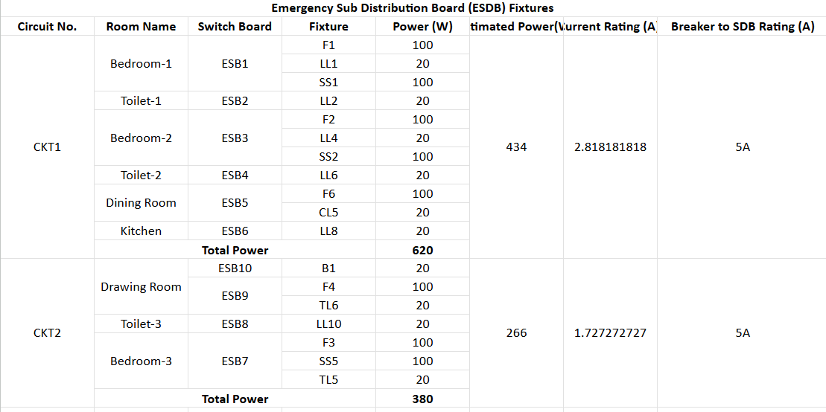
Chart-03: ESDB-1 Summary

Slide 22
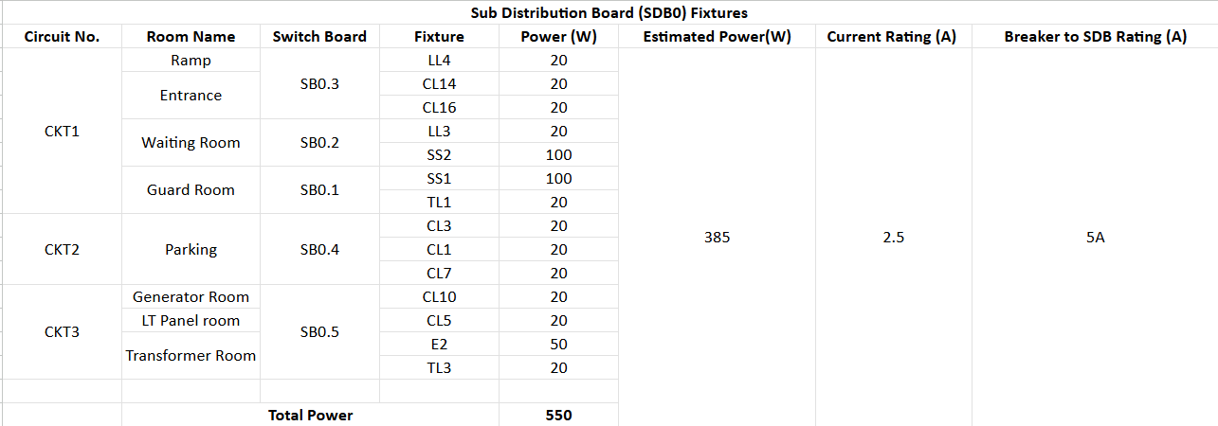
Chart-05: SDB-0 Summary

Slide 23
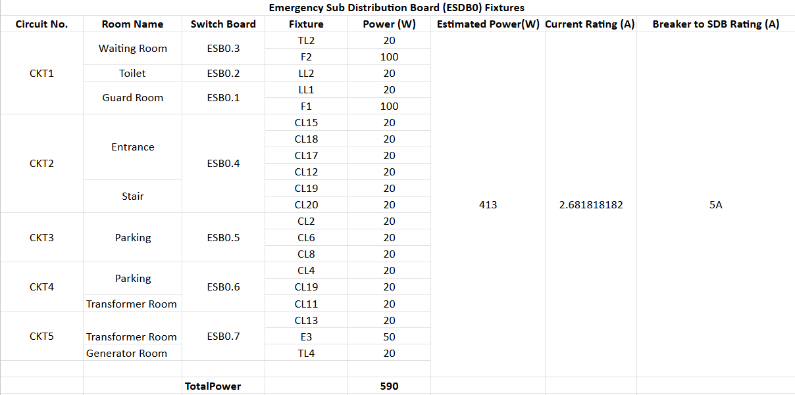
Chart-06: ESDB-0 Summary
Chart-06: ESDB-0 Summary

Slide 24
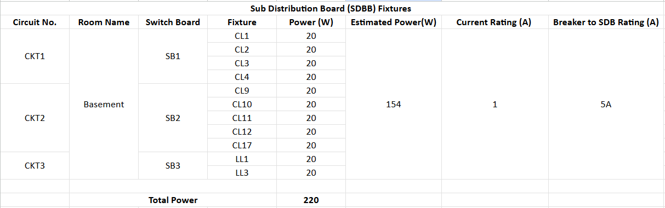
Chart-07: SDB Basement Summary

Slide 25
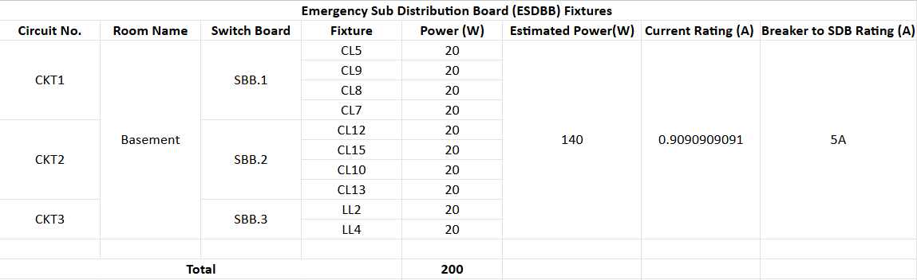
Chart-08: ESDB Basement Summary

Slide 26
Fitting and Fixtures

Slide 27
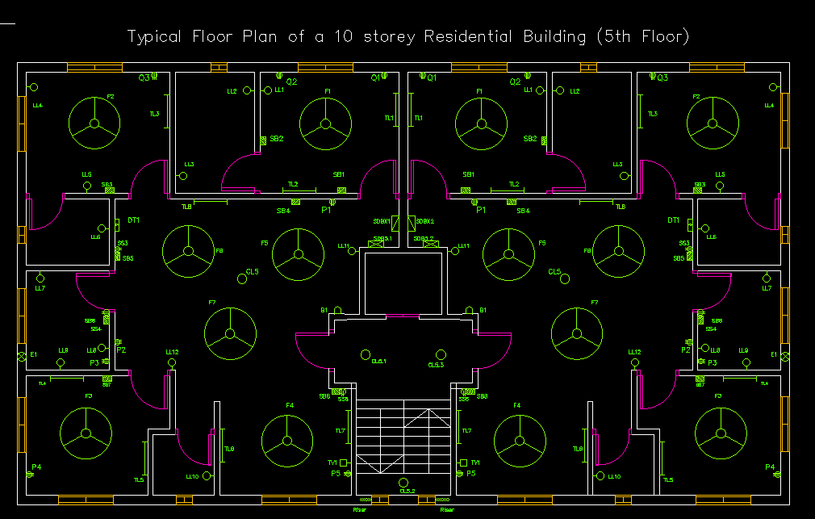

Slide 28
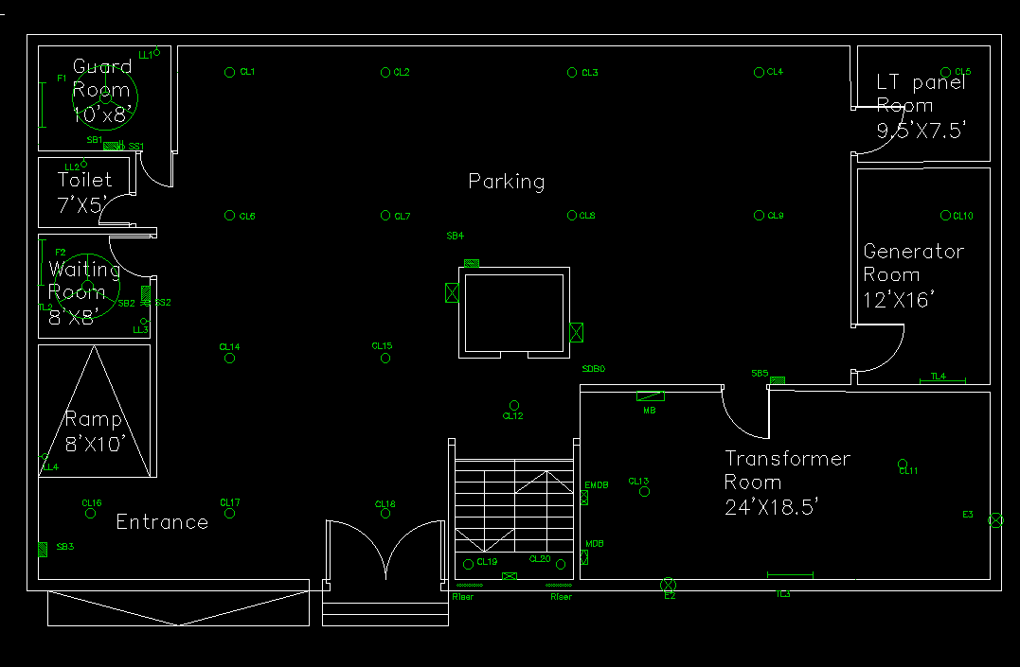
Ground Floor

Slide 29
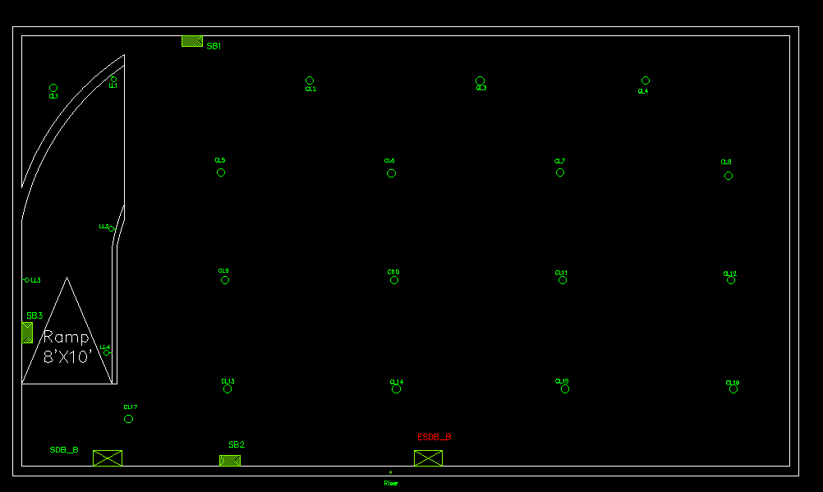
Basement

Slide 30
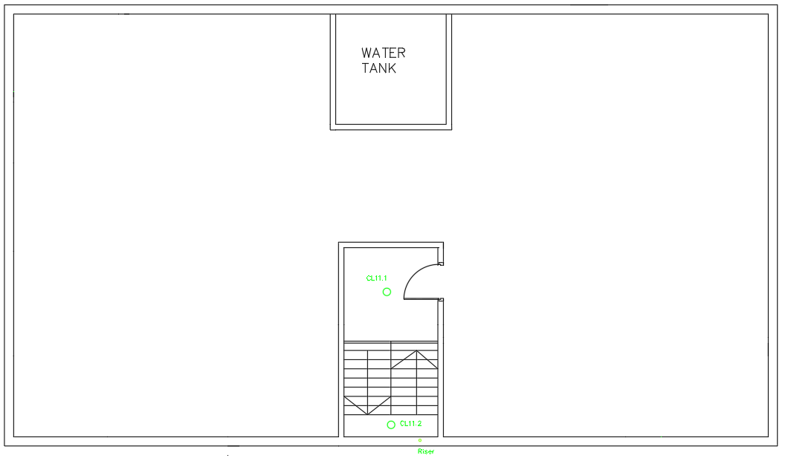
Roof Top Floor

Slide 31
Conduit Connections

Slide 32
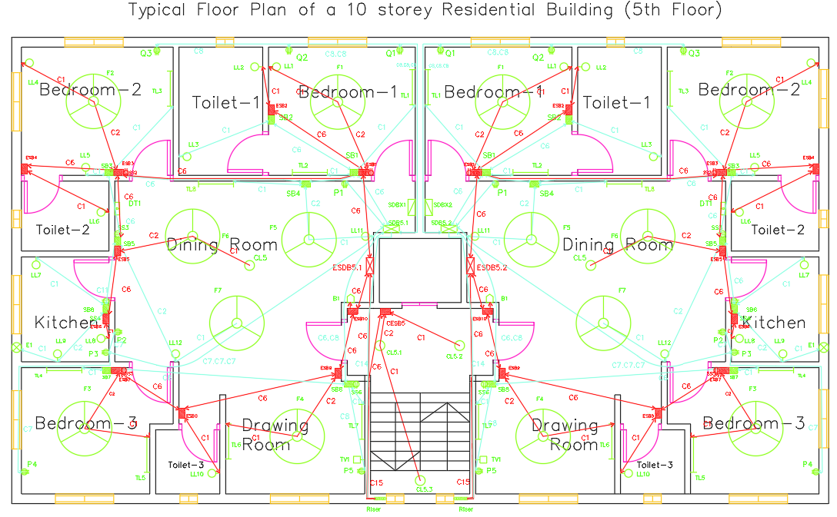

Slide 33
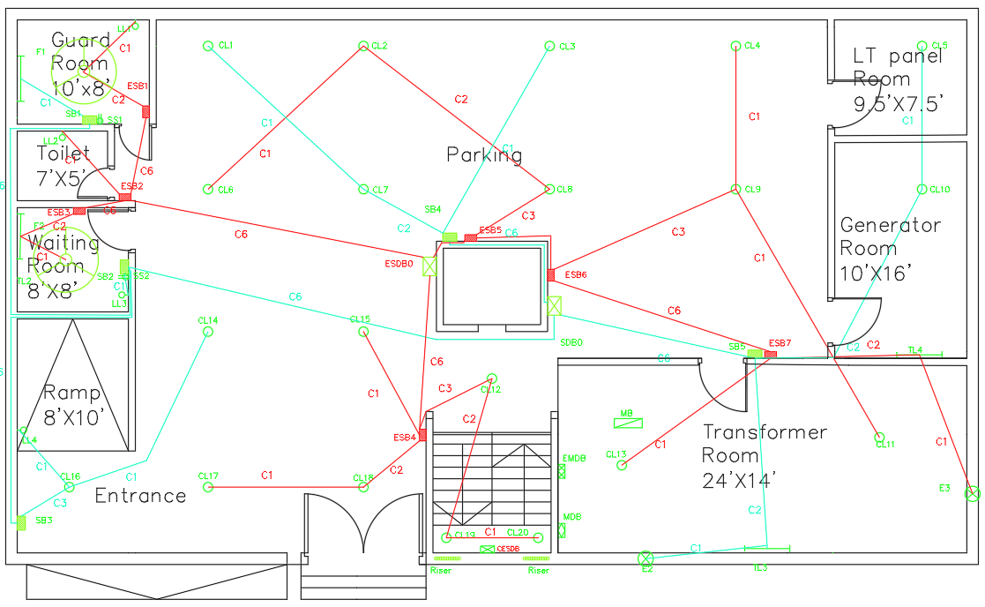

Slide 34
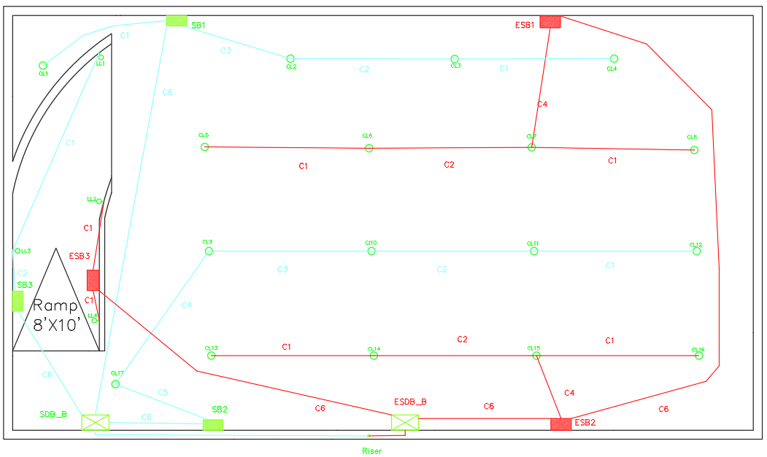
Basement

Slide 35
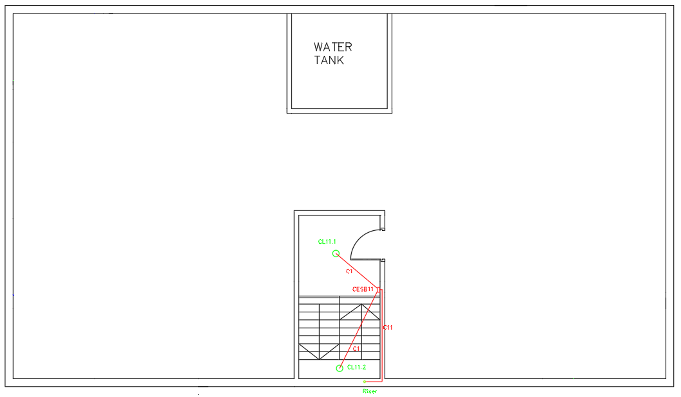
Roof Top Floor

Slide 36
Conduit Connections Diagrams

Slide 37
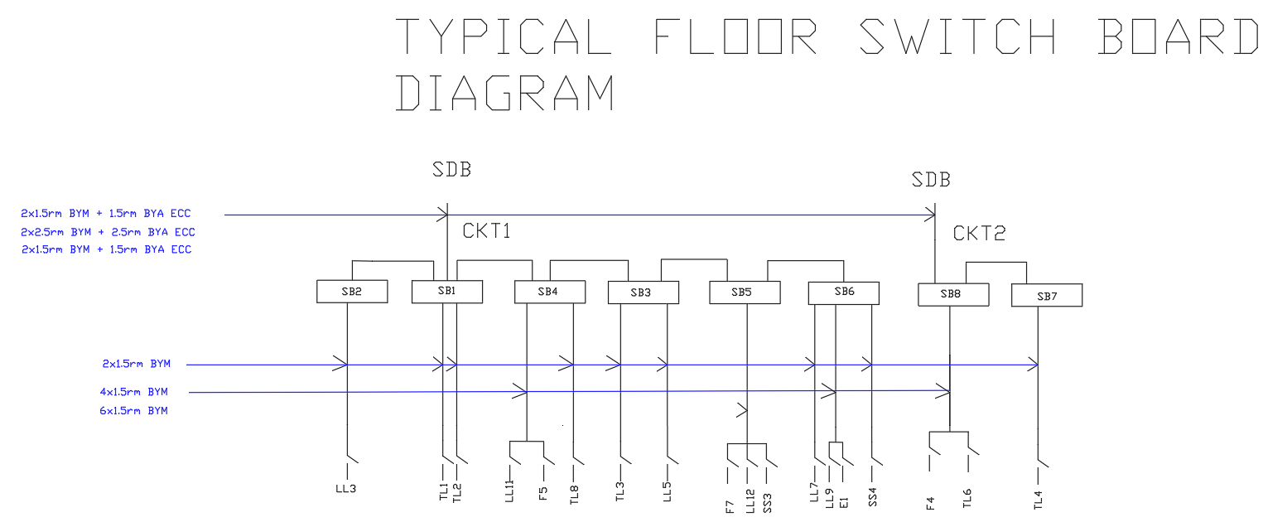

Slide 38
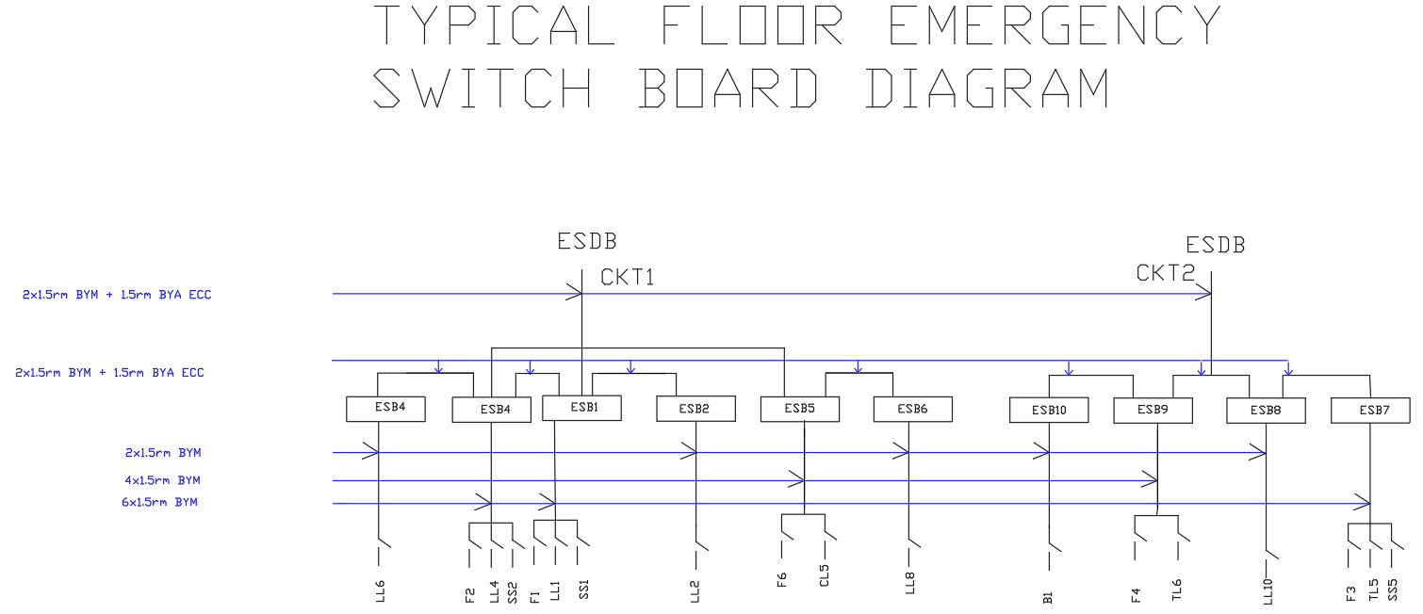

Slide 39
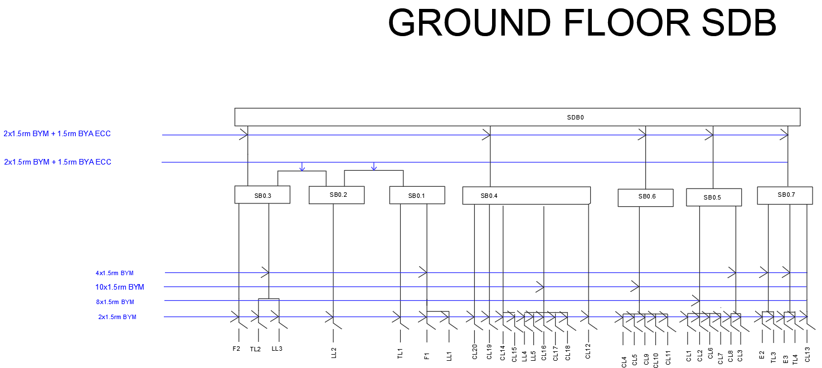

Slide 40
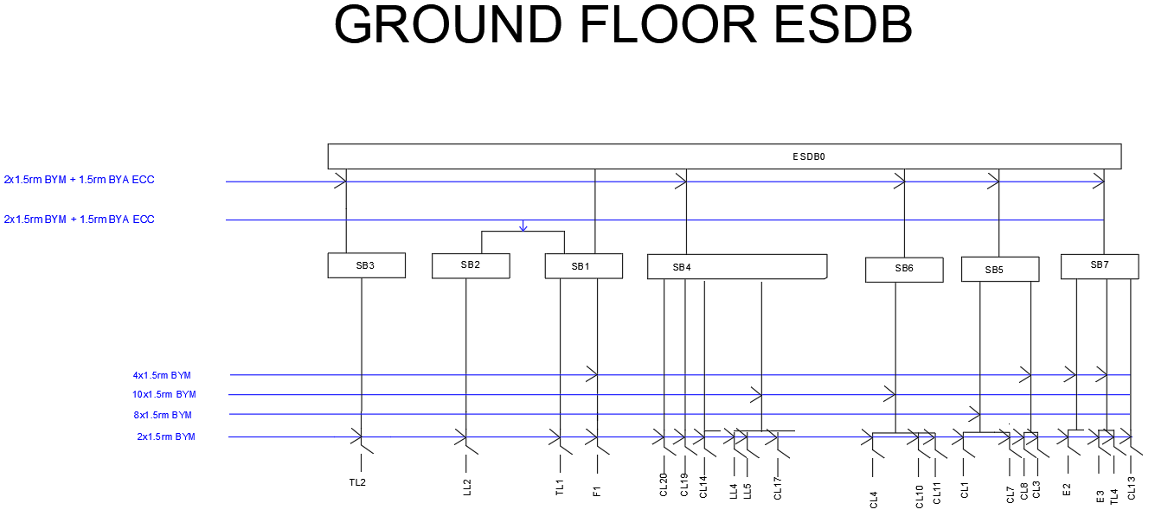

Slide 41
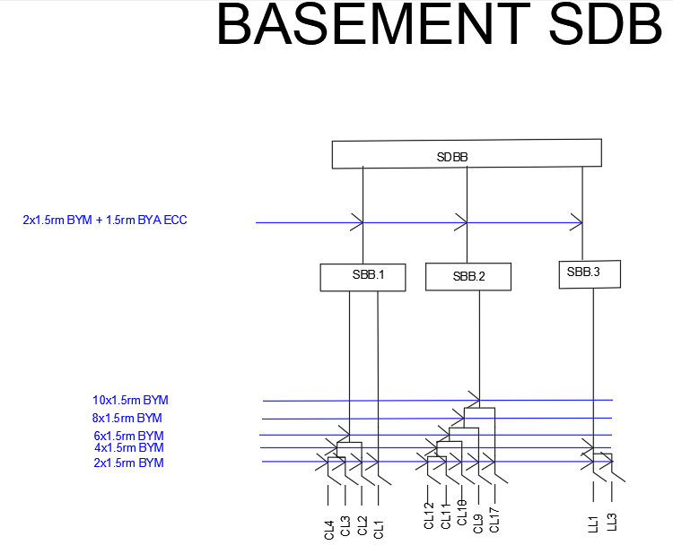

Slide 42
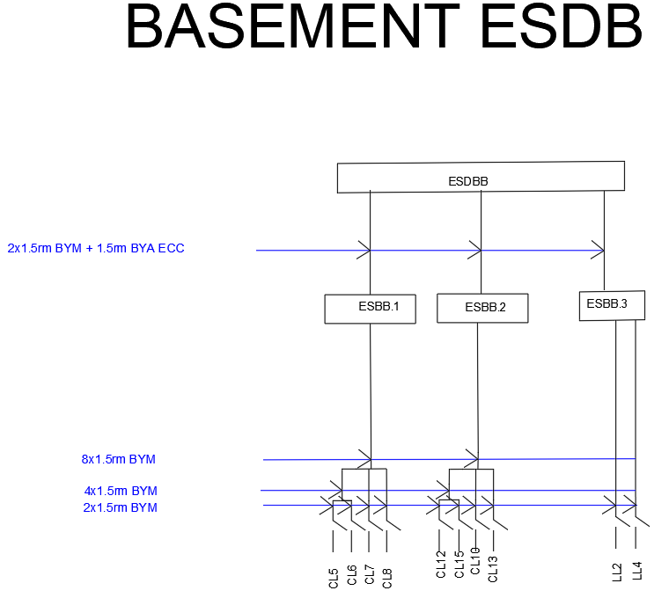

Slide 43
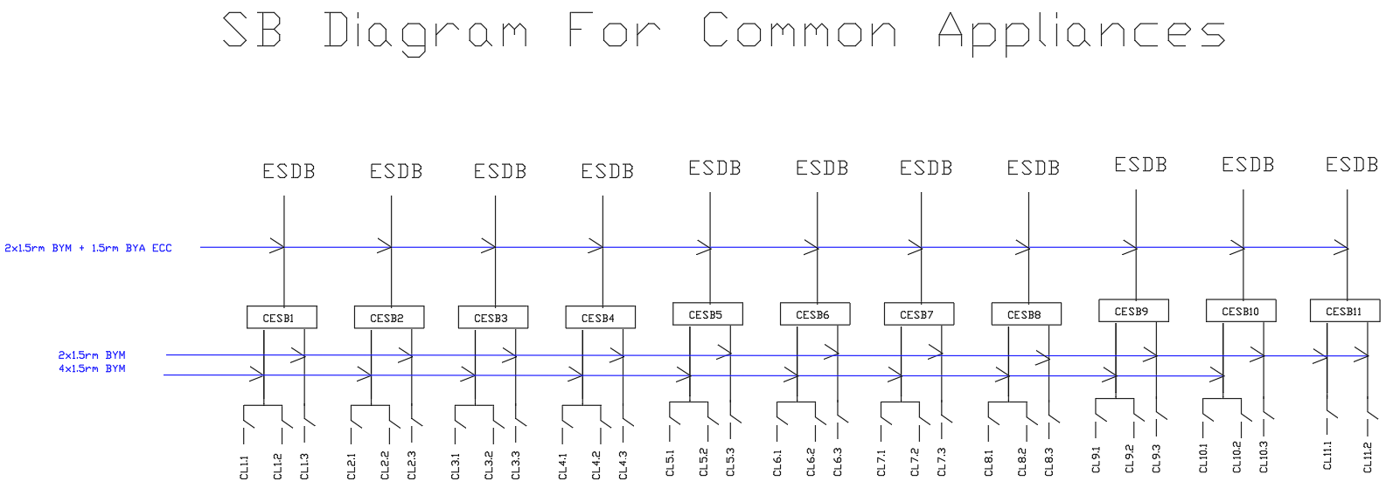
All the lights of the Stairs and Corridors are connected first to a ESB and then connected to a Common ESDB located at Ground Floor.

Slide 44
Transformer and Lift Calculations

Slide 45
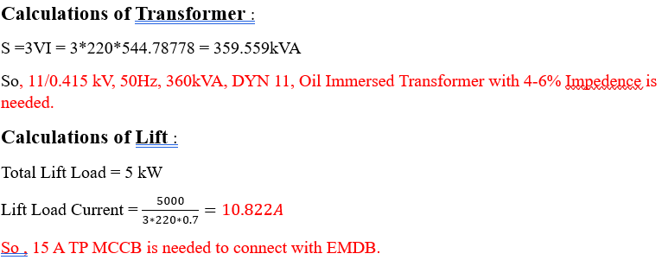

Slide 46
MDB and EMDB Calculations

Slide 47
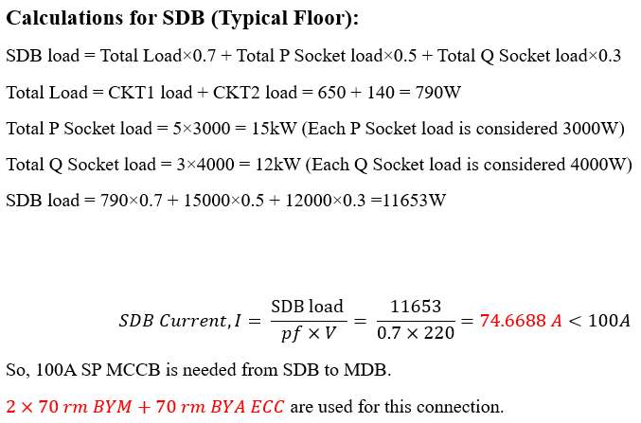

Slide 48
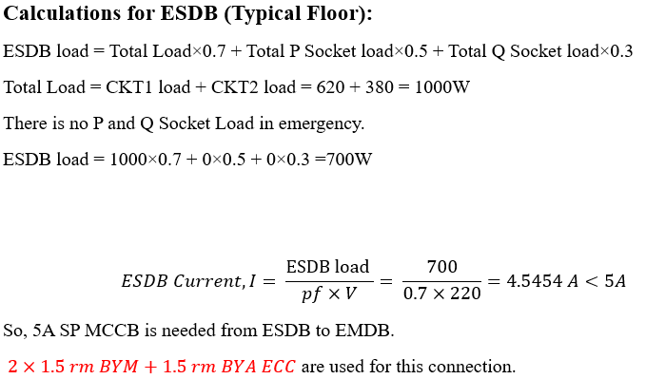

Slide 49
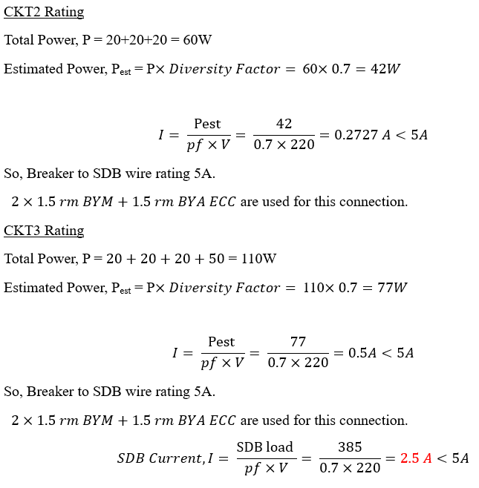
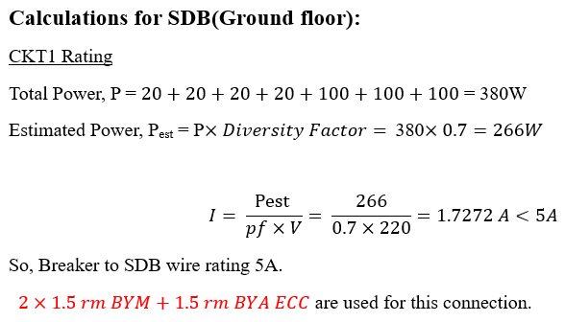

Slide 50
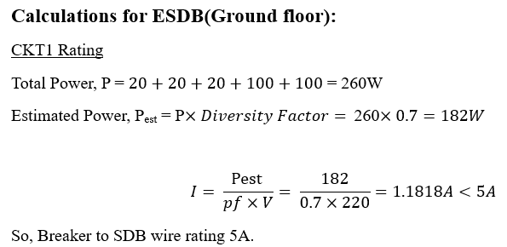

Slide 51
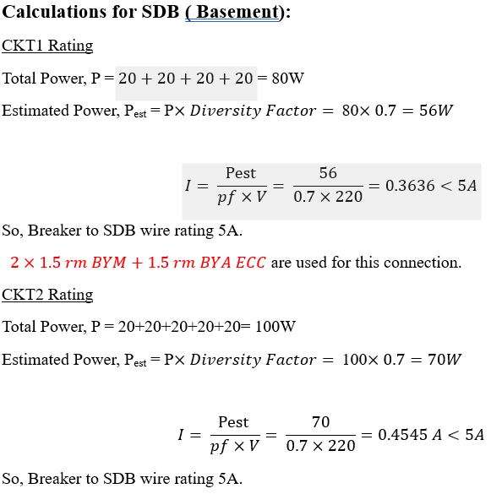
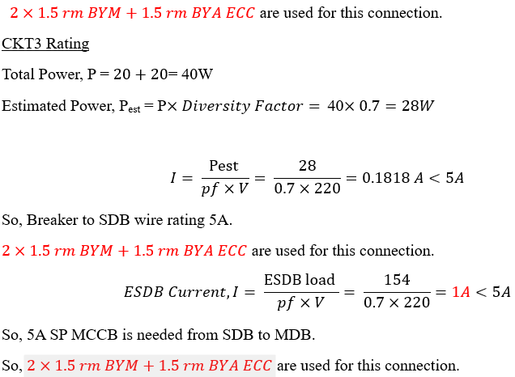

Slide 52
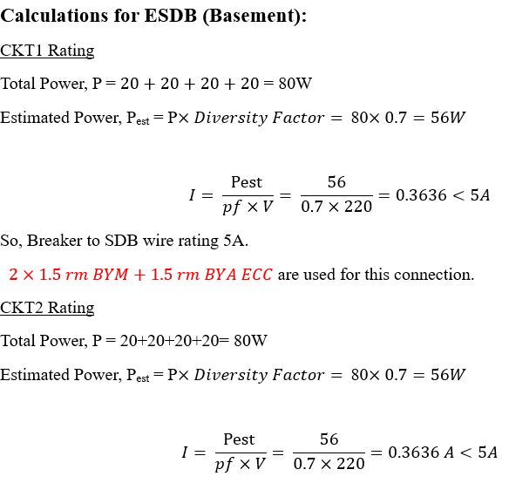
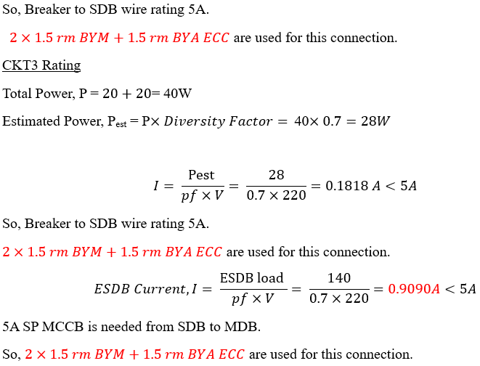

Slide 53


Slide 54


Slide 55
Generator Power Calculation

Slide 56
From EMDB calculation we found,
So, A 20kW generator is taken for our building.

Slide 57
MDB and EMDB Connection Diagrams

Slide 58


Slide 59


Slide 60


Slide 61


Slide 62


Slide 63
Transformer and Generator Room Dimension

Slide 64



Our 360kVA transformer we used in total 47.86m² area.

Slide 65


We used 17.93 m² area for our 20 kW generator

Slide 66
Lightning Protection

Slide 67


Slide 68


Slide 69
Project Contributions of members

Slide 70
ID | Contribution
1906002 | Typical Floor plan, floor drawing, typical floor fitting and fixtures, Conduit design, Writing Report
1906003 | Roof plan, LPS, SB, SDB diagrams, ground basement fitting and fixtures, Writing Report
1906016 | Typical floor drawing, planning, Basement, Ground conduits, SDB, ESDB diagrams, Making PPT
1906019 | Ground, Basement drawing, conduit design, SDB diagrams, Making PPT
1906024 | Typical Floor drawing, conduit drawing, transformer rating and design, Making PPT
1906025 | Floor, Ground and Basement conduits designing, calculations, Writing Report
1906028 | MDB, EMDB diagrams, Generator rating, calculations, Writing Report

Slide 71
Thank You!

