Slide 1
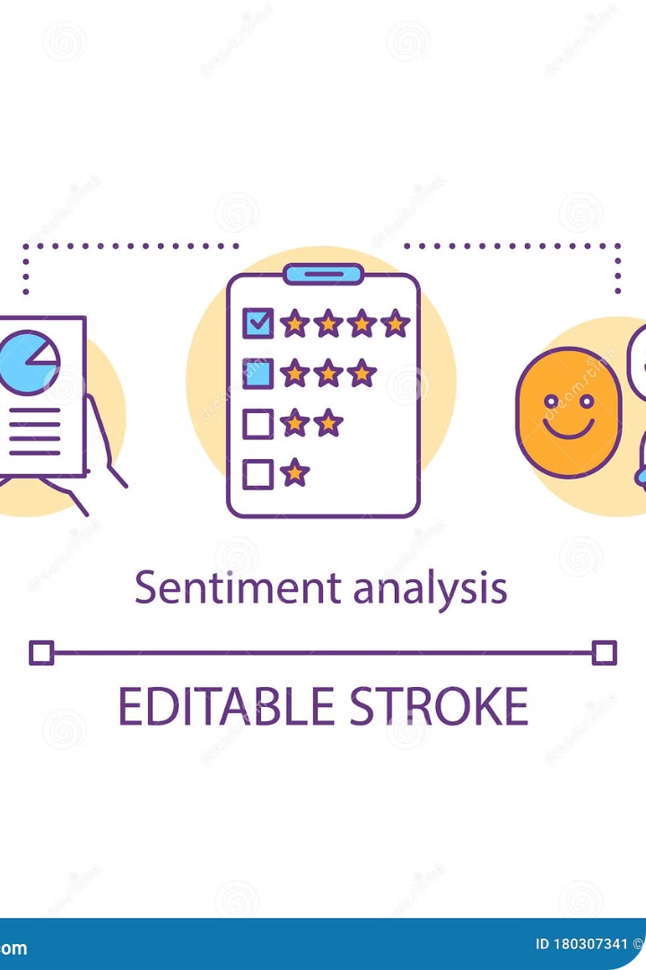
Sentiment Analysis
Presented By
Abishek [192211606]
Guided By
Dr. C. Anitha

Slide 2
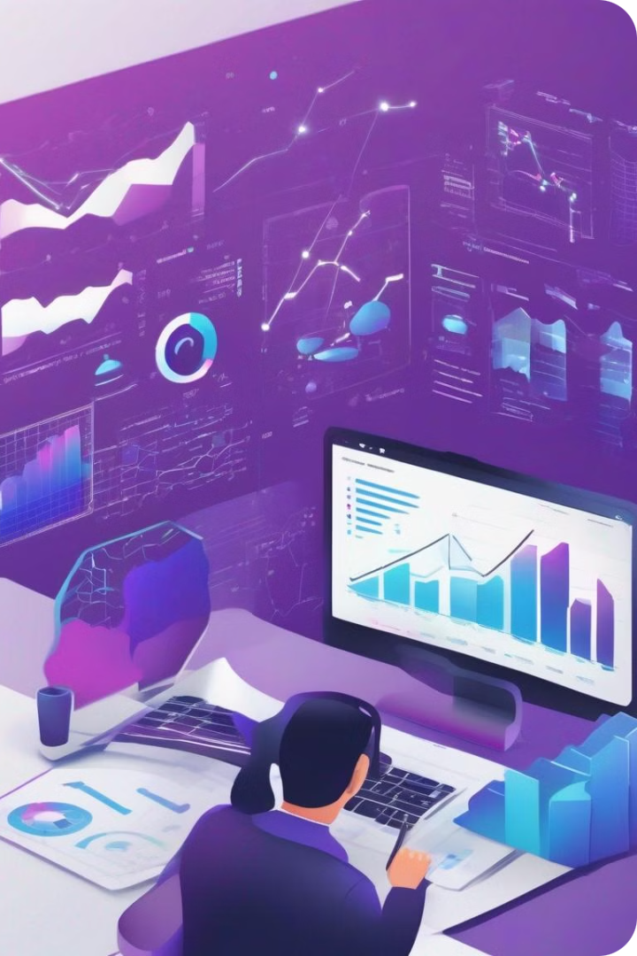
Introduction
Sentiment analysis is the process of extracting and understanding the emotional content within text. By applying advanced natural language processing techniques, we can uncover the underlying sentiment expressed in online reviews, social media posts, and other written communications.

Slide 3
Unlocking Sentiment from Text
Polarity
Emotion
Identifying whether a piece of text expresses positive, negative, or neutral sentiment.
Detecting the underlying emotional states, such as joy, anger, or fear, conveyed in the language.
Subjectivity
Intensity
Distinguishing objective facts from subjective opinions and personal experiences.
Measuring the strength or degree of the sentiment expressed.

Slide 4
Applications of Sentiment Analysis
Marketing
Customer Service
Social Media Monitoring
Gauge customer sentiment towards products, services, and brands to inform decision-making.
Identify and address customer pain points and improve the overall experience.
Track public perception and conversation around events, trends, and issues.

Slide 5
Benefits of Sentiment Analysis
1
Competitive Advantage
2
Informed Decision-Making
Gain insights that can help you stay ahead of the competition.
Make data-driven decisions based on a deeper understanding of customer sentiment.
3
Proactive Problem-Solving
4
Targeted Strategies
Identify and address issues before they escalate, improving customer satisfaction.
Develop more effective marketing, customer service, and product strategies.

Slide 6




Challenges in Sentiment Analysis
Ambiguity
Dealing with the complexities of natural language, including sarcasm, irony, and contextual meaning.
Data Quality
Ensuring the training data is representative, unbiased, and accurately labeled.
Domain Adaptation
Adapting models to perform well in specific industries or use cases.

Slide 7




Emerging Trends in Sentiment Analysis
Multilingual
Multimodal
Deep Learning
Real-Time
Expanding capabilities to analyze sentiment across multiple languages.
Incorporating visual and audio cues to enhance sentiment understanding.
Leveraging advanced neural network architectures for more accurate sentiment predictions.
Enabling instant sentiment analysis for timely insights and rapid response.

Slide 8
Ethical Considerations
Privacy
Ensuring the ethical collection and use of personal data.
Bias
Mitigating algorithmic bias that can perpetuate societal prejudices.
Transparency
Providing clear explanations for sentiment analysis outcomes.
Consent
Obtaining appropriate consent from individuals whose data is analyzed.

Slide 9
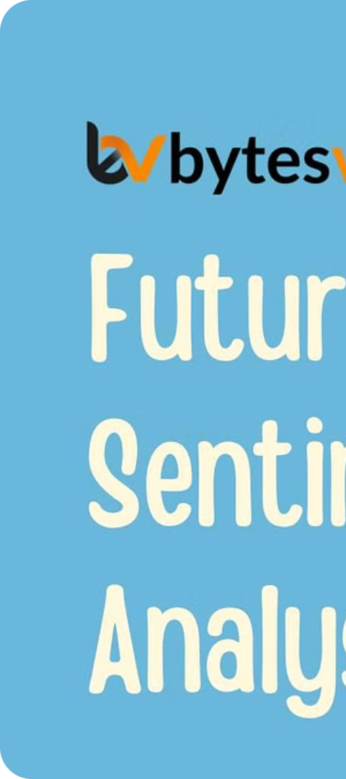
The Future of Sentiment Analysis
1
Deeper Insights
Sentiment analysis will unlock even more nuanced and contextual understanding of human expression.
2
Personalized Experiences
Tailored products, services, and content based on individual sentiment profiles.
3
Proactive Interventions
Sentiment-driven systems that can identify and address issues before they escalate.

Slide 10
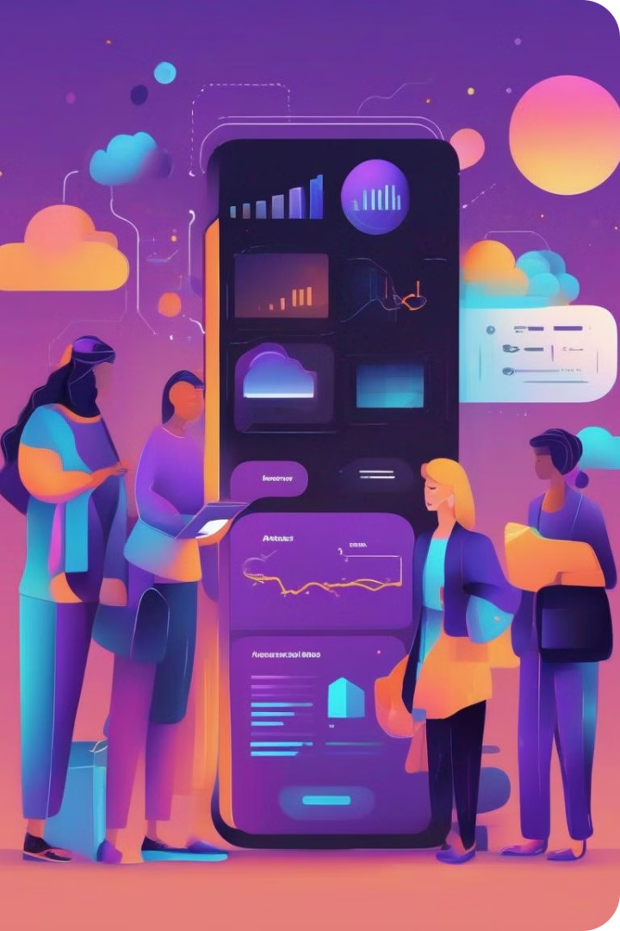
Conclusion
Sentiment analysis has emerged as a powerful tool, unlocking invaluable insights into the opinions, emotions, and behaviors of customers, employees, and the broader public. As the field continues to evolve, we can expect even deeper and more nuanced understanding of human sentiment, leading to personalized experiences, proactive interventions, and a future where businesses and organizations are better equipped to make informed, data-driven decisions.

